Slide 1
SUNY 6900 Information security policy
Joe Grupp
AVP/Information Security Officer

Slide 2
Policy overview
What
  Update of previous Information Security policy
    First update since 2016
  Effective September 1, 2024
  One year implementation roadmap with six month status update required (last week)
Why
  Higher education is a target
How
  NIST cybersecurity framework
  Campus level implementation
  Requires additional campus level policies
  Campus level exception process
Notes:
Fall 2024
Michigan Medicine
Texas Tech Health
Stanford Public Safety
University of Winnipeg (Canada)
University of Manchester (Great Britain)
Justice Department suing Georgia Tech over DOD grants cyber security compliance. Don’t get me wrong, the things that were happening at GT are NOT happening here, but that situation has heightened scrutiny of how higher ed institutions are protecting our research data.
Just this year (2025)
University of Oklahoma
Notre Dame
Interrupted business continuity, costs money, and impacted institutional reputation.
Campus policies
• Requires development and maintenance of campus specific information security policies
that align with unique strategy, goals, operational objectives and risk profile
‘
• Campus policies must adhere to overarching principles and requirements of SUNY 6900
-
and SUNY IT Standards

Slide 3
SUNY 6900 requirements
Information Security management program
Risk management
Incident notification
Access management
Data backups
Data encryption
Firewalls
Network infrastructure management
Network and endpoint security
Vulnerability management
Incident response
Notes:
Information Security Management Program: Set institutional strategy, goals, objectives, and establish an information security governance process.
Risk Management: Establish and maintain a comprehensive information security risk management framework that enables senior management to effectively identify, assess, mitigate, and monitor information security risks.
Incident Notification: Establish a comprehensive and consistent approach to the detection, escalation, notification and reporting of security events and incidents, ensuring adherence to all laws, regulations and legal obligations..
Access Management: Use processes and tools to securely assign and manage authorization to credentials for user accounts, administrator accounts, and service accounts.
Data Backups: Implement and establish a documented and systemic process for backing up institutional data.
Data Encryption: Institutions must use encryption to protect the confidentiality and integrity of sensitive institutional data.
Firewalls: Implement and maintain next generation firewall systems with procedures to control, monitor, and protect network traffic across all organizational boundaries, ensuring the confidentiality, integrity, and availability of data while defending against unauthorized access and potential security threats.
Network Infrastructure Management: Establish, implement, and manage network devices to prevent attackers from exploiting vulnerable network services and access points.
Network and Endpoint Security: Develop processes and tools to establish and maintain network and endpoint monitoring and defense against security threats across the enterprise’s network infrastructure and user base.
Vulnerability Management: Continuously assess, track, and remediate vulnerabilities on enterprise assets to minimize the window of opportunity for attackers.
Incident Response: Develop and maintain an incident response capability, including policies, plans, procedures, defined roles, training, and communications, to prepare, detect, and quickly respond to an attack.

Slide 4
Gap analysis: Strengths
UB is substantially compliant and well-positioned to meet SUNY 6900 requirements, meeting the majority of the requirements.
UB is very strong in the technical requirements of asset management, backups, encryption, endpoint protection and firewall protections.
UB ISO publishes and enforces policies, standards, and guidelines to meet the security program and plan requirements

Slide 5
Gap analysis: Improvement opportunities
  Documentation of the network segmentation plan
  Audit checks and processes required to verify firewall rules
  Account management audits
  Vulnerability management
  Encryption key lifecycle software
  Multifactor authentication on accounts that have access to email

Slide 6
UB key challenges
Documentation of security plan
    UB has multiple policies and standards in distributed locations. Collating these policies and standards into one document, including a security plan, program and risk assessment, requires significant effort.
Multifactor authentication (MFA) for all email
    UB offers email for all faculty and staff retirees, and alumni. Alumni email do not use MFA.
Encryption key lifecycle
    UB currently meets this requirement through a manual process. A system to automate key lifecycle management is being purchased to ensure the university meets SUNY 6900 requirements.
Notes:
We estimate we’ll have roughly 50,000 Alumni mailboxes as of December this year when June 2024 grads become Alumni.
$262,000 (conditional access licensing, Duo, no storage buy) additional $100,000 for alumni email storage.

Slide 7
Next steps
Documentation of security plan
    VPCIO focusing staff members on policy and documentation and are evaluating additional staffing needs.
Multifactor authentication for all UBmail (email)
    Researching
Encryption key lifecycle
    Key encryption management project kicks off on March 17th
Notes:
We estimate we’ll have roughly 50,000 Alumni mailboxes as of December this year when June 2024 grads become Alumni.
$262,000 (conditional access licensing, Duo, no storage buy) additional $100,000 for alumni email storage.

Slide 8
Navigating CMMC Certification: From Initial Assessment to Achieving Level 2
Notes:
---
CMMC certification is crucial for enhancing cybersecurity measures in organizations that handle Controlled Unclassified Information (CUI). This presentation will guide you through the certification process, from understanding the requirements to advancing to Level 2.

Slide 9
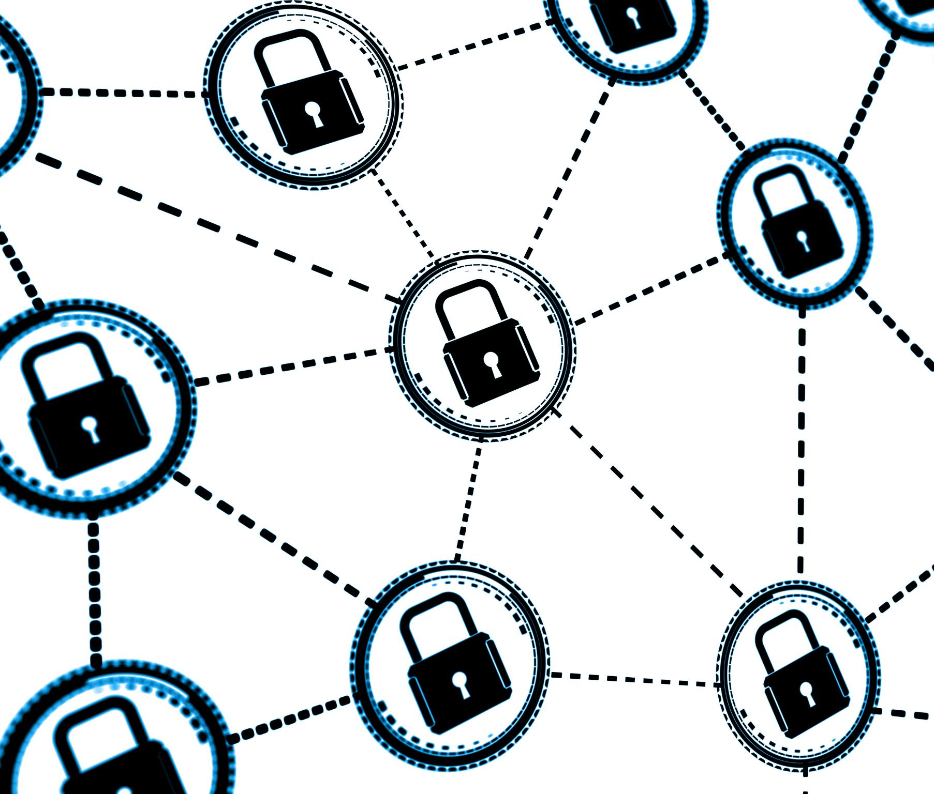
Purpose and importance of CMMC
Establishing cybersecurity standards
  CMMC provides a structured framework that organizations must follow to achieve and maintain cybersecurity compliance.
Protection of sensitive data
  The importance of CMMC lies in its capability to safeguard sensitive government data against potential cyber threats and breaches.
Mitigating cyber threats
  CMMC helps organizations identify and mitigate cybersecurity risks, ensuring a safer operational environment.

Slide 10
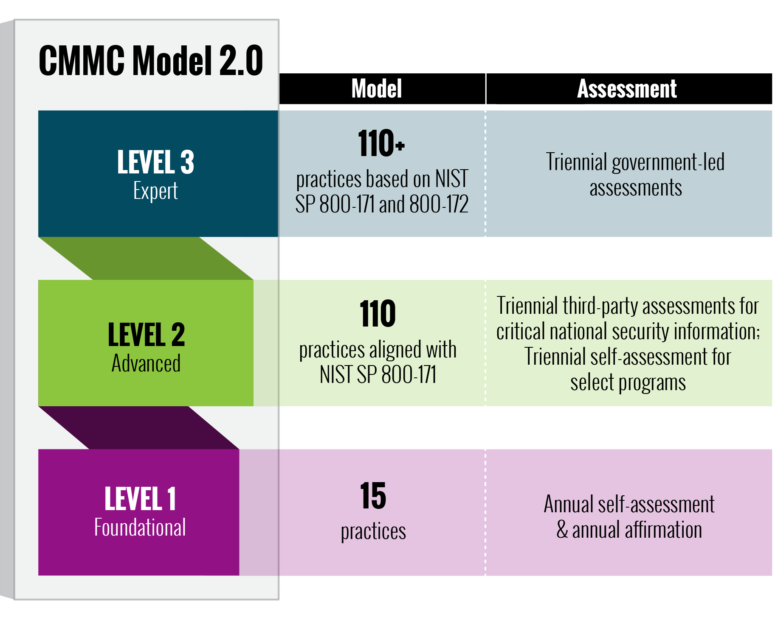
Overview of CMMC levels
CMMC Level 1
  Level 1 emphasizes basic cybersecurity hygiene practices essential for all organizations handling information.
CMMC Level 2
  Level 2 introduces more advanced practices to protect Controlled Unclassified Information (CUI), enhancing security measures.
Increasing maturity levels
  CMMC levels increase in maturity and complexity, ensuring organizations can effectively protect sensitive information.

Slide 11
Compliance requirements and benefits
Strengthening cybersecurity
Achieving CMMC compliance will significantly enhances UB’s cybersecurity measures, reducing vulnerabilities and risks.
Securing government contracts
Compliance with CMMC will position UB favorably to win government contracts, increasing university research opportunities.
Mitigating risks
CMMC compliance helps mitigate risks associated with sensitive data handling, ensuring data protection and privacy.

Slide 12
Initial Assessment

Slide 13
Scope of the initial assessment
Cybersecurity policy review
A comprehensive review of existing cybersecurity policies ensures that the university meets CMMC certification standards.
Assessment of practices
Analyzing current cybersecurity practices helps identify gaps and areas needing improvement for compliance.
Technology evaluation
Reviewing technologies in use allows for understanding their effectiveness and alignment with CMMC requirements.

Slide 14

Recommendations for remediation
Enhance documentation practices
  Improving documentation practices is essential for effective communication and ensuring compliance with regulations.
Conduct regular training
  Regular training sessions for employees ensure they are aware of best practices and stay updated on compliance requirements.
Adopt security controls
  Implementing necessary security controls is crucial for protecting sensitive information and maintaining data integrity.

Slide 15
Where We Are Now?

Slide 16
Summary of current compliance status
Conducting Level 1 certification
We have begun conducting Level 1 self-certification interviews, marking a significant step in our compliance journey.
Areas requiring attention
Several areas have been identified that still require attention to ensure readiness for Level 2 certification.
Preparation for Level 2
We need to focus on the identified areas to prepare for our transition to Level 2 certification successfully.

Slide 17

Milestones achieved
Initial assessment completion
  Successfully completing the initial assessment marked a significant step forward in our journey towards enhanced security.
Level 1 self-certification
  Beginning Level 1 self-certification demonstrates our commitment to security standards and practices.
Security practices implementation
  Implementing recommended security practices has strengthened our overall security posture significantly.

Slide 18
Next Steps to Achieve Level 2 Certification

Slide 19

Action plan and timeline
Specific tasks
  The action plan will detail specific tasks necessary to meet compliance requirements, ensuring clarity and focus on objectives.
Deadlines
  Establishing clear deadlines is essential for maintaining momentum and ensuring timely completion of the project.
Responsible parties
  Identifying responsible parties for each task helps in accountability and ensures that everyone knows their role in the project.
Realistic timeline
  A realistic timeline ensures that the project stays on track, allowing for adjustments as needed throughout the process.

Slide 20

Resources and training required
Cybersecurity tools
  Implementing effective cybersecurity tools is essential for achieving Level 2 compliance with CMMC requirements.
Personnel requirements
  Increasing qualified personnel is crucial to ensure our team can meet the necessary CMMC standards and requirements.
Targeted training programs
  Implementing targeted training programs will enhance our team's understanding of CMMC requirements and improve compliance readiness.

Slide 21

Monitoring progress and continuous improvement
Ongoing monitoring
  Implementing a regular monitoring process helps identify vulnerabilities and ensures compliance with cybersecurity standards.
Continuous evaluation
  Continuous evaluation of cybersecurity practices allows organizations to adapt to new threats and improve resilience over time.
Achieving certification
  Working towards Level 2 certification necessitates a structured approach to ensure ongoing compliance and improvement in practices.

Slide 22
Conclusion
Importance of CMMC certification
CMMC certification is crucial for enhancing our cybersecurity posture and ensuring compliance with industry standards.
Addressing assessment findings
By addressing the findings from our initial assessment, we can identify vulnerabilities and improve our security measures.
Solid action plan
Implementing a solid action plan is key to moving towards achieving Level 2 certification and securing sensitive information.

