Slide 1
IACUC module
Click Training

Slide 2


Meghan Laski
IACUC Coordinator
meghanla@buffalo.edu
Tracie Groves
Training Programs Coordinator, RIS
traciegr@buffalo.edu
829-6650

Slide 3
Some Background about Click
The Pre-Award and Compliance System (PACS) is a multi-year collaborative project to implement the online Click Portal
The Click Portal is being implemented to assist principal investigators, students, compliance and research administration staff with administering sponsored programs
UB is leading the implementation of the Click Portal, working in collaboration with our vendor partner, Huron, and the PACS Leadership Team.

Slide 4
Roles and Responsibilities
Protocol Team - Individuals responsible for developing and editing the protocol. Includes PIs and other study staff.
Administrators - Individuals who guide submissions through the review process.
Coordinators - Individuals responsible for reviewing studies.

Slide 5
workflow
Click IACUC Module

Slide 6
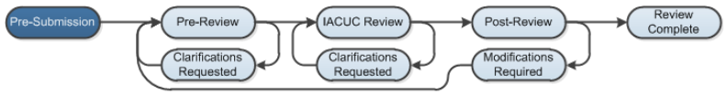
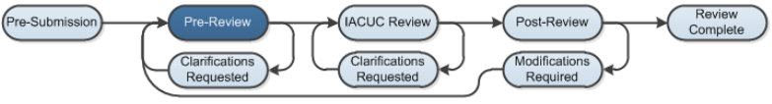
Pre-Submission: During Pre-Submission, the building blocks (e.g., research team, substances, procedures) and the study are created in the system.
Pre-Review: In this state, the study is assigned to an IACUC Coordinator who reviews the submission; the study will also be forwarded to a veterinarian for review.

Slide 7
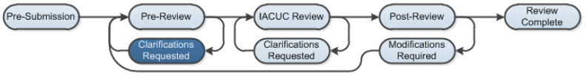
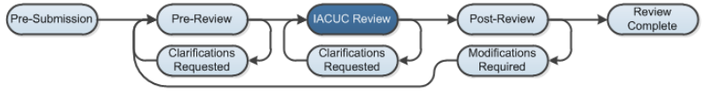
Clarification Requested: The IACUC Coordinator and/or IACUC Committee Members may send a Request for Clarification during the Pre-Review and IACUC Review states. This will send the study into the Clarification Requested state until the PI has responded to the request.
IACUC Review (Designated Review): During this state, exempt or expedited studies will be reviewed by a designated reviewer.

Slide 8
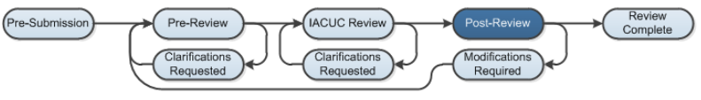
IACUC Review (Committee Review): In Committee Review, the IACUC Committee Members will review the study for completeness
Post-Review: The Post-Review state gives the IACUC staff an opportunity to approve any attached documents, request any modifications, and prepare and send the determination letter.

Slide 9
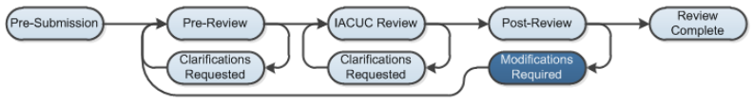
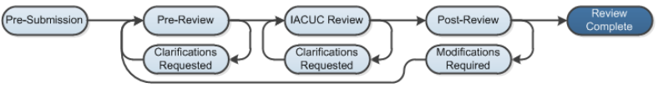
Modifications Required: The study will enter this state if the IACUC decided to require modifications to the study before approving it, providing the study team an opportunity to respond
Review Complete: The IACUC study will reach its final state, Review Complete, after the approval letter is sent.

Slide 10
Navigation
Click IACUC Module

Slide 11
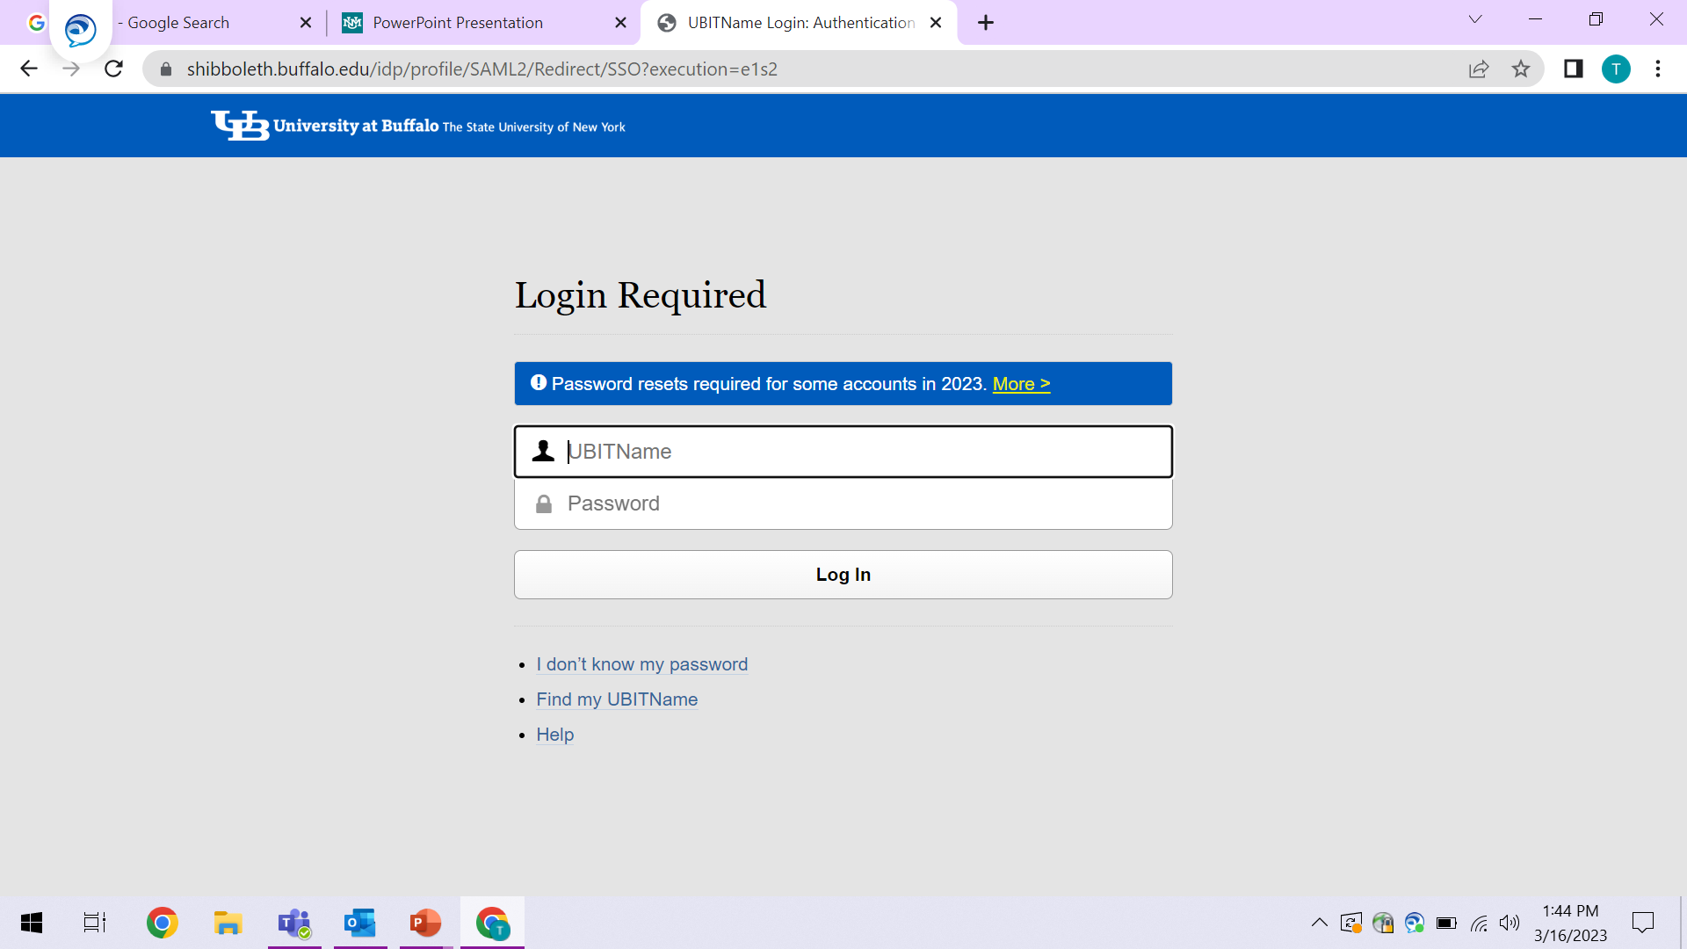
For UB Personnel: Use your UBitname and password to access the Click COI system.
If you don't know your user name / password or you need to reset your password, please contact UB CIT at support@research.buffalo.edu or 645-3542 for help.

Slide 12
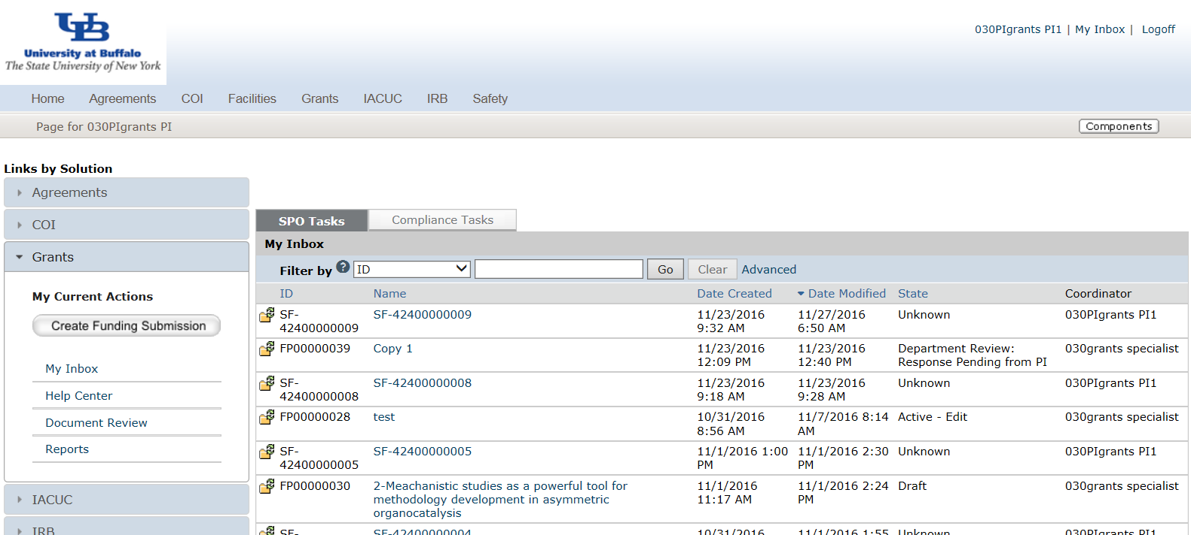
My Inbox
Each time you log into the Click Portal, you will be taken to your Inbox. This area of the portal contains a list of all submissions that currently require you to take an action.
My Inbox is divided into two tabbed pages:
• Compliance Tasks –contains a list of all your submissions that currently require you to take an action.
• SPO Tasks –contains a list of your Agreements and COI Disclosures that currently require you to take an action.
Access to All Modules
Submissions that require action

Slide 13





The listings within My Inbox can be sorted by using the Filter by option.
This option will allow you to search by:
ID number, Name, Date Created,
Date Modified, or State.
IACUC Submissions that will NOT be in My Inbox
• Submissions that are currently under review by the IACUC
• Approved submissions
• Closed submissions

Slide 14


To open a submission, click on its Name. When you open a submission, you will be brought to its Workspace.
• You can return to My Inbox at any time by clicking the My Inbox link in the Header at the top right corner of the screen.
IACUC Submissions
You may navigate directly to the IACUC module by clicking the IACUC tab in the navigation menu at the top of the screen.

Slide 15
The IACUC Submissions area is divided into five tabs
Research Teams – This tab lists all of the Research Team(s) that you are currently a member of.
In-Review – This tab lists all of your IACUC submissions currently under IACUC review.
Active – This tab lists all your currently approved IACUC submissions.
Archived – This tab lists all your archived/closed IACUC submissions.
All Submissions – This tab shows all your submissions, regardless of state.

Slide 16
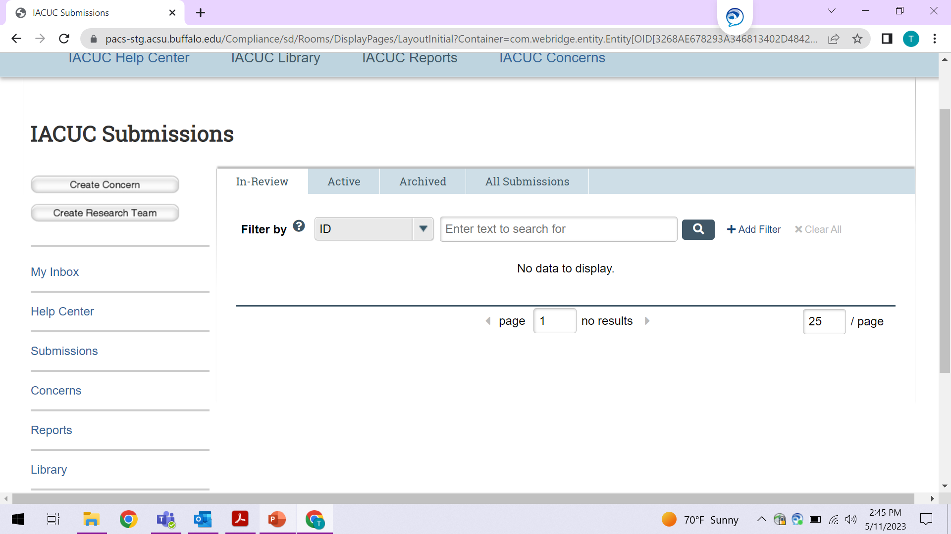
On the left side of the screen, you will see links to Activities you can perform, as well as Shortcuts to other areas of the module.
Activities
Shortcuts
To open a submission that you are associated with, click on the name to open the Workspace

Slide 17
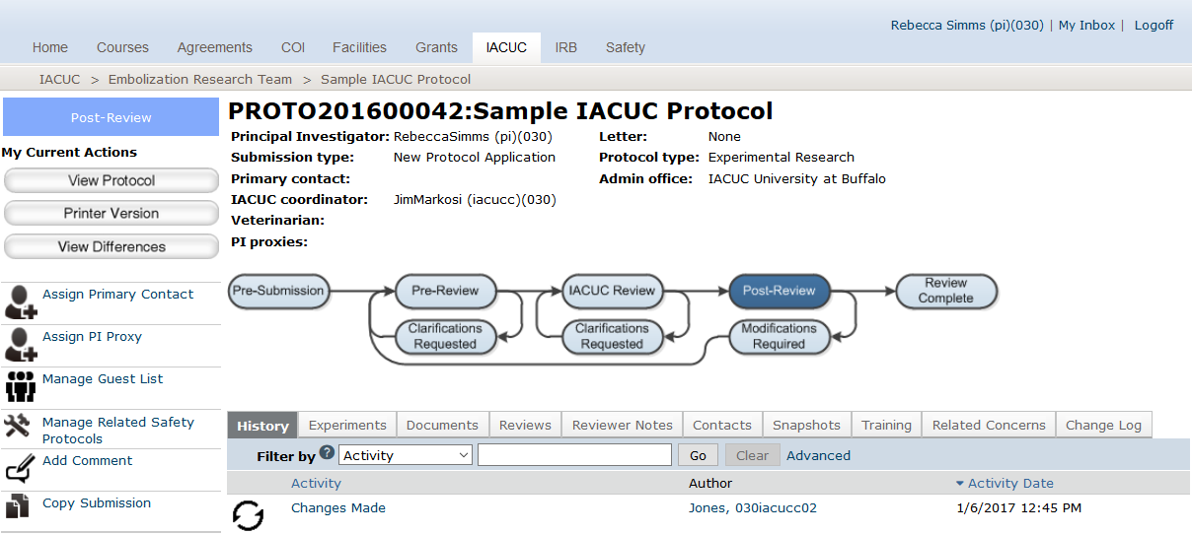
Navigation
Protocol
Workspace
2
1
3
4
From the Protocol workspace, you will see:
Protocol details
The state in the review process
Actions you can take in the protocol’s state
Tabs with information about the protocol and the review process

Slide 18
1. Header – Links to your profile and My Inbox, and lets you log off
2. Top navigation menu – Links to the different modules within Click Portal
3. Breadcrumb navigation menu – Enables you to move quickly to a previous location
4. Activities – Actions that can be taken based on a submission’s current State
5. Resource tabs – Collected information regarding the submission
6. History – Actions taken previously on this submission
7. Shortcuts – Quick links to other frequently used areas of the module
2
1
3
4
5
6
7

Slide 19
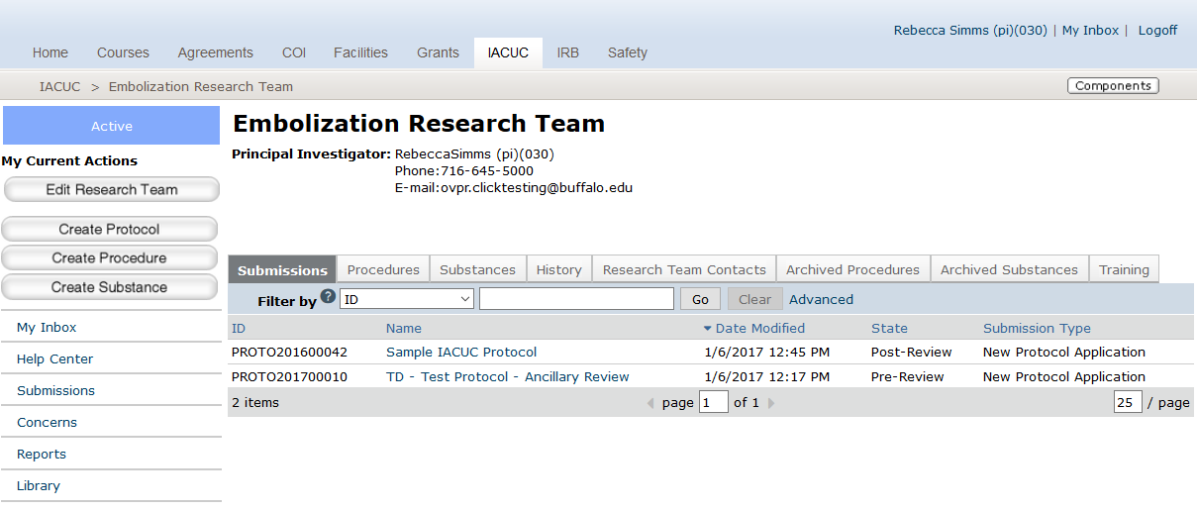
Navigation
Research Team
Workspace
3
4
1
2
From the Research Team workspace, you will see:
All submissions to the IACUC module
State in the review process
Team PI
Actions that can be performed by the research team

Slide 20
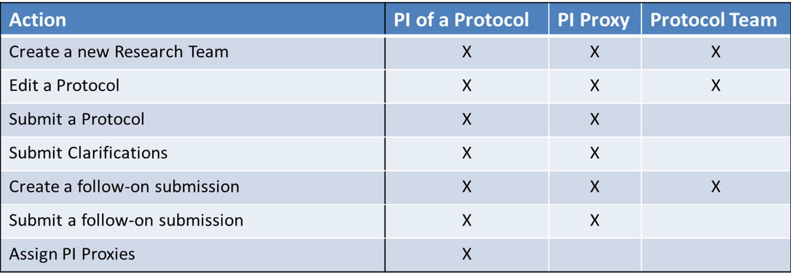
Research Team Actions
Navigation

Slide 21
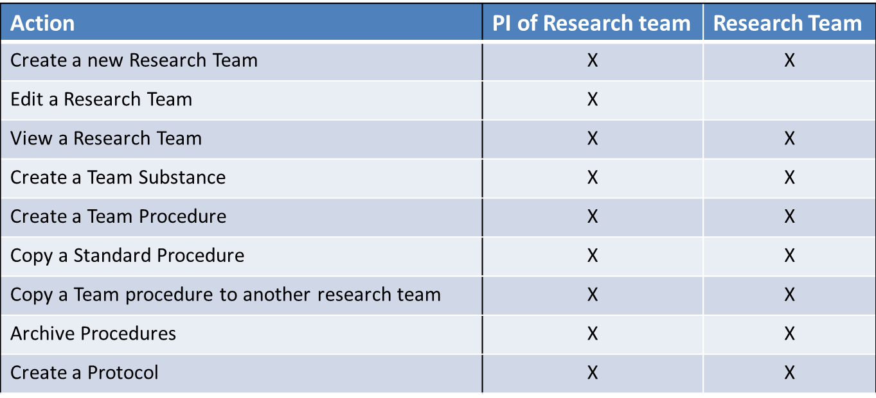
Research Team Actions
Navigation

Slide 22
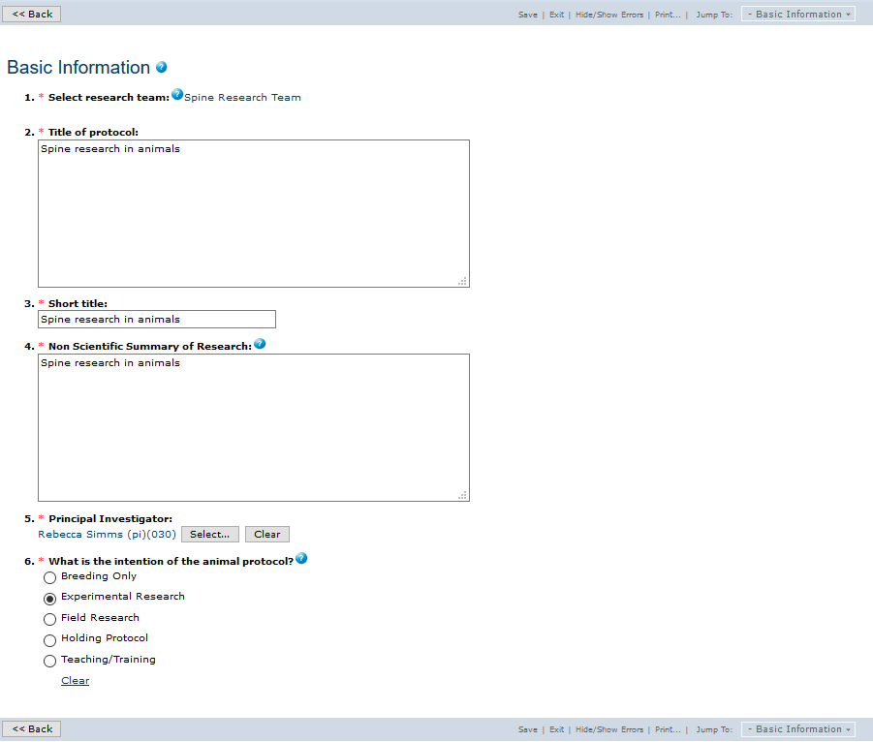
IACUC
Smartform
3
1
To open a protocol from its Study Workspace, click on the Edit Protocol button.
NOTE: This button may also be labeled View Protocol, dependent upon the State of the submission you are opening.
2
On the proposal pages, you
will see:
Required fields (red asterisk)
Field help
Navigation bar (save or exit workspace
Jump to other pages in protocol
Ensure all required fields are completed
5
4

Slide 23
Filtering and Sorting Data
Many pages contain tables you can filter and sort to help you find the data you want.
• Filtering reduces the list to only the data that meets the criteria. The advanced filter lets you combine multiple filter criteria together.
• Sorting displays the data in ascending or descending order by a particular column.
NOTE: To combine multiple filter criteria, such as ID number, Name, and Date Created, use the Advanced Filters.

Slide 24
Filtering Data
1. Select the column to Filter by from the drop-down menu. The menu lists only the columns you can Filter by.
2. In the next box, type the beginning characters for the items you want to find. If you do not know the beginning characters, type a % symbol as a wildcard before the characters.
3. Click Go to apply the filter. The table shows only those rows that are an exact match. If you do not see the expected items in the list, click Clear in the Filter by area to remove the filter.
NOTE: For examples and a list of operators you can use, click the Help icon.

Slide 25
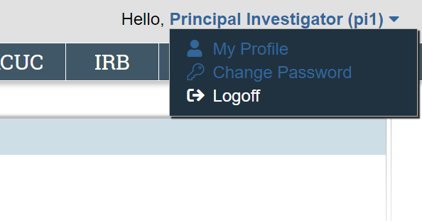
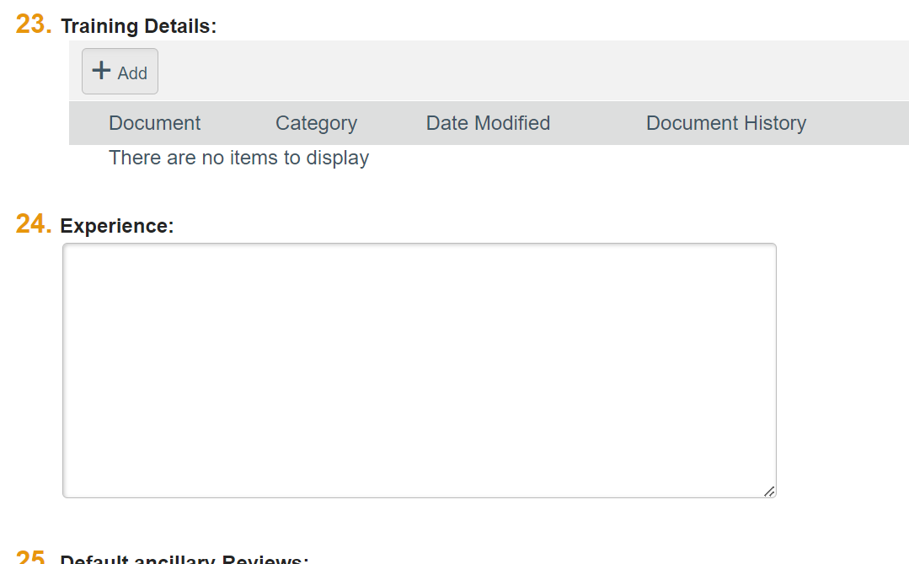
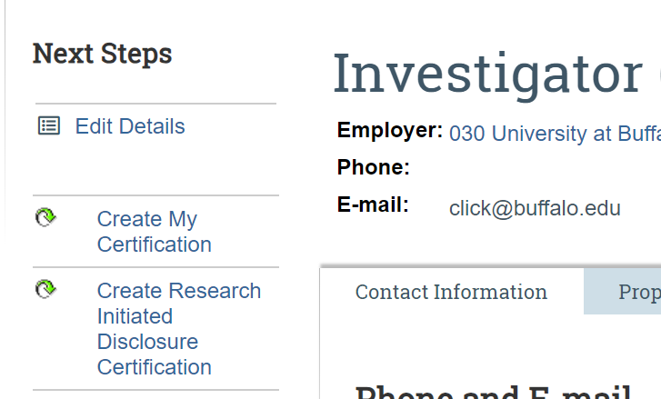
Before You Create a Protocol
Update Your Animal Research Experience
Users can save their animal research qualifications and experiences within their Click user account.
1. Log into the Click Portal.
2. Click on your name in the upper-right corner of the window.
3. From the Select View dropdown menu, select My Profile and then Edit Details. Add Animal Experience in question 24, “Experience”

Slide 26
4. Enter a description of your animal research experience/qualifications in the text box.
5. Click the Apply button. Your experience and qualifications will appear on the Procedure Personnel Assignment page within certain types of IACUC protocols in Click (e.g., Experimental Research protocols).

Slide 27
Plan Out Your Protocol
Determine what individual researchers will need to be listed on your protocol.
Determine the experiments you will perform, and the number of animals required.
Determine all specific substances you will administer to live animals.
Determine all specific procedures you will perform with live animals.
If applicable, download and complete the Non-Pharmaceutical Grade Form in the IACUC Library. This form must be uploaded to the Create Procedure SmartForm.
If applicable, upload the Specific Aims and Vertebrate Animals sections (or their equivalents) of your grant(s).to the Protocol SmartForm in the Funding section.
Download the Enrichment Checklist in the IACUC Library. This form must be completed and uploaded to the Protocol SmartForm in the Supporting Documents section.
Consider the reasons for performing the research, and potential scientific benefits from it

Slide 28

Create a Research Team. Each Research Team will then have Substances, Procedures, and Protocols associated with it.
Check the Substances tab for any pre-existing Substances required for your protocol experiments. If they are not in the library, you will need to create them.
Check the Procedures tab for any pre-existing Procedures required for your protocol experiments. If they are not in the library, you will need to create them.

Slide 29
Pre-submission building blocks
Click IACUC Module

Slide 30
Create Building Blocks
Before you create a protocol, the Building Blocks for a protocol must be created in a specific order:
1. Create your Research Team
2. Create Team Substances
3. Create Team Procedures
If the system does not already contain the Substance or Procedure that you need for your protocol, you will need to create it yourself.
Once created, it will be saved and can be used again in any of your Research Team’s future protocols. It will not be viewable or available to anyone who is not on the Research Team.

Slide 31
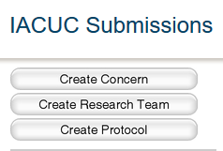
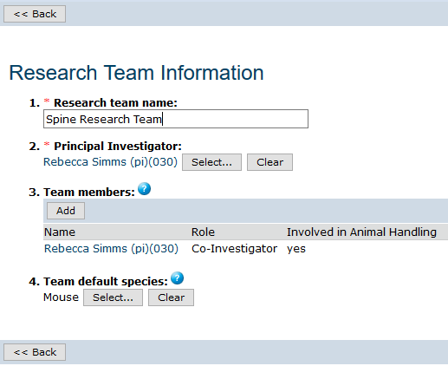
Create a Research Team
Click on the IACUC tab in the top navigation menu.
Click the Create Research Team button.
Complete the SmartForm.
Pre-Submission Activities
Enter a Name for the Research Team.
The Name should easily identify this specific Research Team to you.
Click the Select button to assign the Principal Investigator (PI). Select the PI, and then click OK.

Slide 32
Adding Team Members
Click the Add button to select Team Members.
Click the Select button and enter the individual’s Last Name.
Click the Go button.
Select the appropriate person, and then click OK.
Indicate whether the person has an animal handling role.
Indicate whether the person is authorized to order animals.
Check the person’s Role(s) in the research.
Click OK if you are finished, or OK and Add Another to add more members.
NOTE: You do not need to add the PI as a Team Member

Slide 33
Building Blocks
Research Team
“Standard” Substances and Procedures are those that have been pre-loaded into the library by the IACUC. These are not editable, can be seen by all users, and can be added to any protocol.
Substances
Procedures
Protocols
Create Team Substances
Substance
Create Team Procedures*
*Team Procedures can have one or more Team or Standard Substances
Each Research Team can create their own custom Substances and Procedures. Only members of the Research Team can edit and see their Team Substances and Team Procedures.
Create Protocols with Experiments*
*Experiments can have one or more Team or Standard Procedures
Substance
Procedure
Substance
Substance
Substance
Protocol Experiment
Procedure
Procedure
Substance
Substance
Substance
Substance
Procedure
Substance
Standard Substances & Procedures Library
Substances
Procedures

Slide 34
Editing Building Blocks
Pre-Submission Activities
When the protocol is… | The related procedures and substances are…
In Pre-Submission | Editable
In Pre-Review | Editable
Past the Pre-Review stage | Not editable by Research Team, only by the assigned IACUC Coordinator
Clarifications Requested | Editable
Approved | Not editable, including when Follow-On submissions are editable. For Follow-On submissions, create a new Procedure/Substance, and swap it in on the experiment. (Requires redoing the personnel procedure assignments)

Slide 35
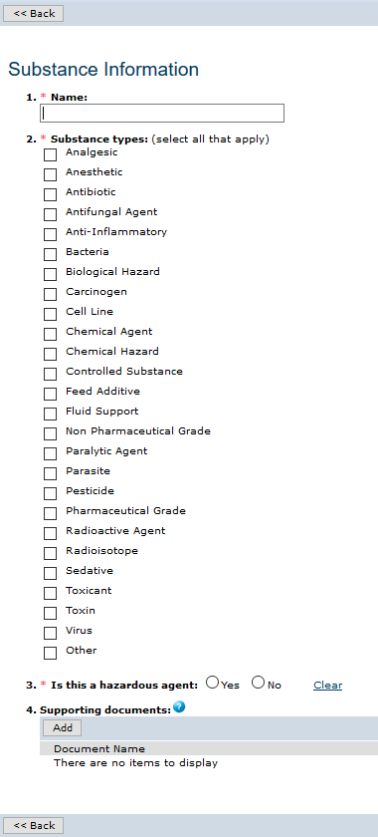
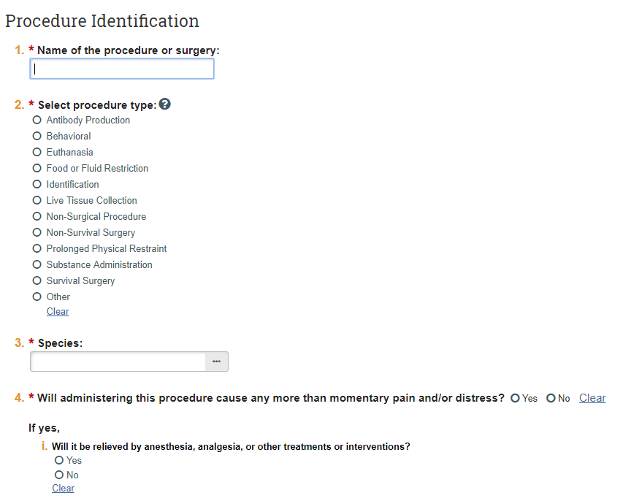
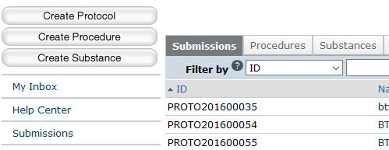




Creating Team Substances and Procedures
Pre-Submission Activities
2
From the Research Team Workspace, click on the Substances or Procedures tab. All Substances or Procedures currently available to this Research Team will display.
1
1
2

Slide 36
If the Procedure you require is already listed in the procedure library but could be made more appropriate by making a few minor changes, you can use the current Procedure as a template to create a new Procedure. Click the Exit button to return to the workspace and then click Copy Procedure.
Enter a new Name for the Procedure.
Select the applicable Research Team and click the OK button.
Click the IACUC tab, and then select your chosen Research Team from the Research Teams tab.
Click the Procedures tab and locate the copy by its Name. Click on the Name.
Click the Edit Procedure button, make the necessary changes, and then click Finish
The new Procedure will now be available when you create your protocol.

Slide 37
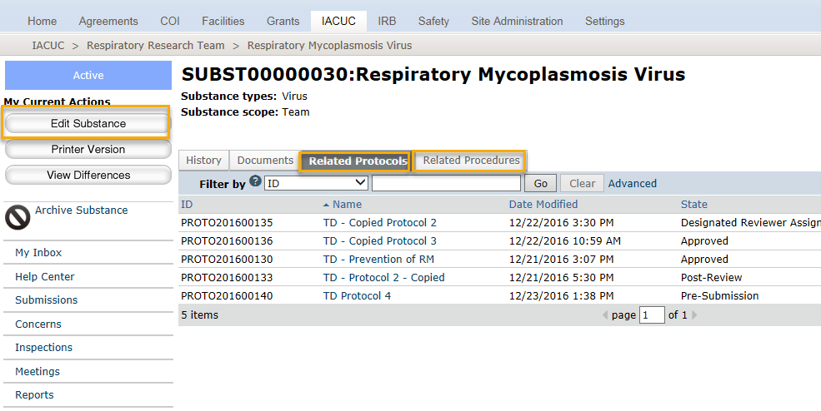
Substance
Workspace
Substances are utilized through the substance administration procedure type. That’s why you see related procedures and related protocols on the substance workspace. If a team substance is on a team procedure, it is editable when the procedure is editable. Substances cannot be copied, but there are only 3 questions on the substance form.

Slide 38
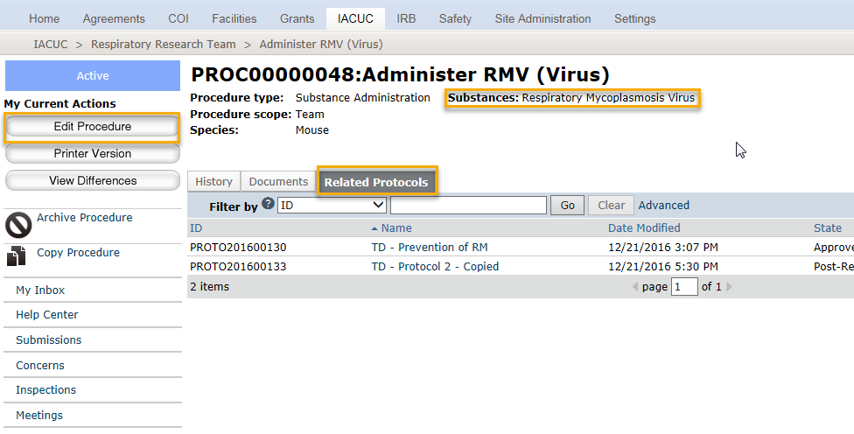
Procedure Workspace
From the procedure workspace you can see all protocols the procedure has been added to.
If the procedure is on many protocols, it could be a candidate for a standard procedure if not already.
If it’s a team procedure that’s already on an approved protocol, it will not be editable. If edits are required, then a copy of the procedure should be made, and that copy can be added to the new protocol or follow-on submission.

Slide 39

Create a Protocol
To begin the process of creating a Protocol, please complete the following steps:
1. Click the IACUC tab in the top navigation menu.
2. Select your desired Research Team from the Research Teams tab. Individuals listed in this Research Team will be imported into the personnel section of the Protocol you create.
3. Click the Create Protocol button.

Slide 40
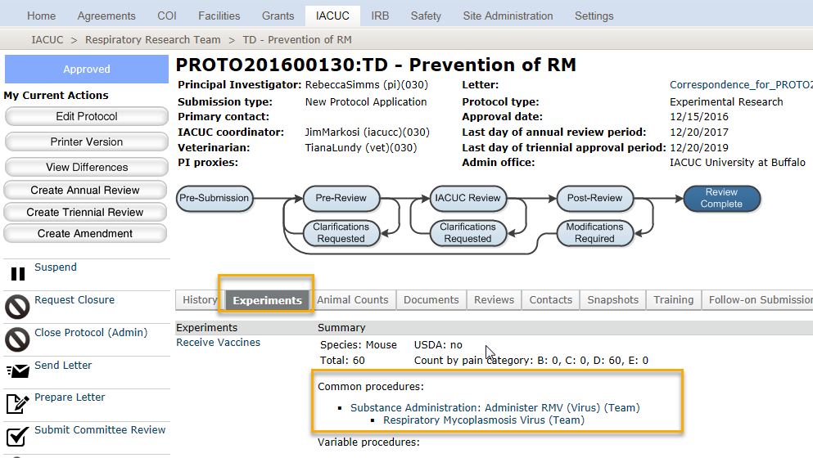
Protocol Workspace
Pre-Submission Activities
From the Protocol workspace, the Experiments tab shows the Building Blocks.
For each Experiment, you will see the Procedures included on the Experiment and if they are Standard or Team procedures. This can be helpful for the reviewer who may need to spend more time on reviewing the Team Procedures, but only look at the Standard Procedures in context with the experiment.

Slide 41
Basic Information
1. The Title for the protocol is the official Title of the protocol and should include the name(s) of any grants associated.
2. The Short Title becomes the unique name of the the protocol in Click.
3. The brief Non-Scientific Summary of Research for the protocolmust be written in non-technical terms.
4. By default, the protocol creator will be listed as the PI.
5. Select the Intention for the protocol.
Click the Continue button to save your work and move to the next page.

Slide 42
Protocol Team Members
To Delete
To Add
The default list of personnel displayed will reflect the individuals included on the selected Research Team, but individuals can also be added or deleted from this page
There is no need to add the Principal Investigator to the Protocol Team Members page, as the PI was already listed on the Basic Information page.

Slide 43
If you anticipate funding for the study, click the Add button.
Click the Select button.
Enter the Name of the organization. Use complete words – no abbreviations.
Click the Go button.
For each grant, the Specific Aims and Vertebrate Animals sections should be included as attached files (click the Add button to attach them).
Indicate if any personnel listed on the protocol have a financial interest in this research

Slide 44
1. State the scientific aims of the research. What are the goals and objectives?
2. State the significance and potential human/animal health benefits of the research.
Click the Continue button to save your work and move to the next page within the SmartForms.

Slide 45
Adding Experiments
NOTE: All Procedures must have been previously created before you can assign them to the Experiments you create in the protocol.
Click the Add button.
Enter a Name for the Experiment.
Click the Select button to choose the appropriate species for the Experiment, and then click OK. There can only be one species per Experiment.
Describe the Experiment. What will happen to the animals? Include animal characteristics such as age, weight, and sex.
Enter a scientific justification for the purpose of this experiment. How is it necessary to your research goals?
Click the Add button to select Common or Variable Procedures;
  Common -procedures which all animals in the experiment will undergo.
  Variable - . procedures which only some animals in the experiment will undergo.
Choose the appropriate Procedure and complete form.
Click OK.

Slide 46
Non‐invasive observation of animals.
Animals that are subject to research related procedures that cause no or only slight pain or distress
Animals subjected to potentially painful or stressful procedures for which they
receive appropriate anesthetics, analgesics, tranquilizer drugs, or euthanasia.
B
How many animals in the experiment will be in each Pain Category?
Only count each animal once, in its highest expected Pain Category
C
D
E
Animals subjected to potentially painful or stressful procedures that are not relieved with anesthetics, analgesics, tranquilizer drugs, or euthanasia.

Slide 47
Supporting Documents
Click the Add button.
Click the Choose File (or Browse) button to locate the file.
Upload the Enrichment Checklist on this page.
You can locate the checklist document in the Library, on the Checklists tab.
Complete the checklist concerning the animals on this protocol.
When uploading the file, please name the document Enrichment Checklist.
If you are conducting a Field Research protocol, upload copies of all your required permits.
Enter a Name for the document. Name the document as you want it to appear in the approval letter.
Select a Category from the drop-down menu.
Click the OK button. If you have additional forms to add, click OK and Add Another to repeat the process

Slide 48
Submitting a Study for Review
In order to submit the submission to the IACUC for review, the PI as a PI Proxy must complete the following actions, from the Study Workspace:
1. Click Submit under My Current Actions.
The Click Portal will run a brief check to ensure that all of the required fields have been completed within the SmartForms.
If an error appears, click the link(s) and update any required fields that were missed. Save your changes, Exit the protocol’s SmartForms, and then click the Submit button again.
If there are no errors, a statement will appear in the window.

Slide 49
2. Read the statement and then click OK to submit the study for review. You do not need to include any Comments or Supporting Documents if you have no further information to provide.
3. After you submit, check to ensure that the following things have occurred:
• The Status Bar in the upper-left corner of the Workspace has now changed from Pre-Submission to Pre-Review.
• The highlighted state in the workflow image at the top of the page is now Pre-Review.
• On the History tab, the most recent action is Submitted

Slide 50
What To Expect After Submitting
Submitting your protocol initiates a series of activities that may include:
  Review by an IACUC Coordinator
  Review by an IACUC committee
  Optional ancillary review by individuals, departments, and other organizations
  Communication of the committee’s decision to the investigator
Any of these may lead to a request for the research team to take further action, such as providing clarifications regarding the protocol
After submitting, you may go back to edit the protocol to create:
  Amendments
  Annual Reviews
  Triennial Reviews

Slide 51
When a PI is making animal count changes to an amendment or triennial, they should always put the TOTAL number of animals used, not the number they are adding with the amendment and triennial. Jared also gives an example where the total is not updated correctly if an animal count is only changed in an experiment, which could also be causing issues.

Slide 52

Questions?
For policy questions regarding IACUC:
  Meghan Laski, meghanla@buffalo.edu
For technical questions regarding Click:
  Tracie Groves, traciegr@buffalo.edu
For assistance with UBITNames and Passwords:
  Electronic Research Administration, support@research.buffalo.edu

