Slide 1
Agreements Module
Click Training

Slide 2


Tracie Groves
Training Programs Coordinator, RIS
traciegr@buffalo.edu
829-6650

Slide 3
Some Background about Click
The Click Portal is a comprehensive software for managing research and streamlining workflow and compliance for research.
The Click Portal was implemented to assist principal investigators, students, compliance and research administration staff with administering sponsored programs
UB is leading the implementation of the Click Portal, working in collaboration with our vendor partner, Huron, and the PACS Leadership Team.

Slide 4
The Click Portal
Click automates the submission, review, and approval processes while managing all major administrative aspects of the research and compliance lifecycle:
Proposal development
Compliance checks
Negotiations
Award setup and management
Eventual project closeout
Notes:
IRB – IRBNet
Safety - Paper
Agreements – Paper, and online forms for MTA and CDA
COI – COI Risk Manager
IACUC – Paper
Grants – Electronic Proposal Submission (EPS), Dropbox

Slide 5
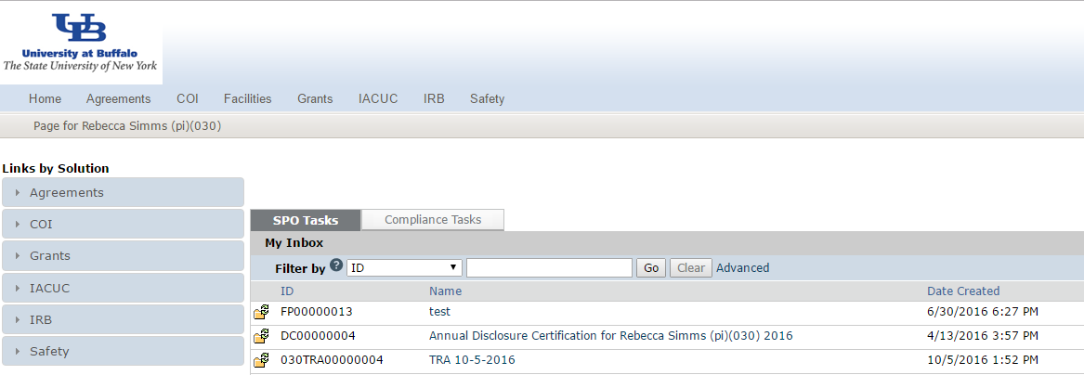


The Click Portal Assists 6 Aspects of Research Management
6 Modules Make up Click

Slide 6
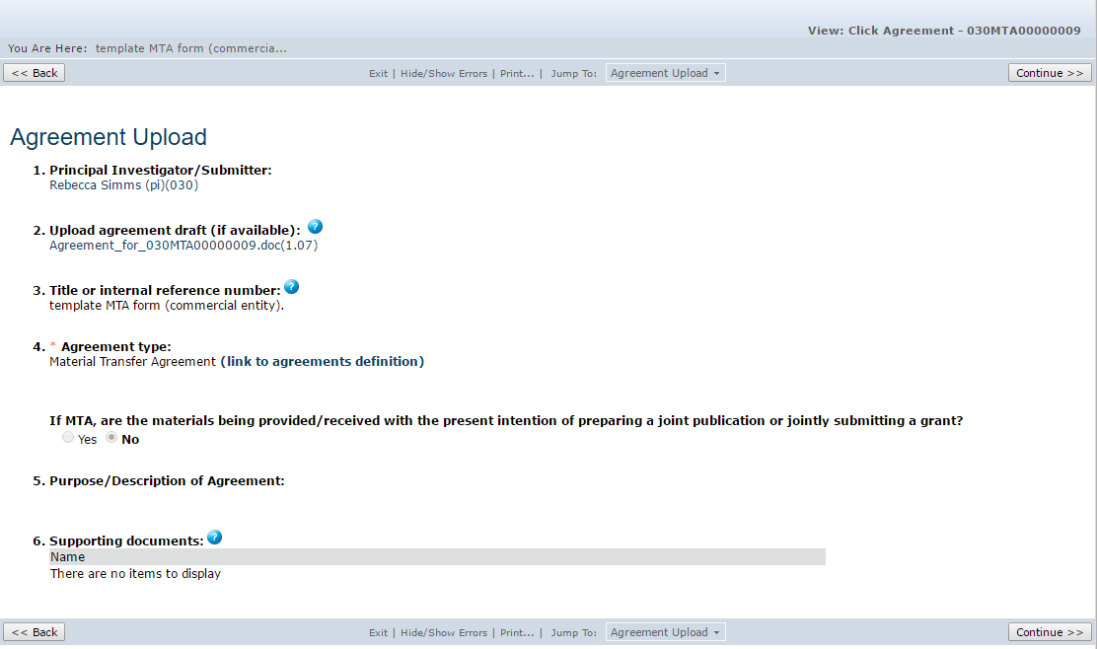
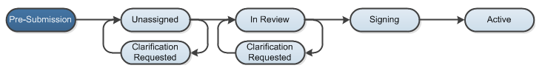
Agreements Module Benefits:
Customized submission forms for various agreement types
Eliminates the risk of storing information in individual email accounts
Interfaces with other modules - simple tracking with relationships to studies and grant awards

Slide 7
RoLES AND Workflow
Agreements Module

Slide 8

Agreements Roles and Responsibilities
Study Team - Individuals who are developing and entering a research protocol. Includes PIs and their contacts, and other study staff.
Agreements Managers- Individuals who guide submissions through the review process. They are responsible for creating an agreement, submitting it to review, and assigning the agreement to a reviewer.
Agreements Reviewers - Individuals responsible for reviewing agreements. Some agreements may also require an optional review by an Ancillary Reviewer.
This Photo by Unknown Author is licensed under CC BY-NC-ND

Slide 9
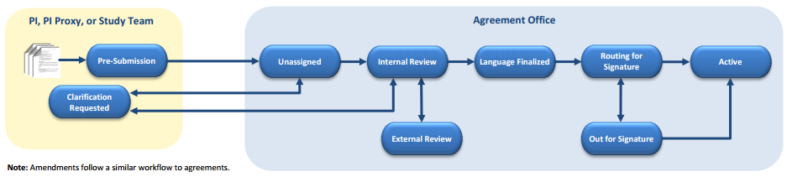
Activities for Each Role/ State of Agreement

Slide 10
Initial State | During This State | To Move to Next State | Next State
Getting Started (No State) | Any user can create an agreement | Agreement is saved in system by selecting the save button in Click | Pre-Submission
Pre-Submission | Study team can edit agreement or add ancillary reviewer | PI or PI Proxy submits agreement to Agreement Office | Unassigned
Unassigned | Agreements Reviewer (REV) reviews agreement | Rev takes ownership, assigns to another user, or requests clarification | Clarification Requested or Internal Review
Clarification Requested | Study team can edit agreement in response to Rev’s request | PI submits changes or responds to clarification requested | Unassigned or Internal Review (state before clarification requested)
Internal Review | Rev can generate, edit, upload agreement, send emails, and set up or update reviews | Rev moves agreement to External Review. | External Review (may move back and forth to internal review until all agree)

Slide 11
Initial State | During This State | To Move to Next State | Next State
External Review | Same as Internal Review | When all parties agree, Rev approves language | Language Finalized
Language Finalized | Rev can upload agreement and convert to pdf if needed for signature | Rev routes agreement for signature to institution (internal) or 3rd party (external) | Routing for Signature/ Out for Signature
Routing for Signature (Internal) | Rev can upload agreement and convert to pdf if needed for signature | When all signatures are received, Rev activates the agreement | Out For Signature/ Active
Out for Signature (External) | Same as Routing for Signature | When all signatures are received, Rev activates the agreement | Active
Active | Rev can terminate the agreement. Study team can create Amendment

Slide 12
Navigation
Click Agreements Module

Slide 13
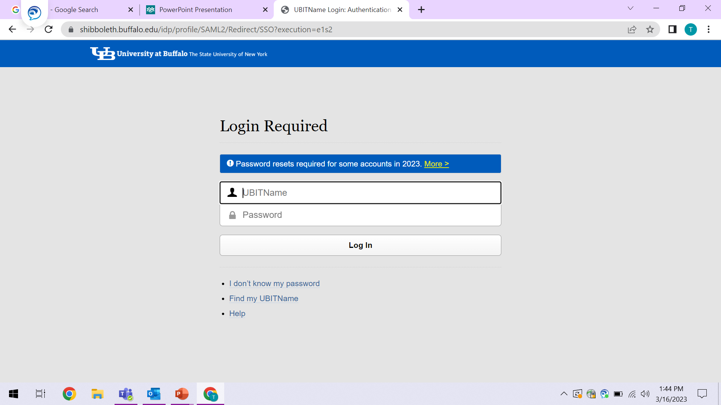
For UB Personnel: Use your UBitname and password to access the Click COI system.
If you don't know your name / password or you need to reset your password, please contact UB CIT at support@research.buffalo.edu or 645-3542 for help.

Slide 14
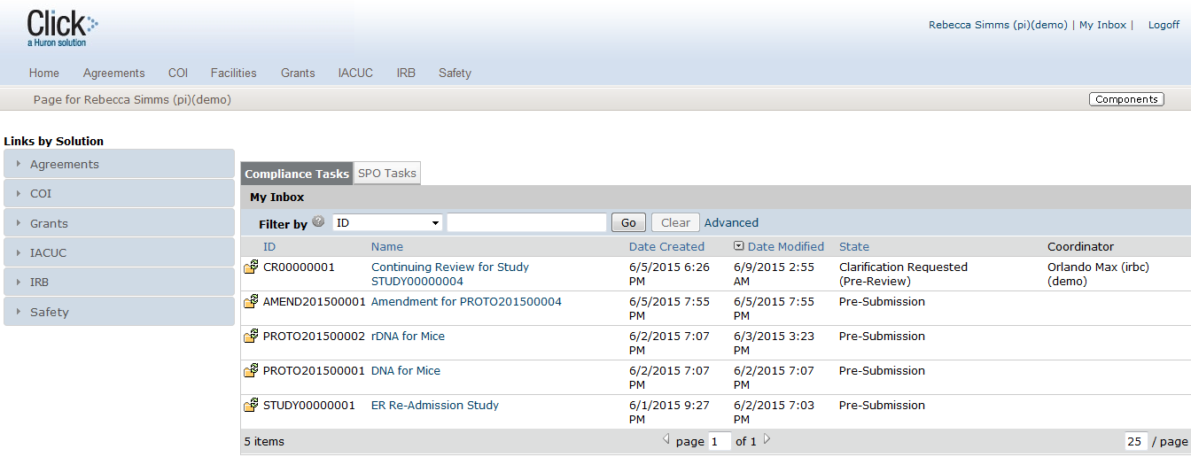

After you log in, you are taken to your Inbox. Found in the Inbox:
Submissions that require action
State in the review process
Navigation Tabs
2
1

Slide 15
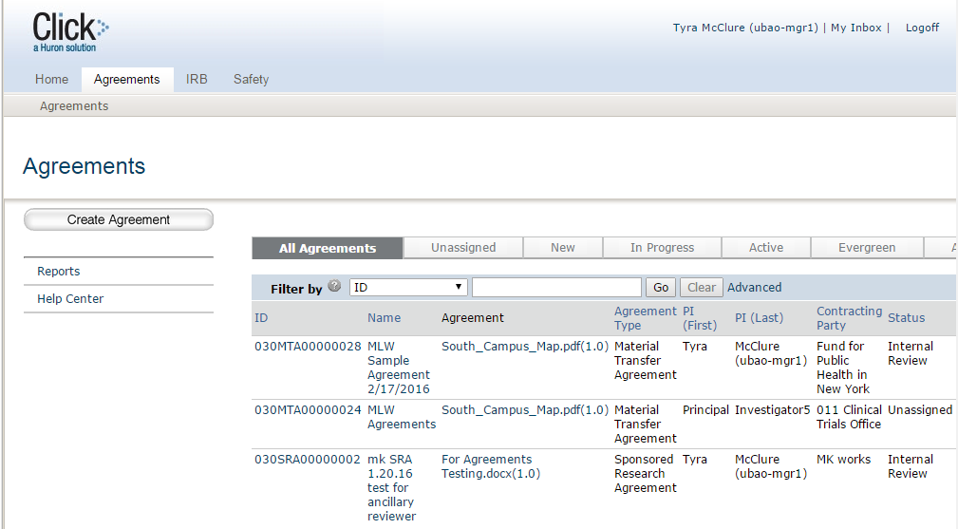

From Agreements Tab, In All Agreements, you will see:
All submissions to the Agreements module
State in the review process
Shortcut to reporting features
Shortcut to user guides and videos
Clicking on the hyperlinked ID will take you to that Agreement’s Workspace

Slide 16

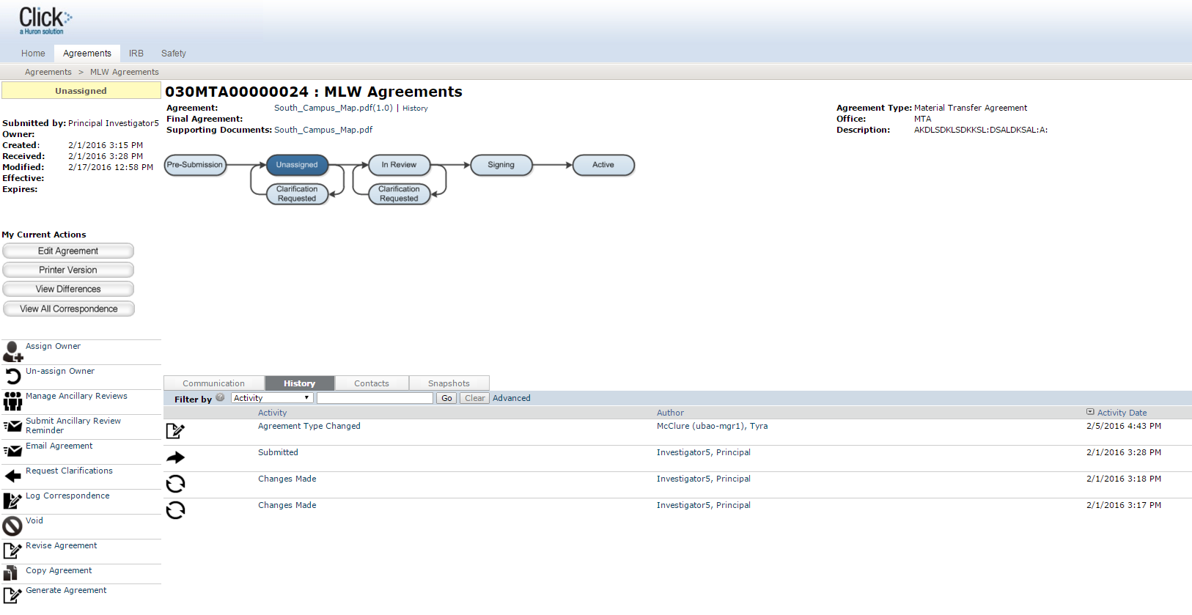
The Agreements Workspace will have:
Agreement details
The state in the review process
Actions you can take in the agreement’s state
Tabs with information about the history of the agreement
1
3
2
4

Slide 17
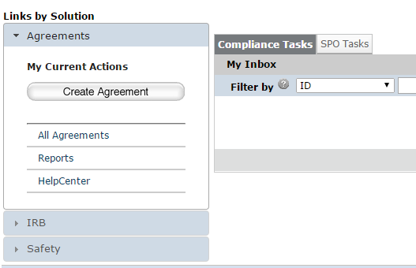
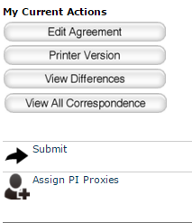


The Principal Investigator can:
Create the agreement and complete the SmartForm pages
Submit the agreement for review

Slide 18
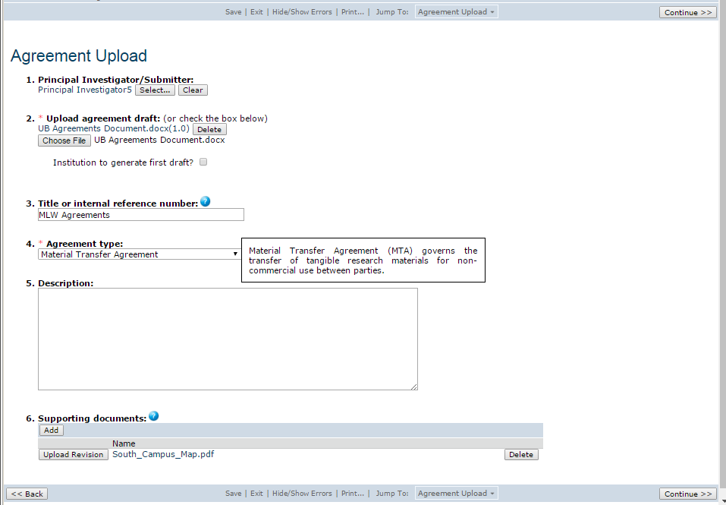
1
All Click SmartForm pages contain:
Required fields ( * )
Field help ( )
Navigation bar
2
3

Slide 19
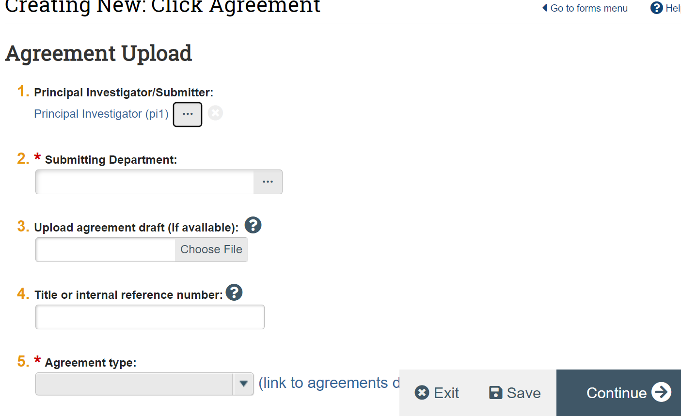
Agreements Smartform

Slide 20
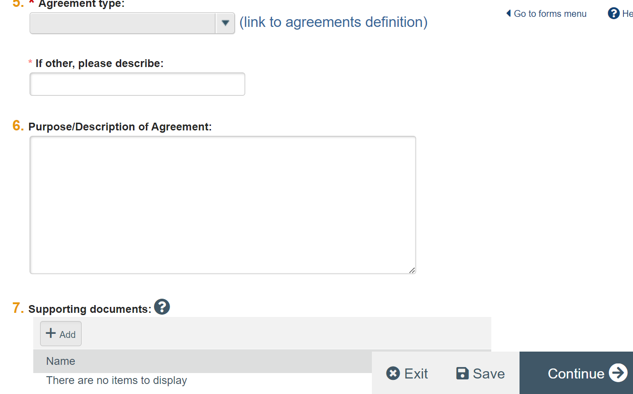

Slide 21
Post-Submission
For Agreements Reviewers

Slide 22
After an Agreement is Submitted
Submitting an agreement initiates a series of activities that include:
Review by Agreements Office
Ancillary review by individuals, departments, and other organizations
Any of these may lead to a request for the study team to take further action, such as providing clarifications regarding the agreement.
The PI will receive e-mail notifications if any action needs to be taken. The study should appear in all study team member’s Click Inbox. Reviewer’s decisions are communicated by email also.

Slide 23

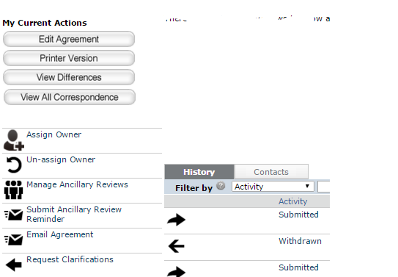
An Agreements Manager can:
Review the agreement and determine if any edits or an Ancillary Review is needed
Request clarifications from the PI as needed
Assign the agreement to an Owner (Agreements Reviewer) for further review
1a
3
1b
2

Slide 24
Reviewers can track agreement reviews and follow up with internal, 3rd party, and ancillary reviewers.
Activities performed from the Agreements Workspace:
Changing the agreement state to Internal or External Review to reflect who is reviewing the agreement
Finding agreements in review and viewing the last action taken
Creating reminders or action items for next steps
Editing the agreement or uploading a revised or final agreement
Following up with ancillary reviewers

Slide 25
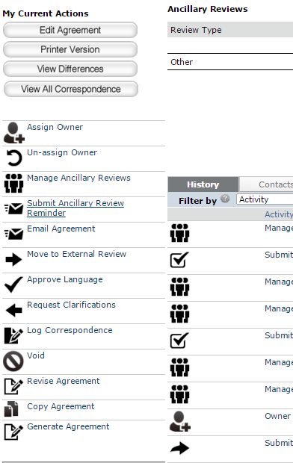
Internal Reviews
The Agreements Reviewer can:
Edit the agreement or upload a revised version
Add and notify Ancillary Reviewers
Email the agreement to other users to review
Move the agreement to External Review
Request clarifications from the PI as needed
Set up correspondence reminders
Approve the language of the agreement
1a
2
3
4
7
5
6
1b

Slide 26
An Agreements Reviewer can:
Approve the language of the agreement, and rout it for internal and external signatures
Upload a final copy of the agreement
Convert the final copy of the agreement to a PDF document
Activate the agreement
3
1
2
4

Slide 27
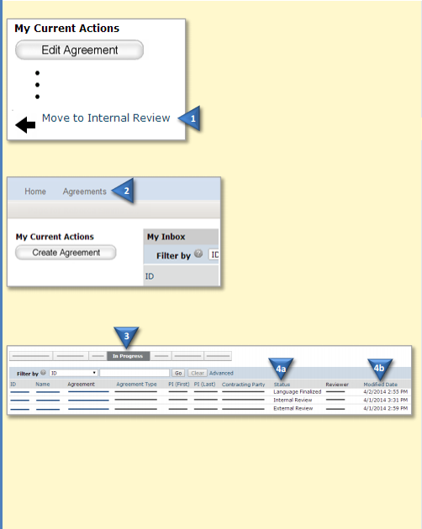
Finding Agreements
Moving Agreement to Review State
On the left, click Move to Internal Review or Move to External Review to reflect who is reviewing the agreement.
1. In the top navigation menu, click Agreements.
2. Click the In Progress tab.
3. On the In Progress tab, see the following columns:
- Status to find agreements in Internal, External and Ancillary Review
- Modified Date to see when action was last taken on an agreement
Tip: Use the Filter by option to show agreements in a certain status.
4, Open the agreement and review the History tab to see the last activity performed.

Slide 28
Ancillary Reviews
Ancillary reviews allow individuals, departments, and other organizations to give feedback on the submission in parallel with the agreements review
The system does not prevent a submission from being reviewed or approved with ancillary reviews outstanding
Decisions about how, when, and whether to interrupt the review process to wait for ancillary reviews are left to the University’s policies and staff

Slide 29
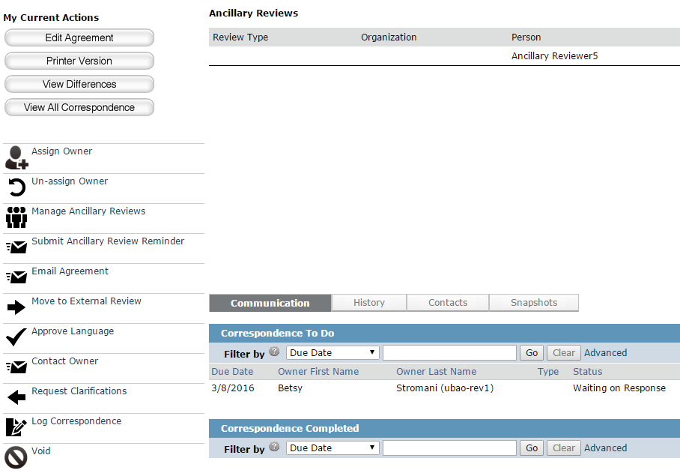
Ancillary Reviews
Ancillary reviews can occur at any time from the Pre-Submission to In-Review states. They can be requested and managed by PIs, Agreements Managers or Reviewers.
The Ancillary Reviewer can submit an ancillary review, and request changes to the proposed agreement.

Slide 30
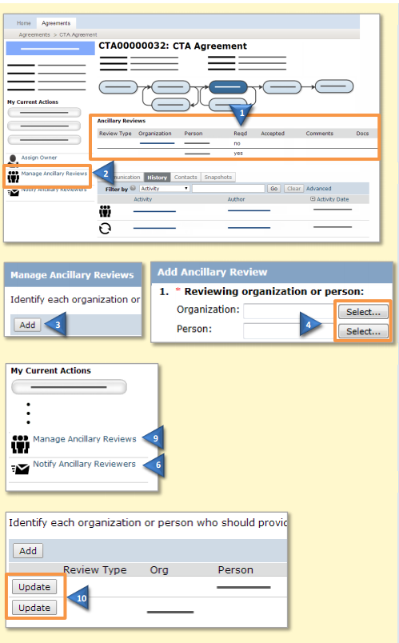
Add an Ancillary Reviewer
On the left, click Manage Ancillary Reviews. Click Add. Next to the Organization or Person, click Select and then choose the desired reviewer and click OK. Complete the rest of the form and click OK.
Remind Ancillary Reviewers
On the left, click Submit Ancillary Review Reminder. Select the reviewers you wish to notify and type a message. Click OK.
Update an Ancillary Review
On the left, click Manage Ancillary Reviews. Click Update next to the Person or Organization for the review you wish to update. Complete the form, indicating if the review accepted the submission and click OK.

Slide 31
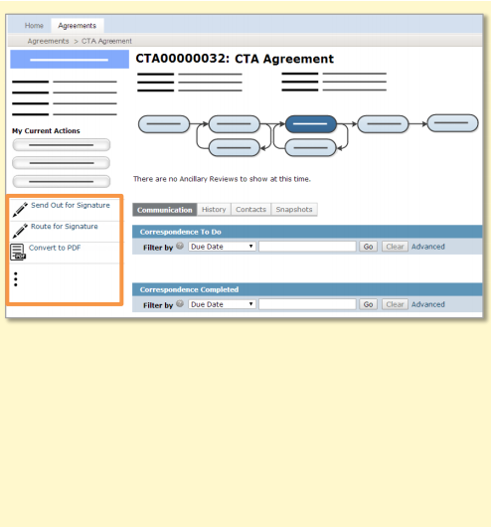
After all internal, 3rd party, and required ancillary reviews are completed, the agreement language can be approved, and the agreement signed.
Approve Language: During this activity, you will indicate of the agreement will be routed for internal signature first.
Convert to PDF: Depending on your system setup, this activity may also add a watermark to the PDF.
Route for Signature: If you are routing for internal signatures first, then perform Send Out for Signature next.
Send Out for Signature: If you are sending the agreement out for external signatures first, then perform Route for Signature next.
Activate (Approve, for amendments): After all signatures have been received and the agreement is converted to PDF, perform this activity to complete the review process.
The following checklist includes the activities to perform to complete the review process.

Slide 32
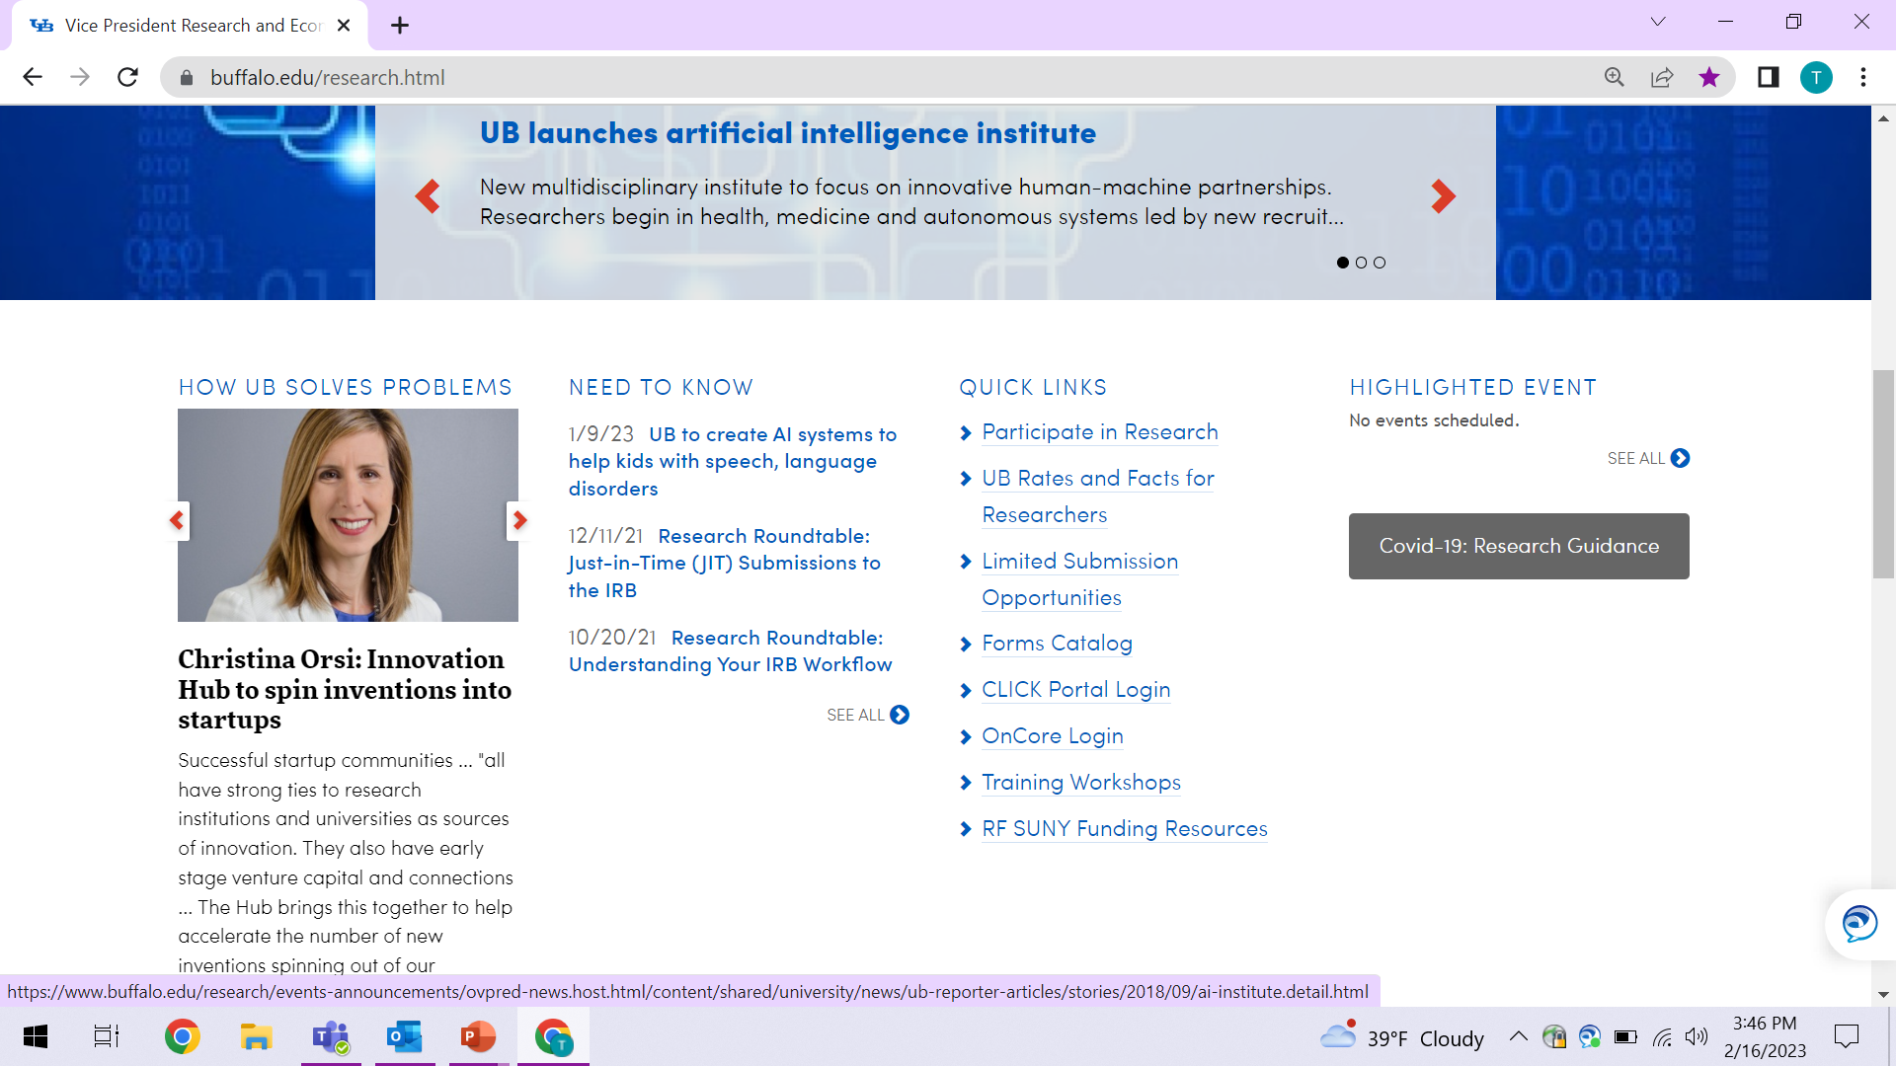


Navigate to http://www.buffalo.edu/research
Locate the QUICK LINKS section of the page:
Click on the Click Portal Login link
Enter your UBITName and Password and click the Log In button.

Slide 33

Questions?
For policy questions regarding Agreements:
  Mary Kraft, mekraft@buffalo.edu
For technical questions regarding Click:
  Tracie Groves, traciegr@buffalo.edu
For assistance with UBITNames and Passwords:
  Electronic Research Administration, support@research.buffalo.edu

