Slide 1
Rolling out the new MyUB
August 11, 2021
Notes:
Rob – RFP – Rethink MyUB; needs have evolved; meets needs of audience and stakeholders; We will leave time at end for questions; Feel free to post questions in chat window;

Slide 2
MyUB One Campus Transition Team
SELECTED FOR:
Expertise
  Digital
  MyUB product expertise
  Audience needs
Proven performance
Understands the importance of MyUB
Rebecca Bernstein, University Communications
Lori Chiarilli, Student Life
Mary Kvetkosky, Finance and Administration
Tim Nabzdyk, UBIT
Joseph Rizzo, Academic Affairs
Diana Tuorto, UBIT
Rob Wright, UBIT
Notes:
Lori – focused on Pilot

Slide 3
Driving Forces
Then
Now
Basic search
Websites must be staffed by techs
Websites difficult to steward, Shantytown
Few web applications
Optimized, enhanced search
Ubiquitous website staffing UBCMS empowers stewardship
More robust and personalized web applications
Notes:
Lori

Slide 4
Best Practice Driven Process
Scalable Information Architecture
Business rule driven content development
Best Practice user-driven UX design approach
User testing
Peer evaluation
Usage data evaluation
Notes:
Rebecca

Slide 5
User Testing Feedback
INTERFACE
“This is already like more aesthetically pleasing than the version right now. Like it just looks so nice.”
“I like the consistency of the look from the desktop to the mobile because it helps it be able to navigate it”
“I like that it’s broken down into categories.”
MOBILE OPTIMIZATION
“More student friendly and like easier to access because the current version of MyUB is not as friendly on my phone.”
USEFULNESS
“I would use this a lot more than I use MyUB right now.”
“It’s nice that there’s a one stop shop for this.”
FINDABILITY
“Pretty self explanatory.”
“It has everything that you would need…it's nice to not have to like go all over the place to find things.”
“I don't think there would be anything that would be impossible to find.”
Notes:
Rebecca

Slide 6
New MyUB TransitionTimetable
Student Pilot
COMPLETE
All Students
COMPLETE
Faculty/Staff Pilot
COMPLETE
All Faculty Staff
Beta Available: Summer 2021
Identify feedback
Refine product
Prepare Stakeholders
Beta Available: Late-Spring 2021
Identify feedback
Refine product
Prepare Stakeholders
New MyUB
Beta Available: Mid-Fall 2020
Beta Available: Winter 2021
COMPLETE
IN PROGRESS
August 18, 2021:
Transition
MyUB-Beta to replace MyUB Classic
Keep MyUB Classic Available
End of Fall Semester:
Sunset MyUB Classic
Notes:
Joe

Slide 7
Introduction to MyUB 2.0
Notes:
DEMO? No demo - go and use it.
And you can change your role if you want to see what a student sees
What's in it for you?

Slide 8
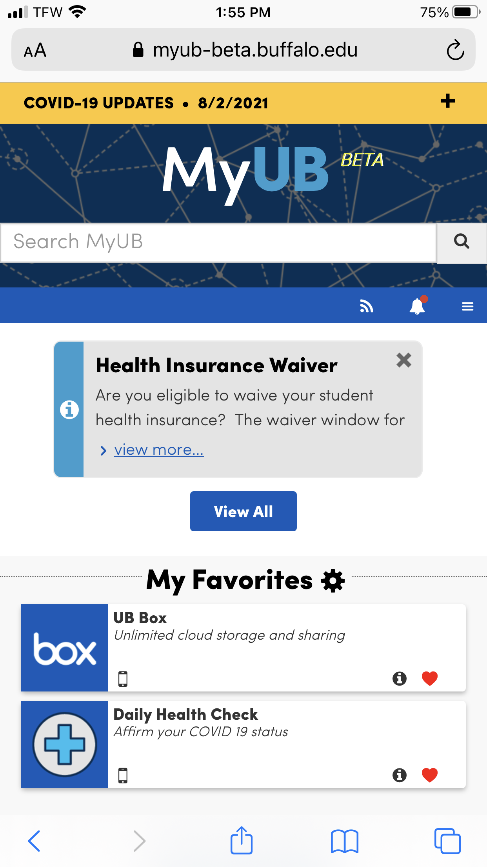
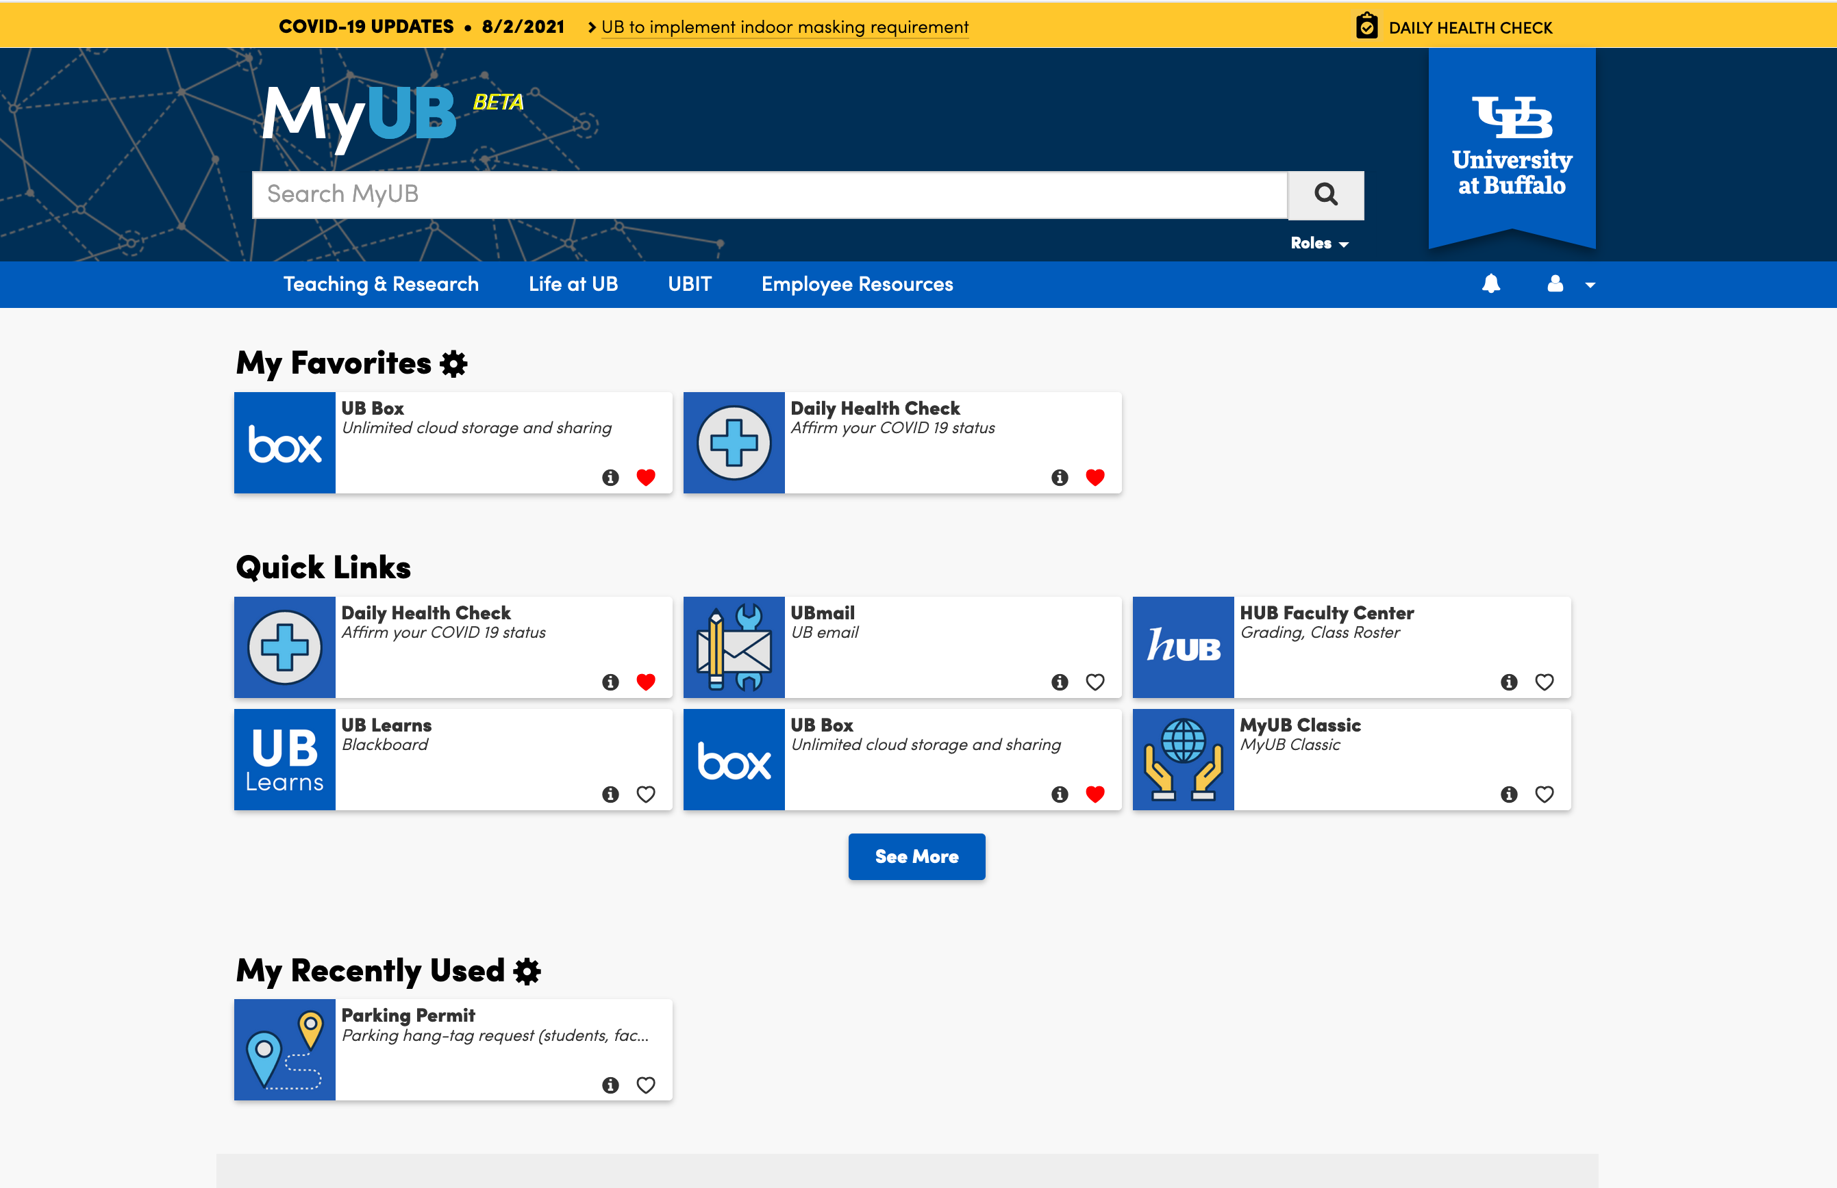
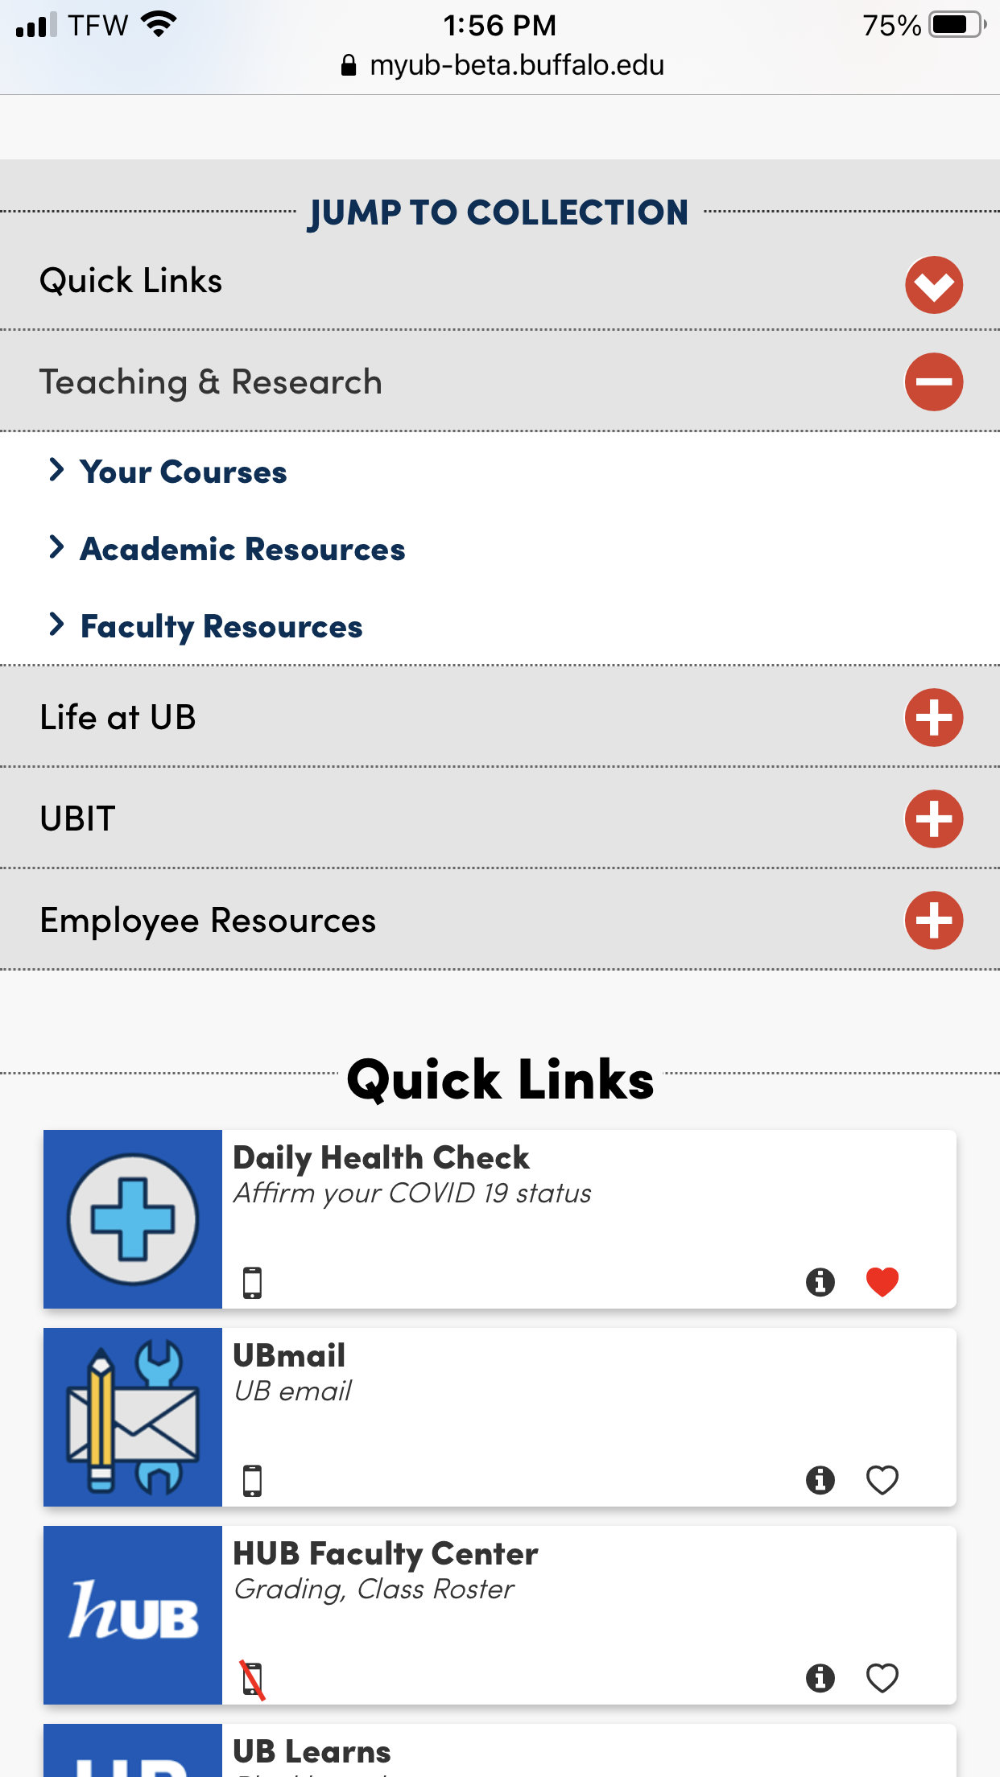

Slide 9
Integration points
Shibboleth
Yellow ISSUES Banner
Rave Alerts
Future: Benchmark rSmart customers re: their integration strategies.
  E.g. BlackBoard, Desire2Learn, etc.

Slide 10
How can you help
Promote
  Awareness of transition
  Utilization of the new MyUB
Incorporate the new tool into your future communications
Start using the tool
Make suggestions
Notes:
Joe – looking for 50-100 students; Students they work with…

Slide 11
Appendix

Slide 12
How Resources (Tasks) have changed
MyUB Classic
New MyUB
Paradigm: Assumes users may not be able to find resources or websites
Comprehensive approach to including resources
  Granular web pages
  Instructional material
  Applications
  Services
Paradigm: Relies on UB’s search to connect users with web pages
Selective and curated approach to including resources
  Applications
  Services
  Key Websites and Service Gateways

Slide 13
How Need to Knows (Announcements) have changed
MyUB Classic
New MyUB
Loose guidance
Focus: Critical Impact and campus-wide audience
Dismissible by end user
Broader audience application
Written concisely
Short timespan
Targeted by Role
Future: Possible target by department/Unit (ldap roles)

