Slide 1


Webex Meetings
Video meetings made simple
Webex Teams
Continuous teamwork in one place

Slide 2
What is Cisco Webex?
ub.webex.com
A collection of platforms enabling faculty, staff, and students to have fully interactive video and audio conferencing as well as persistent, group and one-to-one messaging.
All faculty and students have access to all Webex platforms.

Slide 3
ub.webex.com
Webex Platforms at UB – Use Cases
Meetings | Trainings | Events | Teams
Everyday collaborative meetings or study groups Presenting information Office hours Internal and external meetings | Synchronous learning sessions More host control Attention indicators Breakout rooms Workshops | Large scale events Webinars Communication Announcements Continuing Education | Messaging and file sharing with individuals and groups Asynchronous discussion Group work
Notes:
CMR (Collaboration Meeting Rooms) are not available for Events and Training
Webex Teams can connect with Teams enabled devices such as the Webex Board and desktop devices (DX80, etc.)

Slide 4
ub.webex.com
Webex Platforms at UB – Technical Capabilities
Meetings | Trainings | Events | Teams
Interactive audio and video Up to 200 participants Including 25 hardware video endpoints | Interactive audio and video Moderated Q&A Breakout rooms Polling, pre- and post-tests Up to 1000 participants | Interactive audio and video Moderated Q&A Up to 1000 participants | Persistent messaging with individuals and groups File sharing Calls with up to 100 participants
Notes:
CMR (Collaboration Meeting Rooms) are not available for Events and Training
Webex Teams can connect with Teams enabled devices such as the Webex Board and desktop devices (DX80, etc.)

Slide 5
Webex Meetings
ub.webex.com
Interactive video calls
Share screen, application, video files
Chat to individuals or all participants
Record sessions
Connect to audio via computer or phone
Transfer files
Use the Meetings Desktop App to start and join meetings
without going to the web site
  Connects to Outlook calendar, but Outlook is not required

Slide 6
Your Personal Meeting Room
ub.webex.com
The same capabilities as a Webex Meeting
Meetings don’t need to be scheduled in advance
The same URL every time
  https://ub.webex.com/meet/<your ubitname>
  Example: https://ub.webex.com/meet/eof
Enter the room and lock the door
  Let groups in or select individuals
Assign other people to host (start) meetings in you PMR
Notes:
Regular, scheduled Meetings each have a unique URL that stops working after the meeting.
You can set your PMR to be locked so anyone who goes there needs to wait in a virtual lobby to be let in.
When locked attendees who go to your PMR url will see the message “You can join the meeting after the host admits you”. OR if you haven’t started the meeting, `We’ll start the meeting when the host joins. Would you like to notify the host?”

Slide 7
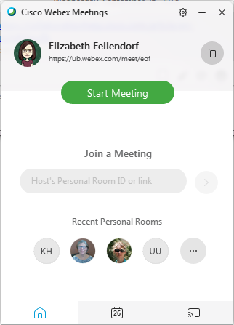
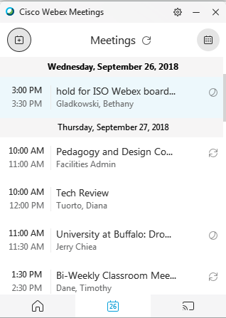
Webex Meetings Desktop App
Notes:
Admin rights are required to install. Meetings App is packaged for deployment from the SCCM or you can download the MSI file and push it through group policy

Slide 8
Webex Teams
ub.webex.com
Persistent stream of chat between individuals or teams
Swapping and downloading of files, whiteboards, and screen shots
  No file editing
Invite non-UB participants to join teams, spaces, and calls
One team can share many spaces
Make and schedule video calls from within the Teams application
Call interface is very similar to Webex Meetings except
  100 participants
  No phone option for audio
  No recording

Slide 9
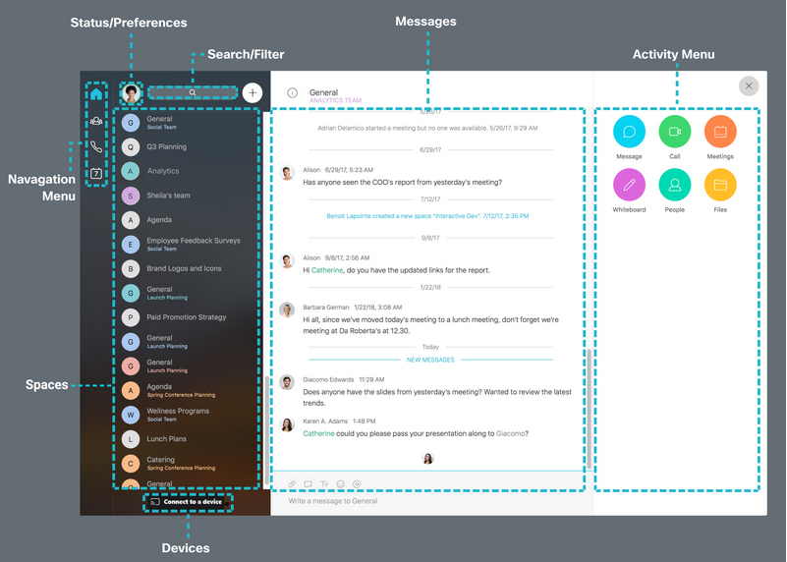
Webex Teams Desktop App

Slide 10
Training
ub.webex.com
buffalo.edu/ubit/service-guides/conference/webex/training.html
  Recordings
  Step-by-step instructions: buffalo.edu/ubit/webex
Cisco Online Help
    collaborationhelp.cisco.com
  Cisco Webex Quick Classes
    Search for “Quick Class”
    30 minute live sessions on basic features and best practices
    Register ahead of time

