Slide 1
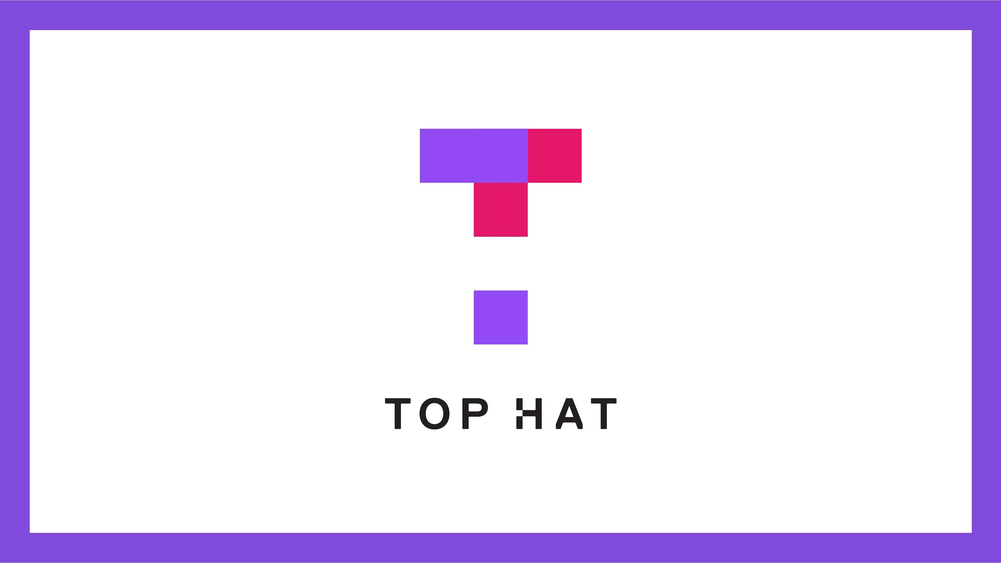

Slide 2
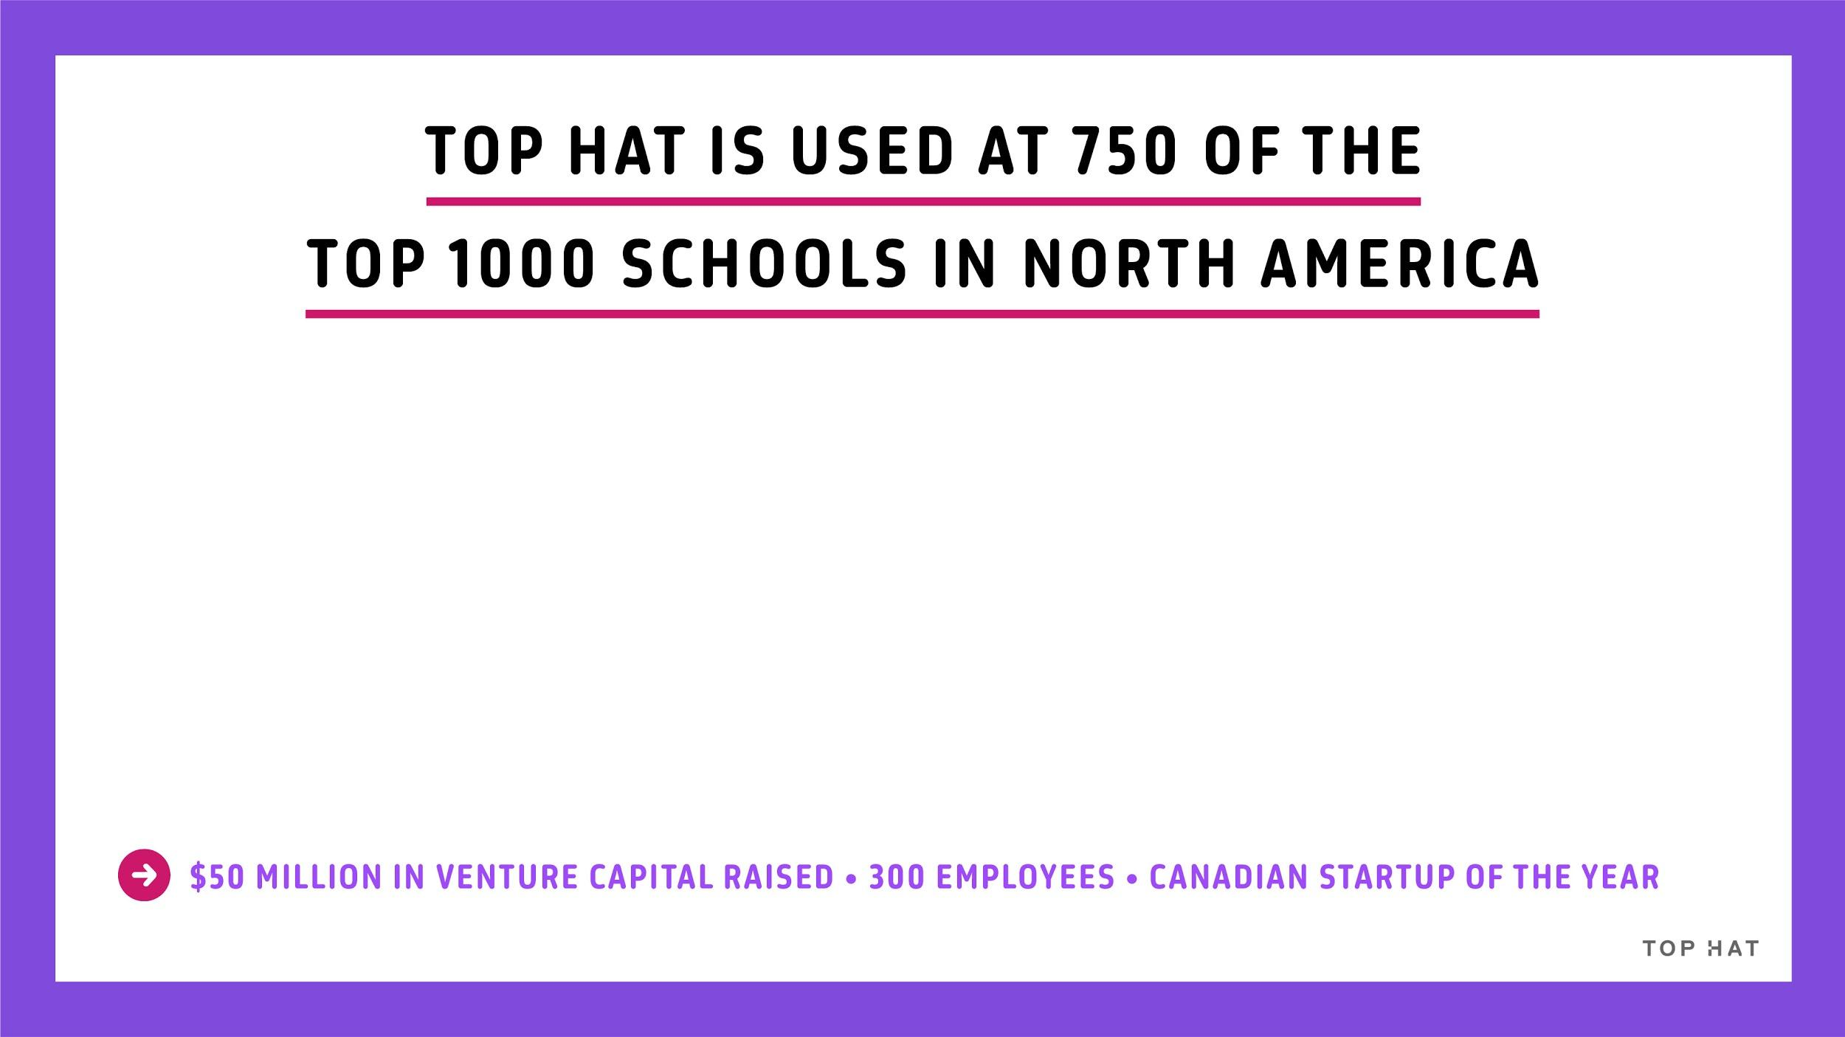






Notes:
Top Hat has worked with a number of institutions, large and small, to positively impact student engagement and improve learning outcomes.
We’ve raised substantial money on the premise of changing higher education, have grown fast, and even earned the honor of Canadian start up of the year this year.
We have users at virtually every large university in North America, and a large number of campus wide adoptions

Slide 3
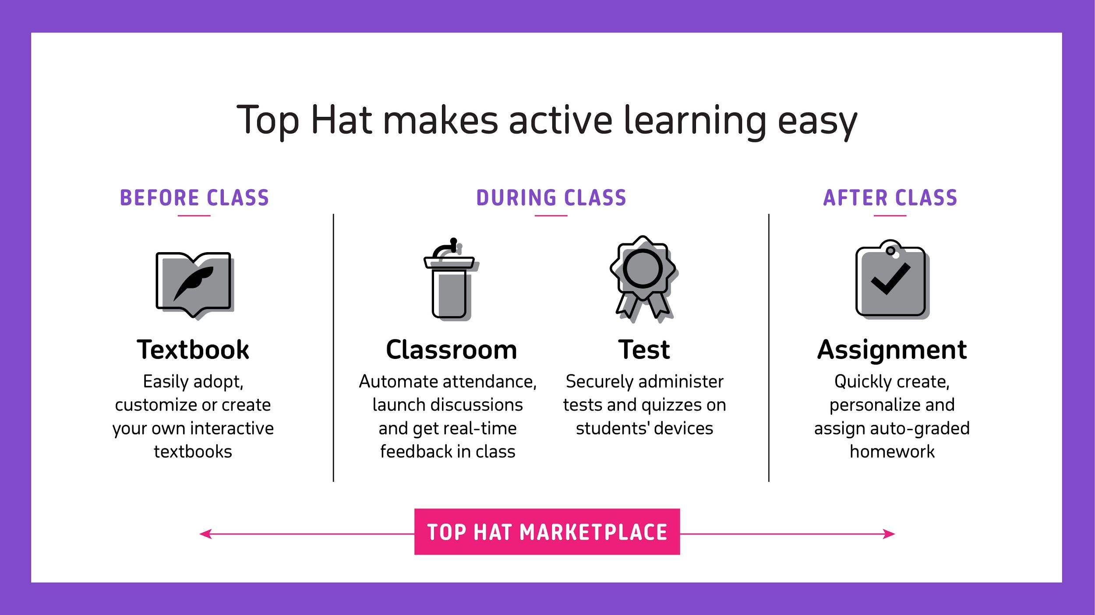
Notes:
This is where Top Hat comes in.
Top Hat was founded on the premise of making active learning easy. It’s the focus of our entire company, all 300 people (and growing!). We are an active learning company.
Our products engage your students with interactive content and assessment throughout the learning process - before, during and after class.
Students want to be engaged through the learning process. Top Hat is the solution to doing that effectively and efficiently.
Product overview:
Before class, it all starts with coming to class prepared. Top Hat Textbook allows you to easily adopt and customize, create or curate your own digital, interactive textbooks and course materials.
During class, easily create an engaging learning environment with Top Hat Classroom which allows you to reward students for attending and participating in class. You can easily automate attendance, launch discussions, and ask polling questions, all of which gives you as the professor real-time feedback while you teach.
As well during class, assess students’ mastery of your course concepts with Top Hat Test, which allows you to save time administering tests and quizzes in a secure, online environment created right on students’ devices.
After class, check for understanding with Top Hat Assignment, which allows you to easily create, personalize and assign auto-graded homework.
All of Top Hat’s products are powered by the Top Hat Marketplace - a hub of over 20,000 content items of free and premium content that can easily be adopted for you course. All of the content is built with active learning in mind - with the goal of enabling you and your students to assess as they go to ensure they are motivated, engaged and ultimately succeeding.

Slide 4
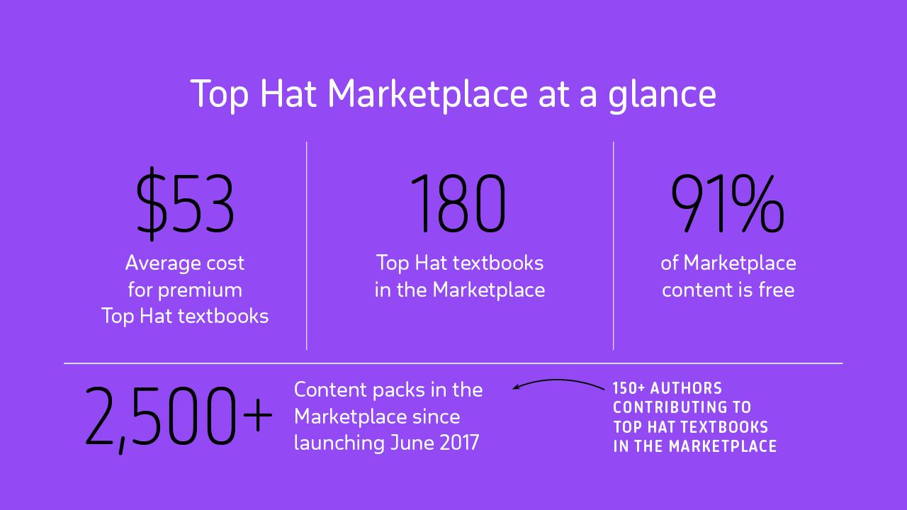
Notes:
As of September 2017:
Over 20,000 content items and counting
Over 1500 pieces of content - from full interactive textbooks to question packs to course notes and simulations - and counting
100 Top Hat Textbooks and counting - includes nearly 60 authored textbooks, 9 Noba books, 5 BookBon books, 15 OpenStax books
Over 150 authors contributing to Top Hat textbooks
815 question packs
343 free slide decks
260 free activities/assignments
Content that ranges across the 20 major areas of study in higher education
91% of content is free
Average cost for premium Top Hat textbooks: $37
This slide is difficult to keep up to date! The Marketplace is growing by the day.

Slide 5
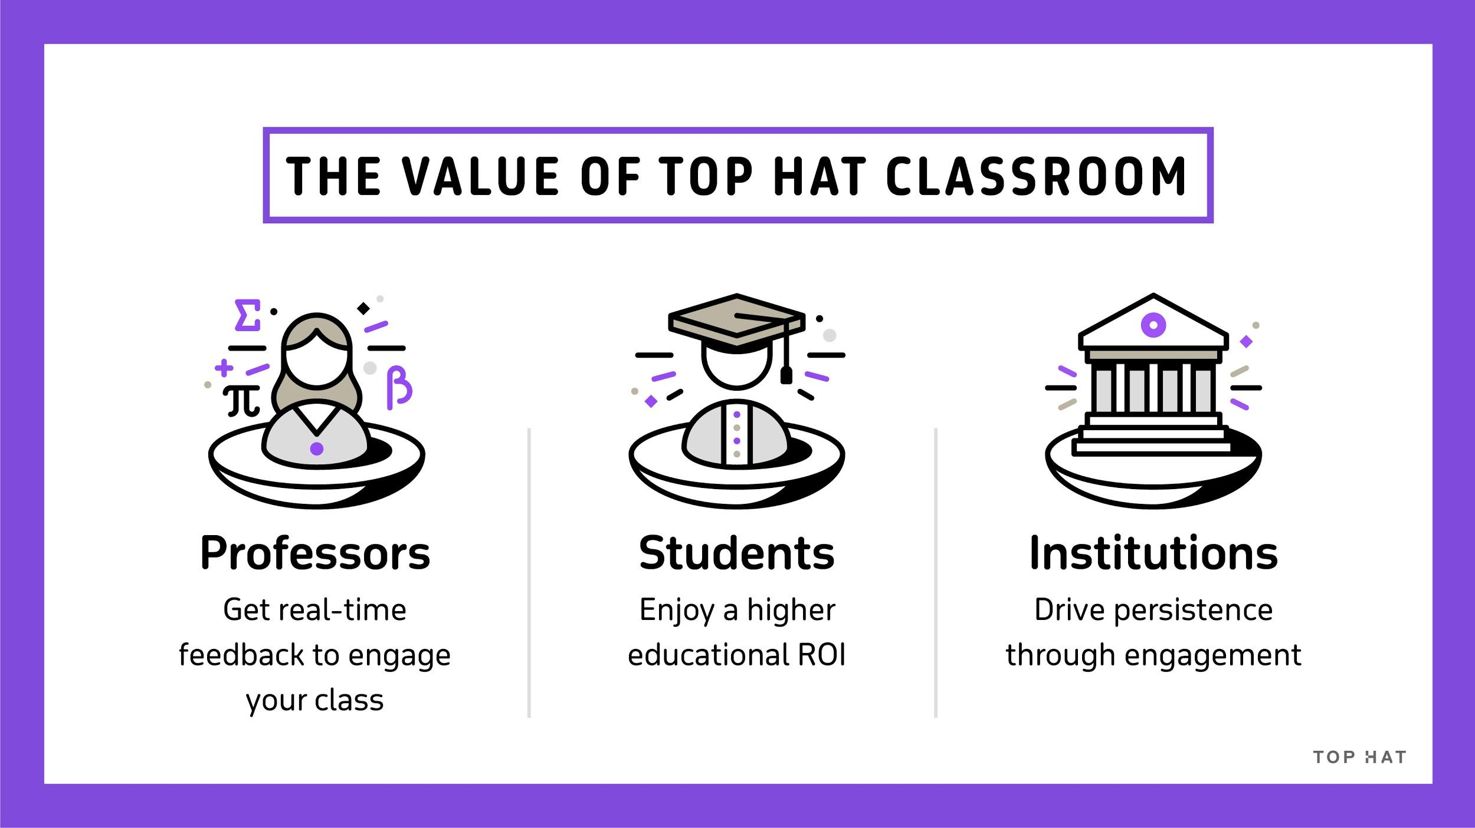
Notes:
Professors: real-time feedback lets professors course-correct or determine where post-class support is needed
Students: Stay engaged during class and enrich their understanding through Top Hat’s multiple activity and assessment types
Institutions: Motivated students means lower drop-out and higher persistence

Slide 6
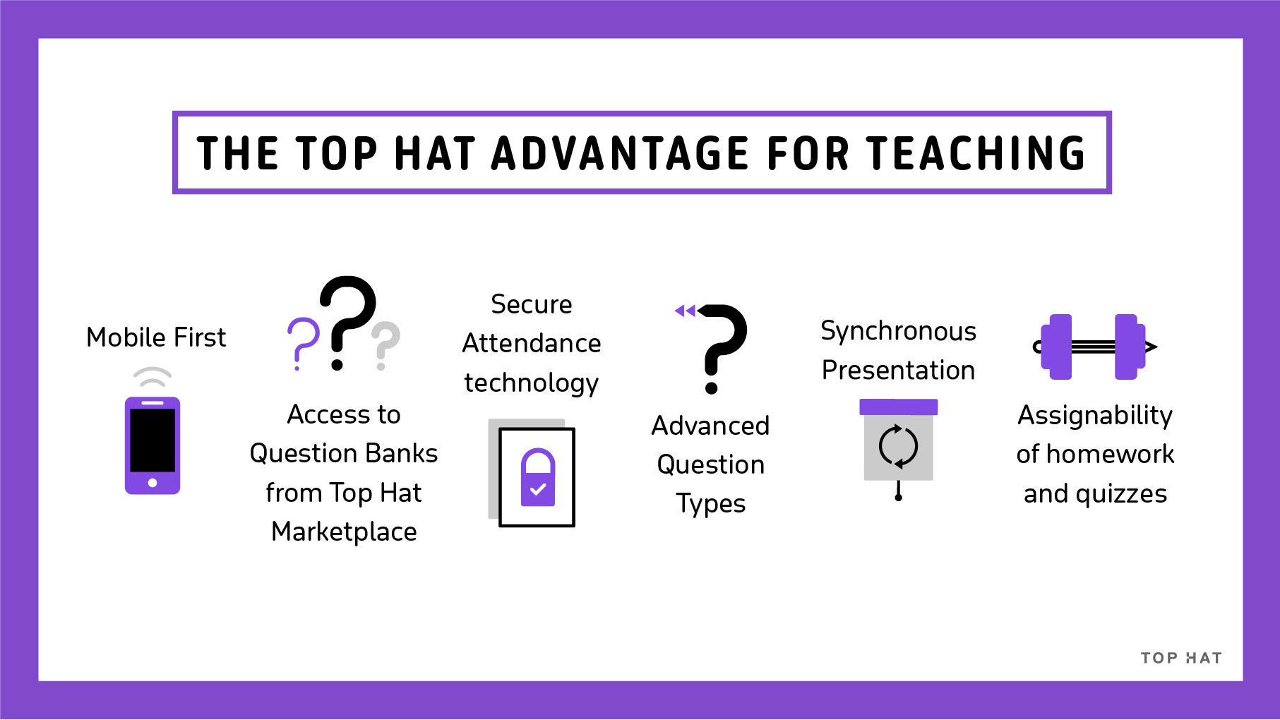
Notes:
Mobile first: We are a technology company. In fact, first bring-your-own-device company in the space.
Question banks: Unlike low-cost solutions, we offer instructors thousands of question banks for instructors to draw on
Secure attendance: Provides more reliable data than any other solution on the market to ensure academic integrity and so that instructors can rely on the data - when students say they’re in class, they really are.
Synchronous presentation: part of active learning - need to be able to engage with the material directly. Allows students to build comprehension more easily.
Assignability: More advanced question types allower deeper understanding of content. E.g. discussions - allow student-to-student interaction; e.g. word cloud and click-on-target, and we are even working on a question type that will take word-based answers.

Slide 7
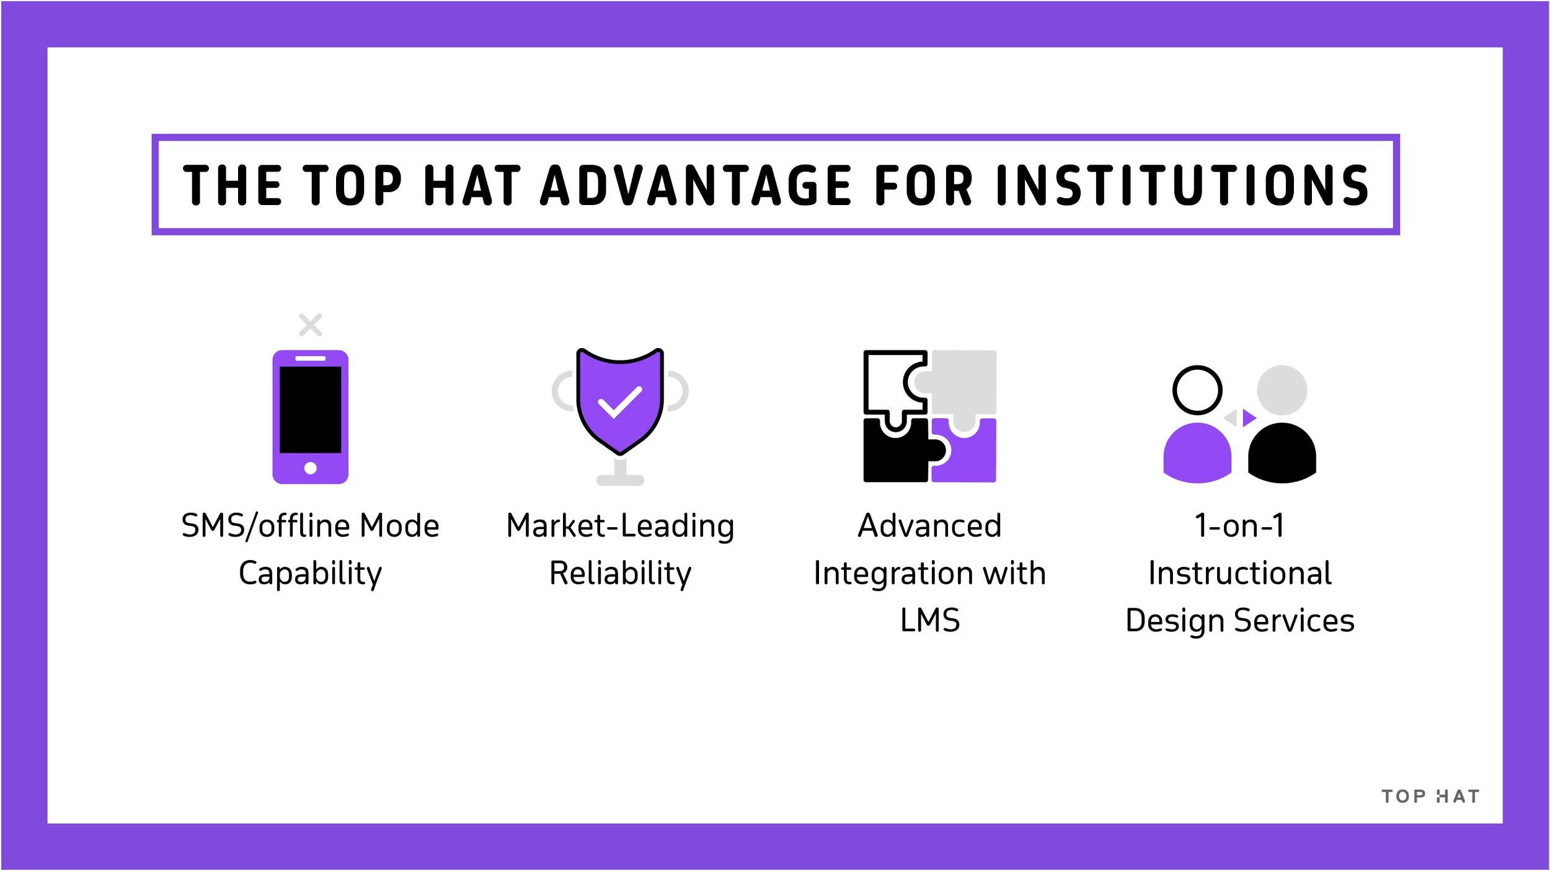
Notes:
What institutions love about our platform:
We’ve thought through the needs of different users. Classroom works for students with non-smartphones and in offline mode when wifi is weak
Our uptime is best-in-class: this year, we are surpassing our target of 99.95%
For our institutional partners, we offer advanced LMS integrations via API that allow for folder grading, points or % based grading, roster management and more.
And, probably our most differentiating service, we offer each instructor 1:1 instructional design services from our in-house team of experts
This is what sets us apart for institutions
We’ve raised substantial money on the premise of changing higher education, have grown fast, and even earned the honor of Canadian start up of the year this year.
Top Hat is used at 750 of the top 1000 institutions in North America, and many of them have adopted site-wide licenses

Slide 8
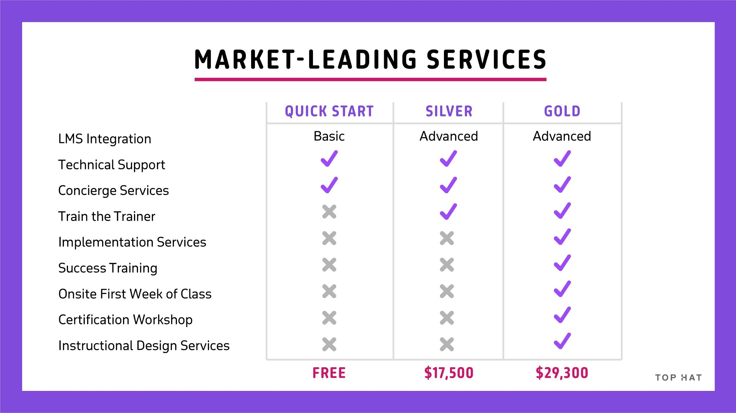
Notes:
Speaker notes:
We have three service level packages
The majority of customers are fully satisfied our Silver package
If you decide to adopt more than Top Hat product, then recommend the Gold package to better support your team on campus and your faculty

Slide 9
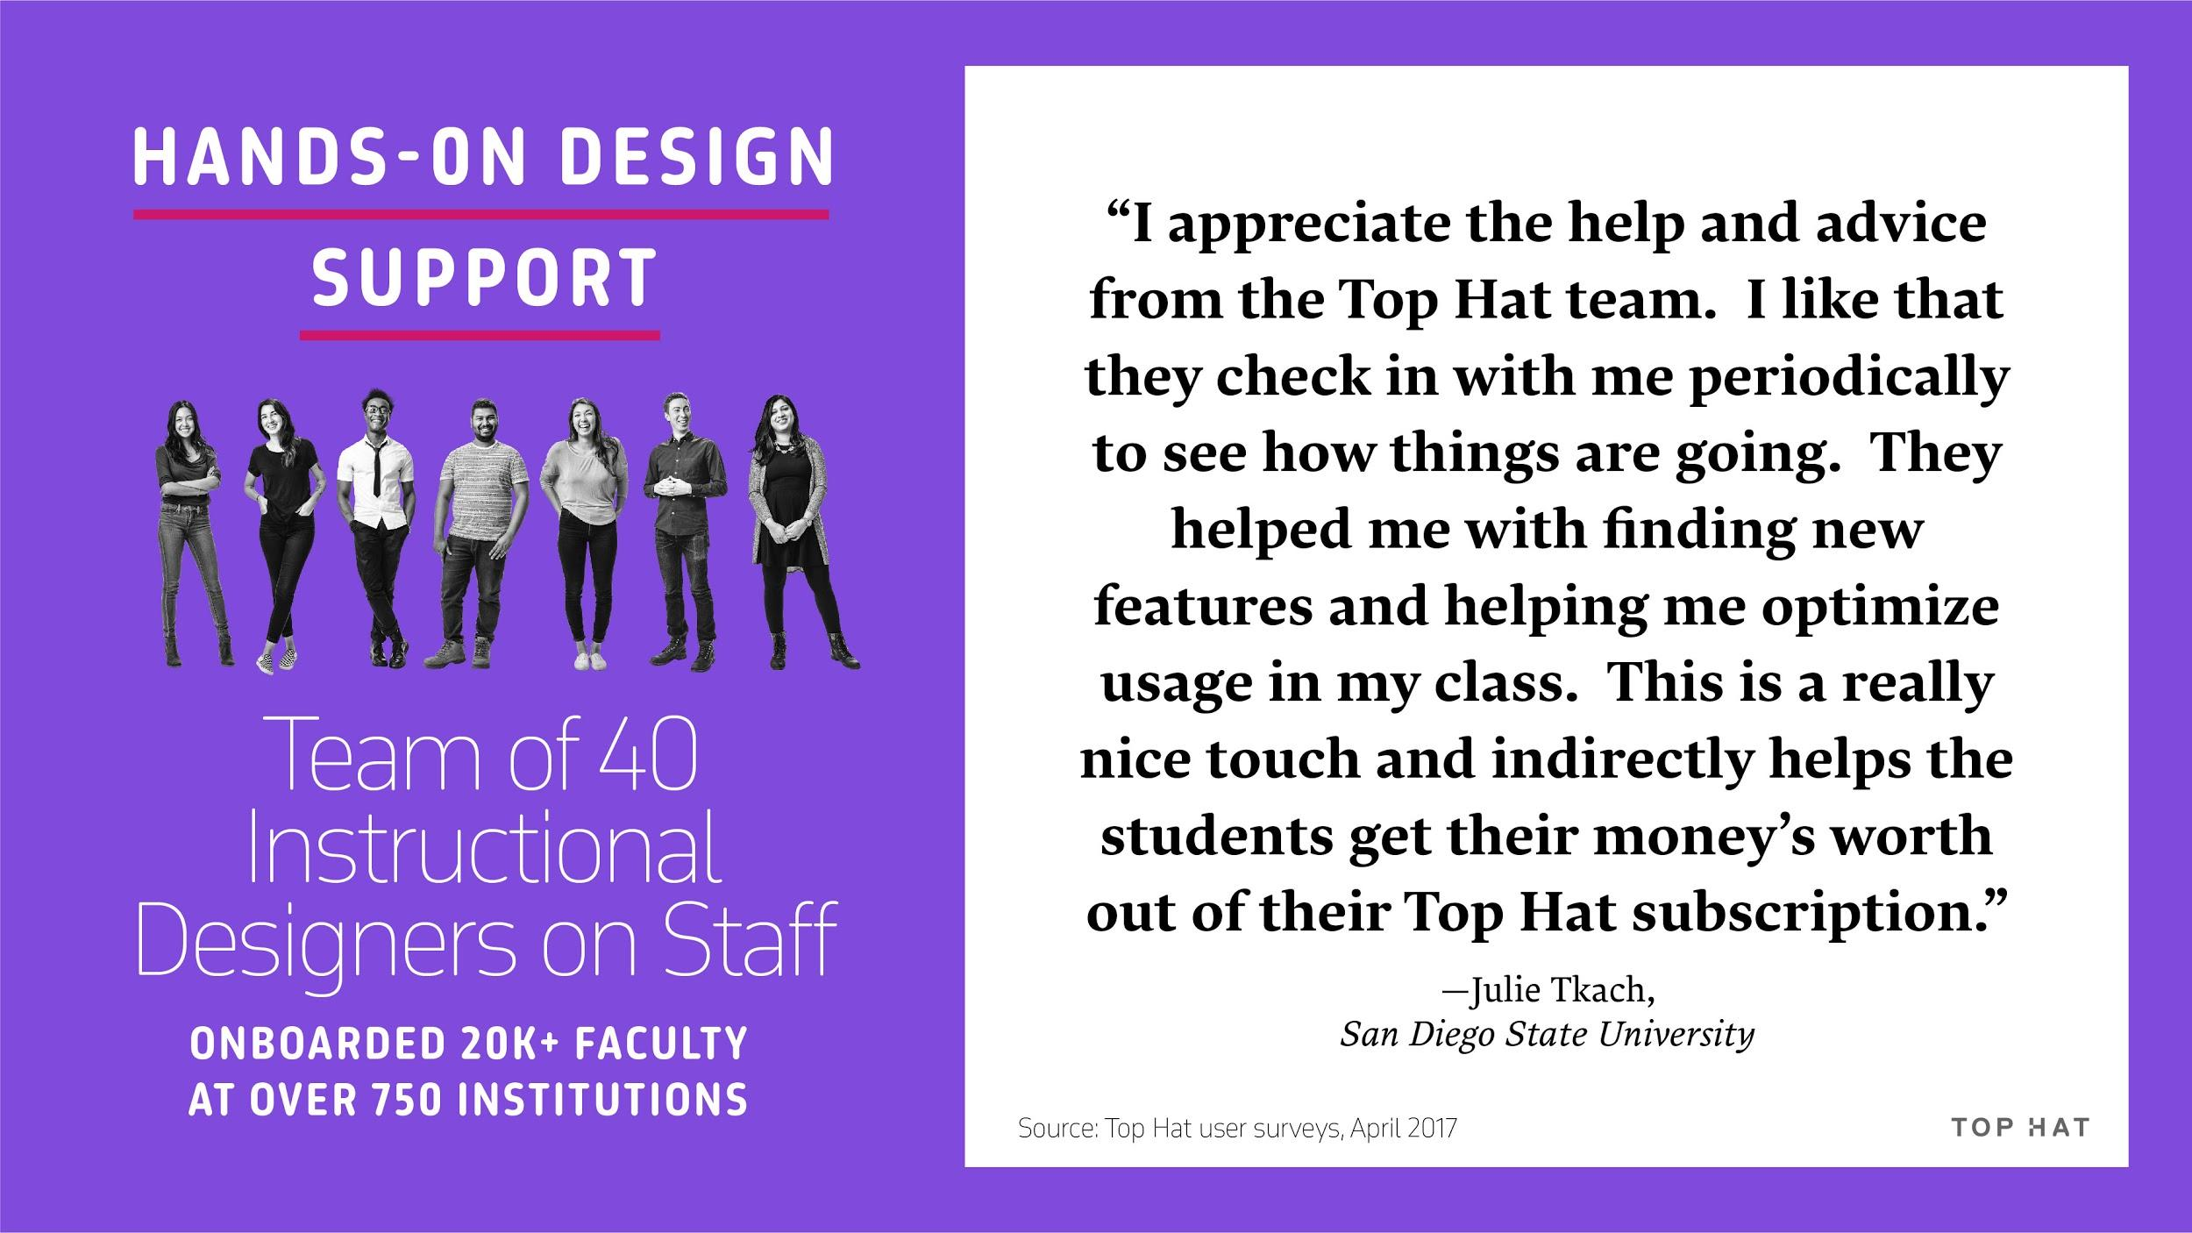
Notes:
Faculty prefer a personalized support system when implementing new technology or redesigning their course.
Our customers work with us because of our hands-on implementation model.
We have a team of 40 instructional designers

Slide 10
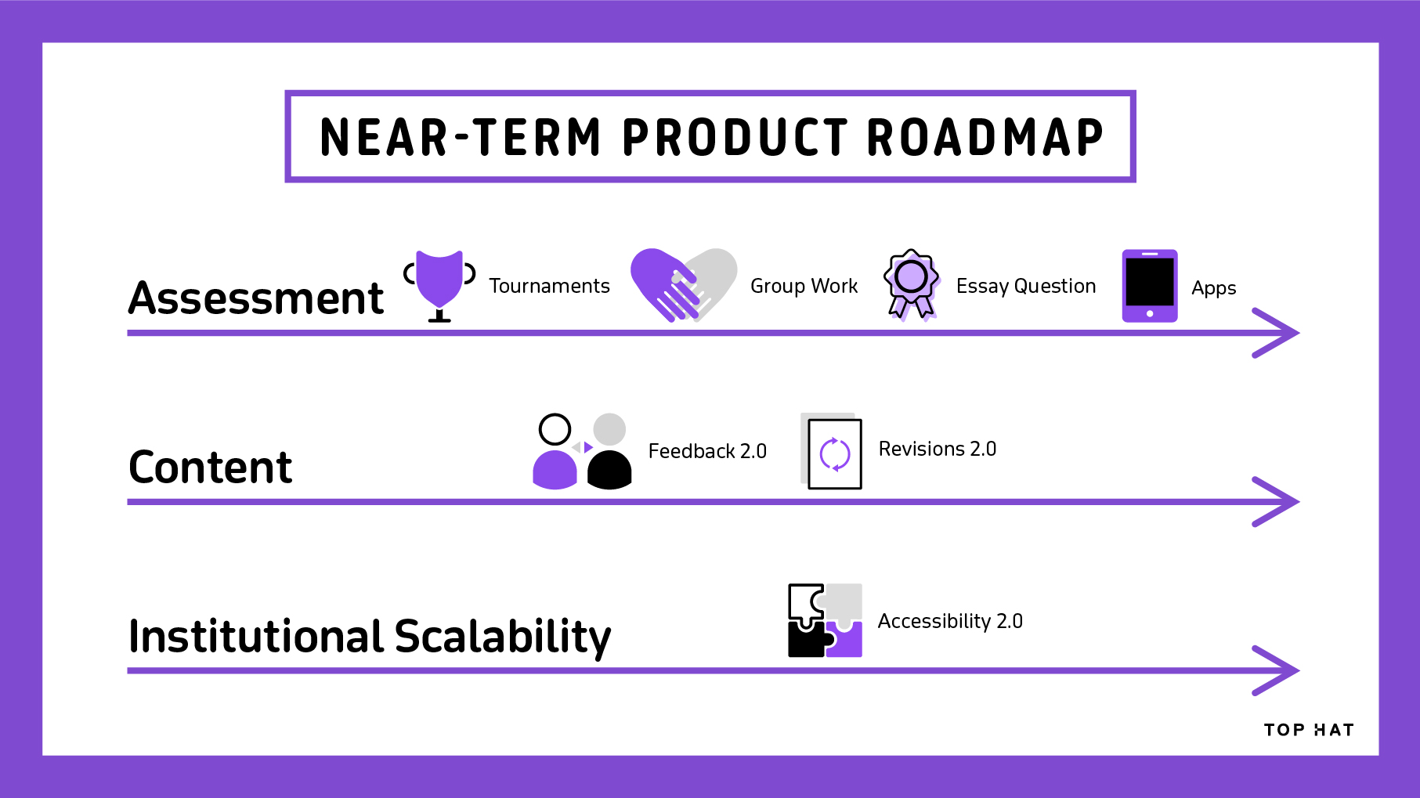
Notes:
Top Hat Test: Our newest feature is Top Hat Test, an easy and reliable way to administer tests and exams using Top Hat. Instructors can create exams from scratch or using question packs from our Marketplace. They can then administer the exam using our secure testing functionality, which allows students to take exams on their own devices. Top Hat Test observes behavioral patterns of students during the exam to ensure academic integrity, and if cheating is detected, can lock students out of the exam and notify the professor. Top Hat Test will also auto-grade tests and exams.
Group Work: Based on the principles of team-based learning, Group Work is a set of features that allows professors to assign students to in-class working groups in their Top Hat course, enabling students to work on problems and submit answers to questions as a team.
Tournaments: Back by popular demand, Tournaments was the most popular feature in our Top Hat Classroom product in the former version of our UI. We’ve now reimagined the capability in our new UI. Tournaments allows instructors to gamify the classroom by setting up teams that compete to answer questions on course material.
Feedback and Revisions: In theory, OER is designed to be a living thing. In practice, though, a lot of that work falls to institutions and educators to keep the content fresh. We have actually built into Top Hat Textbook this concept of continuous revisioning. Here’s how it works: content adopters can share their additions and customizations with the original authors of a Top Hat textbook. Authors can then review the recommended changes and choose what to incorporate into the master version of their Top Hat Textbook and push out to all users via the Marketplace. New adopters of the content get the benefit of the latest and greatest content. And then, existing users get to choose which revisions they want to incorporate. The magic of this model of content evolution lies in the community that Top Hat has created within the Marketplace. It’s collaboration that keeps content fresh and up-to-date at a pace unmatched by traditional publishing.
New Authoring Experience: We’ve updated the Top Hat Textbook authoring experience and added many improvements including inline math, rich copy/paste, and linking between chapters.
New Mobile Reading Experience: We’ve created a smoother reading experience on mobile with insight into the status of questions as well as a chapter navigation index.
LTI-based registration flows: This allows registration to happen via LTI.

Slide 11

Preferred Pricing
$23/semester, $34/year, $68/4 Year
Advanced LMS Integration
Dedicated premier institutional support
Notes:
As you can see, we’re thinking big, and we’re thinking differently about the future higher ed.
We’d love to partner with you to make that vision a reality at your institution.

Slide 12



