Slide 1
Professional Staff Senate meeting
April 27, 2017

Slide 2
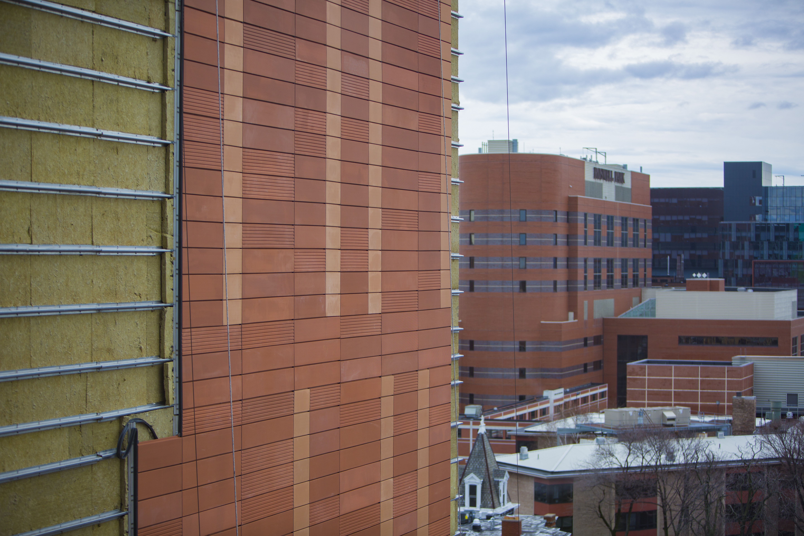
Note: neque digni and in aliquet nisl
et a umis varius.

Slide 3
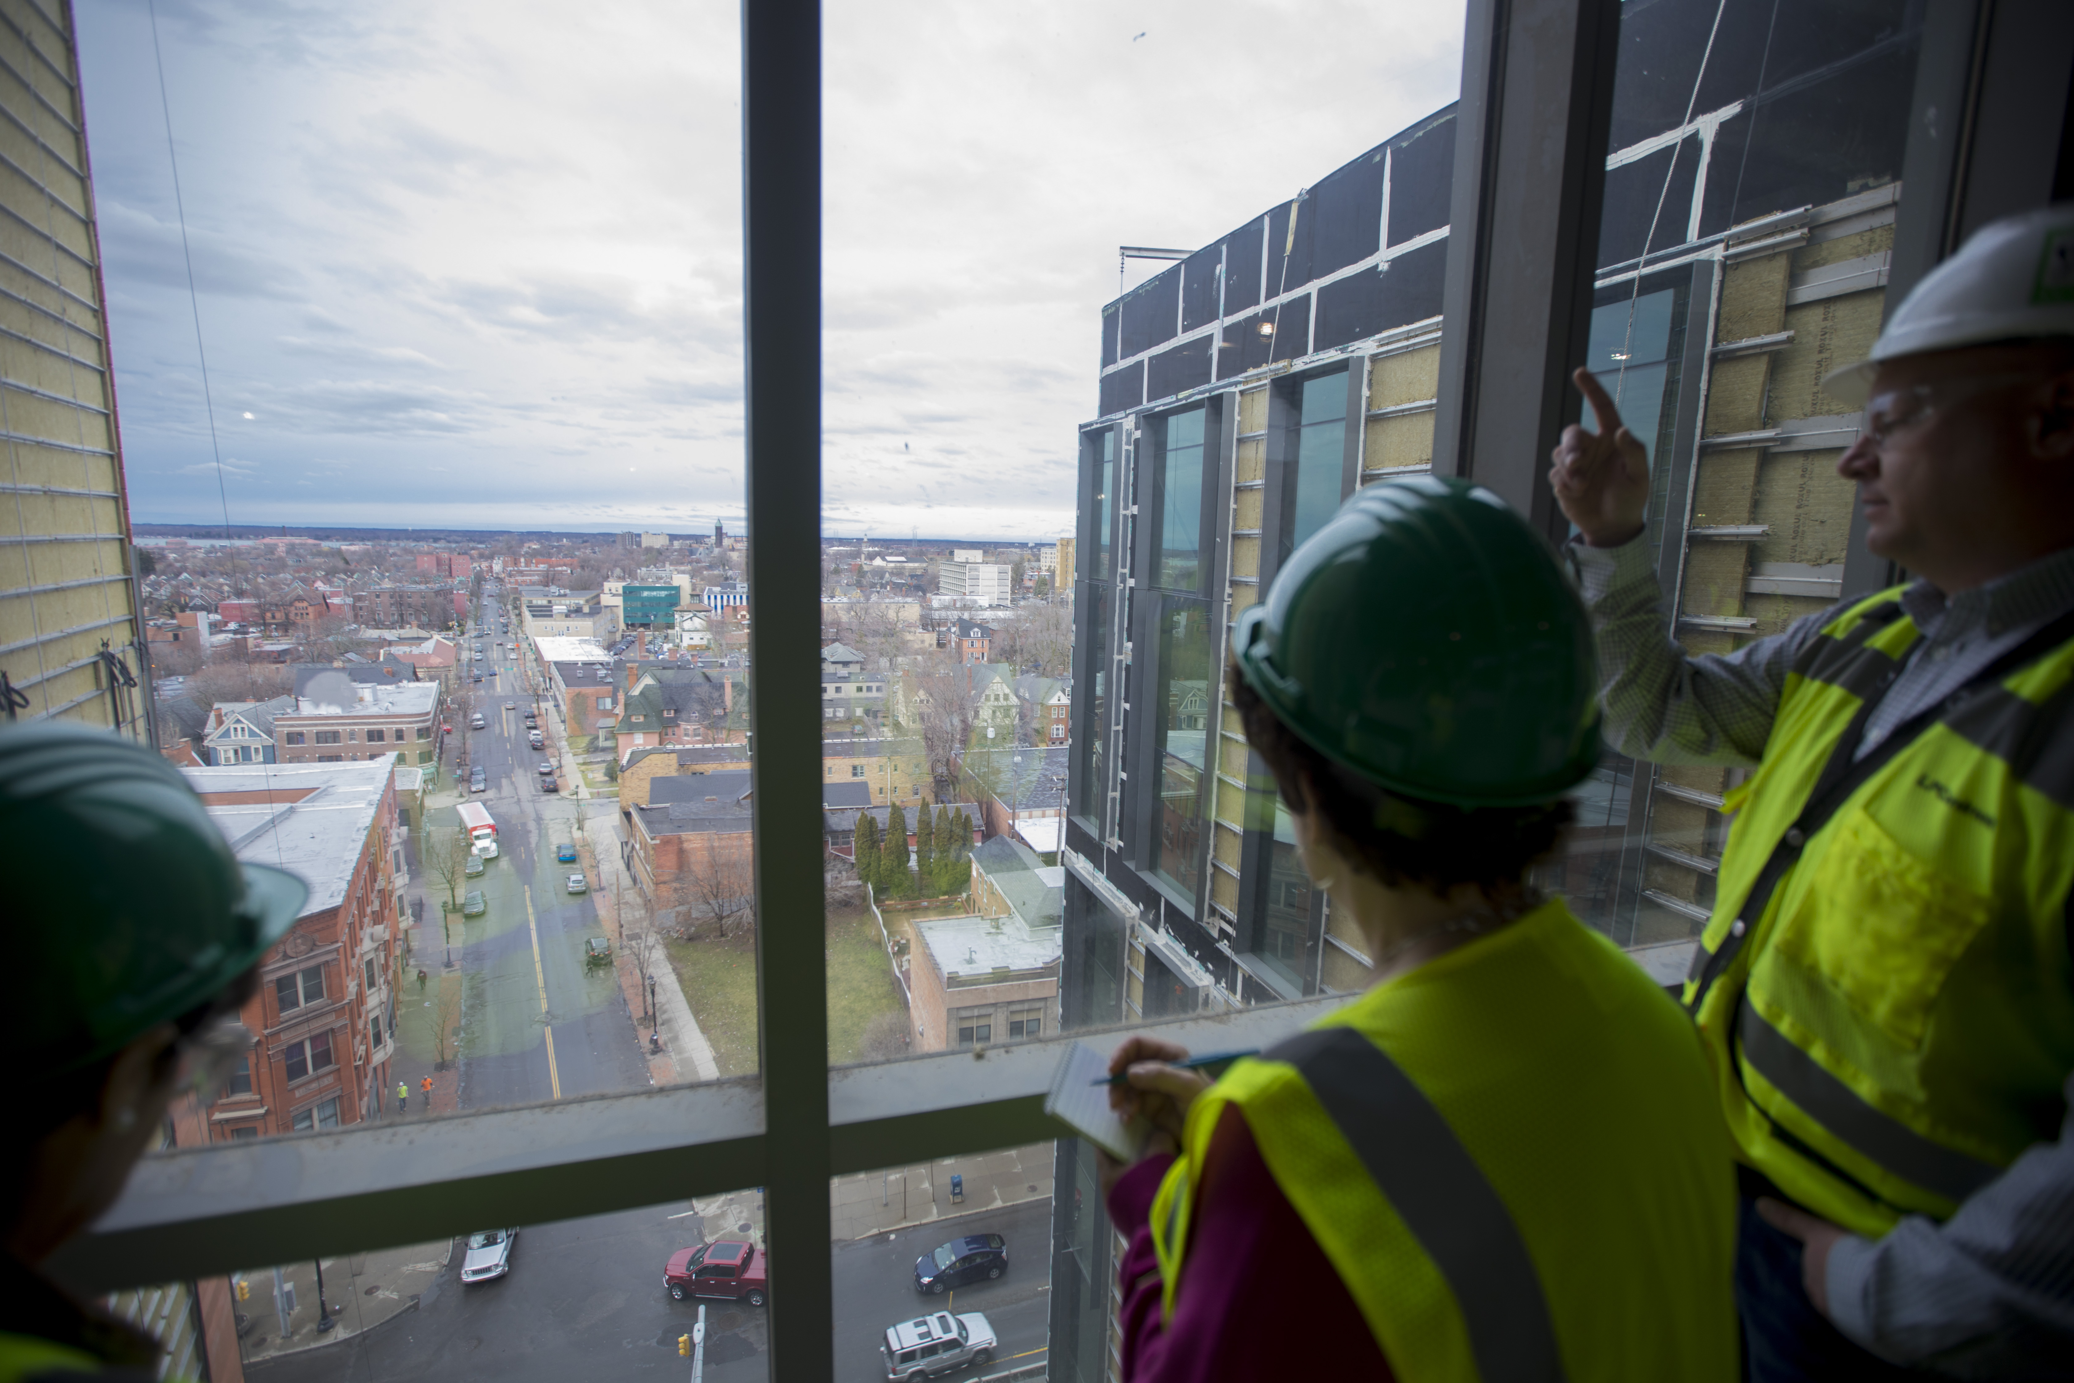
Note: neque digni and in aliquet nisl
et a umis varius.

Slide 4
Note: neque digni and in aliquet nisl
et a umis varius.

Slide 5
Note: neque digni and in aliquet nisl
et a umis varius.

Slide 6
Note: neque digni and in aliquet nisl
et a umis varius.

Slide 7
Note: neque digni and in aliquet nisl
et a umis varius.

Slide 8
Note: neque digni and in aliquet nisl
et a umis varius.

Slide 9
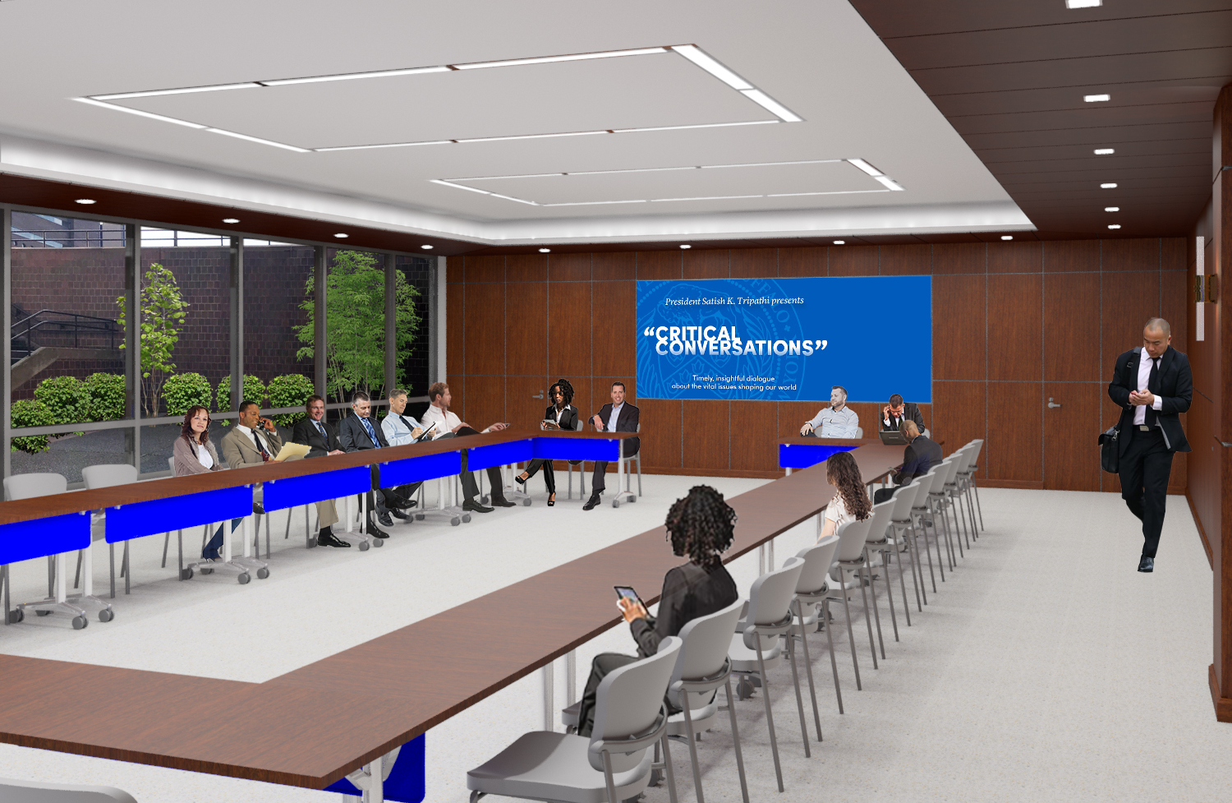

Slide 10
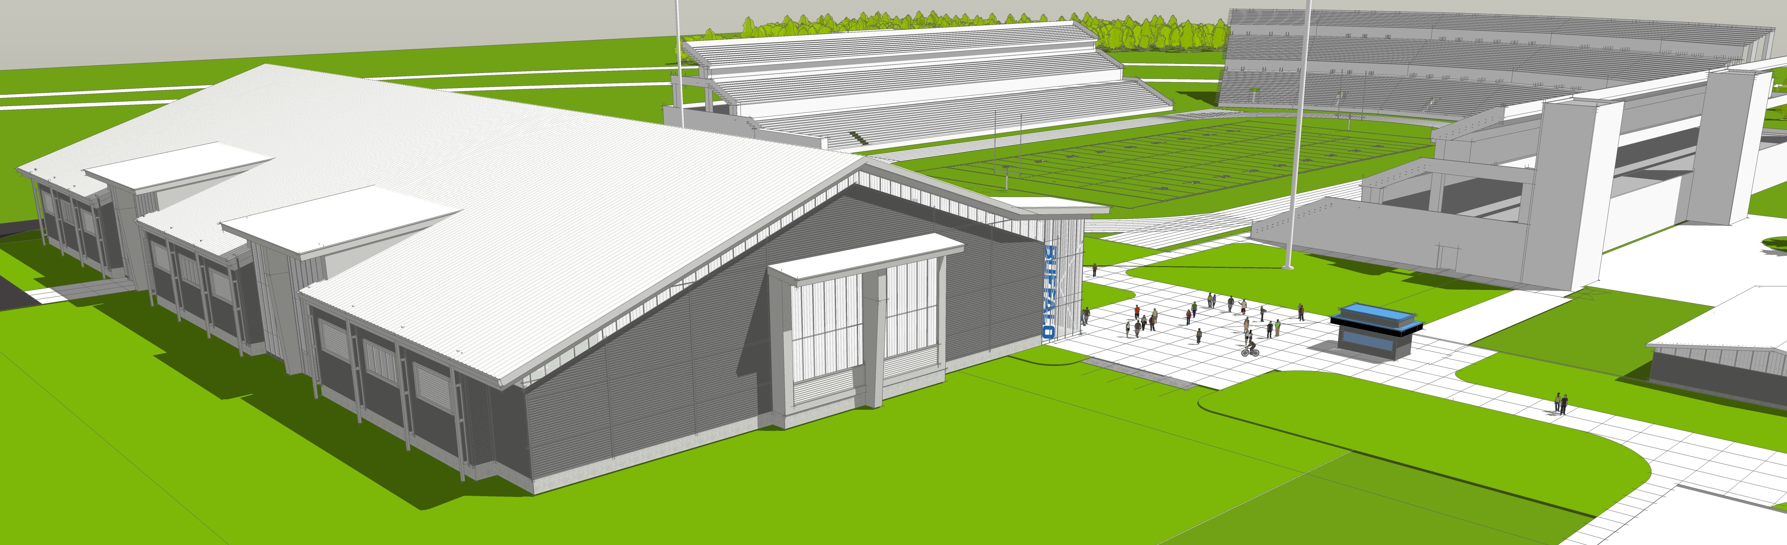
Note: neque digni and in aliquet nisl
et a umis varius.

Slide 11
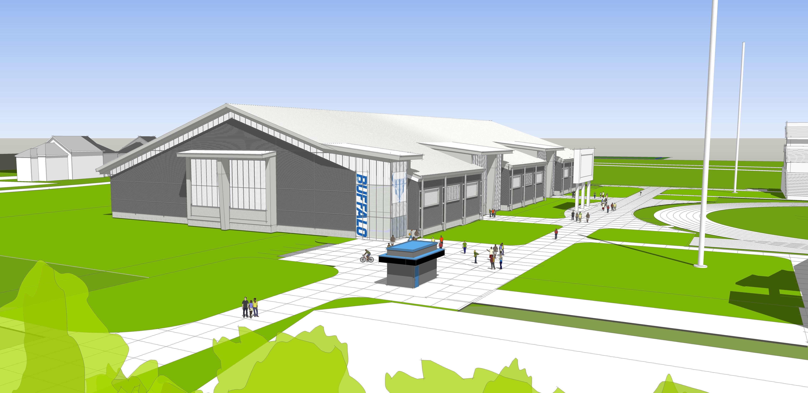
Note: neque digni and in aliquet nisl
et a umis varius.

Slide 12
Professional Staff Senate meeting
April 27, 2017

