Slide 1
Visualizing the Love Canal Timeline
Natalia Estrada
Digital Scholarship Librarian
nestrada@buffalo.edu

Slide 2
What will you learn today?
How to document and manage data for your timeline
How to make a visual timeline with TimelineJS
An overview of the chronology of the events of Love Canal

Slide 3
Data Management Best Practices for Digital Projects

Slide 4
Data Management Best Practices: Documenting
What is this?
Where did you find it?
Will other people be working with the data?

Slide 5
Data Management Best Practices: Metadata
“Data about data”
Helps describes your data items
Name, description, rights, dates, creator
Minimum
Unique identifier
Title
File name

Slide 6
Data Management Best Practices: Storage and More
Where will your data live?
How long do you plan on keeping it?
File naming conventions
Version control
Copyright!

Slide 7
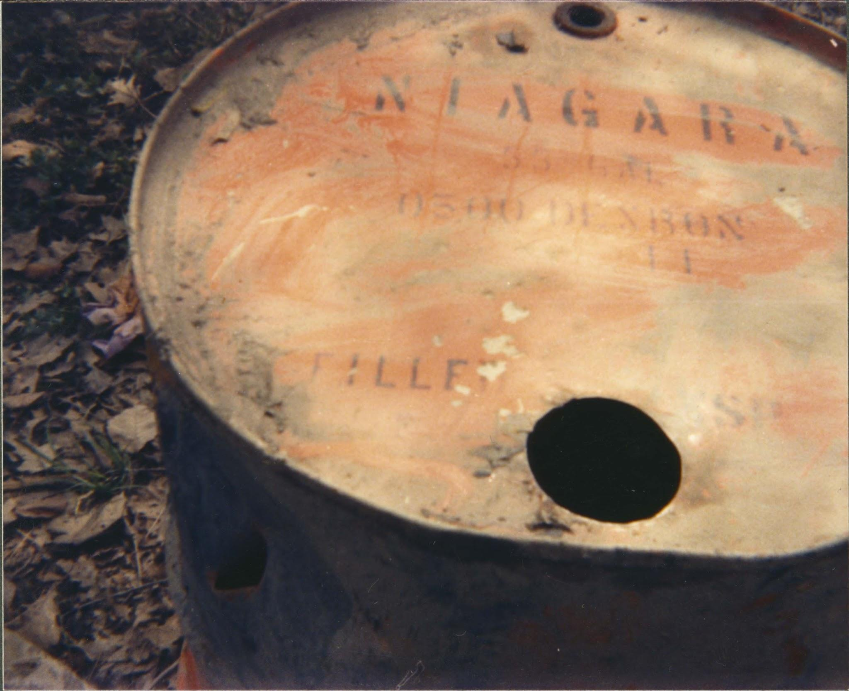
Love Canal

Slide 8
What is Love Canal?
A neighborhood in Niagara Falls, NY
The site of a major environmental disaster event
1894: Construction began on a planned canal between the Niagara River and Lake Ontario, along the Niagara Falls, to produce hydroelectricity
1942-1953: Hooker Chemical dumped over 20,000 tons of toxic waste at the canal site.
1976: Reports of suspicious fluids leaking into basements and contaminating local surface water. Testing showed the presence of ~200 organic compounds, including toxic ones
1978: NY declares a state of emergency, local resident groups fight for more information about risk of contamination, calls for evacuation

Slide 9
TimelineJS

Slide 10
What You’ll Need
Data
All your media items must be hosted/have a link
Browser
TimelineJS has issues with Internet Explorer, so I wouldn’t recommend
Google Sheets
TimelineJS

Slide 11
Tips
Recommend less than 20 items
Map out your timeline before you start making it
Plan out the story you want to tell
Keep a backup of your timeline sheet
If you know CSS, you can makes changes to your timeline’s appearance

Slide 12
Research Data Services at UB Libraries
The Research Data Services Department supports UB researchers in managing data at every stage of the research data process—from initial planning to storage and reuse—helping meet funder mandates, maximize impact, and ensure reproducibility.
For more resources, including requests for consultations, go to:
library.buffalo.edu/research/rds

Slide 13
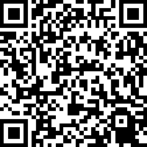
Thank you!
Please scan the QR code to complete a survey to assess this workshop.
Also check out the rest of our great lineup for Love Data Week!

