Slide 1
LOVE DATA WEEK UB's Enterprise Data Strategy Focus
Winter 2025

Slide 2
Greetings!
Mark Molnar,
Assistant VP for University Reporting and Senior Data Architect, Office of Institutional Analysis
Jim Gorman,
Assistant Director, Enterprise Application Services
Agenda
Review of UB's Enterprise Data Strategy Initiative
Data Request Intake
Data Toolset

Slide 3
Review - Enterprise Data Strategy Initiative
Executive level project comprised of leadership from across campus
Application of legacy data governance lessons learned to continue UB's information journey
Expanded access
Process streamlining
Modernized data management
Outcomes
Greater data accessibility and transparency
Modernized data architecture and improved data toolsets
Strengthened data governance
Advancement of data-driven culture

Slide 4
Review - Enterprise Data Strategy Initiative (pt 2)
Two sub-committees focused on immediate presidential priorities
Data Request Intake
PROPOSE a new process to better support access requests for campus information:
Minimize user confusion
Better respond to customer need
Track requests/outcomes across all data areas
Identify opportunities to improve process/products
Data Toolset
RECOMMEND a legacy UB “data system” upgrade/improvement path:
Modern Data Warehouse

Slide 5
Data request intake

Slide 6
Review – Data Request Intake General Definition
Process by which users submit requests for access to university information
Infosource Data and Models
Student
Financial
Personnel
Other
Data Products
Analytics
Reports
Data sets
Other
Systems
SIRI
HUB
Other

Slide 7
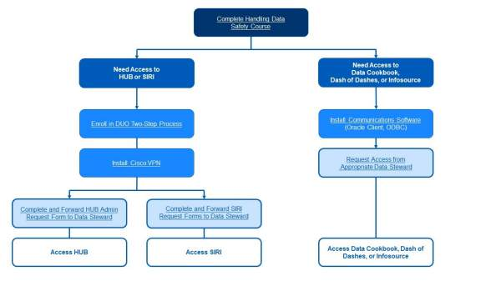
Review - Current UB Data Request Intake Process
Users contact individual area data trustees/stewards distributed across campus to request access
Largely self-service with limited assistance
Has been in place for over 30 years
https://www.buffalo.edu/oia/initiatives/data-governance/newsletters/accessing-resources.html

Slide 8

Review - Current UB Data Request Intake Impressions

Slide 9
Review - Current UB Data Request Intake Impressions (pt 2)
Poor User Experience
Don’t know where to go or who to contact for questions
Lack of widespread campus understanding of process or available products
Multiple unconsolidated systems create access confusion
Duplicated requests for documentation
Inconsistent access rules applied across systems
Lack of ability to appeal outcome or request new information
No CENTRAL audit of requests or outcomes to resolve access challenges, identify potential improvements or inform campus policy
No single office responsible for this process
These are the challenges the Data Request Intake Proposal will address

Slide 10
Review - How Do We Improve?
Evaluate
Selected peer institutions
Online Presence
Intake Tools
Responsible Offices
Marketing
Data Steward Impressions
Local UB examples
Synthesize what we’ve learned to create a proposal

Slide 11
Review – What We Learned
UB needs to develop a universal, centralized campus data request intake effort.

Slide 12
Review – Additional Intake Considerations
Respond to immediate presidential need
Facilitate central tracking of access requests and outcomes across areas using extant process and tools
Identify an office responsible for the coordination, process, and reporting
Suggest a measured development path
Mirrors similar efforts at other AAU institutions
Leaves current system of trustees and stewards in place
Provides a common entry point for access requests
Supports continuous analytics/reporting to assess outcomes and areas for improvement
Builds expertise to further develop process, products and policy
Respond to Data Steward thoughts
Support centralized intake
Enhance user experience
Continue trustee/steward engagement
Enhance workflow efficiency and support automation of process
Develop persistence of leadership and resourcing

Slide 13
Our Plan - AccessUB
Provide immediate resolution to current access challenges
Phase 1
Identify and resource an office to coordinate the campus access effort -> persistence of leadership
Create a single "front door" to campus data access
Develop a network of associates across campus engaged in supporting access requests
Create ability to centrally collate, track, analyze and report success of pilot area access requests
Assess policy challenges and develop recommendations for process and solution
Utilize separate extant channels accessed via a central web site to field requests
Provide foundation for improvement
Phase 2
Evaluate lessons learned and suggest next phase concentrations
Develop tools to better support user needs
Searchable knowledge base
Data flow diagrams
Create a continuous online presence and communication plan
Deliver campus-wide awareness, training and reinforcement
Includes branding (ex. "AccessUB") and functional partnerships
Utilize extant personnel, process and toolsets wherever possible
Area Data Trustees/Stewards continue to approve access

Slide 14
The Essential AccessUB Component – Single Office Oversight to:
Facilitate persistence of leadership for the effort
Remove ambiguity of where to go to request access
Develop a central request website to unify submission experience
Channel access requests to appropriate steward
Support limited triage of requests for additional action
Establish a network of campus associates to inform discussion re: policy and process
Identify, summarize and recommend solutions to emergent challenges
Collect and summarize request activity on a regular basis
Evaluate Phase 1 results and suggest new directions
Coordinate development of next-generation tools to better support campus needs
Assist with development of a continuous marketing/awareness/training effort

Slide 15
Phase 1 – Identify an Office to Coordinate and Lead
The Office of Institutional Analysis (OIA) will assume responsibility for coordinating centralized data request intake, tracking and reporting.
Extensive campus functional and technical experience
Deep involvement creating UB’s information architecture and culture
History coordinating, supporting and delivering information requests from across the institution
Demonstrated skills developing custom process, systems and definitions for any campus stakeholder
OIA will partner with other campus entities to inform the discussion, recommend policy and create process to:
Architect an easy to locate central campus website to facilitate submitting data and system access requests
Perform limited triage of requests requiring further information or support
Maintain an up-to-date catalog of area trustees, stewards, data and systems
Develop analytics to categorize requests and outcomes for executive leadership
OIA will not approve area data and system access
Trustees, stewards and system administrators will continue to perform approval functions

Slide 16
Phase 1 – Create AccessUB Central Request Website
Will function as an overarching “Front Door” to unify centralized data intake
Remove ambiguity of where to go to obtain access to campus information
Provides a single stop to facilitate user access to campus data
Will provide a common web page to link disparate extant area request channels
Detail submission process by data area and system
Catalog responsible personnel and access prerequisites, if any
Provide a single stop for links to current request channels
Will NOT replace established process, personnel or toolsets
Provide a channel to ask for and receive live assistance

Slide 17
Phase 1 – Catalog UB Data Areas, Products and Systems
Supports effective triage and communication with responsible custodians if necessary
Identify data area, product and system personnel that need to be involved
Create initial validated inventory of university data and systems
Both on premises and cloud-based data and systems
Identify data and system managers, trustees and stewards
Detail areas that are in/out of centralized intake scope
Establish process to continuously validate campus data and system inventory to identify contacts for provisioning
Create process to identify data and systems additions as well as changes in responsible personnel

Slide 18
Phase 1 – Suggest Pilot Focus
Evaluate and identify areas, data, products and systems to be included within initial AccessUB scope
Most often requested by users
Validate inclusion with area personnel and executive leadership
Pilot candidates should include major areas having well defined personnel, process and content such as:
Infosource
HUB
Oracle Analytic Server
SIRI
Data Cookbook
SUNYIR
Tableau
TeamDynamix
UPlan
Experience gained will determine how to expand to other areas

Slide 19
Phase 1 – Establish Persistent Communication Channels and Process
Communication between campus associates, data area personnel and OIA to support
Coordination of request submission, triage and reporting
Trustees and stewards will reinforce necessity of supplying OIA with necessary information
Process for requesting access to a given data area or system as well as personnel involved will be clearly communicated via the central request website
Identify and communicate potential process changes/improvements
Process identification minimizes campus uncertainty with respect to requirements and personnel involved

Slide 20
Phase 1 – Collect Information For Analytics and Outcomes
Effort will build foundation for continuous central tracking and auditing of access requests, outcomes and analytics across areas
Utilizes successful OIA experience performing this service across a number of efforts
Collection cadence and population of standardized analytic series will be established
Identify standardized request elements to capture
Summarize requests and outcomes on a regular basis
Guide process streamlining and development of new information products
Analytics will be restricted to executive leadership and designated parties
Provides the foundation for an institutional knowledge base

Slide 21
Phase 2 – Determine Next Steps
Evaluate Phase 1 AccessUB Performance – What Have We Learned?
Review performance, lessons learned, and areas to improve
Apply expertise to suggest process, policy and technology improvements
Create established process to add new overarching "front door" links as campus information and need evolves
Interaction with OIA and other trustees/stewards
Communication/messaging/training
Begin development of tools to support user experience enhancement
Searchable knowledge base
Data flow charting
Role Based Access

Slide 22
Timeline Estimate
Implementation schedule will be highly dependent upon resource, technical and policy contention with other campus Data Strategy and related information-centric efforts:
Phase 1 – 16 months
AccessUB Website
Comprehensive Data Area and System Inventory
Evaluation, identification and validation of Phase 1 intake candidates
Development of policy and process for request intake and triage
Communication/marketing/training
Execution of "front door" intake for selected areas/systems
Analytics
Phase 2 – 24 months
Phase 1 Evaluation
Identification and inclusion of additional areas
Searchable knowledge base
Data flow diagrams
AI Inclusion
Other

Slide 23
Data Toolset

Slide 24

Data Toolset Subcommittee Charge
Develop a proposal to modernize data architecture and improve data toolsets to reduce data silos and share data more easily.
Notes:
Assignee: Mark

Slide 25
2025 EDUCAUSE Top 10 Issues
#1 – The Data Empowered Institution
Using data, analytics, and AI to increase student success, win the enrollment race, increase research funding, and reduce inefficiencies
Recent EDUCAUSE QuickPoll
Nearly all respondents (92%) reported that their institution is in either early discussions or already has some systems modernized. However, the path to data modernization in higher education is complex, with only 1% of respondents indicating they feel their institution has fully modernized its data management and strategy.
EDUCAUSE is a nonprofit professional association focused on information technology in higher education.
In practical terms, EDUCAUSE brings together universities, colleges, and higher-ed technology professionals to help them use technology more effectively to support teaching, learning, research, and administration.
Notes:
Assignee: Jim

Slide 26
Assessment of Need
Data are siloed
Data are not easily shared
Notes:
Assignee: Mark

Slide 27
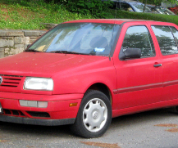
Legacy Data Warehouse (aka Infosource)
Established early 1990s
Functional, but does not meet modern requirements
Notes:
Assignee: Mark

Slide 28

Legacy Data Warehouse (aka Infosource) (pt 2)
Established early 1990s
Functional, but does not meet modern requirements
Fast-forward to 2026
Data/Technology has changed
Not optimized for future needs
Notes:
Assignee: Mark

Slide 29
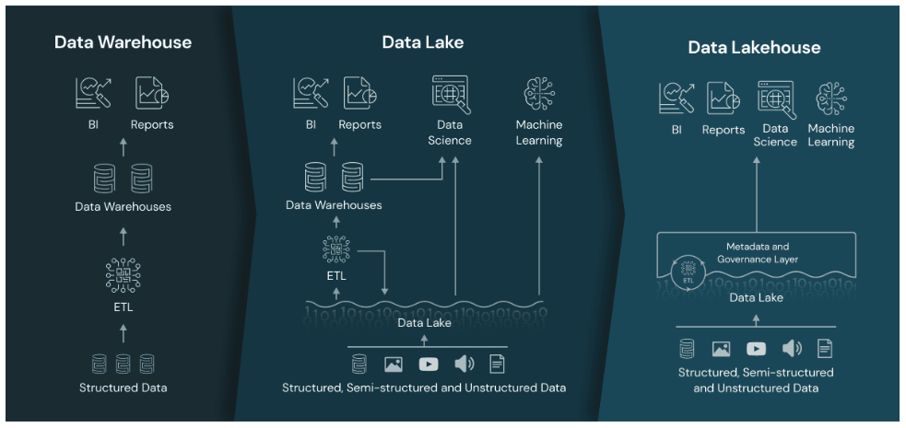
Warehouse vs Lake vs Lakehouse
Notes:
Assignee: Jim

Slide 30
Data Management Upgrade Options
Modern Data Lakehouse
Foundational and transformational
Modernizes our data platform
Collects many data sources, in varied formats, into a consolidated infrastructure
Future-proofs our ability to utilize data as a critical asset
Facilitates data sharing
Allows data teams to move faster
Master Data Management
Works to reconcile conflicting data across varied systems
Codifies negotiated agreements for where the most accurate/best data is found
Enforces policies
Notes:
Assignee: Jim

Slide 31
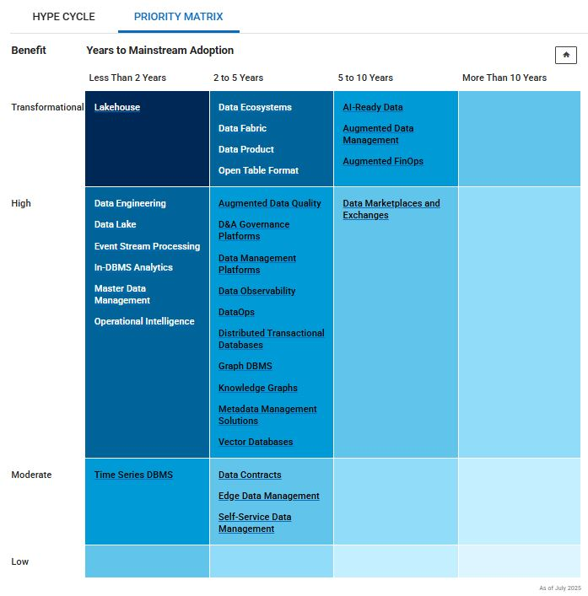
Priority Matrix for Data Management
Source: Gartner, As of 7/9/25
Notes:
Assignee: Jim

Slide 32
Summary of Gartner Calls
Data Lake and Data Lakehouse technologies have been converging in recent years. There is still some converge occurring, but it’s not a bad time to buy Data Lakehouse technology.
If you’re looking to do something Transformational, start with Data Lakehouse technology.
There are opportunities to do “Just good enough” MDM in Data Lakehouse tools
Building key reference data
Define data quality rules and run data quality utilities
Further inform the need for full-scale MDM product
Data Lakehouse technologies allow for de-centralizing data analyst activities. Data teams across campus can participate in data ingestion, cleaning, modeling and sharing data.
Gartner is a global research and advisory firm that provides insight, analysis, and guidance on technology, business, and management strategy.
Notes:
Assignee: Jim

Slide 33
Huron Consulting: Related Recommendations
Strengthen Data Governance
Strengthening existing data governance structures ensures consistent, accurate, and secure management of data across UB, critical for maintaining data quality, compliance and trust.
Create A Universal Student Record
A universal student record across all Schools, Colleges, and programs will enable more consistent tracking of student progression, retention and outcomes.
Reporting Accessibility & Perceptions
Hosting regular user feedback sessions will help UB better understand user perceptions of reporting and data access and provide opportunities to socialize data standards and best practices.
Huron Consulting Group is a global professional services and management consulting firm that helps organizations improve performance, solve strategic challenges, and navigate complex change.
Notes:
Assignee: Jim

Slide 34
Stakeholders Interviewed
Date | Department | Representative(s)
July 18, 2025 | University Advancement | Kathleen Heckman, Justin Hegyi, Nicole Shepherd
July 21, 2025 | Student Life | Dan Kaczmarek
July 24, 2025 | Office of the Registrar | Kara Saunders
July 24, 2025 | Enrollment Management | Alissa Shugats
July 30, 2025 | Office of Institutional Analysis | Mark Molnar
July 31, 2025 | Business Reporting and Systems | Tom Okon
July 31, 2025 | Human Resources | Amanda Brown, Jamie Bluhm
August 1, 2025 | College of Arts & Sciences | Patrick McDonald
August 6, 2025 | University Communications | Jeff Smith, Row Onishi, Krista Glenn
Notes:
Assignee: Kathleen

Slide 35
Option Preference Summary
Option | Primary Business Benefit | Preference
Modern Data Lakehouse (MDL) | Enhance decision-making by centralizing data and connecting siloed data sources | Student Life, Enrollment Management, Office of Institutional Analysis, Business Reporting and Systems, Human Resources, College of Arts & Sciences, University Communications
Master Data Management (MDM) | Improve operational efficiency by reconciling duplicate or conflicting data, resulting in a “Single Source of Truth” | University Advancement
Most stakeholders agreed that both options would be beneficial: “I would love both. We currently don’t have either.” Many stakeholders also view a Modern Data Lakehouse as an enabler of Master Data Management.
Notes:
Assignee: Kathleen

Slide 36
Use Cases & Their Themes
We’ve received 13 written use cases, some related to Master Data Management, but most relating to centralizing data via a modern Data Lakehouse
Themes:
Breaking down the silos
Improved data sharing
Future-Readiness
Single source of truth
Notes:
Assignee: Rob

Slide 37
Theme: Breaking down the silos
Use case to create a more complete picture of the student experience
If we were able to pull in data into one place from siloed platforms like UBLinked or Handshake, we could have a fuller picture of the student experience and how they are leveraging all the resources the university provides
Create targeted opportunities for intervention from success coaches or engagement ambassadors
Create customized journey mapping for students to guide them to the resources and experiences that we know will lead to their success.
Implications for Advancement, Digital Communications, Student Success, Advising, etc.
Notes:
Assignee: Rob

Slide 38
Theme: Breaking down the silos (pt 2)
Support Ongoing Student Success efforts
Use case describing efforts to improve student success using traditional predictive data, plus …
educational aspiration, social integration skills, leadership potential, positive self-concept, and academic aptitude on first year student retention
And, behavioral factors like student academic, social, financial, and career engagement with faculty, staff, learning, and required actions, etc.
“Given the current state of our infrastructure it is difficult to imagine how a data-intensive project this ambitious might be executed.”
Notes:
Assignee: Rob

Slide 39
Theme: Breaking down the silos (pt 3)
UB has 40+ cloud applications that do not feed data to InfoSource
Examples: Brightspace, UBLinked, Maxient, Handshake, SmartEvals, Studio Abroad, VisualZen, PointNClick, Clockwork, Alma, Sonia, UB Jobs and TDX.
Formstack
UB has numerous Formstack instances and thousands of forms.
There is no easy way to join this data with other InfoSource data, or share the data in an efficient, automated way
OIA
OIA has developed numerous processes to ingest transactional data for analytics and reporting.
Models reside in siloed OIA/EIS SQL Server and Oracle environments, separate from Infosource.
Notes:
Assignee: Rob

Slide 40
Theme: Breaking down the silos (pt 4)
Research Foundation Financial Reporting
Multiple offices involved
Risk of inconsistent reporting
Notes:
Assignee: Rob

Slide 41
Theme: Future Readiness
Future HRIS or SIS implementations
A new platform will better position us for data extraction out of new ERP’s
Unstructured data
10%-15% of our data is structured (in databases)
iOT
Ability to ingest, store, and analyze high-volume streaming data from IoT sources—such as smart building sensors, lab equipment, or campus infrastructure
AI
Build AI-Ready data
Notes:
Assignee: Rob

Slide 42
Adopted Recommendations and Current Activity
Pursue a modern cloud-based Data Lakehouse Platform
A proof-of-concept approach is currently being formulated
A multi-week consulting engagement with Gartner is planned for Q126
Continue campus stakeholder outreach and collaboration
Outreach to aspirational peers
Consider a Data Lakehouse implementation as a foundational step towards MDMM
Notes:
Assignee: Tom

Slide 43
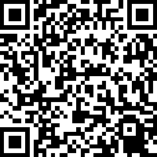
Thank You for Attending!
Tell Us How We Did:
Want more info?
Data Request Intake:
Mark Molnar, Assistant VP for University Reporting and Senior Data Architect, Office of Institutional Analysis: mmolnar@buffalo.edu
Modern Toolset:
Jim Gorman, Assistant Director, Enterprise Application Services: jgorman@buffalo.edu

