Slide 1


Saving the Planet with Data*
Derek Nichols
Associate Director for Sustainability
*a story
February 25, 2025

Slide 2
STORY TIME
My Story
Earth’s Story
UB’s Story
Questions

Slide 3
MY STORY

Slide 4
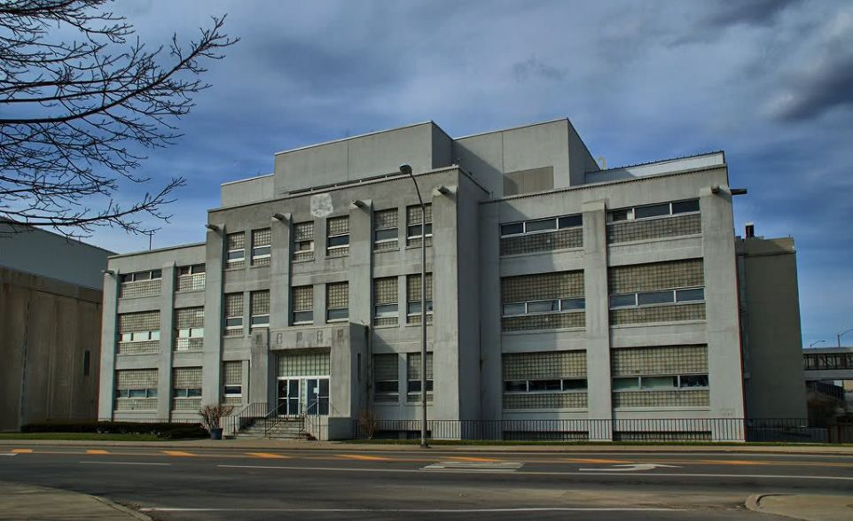
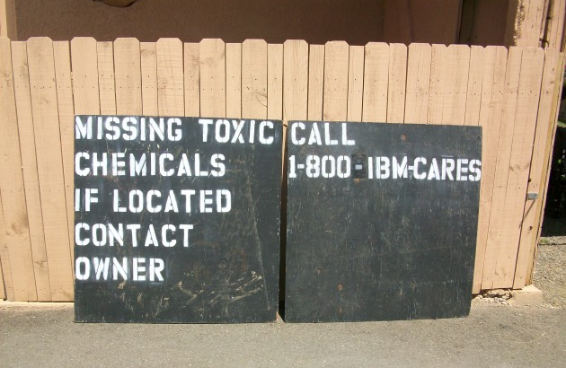
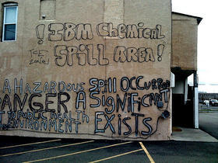
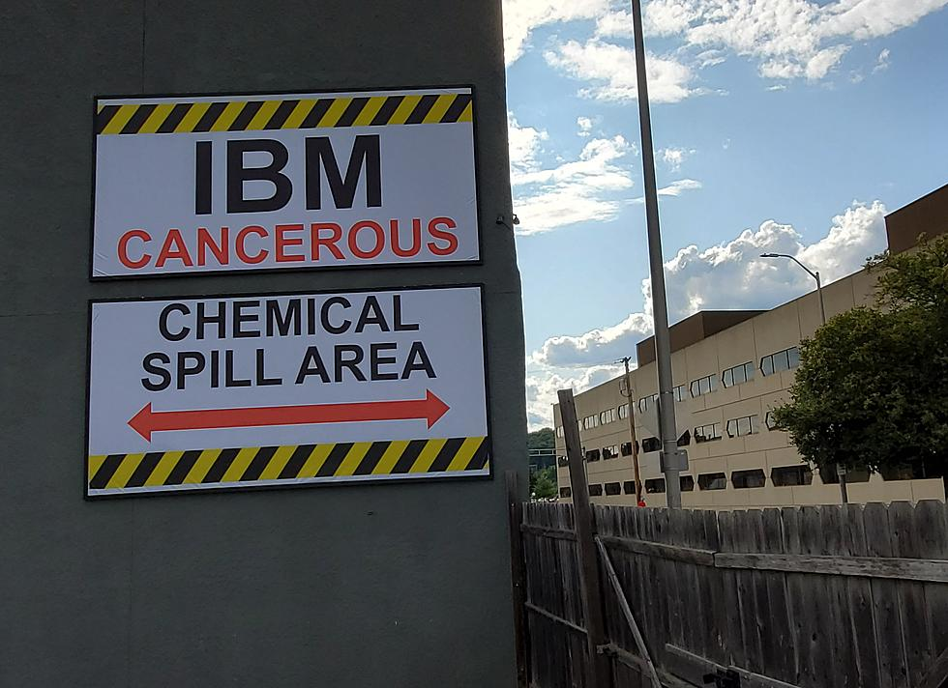
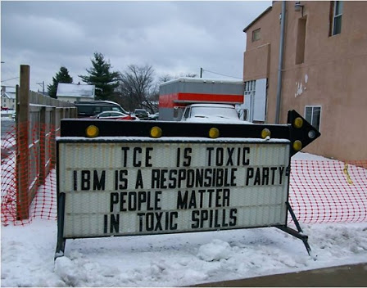
Images of the IBM plant in Endicott New York
Notes:
IBM- Endicott- “The Plume” loomed large
U.S. EPA Superfund site—a high-priority hazardous waste site (reported in 1979)—consisting of a 300-acre toxic plume of trichloroethylene (or TCE). chlorine-based cleaning solvent was heavily used by IBM to manufacture chip boards and other microelectronics-- impares fetal development, cancers. The New York State Department of Health (DOH) reported fifteen cases of infants born with heart defects over seventeen years in one Endicott neighborhood. This number is more than twice that of the normal population. (https://logicmag.io/nature/in-the-shadow-of-big-blue/)
This census tract 66% white, 12% black, [all of Endicott is 9%, all of Broome County is 5%], 14% Hispanic [4% in Endicott and BC] 40% of people are under the poverty line [double the rate of Endicott and BC] , 70% Renter occupied (which is important) - has changed over time. 1980 it was 1% Black, 2000 it was 5% Black, now 12 %
2002- found that toxins were seeping into houses through soil
IBM launched “Smarter Planet Initiative”IBM purports to be building a smarter, more modern, more urban and more sustainable world, it is actually leaving behind a trail of exploitation, economic marginalization and environmental degradation in out-of-the-way places like Endicott—corporate acts that capture non-urban labor and environmental resources and exploit them to make products for urban markets, thereby exacerbating social inequalities between cosmopolitan centers and their peripheries.
Town has not recovered- international corp vs. small town
Microelectronic Disaster and the “Smarter Planet” Paradox, Peter Little
Since 2004, Plume has decreased by 80%

Slide 5
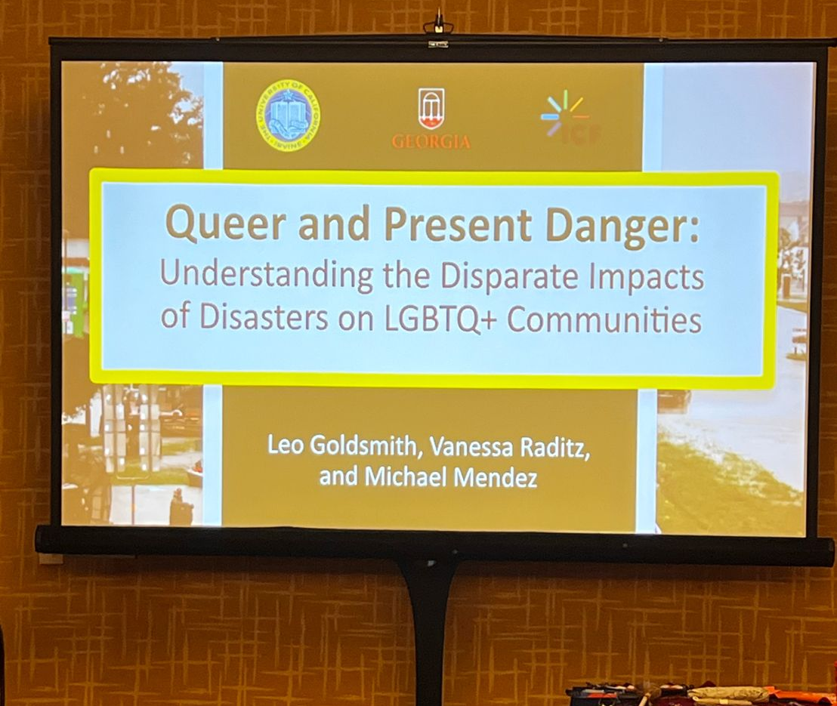
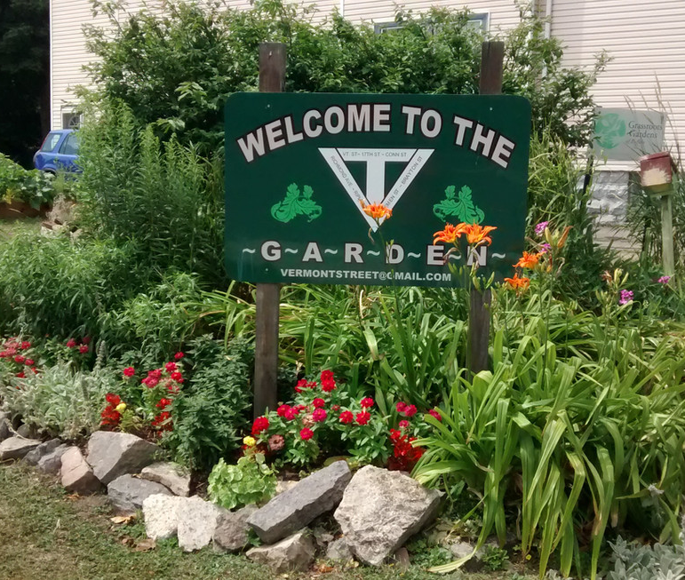
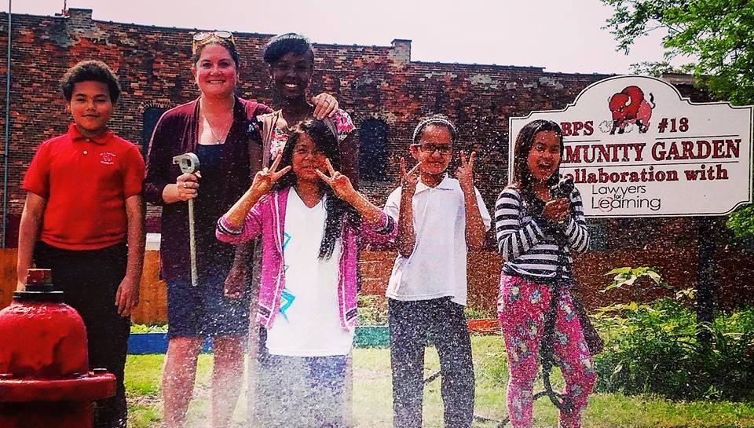
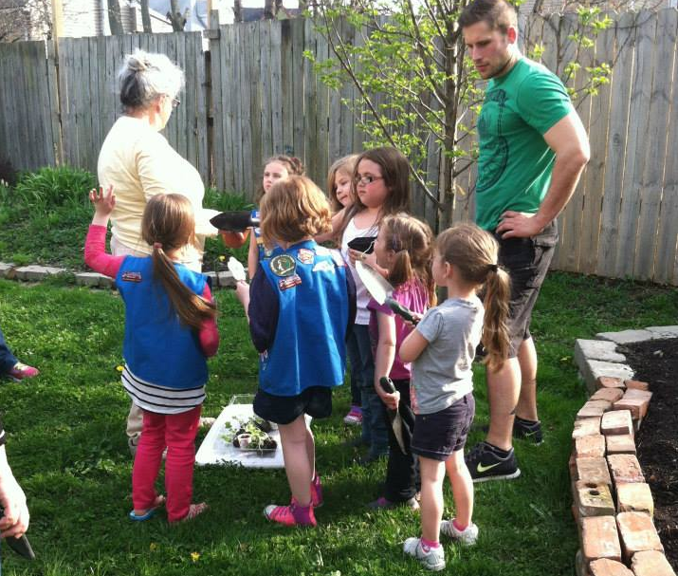

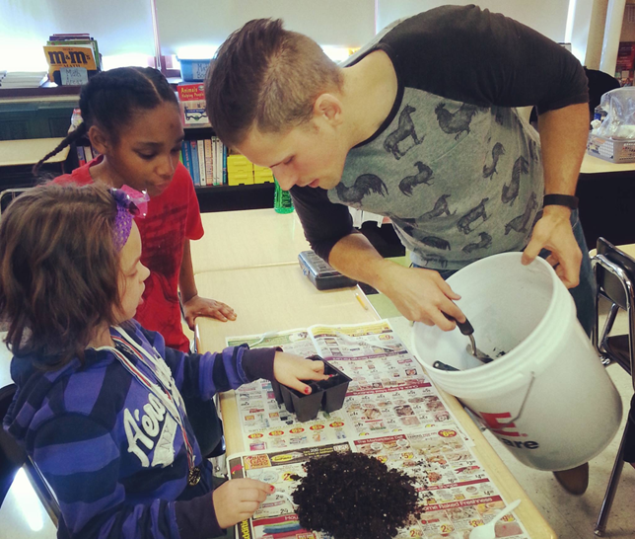
My Background
Notes:
Marginalized people: 40% of homeless youth are LGBTQIA
25% are food insecure
29% of transgender people are below the poverty line
3x Incarceration rate LGBTQ
82% of trans people have thought about killing themselves vs. 35% cis =40% have attempted (11% cis)
Buffalo food access- panel on that later on this week (Samina next slide)
15,000 vacant lots- half of them owned by city- gardens
where 45% of people in Buffalo and Erie County live below the poverty line, and more than 12% of Erie County is food insecure.
using the term “food apartheid” rather than “food desert” would be more accurate because “food apartheid” shows that accessibility to nutritious food has been restricted due to intentional discriminatory policies- redlining, urban renewal and white flight
In a UB-Johns Hopkins study nearly 1 out of 2 residents (42%) of East Side respondents reported food insecurity, and of these food insecure households, more than 64% relied on SNAP in the past year
Tops Massacre

Slide 6
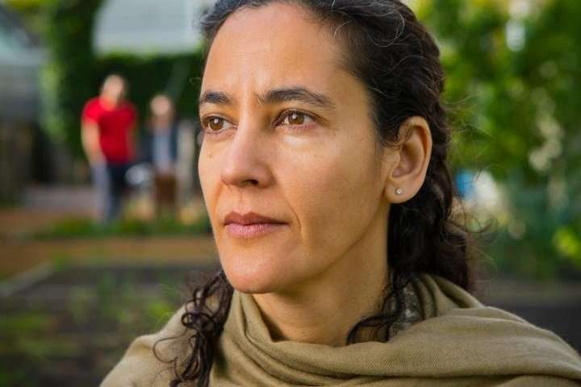
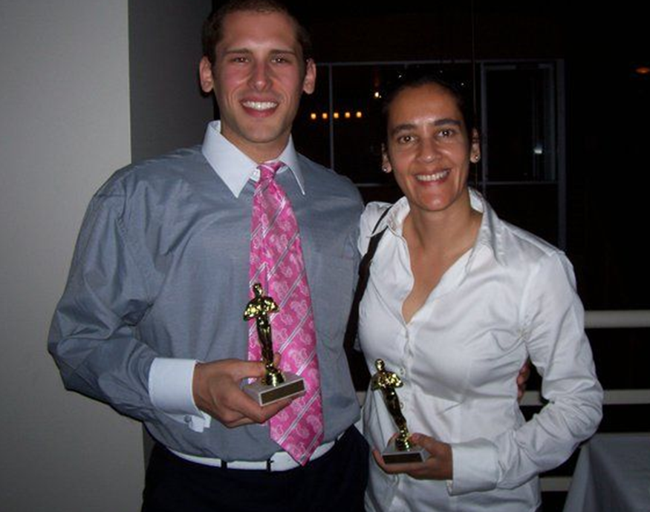
Dr. Samina Raja
Notes:
-Dr. Samina Raja- data and visualization = foundational – book- transformative- show power of communicating data effectively
This is why this presentation is more about the importance of communication

Slide 7
EARTH’S STORY

Slide 8
2 DEGREES
Notes:
In 2015, countries made a breakthrough in climate negotiations and adopted the Paris Agreement. This historic, legally binding international treaty became the foundation for climate action on a global scale, pushing countries to adopt mitigation and adaptation goals
Did you know: Every incremental degree of warming makes climate extremes and risks become larger. For example, at 1.5°C of warming, 14% of the global population is likely to face at least one severe heatwave every five years. At 2°C of warming, that figure increases to 37%, a difference of around 1.7 billion people.
IF everyone on earth lived like someone in the US, we’d need 5 earths to sustain us

Slide 9
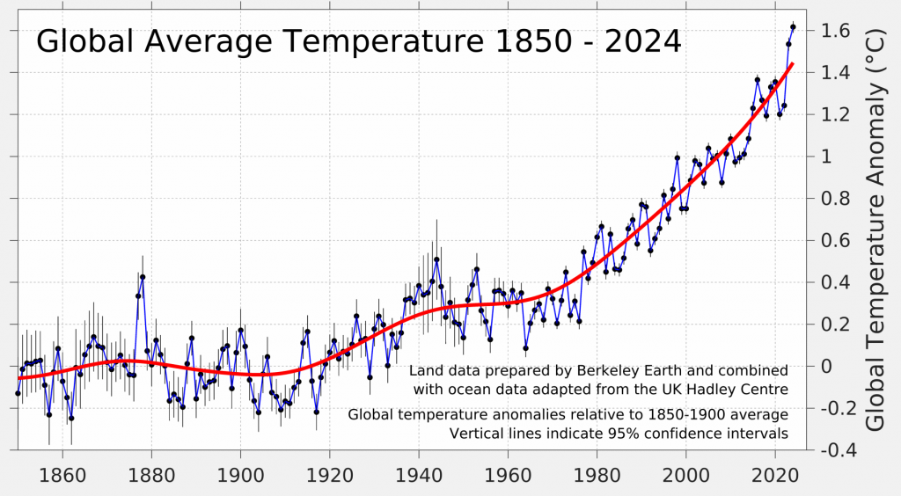
Global Average Temperatuer

Slide 10
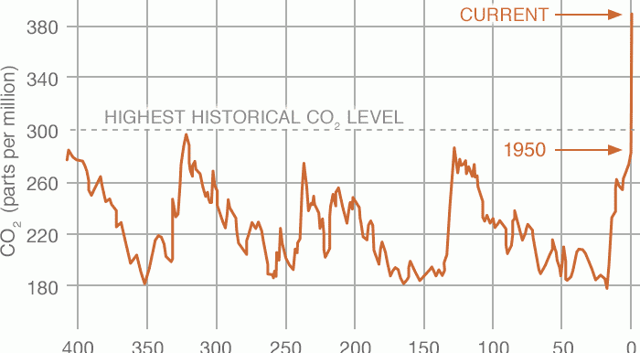
Highest CO Levels
Notes:
https://www.ucs.org/resources/planets-temperature-rising

Slide 11
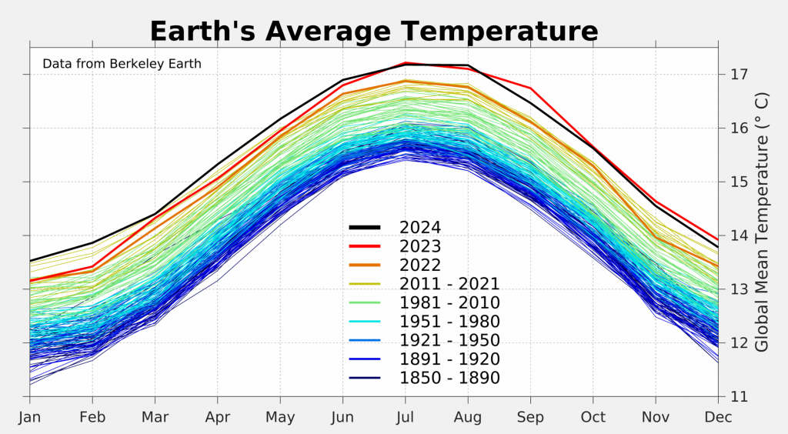
Earth’s Average temperature
Notes:
https://www.ucs.org/resources/planets-temperature-rising

Slide 12
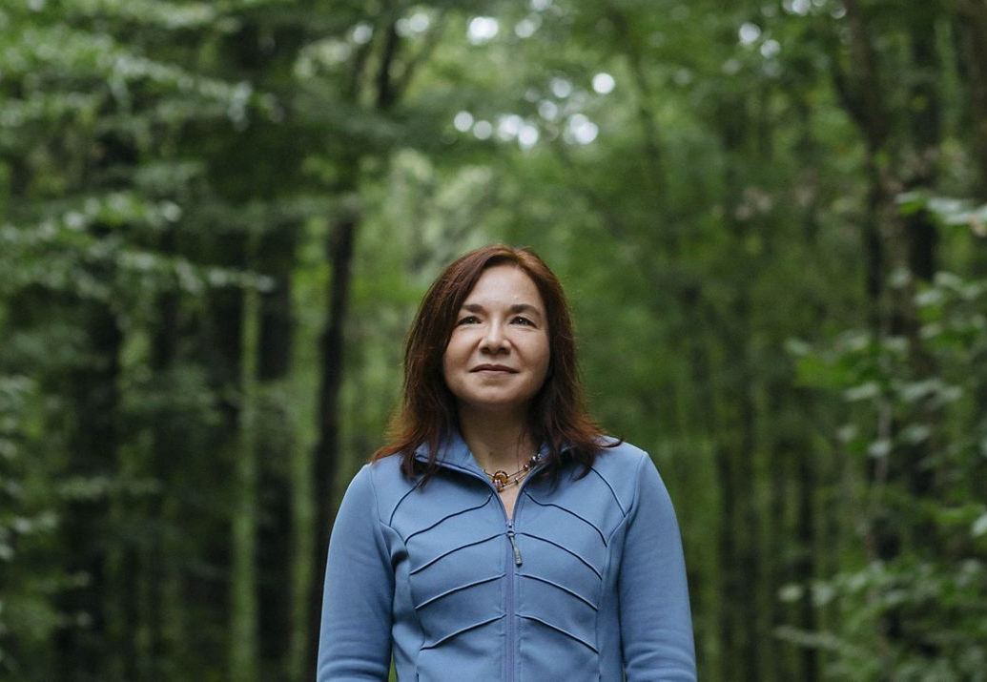
Dr. Katherine Hayhoe
Notes:
Climate change is a wicked problem intertwined with the way the western, capitalist world as been built on colonialism and racism and oppression. So we need lots of data to tell how and why, but also data to predict future outcomes
The problem in climate science is that it’s stuck in jargon
https://www.katharinehayhoe.com/category/communication/

Slide 13
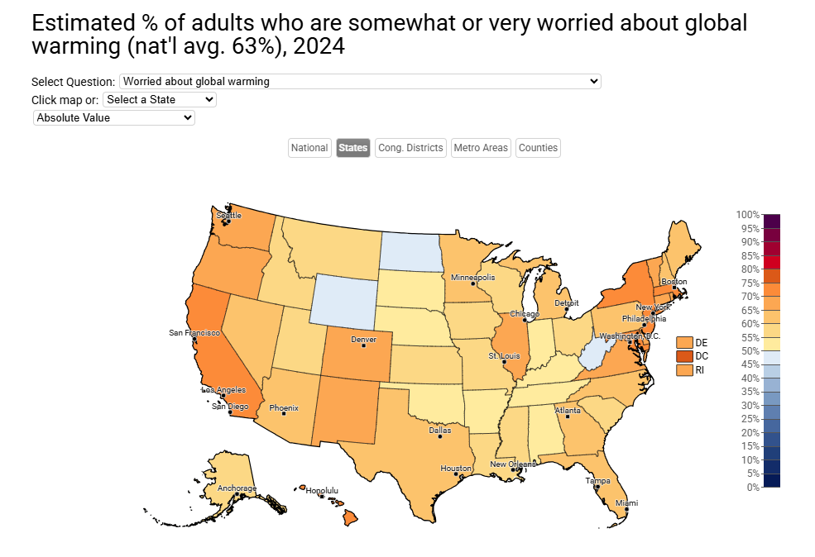
Estimated percentage of adults who are worried about global warming
Notes:
Katherine Hayhoe

Slide 14
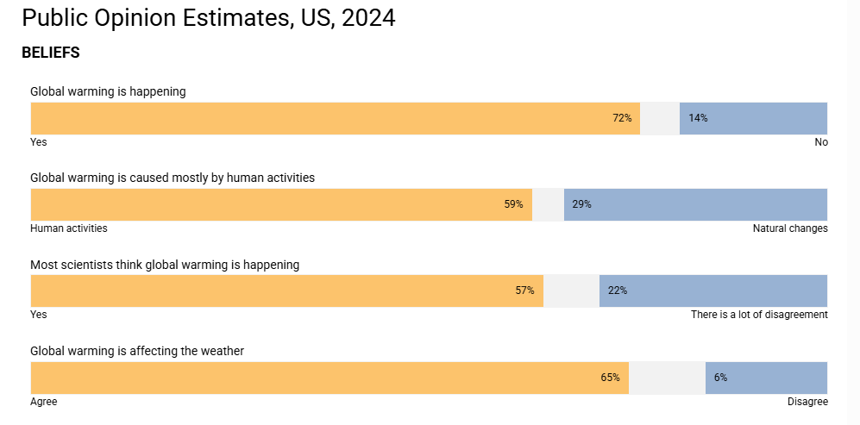
Public Opinion Estimates

Slide 15
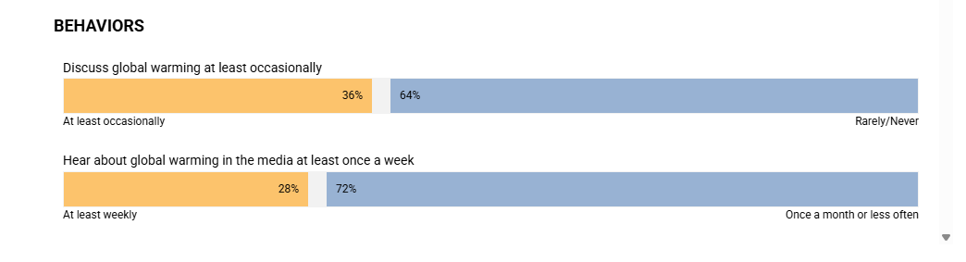
Behavioral polling
Notes:
Vocal minority making policy changes
How you communicate- finding something relatable- farmers weather’s weird right?
https://www.americanscientist.org/blog/science-culture/a-handbook-for-climate-communication
https://climatecommunication.yale.edu/publications/who-is-most-likely-to-talk-about-climate-change/

Slide 16
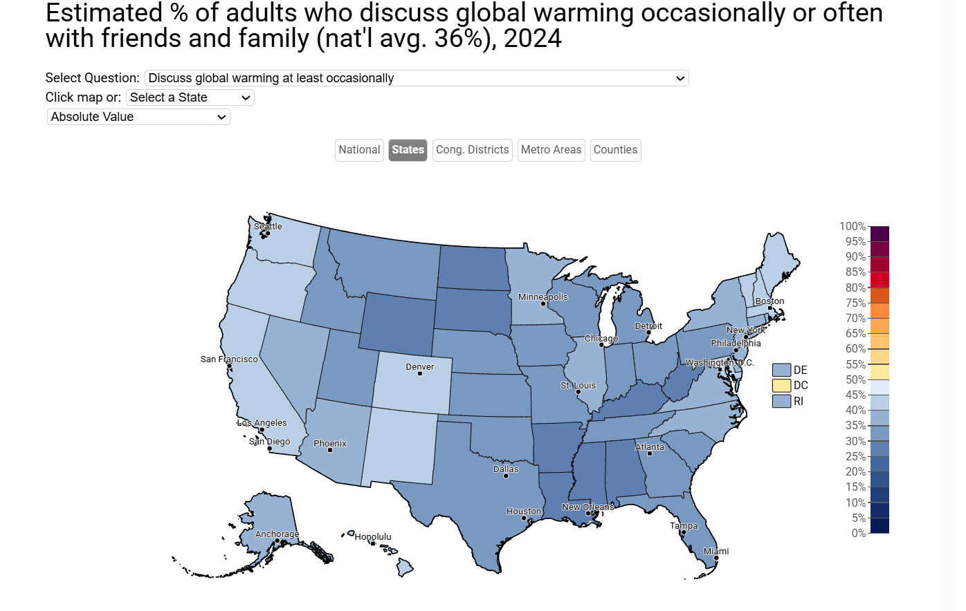
Estimated Percentage of adults who discuss this
Notes:
How you communicate- finding something relatable- farmers weather’s weird right?
https://www.americanscientist.org/blog/science-culture/a-handbook-for-climate-communication
https://climatecommunication.yale.edu/publications/who-is-most-likely-to-talk-about-climate-change/

Slide 17
Comparission
Notes:
How you communicate- finding something relatable- farmers weather’s weird right?
https://www.americanscientist.org/blog/science-culture/a-handbook-for-climate-communication
https://climatecommunication.yale.edu/publications/who-is-most-likely-to-talk-about-climate-change/

Slide 18
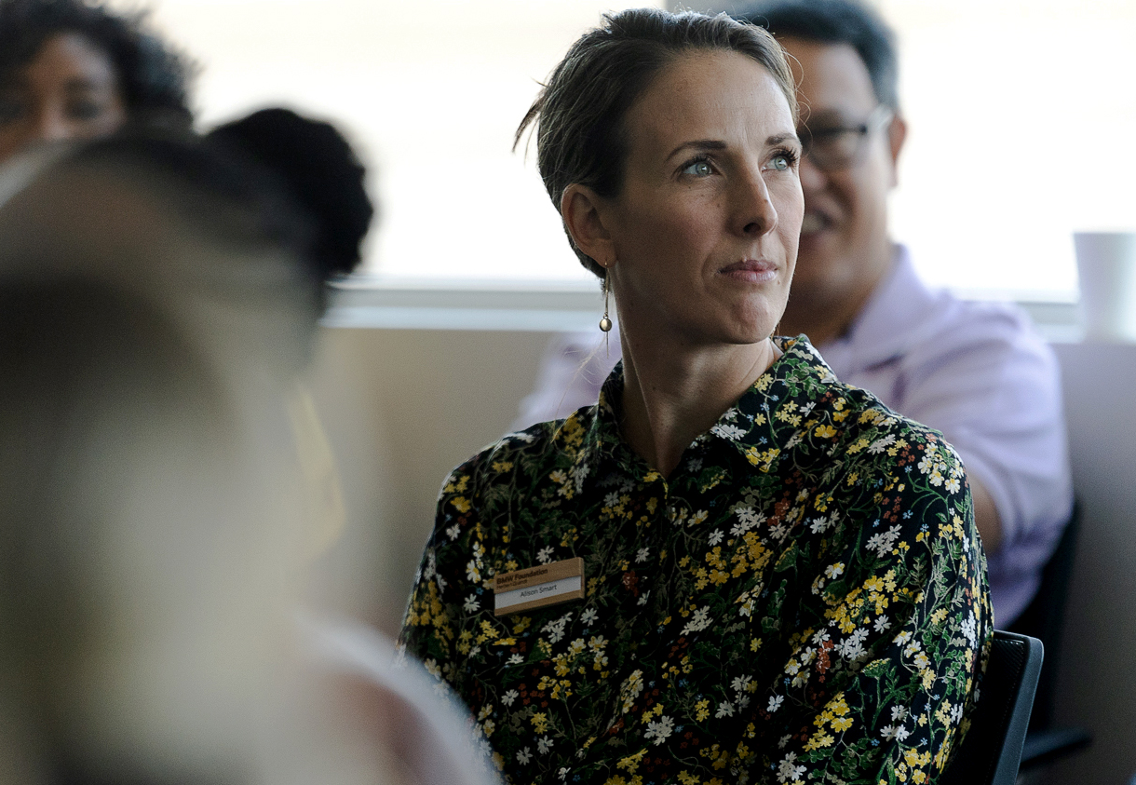
Alison Smart
Notes:
Recently, Effective example of story telling:
Alison Smart- ED of Probable futures. We only talk about one climate scenario, but it’s not so set in stone
https://probablefutures.org/

Slide 19
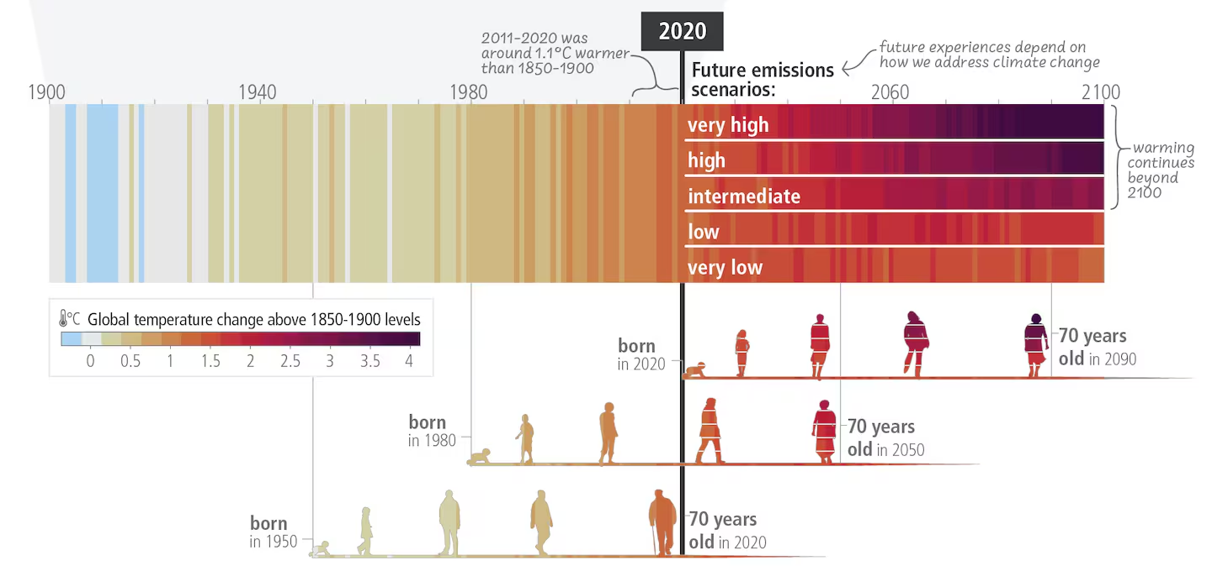
Global temperature Scenarios
Notes:
Alison Smart ED of Probable Futures
Me- 1980
Nephew- 2020- the 4 degree mark
Ecological disruption based on climate change. RCP 2.6 is if we keep heating below 2 degrees

Slide 20
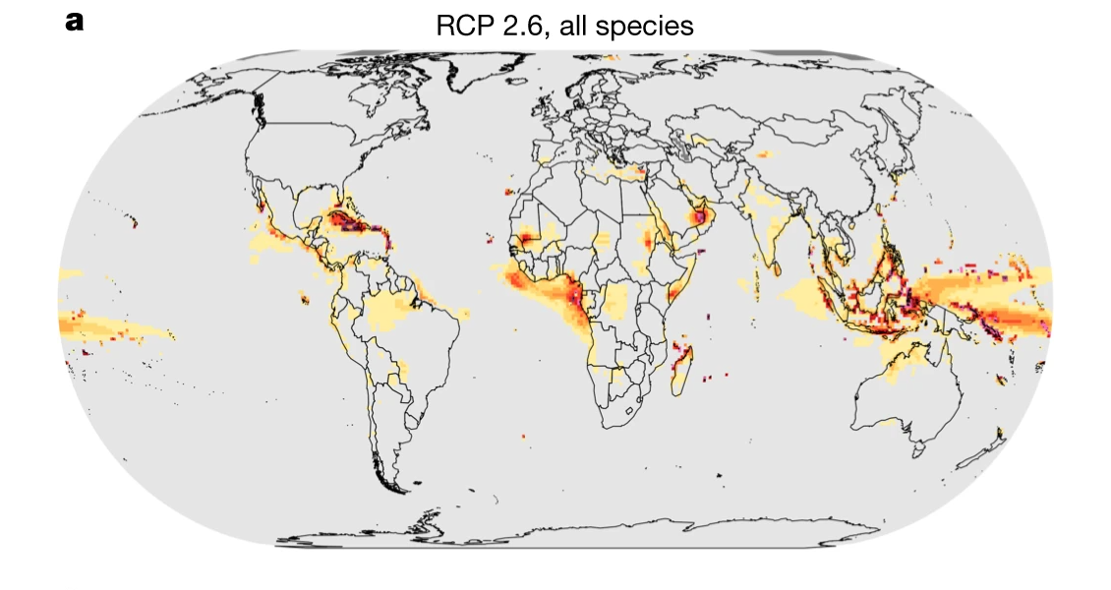
Ecosystem destruction with best case scenario
2 degrees
Notes:
https://www.weforum.org/stories/2020/11/earth-natural-habitats-destroyed-biodiversity-loss/
https://www.ucl.ac.uk/news/2020/apr/climate-change-could-cause-sudden-biodiversity-losses-worldwide
https://www.nature.com/articles/s41586-020-2189-9

Slide 21
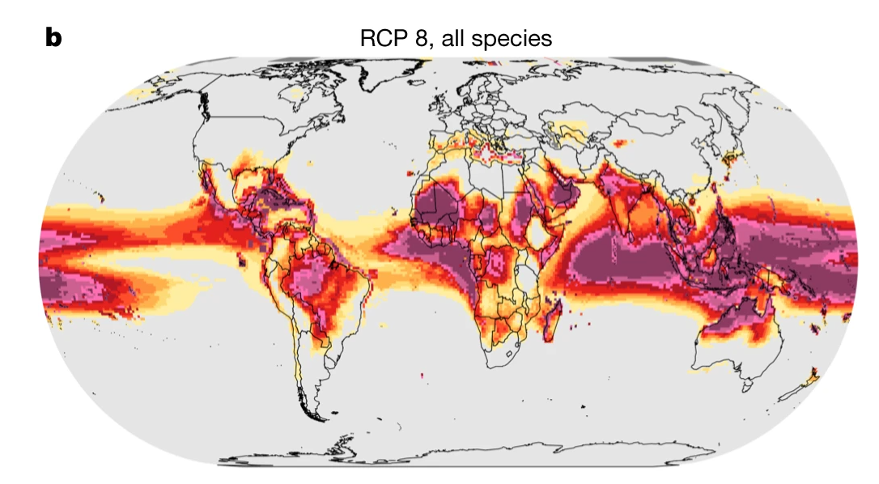
Ecosystem destruction worst case scenario
Notes:
4 degrees

Slide 22

UB’S STORY
Notes:
Survey

Slide 23






About University at Buffalo
3 Campuses
1,170 Acres
18 Residence halls & apartment complexes housing more than
7,000 students
197 Buildings
5,462 Faculty and Staff
(full- and part-time)
30,452 Students
Notes:
The town I grew up in – 31,847 people

Slide 24

University at Buffalo Current Goal: Zero Carbon By 2030

Slide 25
State agencies mandated to purchase 30% Local Food by 2027
Achieve Climate Neutrality by 2050 (Climate Leadership Community Protection Act)
Mandate 70% Renewable Power by 2030
Phased out Coal Power in 2020
State Agencies to Decarbonize their Investment Funds and Invest in Clean Energy
Phase out of Fossil-Fueled Vehicles Banning Sales after 2035 in NYS
Zero Waste Initiatives (compost mandate and phasing out of single use plastics)
Leveraging Low Carbon Concrete and Building Materials
New York State
Climate Commitments
EO22
Notes:
Mandate 100% clean power by 2030
Quadrupling New York's offshore wind target to 9000 megawatts by 2035, up from 2400 megawatts by 2030
Doubling distributed solar deployment to 6000 megawatts by 2025, up from 3000 megawatts by 2023
More than doubling new large scale land based wind and solar resources through the Clean Energy Standard
Deploying 3000 megawatts of energy storage by 2030
Direct State Agencies and Authorities to Pursue Strategies to Decarbonize their Investment Funds and Ramp Up Investment in Clean Energy
Increase Carbon Sequestration and Meet the US Climate Alliance Natural and Working Lands Challenge
Prohibit Use of Plastic Bags

Slide 26
Overall, how important is sustainability to you personally?
Employee
Students

Slide 27
How often have you heard that UB has/is:
Employee
Students
Notes:
Then we ask 2 separate groups of questions: 1 is about what they know about sustainability work, and one about how they value sustainability

Slide 28
How often have you heard that UB has/is:
Employee
Students

Slide 29
How often have you heard that UB has/is:
Employee
Students
Notes:
Goes back to Hayhoe- communication!!

Slide 30
I believe that….
Employee
Students

Slide 31
I believe that…. The university has a responsibility to consider its climate impact on the wider community, specifically those that may be more vulnerable to increasingly frequent or severe climate events.
Employee
Students
Notes:
Made me smile

Slide 32
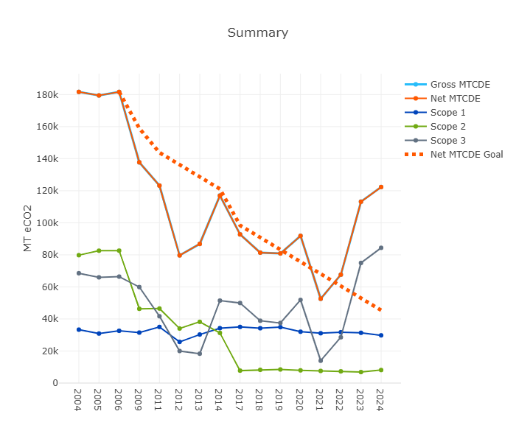
UB Greenhouse Gas Emissions
Notes:
What are we trying to communicate- this!

Slide 33
MTCDE
Notes:
6 Greenhouse gasses that have different impacts on the environment (ex Methane), standardized.
I can report our emissions in this unit, but what does that mean?

Slide 34











UB’s 10 IN 10
PUT A PRICE ON POLLUTION
NOT ALL ELECTRICITY IS CREATED EQUAL
ZERO CARBON MOBILITY
KEEP IT COZY AND GREEN
WASTE NOT
INCREASING EFFICIENCY
EVERY ACTION COUNTS
TAKING STOCK OF OUR FOOD
INVESTING LOCALLY TO PROVIDE FLEXIBILITY
RESPONSIBLE INVESTING

Slide 35



THE THREE INTEGRATORS
CLIMATE JUSTICE
RESILIENCE
MAKING IT HAPPEN

Slide 36
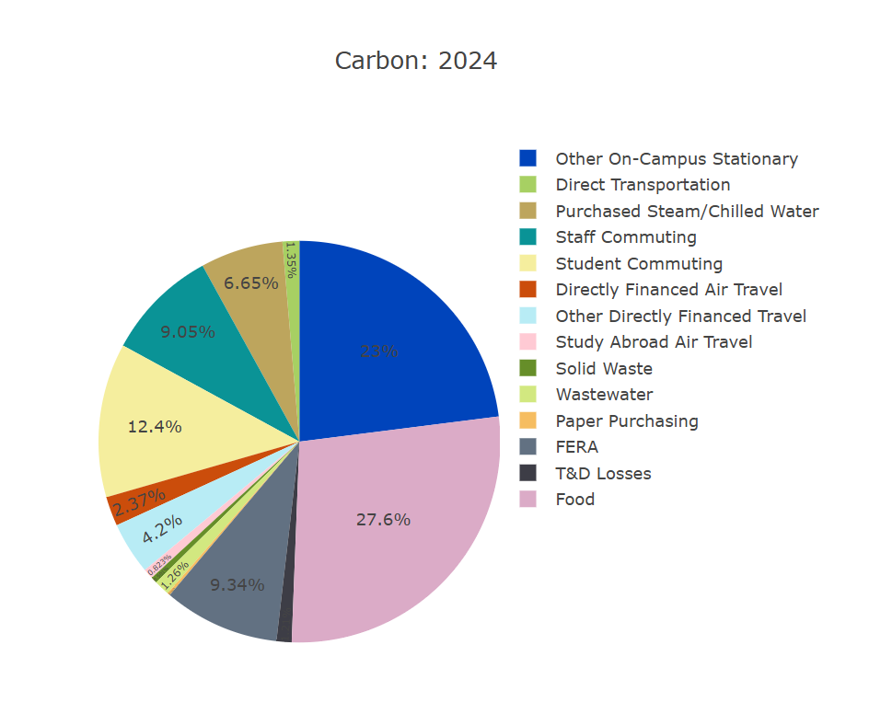
GHG 2024
Notes:
Each one has a source of emissions

Slide 37
Renewable energy

Slide 38
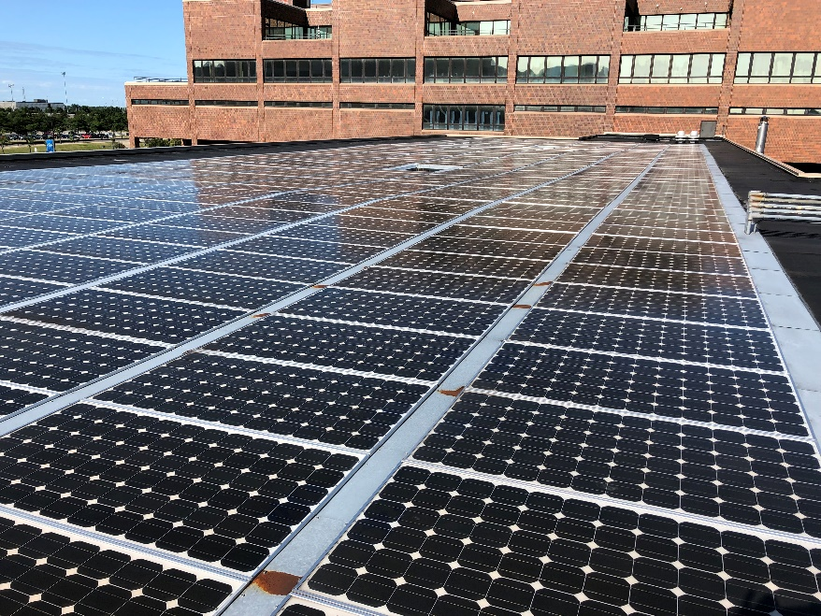
Norton Solar Panels

Slide 39
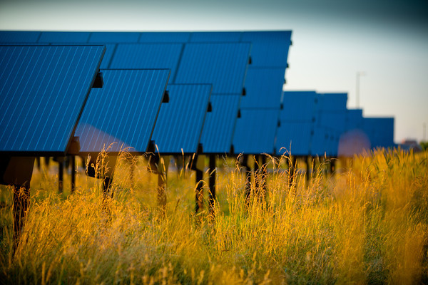
Solar Strand

Slide 40
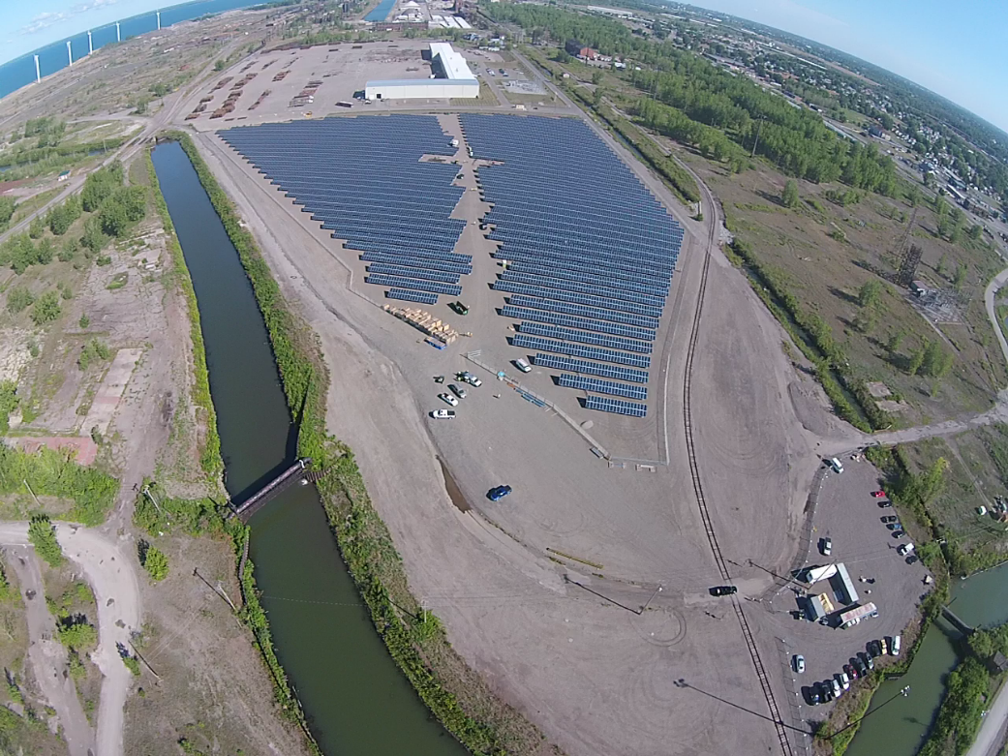
Solar Field

Slide 41
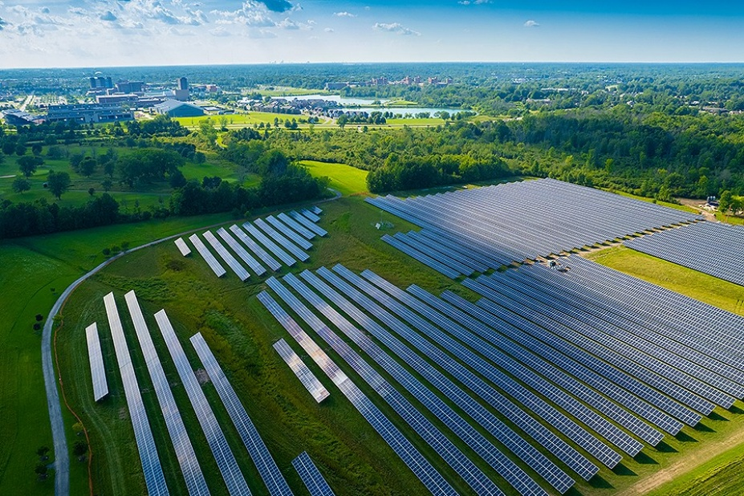
Solar Stroll

Slide 42
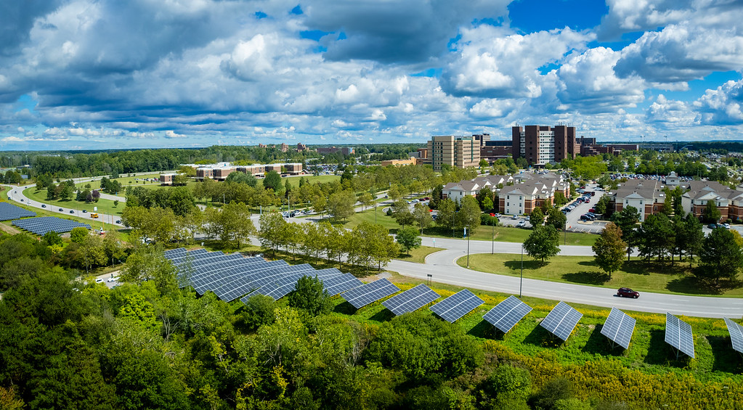
Bizer Arrays

Slide 43
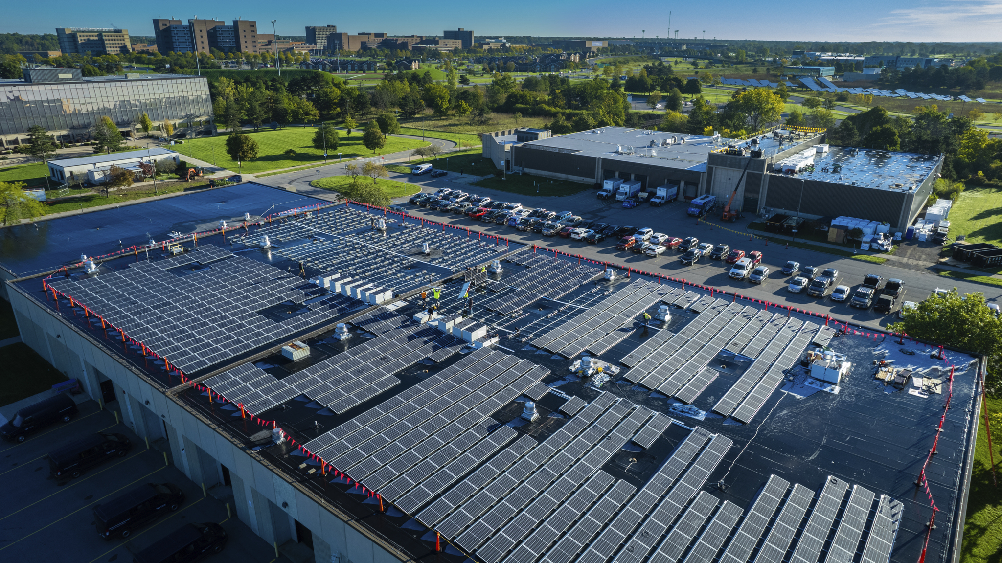
Beane Panels
Notes:
Through this this work, we have dropped our emissions

Slide 44
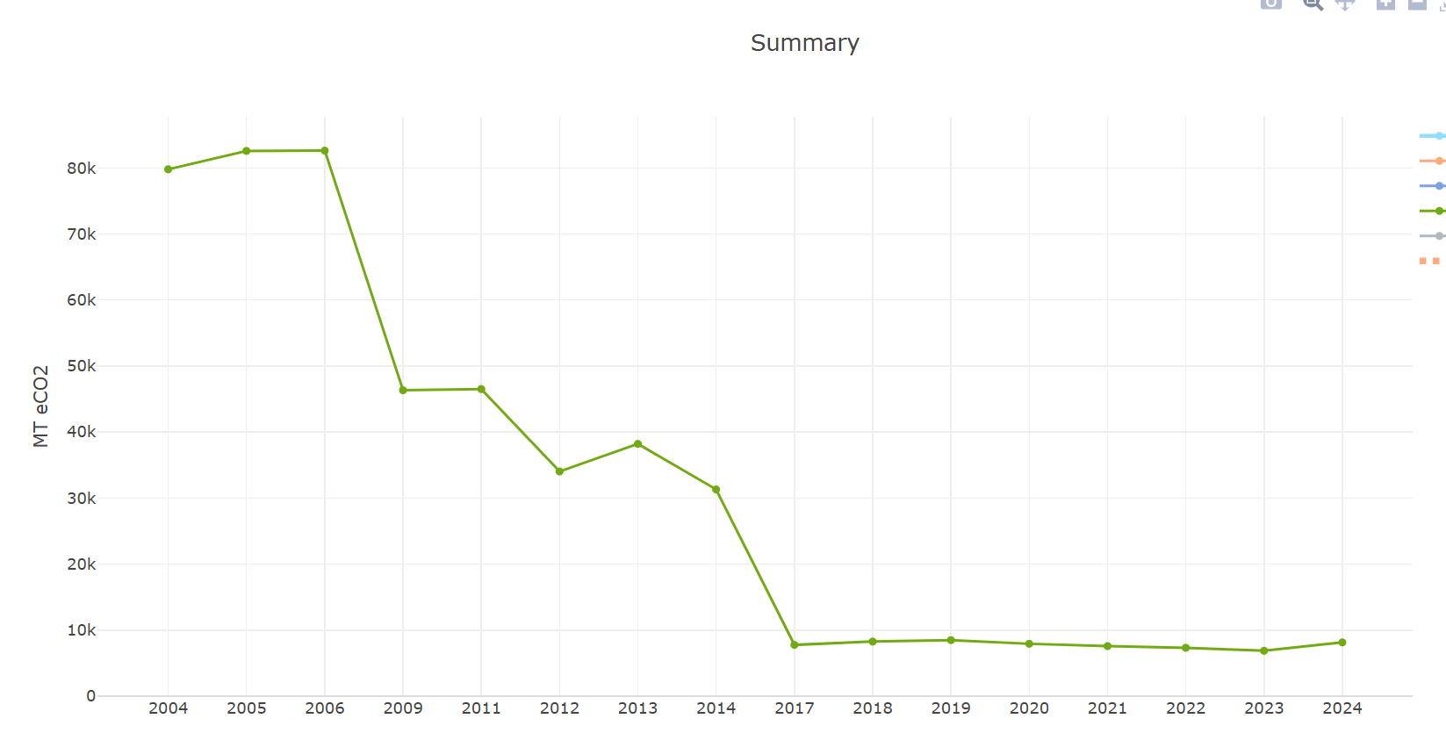
UB Scope 2 Emissions over time
Notes:
Scope 2 emissions= natural gas still a source
2006- 11k homes energy use
1k in 2024

Slide 45
Mobility
Notes:
Transport sector accounts for 14% of global emissions

Slide 46
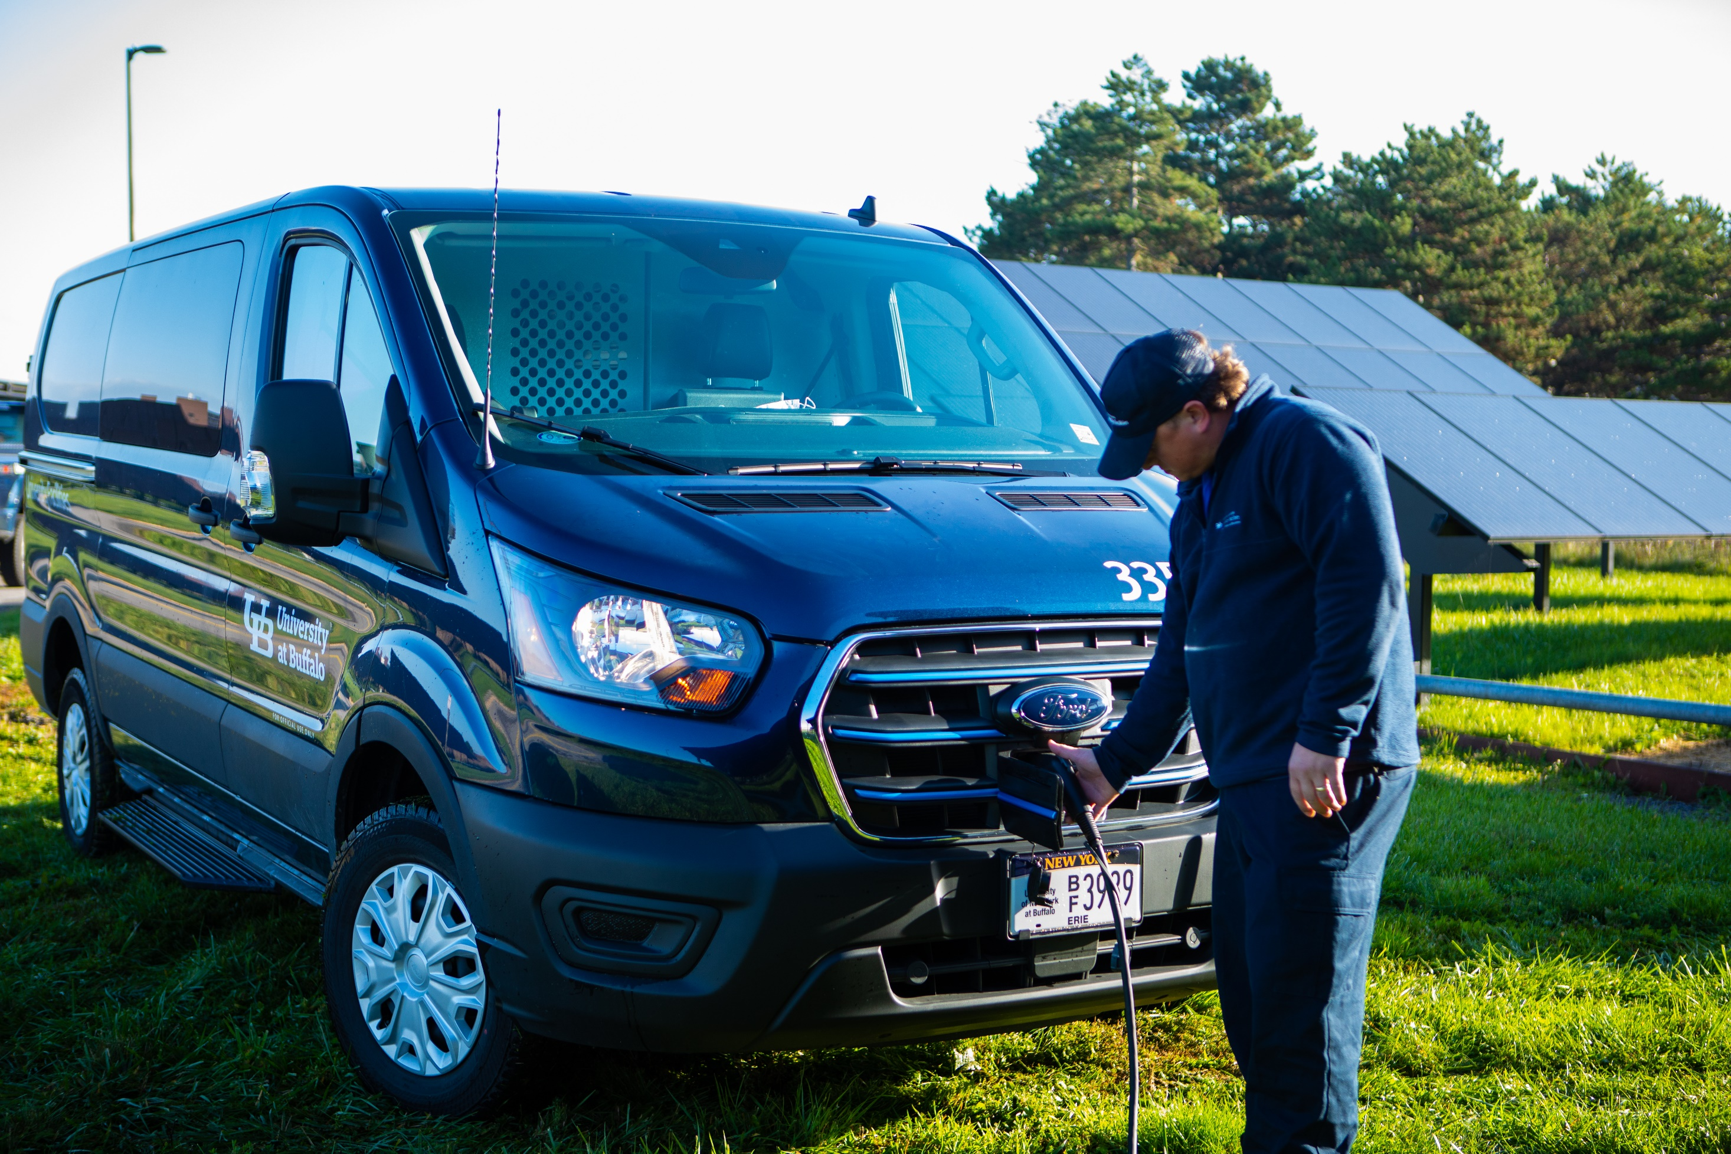
Fleet

Slide 47
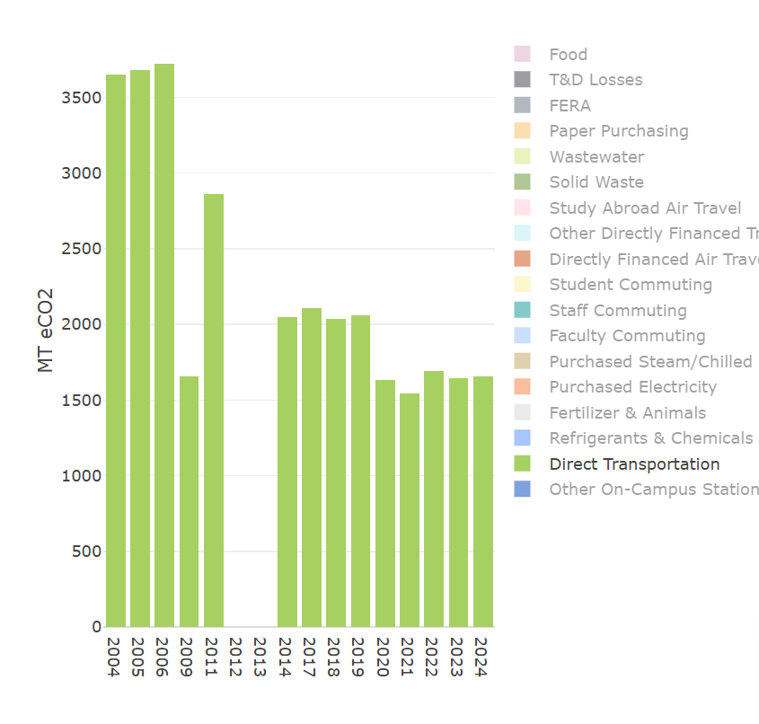
Fleet Fuel
Notes:
Fleet- Gasoline
Transition over- EV Busses in fall

Slide 48
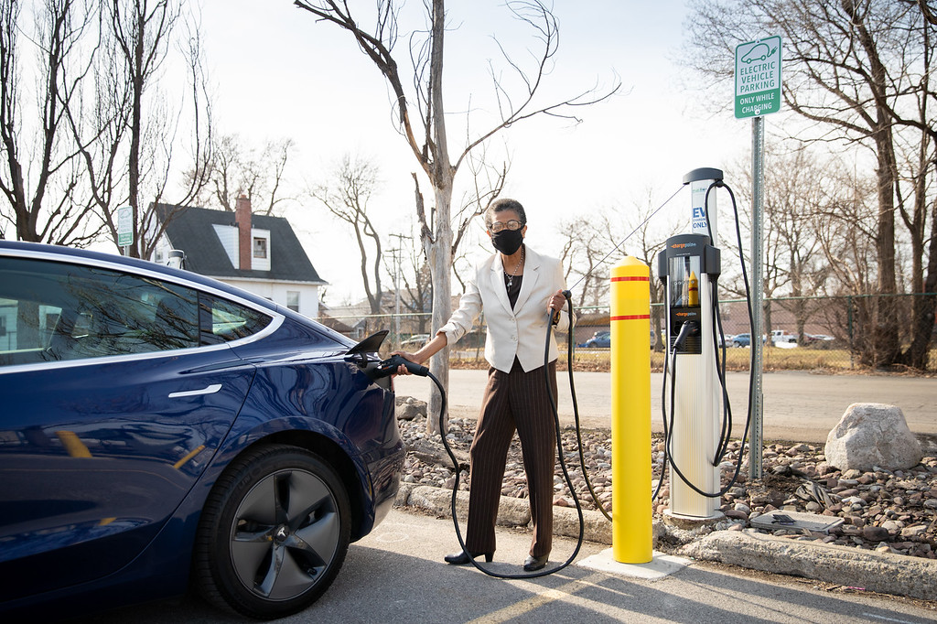
EV Charging
Notes:
2024- 20% of cars sold were EVs

Slide 49
Percentage of Greenhouse Gas Emission at UB 2024
Notes:
Commuting: 26,000 MTCDE
430,000 trees growing for 10 years (we just planted 1600)

Slide 50
Waste

Slide 51
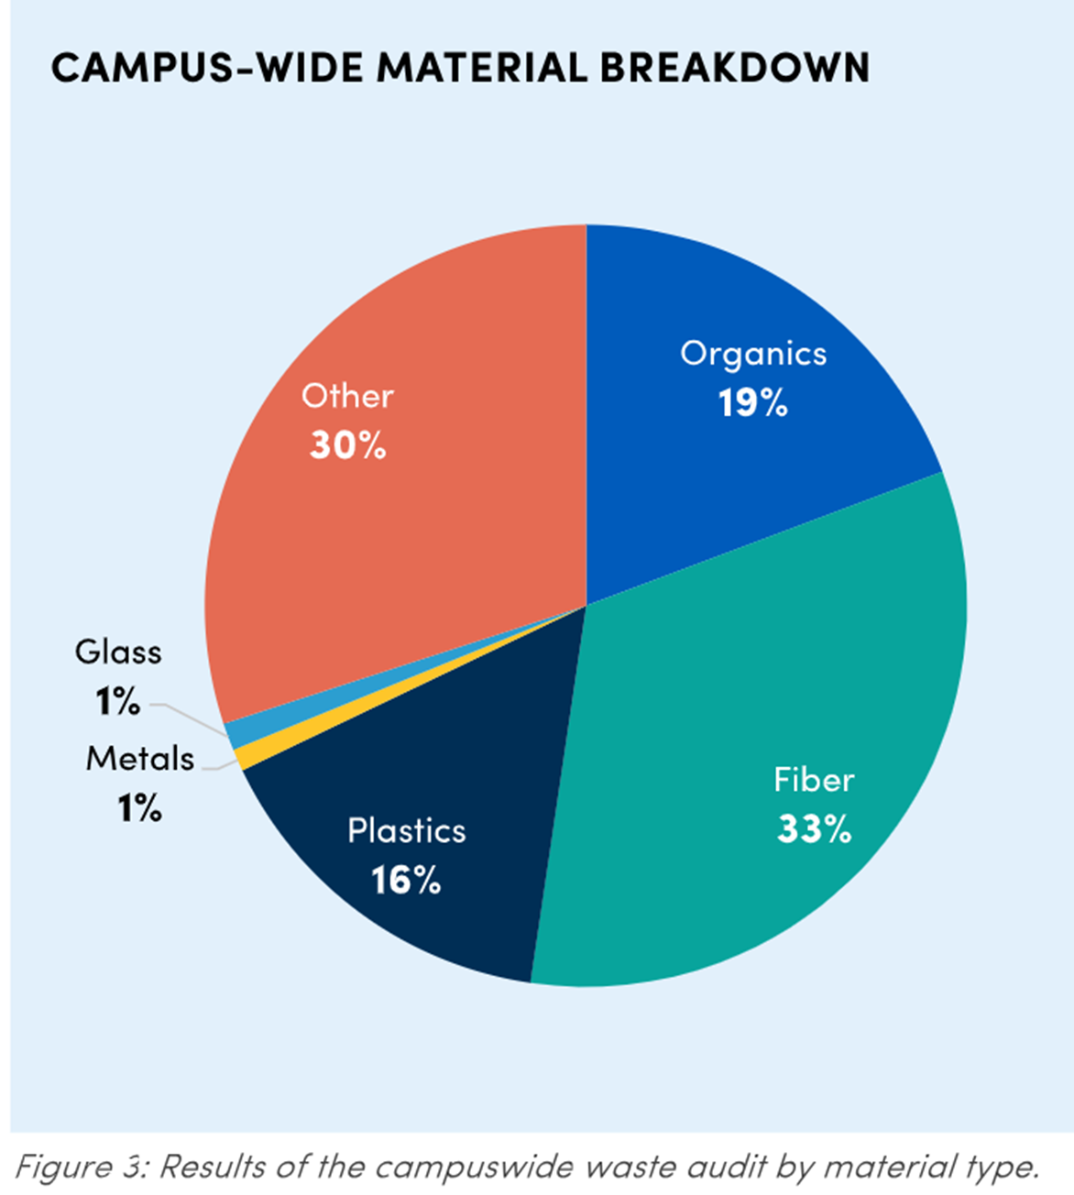
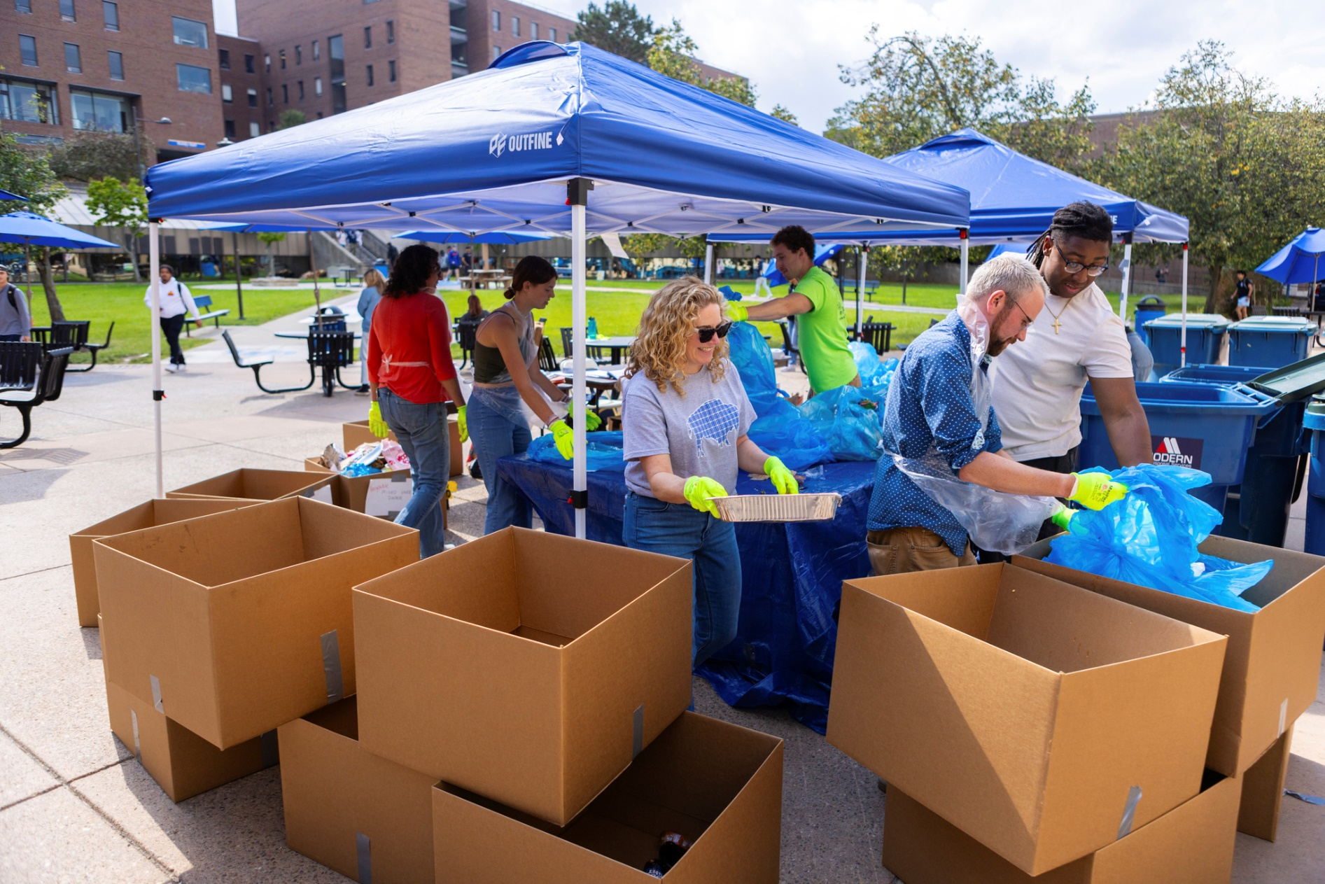
Waste Audits
Notes:
Data for education

Slide 52
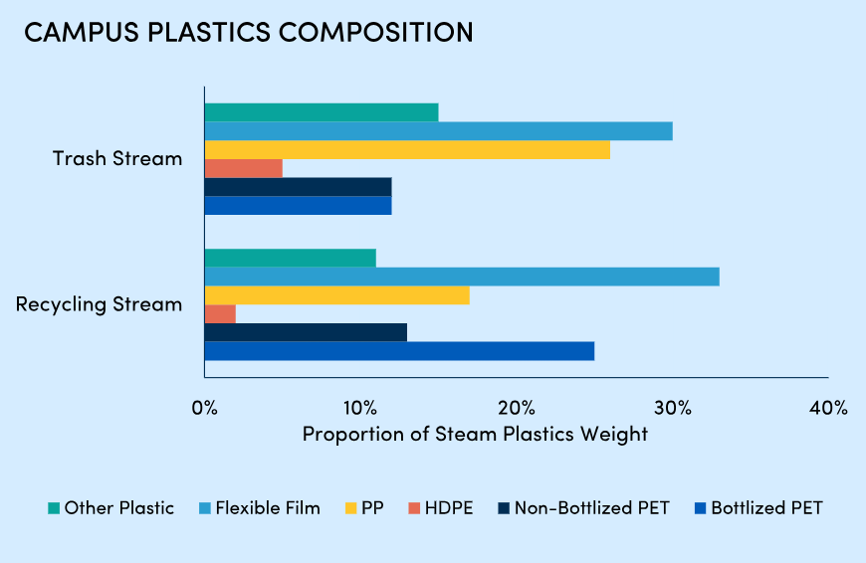
Campus Plastics Composition

Slide 53
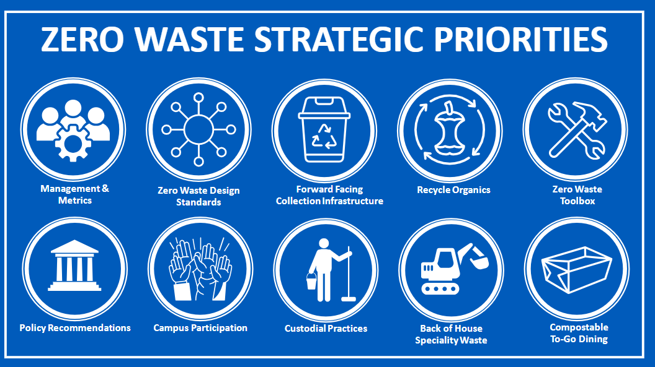
Zero Waste Strategic Priorities

Slide 54
Food systems

Slide 55
UB Greenhouse Gas Emissions over time
Notes:
Back to this chart – why the increase some of you may have been asking.
More things to measure like food
Globally- 25%
Not just transportation- local does not always mean better, industrial farming, food types

Slide 56
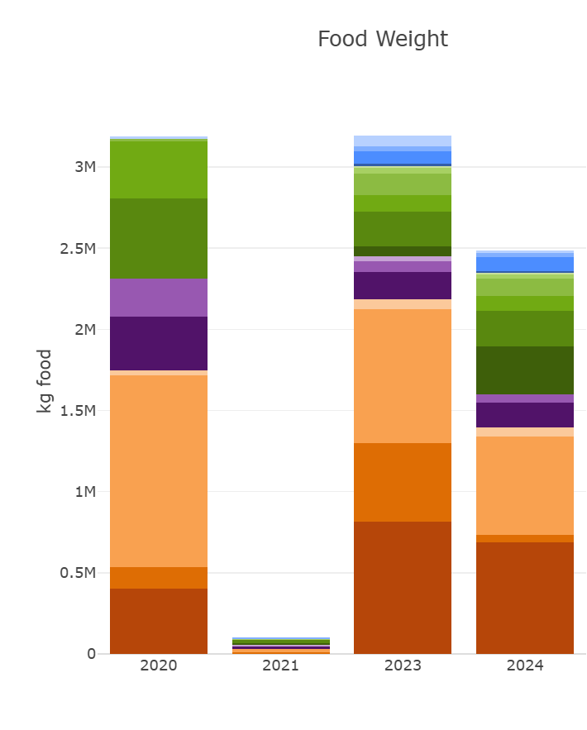
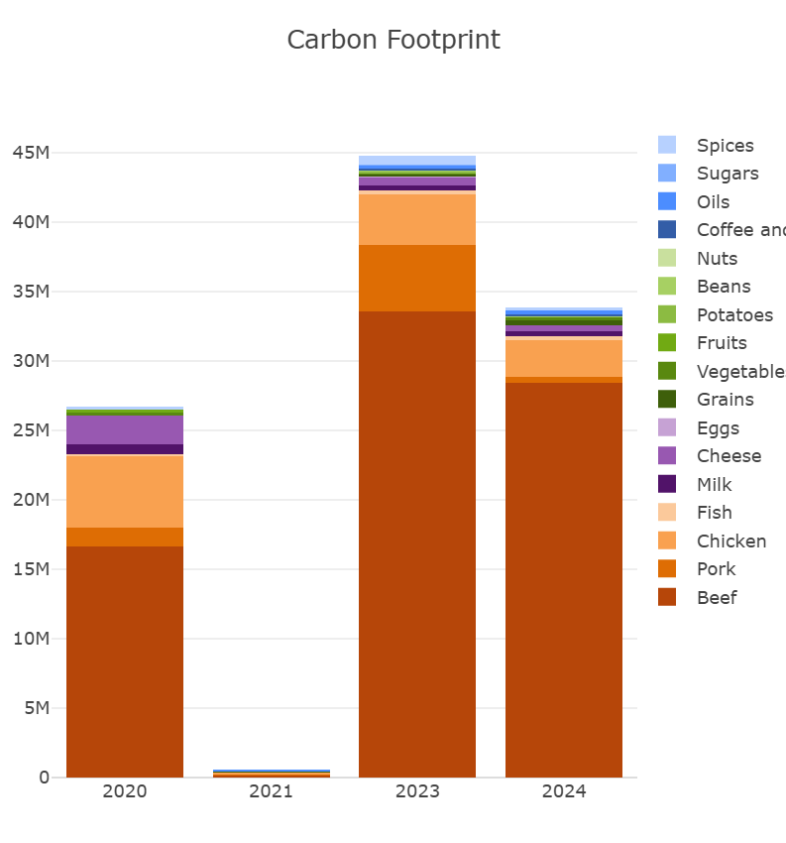
Carbon footprint of UB Procured food
Notes:
AI vs. CAFOS- on going EJ issue

Slide 57

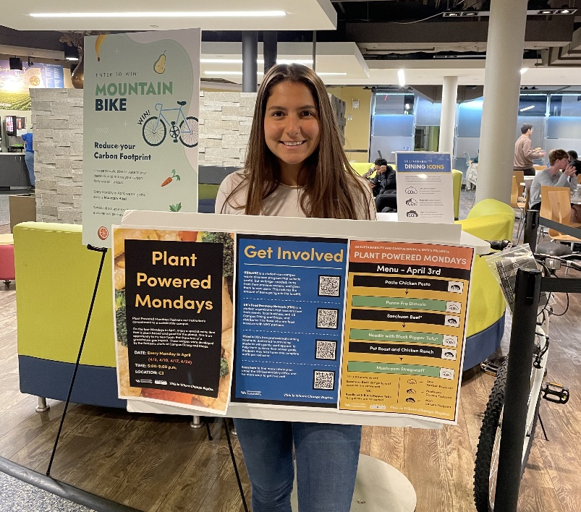
Greenhouse Gas labeling in dining halls

Slide 58
Notes:
Most expensive, long-term strat- shows hidden costs

Slide 59
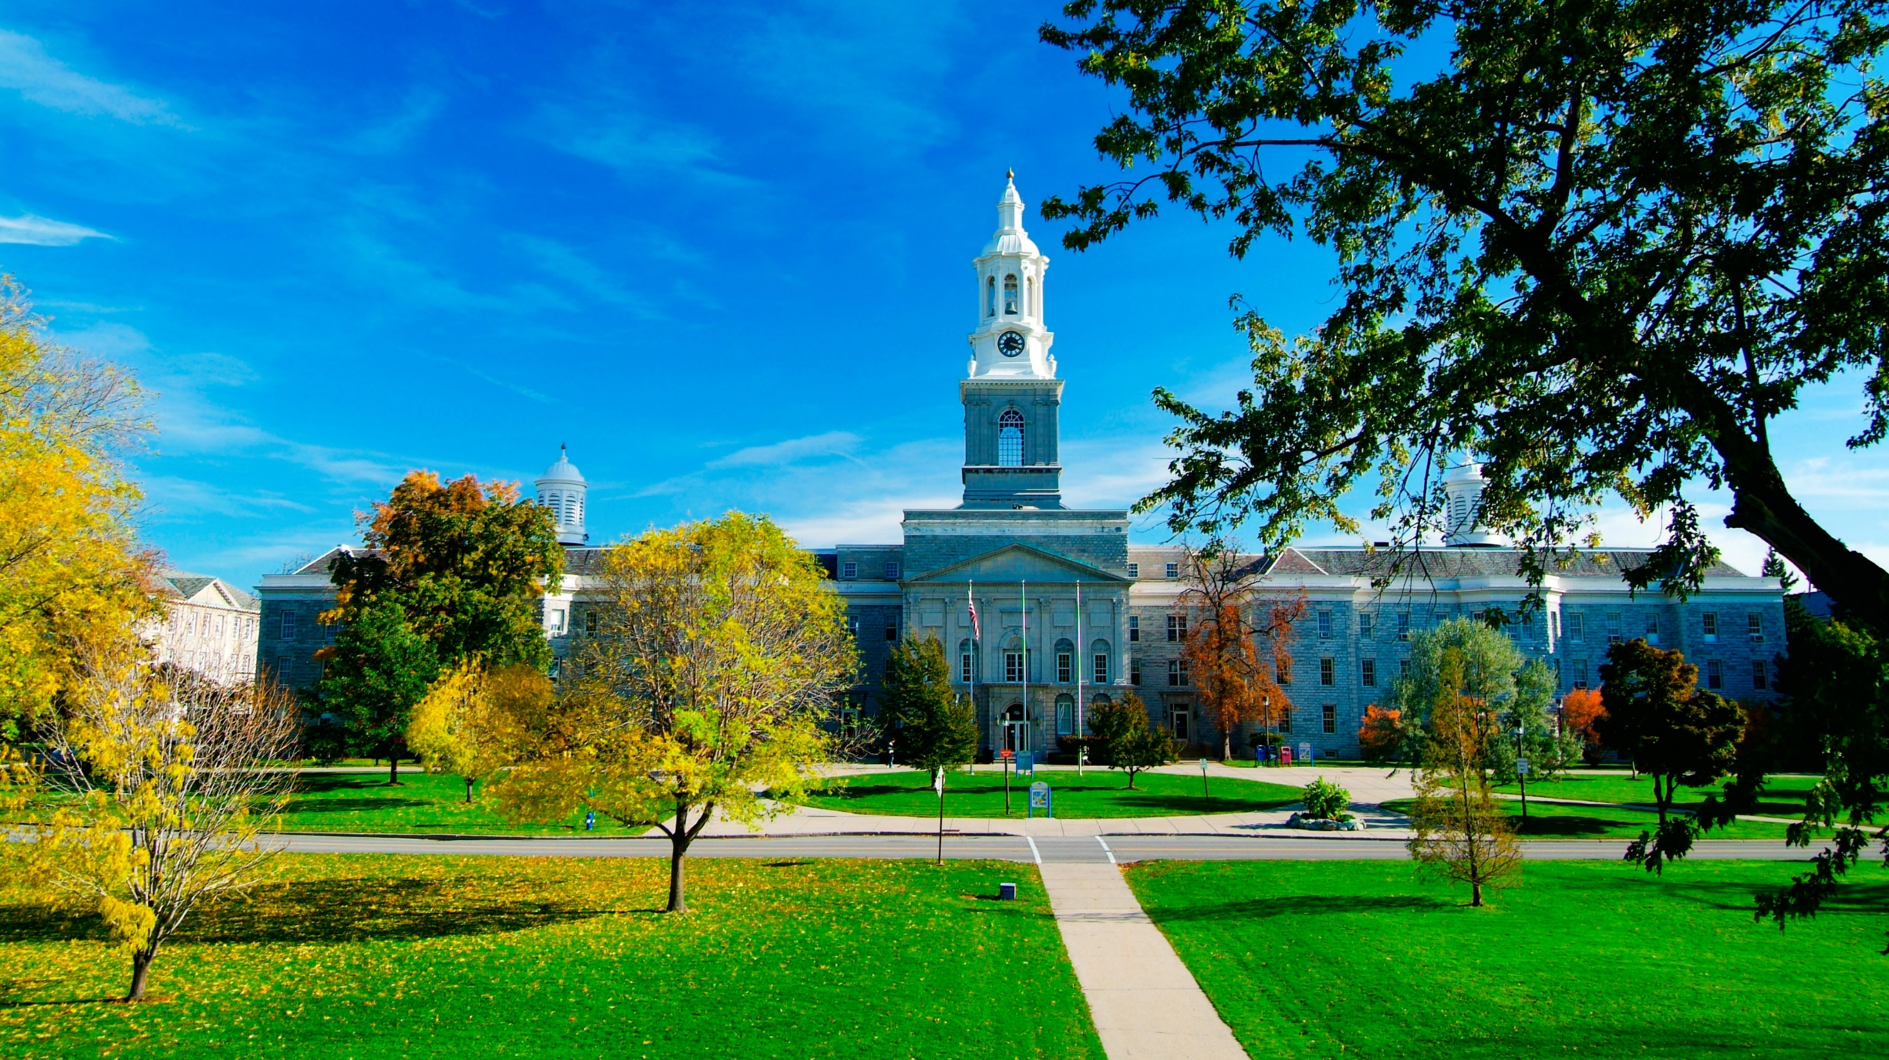
We need to radically change the way we approach ENERGY FOCUSED PROJECTS.
We need to adjust our mindset to PRIORITIZE SAVING ENERGY and reducing emissions vs. only reducing energy costs.
We need to TRANSITION AWAY FROM FOSSIL FUELS being our primary energy source.
Starting Point

Slide 60
SOCIAL COST OF CARBON
Notes:
Social Cost of Carbon
One study, analyzing 185 extreme weather events from 2000 to 2019, found that the cost of climate-related damages was US$143 billion annually, or $16 million per hour. Since some of the data was incomplete, particularly in low-income countries, this is likely an underestimation of the true cost.

Slide 61
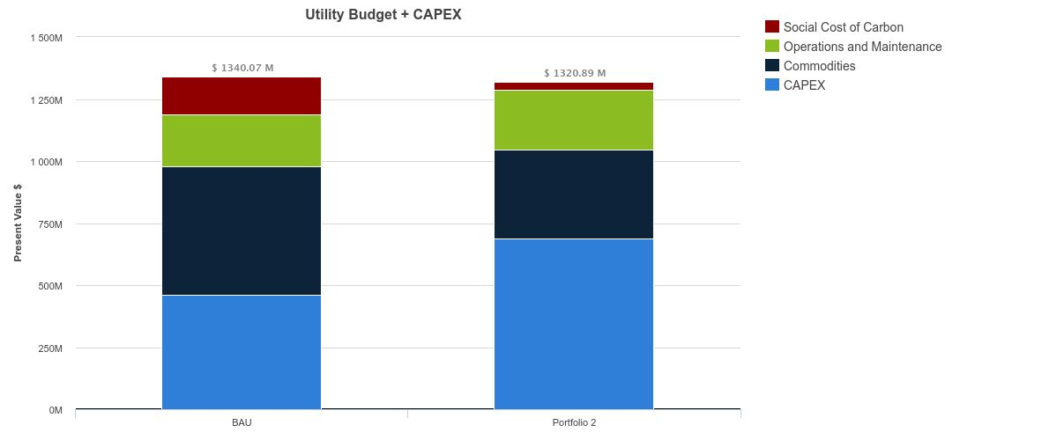
Business Case
Preliminary life cycle cost analysis (2024-2050) – Scope 1 & 2 only
$1.34B
$1.32B
$1,334 M
$239 M
$208 M
$340 M
$519 M
$460 M
$687 M
BAU
BAU
Decarbonized
Notes:
Social Cost of Carbon

Slide 62
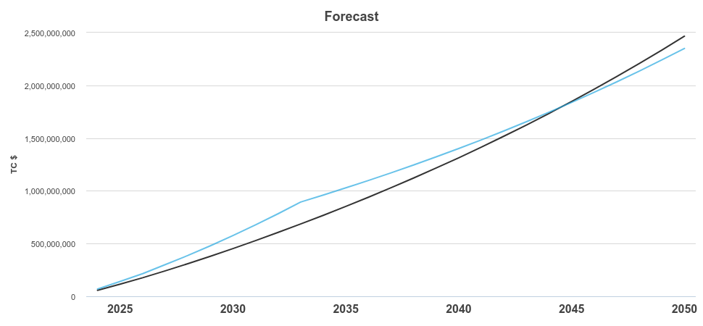
Cumulative Cashflow with Cost of Carbon
Business-as-Usual vs. Decarbonization Roadmap
Business-as-Usual
Decarbonization Roadmap

Slide 63
MORTALITY COST
OF
CARBON
Notes:
https://www.nature.com/articles/s41467-021-24487-w#:~:text=This%20implies%20that%20the%20lifetime,if%20all%20added%20in%202020.
We find that in the DICE baseline scenario that results in 4.1 °C warming above preindustrial temperatures by 2100, the 2020 MCC is 2.26 × 10⁻⁴ lives per metric ton in the central estimate, which implies that adding 4,434 metric tons of carbon dioxide in 2020—equivalent to the lifetime emissions of 3.5 average Americans—causes one excess death globally in expectation between 2020 and 2100
UB 2024: 120,000MTDCE = 27 global deaths between 2020-2100

Slide 64
JOY
Notes:
A lot of this data is scary or sad. World sucks. But there are great points like the increase in renewables across the planet.

Slide 65
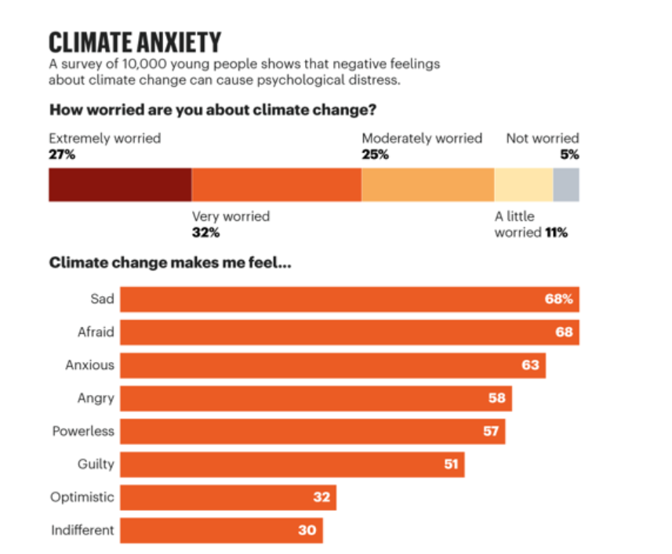
Climate Anxiety Rates
Notes:
16-25, 10,000 young people around the world
https://www.greenschoolsproject.org.uk/2022/04/29/elementor-2248/

Slide 66
DAILY ECOJOY
Micro-volunteer
Curate positive social media
Say hi to a stranger
Send one appreciative message
Go outdoors, grab a friend
Notes:
Climate communication!
An analysis released Tuesday from scientists behind a research initiative called the BIG JOY Project finds that people who commit daily "micro-acts" of joy experience about a 25% increase in emotional well-being over the course of a week.
Examples include making a gratitude list or journal, or engaging in acts of kindness such as visiting a sick neighbor or doing a nice gesture for a friend – or a stranger. Some micro-acts involve celebrating another person's joy, or engaging in self reflection, meditation, or taking the time to identify the silver lining in a bad situation, known as positive reframing.
When people intentionally plan out a daily micro-act, it may help them feel as if they have a bit of control over their emotions, explains researcher Elissa Epel, a BIG JOY collaborator, and a professor of psychiatry, at the University of California, San Francisco. "So there's this feeling of agency," Epel says, and that could be one explanation for the improvements in well-being seen in the survey.
For instance, participants were asked how much they agreed with the statement: "I have felt able to impact, influence, or play an active role in how happy I generally feel." The participants' level of agreement with this statement increased by about 27%, over the course of the week.
"So many of the things that are causing us stress and sadness are out of our control," Moskowitz says. "So these micro moments can give you something to hold on to," she explains, and help you stay engaged.
https://www.npr.org/sections/health-shots/2023/11/14/1212908276/can-little-actions-bring-big-joy-researchers-say-micro-acts-can-boost-well-being
Increasing prosocial behaviour – donating, volunteering, and helping strangers – is reliably connected to decreasing deaths of despair around the world. Regression results indicate that a ten percentage-point increase in the share of people engaging in prosocial behaviour is associated with approximately one fewer death per year per 100,000. For a country like the United Kingdom, with an adult population of approximately 55 million, that is equivalent to about 550 preventable deaths per year.
On average, deaths of despair decreased around the world by nearly 5 deaths per 100,000 people over the period 2000–2019 in 59 middle- to high-income countries. This equates to approximately 2,750 people in a country like the UK. The largest declines occurred in northeastern European countries, such as Lithuania and Latvia, which tended to have very high initial levels.
called acts of kindness or altruism
https://www.worldhappiness.report/ed/2025/supporting-others-how-prosocial-behaviour-reduces-deaths-of-despair/
Next slide is my gift to you- some joy. Favorite picture taken at UB

Slide 67
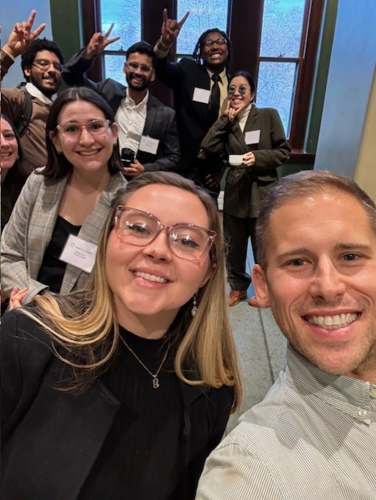
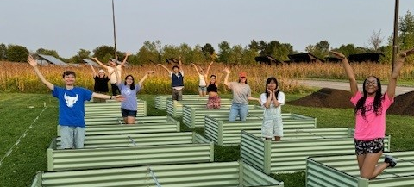
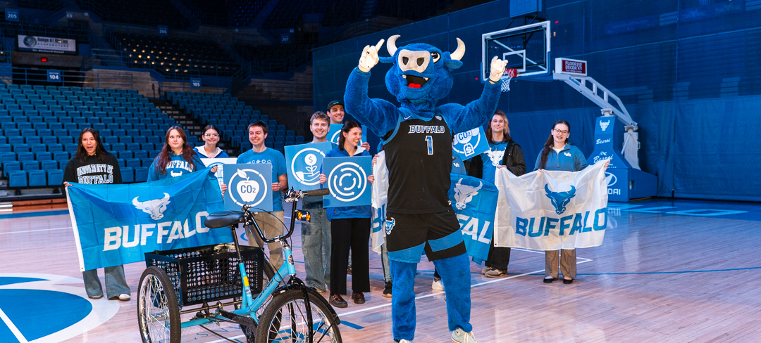
My joy
Notes:
Not every day is like this, but especially in hard times, looking at defeating data, this helps.
Building community

Slide 68

Keirra Johnson
Notes:
Our national landscape isn’t joyous.
Keirra Johnson, National LGBTQ Task Force President
Johnson offered a sharp critique of past movement strategy: that success itself can create new vulnerabilities: particularly following major federal wins such as the U.S. Supreme Court’s Obergefell decision guaranteeing same-sex marriage and workplace protections for transgender people under Bostock v. Clayton County.
Those victories, she said, risk lulling parts of the movement into a false sense of security.
“What we didn’t pay close enough attention to are the unintended consequences of winning,” Johnson said. “Winning invigorates the opposition. Winning can produce a dangerous sense of safety and permanence.”
Building community- joy, the opposite of fascism is community
Call to action: Build your community, talk about climate and sustainability (at UB and your personal lives)
With that, Leave you with my favorite picture ever taken at UB.
https://www.washingtonblade.com/2026/01/27/task-force-urges-renewed-organizing-amid-growing-political-threats/

Slide 69

Joyful picture of goats
Notes:
So much joy in this picture

Slide 70

Discussion & Questions
DISCUSSION

