Slide 1
Open Research & Contributor IDs (ORCID)
UB Love Data Week 2026
Scott Peterson
sp277@buffalo.edu
UB Libraries
Research Data Services
Notes:
https://firbolg.github.io/LC_ORCID/instructor/index.html

Slide 2

Training with open educational resources
The Carpentries is a non-profit global community that teaches foundational coding and data science skills
The curriculum is open and collaboratively developed to be up to date
Since 2012 they have run workshops in 72 countries and on every continent to over 100,000+ learners
Notes:
This presentation is adapted from a Carpentries lesson Open Research and Contributor IDs (ORCID) for Librarians
https://carpentries.org./
https://firbolg.github.io/LC_ORCID/instructor/index.html

Slide 3
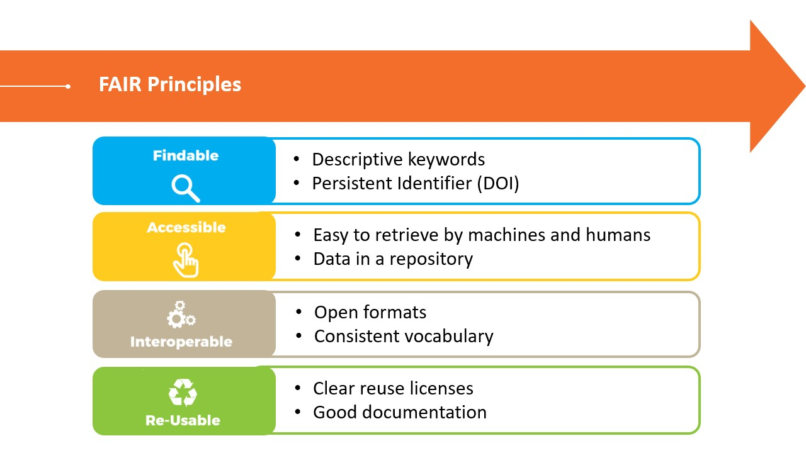
FAIR Principles
Government-funded research increasingly mandates the use of Persistent Identifiers (PIDs) to improve transparency, accountability, and the FAIR principles.
St. Lawrence Global Observatory (2018) FAIR Principles. Retrieved 20190918 on https://ogsl.ca/en/fair-principles

Slide 4



Types of Persistent Identifiers (PID)
PIDs for Organizations
The most widely used PID for organizations is a Research Organization Registry ID (ROR)
Covers funders, employers, and research institutions
PIDs for Work Products
Typically, digital object identifiers (DOIs) are used for work products or outputs
Used as a stable method for citation and discovery
PIDs for Individuals
The most notable of these PIDs is ORCID (Open Researcher and Contributor ID)
Used to disambiguate individuals
UB ROR ID: https://ror.org/01y64my43
https://library.noaa.gov/PIDs
Notes:
https://www.doi.org/
DataCite is one of the bigger DOI services. We will connect to DataCite and you can have your ORCID profile populated by DataCite when you publish with a DOI.
There is no single system accepted by all, though DOIs are very well established and widely deployed
As a general rule, authors cannot assign a DOI to their document themselves. The provider of the publication (e.g. the publisher) will have signed a contract with a registration agency which is responsible for assigning DOIs. Crossref and DataCite are the two best-known DOI registration services. Authors do not pay any charge for having a DOI assigned to their work.
https://www.publisso.de/en/advice/publishing-advice-faqs/doi-orcid-and-ror-what-makes-persistent-identifiers-so-useful
https://ror.org/
PIDs make scholarly papers, authors and institutions permanently findable, retrievable and citable. As well as uniquely identifying each object, they also enable us to enrich the information on each individual paper, author and institution by establishing mutual links between them.

Slide 5
Author Disambiguation: Part 1
As the number of scholars publishing work increases, the problem of telling authors apart from each other becomes more important to solve.
Especially as scholars move from institution to institution, and affiliations are listed in a variety of ways, records become harder to track.
Databases which aggregate journals may not be able to accurately distinguish among many authors with the same name.
Departments may not be able to track their publishing activity.
Researchers working in adjacent areas may not find each other to collaborate.
Recruiters may not be aware of the full scope of a researcher’s contribution to their field.

Slide 6
Author Disambiguation: Part 2
An ORCID disambiguates among scholars with similar or identical names by assigning one persistent, unique identifier per person which serves as the focal point of other relevant information such as affiliation and scholarly works.
Scholarly works become more findable when a person is matched with an ORCID.
Putting the records of an author’s scholarly products in one place that persists across systems helps make their work accessible.
ORCID is interoperable as it integrates with other systems and serves as a "digital passport" for researchers, allowing different platforms—like grant applications and journal websites—to automatically share and sync your professional information so you don't have to type it in every time.
ORCID is a pedigree, as it provides the "provenance" (the history of ownership) that makes data trustworthy enough for others to pick up and reuse while ensuring you get the credit.

Slide 7
What is ORCID?
ORCID is a nonprofit organization with member institutions from all over the world. (UB is a member through the Lyrasis consortium.)
You do not need to belong to a member institution to set up an ORCID for yourself, and individual ORCID records can be created and maintained at no charge.

Slide 8
What is an ORCID?
ORCID stands for Open Researcher and Contributor ID.
It is usually referred to as an ORCID iD (this is redundant, but that’s how you’ll often hear it said).
It is a 16-digit persistent identifier that uniquely identifies an author throughout their career. You can think of it as similar to an online curriculum vitae.
It can be very helpful for:
Disambiguation of authors with similar names
Tracking individual author name changes
Submissions to journals and grant applications
Notes:
By including an ORCID ID in your publication, you can be sure that your work will be properly attributed to you; many journals, conferences and publishing platforms therefore ask authors to provide their ORCID ID whenever they submit a manuscript. The unique and unambiguous nature of an ORCID ID also makes it easier to search for an author’s publications, increases author visibility, and helps identify indexing errors in databases.

Slide 9
Why use an ORCID?
Creating and maintaining an ORCID record allows you to claim your scholarly online presence.
You have the autonomy to list your works, grants, affiliations, etc.
On a larger scale, departments may be interested in their faculty having well maintained records to aid in tracking of scholarly output.
ORCID has an integration with many different tools online.
By curating the ORCID record, researchers can save time later with these integrations that will auto-populate other things they need.
Notes:
Authors have sole control over their own profiles, so they can decide for themselves which information to include and what details to make publicly visible.

Slide 10
Range of Scholarly Products
Different institutions and systems ask for scholarly works to be presented in different formats.
Subscription-based databases, as well as openly accessible databases like PubMedCentral, and webcrawlers like Google Scholar, are all only as complete as the records of scholarly works that have been created, and many systems do not allow the full range of scholarly works to be tracked or recorded.
ORCID can also be a tool for creating a complete record of scholarly works through manual addition of more uncommon scholarly products.
There are more than 40 types of works available to choose when adding a work to an ORCID profile.

Slide 11
Funding Requirements
White House Office of Science & Technology Policy issued a memo stating that all federal funders will need to require grantees to obtain a unique digital persistent identifier no later than by the end of 2025 [NSPM-33].
An ORCID iD is required for most grant funding systems, (e.g., NIH; AHRQ; CDC).
And recommended by others (e.g., NEH).
Helps agencies understand any conflicts of interest.

Slide 12
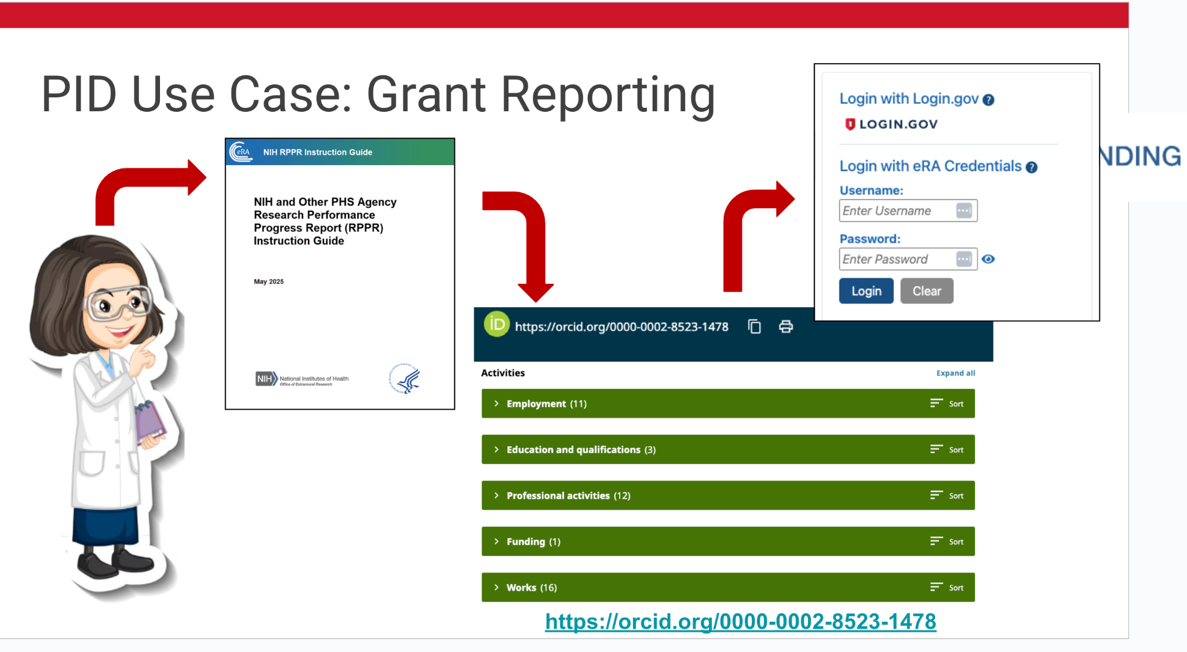

PID Use Case: Grant Reporting
https://sparcopen.org/
Notes:
Researchers can use ORCID to autopopulate parts of their grant reports to reduce the administrative burden.
https://docs.google.com/presentation/d/14TsmBDlN-tDFr478bv64MvNExUwrtTt9foYVnmwf4xs/edit?slide=id.g39bb1518cd0_0_267#slide=id.g39bb1518cd0_0_267

Slide 13
Go to orcid.org
Click on “Sign in / Register” in the top right corner
If you already have an ORCID record, try signing in.
If you do not have an ORCID record, click “Register now”.
Add a backup email to your account so you can always retrieve your account
Notes:
https://orcid.org/

Slide 14
ACCOUNT ALREADY EXISTS Message
If an account with your name already exists, you may see a window pop up asking if it is you. If so, follow the prompts to retrieve this account.
If you have duplicate records, you can contact ORCID directly and let them know which record should be closed.

Slide 15
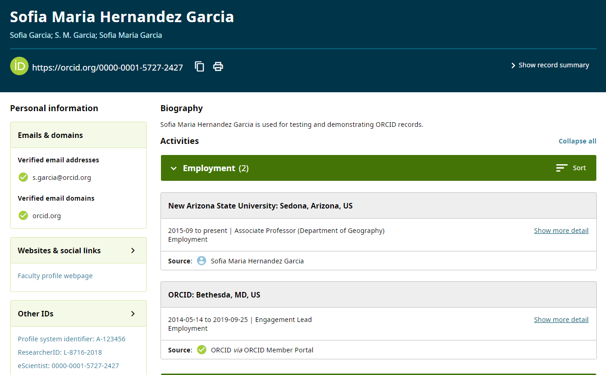
ORCID iD & Record (Public view)
Accessed October 2024: orcid.org/0000-0001-5727-2427

Slide 16
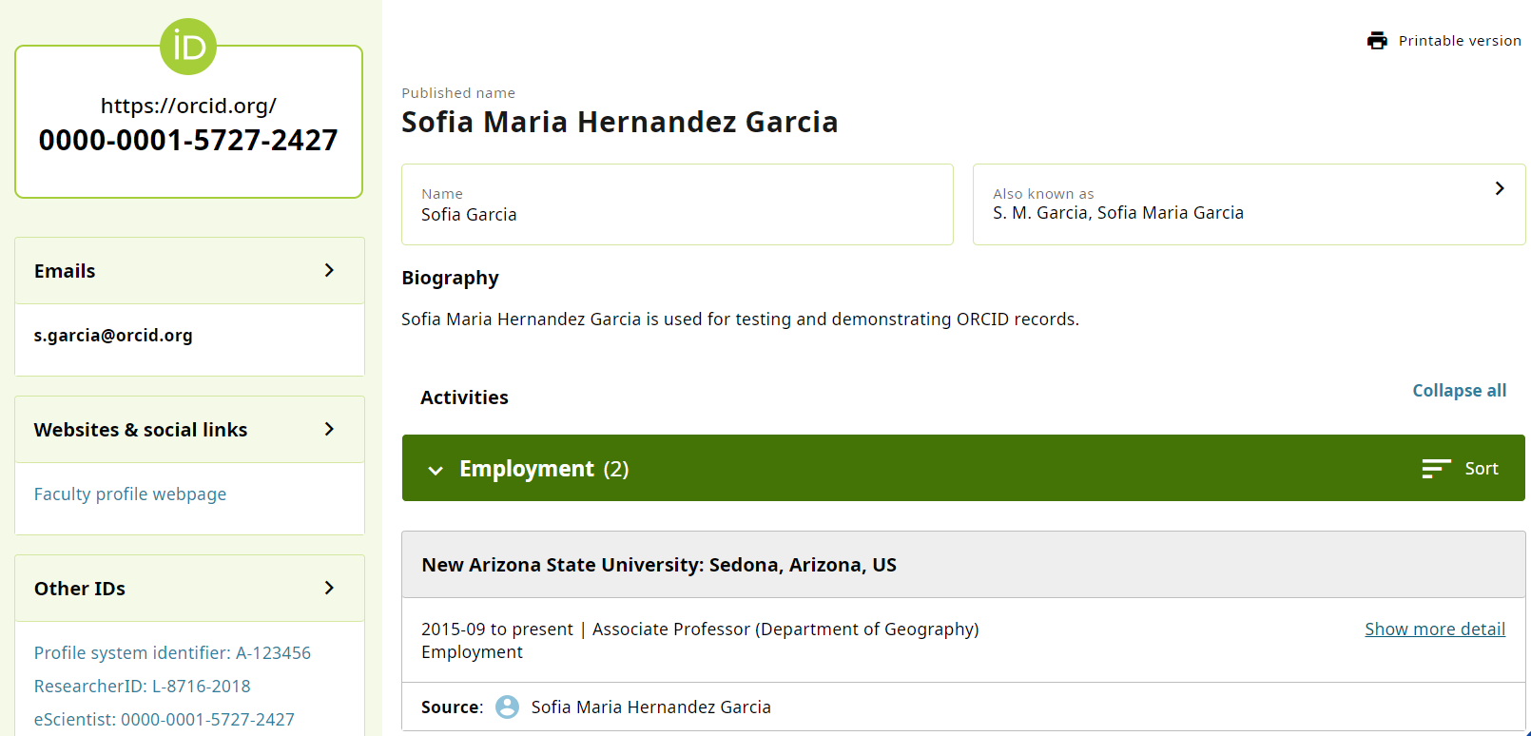
ORCID iD & Record (Edit view)
Accessed October 2024: orcid.org/0000-0001-5727-2427

Slide 17
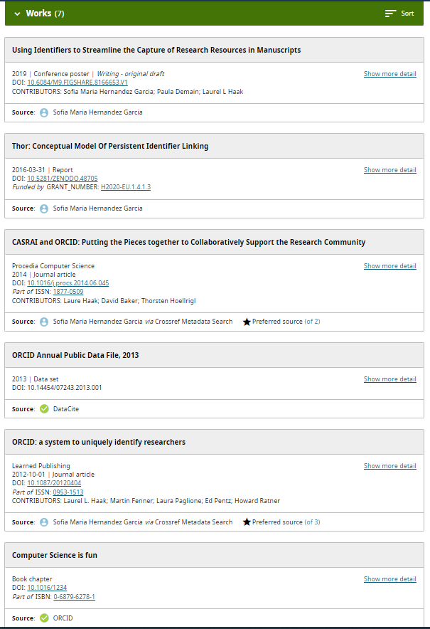
ORCID Record – Works

Slide 18
Populating your record
Edit the Names box to add your preferred Published name, as well as some Also known as names to help people find your record.
Add your affiliations:
Add current employment to make it easier for people to identify your record from the ORCID search results page. Adding past employment could be helpful as well.
Try adding a few of your works
Enter any type of scholarly product you have authored (posters, conference talks, articles, research tools, etc.)
Utilize the uploading tools to populate for you, like Add DOI or Add PubMed ID
In the future, submitting works with your ORCID to the publisher will autopopulate your page when the work is published.

Slide 19
Visibility Settings
In your account settings, there is a section called Visibility.
We recommend selecting Everyone. ORCID is most helpful to you and other users when it is populated for everyone to read.
You can change the visibility of each individual item on your record. For example. You can make one of your emails public, while making your back-up email viewable to “only me”.

Slide 20
Linking to your ORCID record
Place a hyperlink to your record in a few of the following places:
CV header
Email signature
Social media bio
Personal/institutional webpage
Any current works in progress (scholarly papers, posters, presentations)

Slide 21
ORCID Integrations
While ORCID provides a persistent digital identifier for researchers, its full potential comes from its ability to integrate with other scholarly systems.
By connecting ORCID with other systems, you can:
Save time by reducing manual data entry
Ensure accurate attribution of your work
Increase the visibility of your research outputs
Maintain up-to-date records across multiple platforms
Track your research impact more effectively
We will connect to Crossref, DataCite, and UBs Research Connect, as well as add BibTex files from Google Scholar.
Notes:
Crossref
https://www.crossref.org/
Crossref is a nonprofit open digital infrastructure organisation for the global scholarly research community, uniquely and persistently recording and connecting knowledge through open metadata and identifiers for all research objects, such as articles, books, datasets, and grants.
It is the largest digital object identifier (DOI) Registration Agency with around 20,000 members from more than155 countries representing publishers, libraries, research institutions, and funders.
Crossref has identified and connected 150 million records containing metadata about research and made this metadata openly available for reuse - without restriction.
They facilitate an average of 1.1 billion DOI resolutions (clicks of a DOI link) every month, and they see more than 1.2 billion queries of the metadata every month.
Crossref co-founded and developed the prototype for ORCID and collaborates and integrates with like-minded partners, such as those who have also committed to the Principles of Open Scholarly Infrastructure.
https://orcid.org/members/001G000001C8dNEIAZ
DataCite
https://datacite.org/
DataCite makes research more effective by connecting research outputs and resources–from data and preprints to images and samples.
It supports the creation and management of DOIs and metadata records, enhance research workflows with service integration, and enable the discovery and reuse of research outputs and resources.

Slide 22
Crossref
Provide your ORCID when submitting a paper to a journal. Most publishing platforms allow to enter your ORCID iD in the submission system.
Once the paper gets published, the publisher will register it with Crossref and include your ORCID iD in the metadata
You’ll receive a notification in your ORCID inbox with the subject “Crossref has made changes to your ORCID record” after you publish something.
Authorize Crossref Auto-updates. Once you receive the notification, grant Crossref permission to update your record.

Slide 23
Connecting ORCID to DataCite
Log in to your ORCID account
Navigate to your ORCID record
Find the “Works” section
Click on “Add”
Select “Search & Link”
Look for and select the DataCite option
Grant permissions to DataCite when prompted

Slide 24
Adding Grants with ORCID’s WIZARD
ORCID’s Search and Link wizard can be used to select existing grants and add them to your ORCID record. Here are the steps:
Log in to your ORCID account
Go to the Funding section
Click “Add funding”
Select “Search & Link”
Choose “Dimensions Wizard”
Search by your name to find associated grants, or by Grant Title. An asterisk works as a wildcard character here (e.g., “music therap*” finds “music therapy” and “music therapists”).
Choose grants from search results and click “Next” and then “Submit to ORCID” button.

Slide 25
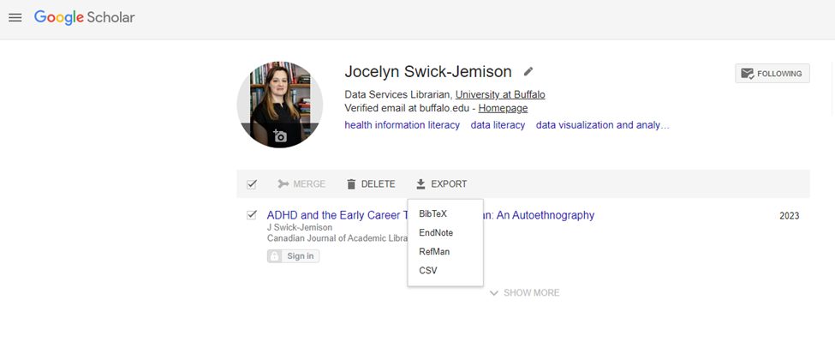
Export BibTeX from Google Scholar
Notes:
Navigate to scholar.google.com and login.
Once logged in, click on My Profile along the top left.
Select the articles you'd like to export - or check the box next to the Title column header to select all articles in your profile - and click the Export button. Follow the prompts to download a BibTeX file.

Slide 26
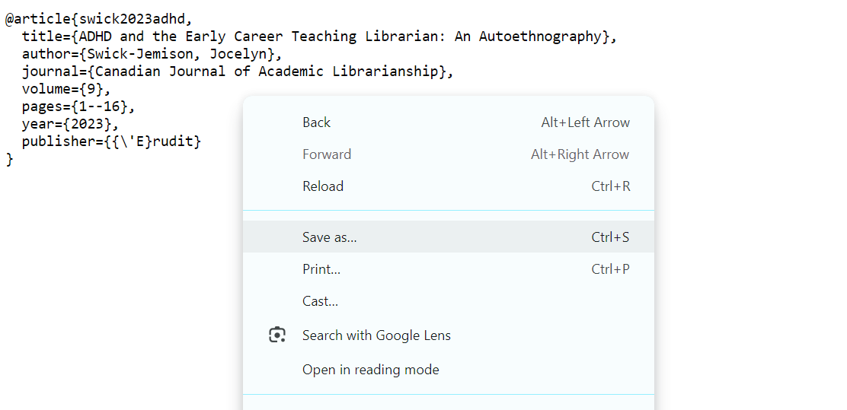
Save BibTeX from Google Scholar
Right-click on your browser screen.
Notes:
This will save your citation as a .txt file

Slide 27
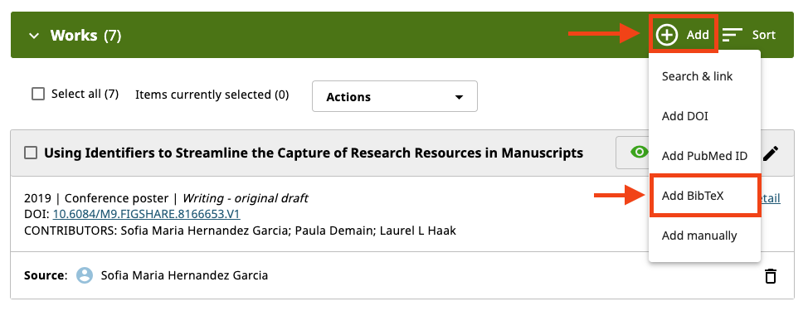
Upload BibTeX to ORCID: Part 1

Slide 28

Upload BibTeX to ORCID: Part 2

Slide 29
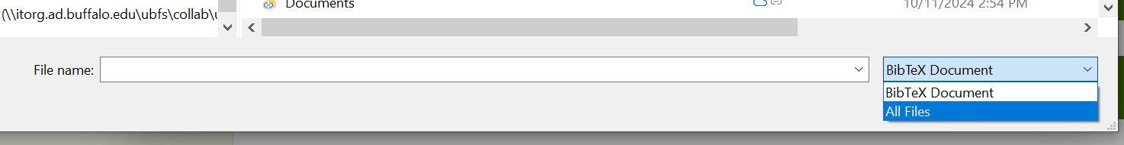
PC users… Not seeing your BibTeX file? Change to All files!

Slide 30
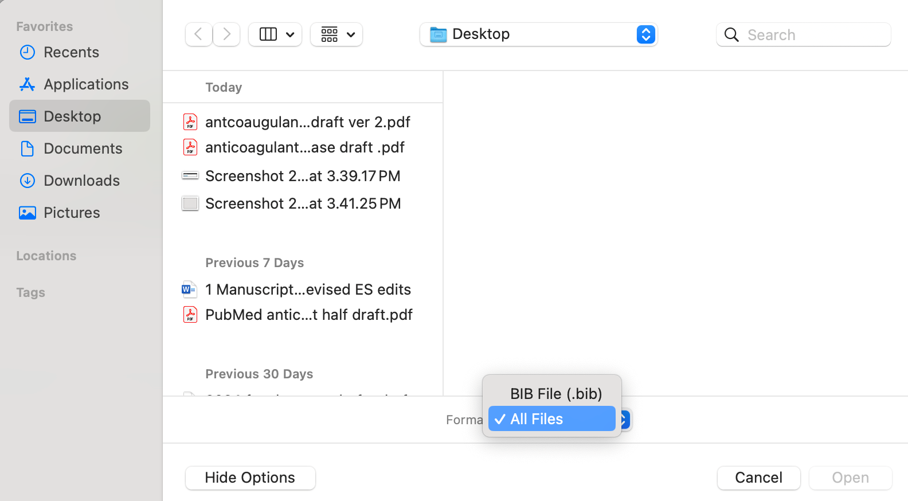
Mac users…
After selecting “Choose BibTeX,” click “show options” in the lower left corner to get the option to switch to All Files

Slide 31
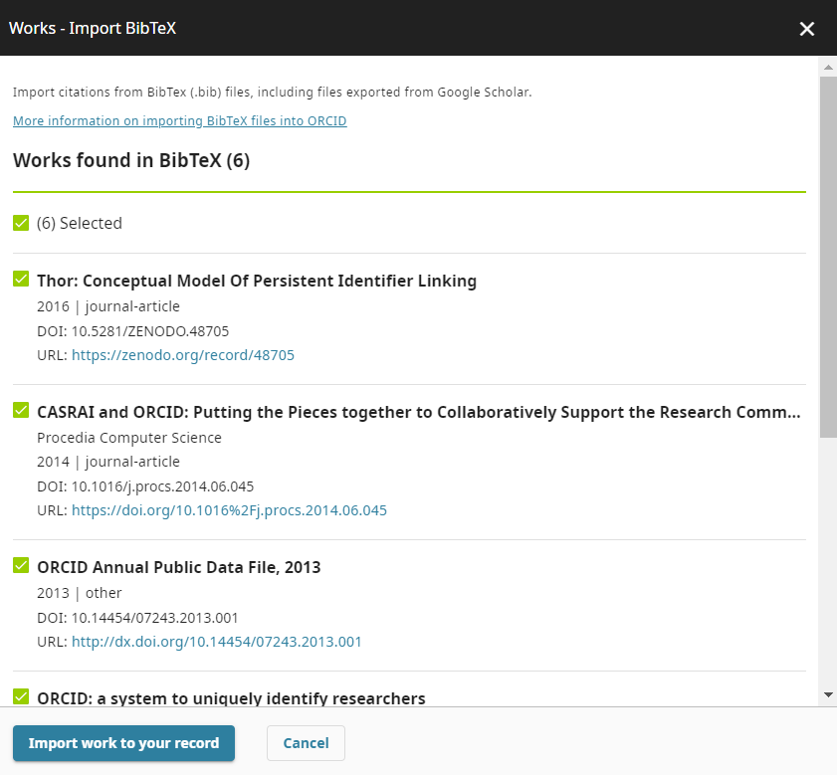
Upload BibTeX to ORCID

Slide 32
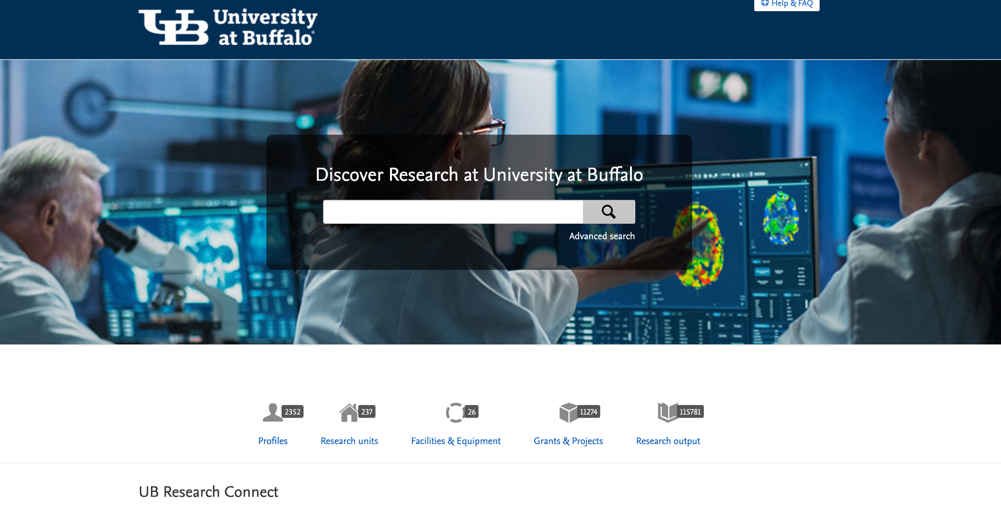
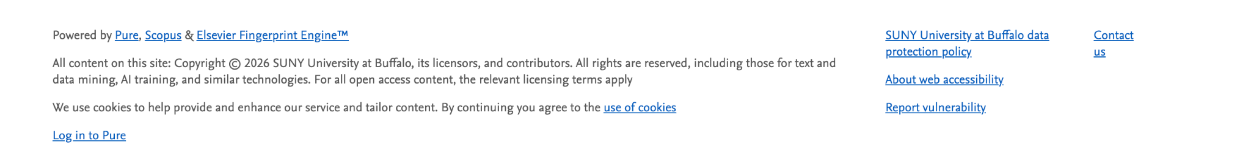
Connecting ORCID to UB Research Connect (Pure)
https://researchconnect.buffalo.edu/en/
Log in at bottom of the page
Notes:
https://researchconnect.buffalo.edu/en/
https://researchconnect.suny.edu/

Slide 33
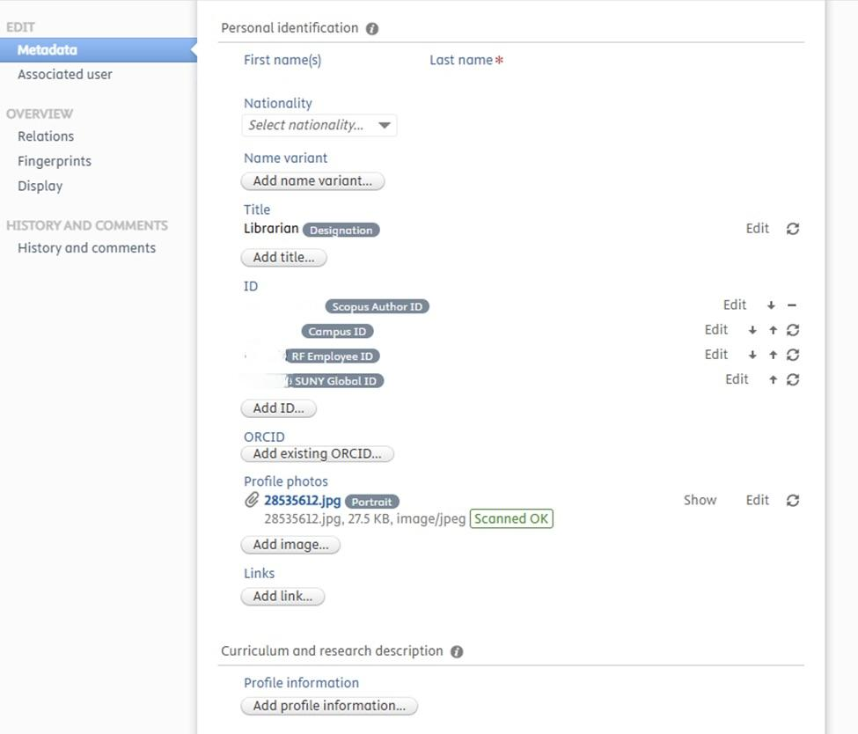
Connecting ORCID to UB Research Connect

Slide 34
ORCID Integrations: Part 1
Because it can both integrate and be integrated into other systems, an ORCID can serve as a key to access a scholarly presence controlled by the scholar.
Many other systems which track publications have integrated ORCIDs.
An ORCID that is connected to other systems makes author identification interoperable.
A link to an ORCID record in a publication, repository, or Research Information Management System (RIMS) can validate that the correct person has been associated with a work they actually authored.
By connecting to some of the major publication tracking systems, scholars can minimize the time they spend entering the same information about their published works over and over in different systems.

Slide 35
ORCID Integrations: Part 2
By connecting to some of the major publication tracking systems, scholars can minimize the time they spend entering the same information about their published works over and over in different systems.
ORCID makes this data reusable.
It can be verified by other tracking systems, and centralize a persistent record of a scholar’s work.
Because an ORCID is institution-agnostic, it will follow the scholar when they change institutional affiliation.
ORCID records help make scholarship FAIR:
(Findable, Accessible, Interoperable, and Reusable)

Slide 36
ORCID Key Points
ORCID is an open, non-proprietary system for author disambiguation that allows you to claim and manage your scholarly online presence.
Connecting ORCID to external systems maximizes its benefit to scholarly online presence and automates the process of keeping your research profile up-to-date and comprehensive.
Regular maintenance of these connections is crucial to ensure the continued accuracy and completeness of your ORCID profile.
The value of an ORCID goes up over the course of a scholar’s career.
ORCID records help make scholarship FAIR (Findable, Accessible, Interoperable, and Reusable).

Slide 37
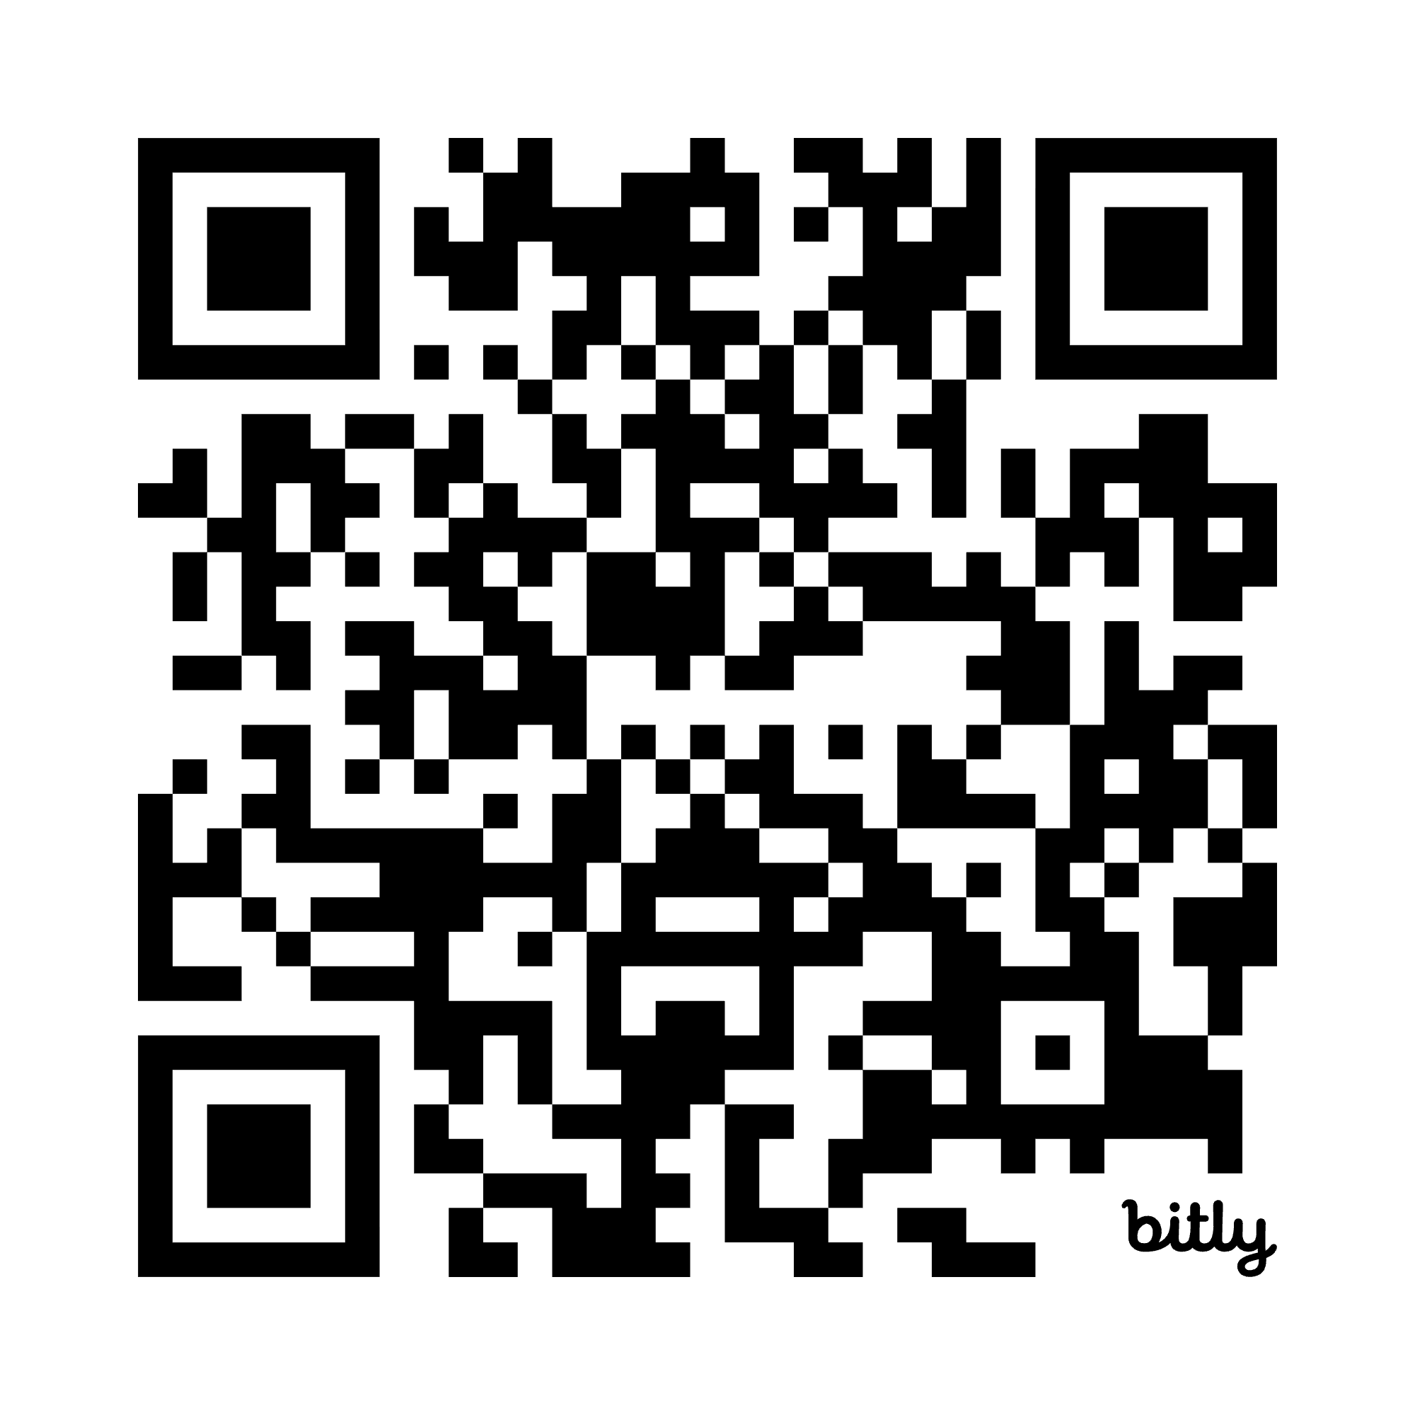
UB Research Data Services Program: Services
Email: dataservices@buffalo.edu
Services
Data Discovery & Access
Data Management Plans (DMSP)
Data Curation, Organization & Storage
Data Sharing, Archiving & Preservation
Data Education & Best Practices
Workshops & Trainings
Consultations
bit.ly/UBDATASERVICES

Slide 38
UB Research Data Services Program: Workshops
Email: dataservices@buffalo.edu
Upcoming Spring Workshops
Research Data Management Essentials
Tidy Data Principles
Intro to the Unix Shell part 1
Intro to the Unix Shell part 2
Intro to OpenRefine
Intro to R: R & RStudio
Intro to R: Dataframes
Intro to R: Visualization
Office Hours following each workshop
bit.ly/UBDATASERVICES

Slide 39
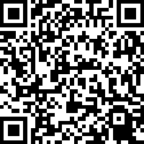
UB Love Data Week Feedback Survey
bit.ly/UBLDW26
Notes:
Survey Link:
https://sunybuffalo.qualtrics.com/jfe/form/SV_beCZ9hrdjc5HomG?Q_CHL=qr

