Slide 1
Managing Qualitative Responses with Smart AI Prompting
Applying the COSTAR method
Mary Odden, M.S.
Office of Accreditation and Quality Improvement
JSMBS
Notes:
Introduction
Why I wanted to present on this

Slide 2
What we will be covering
What is the COSTAR Method of Writing AI prompts
Applying COSTAR to Open-Ended Course Evaluation Questions
How to best apply this information
Notes:
This is not a deep dive on what Generative AI is or how it works, nor is it a hard take on its pros and cons in society. I do have strong opinions on that, actually, one might describe me as quite a Luddite in the historical sense in that I am quite mistrustful of the corporations who create and manage these programs, and I think we should be extremely vigilant about when or if we decide to use Generative AI in our operations so that we can protect our right to fair wages, a safe and healthy environment, and intellectual property….but I digress. Today is really just about “hey, I have a large set of de-identified data that I need to do some thematic analysis on, how can I best do that quickly and reliably in a way that helps me help my students and faculty?”

Slide 3
Writing AI prompts
Not like a Search engine search
Keywords
Provide a Directive, but can be more conversational
COSTAR
Context
Objective
Style
Tone
Audience
Response Format
Notes:
So first, I just want to level set by reminding everyone that when you are writing AI prompts, regardless of the tool you are using—whether its CoPilot, or Claude, or ChatGPT, or whatever—that this is not like a search engine. Search engines are designed to respond to keywords, and can be optimized by adding all sorts of modifiers like Plus and minus signs, and all sorts of tricks. Of course now with GenAI even this is getting blurry, but the point is A standard search in a search engine was originally only bogged down if you were putting full sentences or concepts into the search bar. It was mostly a string of nouns and verbs
Obviously with writing a good prompt, it is designed for you to actually converse with it. But don’t get confused, it is still very much a machine, and a machine will still be optimized by a directive—phrasing that is “do this in this way to this degree by this time.”
Maybe this is why I appreciate a good prompt because my background is in Learning Outcomes, and if anyone listening has experience with writing a good learning outcome, or objective, or SMART goal, you know that all of these things require really really clear statements that include things like Audience, Conditions, Behaviors, Degrees, Timebound, etc.
Specifically today, I want to share with you an mnemonic that I have learned in my own professional development around AI that I have found especially helpful, and that’s CO-STAR

Slide 4
Qualitative data is messy and vast
Example: Questions from Course Evaluation form(s):
“What are the strengths of this course?”
“Comments about the learning environment”
“How can we improve this course?”
“Please Identify one or two specific suggestions for improvement”
“Please share specific suggestions or opportunities for us to incorporate diverse perspectives in the course.”
1 Course, 3 Semesters, 24 contributing faculty, 525 Responses
Notes:
This is the situation I find myself using this COSTAR method in. I not only work thousands of quantitative data responses but qualitative responses as well, and we know that qualitative data is GOOD data, its just hard to manually parse. Its time consuming. It is always worth it though; it provides such good texture and context to the quantitatve responses, it often gives faculty and chairs and directors insight into the “why” the student responses are the way they are. But Our office has 4 people in it, and I am technically the only designated data person, so, something like GenAI can really ease that burden. But it is truly essential that I use it properly to get something actionable out of it.
So, these are the kinds of questions we ask—and forget for a moment that we are asking these questions 5 different ways—actually, don’t forget, because that’s really realistic I think that while I would love for there to be a standard way to ask these questions, isn’t that the way? But actually this is nice because with something as flexible as AI, it can adjust to see how two questions that are thematically similar can be paired together so their corresponding responses can be paired together as well.
I want to use a course evaluation that I analyzed with CoPilot just as an example of how I did this, so you can see how you might be able to apply this to the qualitative data analysis that you do.

Slide 5
The AI is a partner, not an authority.
You are the author of the report, so you need to have a clear purpose in mind.
Who is going to be receiving your report? What do they care about? (The why)
What should this sound like?
Is the data clean and standardized? How can you double check it?
What are you going to be doing with this data? (Closing the loop)
These questions help inform COSTAR
Notes:
So first, remember that AI is your partner, not the actual authority. This is Jarvis before he became Vison. He wants to suck up to you, so he will only tell you what you want to hear. So it is really really important that you understand what you want. So if you aren’t sure what you want, ask yourself some questions. Prompt yourself if you have to. Be prepared to ask the AI follow up questions, that’s totally fine, you aren’t doing it wrong if you do that.

Slide 6
Surface level prompting
“Review this course evaluation data. What are the strengths of this course?”
LDW_Basic Prompt
What Works:
Gives examples that are searchable
Gave a frequency
What doesn’t work:
So what?
Now what?
Actually, Committee wanted a SWOT analysis, not just why things are fine as-is. Where could improvements lie?
Notes:
LDW_Basic Prompt

Slide 7
Iterative Prompting
“Do a swot analysis of the “SPECIFIC” course. provide an example of your categorization by referencing the response id that you pulled it from. This swot analysis is for our Curriculum committee so we can decide how to improve the “SPECIFIC” course”
LDW_Mid Prompt
What Works:
Gives examples that are searchable
Gave a frequency
Executive Summary of working AND Not working
What doesn’t work:
Pushback from skeptical faculty (“this is anecdotal/not enough responses/So what”)
Clarity on next steps – action steps are here, but can we make it more digestible, prioritized, measurable?
Notes:
LDW_Basic Prompt

Slide 8
COSTAR
Report for the curriculum committee on the strengths and weaknesses of the “SPECIFIC” course that was revamped in the last year.
Identify what students are concerned about in the course, and what is working—particularly around supporting students in achieving AAMC Foundational Competencies https://image.email.aamc.org/lib/fe8e13727c63047f73/m/1/3d55a3aa-b3ba-4c14-a447-8c60e27a6f05.pdf)
Style should be clean and neat, Tone should be professional, yet accessible.
Audience is the Curriculum committee – Faculty and administrators.
The format is a SWOT analysis. Each category in the SWOT analysis has an example that I can verify by Respondent_ID.
Context
Objective
Style
Tone
Audience
Response Format

Slide 9
COSTAR Prompting
I want to prepare a report for Curriculum Committee on the strengths and weaknesses of the COURSE course that was revamped this past year. attached are qualitative feedback from the last 3 semesters. I need to identify areas of concern where we can adjust either the curriculum or our teaching and adjust, and maintain the areas that are working well. I'd like this report to be professional, but accessible, and in the form of a SWOT analysis, ensuring that each category in the SWOT has an example that I can verify by Respondent_ID. Please frame your analysis around Foundational Competencies for Undergraduate Medical Education (https://image.email.aamc.org/lib/fe8e13727c63047f73/m/1/3d55a3aa-b3ba-4c14-a447-8c60e27a6f05.pdf)”
LDW_COSTAR Prompt
Notes:
LDW_COSTAR Prompt

Slide 10
COSTAR Prompt: What works?
Executive Summary
Frequency Stats
SWOT by meaningful competencies (the WHY)
Prioritized Action Steps
Suggested Metrics for Committee Members
Output is more human-friendly

Slide 11
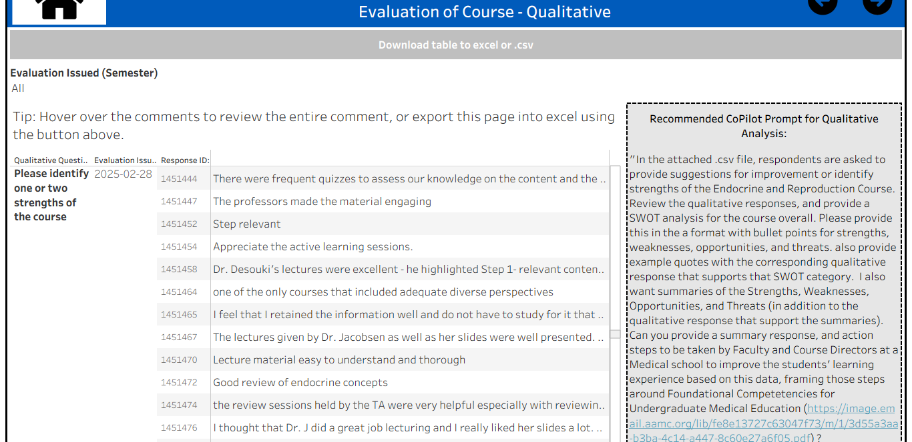
Next step: SCALE IT!
Collaborate with AI to design a repeatable prompt that you can re-use as part of a Standard Operating Procedure

Slide 12
Wrap-up Review:
AI is a Partner, not an authority
The more specific you can be, the better it can be
You must know the who, what, how, and why so that it can execute effectively.
Question AI – challenge it, feed it more, ask it how it came it its conclusions.
Consensus/Decisions on outcomes and objectives are CRITICAL for AI to be worthwhile.

Slide 13
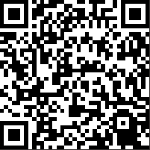
Thanks!
Mary Odden
Data Analyst/Manager
Office of Accreditation and Quality Improvement
Jacobs School of Medicine and Biomedical Science
maryfish@buffalo.edu

