Slide 1



Your Community in Data
Your Community in Data
Exploring Census Tools and Social Explorer

Slide 2

Carolyn Klotzbach-Russell
Social Sciences, Business & Government Information Librarian
422 Lockwood Library
cmklotzb@buffalo.edu

Slide 3

Agenda
  Brief introduction to the U.S. Census Bureau surveys & available geographies
  Overview of data.census.gov
    Additional Census tools
  Social Explorer tutorial
  Q&A
Note: Due to time restrictions, this introduction session will focus on data from the Decennial Census and American Community Survey.
Notes:
Follow along!
Starting in the slides and switching back and forth a bit between slides and demo.
Slides are also there for reference as I will be demo-ing live. Some slides will duplicate what I demo and are for your reference.

Slide 4
Introduction to U.S. Census Data

Slide 5
Measuring America's People, Places, and Economy
The U.S. Census Bureau’s mission is to serve as the nation’s leading provider of quality data about its people and economy.
Quick Facts
  The Census Bureau has conducted a decennial census - the full count of the U.S. population - since 1790.
  The U.S. Population in 1790 was approximately 3.9 million. New York City was the most populous urban place with a population of 33,131.
    In contrast, the U.S. population in 2020 was approximately 331.5 million. New York City remains the most populous urban place with a population of 8.8 million
  Decennial census enumeration records are confidential for 72 years to protect respondents' privacy.

Slide 6


Censuses & Surveys Examples
Population & Housing
  Decennial Census
  American Community Survey (ACS)
Economy
  Economic Census
  Small Business Survey
Use the Census Survey Explorer to learn more about each survey

Slide 7

Data Applications
Government Use
  Apportionment
  Redistricting
  Federal funding distribution
  Planning
  Emergency response
  Base for federal surveys
Additional Uses
  Research and academia
  Grant applications
  Planning & development
  Genealogy
  Business planning, market research, and entrepreneurship

Slide 8
Current Data Availability
2020
  2020 Decennial Census results
2023
  ACS 2023 5-Year Estimates
2024
  ACS 2024 1-Year Estimates (covers all places with more than 65,000 people)
    These estimates are not produced for smaller areas and are not presented by tract or blocks
  ACS 2024 5-Year Estimates release currently in progress.

Slide 9

A Quick Guide to Census Geography
Notes:
Why is this so important? You want to make sure if you're comparing year over year, you are referring to the same geographic area.

Slide 10
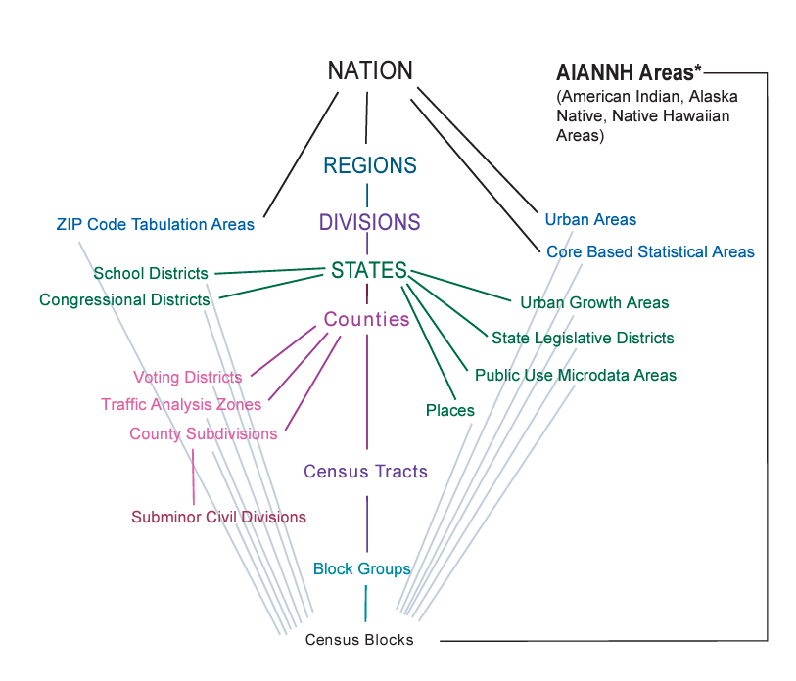
Census Geography
Some data are not available at smaller geographies like tracts and blocks
Source: census.gov/geo/pdfs/reference/GARM/

Slide 11
Zip Code Tabulation Areas
ZIP Code Tabulation Areas or ZCTAs (pronounced zik-tahs) are a geographic product of the U.S. Census Bureau created to allow mapping, display, and geographic analyses of the United States Postal Service (USPS) Zone Improvement Plan (ZIP) Codes dataset.
ZCTAs are generalized areal representations of the geographic extent and distribution of the point-based ZIP Codes built using 2020 Census tabulation blocks.
Source: census.gov/programs-surveys/geography/guidance/geo-areas/zctas.html

Slide 12
Census Tracts
Census tracts are small, relatively permanent statistical subdivisions of a county.
Uniquely numbered in each county with a numeric code.
Came into use in reporting by the Census in 1940.
Census tracts average about 4,000 inhabitants
Minimum Population – 1,200
Maximum Population – 8,000

Slide 13
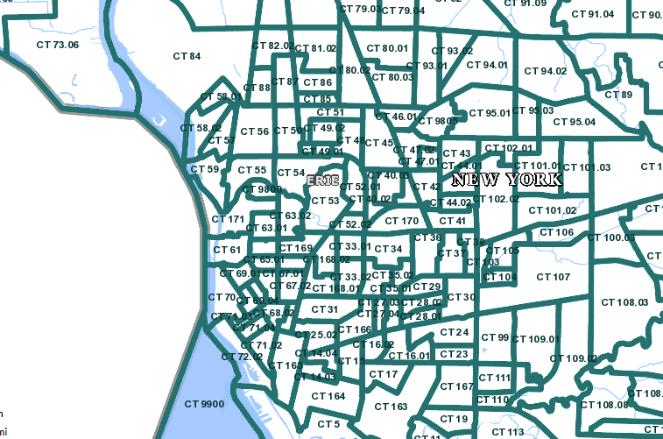
Census Tract Map of Buffalo

Slide 14
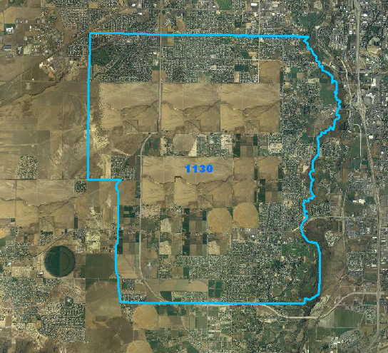
Updating Census Tracts
1970
  Census tracts are designed to be relatively permanent over time.
    Any changes are documented so data can be compared from decade to decade.
  Census tracts with more than 8,000 people are split into 2 or more tracts and are given an extension to their existing numeric code
  Census tracts with less than 1,200 people are merged with a neighboring tract and are given a new numeric code

Slide 15
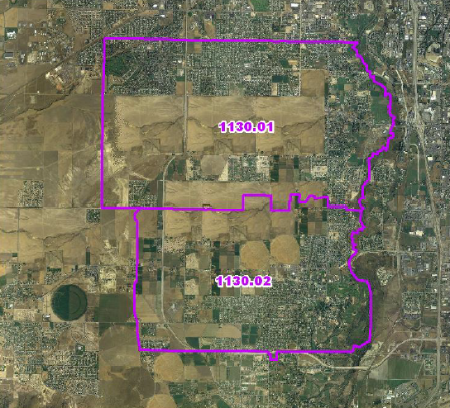
Updating Census Tracts - 1980
1980
  Census tracts are designed to be relatively permanent over time.
    Any changes are documented so data can be compared from decade to decade.
  Census tracts with more than 8,000 people are split into 2 or more tracts and are given an extension to their existing numeric code
  Census tracts with less than 1,200 people are merged with a neighboring tract and are given a new numeric code

Slide 16
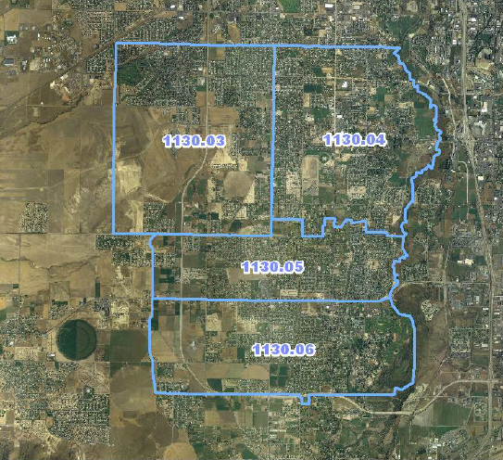
Updating Census Tracts - 1990
1990
  Census tracts are designed to be relatively permanent over time.
    Any changes are documented so data can be compared from decade to decade.
  Census tracts with more than 8,000 people are split into 2 or more tracts and are given an extension to their existing numeric code
  Census tracts with less than 1,200 people are merged with a neighboring tract and are given a new numeric code

Slide 17
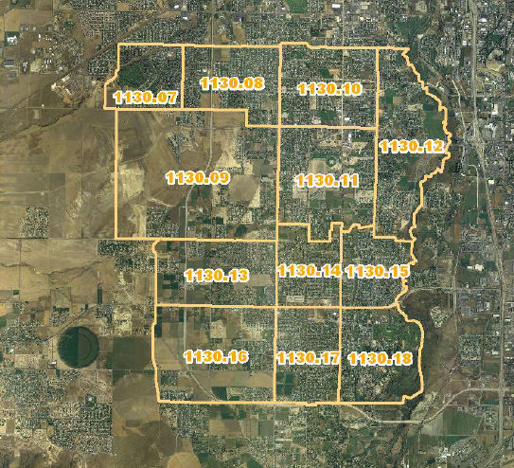
Updating Census Tracts - 2000
2000
  Census tracts are designed to be relatively permanent over time.
    Any changes are documented so data can be compared from decade to decade.
  Census tracts with more than 8,000 people are split into 2 or more tracts and are given an extension to their existing numeric code
  Census tracts with less than 1,200 people are merged with a neighboring tract and are given a new numeric code

Slide 18
Census Places
The Bureau of the Census defines a place as a concentration of population; a place may or may not have legally prescribed limits, powers, or functions.
This concentration of population must have a name, be locally recognized, and not be part of any other place.
A place either is legally incorporated under the laws of its respective State, or a statistical equivalent that the Census Bureau treats as a census designated place (CDP).

Slide 19
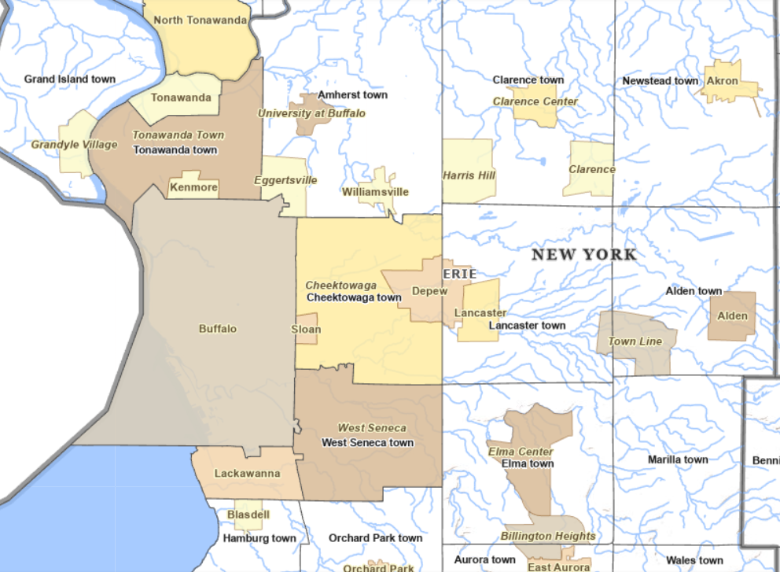
Census Places in Buffalo
Map showing incorporated places and Census designated places
Source: https://tigerweb.geo.census.gov/tigerweb/

Slide 20
Data.Census.gov
Best basic data sources from the Census data website

Slide 21
Before you Search
Ask yourself:
  What type of data do you need? (e.g. demographic, economic, etc.)
  What geographic level do you need?
  Are you looking for current year only or a historic look back?
  What format do you need this data?
  What is your end product? (e.g. interactive map, infographic, statistics in a research paper, chart, etc.

Slide 22
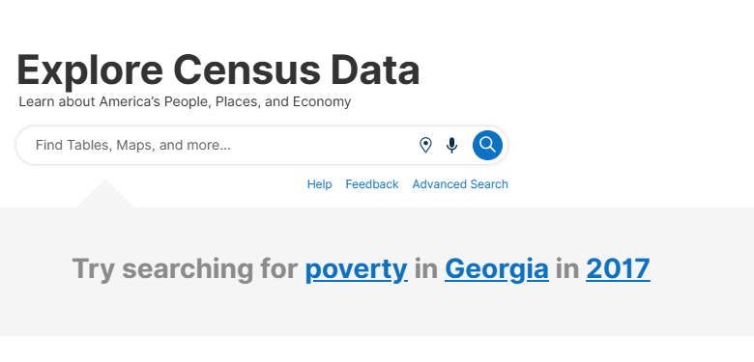
Ways to Search data.census.gov
  Geographic profiles
  Simple search
  Advanced search

Slide 23
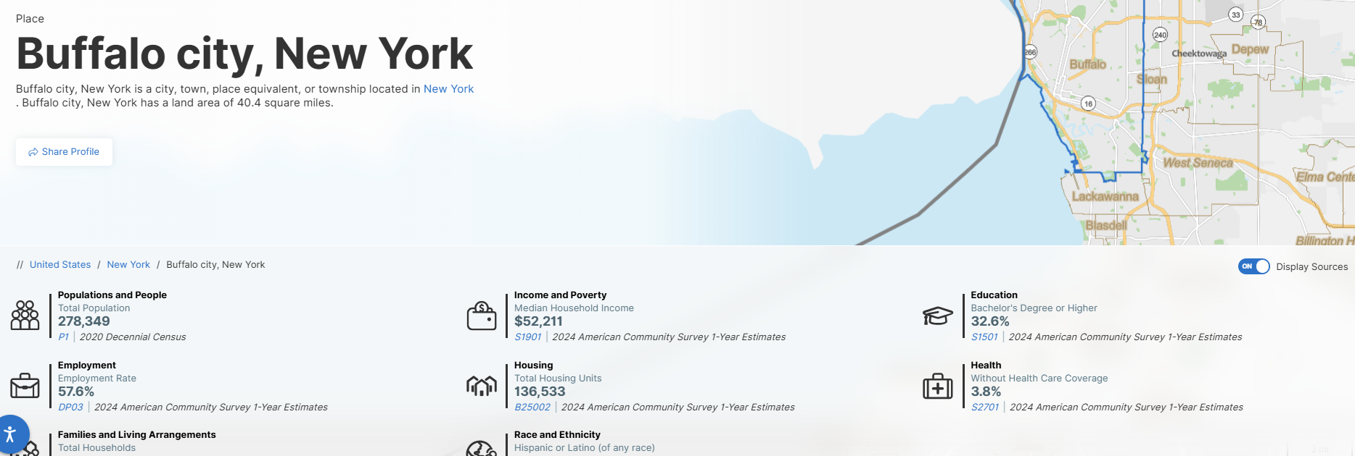
Data Profiles
Covers topics like education, employment, health, and housing, just to name a few.
Use to find the latest statistics and specific data tables.
Find data profiles for places, congressional districts, census tracts, and more.
Great way to become familiar with a specific geographic location.
Use prebuilt charts and graphs in your own work.

Slide 24
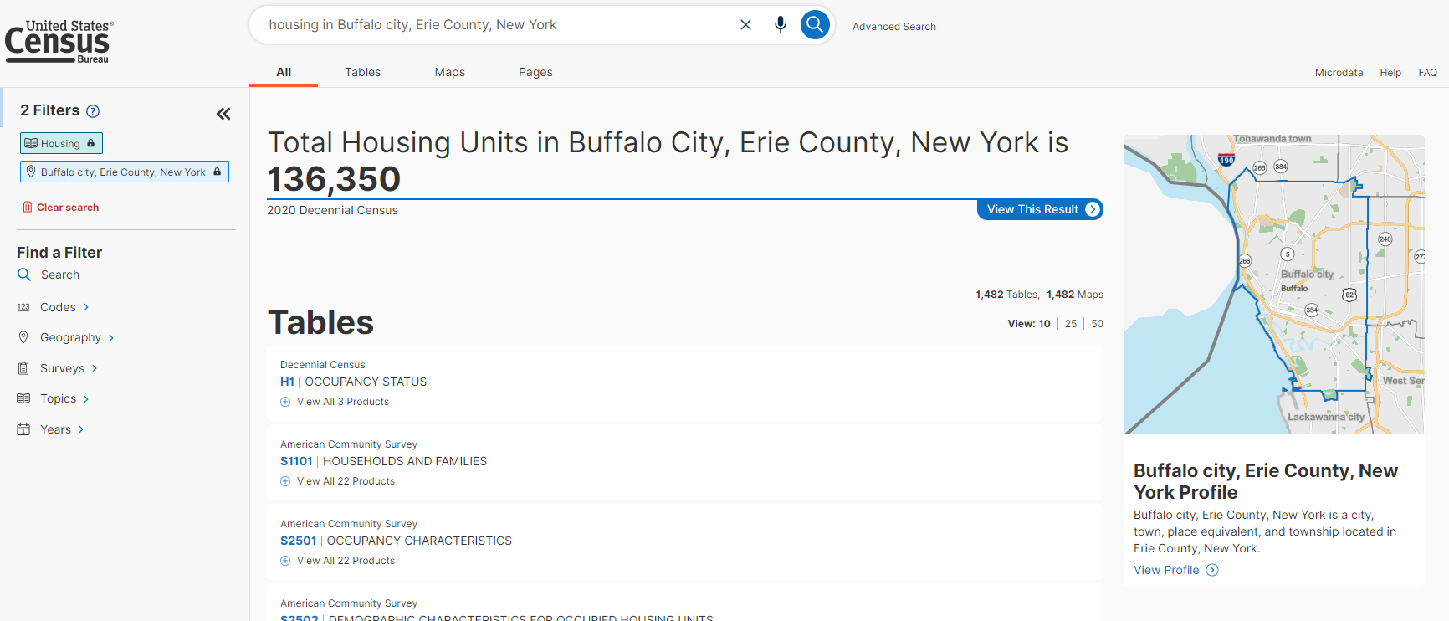
Simple search in data.census.gov
Use the format: [topic] + [location]
Browse Tables, Maps, and Page results

Slide 25
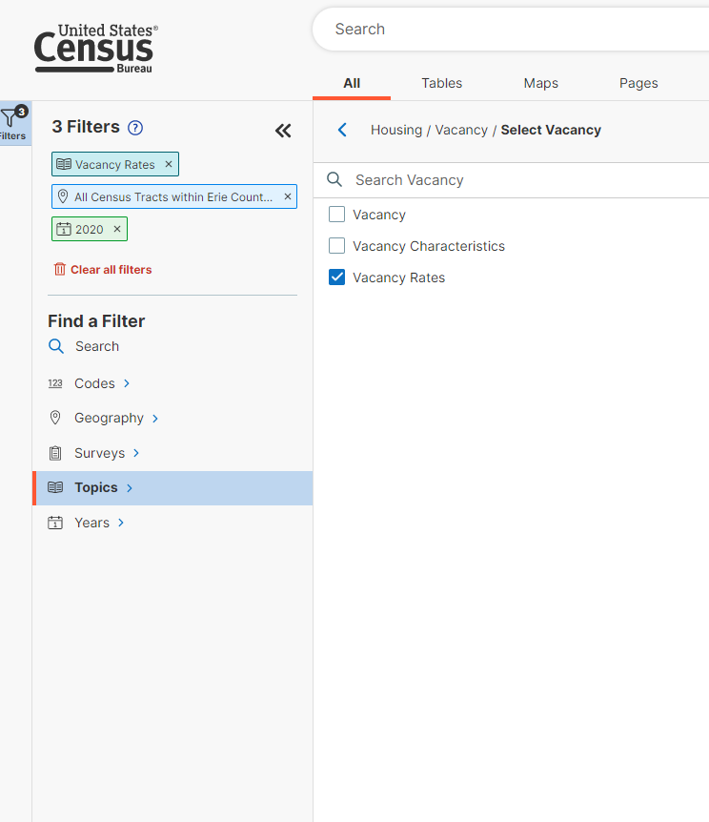
Advanced search in data.census.gov
Use filters to limit results!
1.Browse or search for your topic
2. Set your geography
(do you need data by county, place, zip code, tract, etc?)
3. Add a topic and/or year

Slide 26
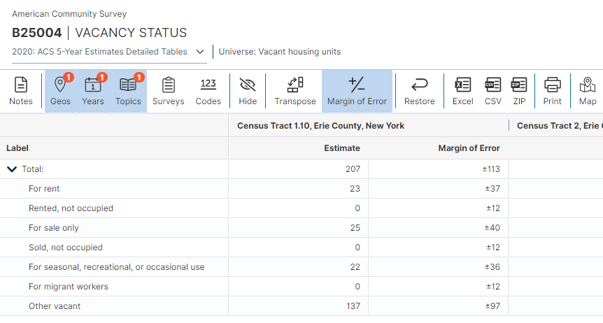
Working with Tables
  Select Tables in the menu to view list of available tables
  Select the table to work with
  Edit Geos, Years, Topics if desired/available
Customization
  Hide: select columns to hide
  Transpose: switch rows and columns
  Margin of Error: hide or include margin of error columns
  Excel/CSV/Zip: export format options
  Map: switch to map view

Slide 27
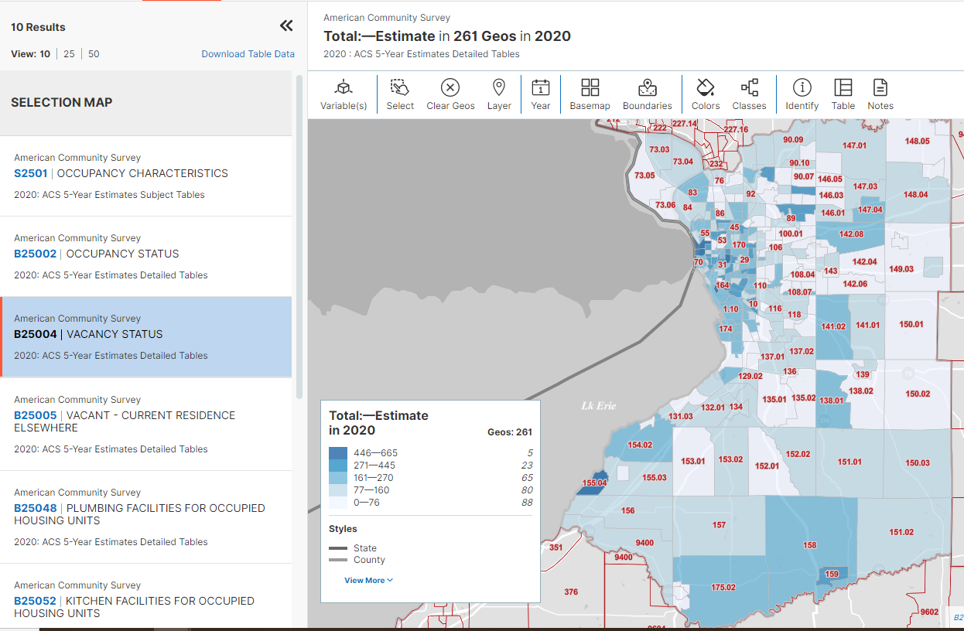
Working with Maps
  Select Maps in the menu to view list of available maps
  Select the table to work with
  Choose the Variable(s) you want to map
Customization
  Select: manually select additional geographies
  Basemap: basic, detailed, none
  Boundaries: add additional boundary lines
  Colors: change color and transparency
  Table: view underlaying map data in table format

Slide 28
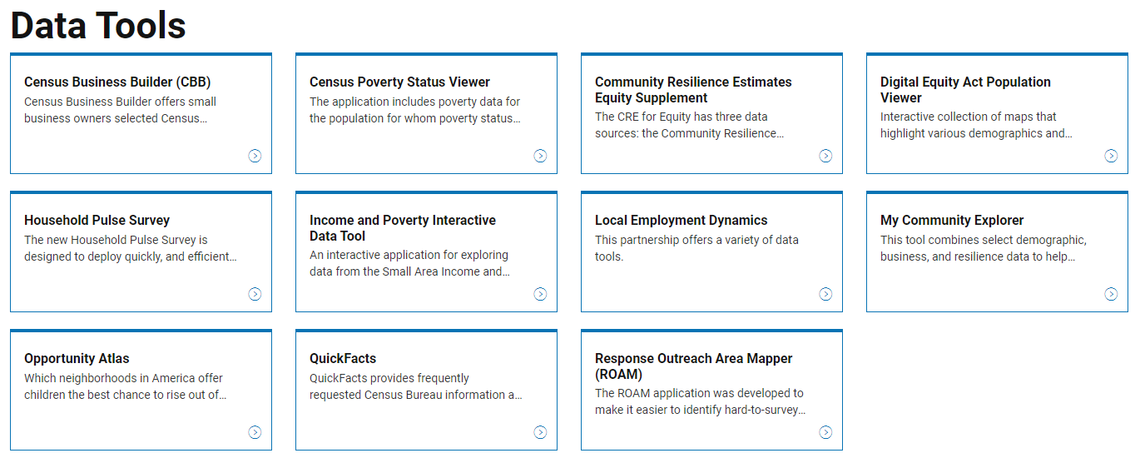
Did you know?
The Census website hosts several other data tools and apps that use interactive applications to get statistics from multiple surveys.
Highlights:
  Visualizations
  QuickFacts
  My Community Explorer
  Census Business Builder

Slide 29
Indigenous Peoples
American Indian Tribal geographies are available through data.census.gov. Additional resources are listed below.
My Tribal Area: My Tribal Area gives you quick and easy access to selected statistics from the American Community Survey (ACS). The ACS provides detailed demographic, social, economic, and housing statistics every year for the nation's communities.
Intergovernmental Affairs: Tribal Affairs — American Indian and Alaska Native (AIAN): This website highlights the Census Bureau's relationship with tribal governments and provides important AIAN and tribal resources.

Slide 30
Social Explorer
Social Explorer Tutorials

Slide 31
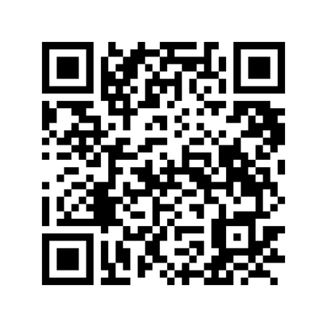
Getting Started
Social Explorer allows users to access 230+ years of data for the United States from present to 1790, including all Decennial Censuses, American Community Surveys, and many other datasets.
Social Explorer pulls data from the data.census.gov website into a convenient mapping tool, making it easy to create maps, filter data, add layers, and tell a story.
Off campus? Ensure that you access via the Social Explorer library website.

Slide 32
Create an Account
Use the Create Account button in the top right. This will allow you save maps and tables to your own private account.
Features
  Geo-zooming
  Compare using side by side or swipe maps
  Layer library
  Full export

Slide 33
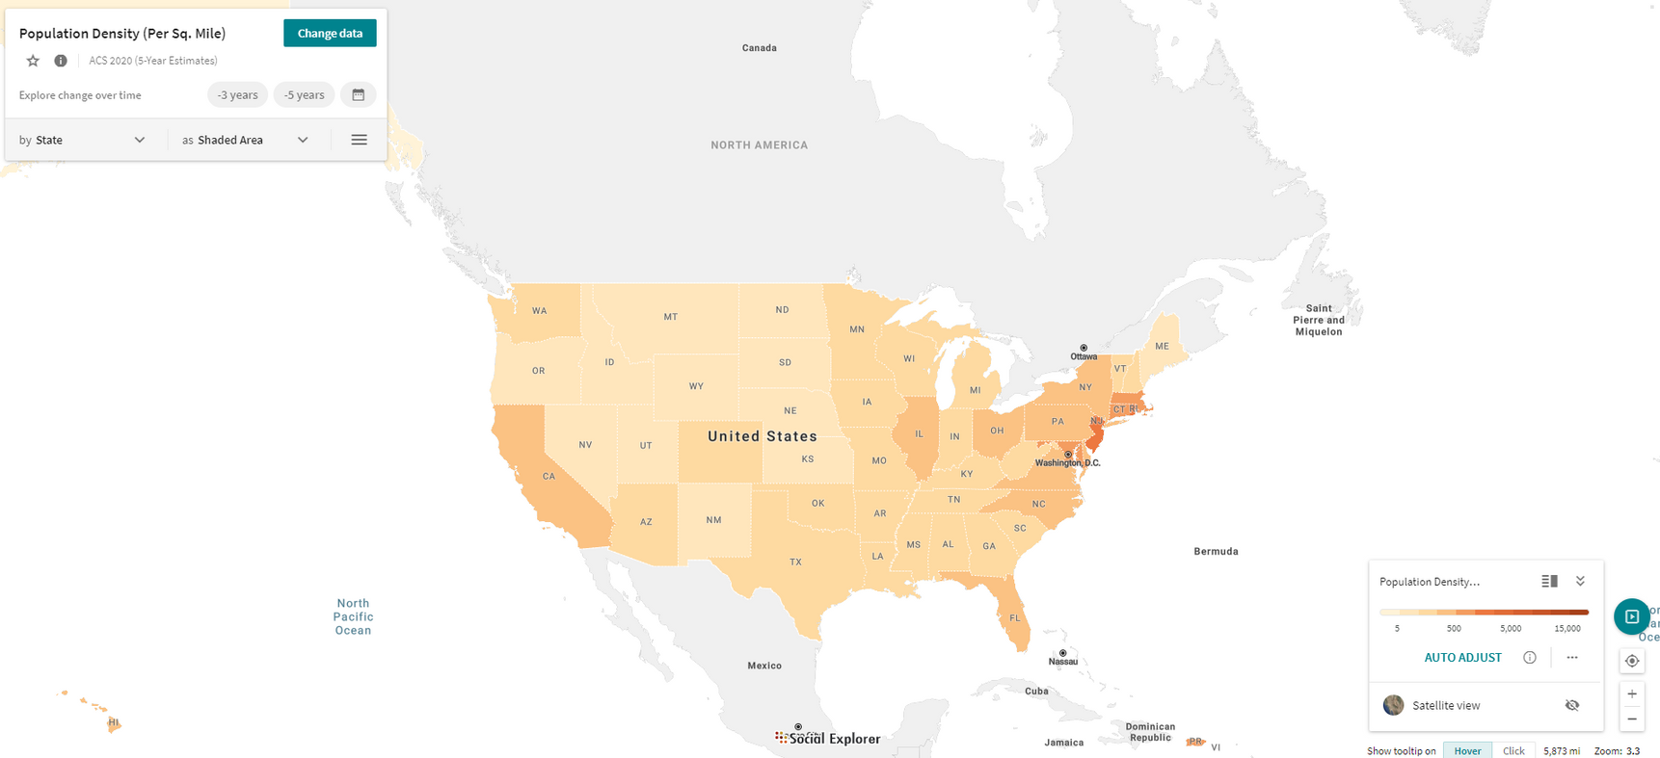
Create a U.S. Map
Click on the Explore button on the United States map located on the main page. This will bring up a basic U.S. population map.

Slide 34
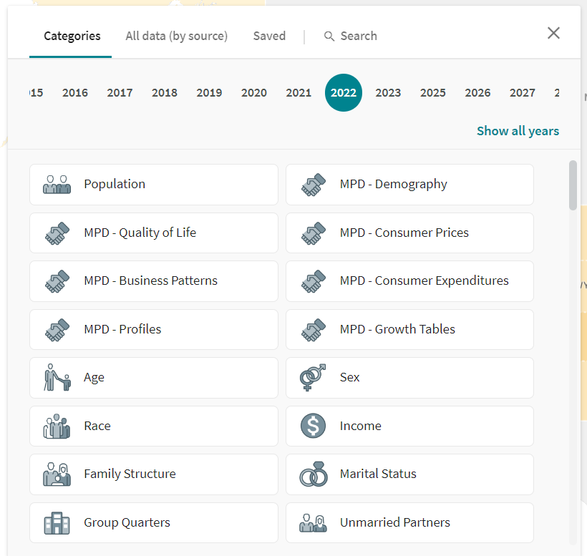
Change Data
Change data lets you browse for data by year and category or type keywords into the search bar.

Slide 35
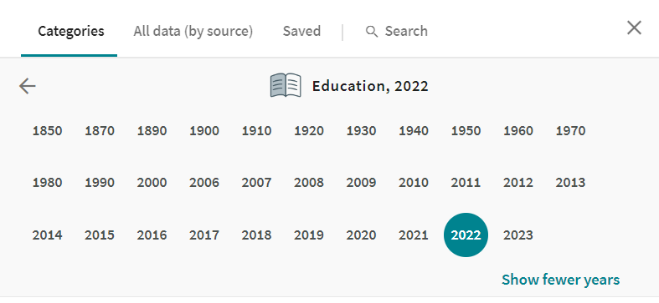
Choosing a Year
Choose your year based on data availability by geography.
The most recent year will not always let you map by census tract or block group.
When you select your year early in the map creation process, you are getting a better look at what is available.

Slide 36
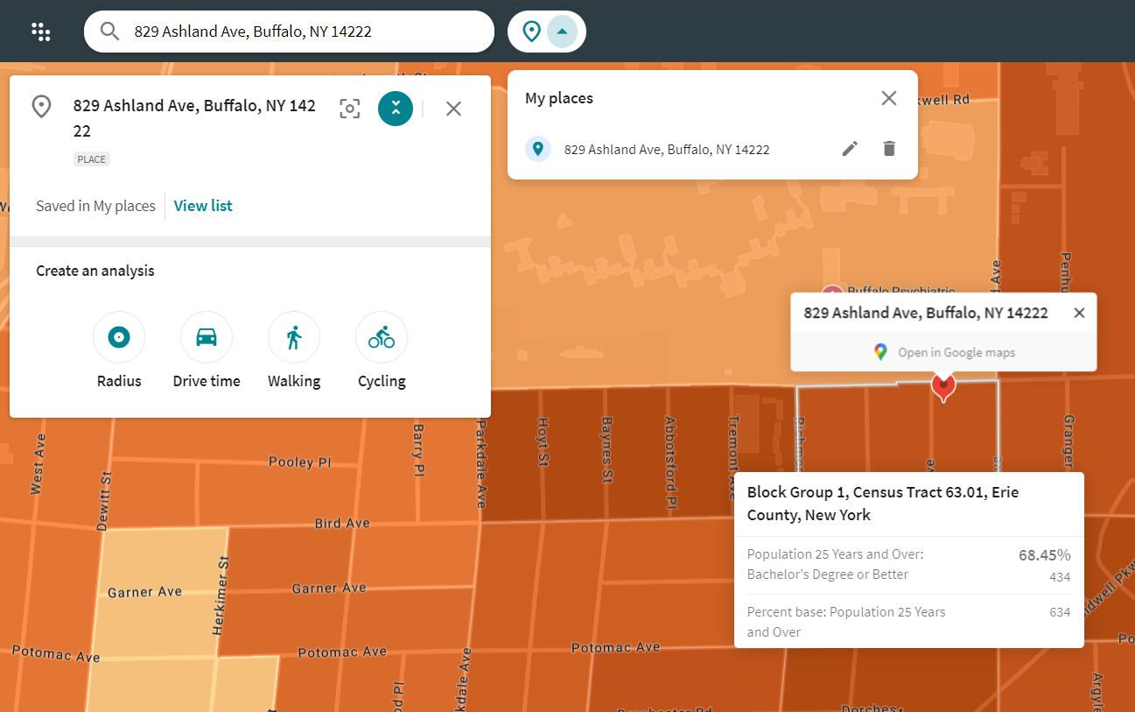
Select Location
Zoom into your area OR click on the Explore button on the United States map located on the main page. This will bring up a basic U.S. population map. You can search by address, postal code, place name, and more.
You can also save places you frequently use.

Slide 37

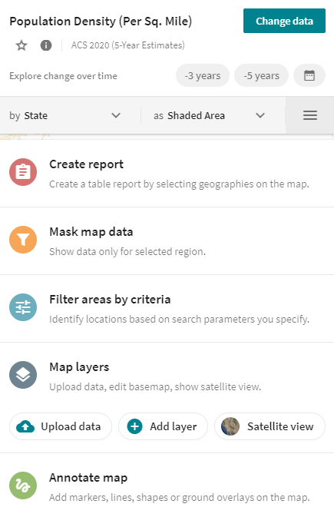

Quick Reference
Change data lets you browse for data by year and category or type keywords into the search bar
Change geography type
Switch between shaded area maps and bubble, and dot density
Identify locations based on search parameters

Slide 38
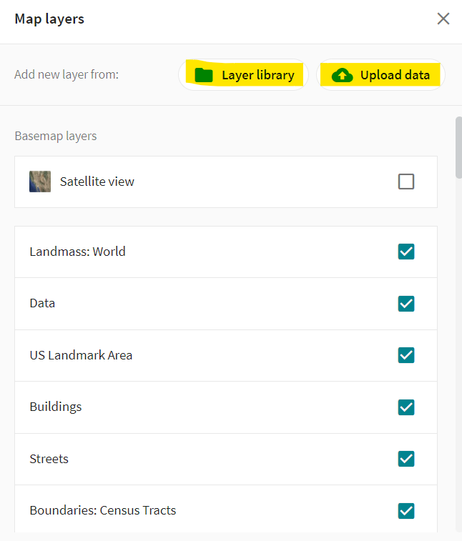
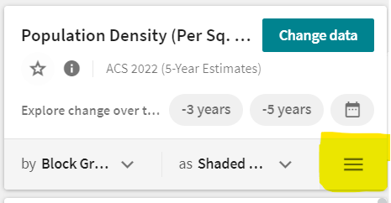
Other Features
  Create Report
  Mask Map data
  Map layers
  Annotate map

Slide 39
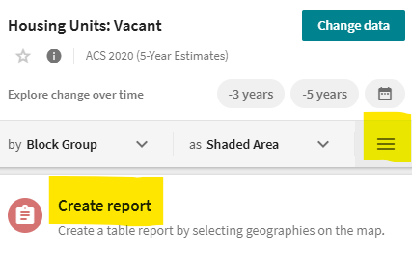
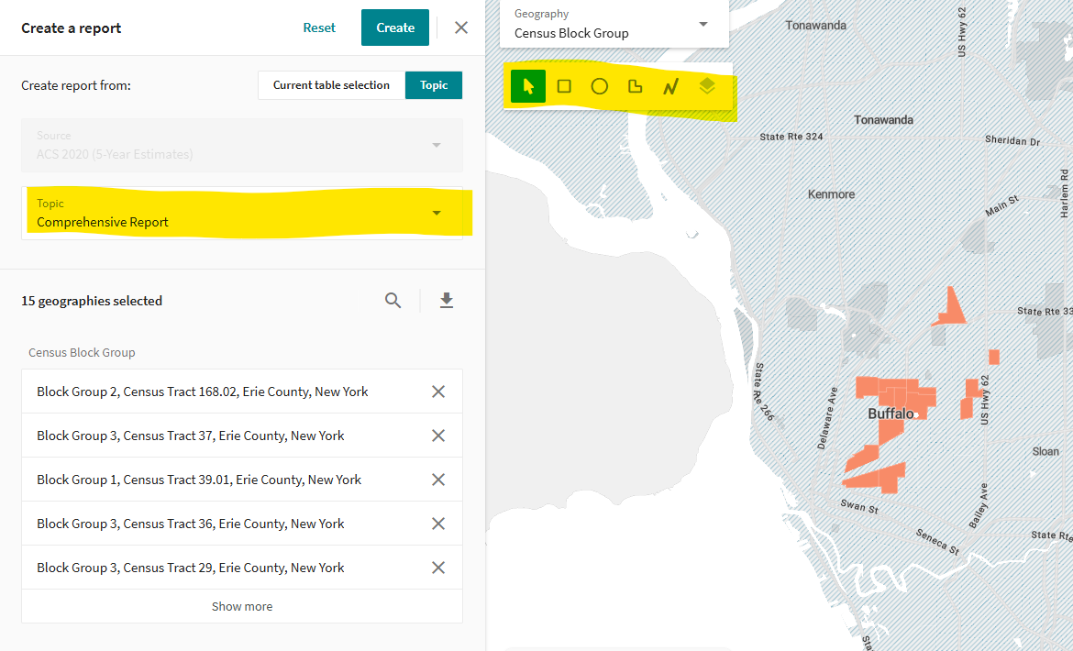
Create Report
  Go to other options and Create Report
  Choose a report by topic from the dropdown (e.g. Comprehensive Report)
  Select geographies using individual select or radius select.
  Click Create

Slide 40
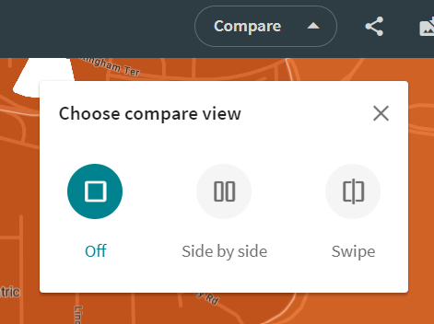
Compare
Best way to compare data from two time periods.

Slide 41
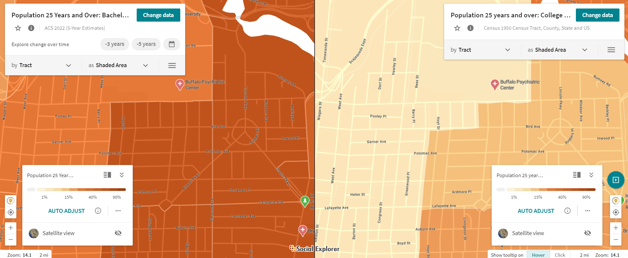
Side by Side Compare View

Slide 42
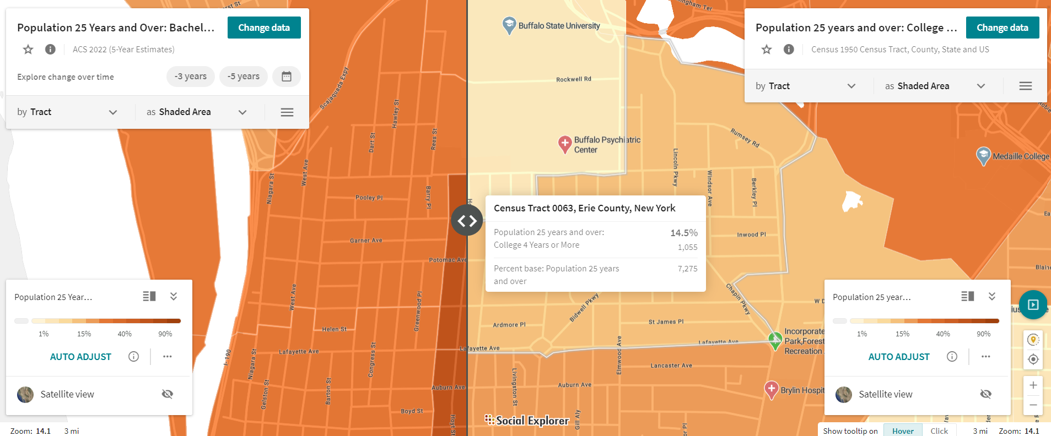
Swipe Compare View

Slide 43


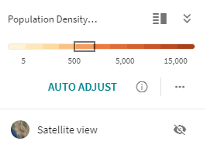
Additional Features
Legend detailed view
Hide legend
Compare: Switch to side by side or swipe map mode
Share: Get a shareable link, embed code, or send via email
Download: Set aspect ratio, Zoom, DPI, and format for export
More: Help and tour features
Change visualization or edit color palette.
Toggle satellite view

Slide 44
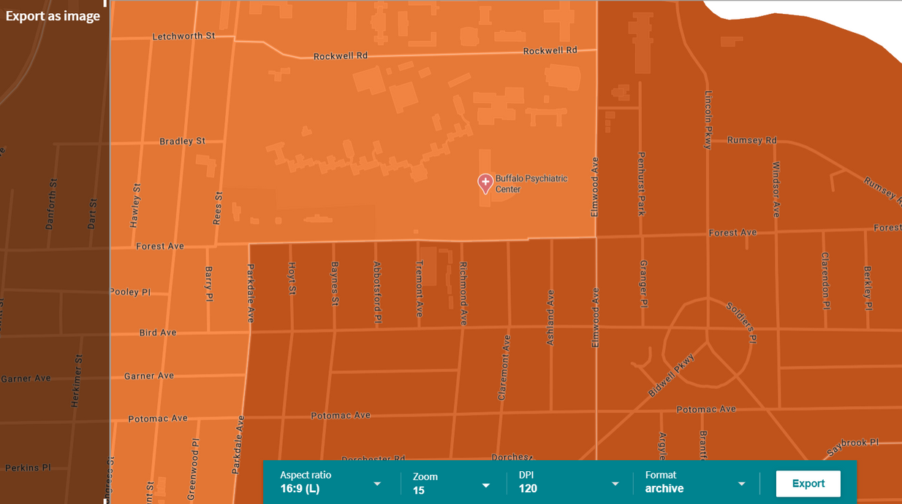

Export, Share, Save
  Share
    Link
    Embed
    Email
  Export as image
    Select DPI, image type, zoom, etc.
  Save as...
    Save with title and description to refer to later

Slide 45
In Summary
data.census.gov
Social Explorer
  Census data direct from the Census Bureau
  Detailed, exportable tables
  Accessible geographic profiles
  Limited historic data (2000-present)
  Includes additional data sources (e.g. BLS, Eurostat, etc.)
  Historic data
  Robust mapping
  Best features for storytelling
  Limited customization on reports

Slide 46
Contact Me!
Carolyn Klotzbach-Russell
422 Lockwood Library
cmklotzb@buffalo.edu

Slide 47
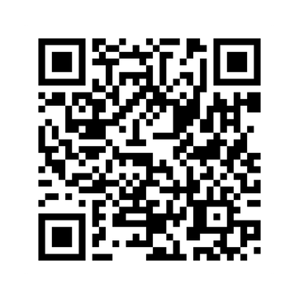
Research Data Services at UB Libraries
The Research Data Services Department supports UB researchers in managing data at every stage of the research data process—from initial planning to storage and reuse—helping meet funder mandates, maximize impact, and ensure reproducibility.
Check out our services and upcoming workshops at: library.buffalo.edu/research/rds

Slide 48
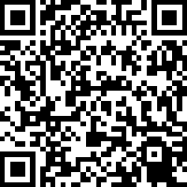
Thank You!
Please consider filling out the survey for this session.

