Slide 1
The human side of numbers – how stories make data matter
Love Data Week 2026
Notes:
LoveDataWeek: The Human Side of Numbers - How Stories Make Data Matter
Session Description:
In a world increasingly driven by dashboards, metrics, and algorithms, the ability to make meaning from data has never been more essential. This session explores how storytelling—long a core strength of the humanities—can transform data from static numbers into narratives that inform, persuade, and inspire action.
Participants will gain insight into the unique value that humanities scholars bring to data-centered work, from critical thinking and audience awareness to ethical reasoning and cultural analysis.
This interactive session will highlight emerging career paths at the intersection of data and the humanities—including data communication, visualization, UX research, digital scholarship, and research outreach—and offer practical strategies for helping students connect their storytelling skills to data-driven roles.
Join us to explore why data needs storytellers, and how UB’s humanities community can play a powerful role in shaping meaningful, responsible data narratives.

Slide 2
Career Design center
259 Capen Hall
jobs@buffalo.edu
buffalo.edu/career.html
Notes:
1:00-1:15pm – Holly
1:15-1:45pm – Nate (30 minutes)
1:45-1:50pm – Holly – wrap up

Slide 3
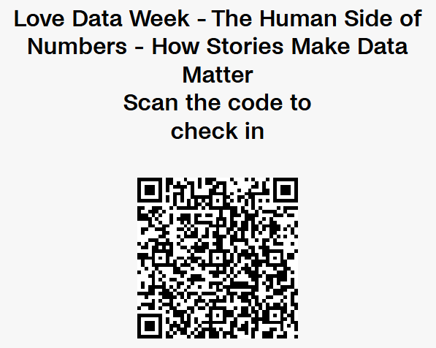
Please scan QR code to check-in

Slide 4

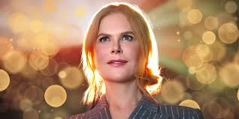
Data informs but stories create meaning
Notes:
data science has emerged as one of the most in-demand professions of recent years – taking hold with a hype that normally only surrounds celebrities
Analytics isn’t just math—it's interpretation + communication + judgment
Data informs but stories create meaning

Slide 5

A world overloaded with data

Slide 6
What does a Data Analyst actually do?
Three typical roles
Data Scientist (models/predictions)
  Builds software that can be used by the business to make predictions, personalize recommendations and more.
Data Engineer (infrastructure)
  Manages the computing tools necessary for the collection, storage and access of ‘big’ data.
Data Analyst (insights + decisions)
  Explores data for insights that can be used for business decision making.
Notes:
Emphasize: analyst work is often like journalism:
investigate questions
build evidence
find patterns
persuade through clear storytelling + visuals

Slide 7
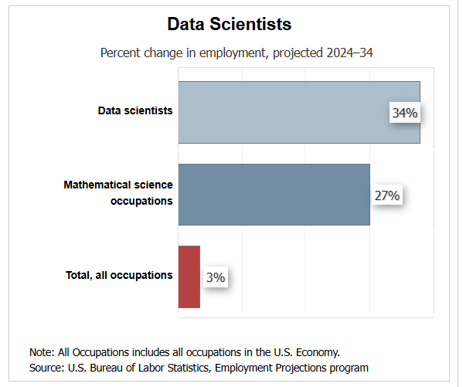
Job Outlook
Employment of data scientists is projected to grow 34 percent from 2024 to 2034, much faster than the average for all occupations.
In OOH Data Scientist is being used as a broad overarching term encompassing
Data Scientist
Data Engineer
Data Analyst
Reference: https://www.bls.gov/ooh/math/data-scientists.htm#tab-6

Slide 8
Impact of AI on the Data Scientist job market
How do you think the rise of AI has impacted the data science job market?
AI can automate significant portions of a data scientist's workflow, including data cleaning, preprocessing, exploratory data analysis, and generating boilerplate code.
  Which job role(s) does this impact the most? Data Analyst, Data Engineer, Data Scientist?
Limitations of AI in Data Science:
While AI can handle these tasks, it cannot fully understand the organizational context, meaning, or strategic impact of data.
Now more than ever we must question and interrogate the data.
Notes:
AI can automate significant portions of a data scientist's workflow, including data cleaning, preprocessing, exploratory data analysis, and generating boilerplate code.
- Which sounds like some of the work of Data Engineers and Data Scientists but not the work of Data Analysts.
Limitations of AI in Data Science:
While AI can handle these tasks, it cannot fully understand the organizational context, meaning, or strategic impact of data. Data scientists are still required to validate AI results, ensure accuracy, and translate business needs into technical solutions.
AI can automate significant portions of a data scientist's workflow, including data cleaning, preprocessing, exploratory data analysis, and generating boilerplate code. It enables faster, iterative model building, automates data visualization, and generates reports. AI enhances predictive modeling and accelerates exploratory data analysis, allowing for rapid, high-level analysis.
Key tasks AI can perform that are typically done by data scientists include:
Data Cleaning and Prep: Automating the preparation of raw data, fixing errors, and structuring datasets.
Code Generation: Using tools to write basic code for data manipulation, cleaning, and model building.
Data Visualization and Reporting: Creating charts and summaries to communicate insights.
Exploratory Data Analysis (EDA): Detecting patterns, anomalies, and outliers in datasets.
Model Generation and Selection: Creating hundreds of model variations and simulating to find the best performing one.
Natural Language Processing (NLP): Summarizing text, performing sentiment analysis, and providing conversational search capabilities.
Limitations of AI in Data Science:
While AI can handle these tasks, it cannot fully understand the organizational context, meaning, or strategic impact of data. Data scientists are still required to validate AI results, ensure accuracy, and translate business needs into technical solutions.

Slide 9
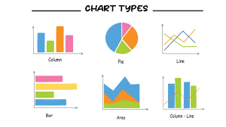
Data Analyst – the Investigative Journalist
Data Analysts need to
investigate questions
build evidence
find patterns
question and verify sources
persuade through clear storytelling + visuals
Notes:
Emphasize: analyst work is often like journalism:
investigate questions
build evidence
find patterns
persuade through clear storytelling + visuals

Slide 10

The Humanities degree advantage
The skills that are cultivated in the pursuit of a humanities degree have even more relevance than ever to the Big Data industry. We must question and interrogate the data.
Critical thinking: questioning assumptions, spotting weak conclusions
Context & interpretation: meaning, culture, ambiguity, nuance
Ethical reasoning: what’s fair, what’s missing, what could harm
Communication: clarity, persuasion, audience awareness
Curiosity + asking better questions: analytics is only as good as the question
Holistic thinking: seeing systems, multiple viewpoints, “wood for the trees”
Skilled at crafting the narrative, telling the story of the data

Slide 11

The psychological power of storytelling
Humans remember meaning better than raw numbers
Stories reduce overload and create structure
Stories improve recall, attention and empathy
Storytelling can transform data from static numbers into narratives that inform, persuade, and inspire action.
Notes:
This session explores how storytelling—long a core strength of the humanities—can transform data from static numbers into narratives that inform, persuade, and inspire action.

Slide 12

Why does storytelling matter in business?
Leaders / decision makers have limited attention
Stories and visuals create clarity and understanding which can then drive decisions.

Slide 13
What this looks like in real life

Slide 14

Nathaniel Royal, PhD
Director of the Data Alliance & Data Strategist
Moody’s Analytics
Notes:
https://www.linkedin.com/in/nathaniel-royal-phd/

Slide 15
How Stories Make Data Matter
The value that a humanities education brings to the world of data.
Notes:
Questions for Nate
Tell us about your current role. & Tell us about your career journey.
Based on your experience how do the skills from a Humanities degree come into play in the work of data analysts?
In my presentation I conveyed that telling the story of the data is key to helping leaders make informed decisions. What is your perspective?
How have you seen the work of data analysts evolving or splitting into multiple specialty areas?
How can individuals from the Humanities connect their storytelling skills to data-driven roles. What can help them stand out in a competitive job market?
Q&A from audience.

Slide 16
Thank you to Dr. Royal

Slide 17
UB Career Design Center
Resources & Services

Slide 18


Career Design Center Resources & Services
Individual Career Coaching Appointments
Bullseye powered by Handshake
  Internship & job postings
  Part-time On & Off campus jobs
Career & Job Fairs
Big Resume (formerly Resume A.I.)
Big Interview
Practice Interviews
Interstride
Career Design STUDIO
Career Communities (curated content)
Making Connections
    Connect-a-Bull – mentoring platform
    LinkedIn Review & Optimization

Slide 19

Bullseye powered by Handshake
Job & internship posting system
Event – Career Fairs, workshops, Employer information sessions, networking events, and much more!
Connect - Opportunity to connect to alumni, UB students and students in the Handshake community
5x – How much you increase your chance of being contacted by an employer if you complete your profile in Bullseye powered by Handshake!
Join a Career Community!

Slide 20

Assessment QR code

Slide 21
Questions?

Slide 22
References
How to Start a Career as a Data Analyst from the Arts, and Why
Data & AI Career Paths for Arts & Humanities Graduates: Why Your Background Matters + How to Get Started
Beyond Technical Skills: The Case for a Liberal Arts Approach to Data Analytics
Why Storytelling is a Critical Data Analytics Skill
Arts and humanities support the skill of storytelling
Data Storytelling: How to Effectively Tell a Story with Data
Notes:
https://www.buffalo.edu/oia/initiatives/love-data-week.html

Slide 23


Contact Us!
Career Design Center
Monday - Friday | 8:30 a.m. - 5 p.m.
259 Capen Hall, North Campus
Phone: 716-645-2231
You Talk. We Listen. Book online.
buffalo.edu/career/appointments
Use this QR code to book a career design appointment or chat with Virtual Vic about your career questions 24/7.

