Slide 1
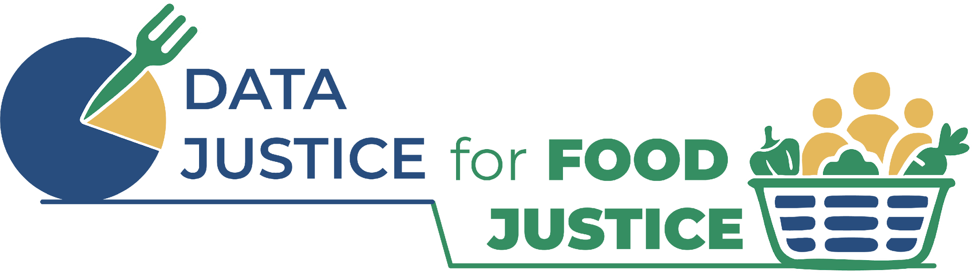

Data Justice for Food Justice
Love Data Week
February 12, 2026
Jane Dai, Kate Hays, and Molly Riordan

Slide 2
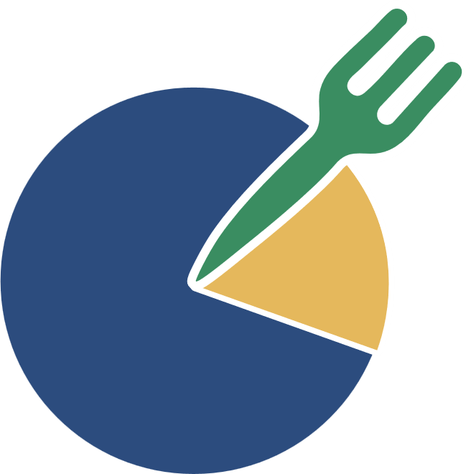
Agenda
Data Justice for
Food Justice
1
Food systems dashboards & data justice
2
Data justice & dashboard user experience
3
Data justice & dashboard outcomes

Slide 3
Food Systems Dashboards & Data Justice
Data Justice for
Food Justice
Researchers and practitioners are increasingly using data dashboards to visualize the complexities of the food system
Inequities in the food system are reinforced by inequities in data systems

Slide 4
Three Problems
Data Justice for
Food Justice
There is a gap between how communities seek to represent their food-related experiences and challenges, and how these are typically measured, reported, and visualized in data dashboards
Scaling-up and standardizing of data has far-ranging consequences for health equity (from surveillance to extraction)
Misgovernance of data systems and food systems create intersecting inequities for Black, brown, Indigenous, and New American communities

Slide 5

Small Group Discussion
Data Justice for
Food Justice
In your group, discuss the following:
What are some ways that data is used in your field, and how is that data governed?
What data injustices are you aware of, and what impact have they had on communities?
What does data justice mean to you?

Slide 6
Data Justice &
User Experience (UX)
Data Justice for
Food Justice
Consider:
What matters for user experience?
Are there sites and software you use that stand out as having a good user experience?

Slide 7
Data Justice &
User Experience (UX)
Data Justice for
Food Justice
What is User Experience?
The user’s journey of interacting with a digital tool
Includes more than “usability”
A truly spectacular user experience is when user needs are met – simply, easily, and consistently

Slide 8
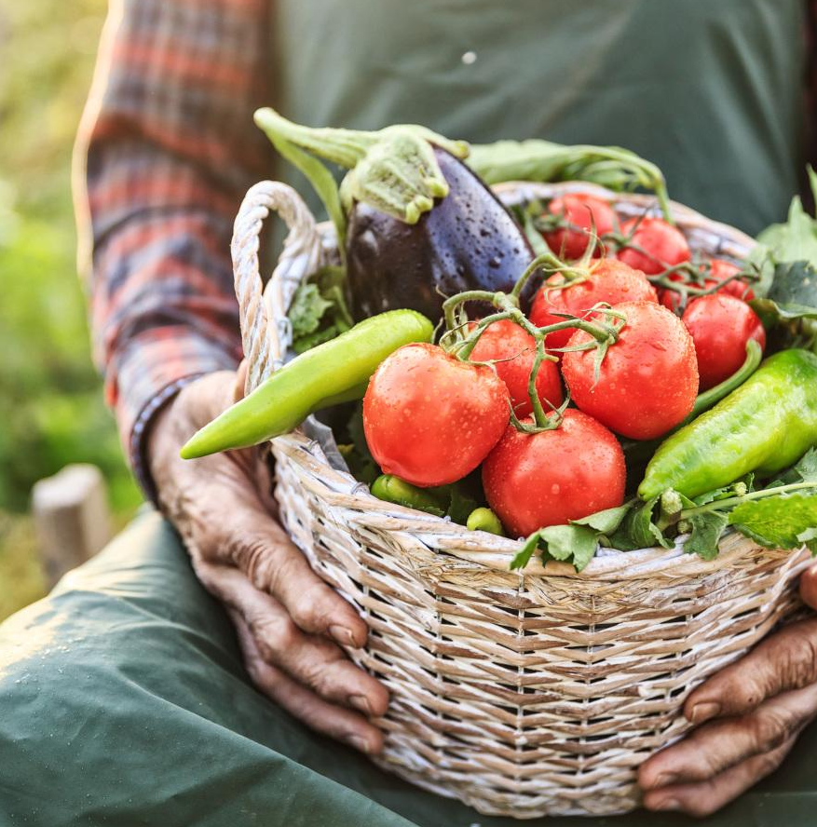
Small Group Activity
Data Justice for
Food Justice
Fiddle around with two existing food system dashboards that service our area:
Click on everything!
Notice what is easy, fun, intuitive
  …and if something becomes annoying as you use it more
Notice what bothers you
Do YOU, personally, like it?

Slide 9
Small Group Activity
Data Justice for
Food Justice
In breakout groups, work together to find:
Something new (that you learned)
Something that needs to be updated
Something that is difficult to see because of color contrast, text size, etc.
Something about the user interface that would not work for everyone

Slide 10
Small Group Activity
Data Justice for
Food Justice
Share-out about your user experiences:
East Buffalo Food and Health Equity Dashboard
Growing Connections, Nourishing a Region (WNY)

Slide 11
Data Justice & Dashboard Outcomes
Data Justice for
Food Justice
What happens as a result of the dashboard?
Does it change the outcomes for the group it is meant to serve?

Slide 12
Data Justice & Dashboard Outcomes
Data Justice for
Food Justice
Depends whether outcomes measurement is part of the design
Depends whether users were part of designing it
Depends on if the dashboard meets the need

Slide 13

Small Group Activity
Data Justice for
Food Justice
Return to breakout groups
Read your “User Profile” and answer the questions in the prompt based on the dashboard you previously reviewed
10 minutes, then brief share-back (2 min ea)

Slide 14
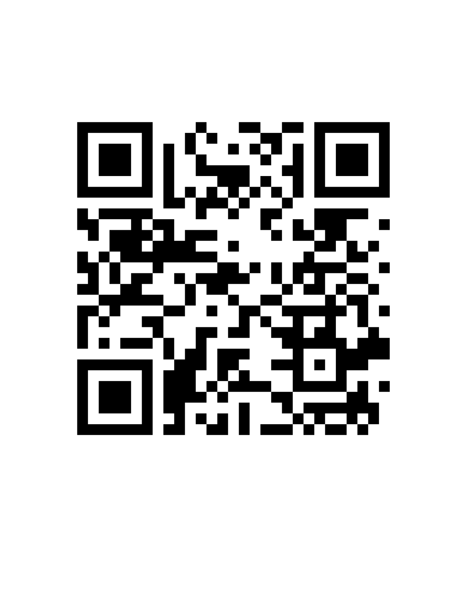
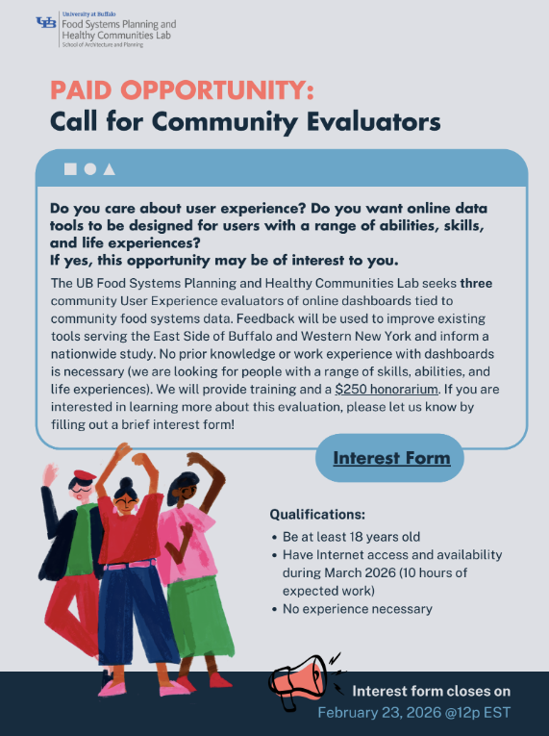
Community Evaluators

Slide 15

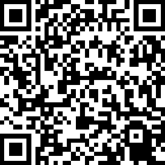

Survey and Questions
Survey
Questions?
Please leave feedback by filling out the survey linked here:
For more information,,
reach out to:
Kate Hays
Research Coordinator
cnhays2@buffalo.edu
UB Food Lab
foodsystems@ap.buffalo.edu
Jane Dai
Postdoc Scholar
janedai@buffalo.edu
Molly Riordan
Learning Circle Lead
mollyrio@buffalo.edu
Alissa Ujie Diamond
Investigator
ad97@buffalo.edu
Mohamed Aly Etman
Investigator
maetman@buffalo.edu
Alex Judelsohn
Principal Investigator
ajudelso@buffalo.edu
Samina Raja
Principal Investigator
sraja@buffalo.edu

