Slide 1

Ethical Data dilemmas in budget development
Peter DiNunzio, Assistant Director, Resource Planning
Bin Chen, Senior Resource Analyst, Resource Planning

Slide 2
Agenda
Impacts of Ethical Budgeting
Common Ethical Data Dilemmas
Strengthening Ethical Budget Culture
Summary: Dos and Don’ts
Discussion
AGENDA

Slide 3
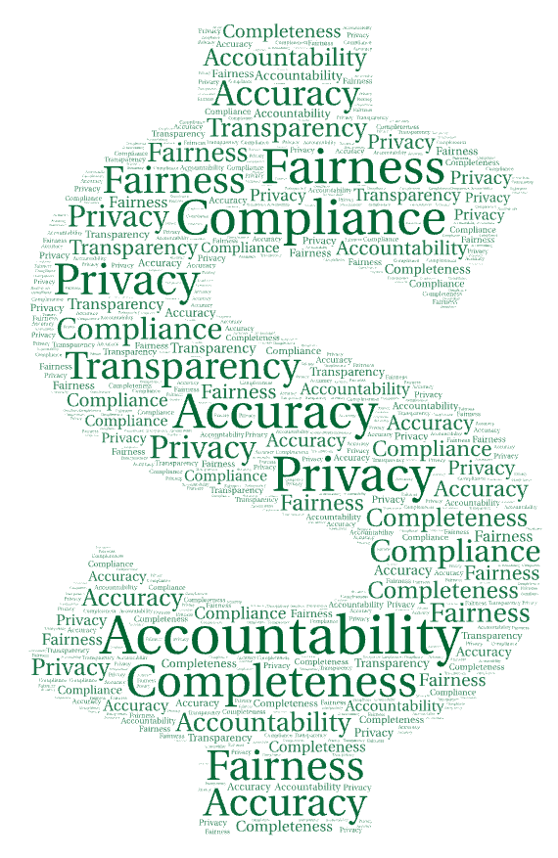
Budgets are not just numbers—they are institutional values expressed in financial form.

Slide 4

Budget Decisions Impact
Hiring
Programs
Tuition & Fees
Services
Personnel

Slide 5

Ethical Budgeting Protects
Ethical Budgeting Protects
Accountability & Compliance
Accuracy
Completeness
Include
all necessary data
Audits
Fund rules
No distortion of data
Fairness
Privacy
Transparency
Equitable treatment across areas
Use of personnel/salary data
Explain assumptions
& limitations

Slide 6
Common Ethical Data Dilemmas

Slide 7
Common Ethical Dilemmas
Common
Ethical Dilemmas
Selective
Use of Data
(Cherry Picking)
Overreliance on Forecast Models
Omitting Known Future Costs
Inconsistent Metrics
Pressure to Alter Assumptions
Data Privacy Violations
Using Restricted Funds Improperly

Slide 8

Selective Use of Data
Selective Use of Data
“Cherry-Picking”
Situation:
Leadership wants to use a growth projection to support additional hires that is based solely on growth history that aligns with their preferred budget narrative.
How does one push back respectfully?

Slide 9
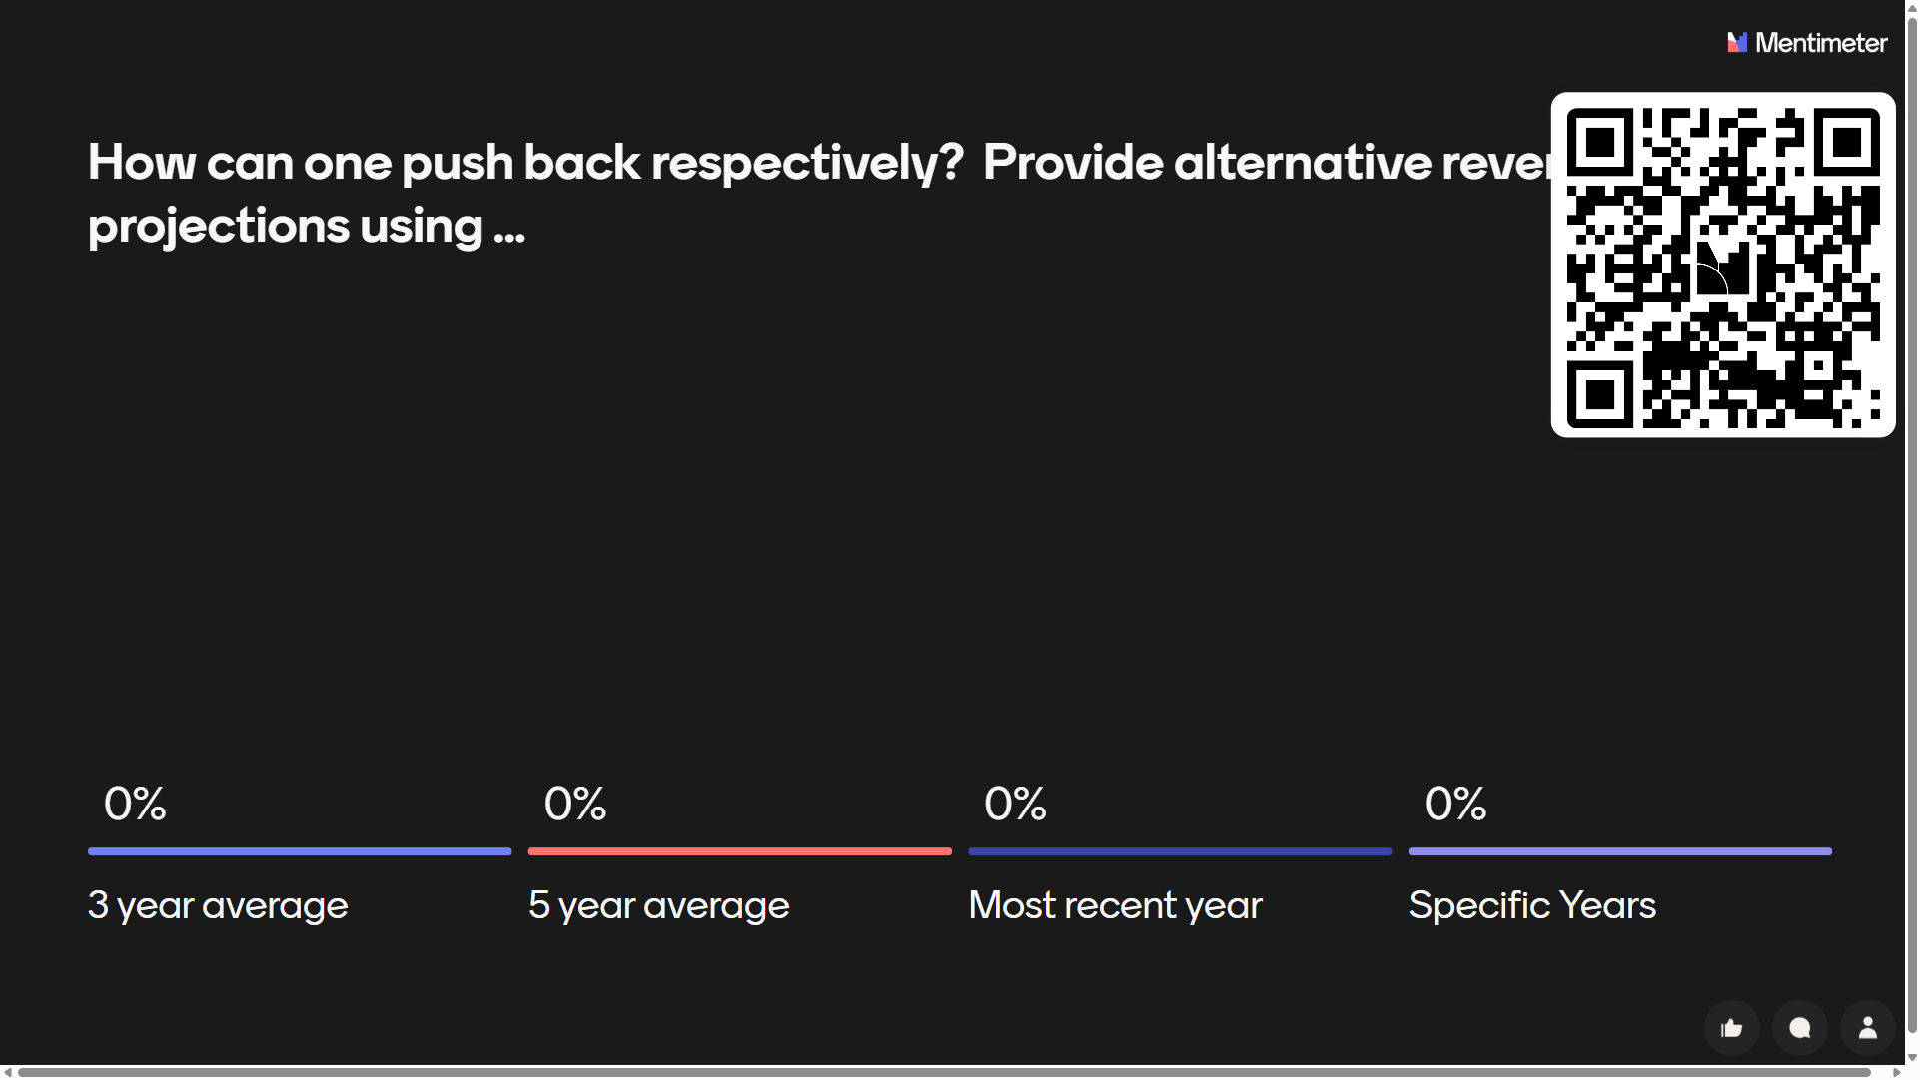
Menti Poll Question/Answers #1

Slide 10

Overreliance on a projection Model
Overreliance on a Projection Model
Situation:
A department provides a 5-year budget for salary expenses and, since they want to ask for an increased budget, they assume 3% year-over-year salary increases for all five years. The 3% figure comes from known annual salary increases.
What should have also been considered?
https://www.flaticon.com/authors/juicy-fish

Slide 11
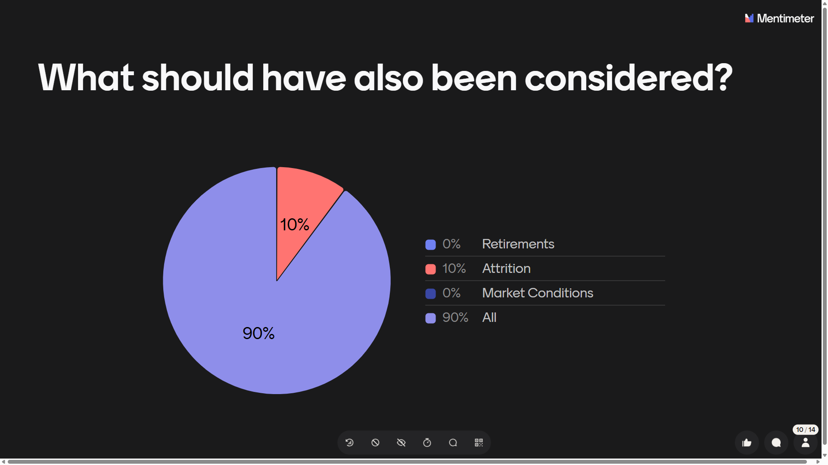
Menti poll question/answers #2

Slide 12

Omitting Known Future Costs
Omitting Known
Future Costs
Situation:
A regional office provides a three-year budget. In year three, a newly built facility will be opening that will increase square footage by 20%. Due to recent adverse market conditions, they decided to omit or underestimate known year-three recurring costs.
What should have been included?

Slide 13
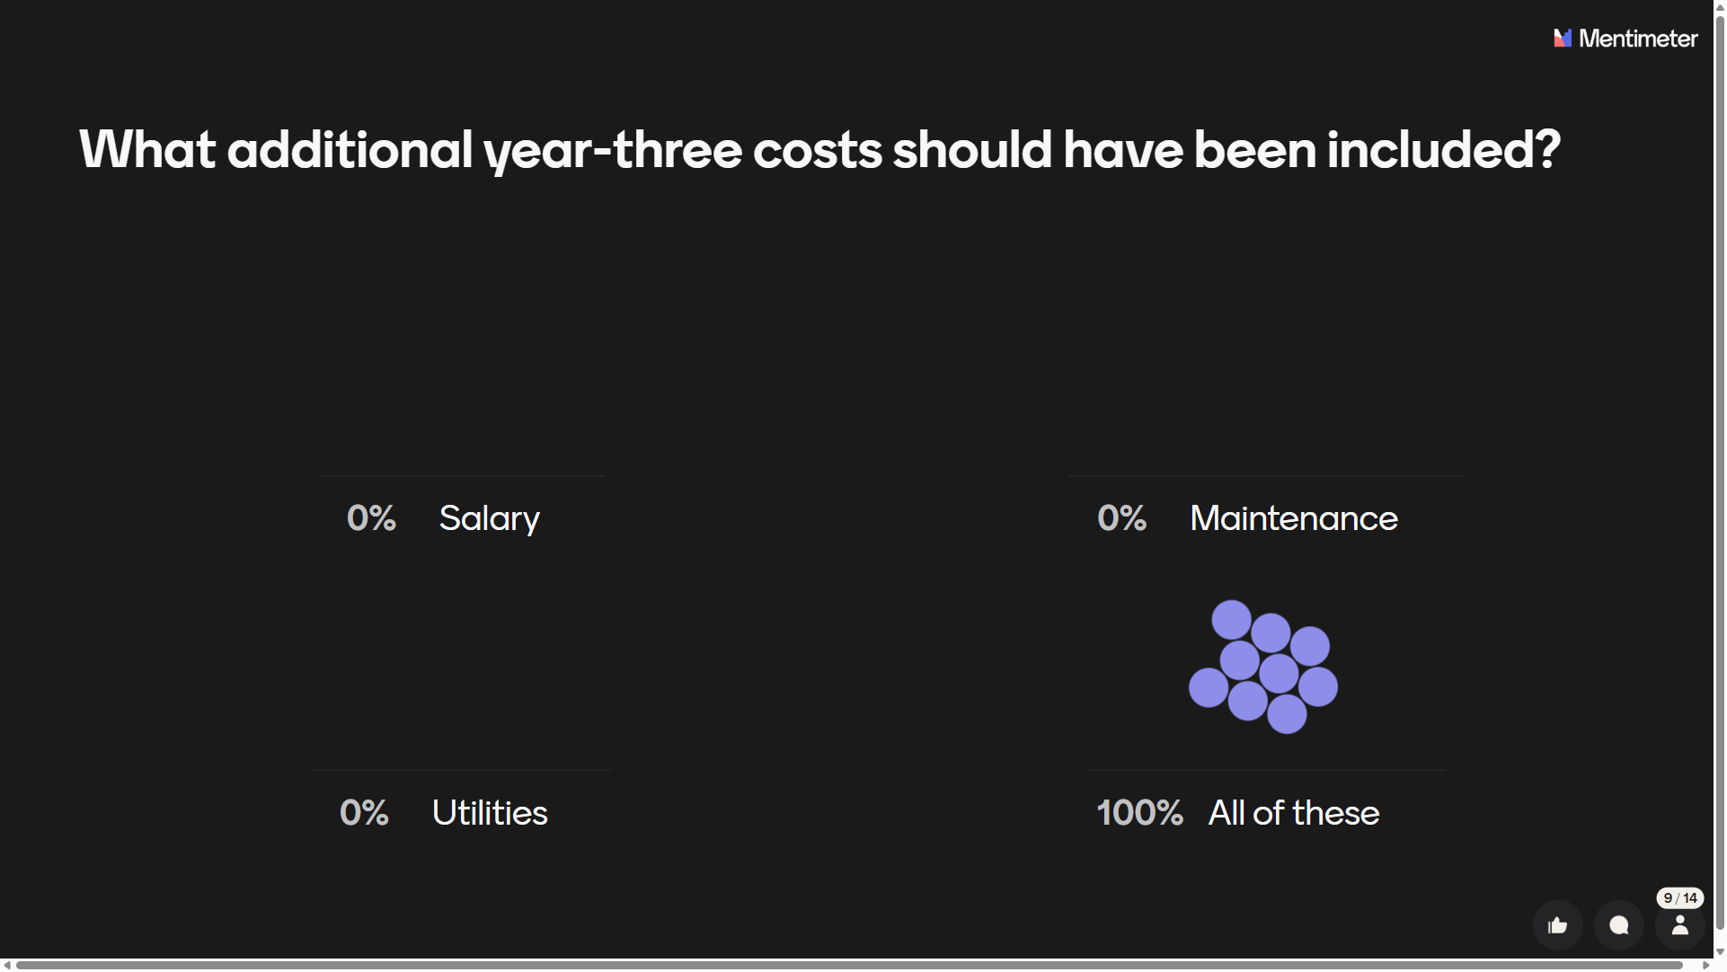
Menti poll question/answers #3

Slide 14
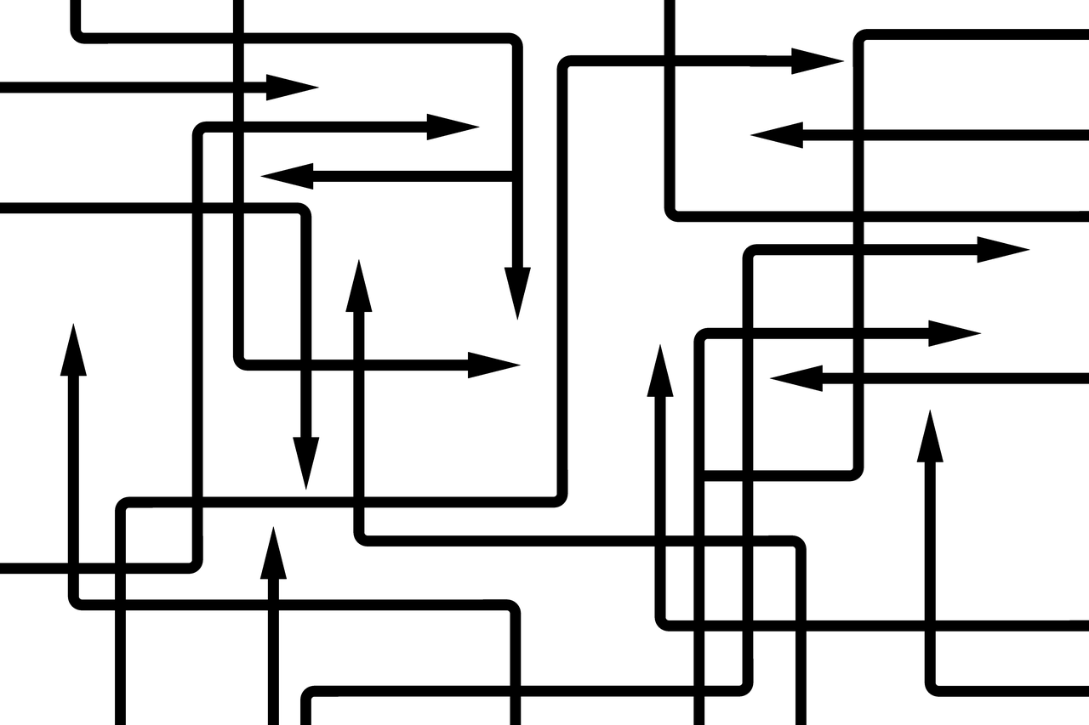
Inconsistent Metrics
Inconsistent Metrics
Situation:
A department uses headcount to support a budget increase request when it is known that the rest of the organization uses FTE. The department has 50 part-time employees working .5 FTE.
What should they do?

Slide 15
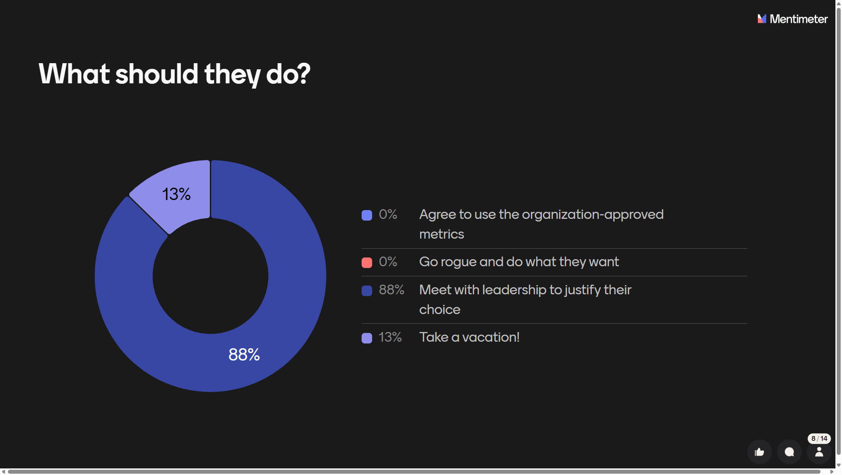
Menti poll question/answers #4

Slide 16

Pressure to Alter Assumptions
Pressure to Alter Assumptions
Situation:
Leadership wants to remove all cost inflation assumptions to ensure budgets are balanced.
How does one push back respectfully?

Slide 17
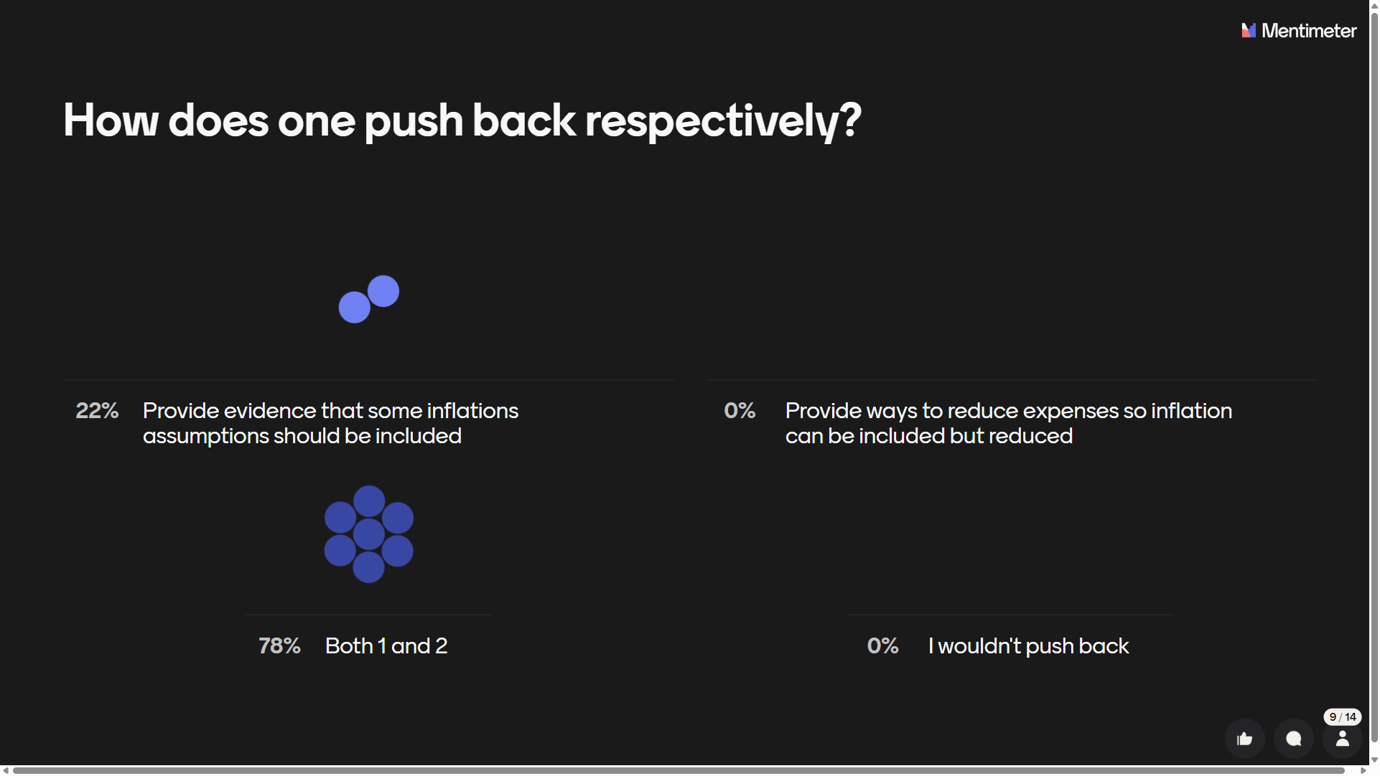
Menti poll question/answers #5

Slide 18

Data Privacy Violations
Data Privacy
Violations
Situation:
A supervisor includes a budget note saying: “Employee is on long-term medical leave—expect higher overtime next quarter” in a budget document visible to multiple departments.
How should this have been handled?

Slide 19
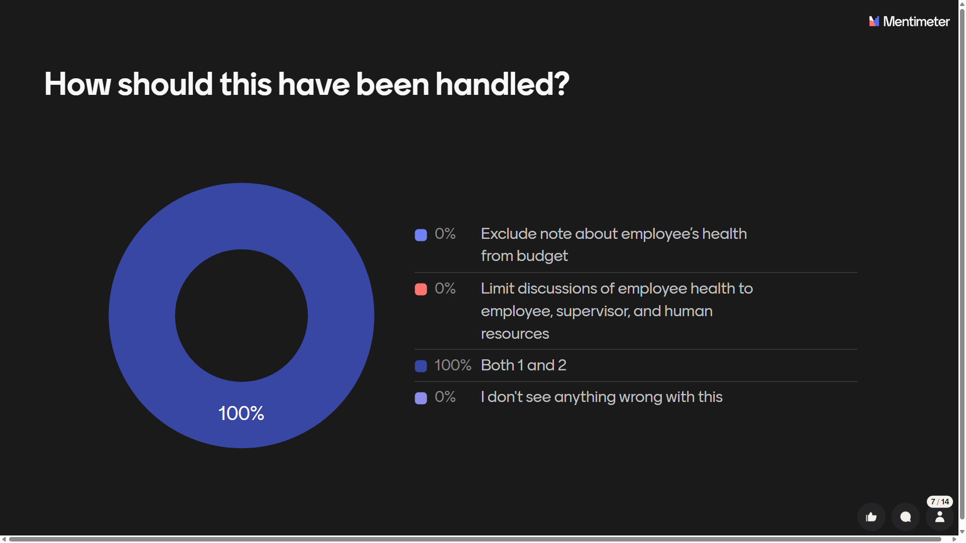
Menti poll question/answers #6

Slide 20

Using Restricted Funds Improperly
Using Restricted
Funds Improperly
Situation:
An employee budgets restricted funds for expenses that do not meet the criteria for their use, assuming the misuse will go unnoticed.
What are the risks?

Slide 21
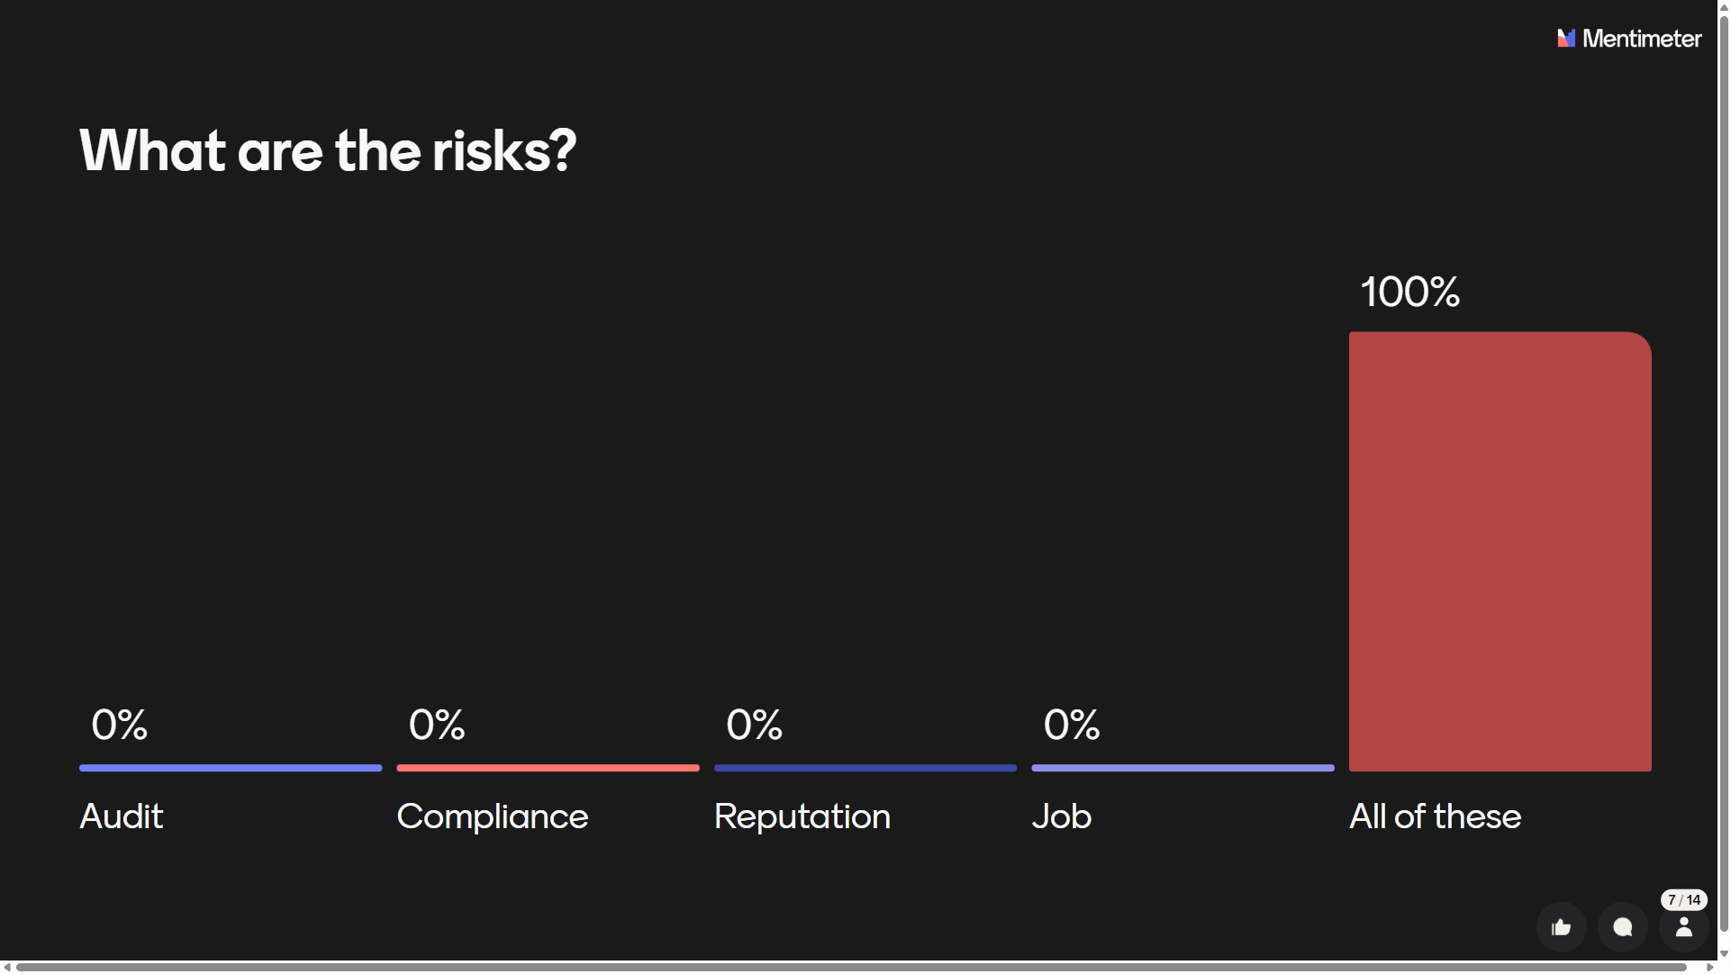
Menti poll question/answers #7

Slide 22
Strengthening Ethical Budgeting Culture
Provide Practical, Institutional-level Strategies

Slide 23

Data Governance
Data Governance
Data Governance
Standard definitions
Version control
Documentation of assumptions
https://www.flaticon.com/authors/ida-desi-mariana

Slide 24

Training and transparency
Training & Transparency
Training & Transparency
New employee onboarding
Policy primers
Budget glossary and methodology guide
https://www.flaticon.com/authors/elzicon

Slide 25

Review Processes
Review Processes
Cross-unit validation
Inter-unit reviews
Annual methodology updates

Slide 26

Communication Practices
Communication Practices
Communication Practices
Annotate anomalies
Explain outliers or unusual variances
Distinguish recurring vs non-recurring funds

Slide 27
Summary - Do/Don’t List

Slide 28

Summary of Dos
Use complete datasets
Disclose assumptions
Maintain standard methodologies
Protect privacy
DO
Escalate ethical concerns early

Slide 29

Summary of Don’ts
Manipulate data
Cherry-pick trends
Hide known future costs
Misclassify expenses
DON’T
Overshare personnel data

Slide 30
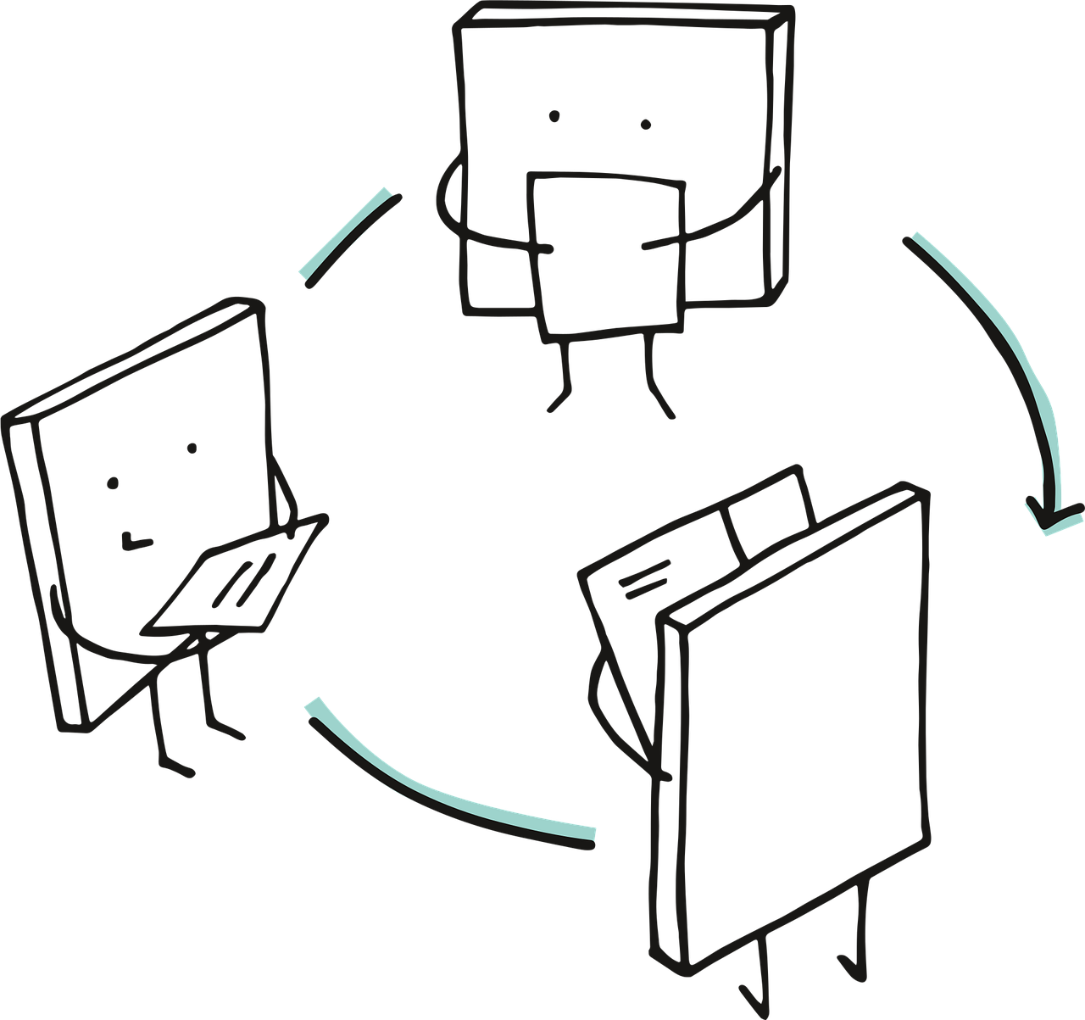
Q & A Discussion
Share your own…
Budgeting dilemmas
Pressures encountered
Uncertainties about “the ethical line”

Slide 31
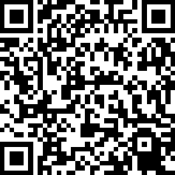
Thank you!
Thank you!

