Slide 1
THE LONG HAUL
Best Practices for Making Your Digital Project Last
UB Love Date Week 2026
Natalia Estrada
nestrada@buffalo.edu
UB Libraries
Digital Scholarship Librarian
Scott Peterson
sp277@buffalo.edu
UB Libraries
Research Data Services
Notes:
You've invested a lot of work in creating a digital project, but how do you ensure it has staying power? We'll look at choices you can make at the beginning of project development to influence sustainability, best practices for documentation and asset management, and how to sunset your project in a way that ensures long-term access for future researchers.
We'll talk about best practices that are broadly applicable.
What works for your specific project and needs might be different.

Slide 2
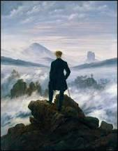
OVERVIEW
What does it mean to have your work survive?
Make sustainable decisions early
Exploring tools and platforms
How to preserve your work
Der Wanderer über dem Nebelmeer by Caspar David Friedrich

Slide 3
WHAT IS PRESERVATION?

Slide 4
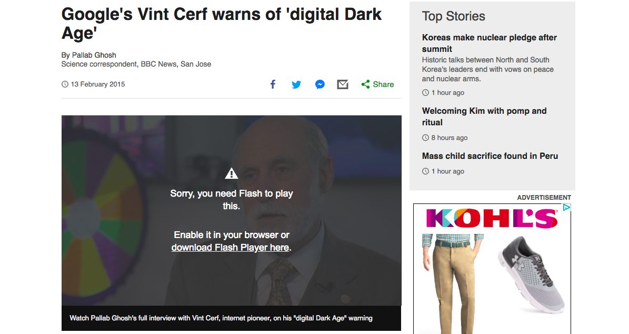
Google’s Vint Cerf warns of ‘digital Dark Ages’
www.bbc.com/news/science-environment-31450389
Notes:
DIGITAL DARK AGE--BBC News
Irony: Flash--article in 2015 uses Flash.
Adobe stopped distributing and updating Flash on January 1, 2021. End of Life date (EOL Date) was 12/31/20
Open standards such as HTML5, WebGL, and WebAssembly have continually matured over the years and serve as viable alternatives for Flash content. New Browsers will not support Flash.

Slide 5
“”The solution is to take an X-ray snapshot of the content and the application and the operating system together, with a description of the machine that it runs on, and preserve that for long periods of time. And that digital snapshot will recreate the past in the future."

Slide 6

What aspects of your project do you want people to have access to in 100 years?
What aspects of your project do you want people to have access to in 100 years?

Slide 7
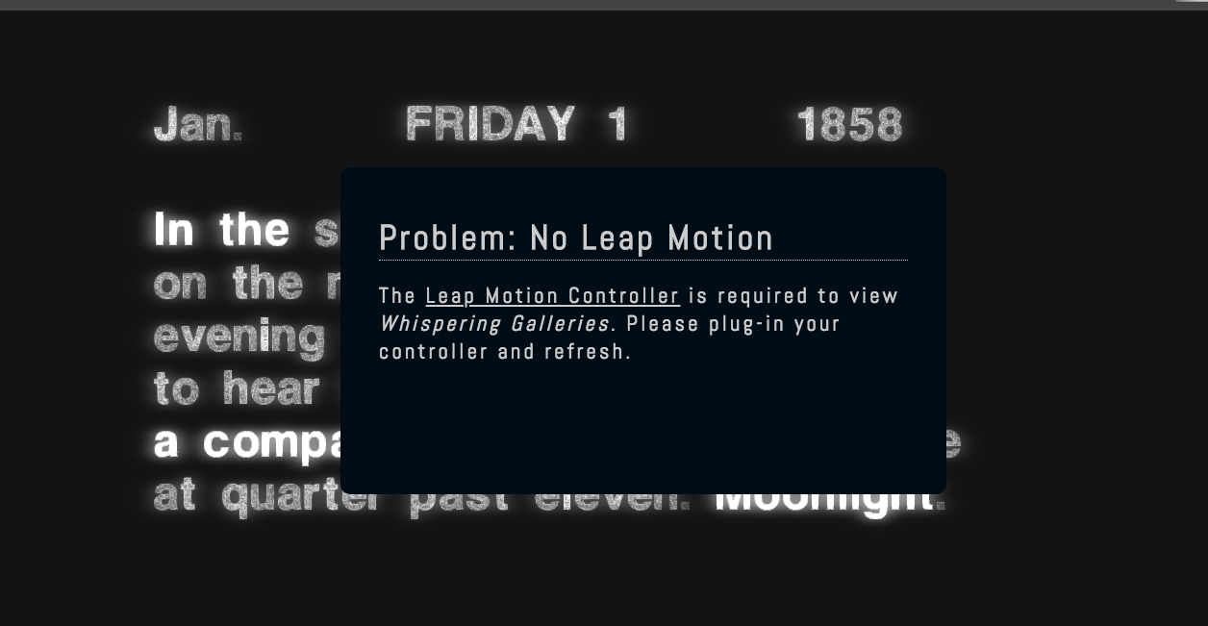
Whispering Galleries
whisperinggalleries.com
Notes:
Whispering Galleries is an interactive digital artwork by Amaranth Borsuk and Brad Bouse for New Haven Free Public Library
Launched in 2014, this digital art project relies on a technology called Leap Motion that has become obsolete.
https://www.whisperinggalleries.com/

Slide 8
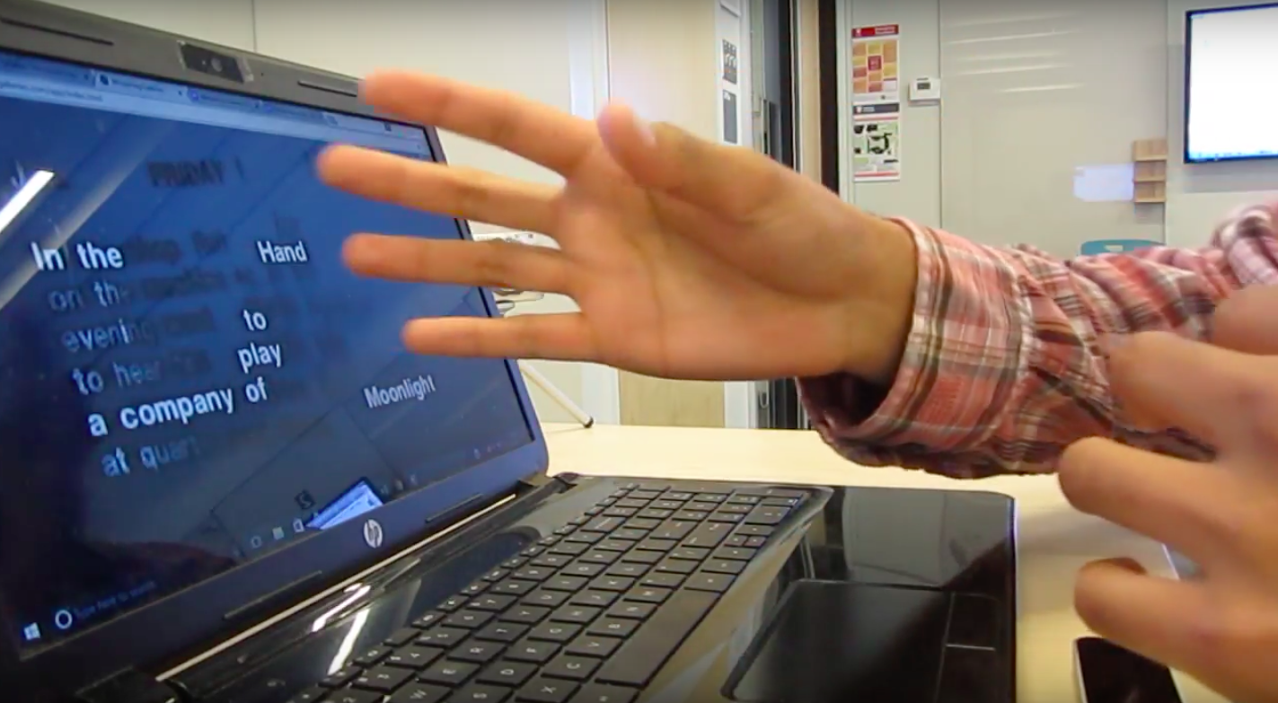
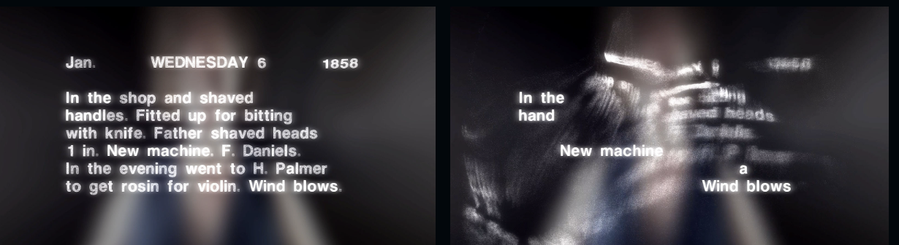
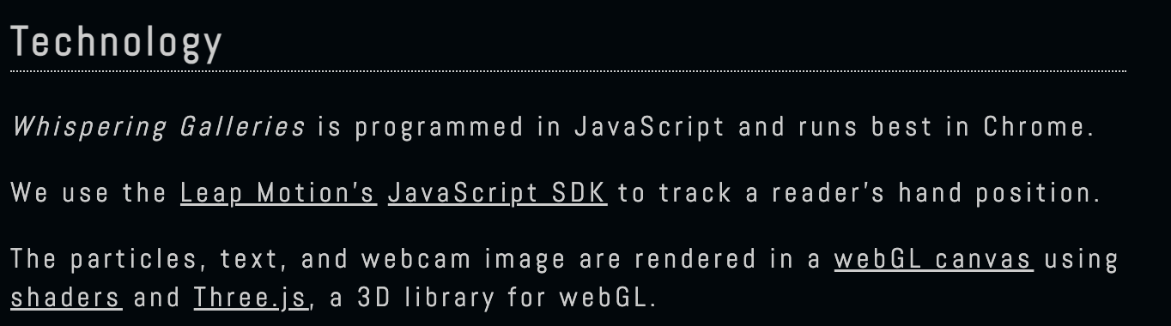
Whispering Galleries Slide 2
Notes:
Visitors to Whispering Galleries use their own hands to sweep away the dust from an anonymous New England shop keepers diary from 1858. Gesturing over the Leap controller, they scatter pixels from the text, leaving behind a web of words: erasure poems that tell a hidden narrative of 19th-century life, labor, and art.
Created a static website about Whispering Galleries
Posted the technology used
Took photos and videos of people using Whispering Galleries
Created interviews with people interacting with the art
You’ve created a piece of art that is interactive.
How do you preserve the experience of this work?

Slide 9
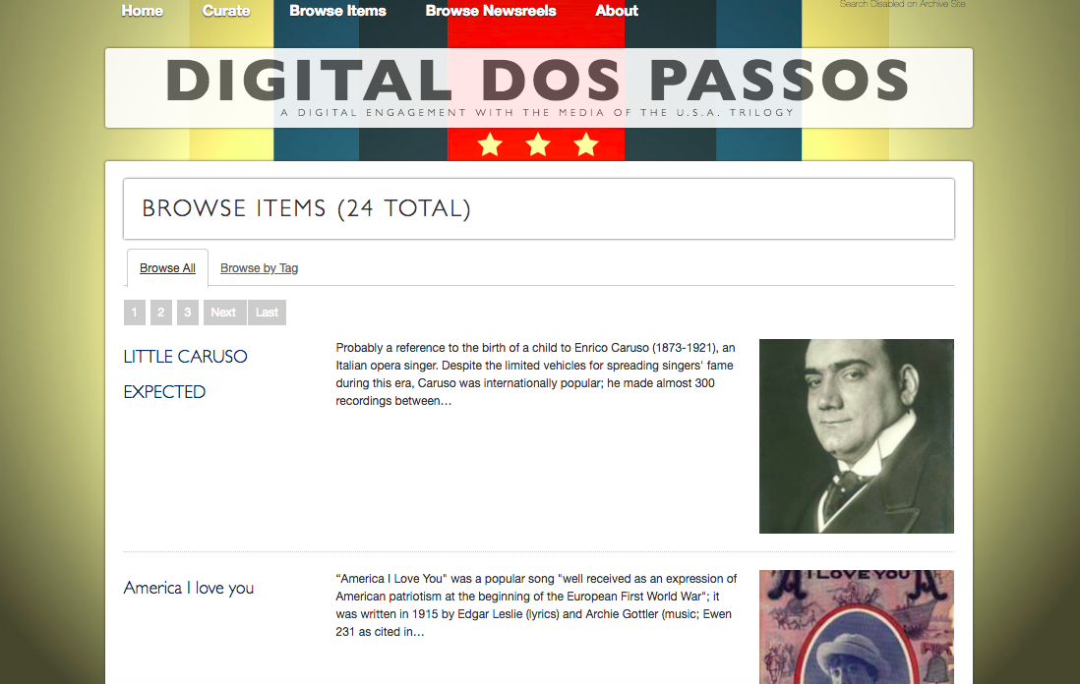
Digital Dos Passos
https://amandavisconti.github.io/digitaldospassos/index.html
Notes:
EXAMPLE: DIGITAL DOS PASSOS
Created in 2010
The goal for the Digital Dos Passos digital text is a site offering immersive engagement with the U.S.A. trilogy's media (photography, video, audio, digitized newspapers, and other historical media), as well as short textual annotations, which alert readers to the events and people to which Dos Passos' media references point to.
For whatever reason, the owner decided to sunset the site
She created a static version of the site.
There is loss:
the site no longer supports search
But: the site is still available
Probably cheaply hosted
And with no updates required.
This site used Omeka but the author moved it to Github from digitaldospassos.com to https://amandavisconti.github.io/digitaldospassos/index.html

Slide 10
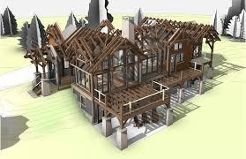
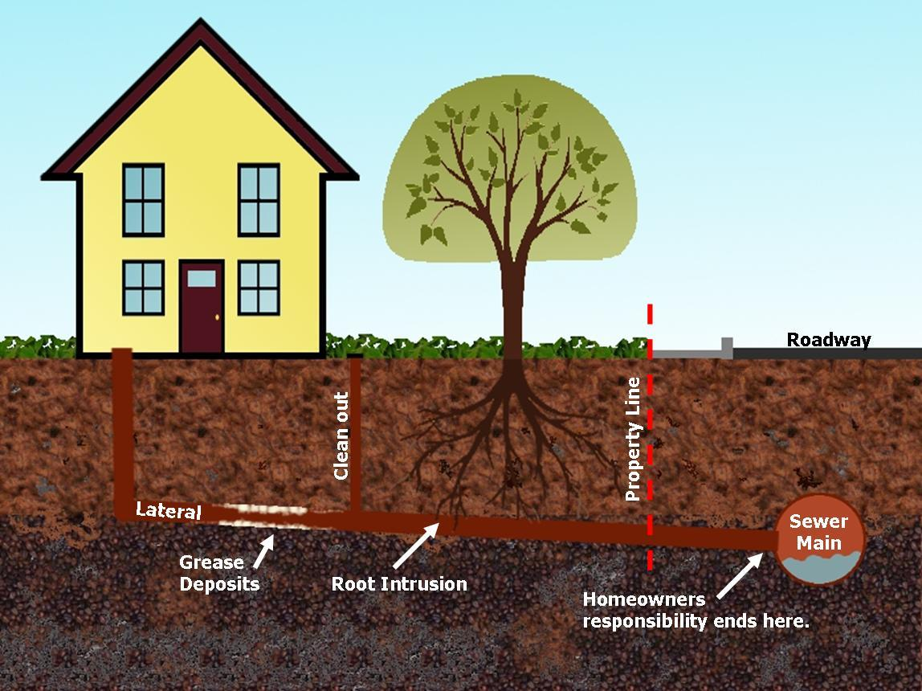
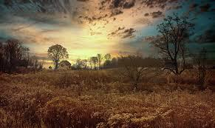
DIGITAL PROJECT STAGES
1. Development
2. Maintenance
3. Obsolescence or Sunsetting
Notes:
DIGITAL PROJECT STAGES
So you might think of digital projects as going through these three stages.
Development is the exciting stage
Maintenance: maintenance may involve
funding for hosting and development,
perhaps a staff person will need to do this
updates for security, compliance, or functionality.
Sunsetting: at some point, your project will no longer be maintained.
You may run out of funding
You may grow bored of the project
You may lose institutional support or take on a new role
The software or hardware you are using may become obsolete.
Sunsetting will happen at some point.
Will this be a planned or unplanned sunsetting?

Slide 11
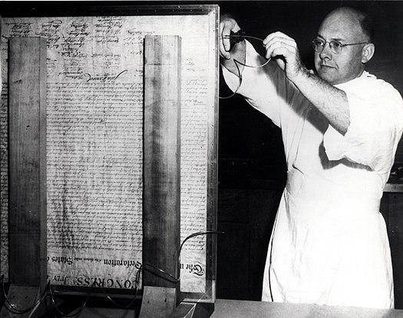
WHAT DOES PRESERVATION MEAN?
National Bureau of Standards preserving the U.S. Declaration of Independence in 1951

Slide 12
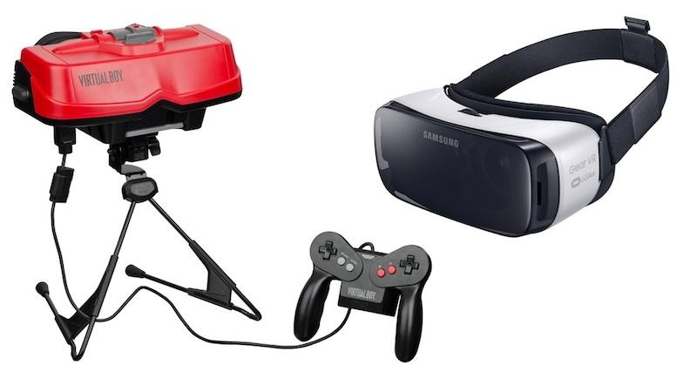
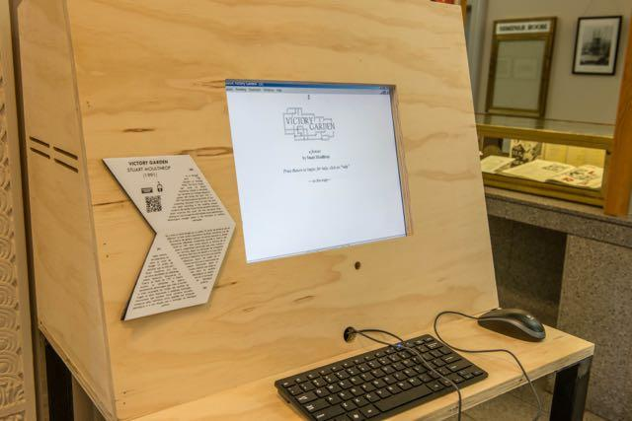

WHAT DOES PRESERVATION MEAN ?
EMULATION
Preserve the way it works in its original environment.
Notes:
The essential idea behind emulation is to be able to access or run original data/software on a new/current platform by running software on the new/current platform that emulates the original platform.
Victory Garden (1991) by Stuart Moulthrop from No Legacy || Literatura Electrónica, and exhibit about electronic literature, is one of the first hyper text novels and it was published by Eastgate Systems but since that technology is now obsolete, Washington State University at Vancouver's Electronic Literature Laboratory and The NEXT Museum, Library, and Preservation Space emulated this work in 2022 using javascript and HTML.
Many people have created emulatations of Nintendo’s Virtual Boy from the 1990s in order to play it.
EaaSI
Emulation-as-a-Service Infrastructure = EaaSI
Yale University Library – with support from OpenSLX, DataCurrent, PortalMedia, Educopia, and the Software Preservation Network, the EaaSI program of work is focused on the development of technology and services to expand and scale the capabilities of the Emulation-as-a-Service software. It has a sandbox with emulators that people can play around with.
https://www.softwarepreservationnetwork.org/eaasi-research-alliance/

Slide 13
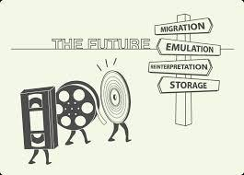
WHAT DOES PRESERVATION MEAN ?
MIGRATION AND FUNCTIONAL PRESERVATION
Update a project and its assets so it works in new environments.
Notes:
Migration: the conversion of data into a new format. Maybe think of it like VHS tapes getting converted to DVDs or a digital format
Does it mean updating a project so it works in new environments?
Maybe it means finding a technology other than the Leap Motion like with Whispering Galleries
For example, migrating to VR
Completely overhauling the code
But does this express the original experience participants may have originally had?
On the verge of VR
Grappling with a weird tool
Still some distance between the person and the experience (not immersive)

Slide 14
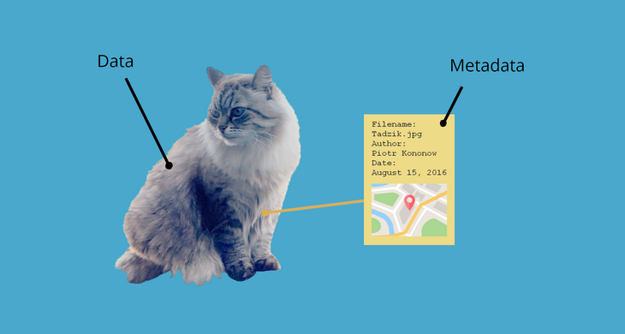
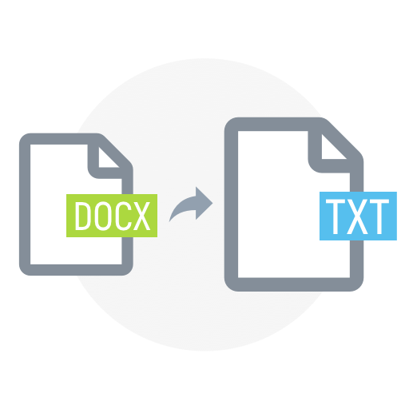
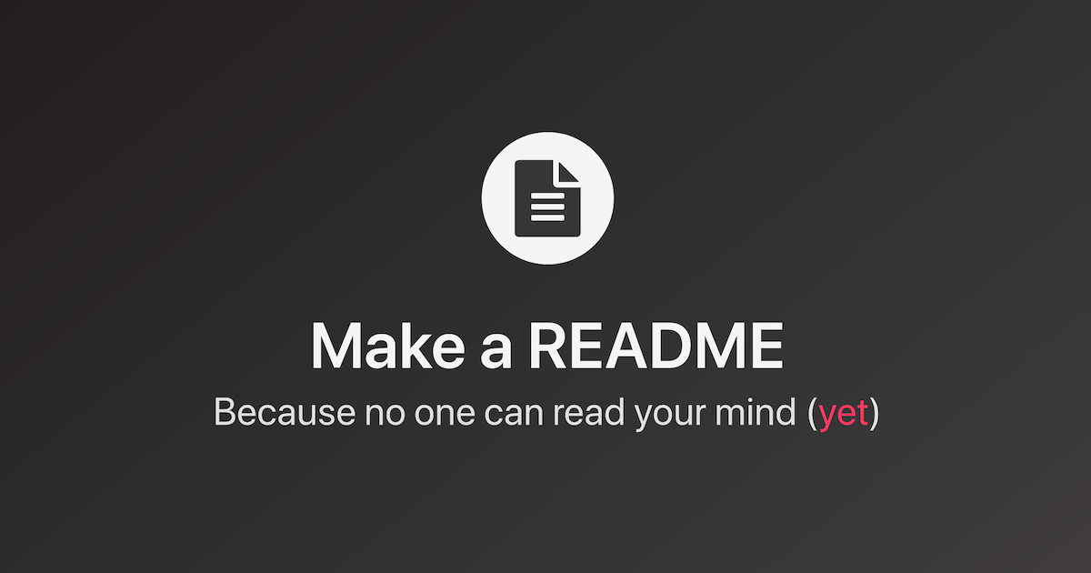
WHAT DOES PRESERVATION MEAN ?
DATA + DOCUMENTATION
Metadata, documentation in a variety of forms, preservation actions
Notes:
Documenting a project for future study
Preserving files, text, and the code in non-proprietary formats
Documenting/describing the technologies needed to run it--readme.txt file
Perhaps video recording someone using it
Metadata Encoding and Transmission Standard (METS)
The Metadata Encoding and Transmission Standard (METS) is a metadata standard for encoding descriptive, administrative, and structural metadata regarding objects within a digital library using the XML schema language of the World Wide Web Consortium (W3C). The standard is maintained as part of the MARC standards of the Library of Congress, and is being developed as an initiative of the Digital Library Federation (DLF).

Slide 15

SUNY preservation
Item records in one collection can be linked to other collections so that the content can appear in multiple collections
Dublin Core metadata schema is used for describing content
Web interface is used by authorized contributors to add items to collections
Creative Commons licenses can be assigned to content
While various file formats are supported, the most common are PDF, Word, JPEG, MPEG, and TIFF files
Due to their large size, contributors are asked to store video files in YouTube or other types of streaming services; links in item records can be added for accessing these videos
Notes:
https://sunyolis.libguides.com/olis/openaccess
https://dspace.sunyconnect.suny.edu/home?tl.page=10

Slide 16

DRYAD
UB supported data repository
Upload datasets for free
Provides data curation services for UB
Connected to Zenodo for upload of software and supplementary files
datadryad.org
Notes:
Example: DRYAD / DATA REPOSITORIES
Publishing data will allow others to make new discoveries with your data that you may not have anticipated.
Document your data so others can understand it.
Important note re. Licenses: Dryad applies a CC-0 license to all datasets uploaded. You can temporarily make uploaded datasets “private” till peer review, etc. is complete.
https://datadryad.org/

Slide 17
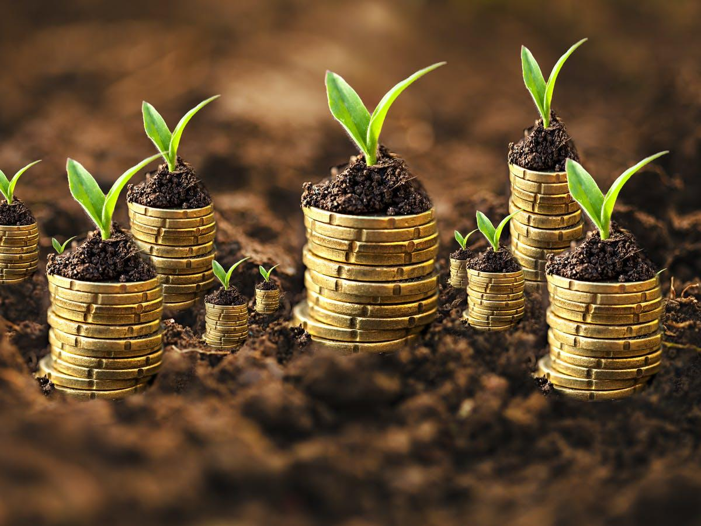
MAKE SUSTAINABLE DECISIONS EARLY

Slide 18
DOCUMENTATION
Have a strategy
Appoint a lead
Workflows will change; keep track
Notes:
One key piece of sustainability is documentation. Some fundamentals:
Establish a documentation strategy and a documentation lead.
Document your workflows as they develop.
Keeping track of generated data
Make it a team activity and effort.

Slide 19
DMPTool
Templates for 50+ funders
Guidance for researchers
Create and/or collaborate on DMPs
Used by 280+ institutions worldwide
dmptool.org
Notes:
One mechanism for bolstering your document is creating a data management plan (DMP):
Do you need a data management plan?
You do if you're applying for any government funding (e.g., NEH grant)
Could be helpful to any project, but especially one with lots of data
Consider DMP Tool
UB is a participating institution and this provides customized help with answering questions about funder requirements when creating your DMP.
The RDS Program can also help you with your DMP and guide you in using the DMPTool.
Example template/plan sections:
Roles and responsibilities
Expected data or assets generated
Period of retention
Data formats and planned dissemination
Storage and access
https://dmptool.org/

Slide 20
Protocols.io
Open access repository for research methods
Create and share detailed methods in published articles
Enable internal organization and tracking of research methods
protocols.io
Notes:
Complement to a DMP:
A free account gives you access to an open-access repository for creating, storing, and sharing research methods, featuring unlimited public protocols and workspaces, but you are limited to 2 private protocols or run records. Users can publish protocols with a DOI, edit, collaborate in teams, and access over 23,000 public methods.
Key Features of a Free Account:
Public Protocol Publishing: Unlimited ability to publish and share research methods, making them citable.
Access to Public Library: Read and use thousands of protocols from other researchers.
Private Content Limits: Generally restricted to 2 private protocols or active run records.
Workspaces: Create unlimited workspaces to collaborate with team members, including up to 10 external members.
Tools & Features: Access to version control, protocol optimization tools, and the ability to add comments or corrections to methods.
For unlimited private protocols and increased storage, a paid or institutional premium subscription is required.
Public content in protocols.io is archived in CLOCKSS, and there is a free public API allowing a snapshot of the entire protocols.io public content at any time. PDFs and JSON files of all public protocols are also mirrored in the open and searchable GitHub repository. For private protocols, every researcher can export all of their protocols and records in bulk as PDF or JSON files; there is also integration with OneDrive and Box for single-click export from protocols.io.
Example: Digital Scanning Recommendations (https://dx.doi.org/10.17504/protocols.io.bwr3pd8n)
https://www.protocols.io/

Slide 21
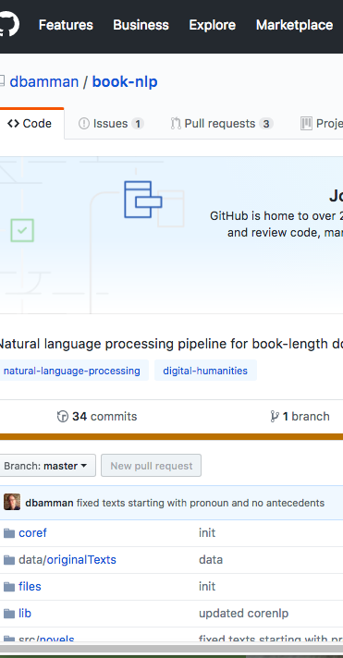
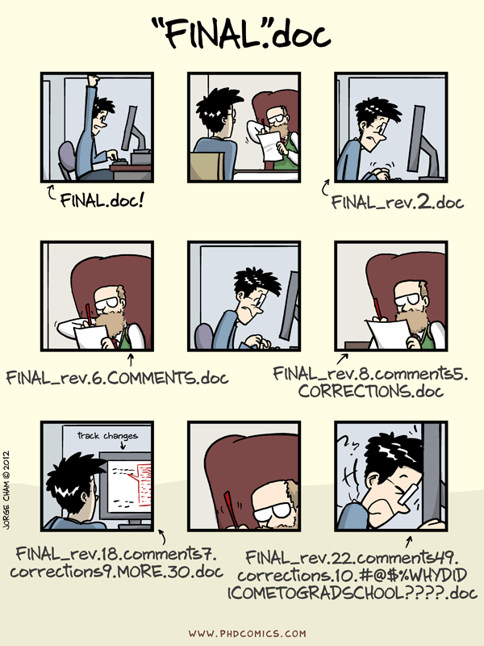
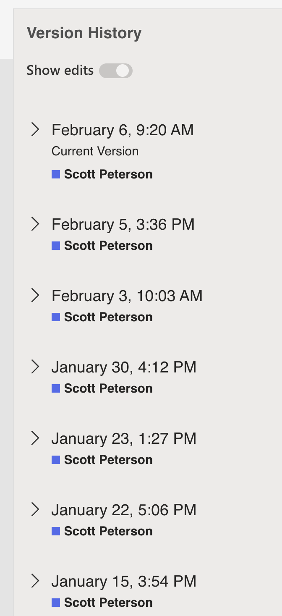
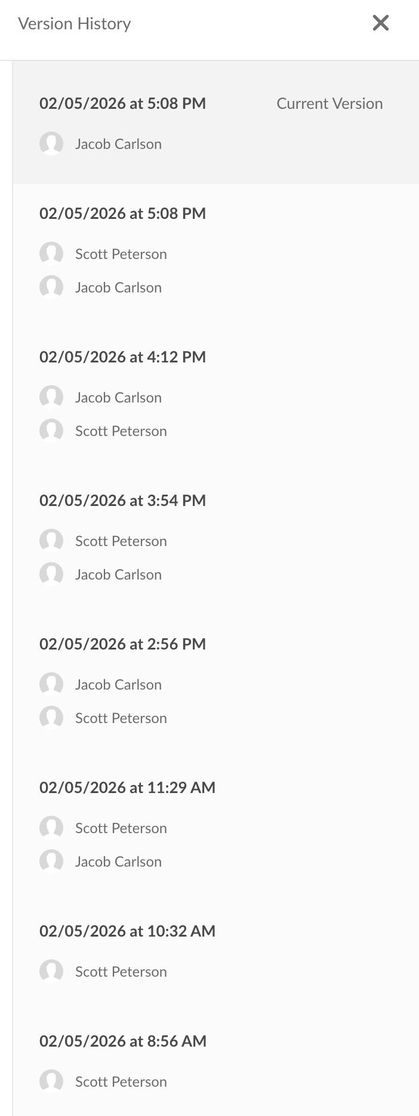
Sustainability strategy 1: VERSION CONTROL
Sustainability strategy 1: VERSION CONTROL
“notFinal.doc” by Jorge Cham, https://www.phdcomics.com
Notes:
Sustainability strategy 1: VERSION CONTROL
Use automated version control tools or features
in-app tools,
Word
Box
Git and GitHub
Version control = you know what changes you made not just what version it is.

Slide 22
Sustainability strategy 2: FILE NAMES
Sustainability strategy 2: FILE NAMES
project_year_collection_archive_scannedPages_originalScanNumber.tiff
lsc_1791_not_agi_140_0589.tiff
lsc_1791_not_agi_141_0590.tiff
lsc_1791_not_agi_142_0591.tiff
Notes:
Sustainability strategy 2: FILE NAMES
Establish standardized file naming conventions
Be descriptive and consistent.
How will you be looking for files later?
Include metadata in filename
Consider how they will sort
Conventions
Avoid starting with punctuation.
Avoid spaces.
Example from Louisiana Slave Conspiracies: https://lsc.berkeley.edu/content/louisiana-slave-conspiracies

Slide 23
Sustainability strategy 3: FILE TYPES
.txt
.csv
.json
.xml
.tiff
.mp4
.pdf (PDF/A)
Non-proprietary formats
Uncompressed
Unencrypted
Commonly used
Notes:
Sustainability strategy 3: FILE Types
Start off in non-proprietary formats if possible,
or migrate to them later
If migrate later, keep originals if possible,
data may be lost
Best in uncompressed formats
Unencrypted
Are in common use
List of open formats: https://en.wikipedia.org/wiki/List_of_open_formats
Example from Mapping Inequality: https://dsl.richmond.edu/panorama/redlining/#loc=5/39.1/-94.58

Slide 24
ACTIVE STORAGE
How you will store, share, and backup
your data?
Store in the cloud and locally
3-2-1 Rule
Organize with future uses in mind
Backup regularly
Notes:
ACTIVE STORAGE
Store your archived files in multiple locations and in different types of platforms.
Example store both on a local hard drive and two cloud storage platforms (e.g., Box, OneDrive).
Mention 3-2-1 rule for backup: Keep at least three (3) copies of your data, and store two (2) backup copies on different storage media, with one (1) of them located offsite.
Schedule regular file backups.
During your research project, your data management plan and best practices should come together in a way that facilitates the project, rather than gets in its way.

Slide 25
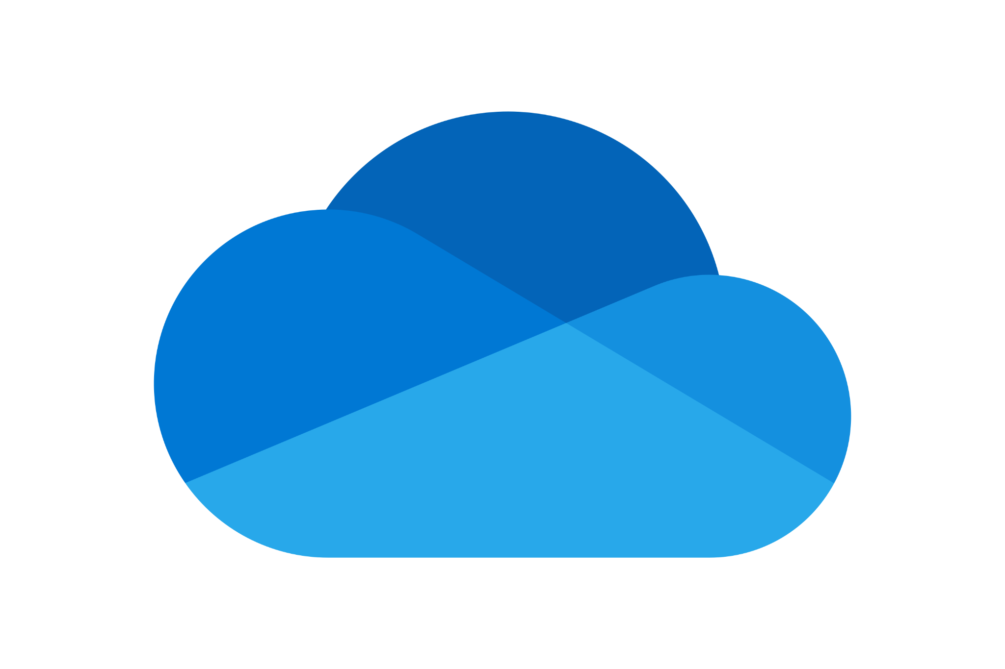

UB Storage Options
Enterprise version of Box
128GB per individual
Cloud-based, accessible from anywhere, easy file sharing and collaboration.
Data protection Level: 1-3
(Special account for restricted data cat 1 data)
Enterprise version of OneDrive
128 GB per individual
Seamless integration with Microsoft 365 apps, real-time collaboration.
Data protection Level: Cat 2-3 (SharePoint security configurations can be used with cat 2 data)
Manage access permissions
Establish a shared storage strategy
Notes:
Services like UBbox and OneDrive can serve as an excellent backup location for your important files, automatically syncing them to the cloud.
RDS storage page: https://library.buffalo.edu/research/rds/education/storage.html
In both cases, important to use UB affiliated version of these tools, not your personal log-in ones.
BOX
Store digital assets in Box
Can sync with a local hard drive
Backed up regularly without your intervention
Allows for sharing
https://www.buffalo.edu/ubit/services/box/overview.html
OneDrive
Store digital assets
Unlimited storage (for now)
Allows for sharing

Slide 26


Licenses
CC0
(Waiver)
CC-BY
(License)
Creative Commons licenses are a gold standard.There is also MIT License & GNU General Public Licenses -- for software (essentially CC-BY)
creativecommons.org
Notes:
A last tips is to consider COPYRIGHT AND CREDITS:
Keep track of copyright of the materials going into your project
And any privacy or ethical concerns over the data
Determine copyright and usage rights for your materials
Keep track of who is involved and what their contribution was
Creative Commons is a Global organization that promotes the sharing and reuse of creative, educational, and scientific works by supplying standardized public licenses that anyone can use to permit reuse of works they created or to which they own the rights.
The primary tools are six flavors of copyright licenses, a copyright waiver and a label that indicates that a work is free from copyright in the public domain (Public Domain mark and CC0 are not licenses bc you’re not reserving or granting any rights)
These are designed for creators who have different appetites for reuse of their works
https://creativecommons.org/

Slide 27
SUSTAINABLE TOOLS & PLATFORMS

Slide 28
ALL PLATFORMS
Maintenance & Updates
Migration
Obsolescence
Notes:
Understand that all tools and platforms may require maintenance, updates, and migration.
Make decisions with an awareness of obsolescence.

Slide 29
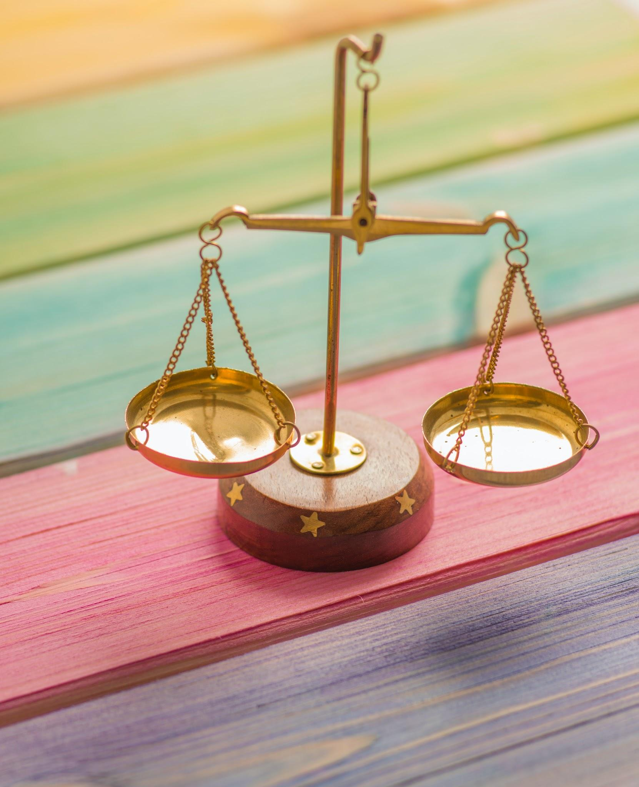
Balance customization with sustainability
Balance customization with sustainability
Photo by Elena Mozhvilo on Unsplash
Notes:
Balance customization with sustainability:
Custom code
Plugins
Specially designed websites and themes
Boutique files
Nonstandard practices

Slide 30
LOOK FOR TOOLS THAT...
Open source
Heavily used in your community
Robust community support
Established a long and proven history
Notes:
When possible, choose sustainable tools, especially those that are:
open source,
heavily used in your community,
have a robust support community, or
have established a long and proven history.

Slide 31
UNIVERSITY-SUPPORTED
Local support
Pre-researched
Migration strategy
Notes:
UNIVERSITY SUPPORTED
If possible, use a platform that is institutionally supported or affiliated.
University-supported platforms may have a longer staying power, and
They may have a managed migration strategy if platforms are changed.
Understand the limits of the services and platforms of your university.

Slide 32
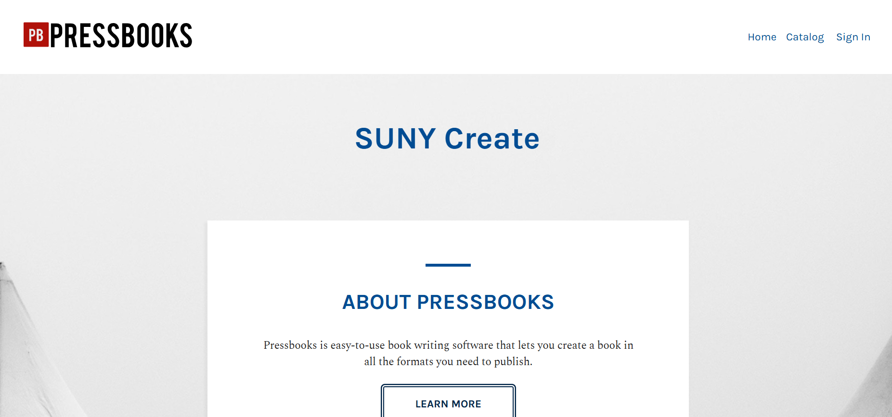
pressbooks.sunycreate.cloud
Notes:
https://pressbooks.sunycreate.cloud/
https://research.lib.buffalo.edu/affordable-and-open/pressbooks
Example: Pressbooks
Platform for publishing open educational resources and other online books.
Experts have assessed for you if this is a sustainable and reliable platform.
Extensive support from the Library's Scholarly Communications team
Services: approve shell requests
Easy transfer: you can easily clone and make a personal copy
Export work in standard formats.
They will guide you in preservation decisions,
such as exporting and adding your work as a book to UBIR

Slide 33
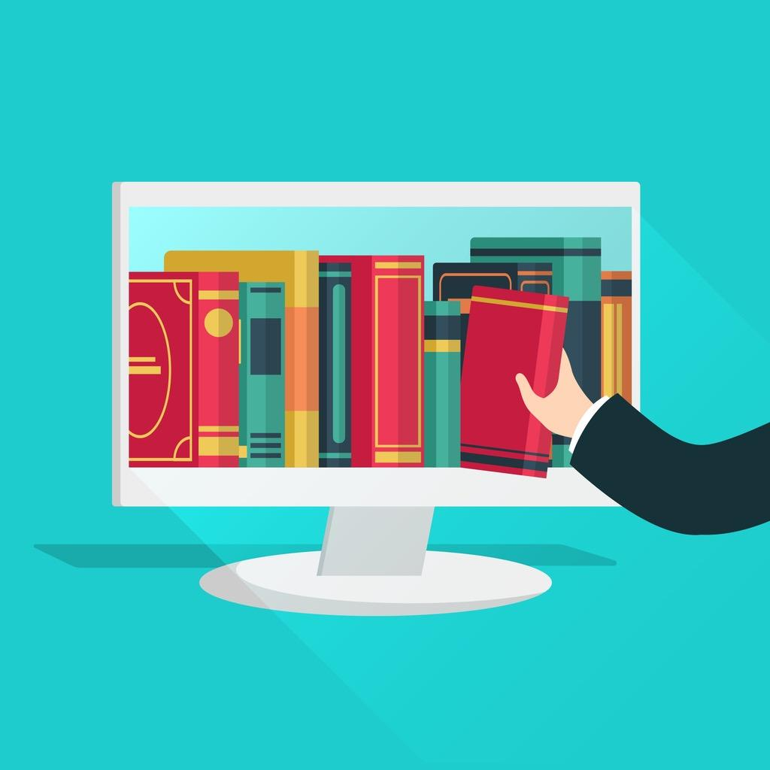
HOW TO PRESERVE YOUR WORK
Image by Olga Kurbatova

Slide 34
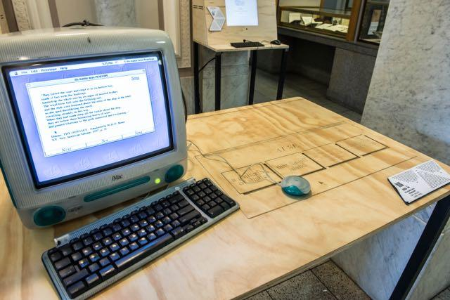
WILL THE LIBRARY COLLECT IT?
Notes:
WILL THE LIBRARY COLLECT IT?
Maybe not, But it’s better to make your project "collection ready."
You may need to be your own steward for some time.
Reach out and ask about this, and librarians and the RDM team can provide guidance.
There may be aspects of your work that can be collected
And the library may offer or know of tools and repositories you can use to do this.

Slide 35
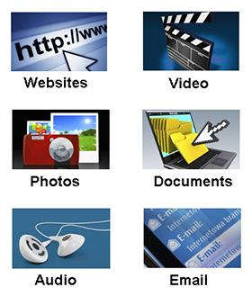
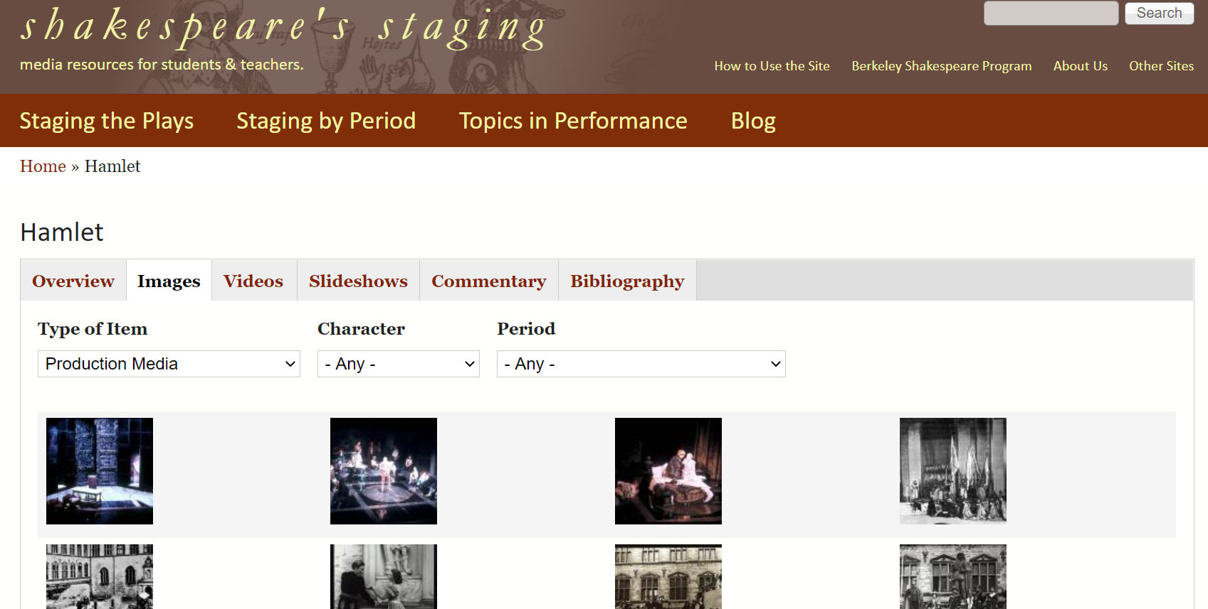
Break Up Your Project & Preserve the Parts
Notes:
Break up your project and preserve the parts
As we have pointed out, it will be easier to archive if you divide your project into its component pieces like Shakespeare’s Staging
Some pieces may be more important for you to preserve than others
Example: you created a digital archive of sound recordings
In the long run, you don't care so much about the website itself
But you do wish to preserve the audio files.
Different components of your project can be stored differently and in different places
Mention 3-2-1 rule for backup: Keep at least three (3) copies of your data, and store two (2) backup copies on different storage media, with one (1) of them located offsite.
https://shakespearestaging.berkeley.edu/

Slide 36
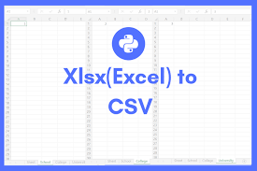
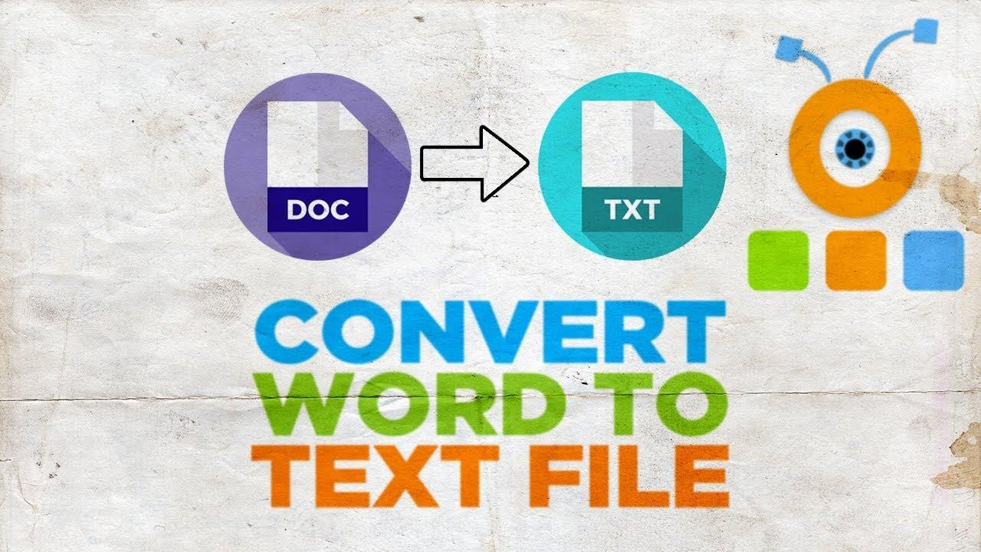
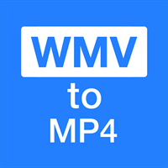
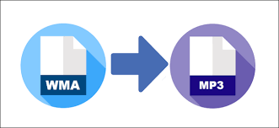
CONVERT FILES
Notes:
CONVERT FILES
Convert files to standard formats and plain text if not already. You don’t want to preserve proprietary formats, as this might make it harder to access the files down the road.
Note if you might lose data in conversion
Convert proprietary -> open
Library/RDS team can help find tools

Slide 37

THINK LIKE AN OUTSIDER
Get rid of duplicate or superfluous materials
Specify versions
Make file names consistent
Consider file structure
Add dates as needed
Notes:
THINK LIKE AN OUTSIDER
Imagine you're a person 50 years later trying to make sense of your materials. Could you?
Ask yourself if your files would make sense to an outsider, and change file names and file structure accordingly.
Get rid of duplicate and superfluous materials
Clarify versions
Add dates
Think about how an art conservator deals with time-based media artworks.
The conservation of these artworks entails documenting their creation and installation, planning for their exhibition, and performing preservation, conservation, and restoration work on the art where every reinstallation introduces some extent of interpretation

Slide 38
readme.txt
Project summary and description
Development of the project, including dates
Tools, platforms, & standards used and their versions
Copyright and usage information
Team members and credits
Notes:
README.TXT
Add a readme.txt file.
Describe the project summary and description.
Describe the development of the project, including dates.
Identify any tools or platforms used and their versions, be as specific as possible.
Include copyright and usage information.
Identify team members and credits.
If you go to a project on GitHub, you will most likely see a readme.txt file in each project.
.

Slide 39
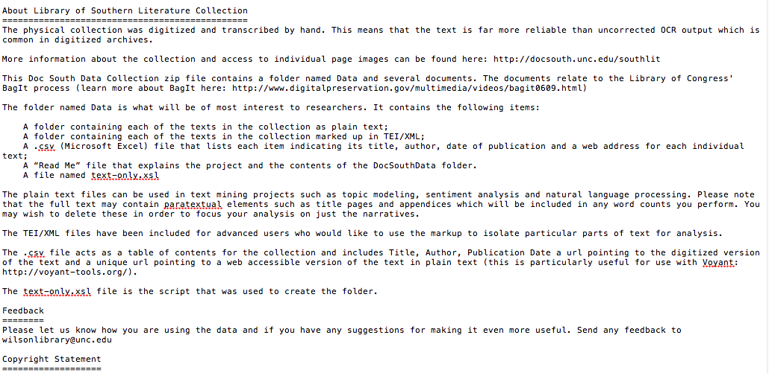
readme.txt
readme.txt docsouth.unc.edu/southlit
Notes:
EXAMPLE OF README.TXT
Library of Southern Literature Collection
This tells how the collection was digitized--by hand, not OCR--what is in the folder--plain text, .csv, and TEI/XML files, how they can be used--text analysis, Topic Modeling--a copyright statement.
https://docsouth.unc.edu/southlit/

Slide 40

Exit Interviews
Notes:
EXIT INTERVIEWS
Consider exit interviews or final reports from team members, so that they can pass their knowledge of the project on to you and others.

Slide 41
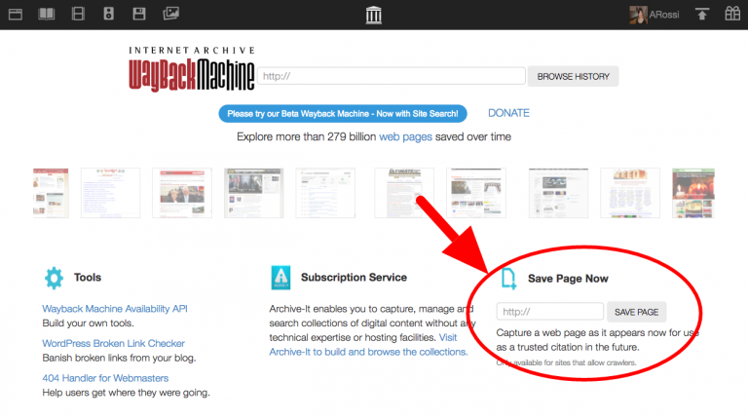
The Wayback Machine
https://web.archive.org/
Notes:
Web Archiving
If your project has a web component, look into the possibility of web archiving (e.g., Archive It).
Look for a tool in the wild (e.g., SiteSucker)
Then add the files to a repository
Look at your platform to see if there is a way to export content. (Note: database-driven platforms often need the software package to play)
Save pages to Waybackmachine- new blog post with details about this upgraded feature: https://blog.archive.org/2019/10/23/the-wayback-machines-save-page-now-is-new-and-improved/
Save Page Now (SPN) features:
all the “outlinks” of a web page with a single click. By selecting the “save outlinks” checkbox you can save the requested page (and all the embedded resources that make up that page) and also all linked pages (and all the embedded resources that make up those pages).
When users are logged in with their free Archive.org account, SPN-generated archives can be saved to that user’s “My web archive” public gallery of archived pages.
https://web.archive.org/

Slide 42
EXPERIENCE & INTERACTIVITY
Preserve interactiveness
Document interactive components
Discard interactive components
Notes:
EXPERIENCE AND INTERACTIVITY
if your project has an interactive component these can be challenging to preserve
You have 3 questions to ask
How important is it to preserve that interaction for new users?
Or do you just need to document that interaction?
Some degree of documentation is probably best
Or is it relevant to your project at all?

Slide 43
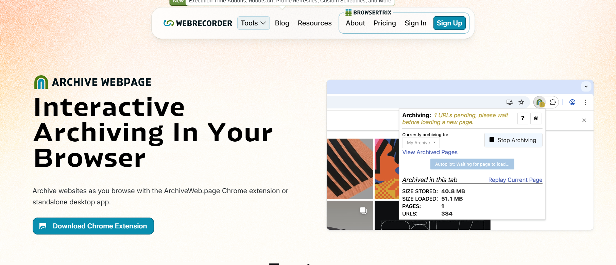
Archive Webpage
webrecorder.net/archivewebpage/
Notes:
Archive Webpage: Chrome extension and desktop application for web archiving
Capture websites via browser
Download as WACZ files (Web Archive Collection Zipped) and WARC files (approved for web archives)
Note: Browsertrix, a related tool, requires paying
https://webrecorder.net/archivewebpage/
.

Slide 44
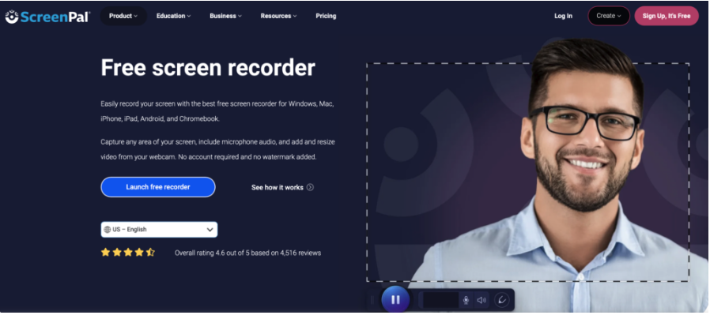
ScreenPal
screenpal.com
Notes:
This is ScreenPal now
https://screenpal.com/
SCREENCASTING AND SCREENSHOTS
Consider screen recording interactive aspects of the project
Screencast O'Matic
Mac users: you can use QuickTime
Camtasia or Captivate
Even screenshots could be helpful

Slide 45
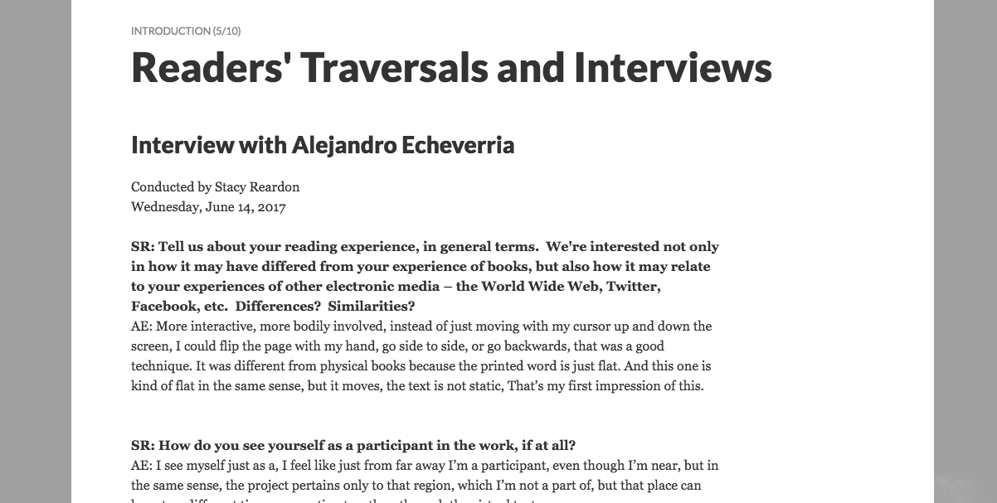
RECORD USERS INTERACTING WITH THE PROJECT
Notes:
RECORD USERS INTERACTING WITH THE PROJECT, DO INTERVIEWS
Interview with Alejandro Echeverria by Stacy Reardon, UCB DH and literatures librarian about the Whispering Galleries Project.
Alejandro was acting in the role of a user/audience member of the digital project. So he went and explored Whispering Galleries without a particular agenda. While he did so, he spoke aloud to convey what he was thinking as he tried different things and read the work, which Stacy recorded. At the end, Stacy asked him some follow-up questions. It's meant to record what it is like for an audience to experience the project in real time in the way it was originally conceived in the event that one day the project can't be experienced directly anymore.
Video record audience members/participants engaging with those aspects of the project.
Follow-up interviews or
usability studies-styled walk throughs may also be desirable.
"Speak aloud"
In the Whispering Galleries example, a researcher engaged with the project and spoke aloud as he was using it.
This was recorded and posted as part of the documentation
A follow-up interview sought to further bring out elements of the experience.

Slide 46
MORE

Slide 47
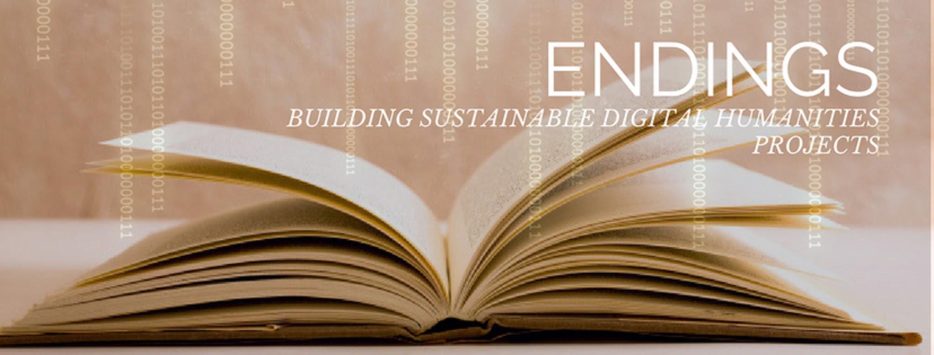
Endings
onlineacademiccommunity.uvic.ca/endingsproject
Notes:
ENDINGS
Endings: Concluding, Archiving, and Preserving DH projects for Long-Term Usability
4 case studies of U of Vic projects
Tool kits to aid DH implement best practices in ending and archiving
Team: Stewart Arneil, Claire Carlin, Ewa Czaykowska-Higgins, John Durno, Lisa Goddard, Elizabeth Grove-White, Martin Holmes, Matt Huculak, Janelle Jenstad, Greg Newton
https://endings.uvic.ca/index.html

Slide 48
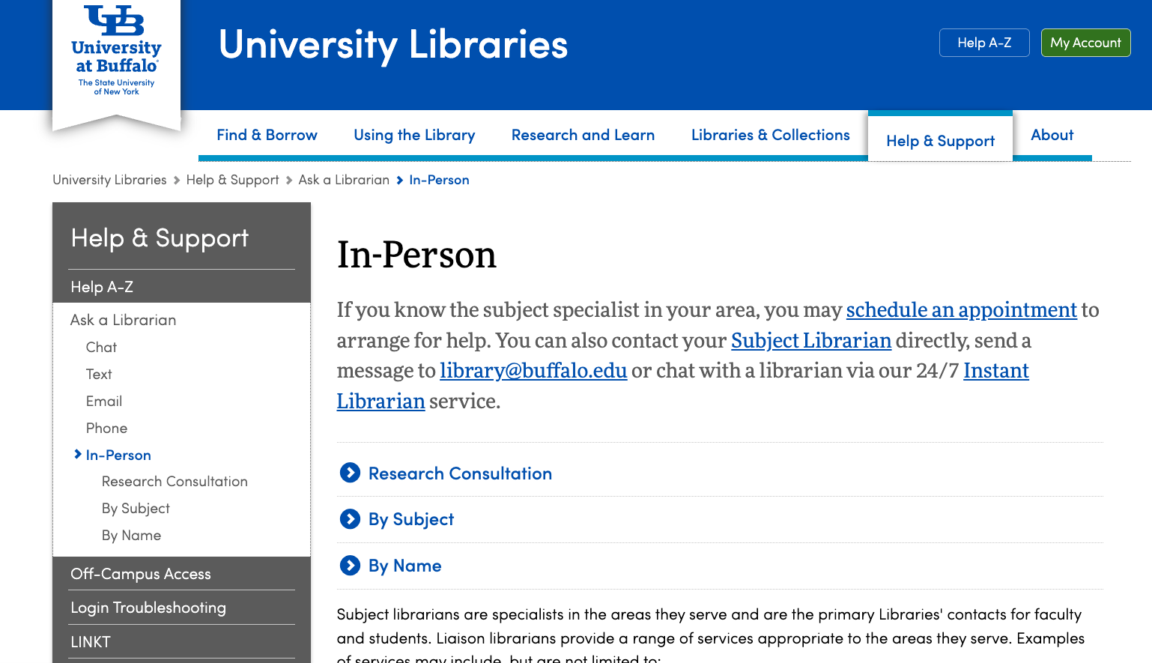
Library Help
https://library.buffalo.edu/help-support/askalibrarian/inperson.html
Notes:
TALK TO A LIBRARIAN
https://library.buffalo.edu/help-support/askalibrarian/inperson.html

Slide 49
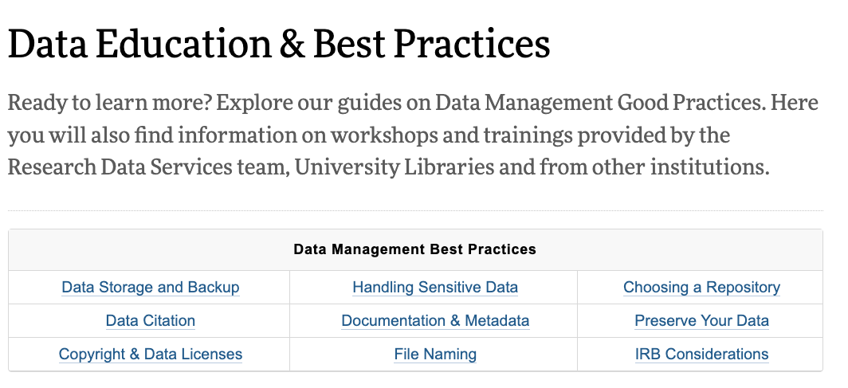
Research Data Services Data Education and Best Practices page
https://library.buffalo.edu/research/rds/education.html
Notes:
https://library.buffalo.edu/research/rds/education.html

Slide 50
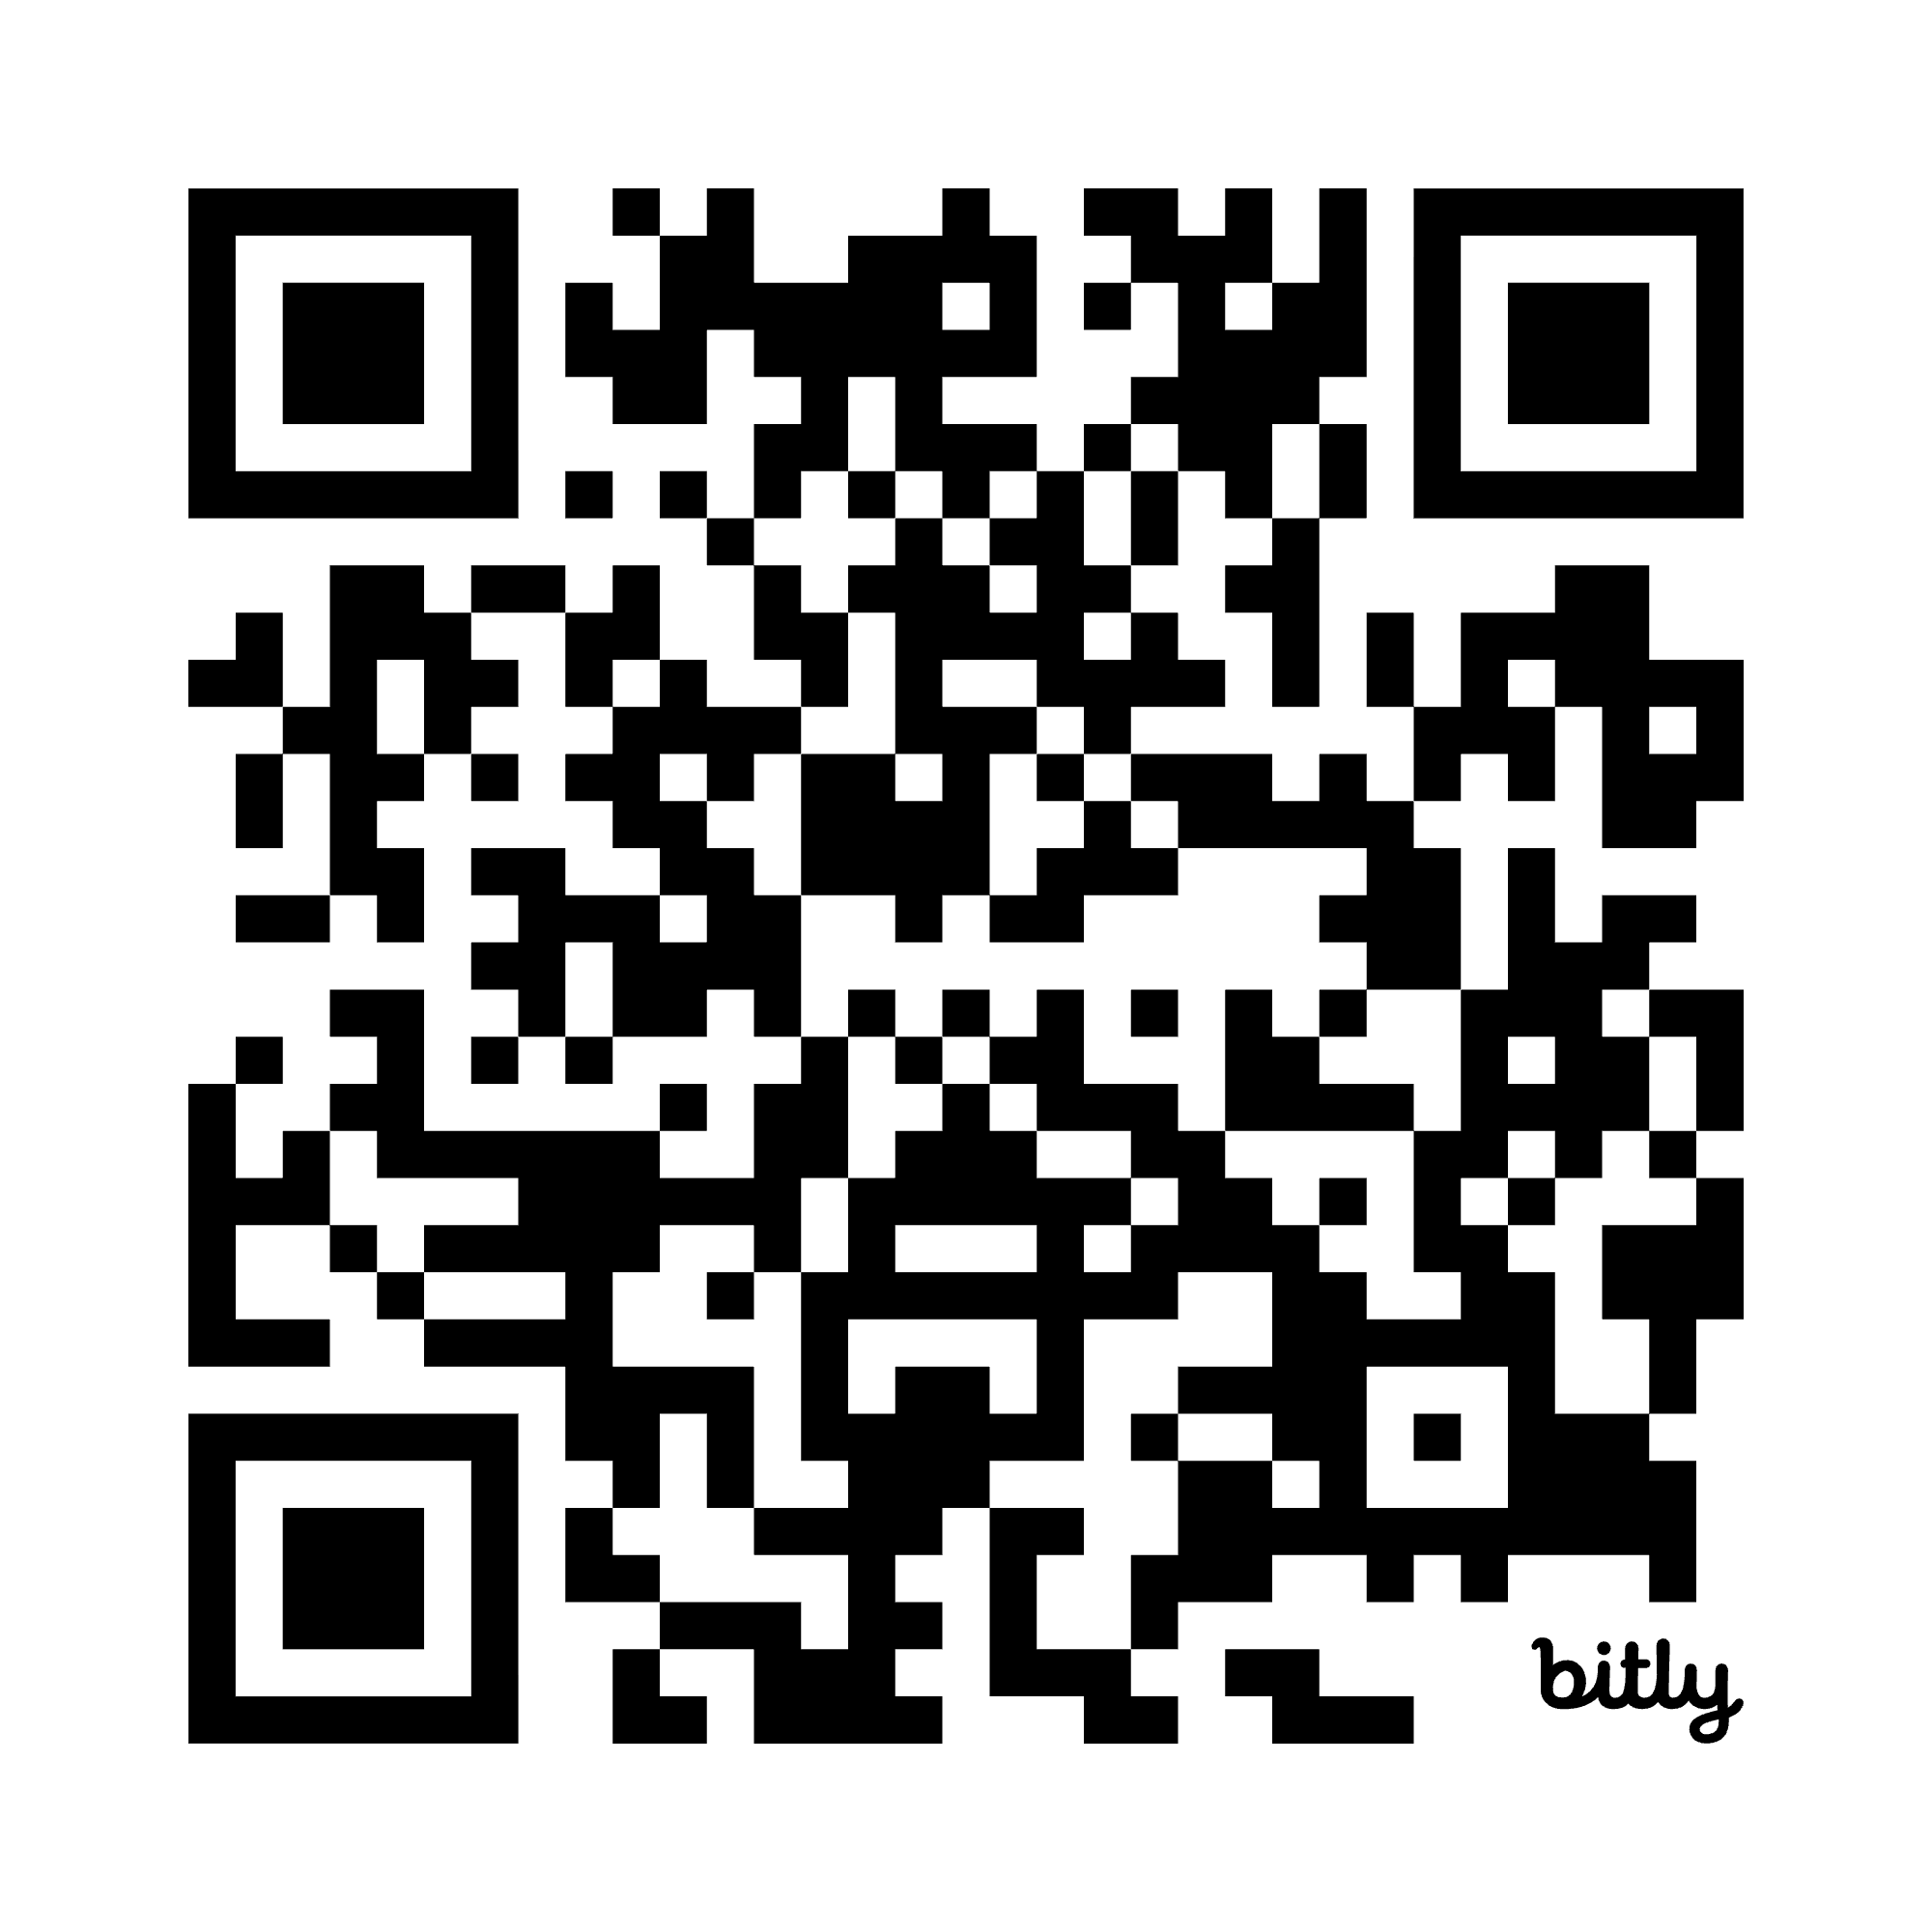
UB Research Data Services Program
Email: dataservices@buffalo.edu
Services
Data Discovery & Access
Data Management Plans (DMSP)
Data Curation, Organization & Storage
Data Sharing, Archiving & Preservation
Data Education & Best Practices
Workshops & Trainings
Consultations
bit.ly/UBDATASERVICES

Slide 51
UB Research Data Services Program
Email: dataservices@buffalo.edu
Upcoming Spring Workshops
Research Data Management Essentials
Tidy Data Principles
Intro to the Unix Shell part 1
Intro to the Unix Shell part 2
Intro to OpenRefine
Intro to R: R & RStudio
Intro to R: Dataframes
Intro to R: Visualization
Office Hours following each workshop
bit.ly/UBDATASERVICES
Notes:
Google Doc with resources from this presentation: https://docs.google.com/document/d/10Xfzhu9ny3s8F2jbz3sInHvHSZJIOY4T5H8dqUiKR8E/edit?usp=sharing

Slide 52
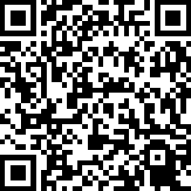
UB Love Data Week Feedback Survey
bit.ly/UBLDW26
Notes:
Survey Link:
https://sunybuffalo.qualtrics.com/jfe/form/SV_beCZ9hrdjc5HomG?Q_CHL=qr

