Slide 1
Maintaining Employer Continuity for TA, GA, and RA Long Term Appointments
Ensuring seamless employment, pay and benefits for compliant student appointments
Notes:
---

Slide 2
WHY IS THIS A CURRENT INITIATIVE OF THE UNIVERSITY AT bUFFalo?
The University at Buffalo has decided it in the best interest of the student not to change payrolls and benefits and potentially impact them significantly.
In 2024, The University at Buffalo under the sponsorship of many academic and administrative offices initiated a large cross-sectional group of faculty and staff to engage on evolving the student and graduate funding experience. Taskforces delivered their findings and recommendations in Spring and Summer, 2025. One of the two taskforces recommended (approval was obtained) that at appointment, employment duties and offers of employment must occur at the same time and even drafted drat templates for consideration. Phases of this approval start in January of 2027.
The University at Buffalo must support the current and future collective bargaining agreements of our participating colleagues and all associated federal and state employment and labor requirements .
Notes:
RA - https://rfsuny.photoshelter.com/galleries/C0000DcWdz4dureA/G0000KQ5wkDnzl28/I00001isgDp_UA7o/Research-Aide-pdf

Slide 3

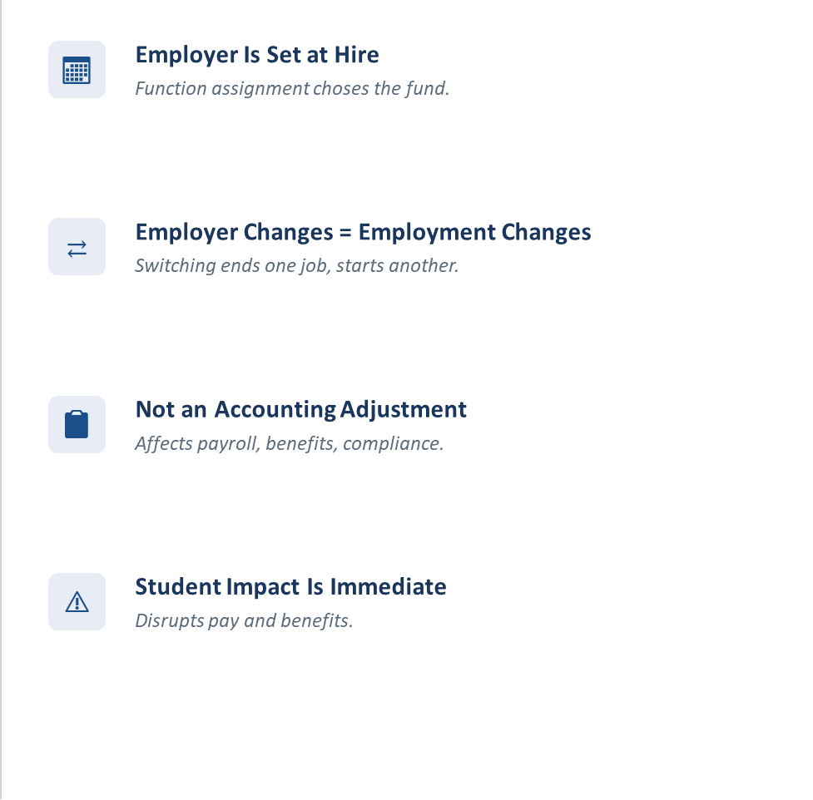
Fund Type at HIre

Slide 4
Base STATE Appointment Type Title Descriptions
GRADUATE ASSISTANT, assists faculty members in classroom and laboratory assignments, while concurrently pursuing graduate studies. Does related work as required. Provides support for faculty members by assisting in teaching, reading papers and examinations, preparing bibliographies, and performing other ancillary tasks; assists academic staff in assignable phases of individual and departmental research activities; supplies other types of support for departmental functions as requested.
STUDENT ASSISTANT perform a variety of paraprofessional, technical, and professional duties in support of agency programs. All positions are temporary and filled only by part-time or full-time undergraduate and graduate students of colleges recognized by the New York State Education. Non-competitive roles; student gains work experience, which may be related to an individual’s area of formal educational study, by assisting professional staff in
support of an agency program; duties are assigned commensurate with an individual's
level of education and experience.
TEACHING ASSISTANT, performs teaching assistance at a campus, while concurrently holding graduate student status. Does related work as required. Assists faculty members by teaching part-time in undergraduate classes; supplements faculty instruction and classroom supervision of a faculty member.
Notes:
Slide highlights SUNY State Title/Position descriptions. An important item of note is that it is permissible per GA position description for a component of a GA’s responsibilities to include assistance with research activities. Under current practice if a GA contributes towards a research project within their GA role there is no chargeback to the grant for direct salary costs and thus no indirect earned. Likewise it is permissible for a GA to assist a faculty member with teaching. While GA’s assist faculty with teaching, TA’s perform undergraduate teaching. Also, its important to note the absence of research activities from the TA position description. The student assistant position may be filled by an undergraduate or graduate student. Assignment of the Student Assistant title is dependent on the nature of the workload; non-technical, paraprofessional.
GA - https://www.suny.edu/hr/compensation/unclassified/g/graduate-assistant/
TA - https://www.suny.edu/hr/compensation/unclassified/t/teaching-assistant/
SA - https://www.cs.ny.gov/tsplan/tsp_getpage.cfm?specCode=2883100F

Slide 5
Base RESEARCH FOUNDATION - Research Assistant Appointment Type Title Description
RESEARCH ASSISTANT, assists project investigators, with the collection, organization and maintenance of research data. Assist in analyzing data, summarize findings and contribute to the interpretation of the data. Assist in report preparation, documentation of methodologies, procedures and set up. Provide technical assistance of lab equipment, specialized tools. Assist in administrative tasks such as scheduling, coordinating participants and managing communications.
Notes:
RA - https://rfsuny.photoshelter.com/galleries/C0000DcWdz4dureA/G0000KQ5wkDnzl28/I00001isgDp_UA7o/Research-Aide-pdf

Slide 6


Planning and Oversight Expectations
Careful Appointment Planning
Determination of job functions and assignment are mandatory at time of appointment and funding follows. Confirm full funding availability and identify funding sources before appointments. January rollout of joint appointment/offer letter templates - usage will be mandatory.
Maintain Employer Consistency
Keep students on the same employer with long term assignments at initial hire to avoid unilateral changes and complications.
Some exceptions apply where duties abruptly end for significant documented and approvable reasons that comply with CBAs and university approach and original long-term appt./offer letter.
Early Coordination
Anticipate funding constraints and coordinate early with administrative partners to prevent disruptions.
Support Compliance and Efficiency
Thoughtful planning at appointment/ employment offer protects students and ensures institutional compliance and operational efficiency.
Notes:
Supervisors are expected to plan carefully before offering or extending TA, GA, or RA appointments. This includes confirming that funding is available for the full appointment period, identifying anticipated funding sources, and discussing any potential risks or timing gaps with the unit business office. Supervisors should prioritize keeping students on the same employer used at initial hire and avoid making unilateral changes. When funding constraints are anticipated, early coordination with administrative partners is one of the most effective ways to protect students from avoidable disruptions. Thoughtful planning not only safeguards students but also supports institutional compliance and operational efficiency.

Slide 7
Funding Strategies and Support
Salary Recovery Benefits
  Salary recovery helps maintain employer continuity by charging eligible work to sponsored awards while preserving payroll/benefits status.
Fund Swaps Usage
  Fund swaps cover funding gaps.
Notes:
There are funding strategies that may help maintain employer continuity when challenges arise. Salary recovery may allow eligible work to be charged to a sponsored award while keeping the student on their existing State employer payroll, thereby avoiding benefit loss and payroll disruption. Fund swaps may be used in short-term, unplanned situations to bridge unexpected funding gaps, but they are not intended for ongoing or planned needs. Both approaches require confirmation of allowability and appropriateness through the UBO or RASC Finance Manager. Supervisors should rely on these experts to guide decision-making and ensure proper use.

Slide 8
Salary Recovery Facts
Student Salary recovery is similar to faculty salary recovery.
Salary charges are placed on grant and the state is reimbursed by the Research Foundation.
Student salary recovery represents salary only, no fringe.
Salary Recovery fee does not apply to student salary recovery.
A separate and distinct IFR account is utilized to collect student salary recovery.

Slide 9
How to initiate Salary Recovery ?
Gather the details:
    Appointee name and person number
    Appointee supervisor
    Appointee academic department
    Appointment FTE% and hours per week
    Appointment payment amount. List as biweekly, hourly or total amount
    Appointment PTA (project, task, award)
    Appointment start date and end date
    Appointment Title: Research Aide, Research Project Assistant, etc.
    Appointment Type: Graduate MS, Graduate, PHD, undergrad, etc.
    PI Name and Email
    Student IFR Salary Recovery Account
Contact your RASC Unit Financial Manager

Slide 10
What is A Fund Swap?
Initiated only by the Unit Business Officer (UBO)
Standard swap rules apply: one funding source replaces another
Unit Business Officer utilize form for swap request.

Slide 11
Decision Tree

Slide 12
SHORT TERM APPLICABILITY CHART

Slide 13
Long term applicability chart

Slide 14
examples

Slide 15
Example A: Position Responsibilities outside of base appointment(State)
Scenario: Student has primary long-term responsibility for teaching undergraduate science labs which will be known at appointment/offer letter, however, will also work with a PI on a research grant deliverable. Research activity is outside of the student's core research.
Implementation
Student is appointed as a Teaching Assistant on state payroll based on core long term responsibility identified. PI identifies student maintenance of effort on grant for desired services. Salary recovery conducted on student stipend salary, whereby grant is charged for services rendered and reimbursement for services rendered is provided to the state and deposited to IFR account. State entity is made whole for services rendered outside of core appointment.
Pro’s – Consistent procedure for all University constituents. Student maintains one employer; grant assessed for services rendered and stipend cost matched with reimbursement from Research Foundation.

Slide 16
example B : Position Responsibilities outside of base appointment(RF)
Scenario: Student has primary long-term responsibility for PI research support known at the time of join appointment/offer letter. Grant ends mid-way through semester however the PI would like to retain the services of the student despite not having a viable grant to charge for continued salary costs. The PI does not have access to indirect cost funds to support student appointment but does have IFR funding based on historical salary recovery efforts.
Desired Implementation: Student is appointed as a Research Assistant on Research Foundation payroll based on core responsibility identified. Through the annual budget planning process, it is determined that the PI will not have adequate Research Foundation funds to support the entirety of the student appointment. Unit/UBO reviews icr funding at the department / unit level. A swap is conducted pulling IFR salary recovery funds to the Dean and in return icr funding is provided. In the event school does not have adequate icr funding to support swap, request is made through annual resource planning process for a funds swap.
Pro’s – Student maintains one employer and thus no lapse in bi-weekly salary payment or benefits.

Slide 17
Example C: Example A With Summer RF Position outside of base appointment(State)
Scenario: Student has primary long-term responsibility for teaching undergraduate science labs which will be known at appointment/offer letter as a 10-month TA/GA appointment, however, will also work with a PI on a research grant deliverable. Research activity is outside of the student's core research. 10-month TA/GA can be appointed to a RF Hourly or Salaried Graduate Employee for the summer (See Long Term Applicability Chart) for the summer returning to original appointment/offer of employment status.
Implementation
Student is appointed as a Teaching Assistant on state payroll based on core long term responsibility identified. PI identifies student maintenance of effort on grant for desired services. Salary recovery conducted on student stipend salary, whereby grant is charged for services rendered and reimbursement for services rendered is provided to the state and deposited to IFR account. State entity is made whole for services rendered outside of core appointment. For the summer, refer to the 10-month appointment guide on the website. Paid according to summer status for the summer.
Pro’s – Consistent procedure for all University constituents. Student maintains one employer; grant assessed for services rendered and stipend cost matched with reimbursement from Research Foundation while maintaining summer flexibility.

Slide 18
Example D : example B Position Responsibilities outside of base appointment(RF)
Scenario: Student has primary long-term responsibility for PI research support known at the time of join appointment/offer letter as an RPA. Grant ends mid-way through semester however the PI would like to retain the services of the student despite not having a viable grant to charge for continued salary costs. The PI does not have access to indirect cost funds to support student appointment but does have IFR funding based on historical salary recovery efforts. If no obligation exists for the summer, can be appointed to 1) RF Hourly Graduate Employee or 2) State Hourly Student Assistant or Summer State Lecturer 10 because an RPA is considered an exempt employee by SUNY Research Foundation. Refer to Long Term Applicability Chart on website.
Desired Implementation: Student is appointed as a Research Assistant on Research Foundation payroll based on core responsibility identified. Through the annual budget planning process, it is determined that the PI will not have adequate Research Foundation funds to support the entirety of the student appointment. Unit/UBO reviews icr funding at the department / unit level. A swap is conducted pulling IFR salary recovery funds to the Dean and in return icr funding is provided. In the event school does not have adequate icr funding to support swap, request is made through annual resource planning process for a funds swap. Paid during the summer per summer status.
Pro’s – Student maintains one employer and thus no lapse in bi-weekly salary payment or benefits and has summer flexibility if there is no summer obligation. Returns to RPA status for the fall per original appointment/offer letter.

Slide 19
SHORT TERM APPLICABILITY

Slide 20
Where to go for Help
State appointments: Angela Kuc at akuc@buffalo.edu
RF appointments: Bob Palmer at rp9@buffalo.edu and Stephanie Gruarin at sgruarin@buffalo.edu
Funding Issues : Business Services
Website: www.buffalo.edu/hr/ta-ga-ra-employer-continuity.html which will include the Decision Tree, Applicability Charts and Appointment Guides.

