Slide 1
What Do IQ Tests Measure?
Barry Smith
Romanell Workshop, March 10, 2018

Slide 4
Artiga: four major desiderata for an account of function
TELEOLOGY: reference to the function of an entity should play an important role in explaining why the entity exists.
NORMATIVITY: the function of an entity determines a criterion against which the activity of the entity can be normatively evaluated, which means: it can be evaluated as better or worse relative to some norm
ACCIDENT: An entity’s function is appropriately distinguished from its accidental effects (called “side-effects”)
EPIPHENOMENALISM: the function of an entity is determined by the entity’s current performance.

Slide 5
Artiga’s criterion of normativity
NORMATIVITY: the activity of the entity in realizing the function can be normatively evaluated, which means: it can be evaluated as better or worse relative to some norm

Slide 6
Prototype functionings of the heart
good functioning

Slide 7
Prototypes
reasonable functioning

Slide 8
Poor functioning
poor functioning

Slide 9
Malfunctioning
malfunctioning

Slide 10
Death?
not functioning at all

Slide 11
Artiga: four major desiderata for an account of function
TELEOLOGY: reference to the function of an entity should play an important role in explaining why the entity exists.
NORMATIVITY: the function of an entity determines a criterion against which the activity of the entity can be normatively evaluated, which means: it can be evaluated as better or worse relative to some norm
ACCIDENT: An entity’s function is appropriately distinguished from its accidental effects (called “side-effects”)
REJECT: EPIPHENOMENALISM: the function of an entity is determined by the entity’s current performance.

Slide 12
Artiga: four major desiderata for an account of function
TELEOLOGY: reference to the function of an entity should play an important role in explaining why the entity exists.
NORMATIVITY: the function of an entity determines a criterion against which the activity of the entity can be normatively evaluated, which means: it can be evaluated as better or worse relative to some norm
ACCIDENT: An entity’s function is appropriately distinguished from its accidental effects (called “side-effects”)
REALIZATION: the function of an entity is a disposition of the entity to perform (realize, execute, …)

Slide 13
Artiga: four major desiderata for an account of function
TELEOLOGY: reference to the function of an entity should play an important role in explaining why the entity exists.
NORMATIVITY: the function of an entity determines a criterion against which the activity of the entity can be normatively evaluated, which means: it can be evaluated as better or worse relative to some norm
ACCIDENT: An entity’s function is appropriately distinguished from its accidental effects (called “side-effects”) REDUNDANT, GIVEN TELEOLOGY
REALIZATION: the function of an entity is a disposition of the entity to perform (realize, execute, …)

Slide 14
Artiga’s list simplified
TELEOLOGY: reference to the function of an entity should play an important role in explaining why the entity exists
NORMATIVITY: realizations can be evaluated as better or worse relative to some norm
REALIZATION: the function of an entity is a disposition of the entity to perform in a certain way (to realize the function)
*Artiga, M. (2011). Re-organizing organizational accounts of function. Applied Ontology 6:105–124.

Slide 15
Realization = every function is a realizable entity
i.e. it is an attribute that only becomes manifest under certain conditions

Slide 16
Two sorts of realizable entity
externally grounded = role (student, employee, president …)

Slide 17
Two sorts of realizable entity
externally grounded = role (student, employee, president …)
internally grounded = disposition (fragility, elasticity, hunger, …)

Slide 18
Disposition
Disposition = a tendency that an entity has, because of the way it is structured physically
Human dispositions: habits, skills, instincts, diseases, …

Slide 19
Function
f is a function =def. f is a disposition
& this physical make-up is something that this bearer possesses because it came into being,
either through evolution (in the case of natural biological entities)
or through intentional design (in the case of artifacts),
in order that processes of a certain sort should occur.

Slide 20
Human dispositions
to grow to learn to speak to fight to dance to rust to lose teeth | to argue to curtsy to mock to sicken to die to sweat to shatter
In general: habits, skills, instincts, …

Slide 21
In Artiga-speak:
function =def. disposition of an entity which
1. plays an important role in explaining why the entity exists
2. has realizations which can be graded on a scale and

Slide 22
There are no functions on this list
 | to speak to fight to dance to grow to yawn to go bald to lose teeth |  | to argue to curtsy to mock to sicken to die to sweat to shatter

Slide 23
But there are items on this list which satisfy NORMATIVITY = their realizations can be evaluated as better or worse relative to some norm
Y Y Y | to speak to fight to dance to grow to yawn to go bald to lose teeth | Y Y Y | to argue to curtsy to learn to sicken to die to sweat to shatter

Slide 24
But there are items on this list which satisfy NORMATIVITY = their realizations can be evaluated as better or worse relative to some norm
Y Y Y | to speak to fight to dance to grow to yawn to go bald to lose teeth | Y Y Y | to argue to curtsy to learn to sicken to die to sweat to shatter

Slide 25
Let’s use normativity to define ‘capability’
Dispositions

Slide 26
Let’s use normativity to define ‘capability’
Capabilities = Dispositions + Normativity
Dispositions

Slide 27
Capability
capacity
ability
competence
facility
A missing dimension in standard ontologies of functions

Slide 28
Then use etiology to define ‘function’
Functions = Capability + Reason for existence of bearer
Capabilities = Dispositions + Normativity
Dispositions

Slide 29
This works for machines, too
Functions = Capability + Reason for existence of bearer
Capabilities = Dispositions + Normativity
Dispositions

Slide 30
There are dispositions of machines
Y Y Y | to weld to bend to rust to overheat to explode to rattle | Y Y Y | to heat to pump to lift to seize to crack to shatter

Slide 31
There are capabilities of machines
Y Y Y | to weld to bend to rust to overheat to explode to rattle | Y Y Y | to heat to pump to lift to seize to crack to shatter

Slide 32
Some capabilities of machines are also functions
the function of a welding machine is: to weld
the function of a pump is: to pump
the function of a heater is: to heat
‘function’ here means: reason the machine was built
each sort of machine brings along certain capabilities in addition to its function (car has capability to resist rust, avoid skidding, …)

Slide 33
Recall: There are items on this list whose realizations can be evaluated as better or worse relative to some norm
Y Y Y | to speak to fight to dance to grow to yawn to go bald to lose teeth | Y Y Y | to argue to curtsy to learn to sicken to die to sweat to shatter

Slide 34
But what sort of norm?
We can evaluate these on a scale:
to rot
to become gangrenous
to decay
to bang one’s head against a wall
to do French philosophy

Slide 35
“According to some norm”
norm = statistical standard?
some poisons are statistically more effective than others
some proponents of French philosophy are statistically more unintelligible (higher on the scale) than others

Slide 36
Norm has to be a norm of benefit
‘Capability’ means the capability to do something well
Beneficiaries = self, family, community, organization, profession, species, owner (in the case of an artifact), …

Slide 37
Counterexamples?
Capability = a disposition of a human whose realization can be evaluated along a scale of more or less good
The scale may be multi-dimensional: how beneficial are the results of realization? are the results appropriate / sufficient in quantity? …
Interested here in typical cases
Aware of reference class problems

Slide 38
Norm has to be a norm of benefit
the values are measures of benefit
it includes only values ≥ zero
the values apply to the general or typical case (perhaps we can still use statistical norm for this)
the scale may (must?) obey a law of diminishing returns

Slide 39
All of these are human capabilities
not learned
to eat to think to see to speak | to digest to recognize other humans to categorize to argue
learned
to speak to dance to do philosophy to compose music | to argue to curtsy to mock to command to cook to eat | to command to cook to eat to lead a political party

Slide 40
Then use etiology to define ‘function’
Functions = Capability + Reason for existing
Capabilities = Dispositions + Normativity
Dispositions

Slide 41
Therefore all of these are dispositions
not learned
to eat to think to see to speak | to digest to recognize other humans to categorize to argue
learned
to speak to dance to do philosophy to compose music | to argue to curtsy to mock to command to cook to eat | to command to cook to eat to lead a political party

Slide 42
Dispositions are continuants
not learned
to eat to think to see to speak | to digest to desire to categorize to argue
learned
to speak to dance to do philosophy to compose music | to command to cook to eat to lead a political party

Slide 43
There are no functions here
to grow to go bald to speak to fight to dance to yawn to lose teeth | to argue to curtsy to learn to sicken to die to sweat to shatter
Human beings do not have functions

Slide 44
Capabilities of both human beings and machines often flow from the functions of their parts
humans have the capability to think and digest, because their brains and digestive systems have corresponding functions
cars have the capability to brake and turn because their braking system and differential have corresponding functions
…

Slide 45
Whether a capability is a function
depends on the etiology of the bearer
Whether a disposition is a capability
depends on whether its realizations can be graded on a scale

Slide 46
Human intelligence
American Psychological Association (1995):
Individuals differ from one another in their ability to understand complex ideas, to adapt effectively to the environment, to learn from experience, to engage in various forms of reasoning, to overcome obstacles by taking thought.

Slide 47
Human brain development begins at 16 days
Human brain development includes the development of that part of the brain which serve as the bearer of dispositions to cognition
Call this the g-part

Slide 48
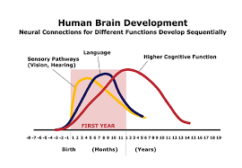

Slide 49
The g-part of the brain has a function
It is because the g-part has this function that humans have the capability called intelligence

Slide 50
What do IQ tests measure?
An IQ test performed on a subject S measures the value on a common scale of those realizations of the function of the g-part of S’s brain which were triggered by the items on the test = IQ
Why should we believe that IQ exists? Because we have independent measures whose results are highly correlated with each other, including measures not involving traditional question-answer tests.

Slide 51
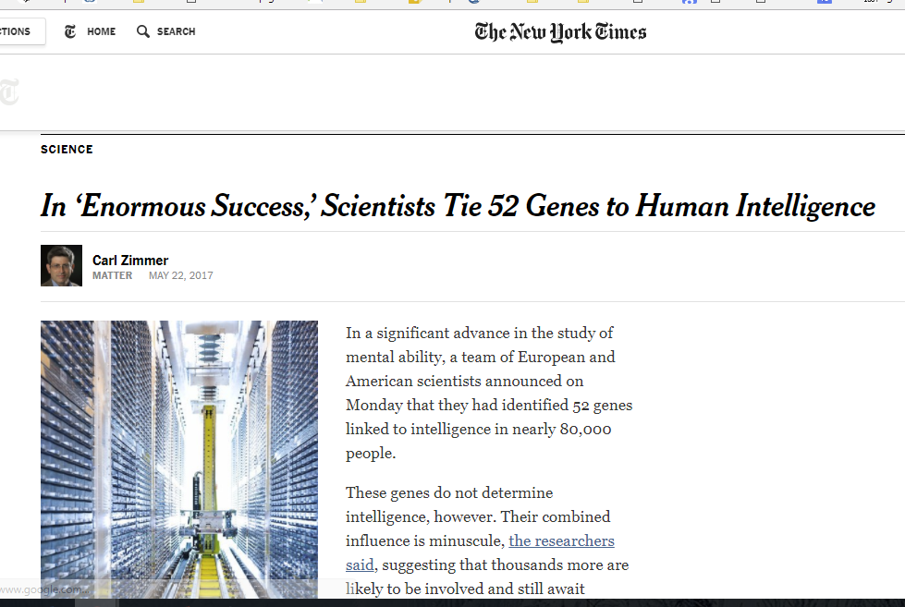
May 15, 2017
genome-wide association study with 80,000 subjects

Slide 52
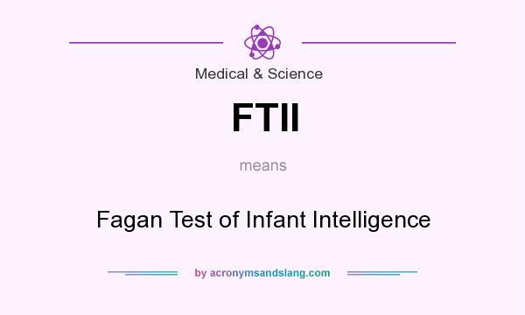
assesses infant mental capability (visual recognition) by measuring time spent looking at a novel stimulus
Notes:
http://acronymsandslang.com/definition/552028/FTII-meaning.html

Slide 53
assesses infant capability for visual recognition and memory on the basis of the time spent looking at a novel stimulus

Slide 54
tests the capability of sympathetic nerve terminals in the skin to release acetylcholine and increase sweat production
Notes:
http://acronymsandslang.com/definition/3547195/QSART-meaning.html

