Slide 1
ADVANCED TECHNOLOGY IN UB CLASSROOMS
Gary Boulware, CTS
Instructional Technology Manager
University at Buffalo
garyb73@buffalo.edu
716-645-3589

Slide 2
Improvements Summer 2020
CTS worked on and improved more than 86 Rooms
67 rooms were upgraded to synchronous classrooms
80 classrooms received onboard document camera upgrades
85 teaching station tops were rearranged and modified
20 no-touch button microphones we added to rooms
25 all in one Planar monitors
Capen 240 was modified and upgraded to a no touch audio room
100 webcams were made available for checkout at Silverman
50 webcam tripods as well
9 high-end mobile carts were purchased and made available to check out at the Silverman Library

Slide 3
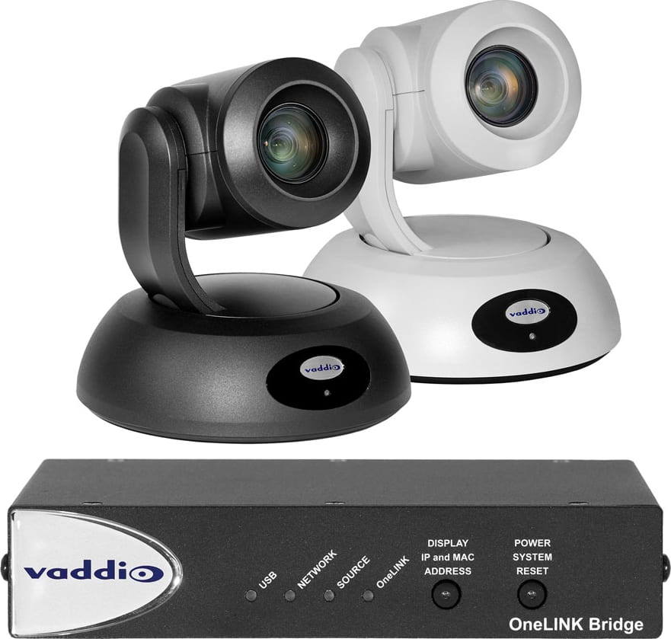
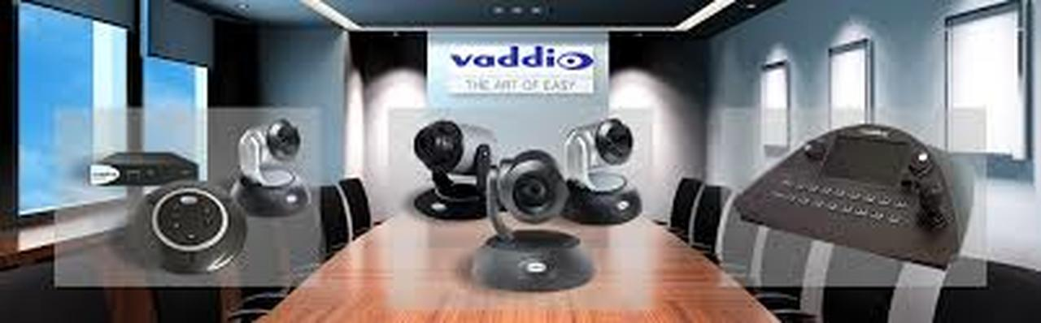
One Shot PTZ Cameras

Slide 4
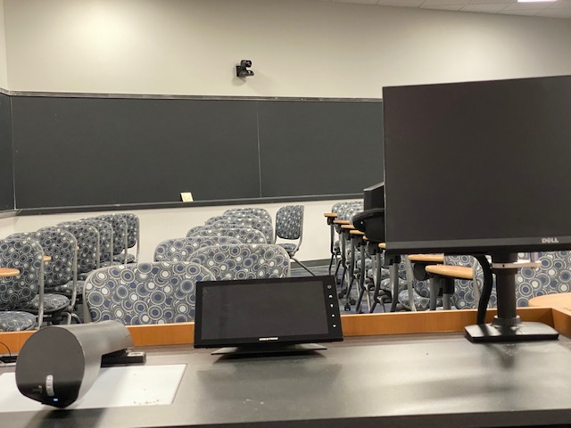
Synchronous Rooms
Table top
Remodeled

Slide 5
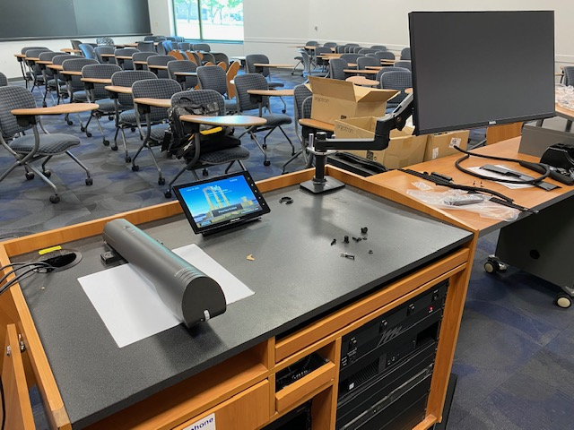

Slide 6
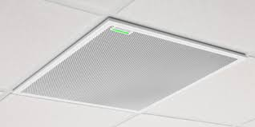
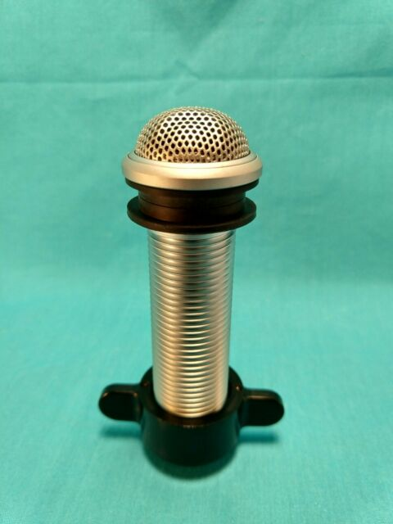
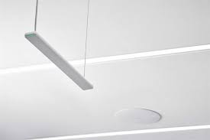
Keeping it clean
We realize that going forward we need to offer a combination of audio input devices. We will continue to supply our standard audio of lavalier and hand held wireless microphones, but also complement the rooms with no, to low touch audio devices.

Slide 7
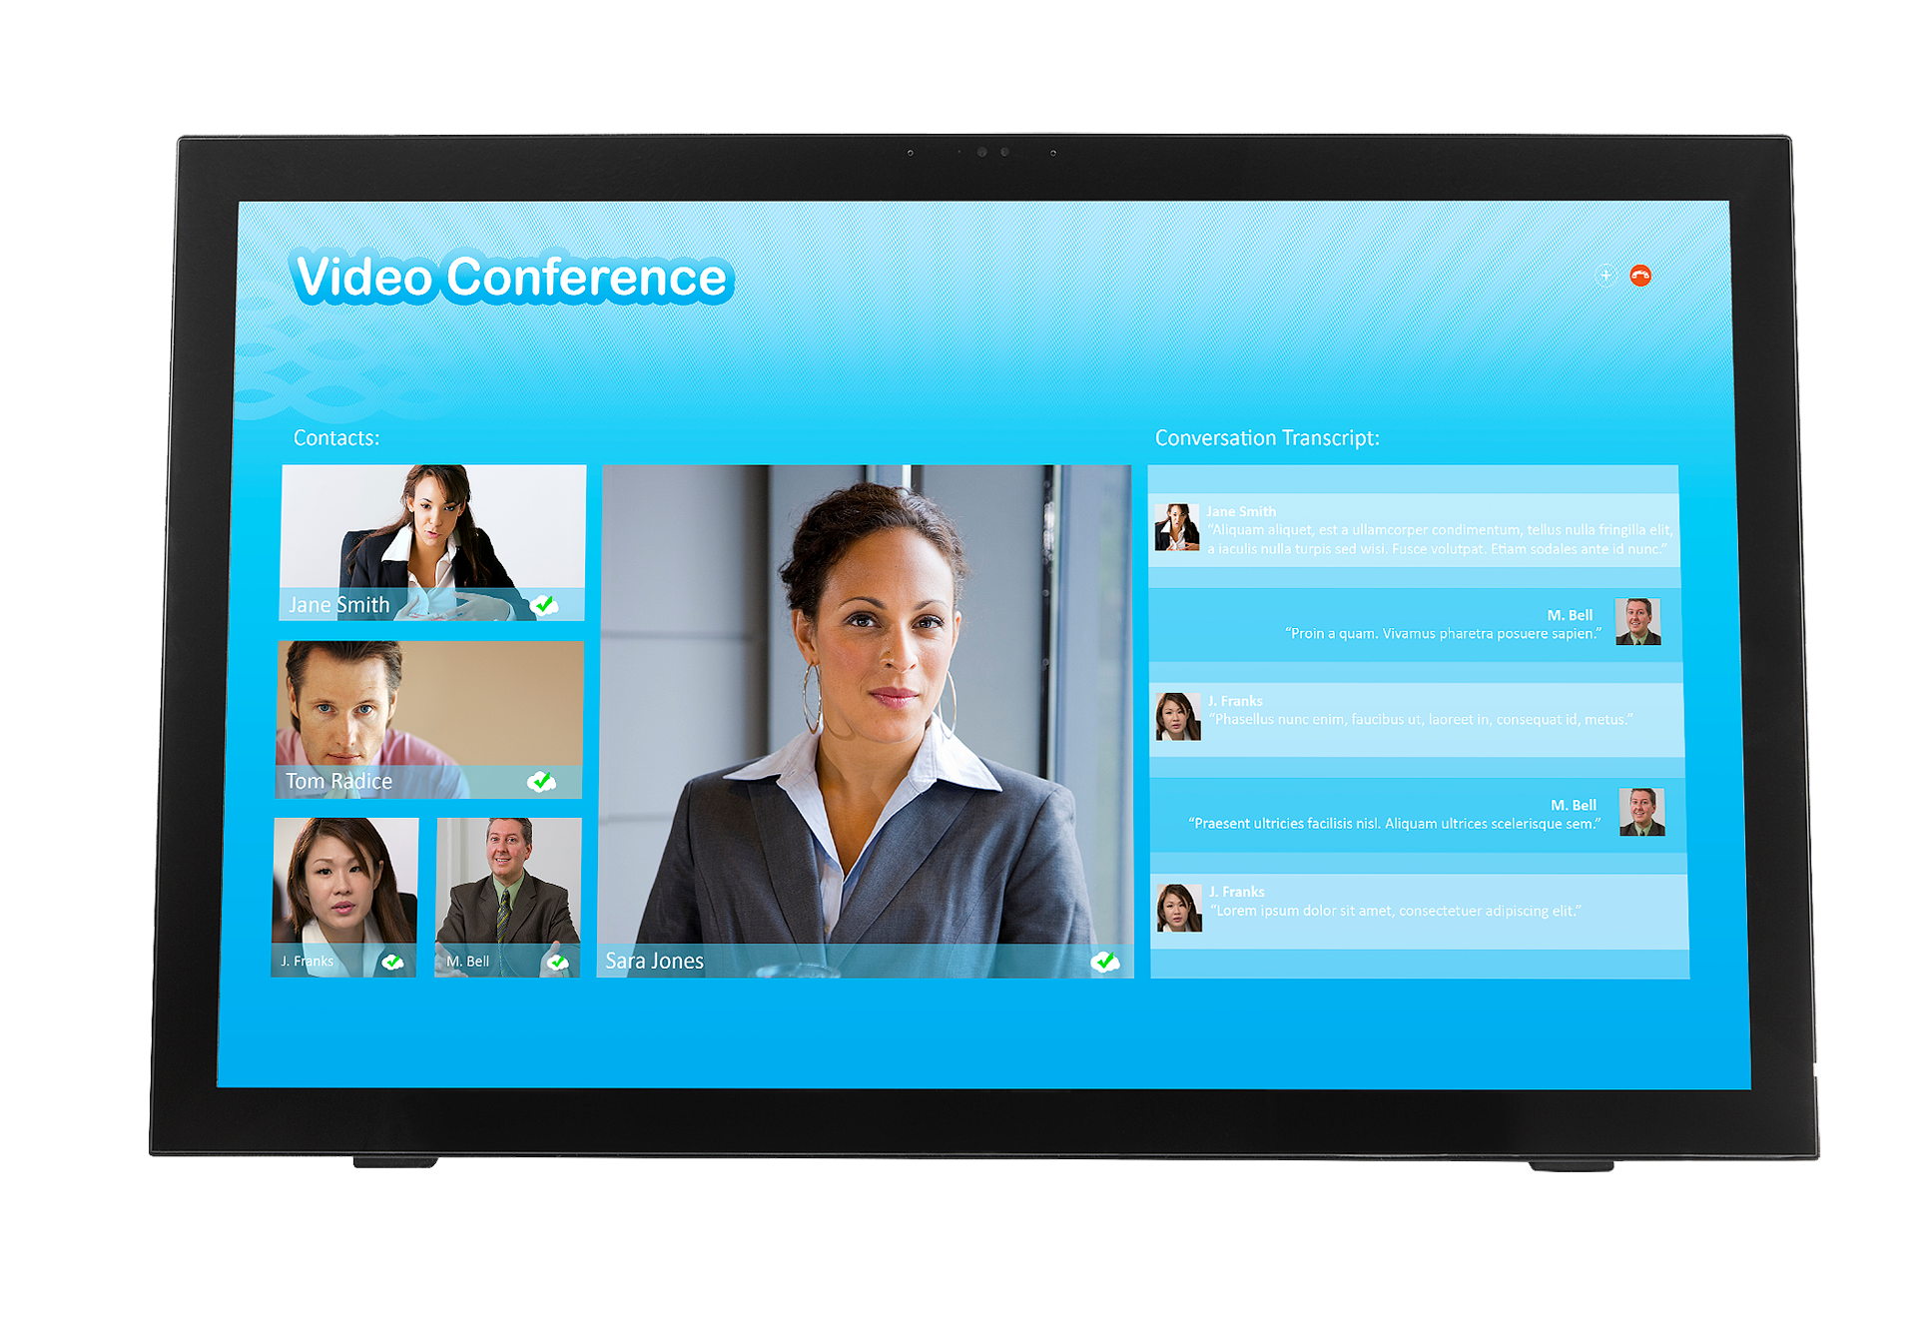
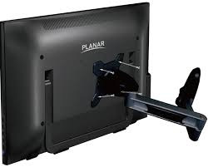
Planar All in One Touch Monitors

Slide 8
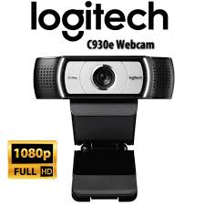
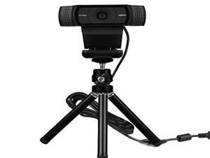
Webcams & Tripods

Slide 9
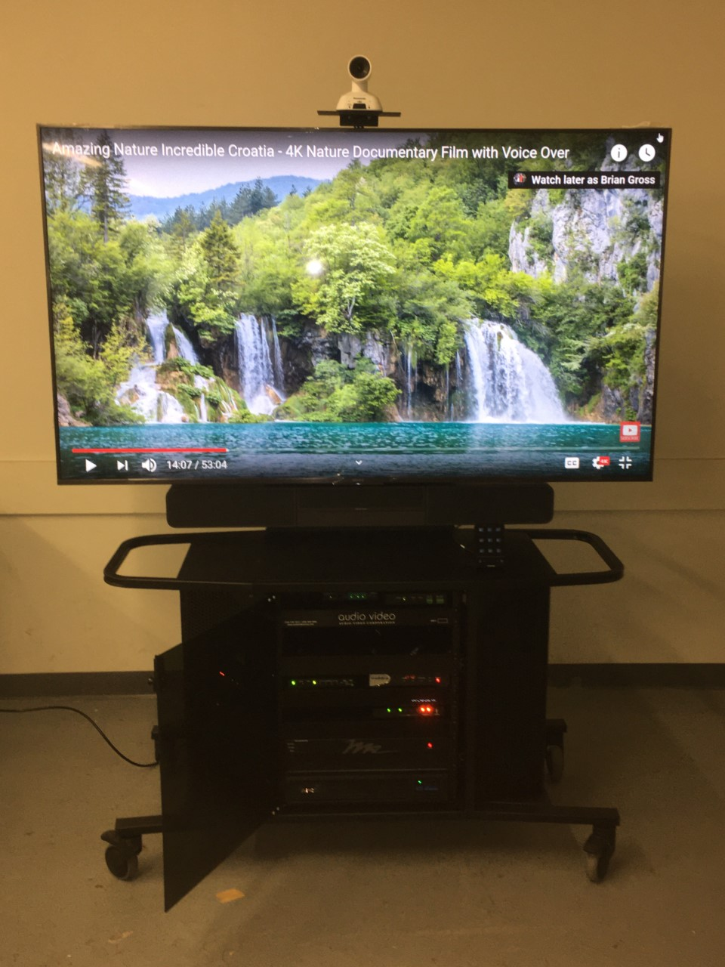
Mobile Carts @ Silverman
75 inch Monitor
Wide angle Camera
Onboard Computer
Speaker & Microphone
Wireless Presentation
Aux Input

Slide 10
The Three Issues
Not Enough Room
Social distancing in classroom spaces all but elliminated the majority of our 20-30 seat capacity rooms.
Keeping it Clean
Touching anything in the rooms put students and faculty at risk. Touch panels keyboards and mice could be wiped down, but audio devices are problematic.
Making it Feel Real
As we know the Hyflex teaching model is the most difficult way to teach. How to appeal to two very different groups of students. At any given time half of the class will feel neglected. Hard for faculty to manage.

Slide 11
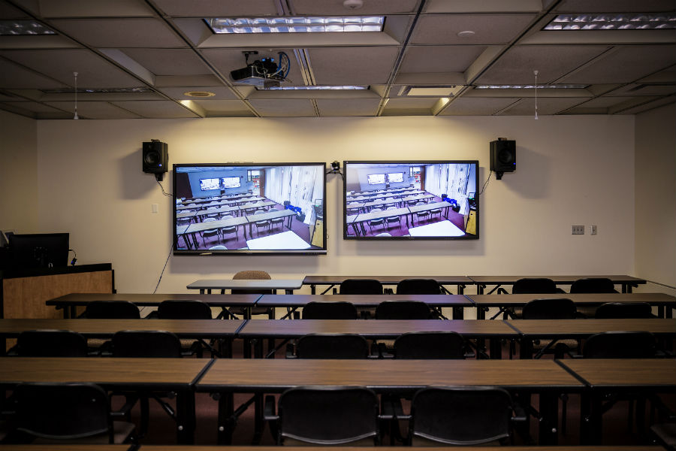
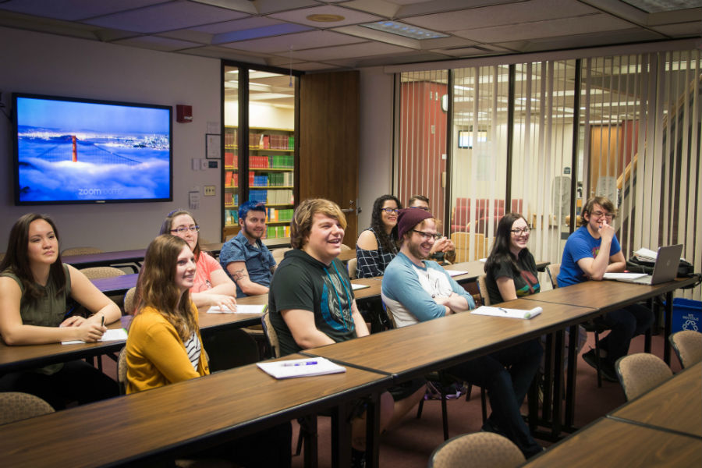
Can we use Zoom to connect small cap rooms together ?
Or use streaming technologies
to send classes to overflow rooms

Slide 12
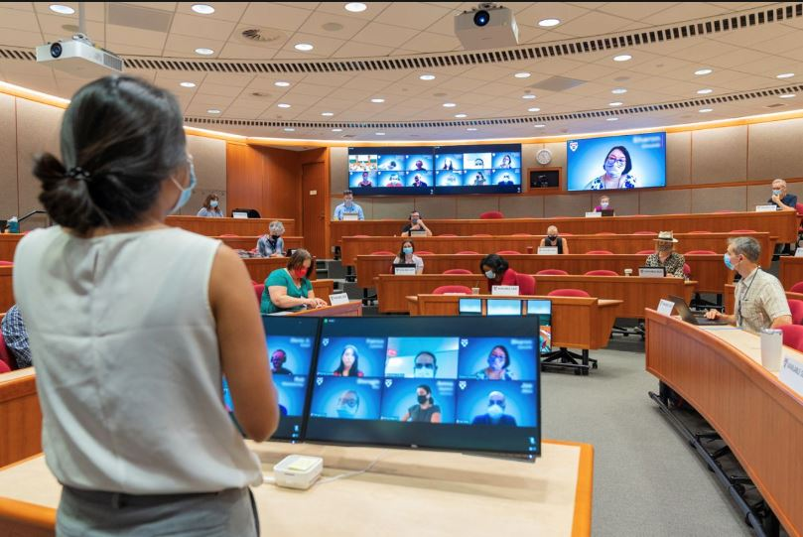
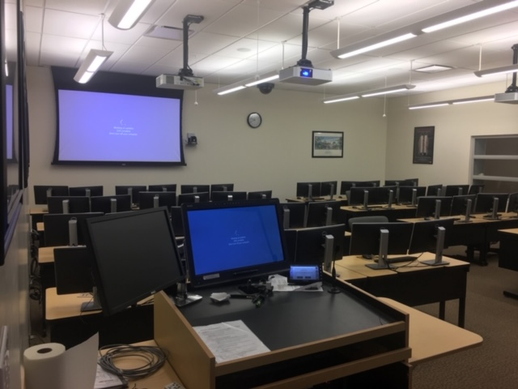
Making it feel real for everyone
One of the biggest issues faculty face in the Hyflex model is to keep track of both sets of students. The ones in the room and the ones at home. We have to manage better ways to close the gap of both groups and help faculty see everyone. One cost effective way to do this is to add large confidence monitors and side by side projection. Little Brady Bunch screens are no help.

Slide 13
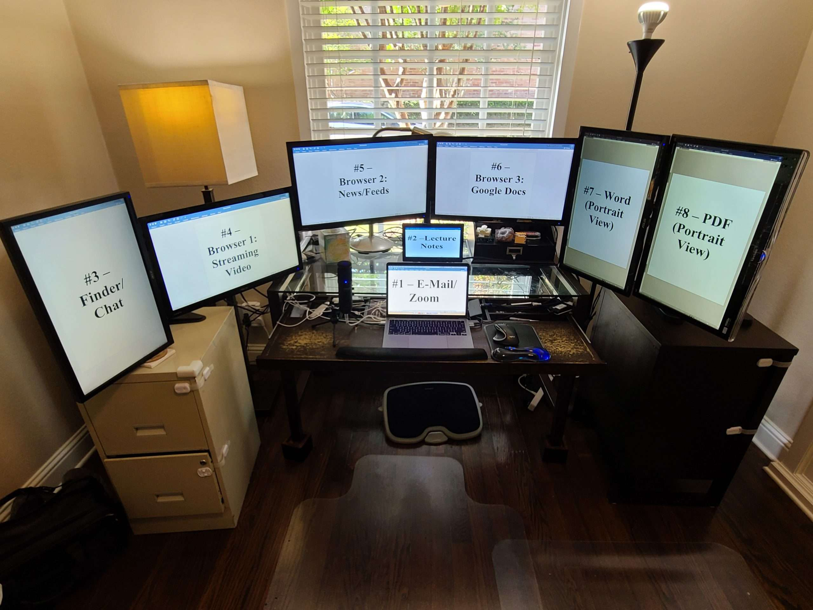
Seriously teaching from home
Got
Monitor

Slide 14
Questions

