Slide 1
Vice Chair’s Report
Committee Activity

Slide 2
Call for Committee Membership
Awards
Budget Oversight
Constitution and Bylaws
Continuous Improvement
Elections
Inclusion and Diversity
Marketing and Communications
Mentoring
Policy and Governance
Staff Development and Engagement
Social & Networking Subcommittee
Welcoming Subcommittee
Sustainable Living
Alternative Transportation Subcommittee
Plant Exchange Subcommittee
Website

Slide 3

Inclusion and Diversity Committee
Notes:
Ticket Price to be established soon.

Slide 4
Awards Committee
Waiting for the names of awards recipients from SUNY Central. They should have already arrived.
The Awards Luncheon was planned for May 24th

Slide 5
Elections Committee
The Elections Committee is reviewing membership roster and senator election calls will be emailed out

Slide 6
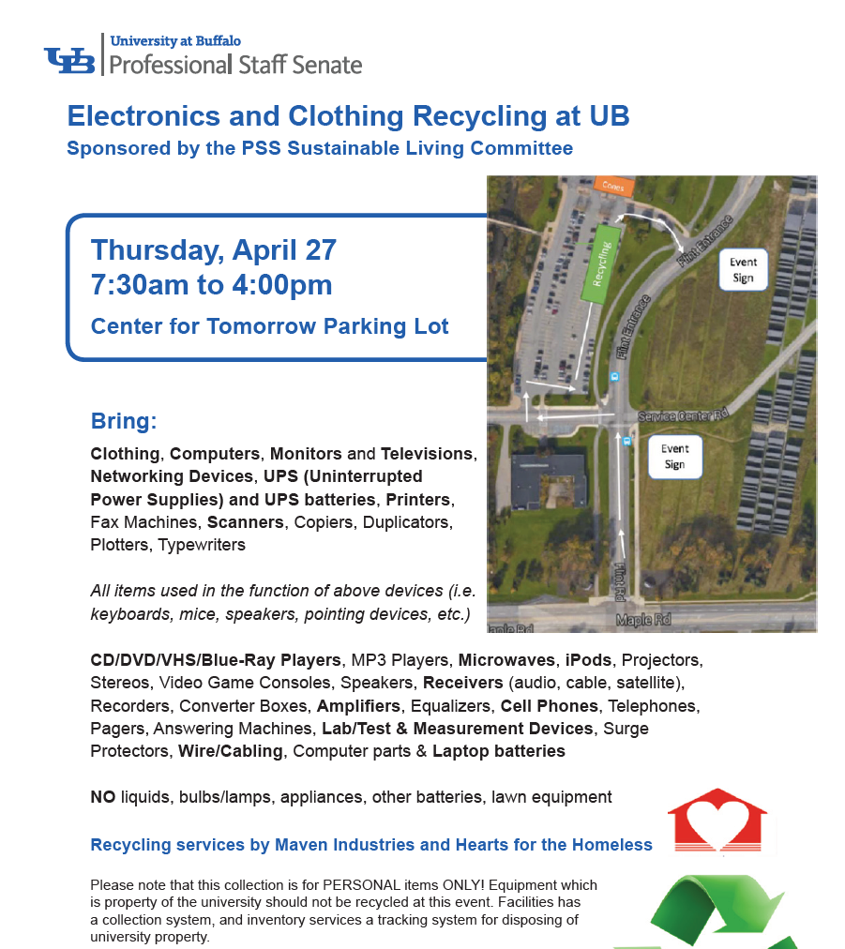
Sustainable Living Committee
Recycling event 4/27/17
314 Donors
1,200lbs of clothes
22,400lbs of electronics

