Slide 1
Tabletop Exercise
UB Professional Staff Senate
February 16, 2017

Slide 2
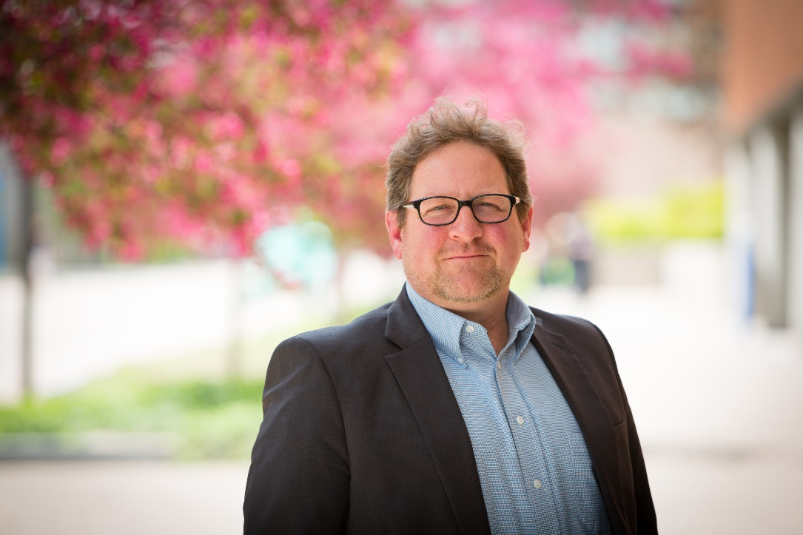
Facilitator
Jay Roorbach, UB Senior
Emergency Planning
Coordinator
13 years US Army Chemical Corps
BS, Management, Upper Iowa University
Strategic Planning with US Department of Homeland Security
Emergency Management and Homeland Security with Michigan State Police
Emergency Manager for Kaleida Health

Slide 3
Format/Agenda
Introductions/Welcome
Module 1: Response
Presentation
Questions for Discussion
Module 2: Continued Response
Presentation
Questions for Discussion
Closing Considerations

Slide 4
Rules and Guidelines
Informal discussion of simulated emergencies
Intended to be thought-provoking and encourage discussion
Time relaxed, Low stress
Focus on evaluating plans and procedures as well as anticipated response
Allow time for resolution of questions or concern and coordination
There are no wrong answers
Feel free to talk amongst yourselves and ask questions if necessary

Slide 5
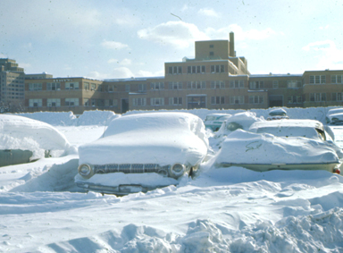
Objectives
Assess current individual and departmental plans for responding to a severe weather incident.
Assess the ability to effectively communicate with all stakeholders during an emergency situation.
Assess the ability to effectively assess critical functions, minimize health and safety threats, and efficiently restore and revitalize systems and services.

Slide 6
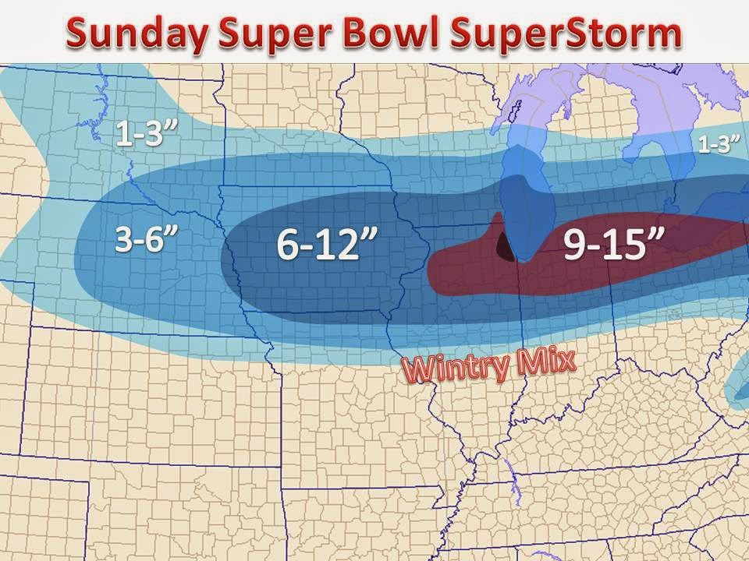
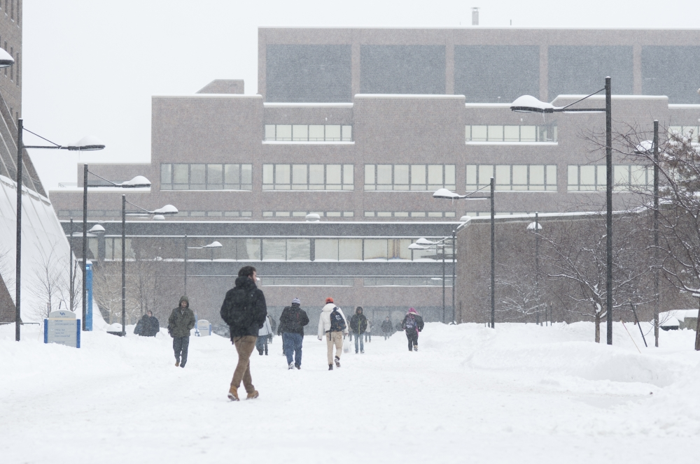
Module 1: Response
February 15, 9:00 a.m. – The National Weather Service (NWS) reports a cold front moving toward Buffalo, expecting to cause a major winter storm within the next 24 hours.
February 15, 5:00 p.m. – The UB Incident Management Team (IMT) has decided to recommend no changes at this time but they will continue to monitor the weather throughout the evening.
February 16, 5:30 a.m. – The snow has not started yet so the IMT recommends that the university continue operations as scheduled and the President confirms that recommendation.
February 16, 11:00 a.m. – The snow has started to come down pretty heavily in the south towns and parts of the city of Buffalo. Traffic conditions are getting significantly worse.

Slide 7
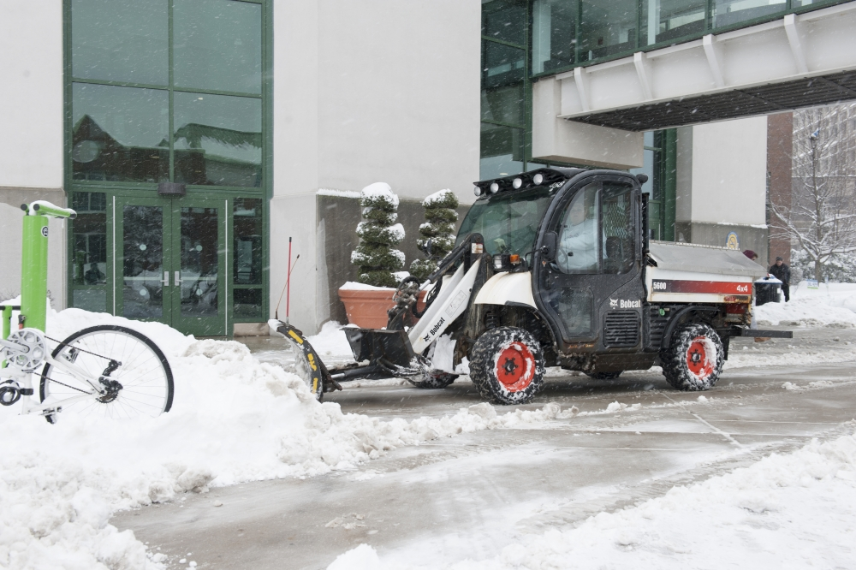
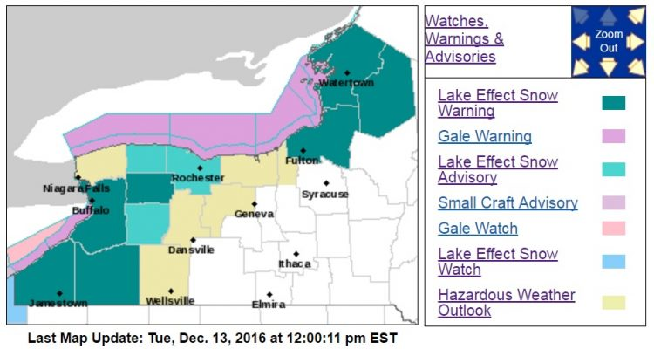
Discussion Questions
Questions are guides for discussion and do not have to be directly answered.
Individually, how do each of you get notified of changes in scheduled operations? How do you prepare?
How do your Essential Personnel, faculty, and staff learn of changes in scheduled operations?
At this point in the scenario, what considerations should be given if this has the potential to turn into a prolonged event?
What specific plans does your department have for a response to severe weather?
What critical functions must be maintained during this type of incident?

Slide 8
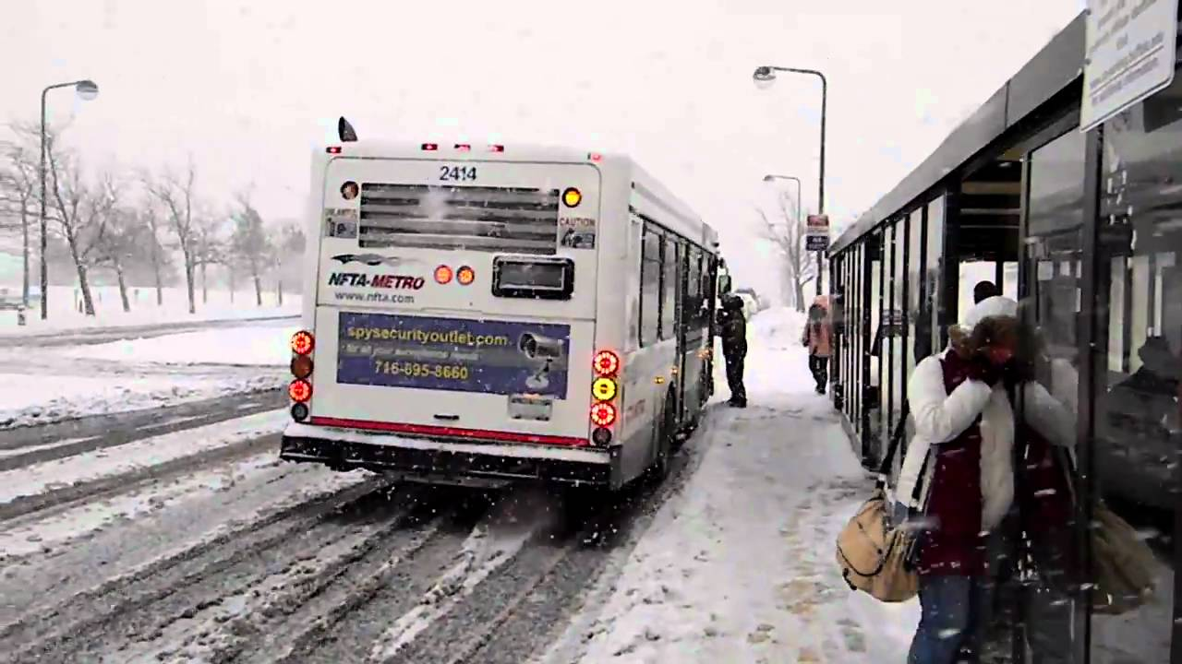
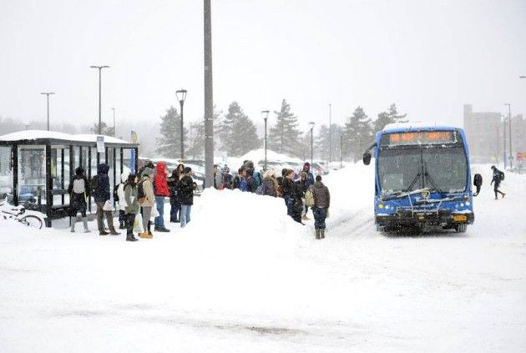
Module 2: Continued Response
February 16, 12:00 p.m. – The snow continues to fall at a quick rate and some towns issue traffic bans. The IMT recommends a change in scheduled operations. The UB President declares a change in scheduled operations cancelling classes and events starting at 3:00 p.m.
February 16, 4:00 p.m. – The inability of roads to be maintained during the snow fall has caused the NFTA and UB P&T to shut down bussing operations.
February 16, 5:15 p.m. – Staff, faculty, and students are stranded at UB campuses due to the change in scheduled operations, weather conditions, and bussing cancelations.
February 16, 7:30 p.m. – The NWS Winter Weather Warning for Western NY has been extended until 9:00 a.m. on February 17, 2017.

Slide 9
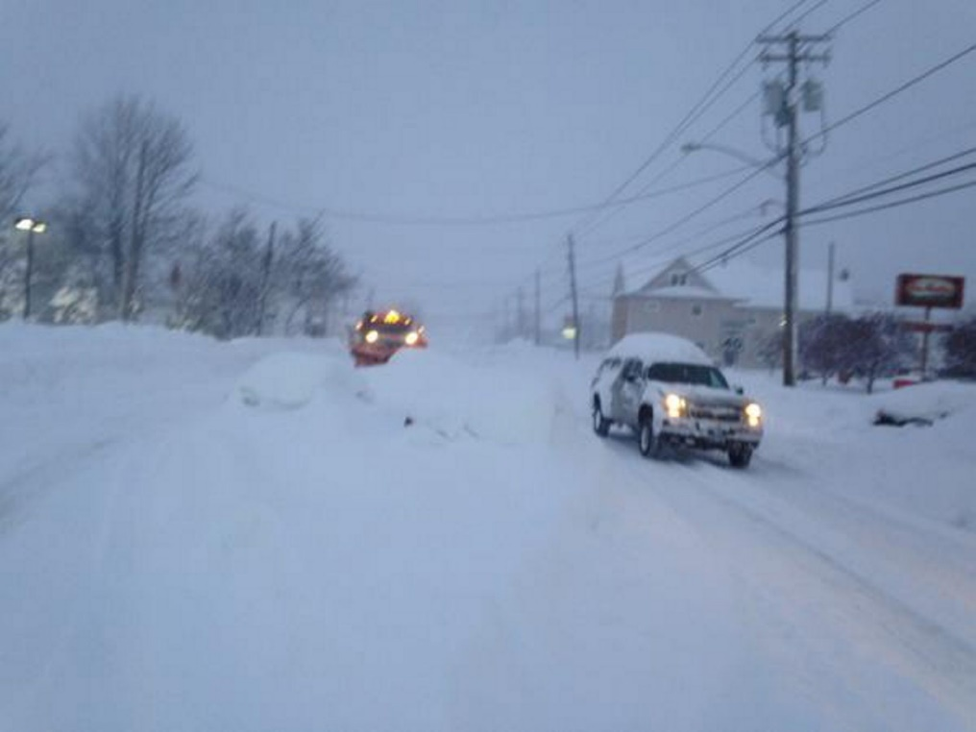
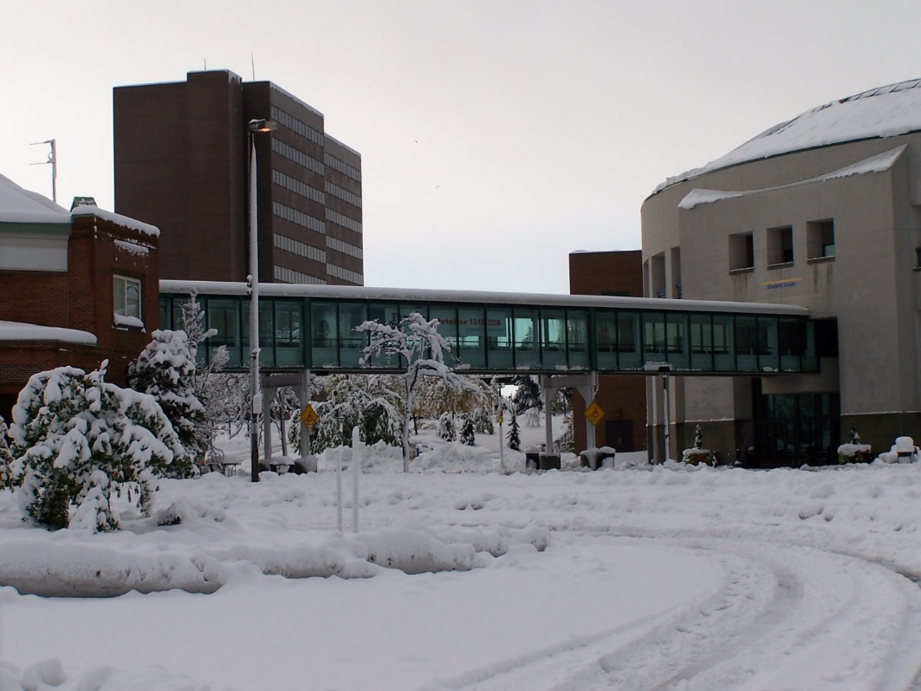
Discussion Questions
Questions are guides for discussion and do not have to be directly answered.
What issues does this scenario present? How should they be prioritized?
Are there any resources that might be needed at this point in the scenario? How will any external resources be requested and received?
What are potential issues you and your department may face during the longer term continuation of the storm?
What individual plans do you have for being stranded at work?

Slide 10
Closing Considerations
You can influence what happens to you in an emergency
It helps to know your vulnerabilities and calculate your risk
Base this on data, not just emotion
Prepare yourself for that risk
Get to know your environment and your neighbors
Here at UB, learn what resources are available and what the organization will support in an emergency

Slide 11
Thank You!
Jay Roorbach
UB Emergency Management
252 Capen Hall, Buffalo, NY 14260
716.645.3431
jayroor@buffalo.edu

