Slide 1
Integrating Non-Tenure Track Faculty
Robert Granfield,
Vice Provost for Faculty Affairs

Slide 2
Charge
How faculty roles in qualified ranks are defined and performances are reviewed for promotion across campus
What opportunities are available within academic units for development, promotion and departmental and university integration
Review practices and policies at comparable institutions to establish best practices
Recommend next steps in developing assessment and promotion criteria and in enhancing the integration and professional development of faculty in qualified ranks

Slide 3
I. Background and Data for UB
Qualified faculty titles at UB:
Full-time
Includes multiple SUNY titles
Lecturers
Clinical (Assistant Professor, Associate Professor, Professor)
Visiting Appointments
Research (Assistant Professor, Associate Professor, Professor)
Appointments are for renewable terms to encourage continual quality review but also offering stability, competitive compensation and pay increases over time. Typically 1-3 year renewable contracts
Teaching obligation is primary for most faculty on qualified lines

Slide 4
Institutional Data for Instructional Workload @ UB
Faculty FTE
Student CH
SCH per FTE
Tenure Track
Non-Tenure Track
Data: Office of Institutional Analysis

Slide 5
Faculty and Instructional Workload by Unit
T/TT – tenured or tenure-track faculty
QR – qualified rank faculty (= non-tenure track)
FTE – full-time equivalent
SCH – student credit hour
Data: Office of Institutional Analysis

Slide 6
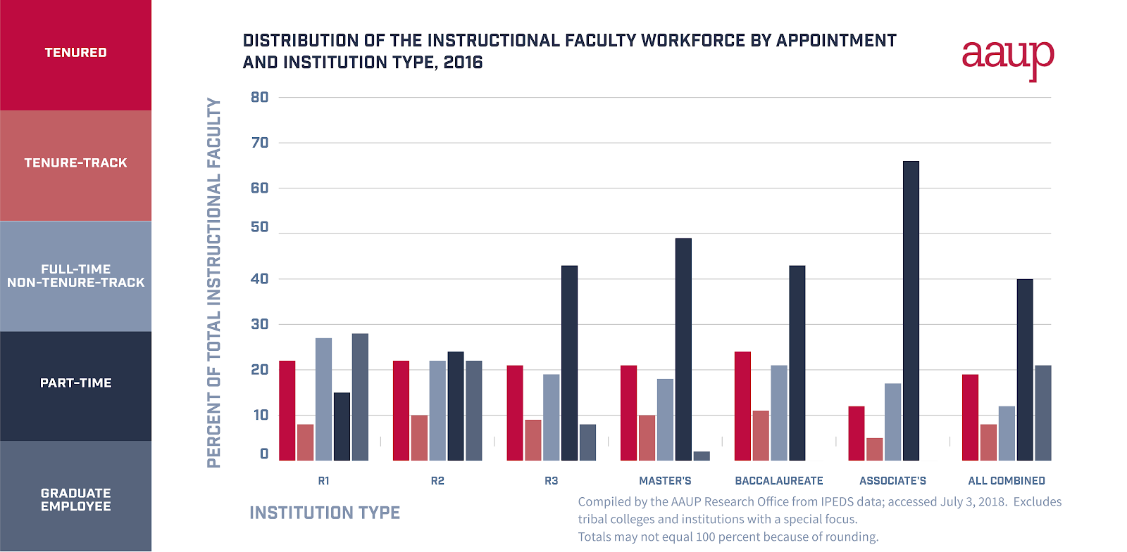
The Use of FT, Non-Tenure Track Faculty

Slide 7
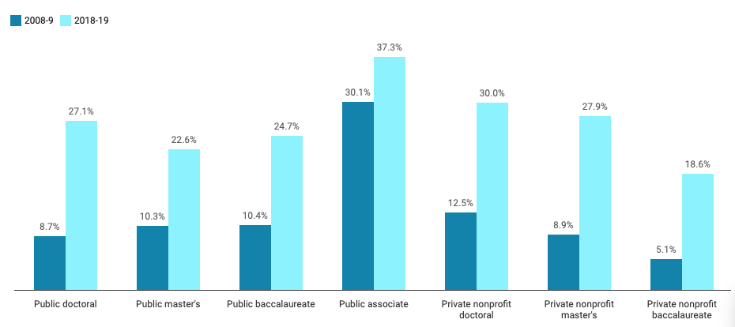
Growth in Full Time Non-Tenure Track

Slide 8
Duke University

Slide 9
Concerns of NTT Faculty – UB COACH 2017
Support for Travel
Availability of Course Release
Support for Leadership Roles
Number of Courses Taught
Balance between Teaching, Research and Service
Support for Improving Teaching
Interdisciplinarity
Effectiveness of Departmental Mentoring
Mentoring of NTT
Amount of Interaction with Tenured Faculty

Slide 10
II. Landscape for NTT Faculty in the Units
Conversations with Deans regarding three dimensions of non-tenure track (NTT) faculty experience in the units:
Promotion Process
Professional Development
Integration in their department/unit
Same question sets for each dean
Qualitative and semi-quantitative analysis
Collection and review of decanal policies

Slide 11
II. Landscape for NTT Faculty in the Units
Path to Promotion
Integration
Professional Development

Slide 12
III. Promotion Process for NTT Faculty in the Units
Units with a robust promotion process:
Fully developed criteria for different qualified ranks
Unit-wide consistent policies and practices
Review by committee established at departmental and unit level
Qualified rank faculty are significantly involved in shaping policies and the review process
Units with a well-developed promotion process:
Fulfills majority or most of the above
Maybe in the process of revisiting or reformulating individual policies or criteria
Units undertaking broad self-review of promotion process:
Committees have been established to gather data on existing policies and practices across the unit
Faculty including qualified ranks are engaged in structured conversation about revision or new establishment of criteria and guidelines for QR promotion

Slide 13
IV. Professional Development & Integration
Broad range of conditions exist for qualified rank faculty across units:
PD may
Formally be established with concrete annual amount of funding
Be awarded at the discretion of the chair or dean
Greatly vary from department to department within a unit
Only be available for ladder faculty
All faculty appear to be voting, participating in department meetings, and involved in committee work
Level of integration still varies in terms of
Ability to chair committees
Guide student research
Assume leadership roles
Existing culture of individual departments and attitudes towards QR faculty, I.e., "Second-class citizen" issue.

Slide 14
V. Perspectives on Provostial Level Review
Broad support across units for benefits associated with university-wide review of promotion dossiers:
Increased recognition for individual faculty
Raised awareness in general for achievements by faculty in qualified ranks and their contributions to the university mission
Improved status of non-tenure track faculty
Enhanced reputation for University at Buffalo

Slide 15
V. Perspectives on Provostial Level Review
Concerns with perceived cost of provost level involvement:
Additional layer of process, time and effort for unit to spend on promotion, i.e. external letters
Added delay and anxiety for faculty
Concerns with process:
Make-up of provost level review body
Qualification and ability of faculty outside the unit to evaluate internal promotion criteria
Broad diversity of roles and functions of faculty in qualified ranks across units
General concerns:
What problems would another level of review solve?
What are the problems it would create? Create expectations of tenure?
Some units feel that their criteria and robust process are rigorous enough

Slide 16
VI. Possible Scenarios
3 Models for Going Forward:
Updated status quo:
No additional review at the level of the provost
Units currently reviewing or reworking their guidelines will finalize efforts & share
Eventually, all units will have guidelines accessible online for faculty across campus
Added layer of rigorous review at level of the provost:
Establish body of faculty, including its composition and oversight, charged with review
Establish policies and guidelines for review
Define criteria for this layer that allow evaluation while acknowledging diverse faculty experiences and expectations for success in the units
Develop approach for existing differences in dossier content, e.g. external/internal letters
Anticipate potential conflict between unit and provost decision outcomes

Slide 17
VI. Possible Scenarios
Blended model: unit decision with provost level recognition
Promotion process is completed with decision of the cognizant dean
All promotion dossiers are forwarded to the provost for approval
Possibly: provost maintains exceptional right to assemble ad-hoc group to solicit second opinion and ability to enter in conversation with the unit
Appropriate body will review cases requested by provost and select a limited number for award; submit to provost
All promotions and awardees chosen by the provost will be recognized at annual event

Slide 18
Possible Recommendations
Efforts should be made to integrate QF into university-wide activities including New Faculty Orientation, Celebration of Faculty and Staff Excellence, award nominations, departmental meetings, and committees.
All departments should be reminded of the UB mentoring policy and informed that QF are to be provided with mentoring opportunities.
QF should be provided encouragement and opportunity to participate in professional development activities available at the decanal and university levels.
An advisory committee of QF should be established, coordinated through the Office of Faculty Affairs, to explore issues related to QF life.
Departments should be encouraged to developed “In-house” title:
Professor of Practice
Teaching Professor

Slide 19
Recommendations: Promotion
The university should develop a policy for provostial/presidential level review of dossiers for promotion of QF. Such a policy would include establishing departmental criteria for promotion within qualified ranks, consistent voting procedures within departments and units, and letters from unit deans making a recommendation to the provost.
A provostial/presidential review should be phased in gradually. It is recommended that units submit dossiers to the provost, through the Office of Faculty Affairs, for review and subsequent recommendation to the president.
QF who are approved for promotion should receive an official letter from the President confirming the promotion.
If there is a desire to establish a PRB-like review committee for all QF promotion dossiers, a committee consisting of QF, TTF, department chairs should be formed to 1) discuss the pros and cons of such a review committee, 2) consider the structure and composition of the review committee, and 3) recommend procedures that should guide that committee.

