Slide 1
Driving Data-Based Decisions in Institutional Research
University at Buffalo
Leah Feroleto School of Social Work
Amy Guthrie Institutional Analysis
Troy Joseph Graduate Enrollment Management
Joseph Mantione Institutional Analysis
May 14, 2014

Slide 2
The University at Buffalo
The University at Buffalo (UB) is the largest university in the State University of New York (SUNY) system.
Founded: 1846
Premier, research-intensive public institution
Association of American Universities (AAU) member
Enrollment: 28,952 (Fall 2012)
19,506 undergraduate
9,446 graduate and professional
Source: UB at Glance

Slide 3
How we brought Tableau to UB http://www.buffalo.edu/provost/admin-units/apbe/reports-documents/tableau-analytics/Tableau-Resources.html

Slide 4
Challenges to Higher Education
Poor endowment returns
Increase in outcome driven accountability
Heightened concerns over affordability
Tighter Accreditation Regulations
Decreasing Enrollments
Government Spending Cuts
Growing public doubt about college value
Source: Jason Lane - The Nelson A. Rockefeller Institute of Government University at Albany

Slide 5
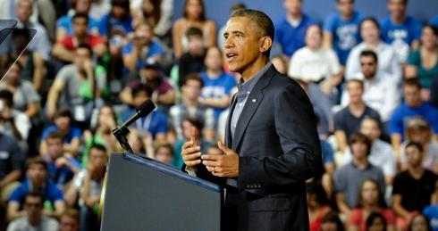
President Vows Action on College Costs
On August 22 President Obama spoke at UB to outline a 4 point strategy to make college more affordable
Source: Obama Speaks on Campus, Making UB History
Obama Vows Action on College Costs
College Affordability

Slide 6
President Vows Action on College Costs
: Tying financial aid to college performance. Students who receive federal aid would not receive assistance for the next semester’s courses until they have completed their current coursework.
: Promoting innovation and competition among the nation's universities by offering students a greater range of study options, including online courses.
: Easing the burden of student loan debt by allowing all borrowers to cap loan payments at 10 percent of monthly income.
: Implementing a new rating system that rewards colleges and universities for performance. Allow students and their families to select schools that provide the “best value.”
http://collegecost.ed.gov/scorecard/

Slide 7
Why Analytics in Higher Ed? Why Now?
Improving student outcomes using assessment
Establishing a partnership between IT and institutional leadership
Assisting faculty with information technology
IT staffing models
Analytics to support institutional outcomes
Funding IT strategically
Access Demand
Service delivery strategy
Sustainable online learning
IT compliance and risk management
Source: EDUCAUSE Top Ten Issues 2000 - 2014 InfoGraphic

Slide 8
Why Analytics in Higher Ed? Why Now?
Too much operational data, too little strategic analytics.
OBIEE (Oracle) and iStrategy (Blackboard) power UB's operational reporting, and while we leverage their data modeling capacity, they lack the ability to easily support the modern visualization efforts necessary for today's strategic policy discussions.
This challenge is by no means unique to UB. Institutions throughout higher education face the same problem every day – and it’s only getting worse!

Slide 9
Unit standards and impact https://oiaanalytics.acsu.buffalo.edu/t/PRV/workbooks?project=41

Slide 10
Unit Standards and Impact (USI) Analysis
Understand the contributions of units
Identify the most important metrics of effectiveness
Determine performance targets
Performance funding
Modify institutional goals based on assessment efforts

Slide 11
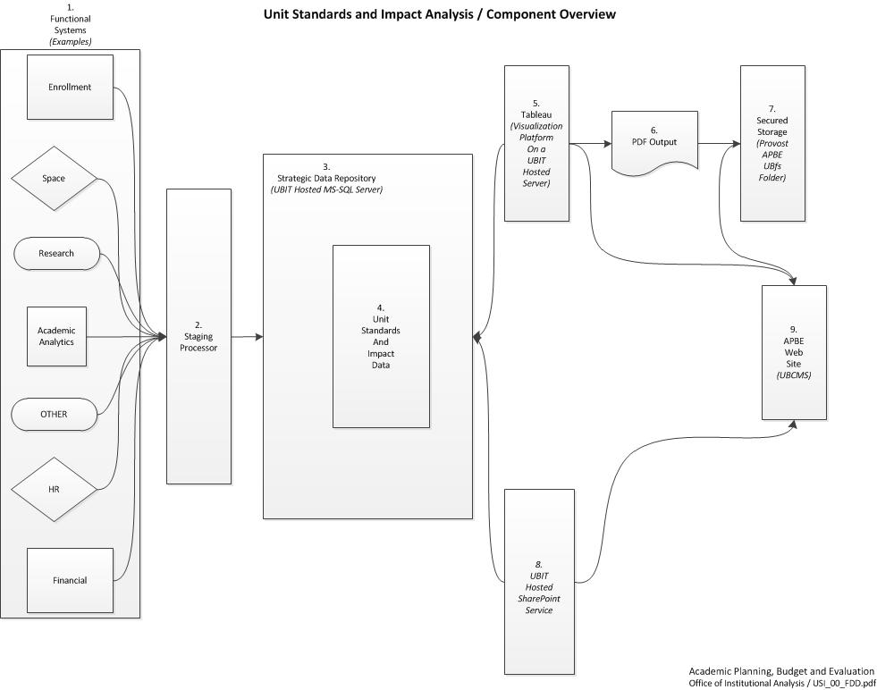
Strategic Data Repository

Slide 12
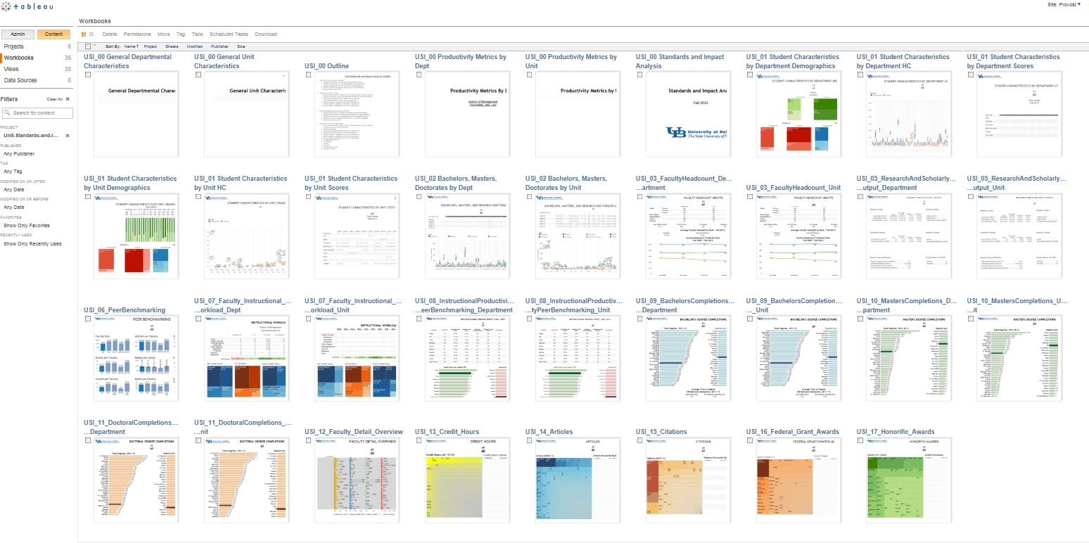
Unit Standards and Impact Analysis

Slide 13
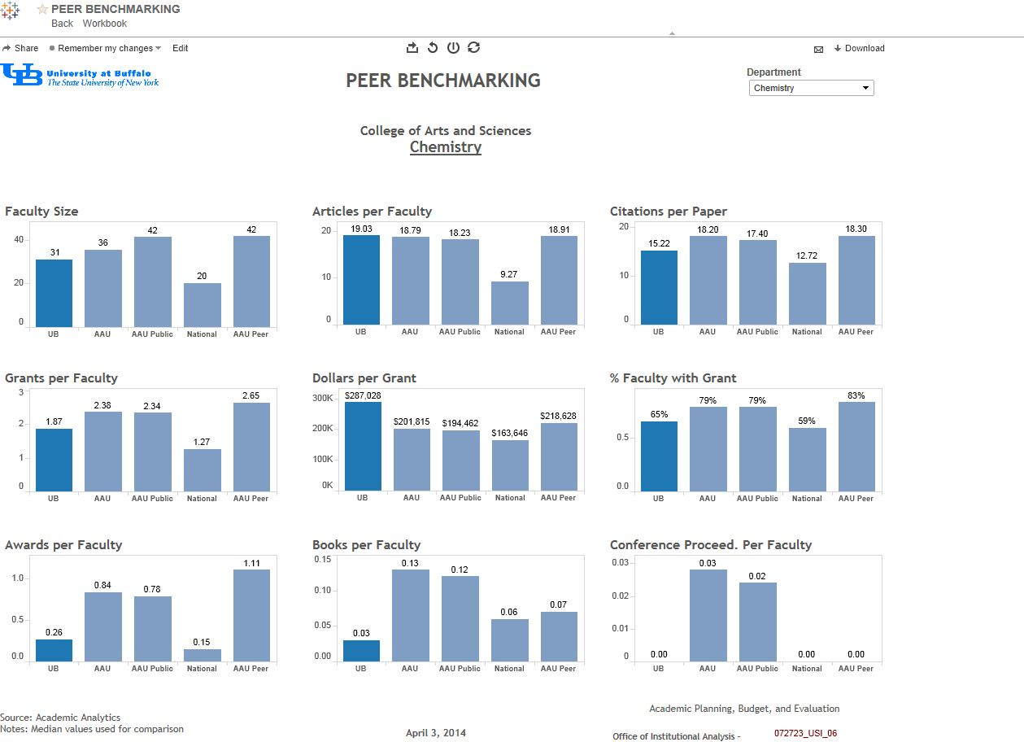
USI – Peer Benchmarking

Slide 14
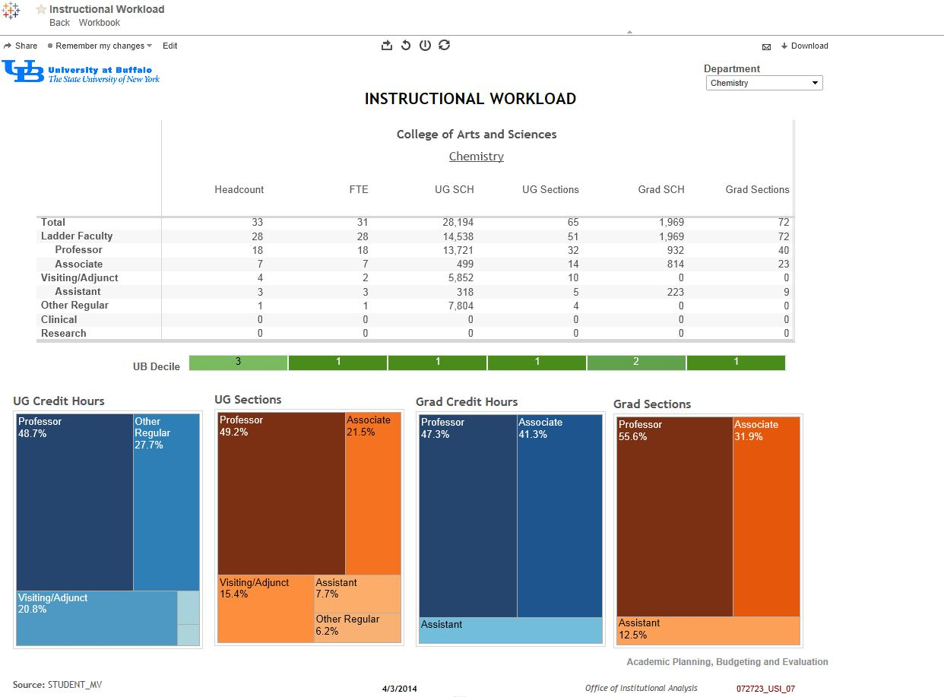
USI – Instructional Workload

Slide 15
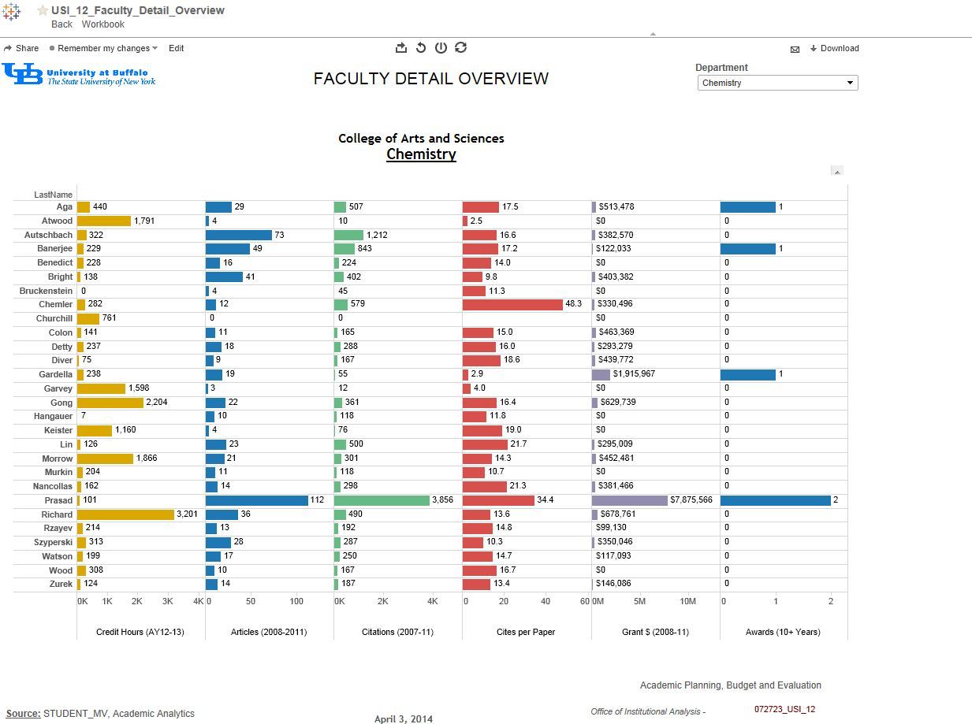
USI – Faculty Detail Overview

Slide 16
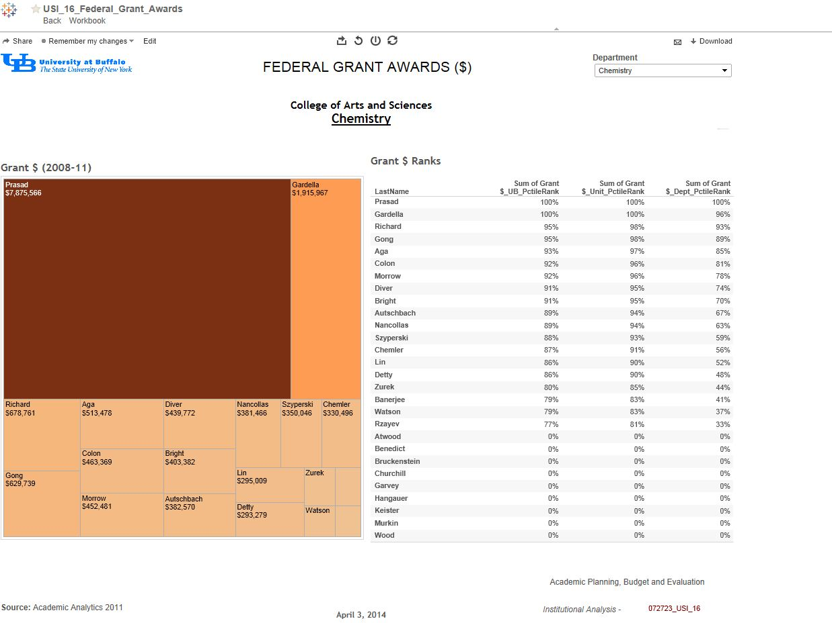
USI – Federal Grant Awards

Slide 17
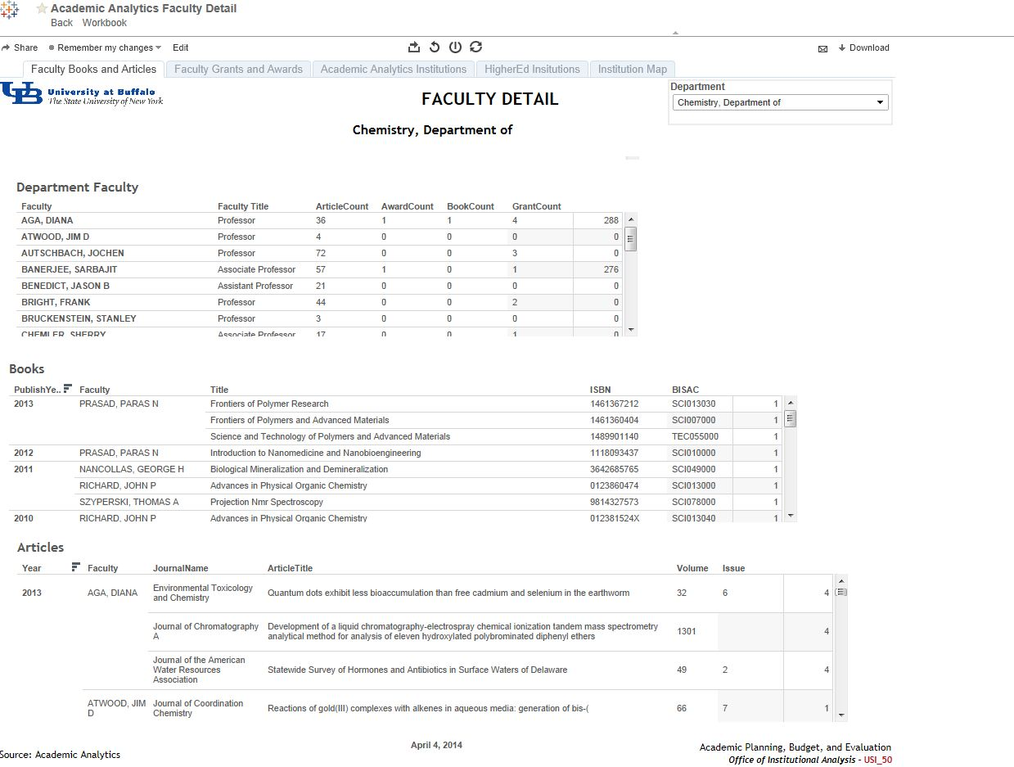
Faculty Detail Tableau Reporting

Slide 18
Graduate Admissions in Social Work http://www.socialwork.buffalo.edu/

Slide 19
The Admissions Funnel: Overview
Having longitudinal data at all points in the admissions funnel allows you to:
Develop effective predictive models for enrollment
Provide analytic, scientific insight beyond the pre-admission funnel
Perfect a comprehensive enrollment management model that takes into consideration the front end admissions funnel, the prospect pool and the back end, student retention.
…It’s a symbiotic relationship
PROSPECTS
INQUIRIES
COMPLETED APPS
ADMITS
DEPOSITED
ENROLLED
CONTINUING
GRADUATED

Slide 20
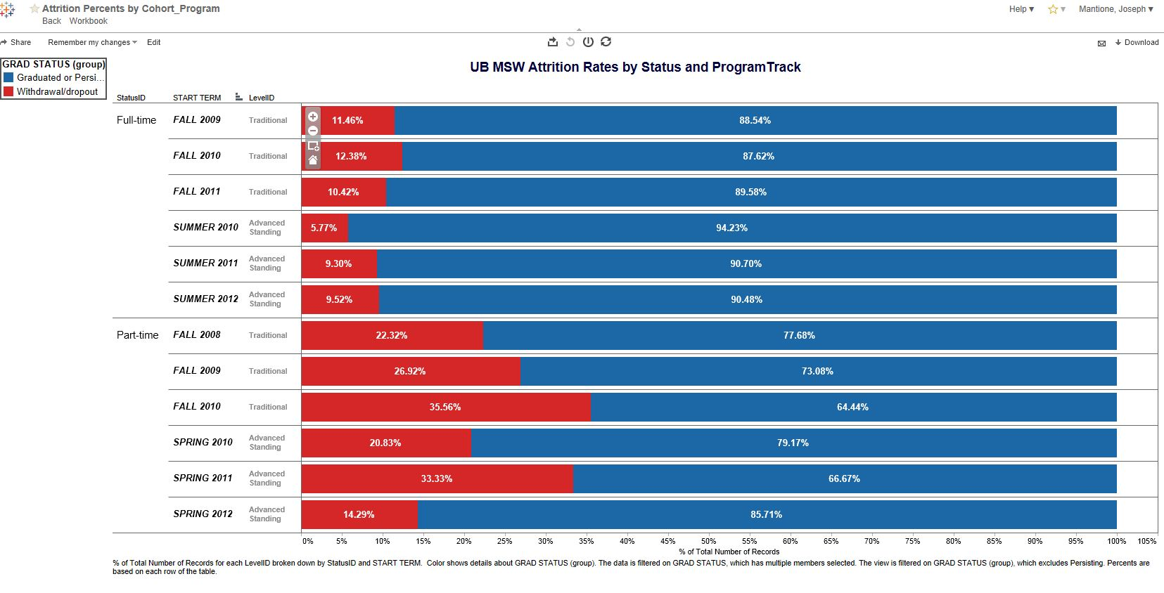
Tableau in Higher Education - Enrollment
School of Social Work Attrition

Slide 21
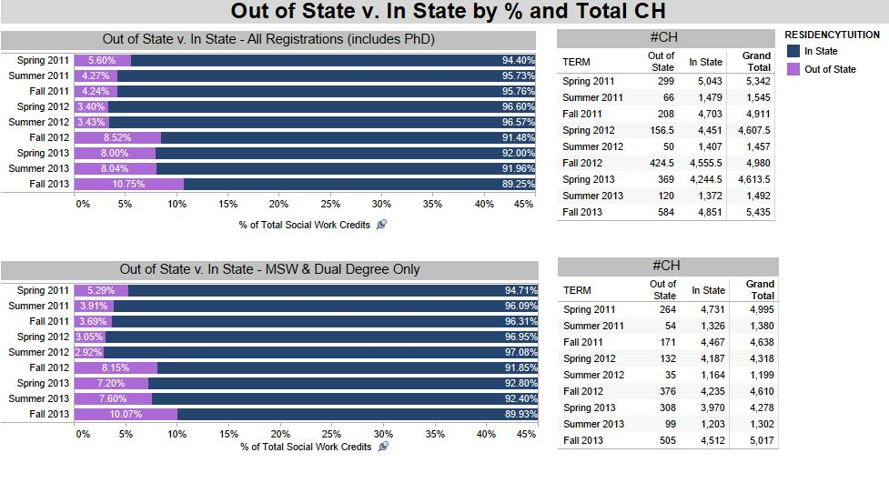
Tableau in Higher Education - Enrollment

Slide 22
Surveys http://www.buffalo.edu/provost/admin-units/apbe/reports-documents/institutional-analysis-briefs.html

Slide 23
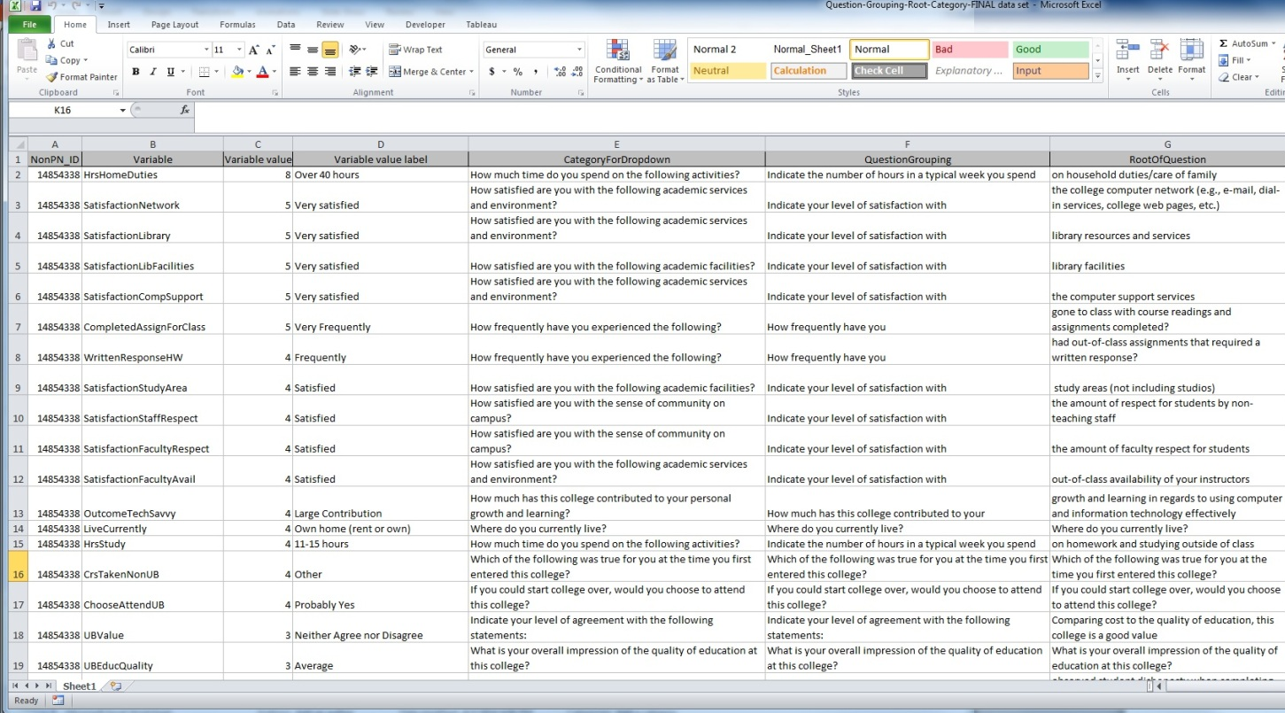

Slide 25
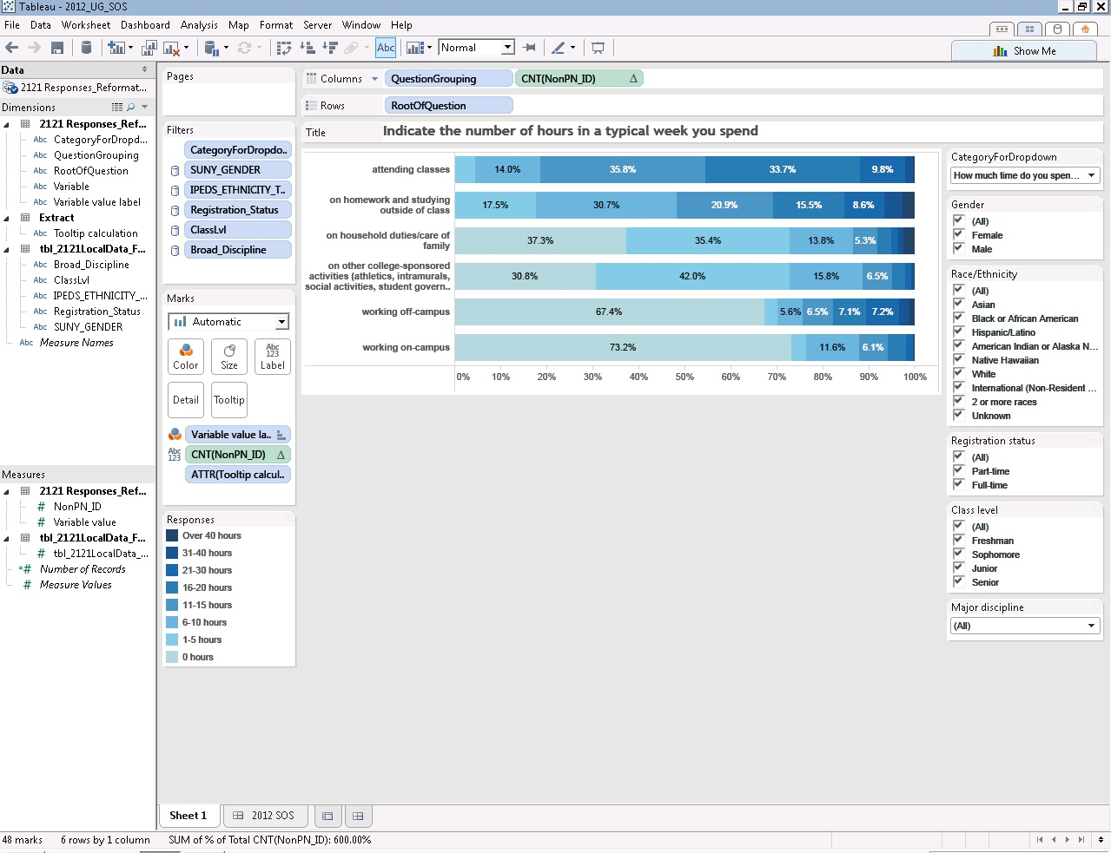

Slide 26
Graduate Enrollment Management http://grad.buffalo.edu/

Slide 27
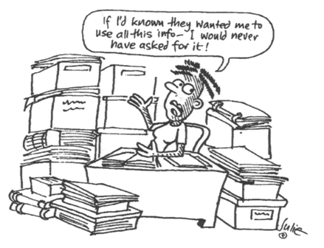
Goals of the Process
The Process
Make the data simpler
Find the relationships
Find the weird stuff
Make predictions
Graduate Enrollment Management Services seeks to supplement UB strategic reporting with accurate Graduate Education visual analytics in support of Institutional Planning and decision-making.

Slide 28
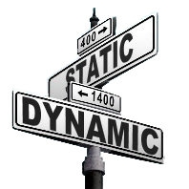
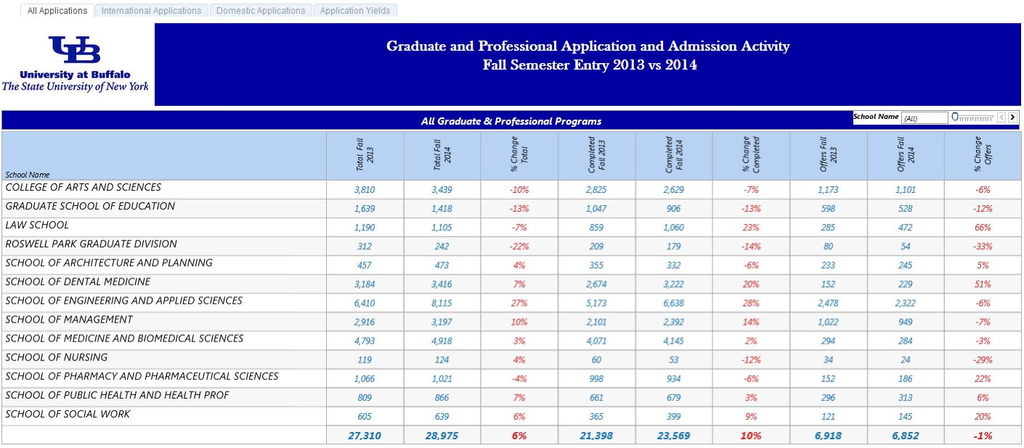
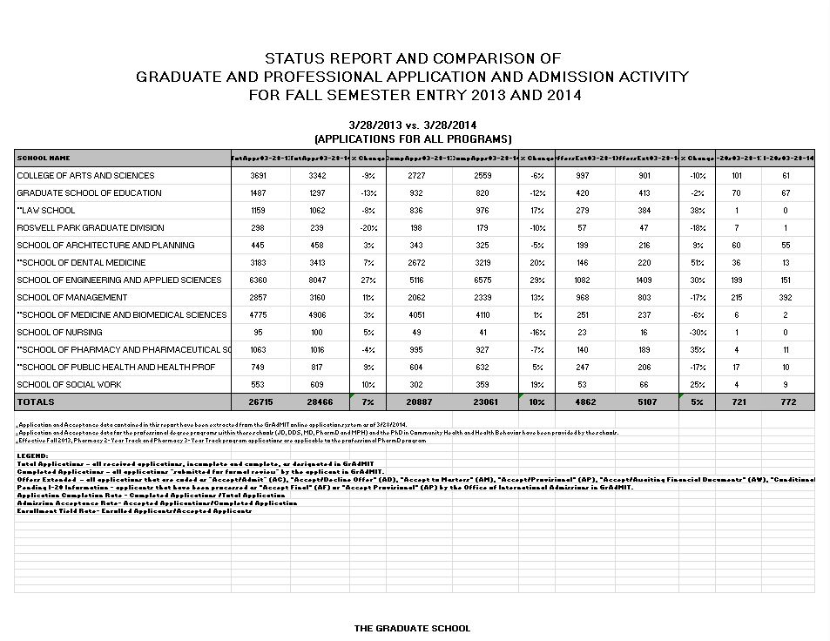
Results of Tableau &
Tableau Server incorporation
Combine all our routine reports into
powerful dashboards.
Publish it so you can filter, highlight and drill
down right in a browser.
Update it in real time. And do it in minutes or
hours, not weeks or months.

Slide 29
Demo
The process highlighting the dashboard.

Slide 30
Driving Data-Based Decisions in Institutional Research
University at Buffalo
Leah Feroleto leahfero@buffalo.edu
Amy Guthrie amyguthr@buffalo.edu
Troy Joseph troyjose@buffalo.edu
Joseph Mantione mantione@buffalo.edu
Analytics powered by Tableau at UB
May 14, 2014

