Slide 1
Analytics in Institutional Research:
The Final Frontier
PRESENTED BY
University at Buffalo
Leah Feroleto - School of Social Work
Joe Mantione - Institutional Analysis
Michele Sedor - Institutional Analysis

Slide 2
Analytics in Institutional Research
The University at Buffalo
Challenges to Higher Education
President Vows Action on College Costs
Why Analytics in Higher Ed? Why Now?
Tableau in Higher Education

Slide 3
The University at Buffalo
The University at Buffalo (UB) is the largest university in the State University of New York (SUNY) system.
Founded: 1846
Premier, research-intensive public institution
Association of American Universities (AAU) member
Enrollment: 28,952 (Fall 2012)
19,506 undergraduate
9,446 graduate and professional
Source: UB at Glance

Slide 4
Challenges to Higher Education
Poor endowment returns
Increase in outcome driven accountability
Heightened concerns over affordability
Tighter Accreditation Regulations
Decreasing Enrollments
Government Spending Cuts
Growing public doubt about college value
Source: Jason Lane - The Nelson A. Rockefeller Institute of Government University at Albany

Slide 5
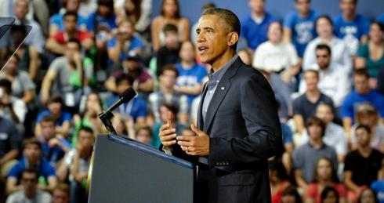
President Vows Action on College Costs
On August 22 President Obama spoke at UB to outline a 4 point strategy to make college more affordable
Source: Obama Speaks on Campus, Making UB History
Obama Vows Action on College Costs
College Affordability

Slide 6
President Vows Action on College Costs
: Tying financial aid to college performance. Students who receive federal aid would not receive assistance for the next semester’s courses until they have completed their current coursework.
: Promoting innovation and competition among the nation's universities by offering students a greater range of study options, including online courses.
: Easing the burden of student loan debt by allowing all borrowers to cap loan payments at 10 percent of monthly income.
: Implementing a new rating system that rewards colleges and universities for performance. Allow students and their families to select schools that provide the “best value.”
http://collegecost.ed.gov/scorecard/

Slide 7
Why Analytics in Higher Ed? Why Now?
Access Demand
Improving student outcomes
Cloud Strategy
IT staffing models
Information security
Funding IT strategically
Sustainable online learning
IT Consumerization and BYOD
Using IT transformatively
Analytics to support institutional outcomes
Source: EDUCAUSE Top Ten Issues 2000 - 2013 InfoGraphic

Slide 8
Why Analytics in Higher Ed? Why Now?
Too much operational data, too little strategic analytics.
OBIEE (Oracle) and iStrategy (Blackboard) power UB's operational reporting, and while we leverage their data modeling capacity, they lack the ability to easily support the modern visualization efforts necessary for today's strategic policy discussions.
This challenge is by no means unique to UB. Institutions throughout higher education face the same problem every day – and it’s only getting worse!

Slide 9
Why Analytics in Higher Ed? Why Now?
Data comes from ever increasing # of internal sources:
Service Platform
Business Intelligence Oracle Business Intelligence Enterprise Edition
Collaboration SharePoint
Database Management Oracle / MS-SQL
Digital Library ContentDM, dSpace
Document Imaging ImageNow
Geocoding ArcGIS
Learning Management System BlackBoard
OnLine Analytical Processing Blackboard iStrategy
Student Systems PeopleSoft
Web Content Management Adobe CQ5

Slide 10
Why Analytics in Higher Ed? Why Now?
Data is also coming from a growing list of external hosted systems with their own set of challenges
Service Vendor
Accreditation Management Campuslabs - Compliance Assist
Benchmarking Academic Analytics
Course Evaluations ConnectEDU - Course Eval
Emergency Notification Rave
Events Management ComputerSOS - Special Events
Faculty Annual Reporting Digital Measures – Activity Insight
Grants Management COEUS
Recruitment Management PeopleAdmin
Student Engagement Campuslabs - CollegiateLink
Surveys Campuslabs – Baseline
data.gov, IPEDS, NIH, NFS, SUNYIR State and Federal Government

Slide 11
Tableau in Higher Education - Admissions
Graduate Admissions - Demographics Dashboard
Graduate Admissions - Analytics
Graduate Admissions - Program Source
Graduate Admissions - Graduate Fair Report

Slide 12
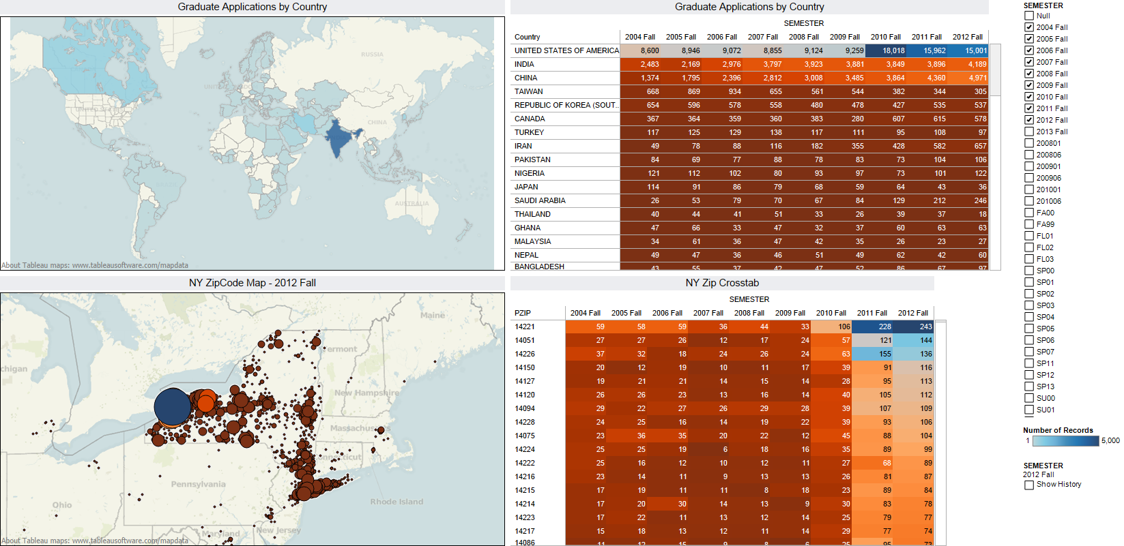
Tableau in Higher Education - Admissions
Graduate Admissions - Demographics Dashboard

Slide 13
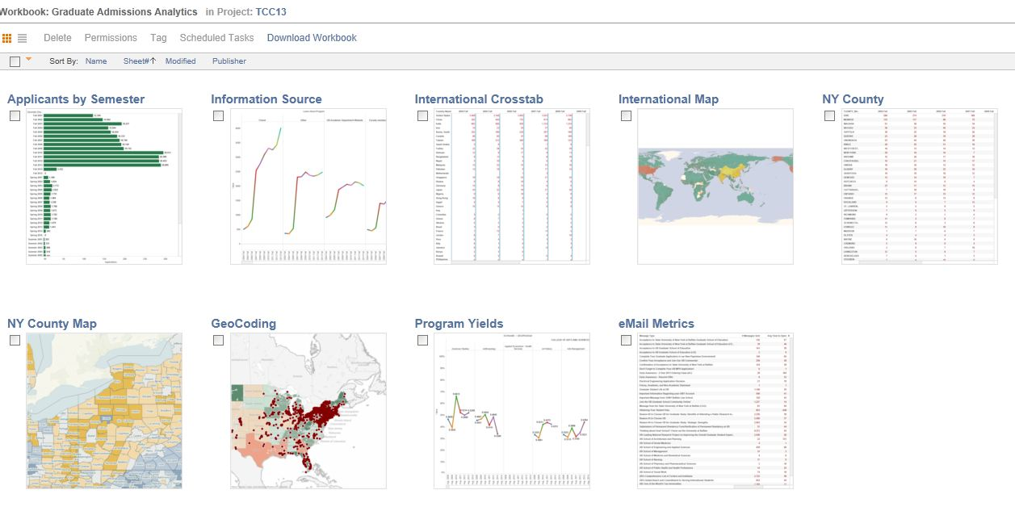
Tableau in Higher Education - Admissions
Graduate Admissions - Analytics

Slide 14
The Admissions Funnel: Overview
Having longitudinal data at all points in the admissions funnel allows you to:
Develop effective predictive models for enrollment
Provide analytic, scientific insight beyond the pre-admission funnel
Perfect a comprehensive enrollment management model that takes into consideration the front end admissions funnel, the prospect pool and the back end, student retention.
…It’s a symbiotic relationship
PROSPECTS
INQUIRIES
COMPLETED APPS
ADMITS
DEPOSITED
ENROLLED
CONTINUING
GRADUATED

Slide 15
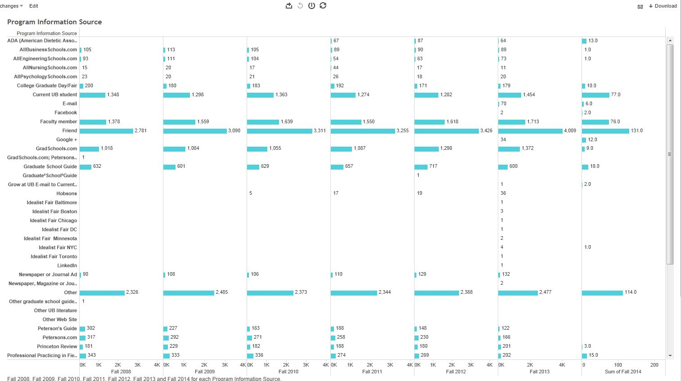
Tableau in Higher Education - Admissions
Graduate Admissions - Program Source

Slide 16
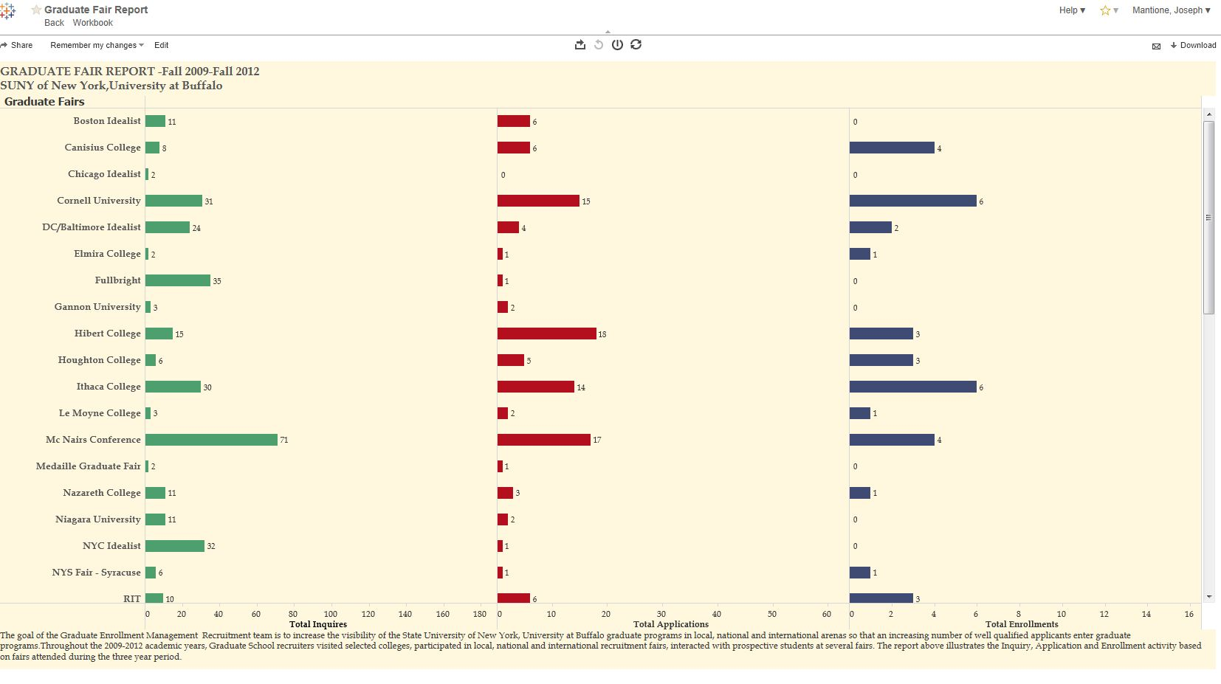
Tableau in Higher Education - Admissions
Graduate Admissions - Graduate Fair Report

Slide 17
Tableau in Higher Education - Enrollment
School of Social Work Attrition
Enrollment - 2013 Spring (Daily)
Enrollment by Unit
Transfer Analysis Dashboards
Time to Degree

Slide 18
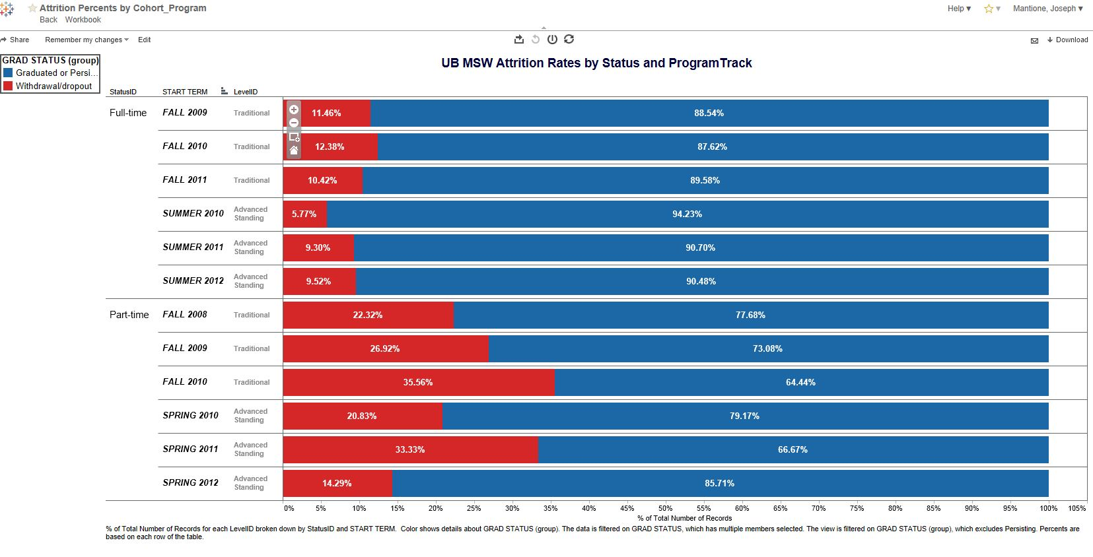
Tableau in Higher Education - Enrollment
School of Social Work Attrition

Slide 19
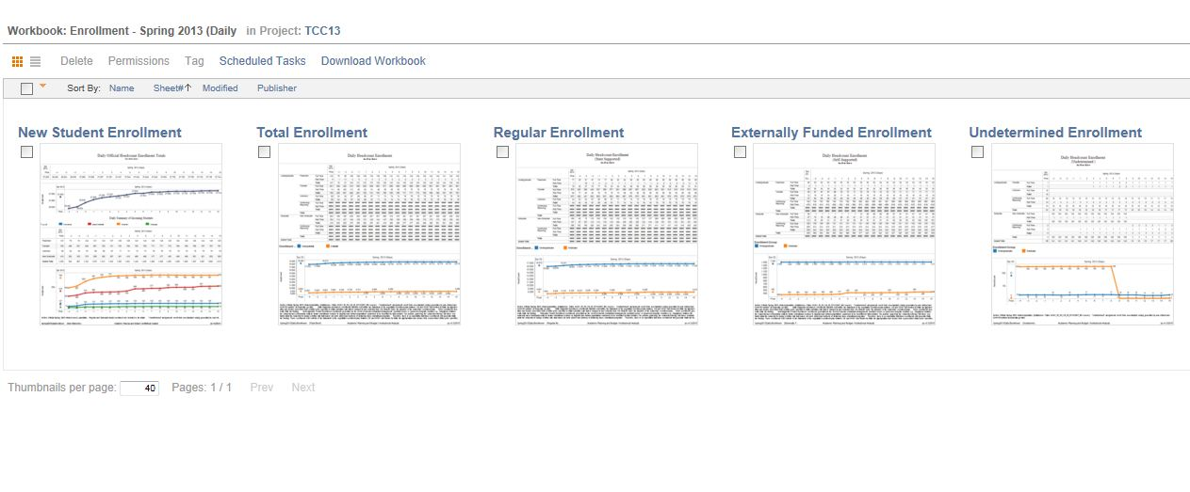
Tableau in Higher Education - Enrollment
Enrollment - 2013 Spring (Daily)

Slide 20
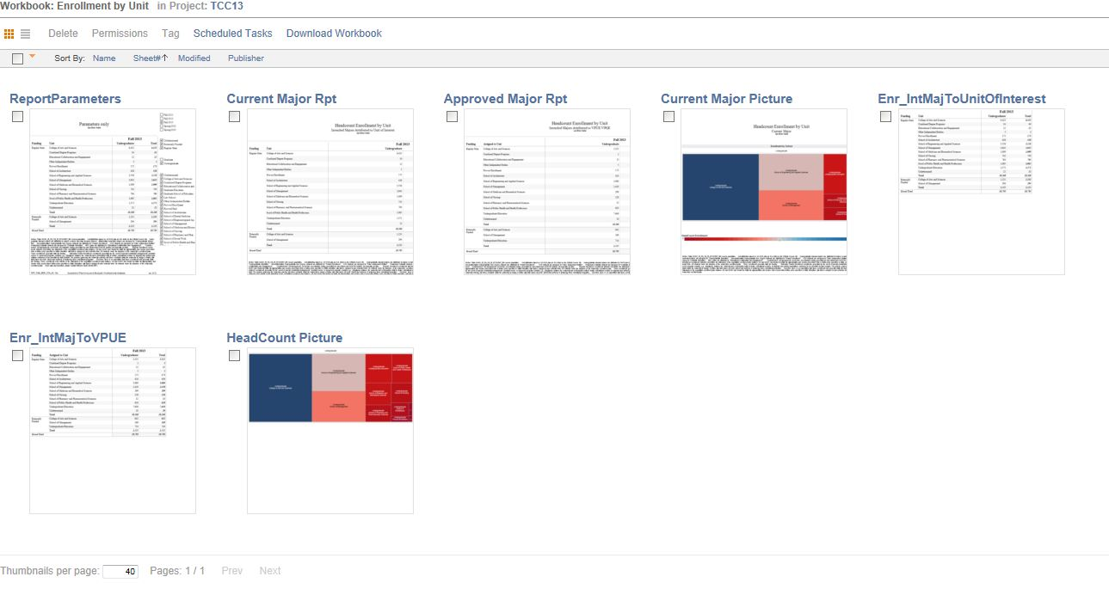
Tableau in Higher Education - Enrollment
Enrollment by Unit

Slide 21
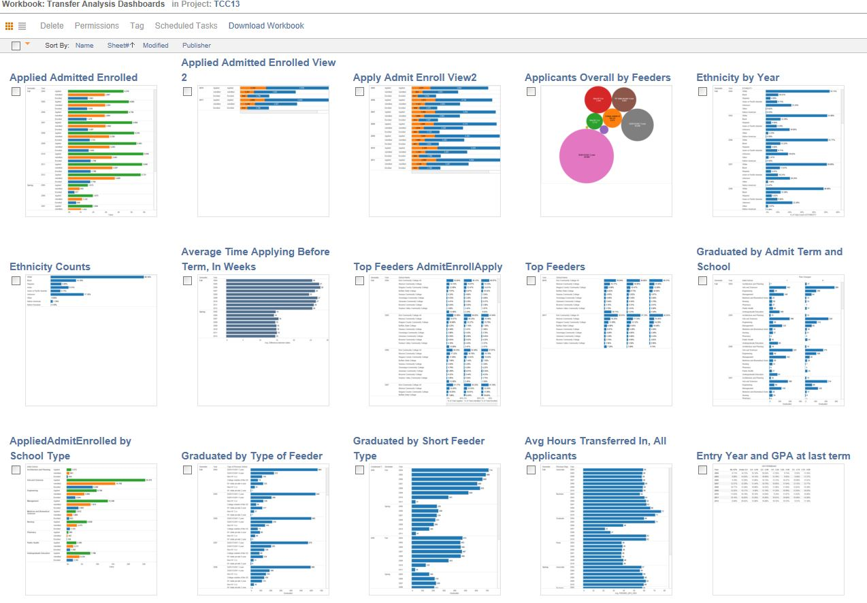
Tableau in Higher Education - Enrollment
Transfer Analysis Dashboards

Slide 22
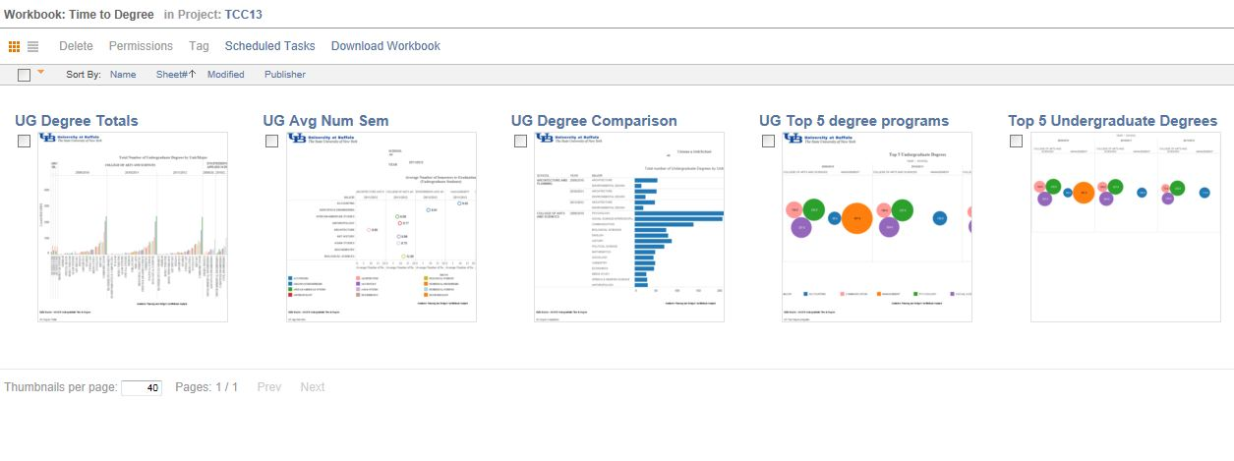
Tableau in Higher Education - Enrollment
Time to Degree

Slide 23
Tableau in Higher Education - Benchmarking
Scholarly Benchmarking
Voluntary Support of Education
Global Research Benchmarking System

Slide 24
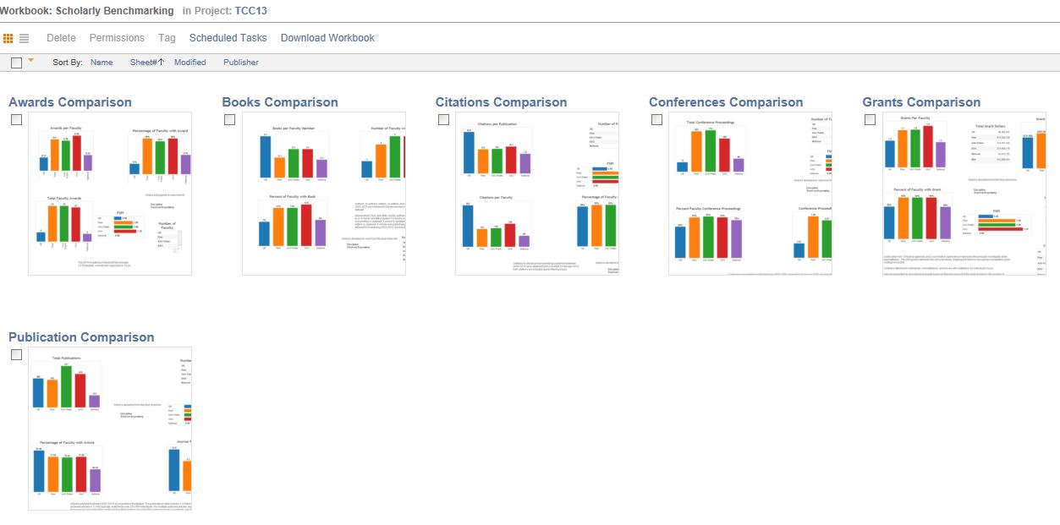
Tableau in Higher Education - Benchmarking
Scholarly Benchmarking

Slide 25
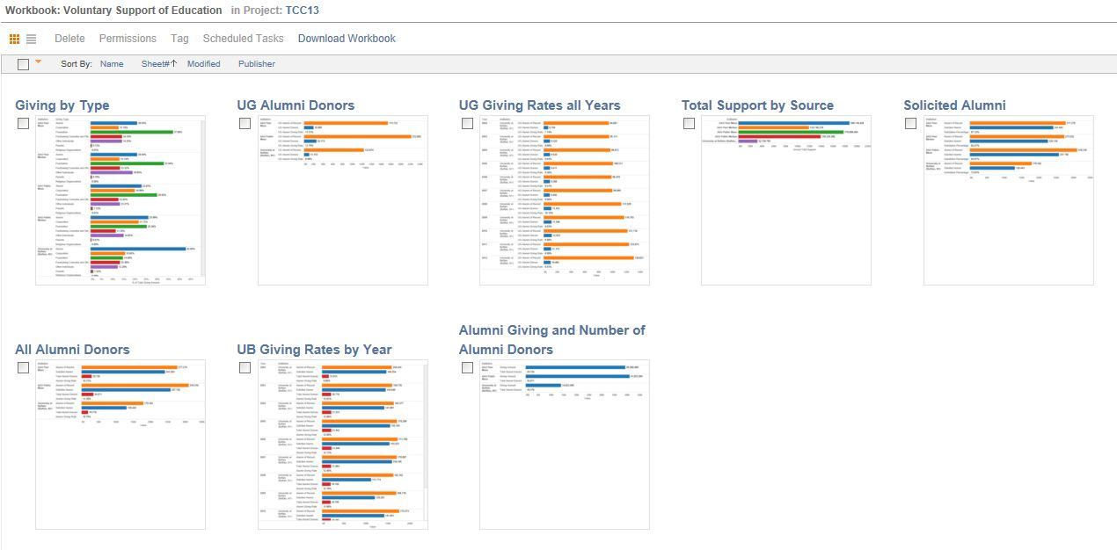
Tableau in Higher Education - Benchmarking
Voluntary Support of Education

Slide 26
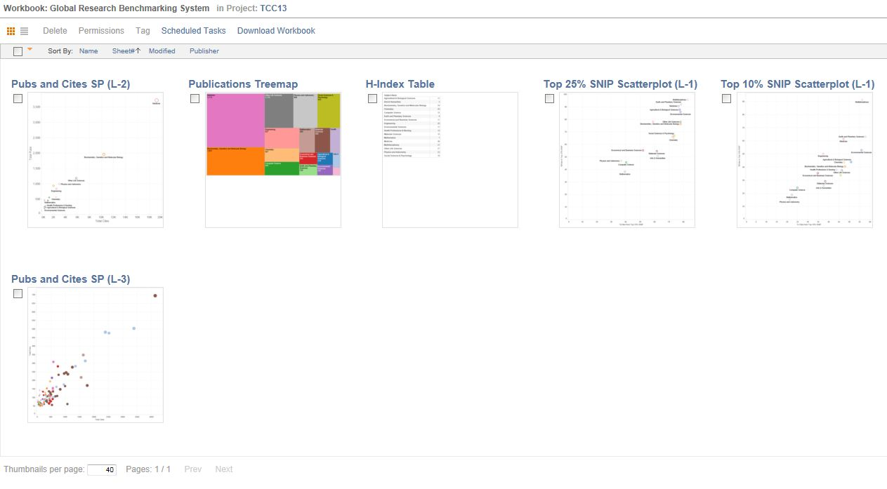
Tableau in Higher Education - Benchmarking
Global Research Benchmarking System

Slide 27
Wrapping Up
"Now that we're in the era of big data we ought to exploit it to provide better services to students.“
David A. Bergeron, Education Department

Slide 28
Wrapping Up
Special thanks for their contributions goes to:
Craig Abbey
Troy Joseph
Rachel Link

Slide 29
Q&A
University at Buffalo
Leah Feroleto School of Social Work
(716) 645-1244 leahfero@buffalo.edu
Joe Mantione Office of Institutional Analysis
(716) 645-3938 mantione@buffalo.edu
Michele Sedor Office of Institutional Analysis
(716) 645-3571 mmsedor@buffalo.edu
Presentation and reference materials available at http://apb.buffalo.edu/

Slide 30
Analytics in Institutional Research:
The Final Frontier

