Slide 1
Mapping the Pipeline:
Changing Demographics and Enrollment Impacts
Michael Randall and Craig W. Abbey
(Special thanks to Sean Brodfuehrer for ArcGIS technical assistance)

Slide 2
Presentation Outline
Overview of University of Buffalo (context)
Basic steps needed to utilize GIS (geographic information systems) software
Tips on preparing data
Viewing results
Analyzing results
Next steps
Notes:
(arcGIS ver 10.1)

Slide 3
Overview of University at Buffalo
Founded in 1846, now part of State University of New York system
Member of Association of American Universities (AAU)
$353 million (FY 2011) in research
28,860 students (Fall 2011)
7,515 degrees (full set of programs including DDS/MD/JD/Pharm D/DPT/DNP)
6,622 full-time equivalent employees
1.4 billion (FY 2011) Annual Budget
Division I, Mid-American Conference Athletics
Notes:
(arcGIS ver 10.1)

Slide 4
Background & Environment
Enrollment Management
NYS Demographics
UB 2020
SUNY Budget Model

Slide 5
Enrollment Pipeline
High School Grads
Inquiries
UB applications
Accepted
Enrolled
Grad

Slide 6
Admissions Decisions
HS GPA’s
ACT/SAT Test Scores
Other Characteristics
Accepted

Slide 7
Projecting High School Graduates
High school graduates projected to decline ~7% through 2020
Source of Projections: NYS Student Report Card
Notes:
Projections thru 2020 by county from New York State Student Report Card data showing high school enrollments K1 thru K12 used to project high school enrollments by county thru 2020
Historical UB applicants as percent of total New York high school graduates assumed to be consistent in future just for this exercise (keep it simple for now)
County (FIPS - Federal Information Processing Standard) codes need to be the same in the high school projection table as in the arcGIS NYS_County table for joining tables to work (numeric codes)

Slide 8
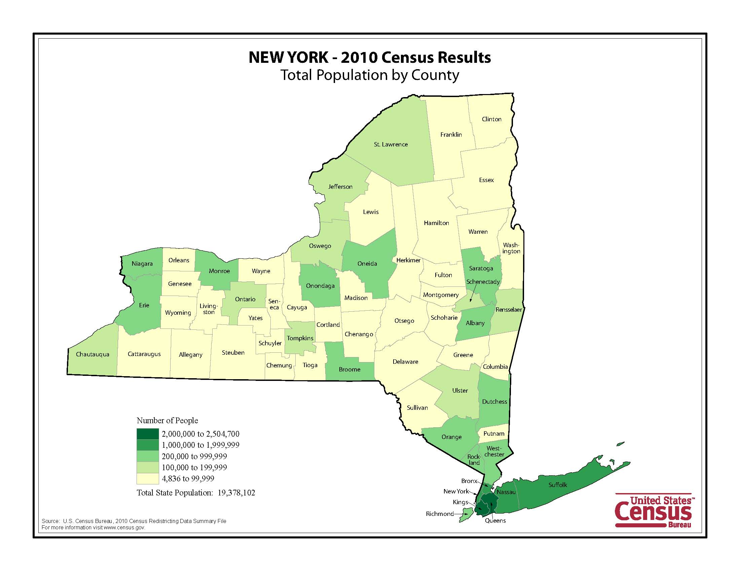

Slide 9
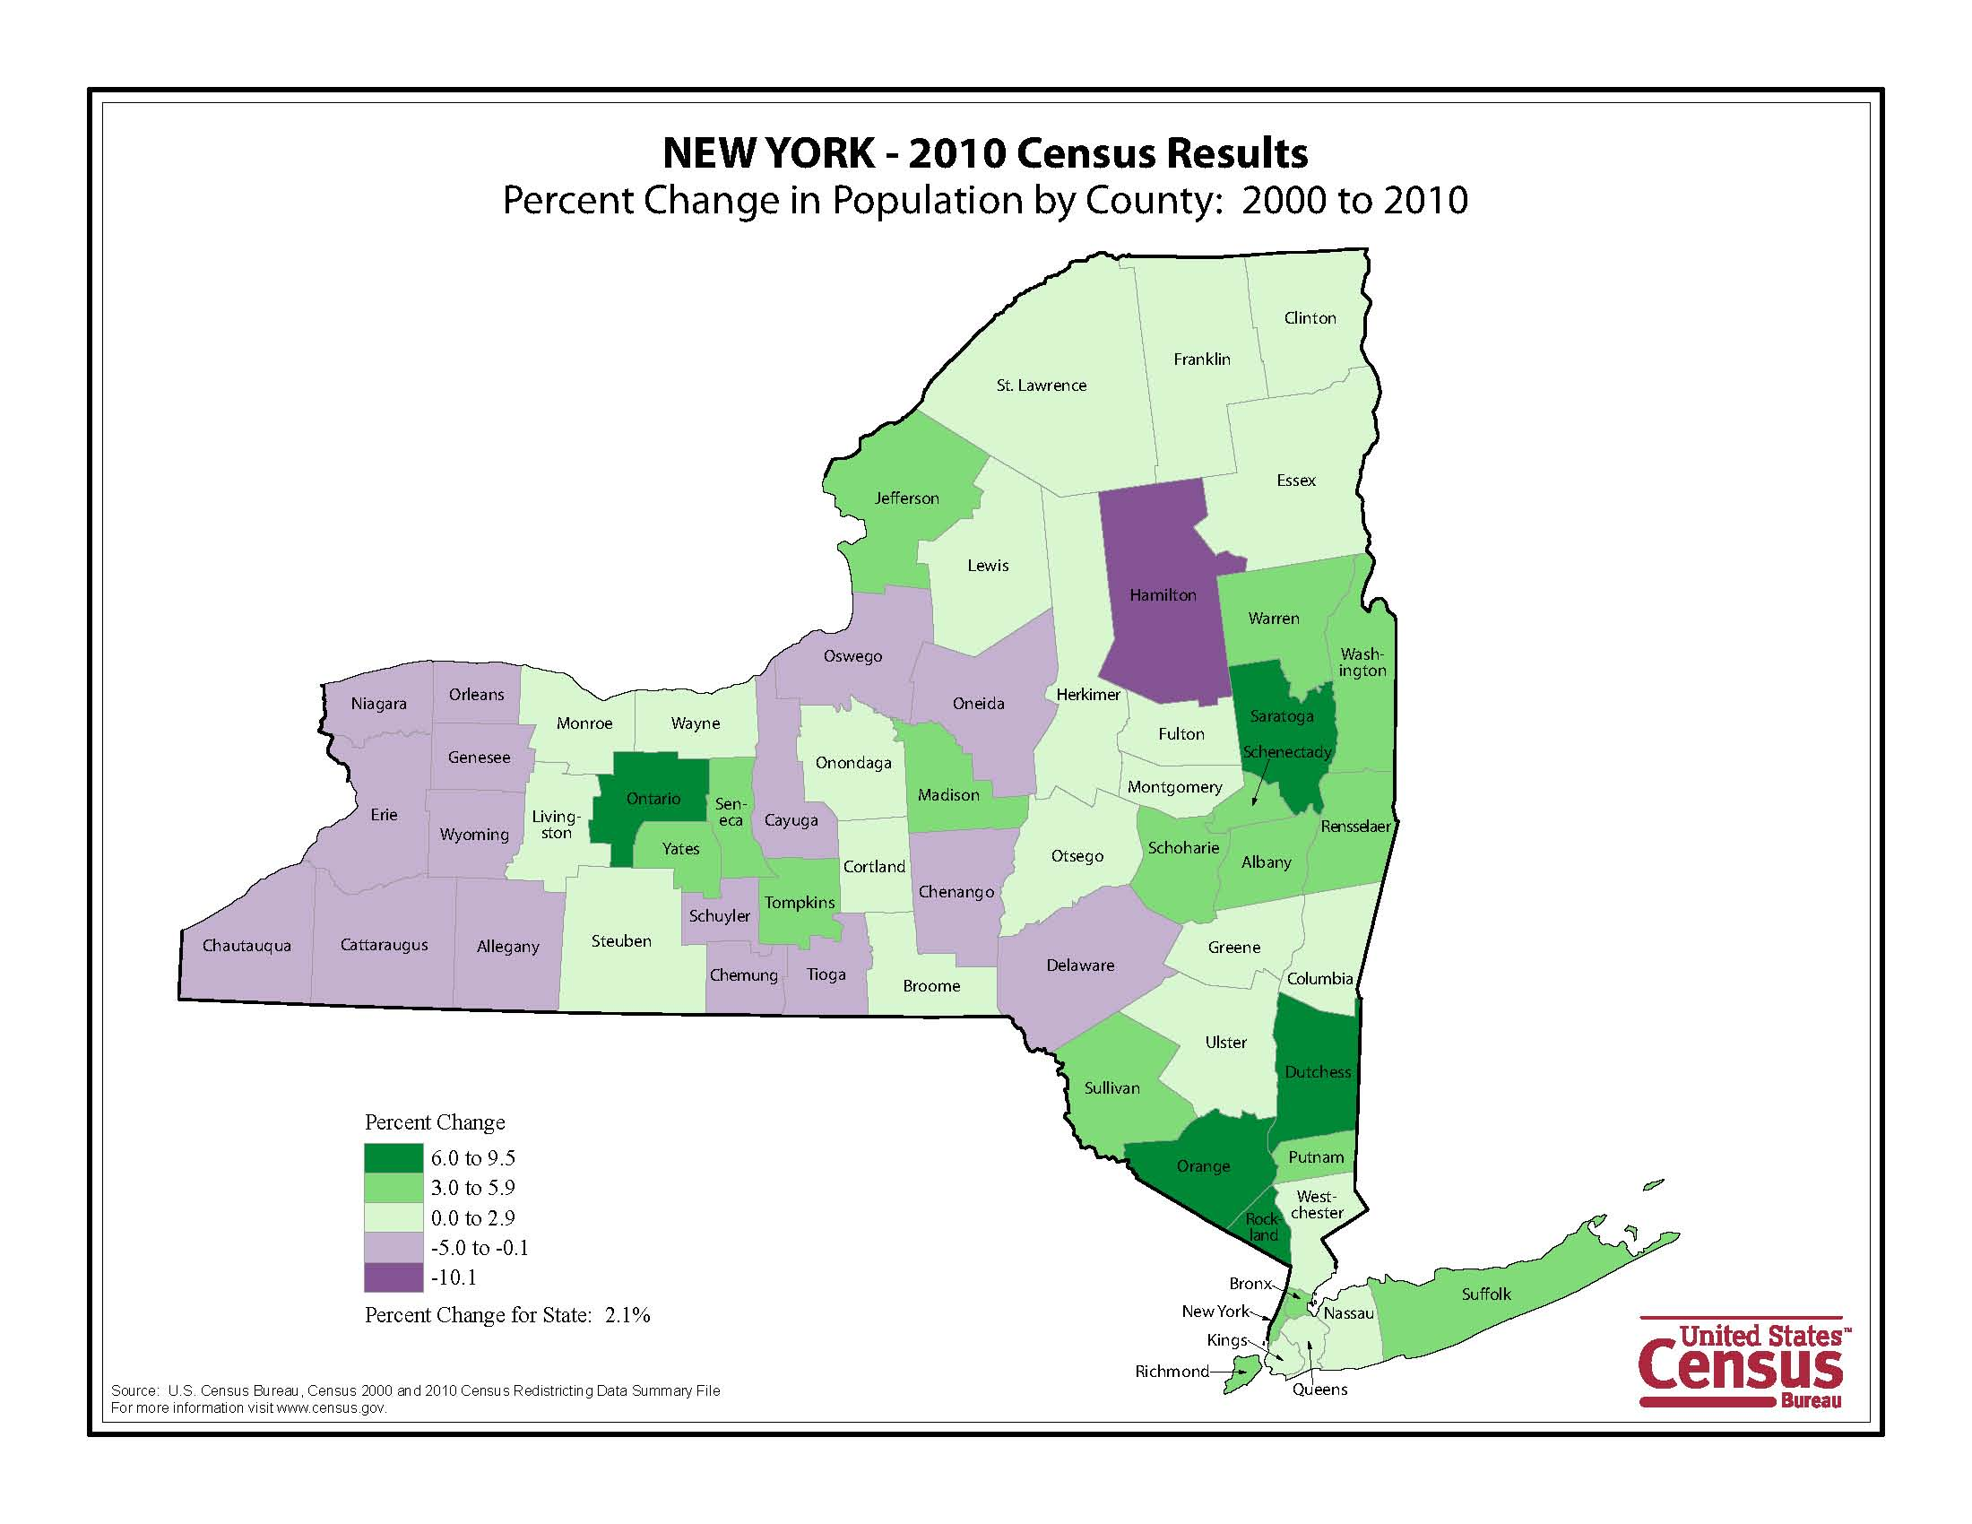

Slide 10
Erie County, New York and the US
 | Erie County | New York | US
Population Change 2000 to 2010 | -3.3% | 2.1% | 9.7%
% Foreign Born | 5.6% | 21.3% | 12.4%
Language other than English Spoken at Home | 9.1% | 28.5% | 19.6%
Female | 51.8% | 51.6% | 50.8%
White, Non-Hispanic | 77.7% | 58.3% | 63.7%
Black | 13.5% | 15.9% | 12.6%
Hispanic of any race | 4.5% | 17.6% | 16.3%
% Population under 18 | 21.6% | 22.3% | 24%

Slide 11
New York’s Minority Population
Source: US Census Bureau

Slide 12
Changing Make-up of NY High School Graduates
Source: WICHE

Slide 13
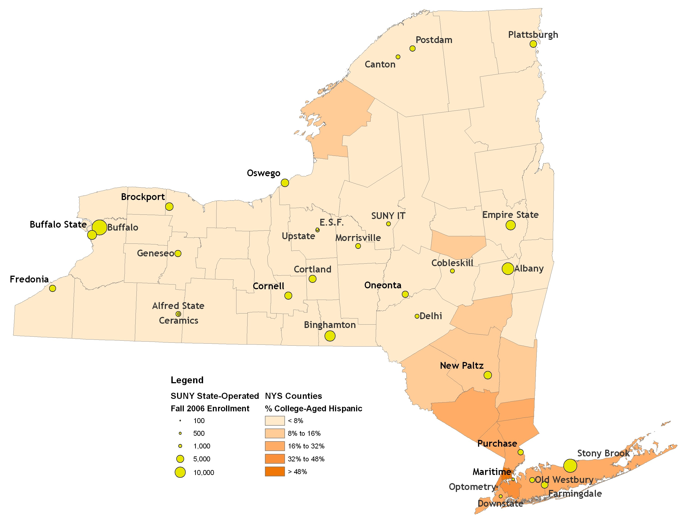
SUNY State-Operated Campus Enrollment and % College Age Hispanic Population by County
Source: US Census Bureau & IPEDS

Slide 14
College Going Rate by Racial/Ethic Group

Slide 15
Data gathering and preparation issues
Consistent Formats
Geocoding Issues
Include all dimensions
ArcGIS software learning
Notes:
First things First – what do we want to show and where do we get the data
We want to include Inquiries/Applications/Admits/Enrolled/Graduated by county (we restricted this initial project to students with a NY state address or attended a high school within NY state)
We want to show dimensions such as: High School averages/ACT or SAT scores/Race-Ethnicity/General New York State Market Segment
Several sources used to gather info. Need to insure that formats were consistent and all data contained the HS CEEB (HS county – numeric FIPS code)
Geocoding of street addresses proved a problem (too many records were not matched, so we compromised on a multi level geocoding approach using street address, then zip code and city/state). In the end, we restricted to New York State until we get more time to track down and resolve other address issues.
Needed to make sure we included all dimensions such as: High School averages/ACT or SAT scores/Race-Ethnicity/General New York State Market Segment.
ArcGIS software learning curve – Although not user friendly, we had access to an in-house expert Sean Brodfuehrer. ArcGIS is a powerful tool already available through university.

Slide 16
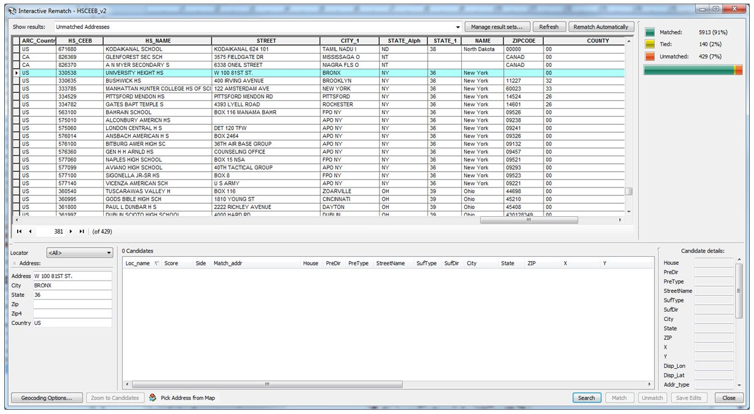
Geocoding Resolution
Fix Unmatched records
Notes:
First things First – what do we want to show and where do we get the data
We want to include Inquiries/Applications/Admits/Enrolled/Graduated by county (we restricted this initial project to students with a NY state address or attended a high school within NY state)
We want to show dimensions such as: High School averages/ACT or SAT scores/Race-Ethnicity/General New York State Market Segment
Several sources used to gather info. Need to insure that formats were consistent and all data contained the HS CEEB (HS county – numeric FIPS code)
Geocoding of street addresses proved a problem (too many records were not matched, so we compromised on a multi level geocoding approach using street address, then zip code and city/state). In the end, we restricted to New York State until we get more time to track down and resolve other address issues.
Needed to make sure we included all dimensions such as: High School averages/ACT or SAT scores/Race-Ethnicity/General New York State Market Segment.
ArcGIS software learning curve – utilized in-house expert Sean Brodfuehrer. Not user friendly, but free and powerful.

Slide 17
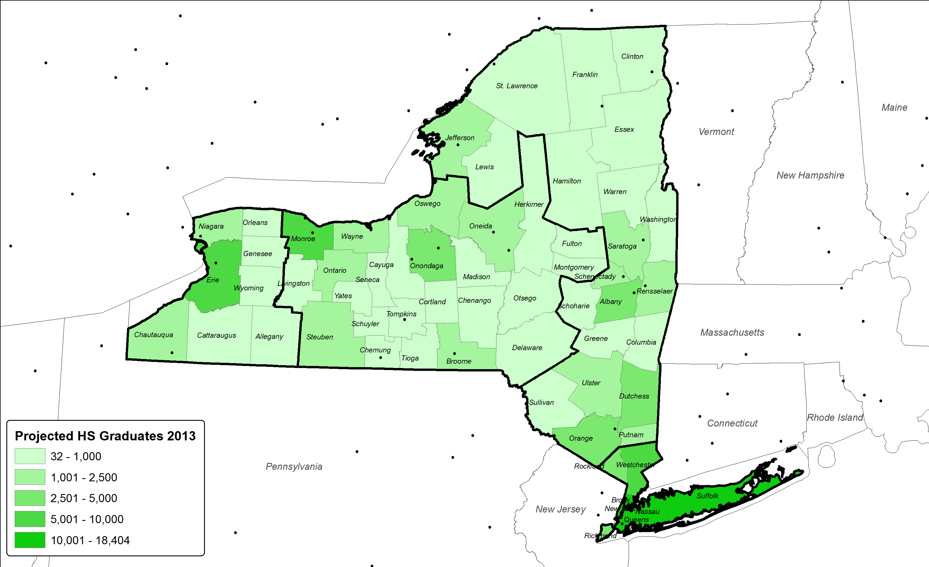
Projected High School Graduates by County - 2013
Rochester
Buffalo
Albany
New York
Notes:
Market segments used by admissions recruiters/advisors

Slide 18

Projected High School Graduates by County - 2020
Rochester
Buffalo
Albany
New York

Slide 19
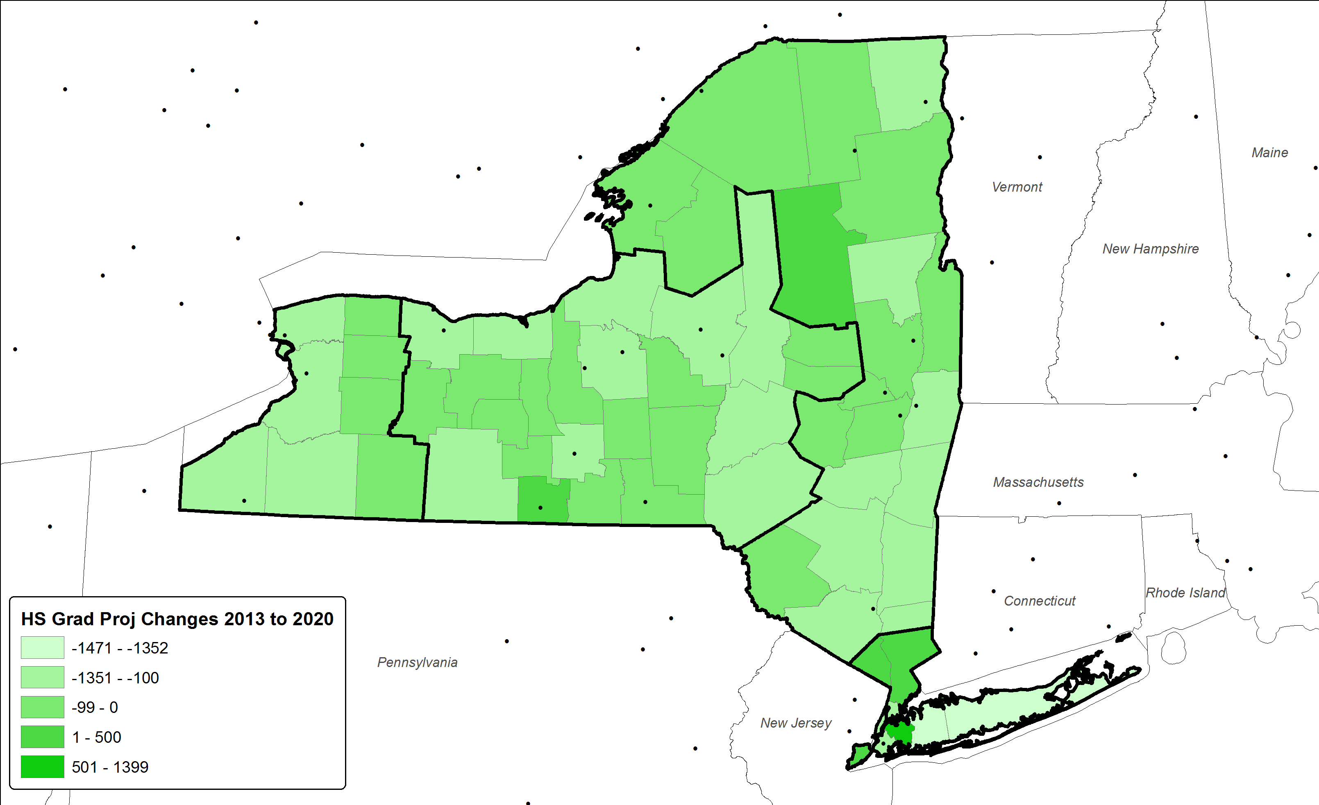
Changes in Projected High School Graduates by County 2013 to 2020
High school graduates projected to decline ~7% through 2020
East
(2,022)
-7.8%
Rochester
Buffalo
Central
(2,929)
-9.8%
West
(1,322)
-8.7%
Albany
New York
Metro
(1,786)
-1.7%

Slide 20
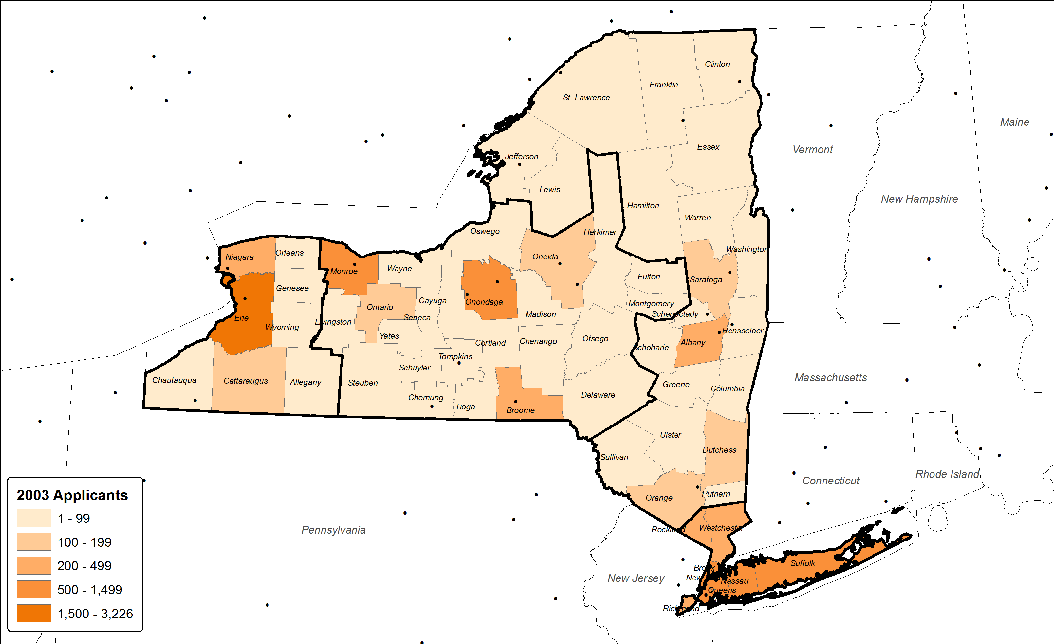
Applicants by County – Fall 2003
Rochester
Buffalo
Albany
New York

Slide 21
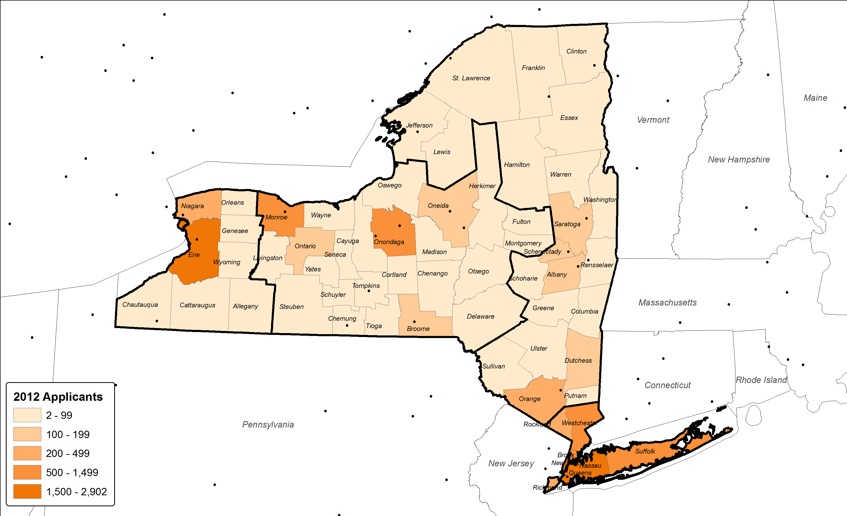
Applicants by County – Fall 2012
Rochester
Buffalo
Albany
New York

Slide 22
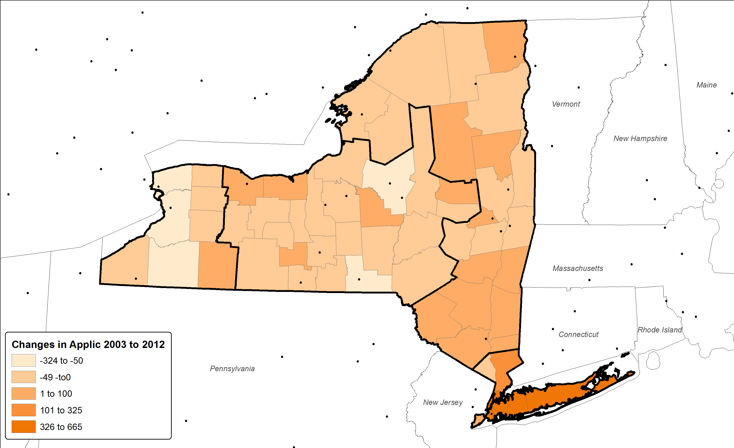
Applicants by County – Changes Fall 2003 to Fall 2012
East
121
9.7%
Rochester
Buffalo
Central
(232)
-7.2%
West
(498)
-12.1%
Albany
New York
Metro
3,057
41.9%

Slide 23
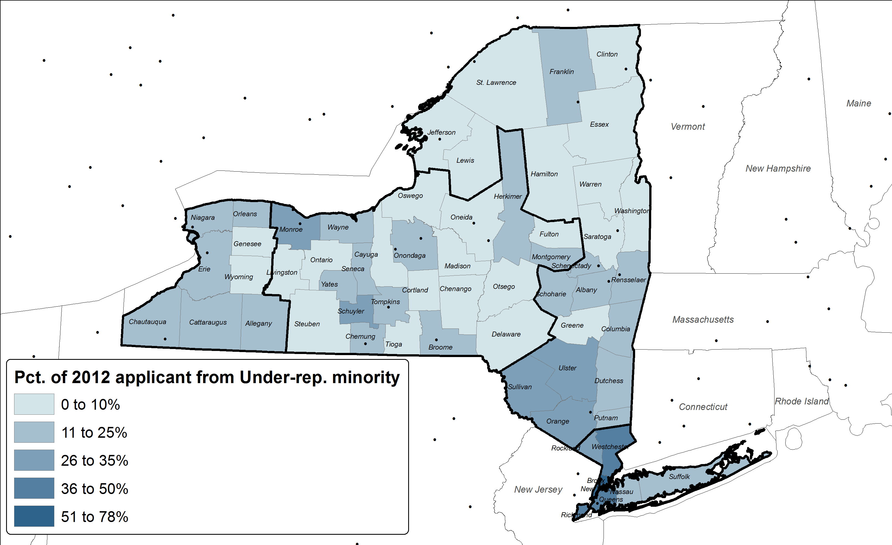
Applicants by County Underrepresented Minority Fall 2012
Rochester
Buffalo
Albany
New York

Slide 24
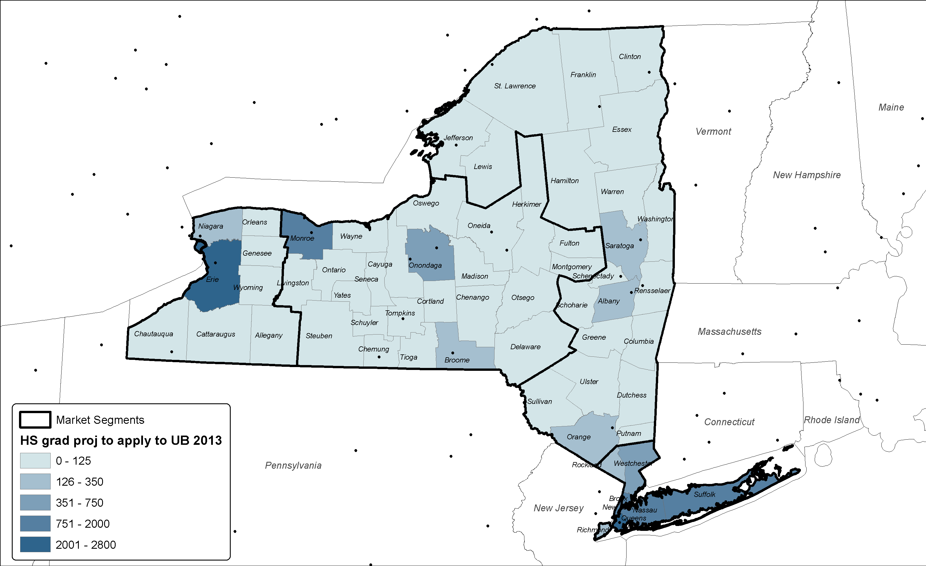
Projected UB applicants 2013
Rochester
Buffalo
Albany
New York

Slide 25

Projected UB applicants 2020
Rochester
Buffalo
Albany
New York

Slide 26
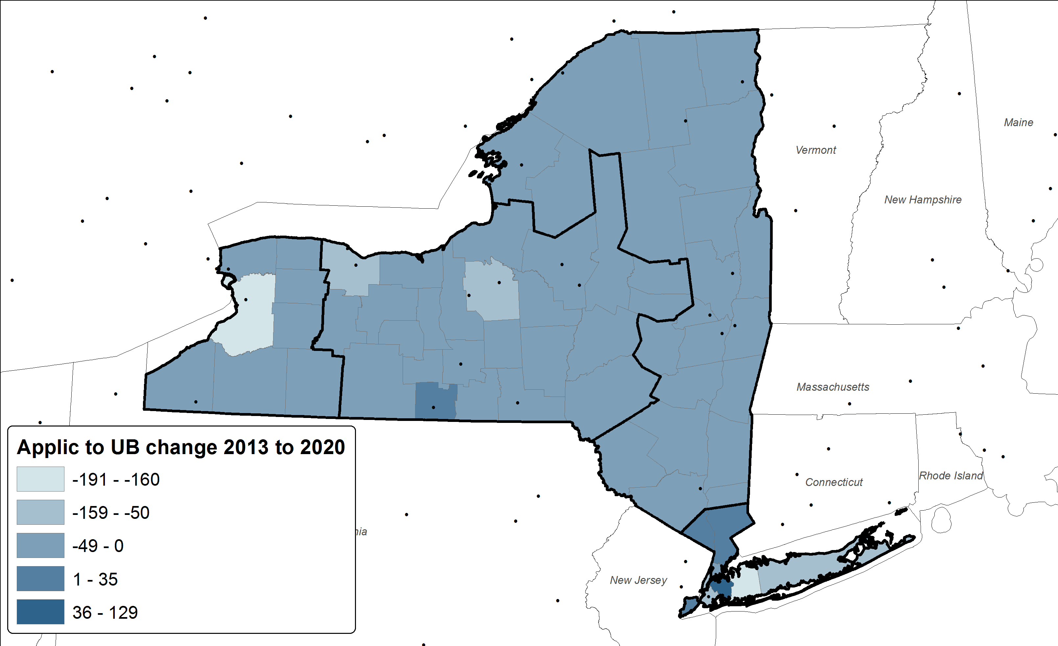
Changes in Projected High School Graduates by County Applying to UB 2013 to 2020
East
(79)
-6.7%
Rochester
Buffalo
Central
(255)
-8.0%
West
(259)
-7.6%
Albany
New York
Metro
(184)
-1.8%

Slide 27
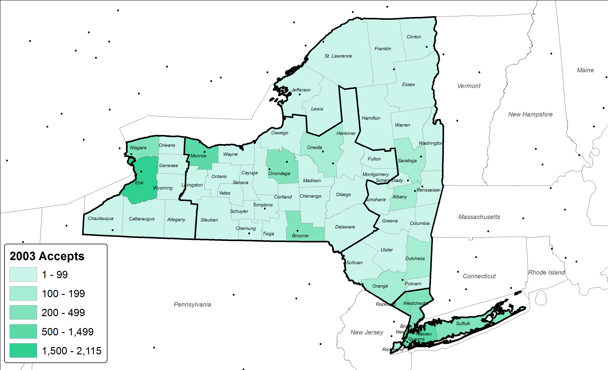
Accepts by County – Fall 2003
Rochester
Buffalo
Albany
New York

Slide 28
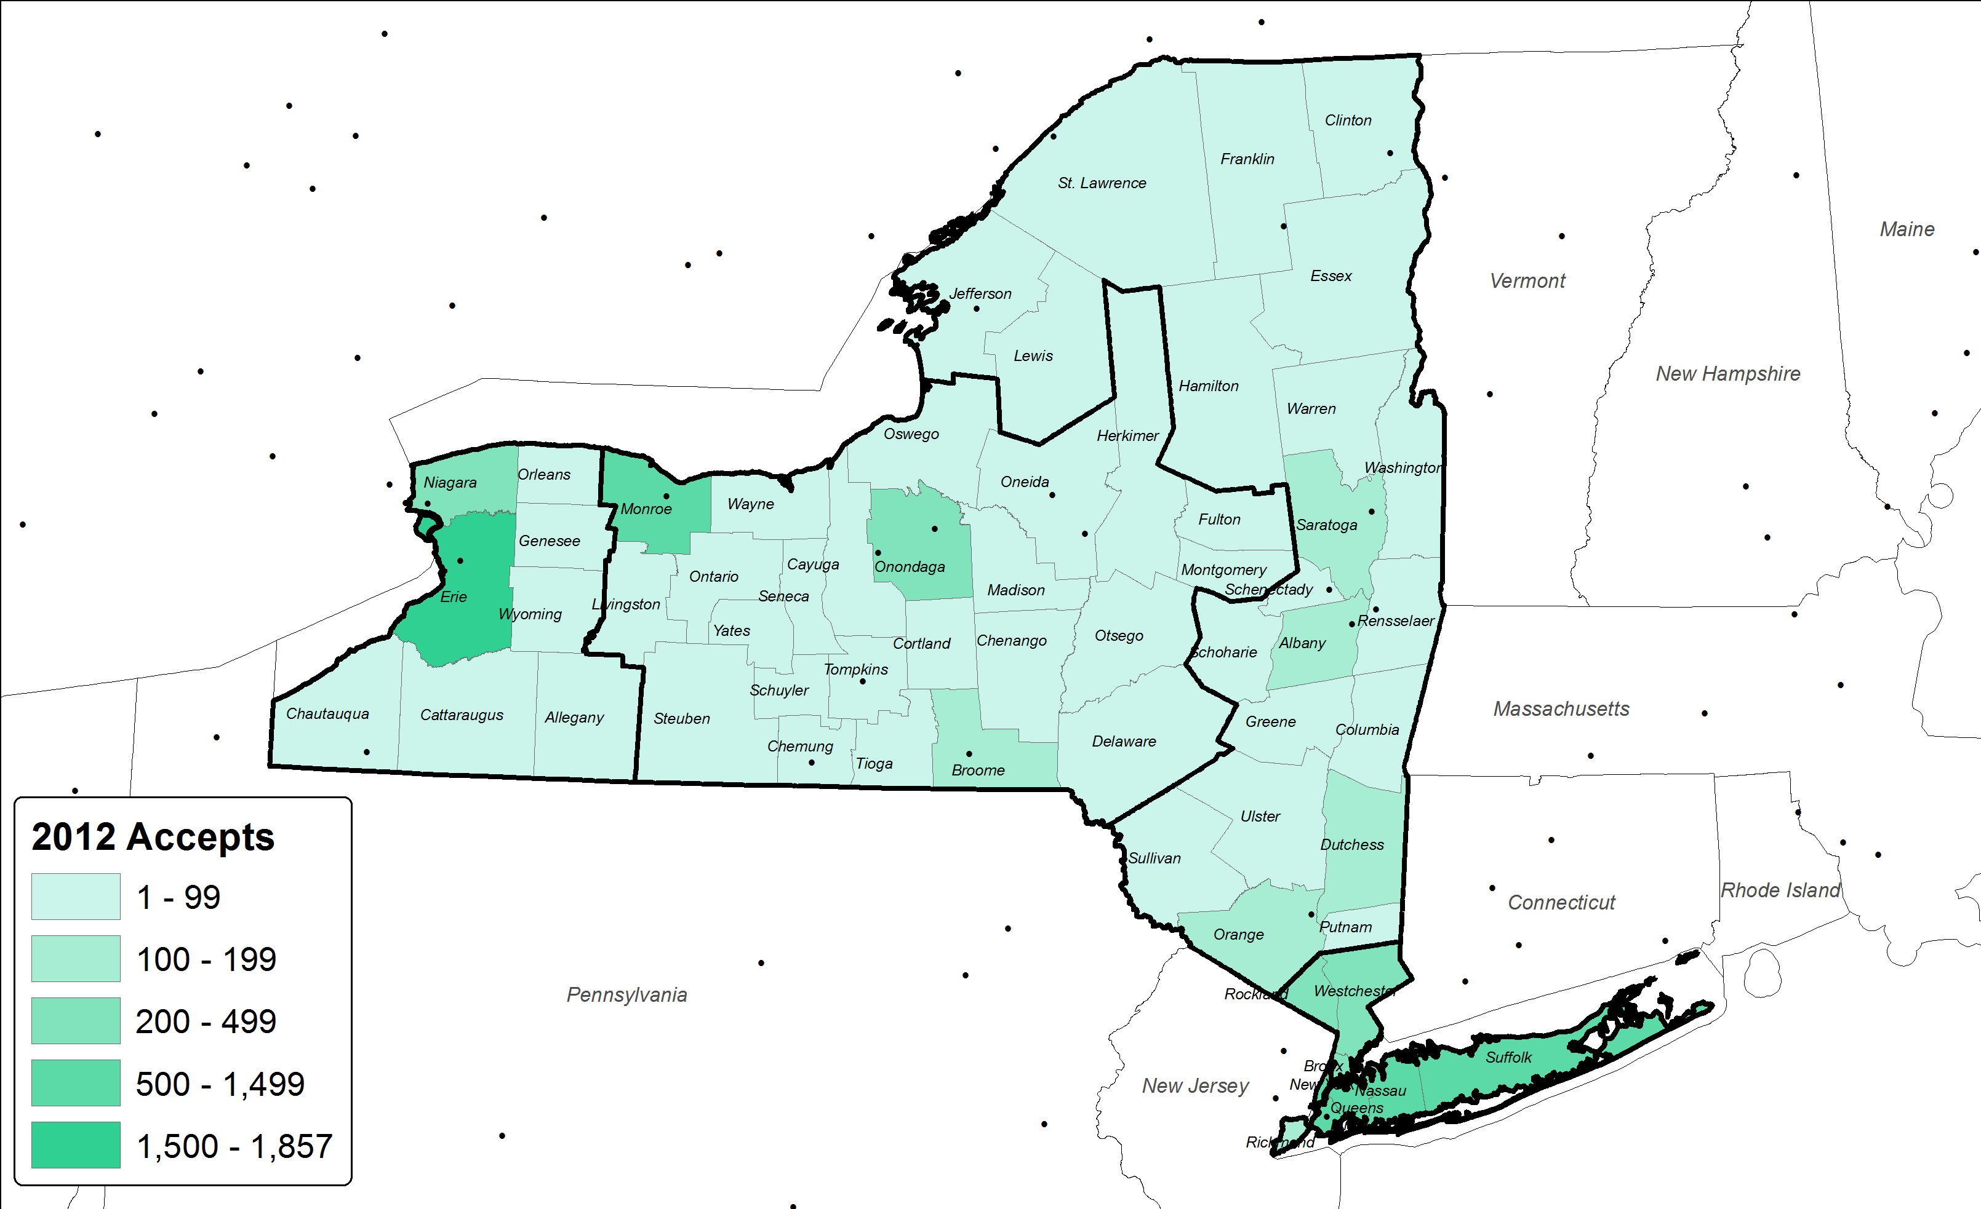
Accepts by County – Fall 2012
Rochester
Buffalo
Albany
New York

Slide 29
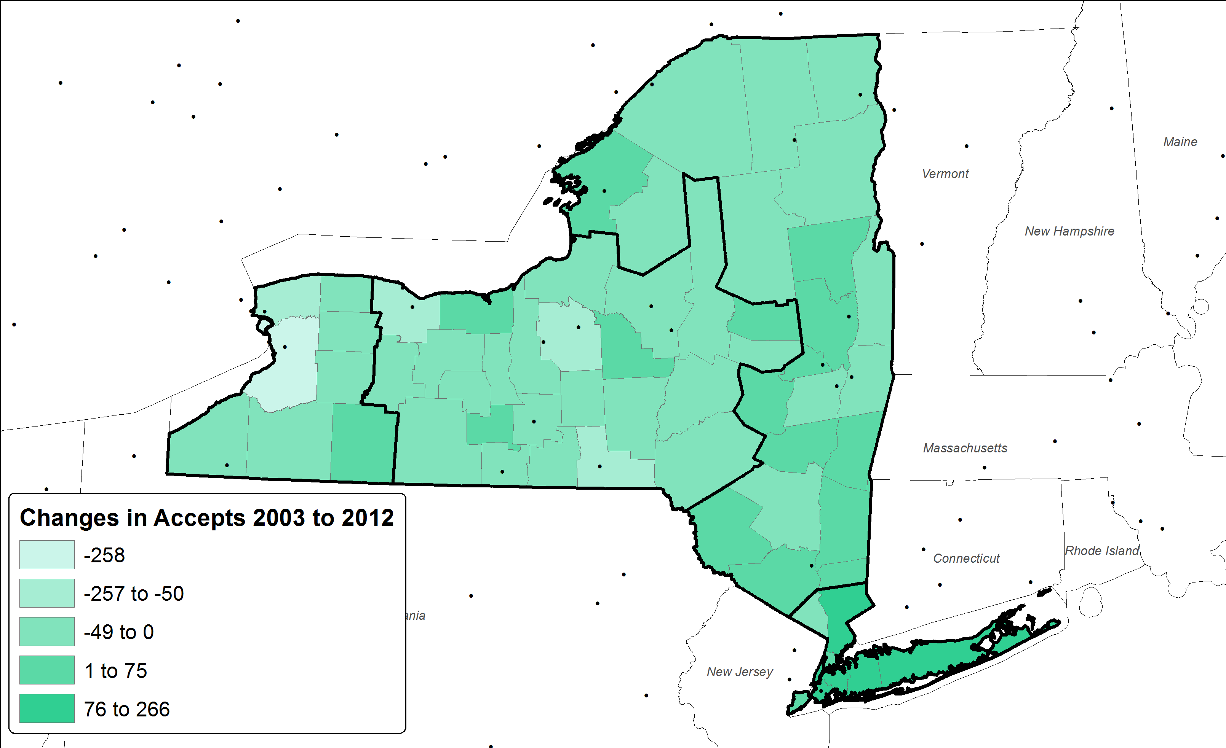
Accepts by County Change– Fall 2003 to Fall 2012
East
37
4.0%
Rochester
Buffalo
Central
(381)
-16.8%
West
(422)
-15.3%
Albany
New York
Metro
1,151
28.8%

Slide 30
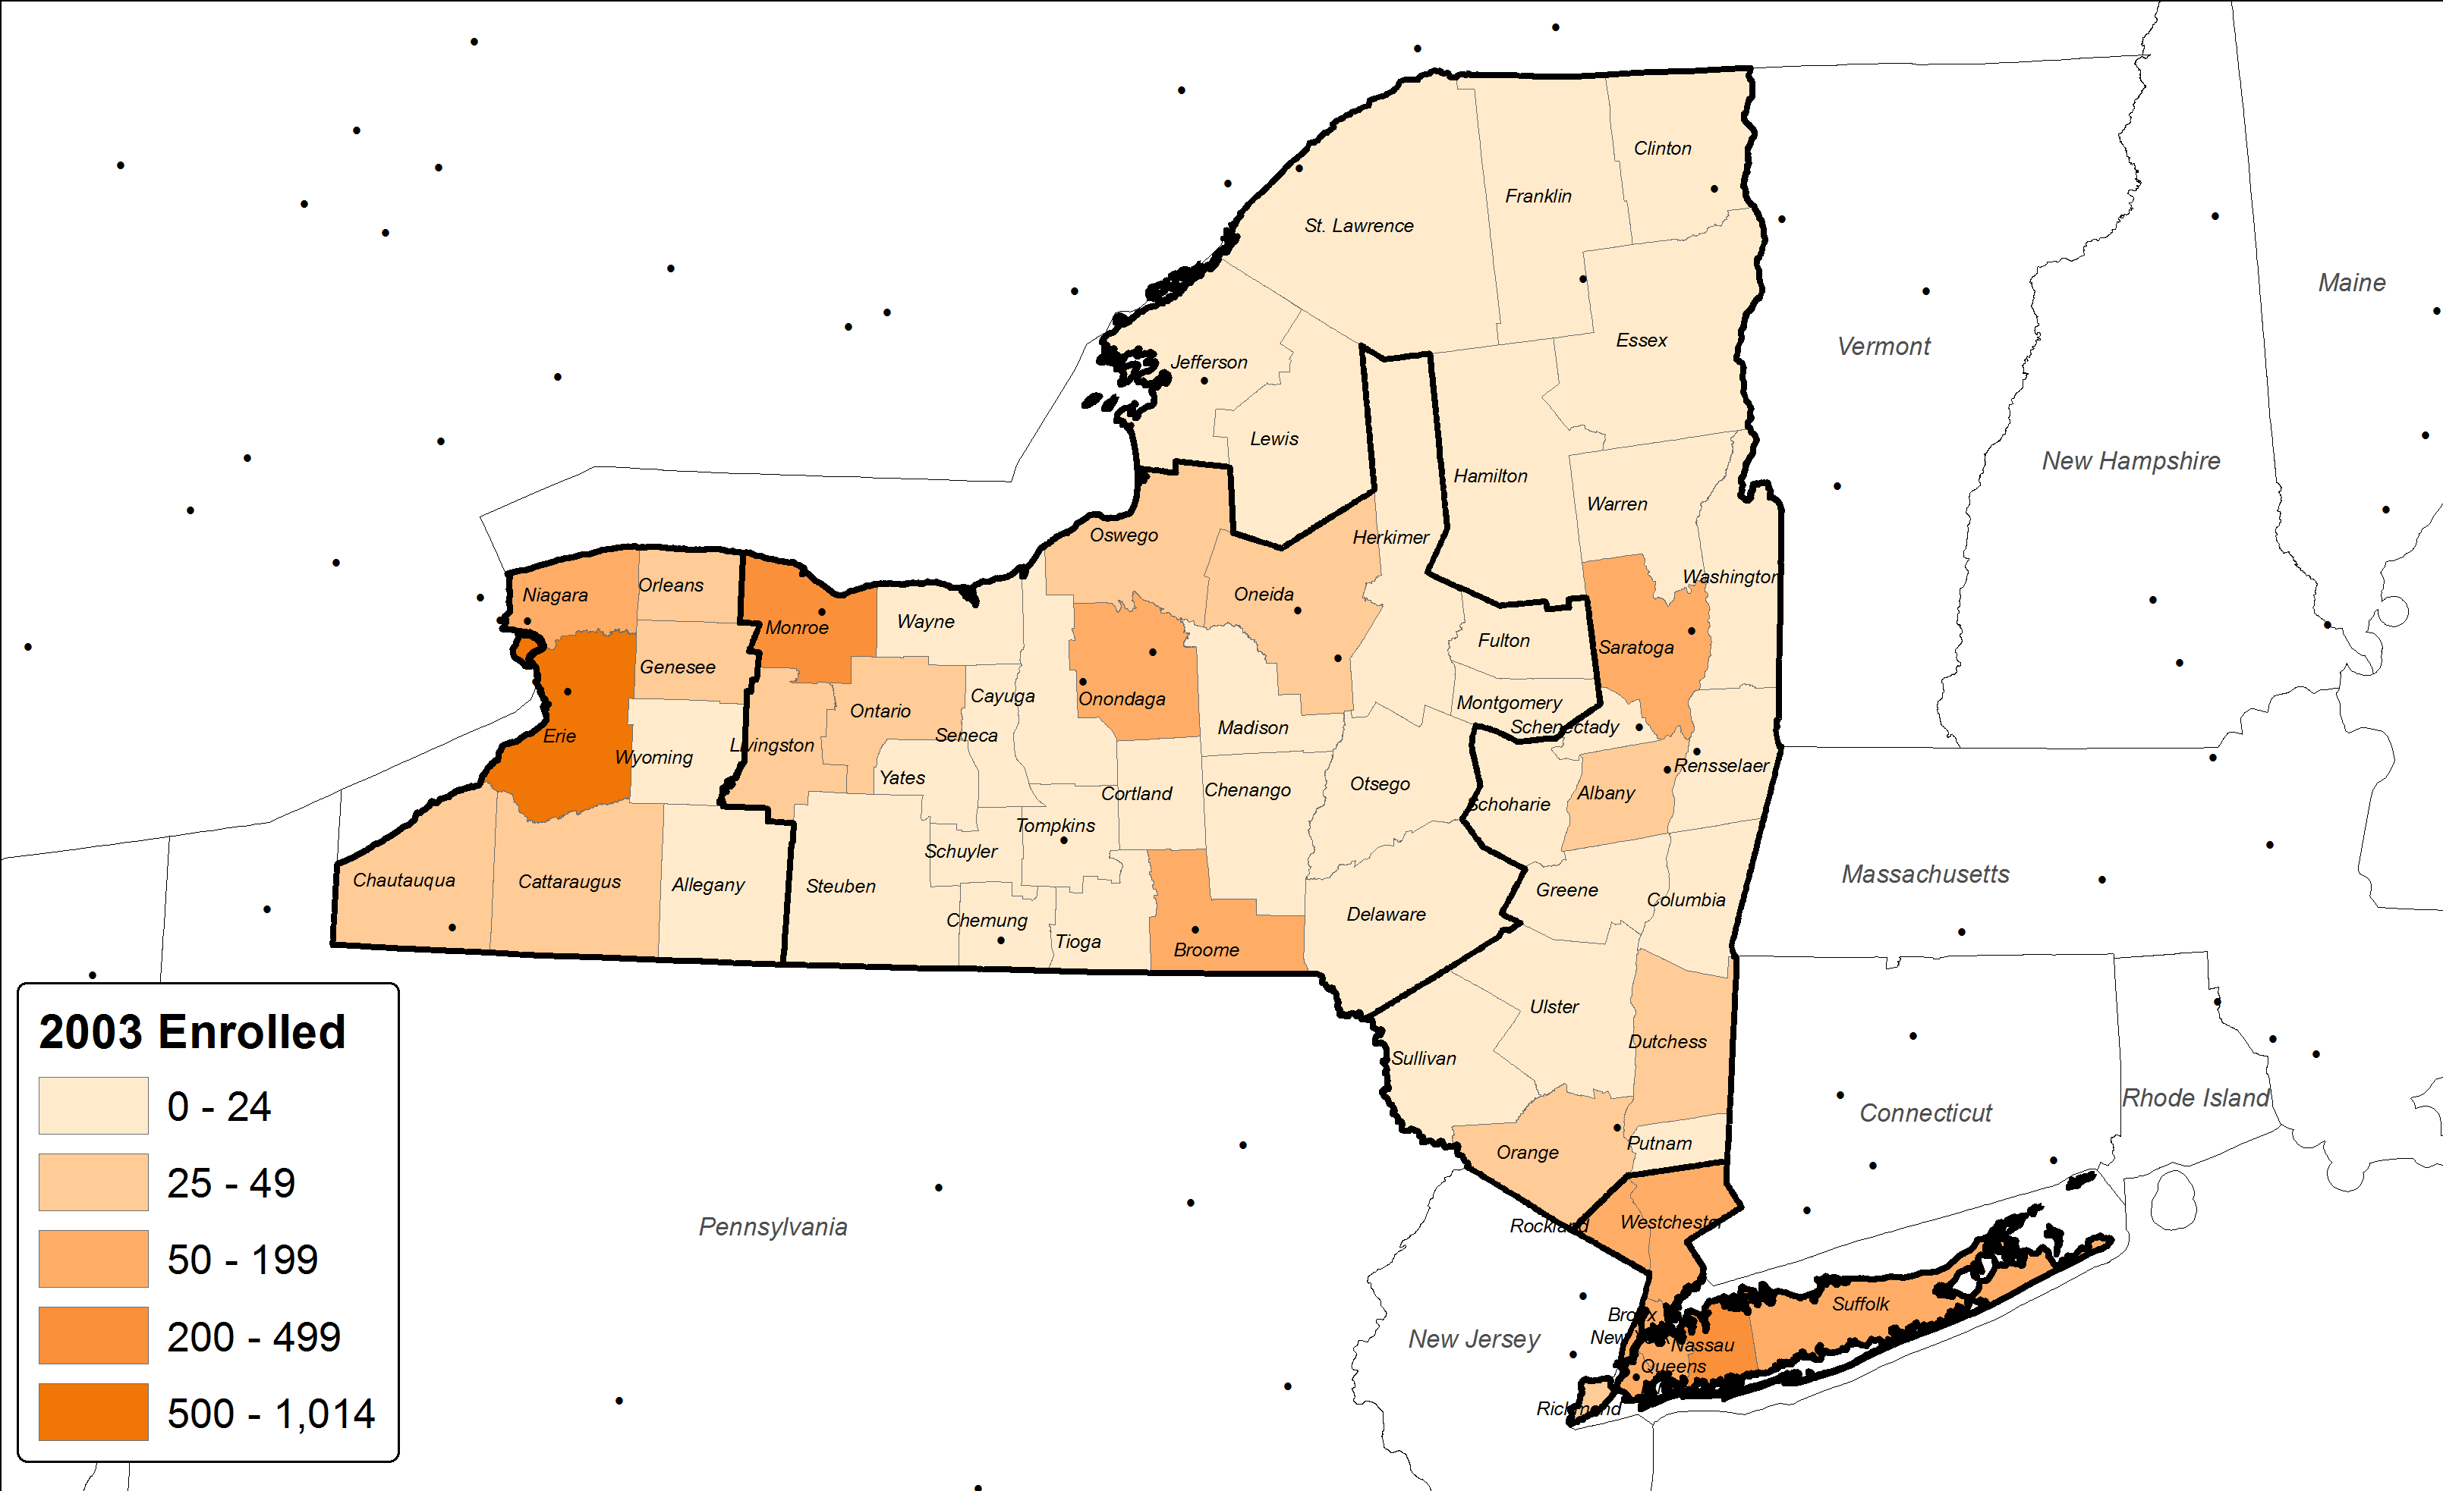
Enrolled by County – Fall 2003
Rochester
Buffalo
Albany
New York

Slide 31
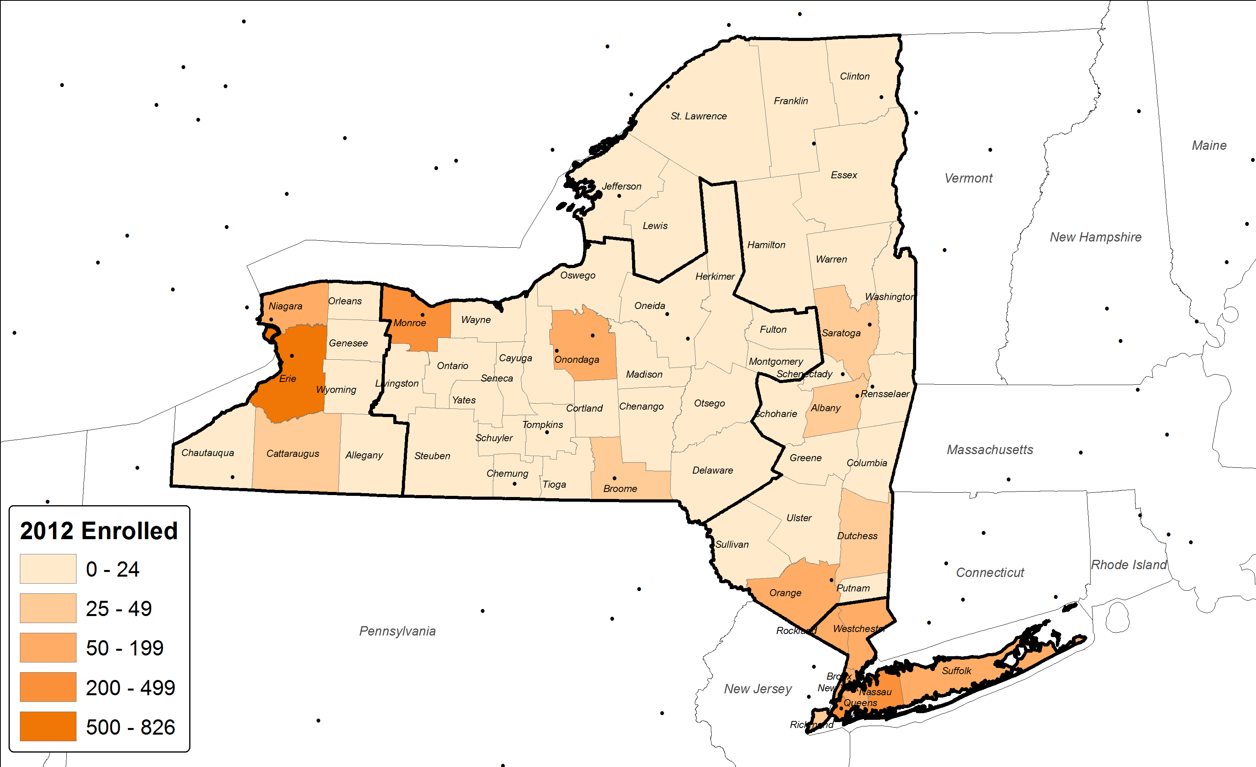
Enrolled by County – Fall 2012
Rochester
Buffalo
Albany
New York

Slide 32
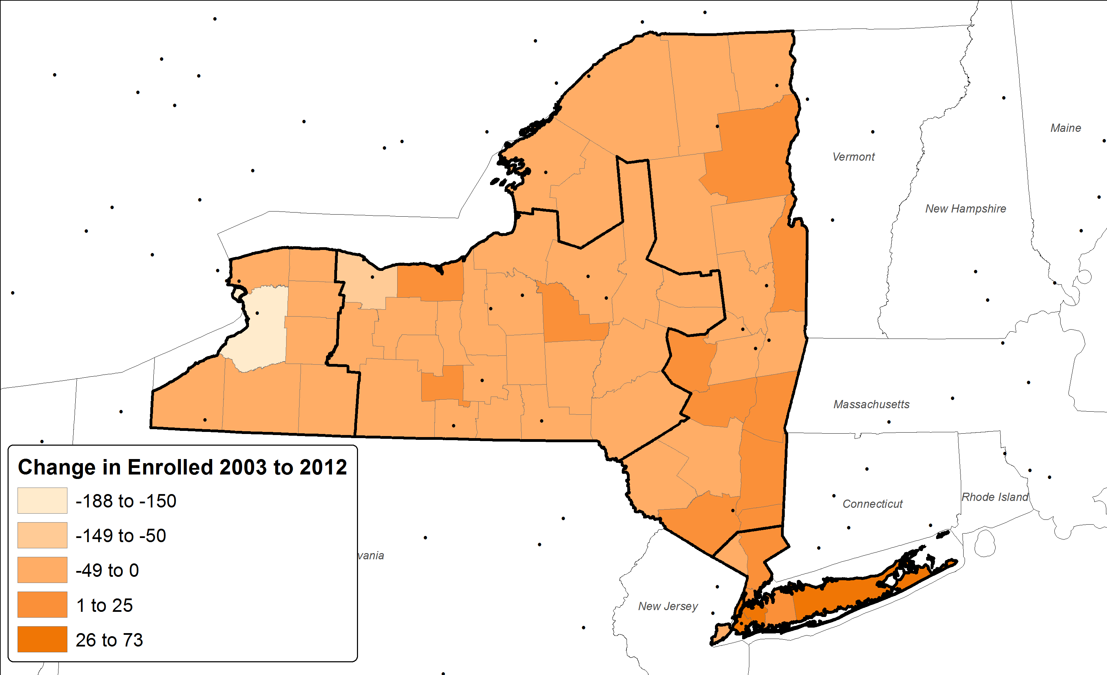
Enrolled by County – Changes Fall 2003 to Fall 2012
East
(7)
-2.7%
Rochester
Buffalo
Central
(314)
-36.6%
West
(296)
-22.2%
Albany
New York
Metro
276
31.5%

Slide 33
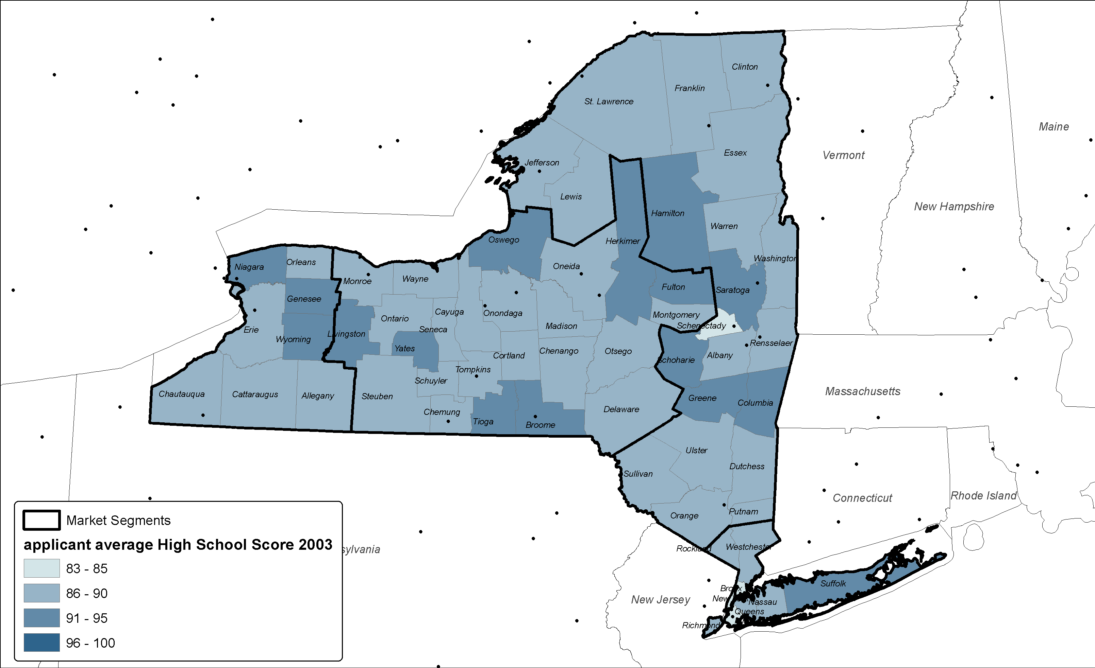
High School Average - Fall 2003
Rochester
Buffalo
Albany
New York

Slide 34
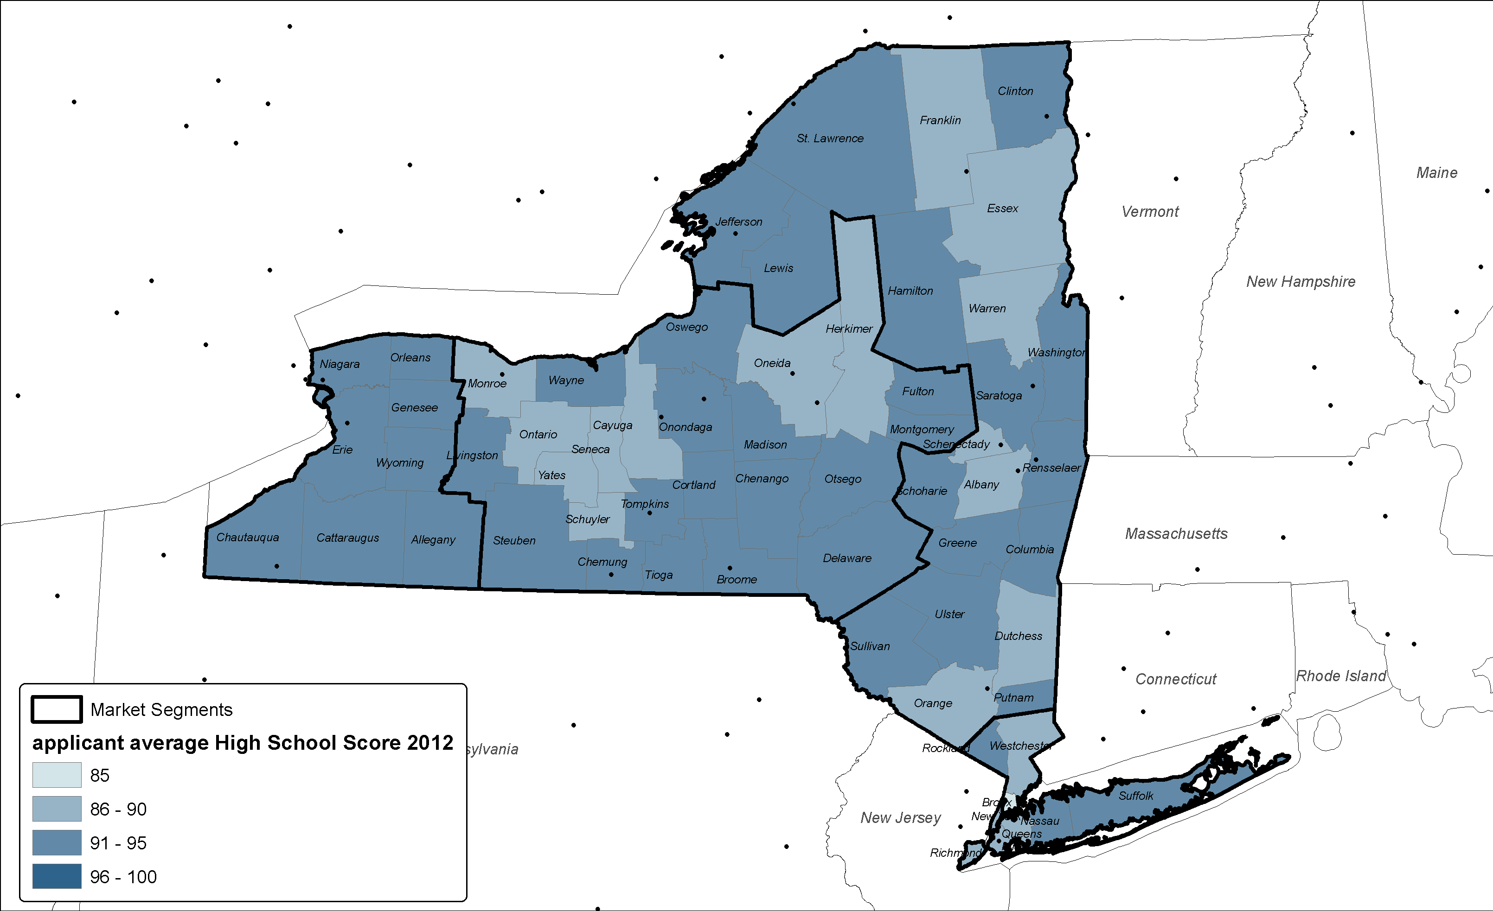
High School Average - Fall 2012
Rochester
Buffalo
Albany
New York

Slide 35
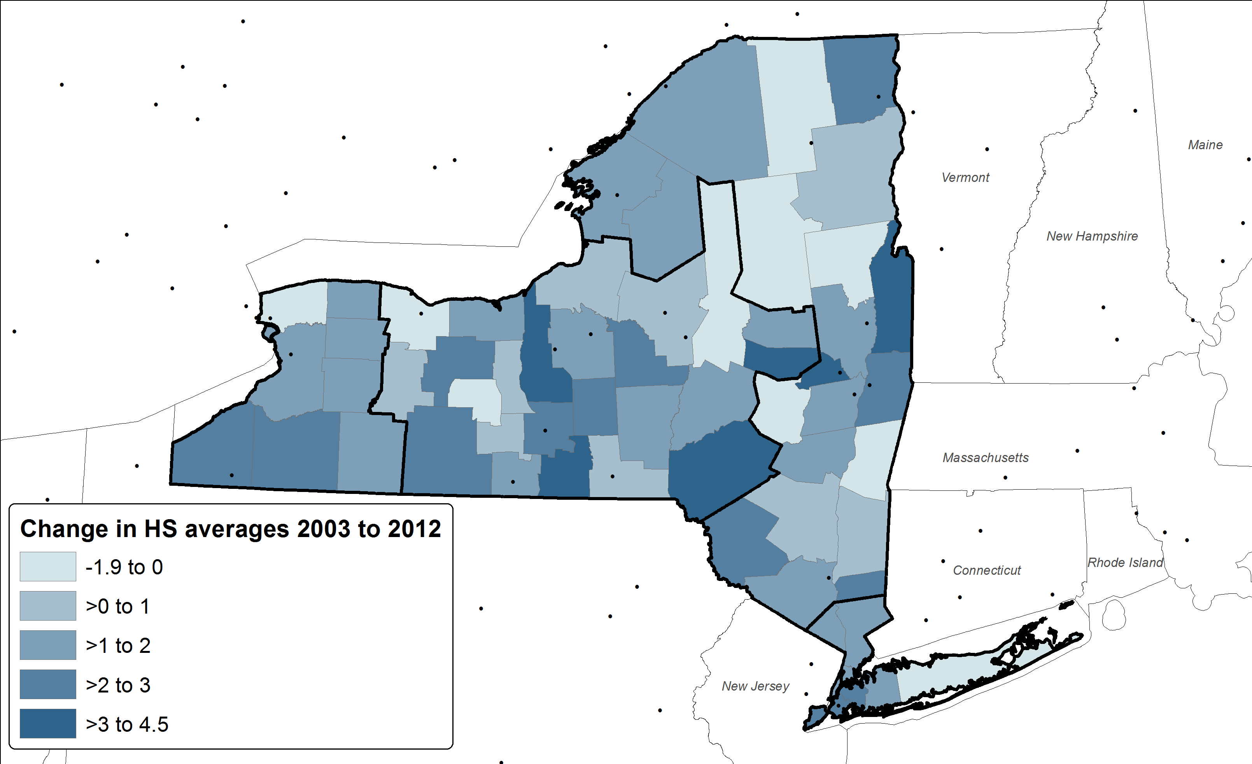
Change in High School Average – Fall 2003 to Fall 2012
East
1.29
1.5%
Rochester
Buffalo
Central
.64
.7%
West
1.62
1.8%
Albany
New York
Metro
1.52
1.8%

Slide 36
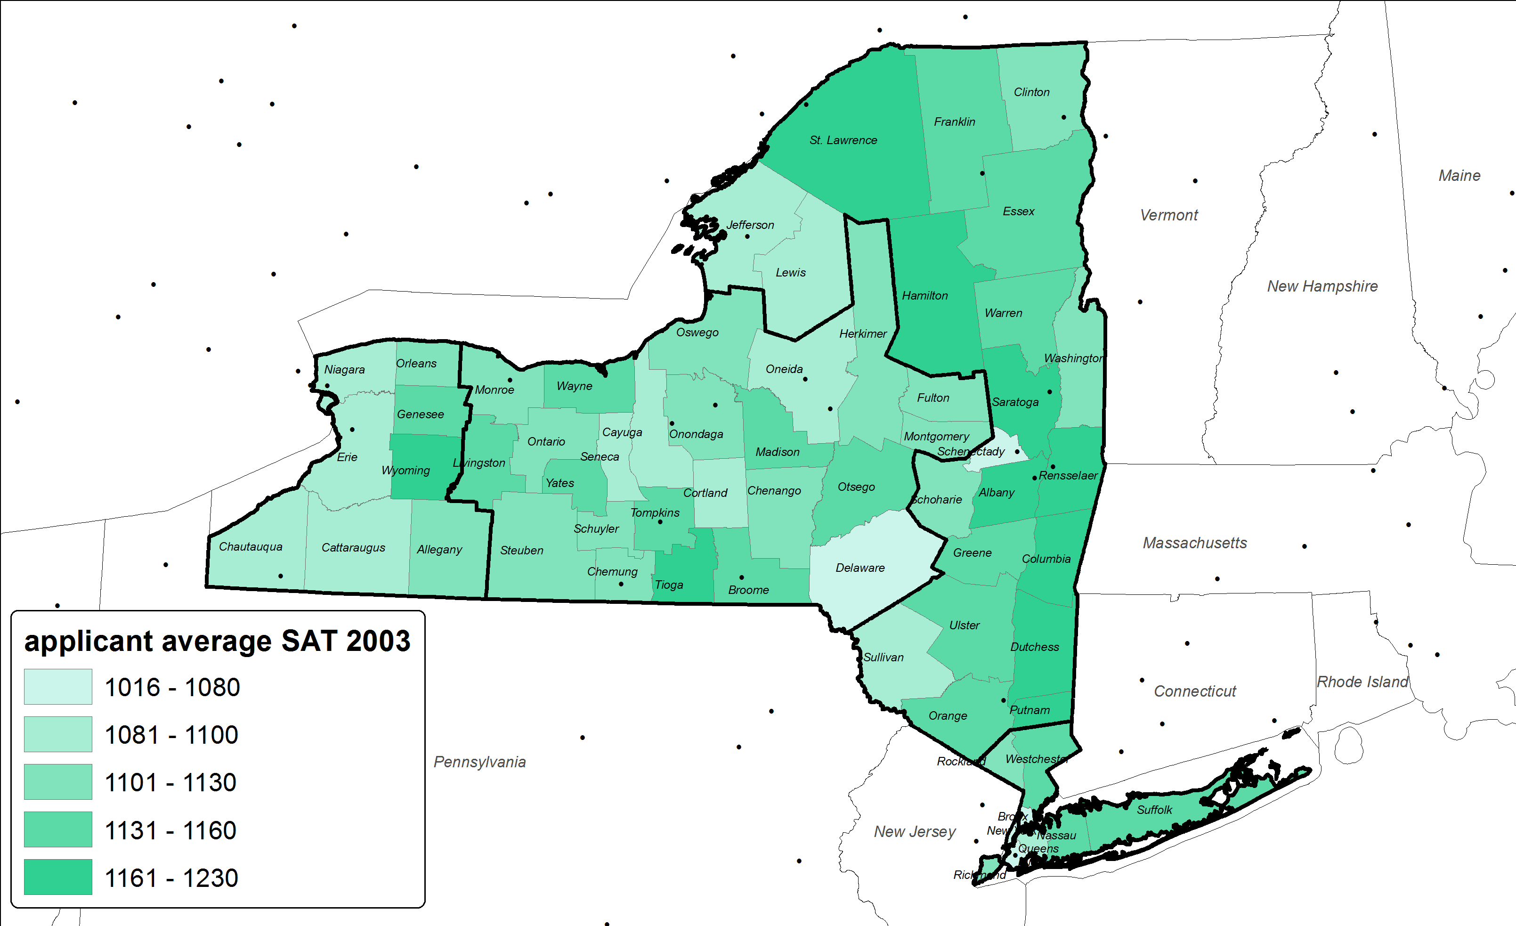
Average SAT scores - Fall 2003
Rochester
Buffalo
Albany
New York

Slide 37
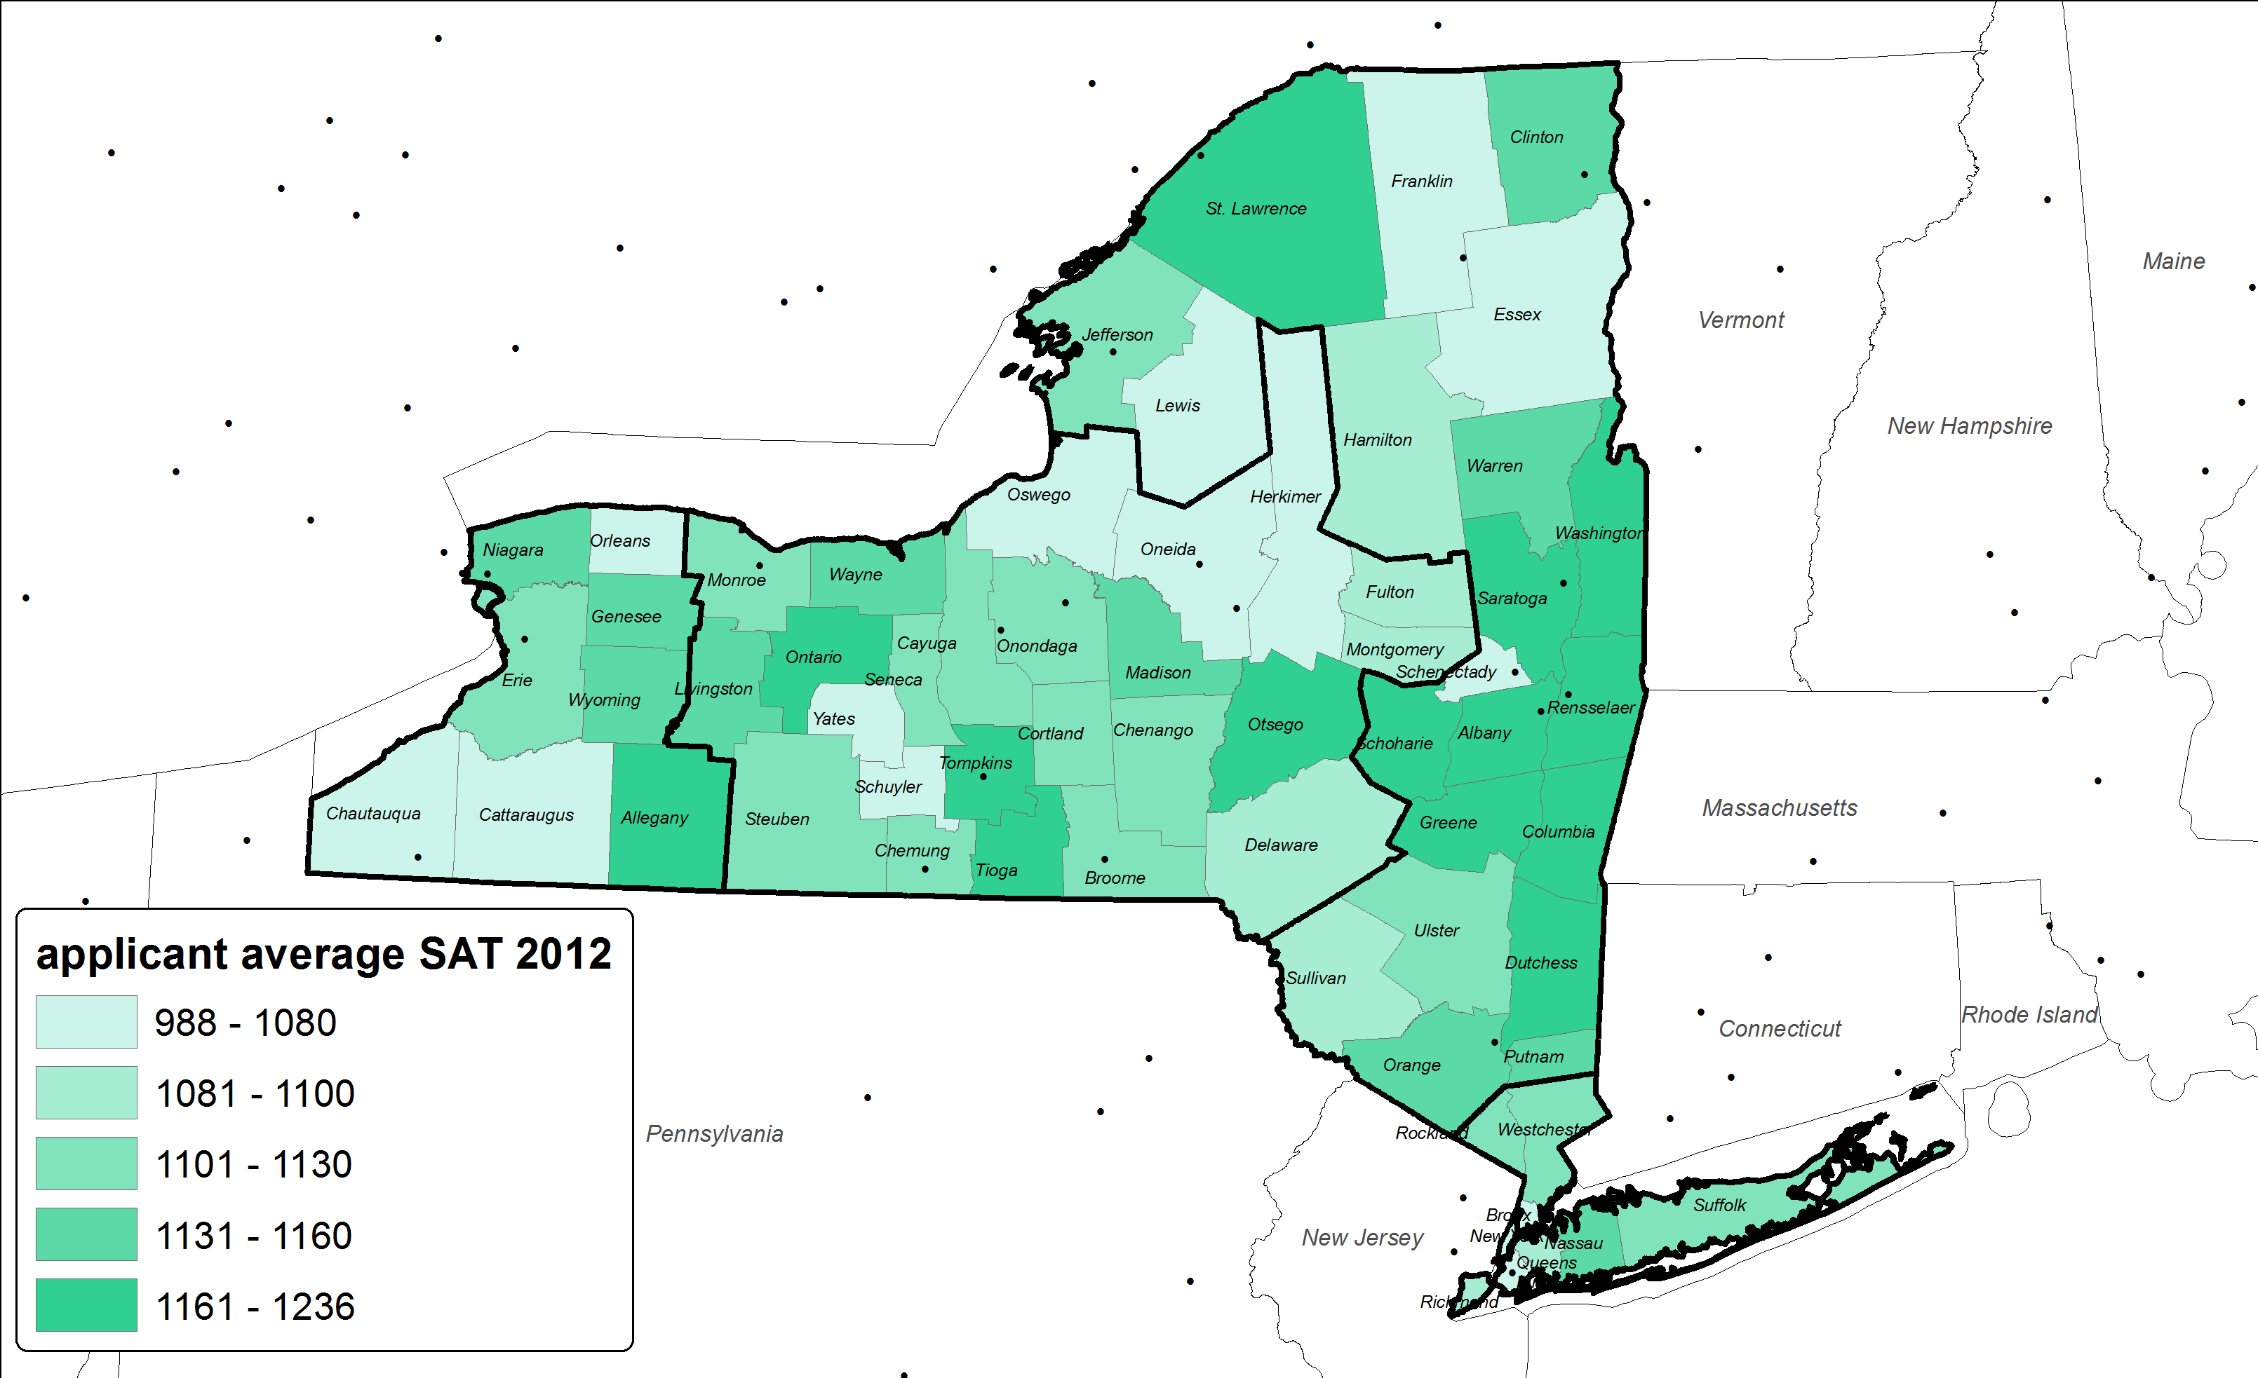
Average SAT scores - Fall 2012
Rochester
Buffalo
Albany
New York

Slide 38
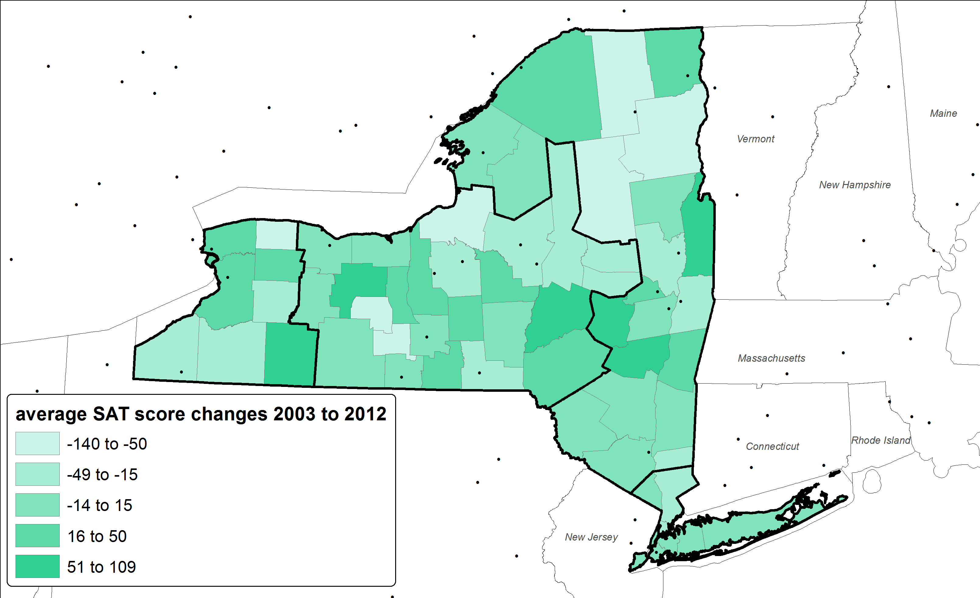
Change in Average SAT scores - Fall 2003 to Fall 2012
East
(11)
-1.0%
Rochester
Buffalo
Central
(18.9)
-1.7%
West
10.26
.9%
Albany
New York
Metro
(19.3)
-1.8%

Slide 39
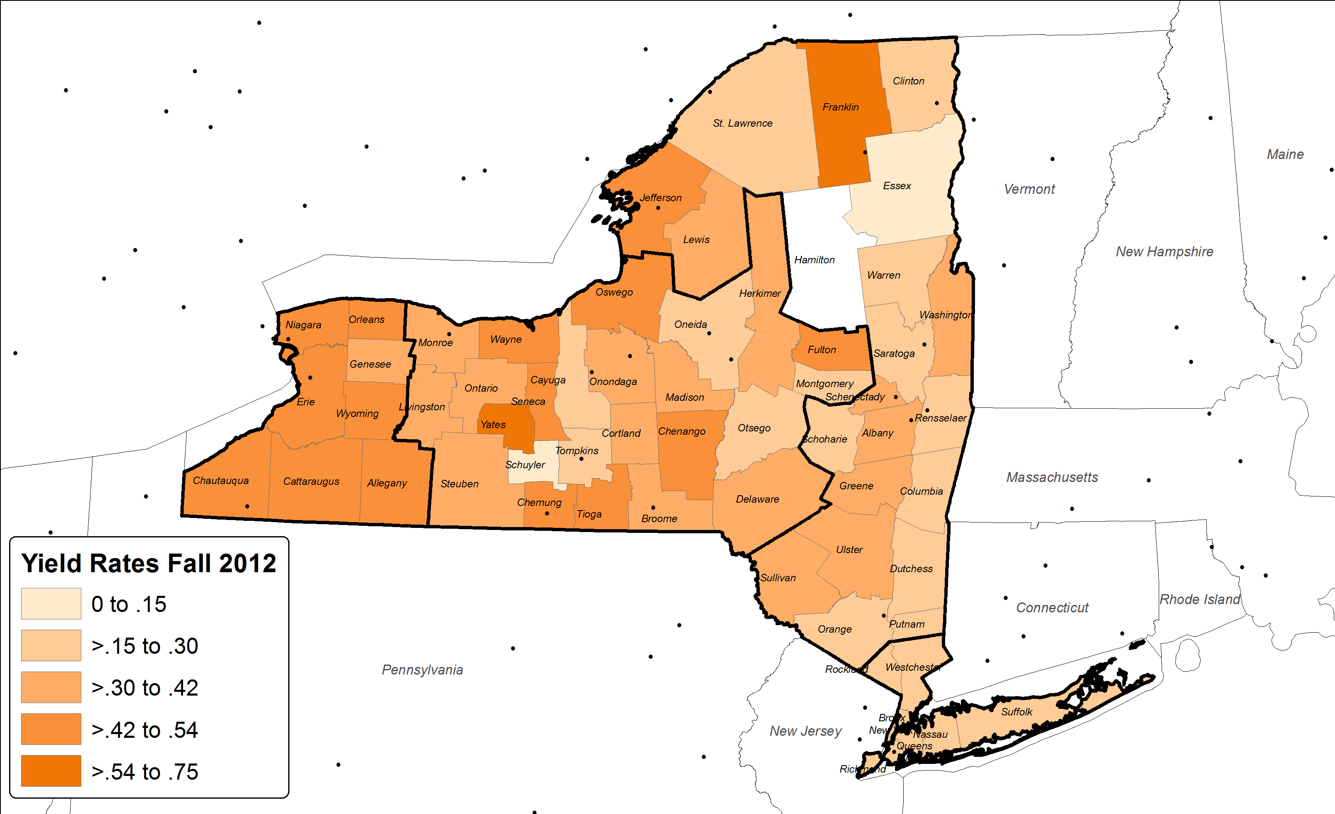
Yield rates - Fall 2012
Rochester
Buffalo
Albany
New York

Slide 40
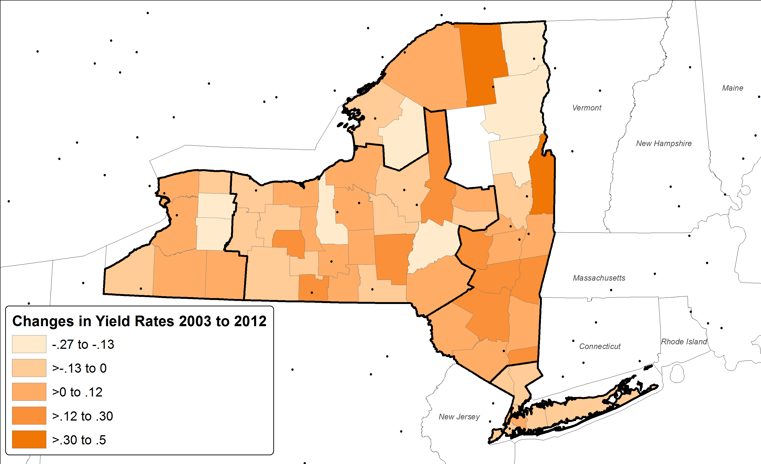
Change in Yield rates - Fall 2003 to Fall 2012
East
(1.8)
-6.5%
Rochester
Buffalo
Central
(9.0)
-23.8%
West
(3.9)
-8.1%
Albany
New York
Metro
.5
2.1%

Slide 41
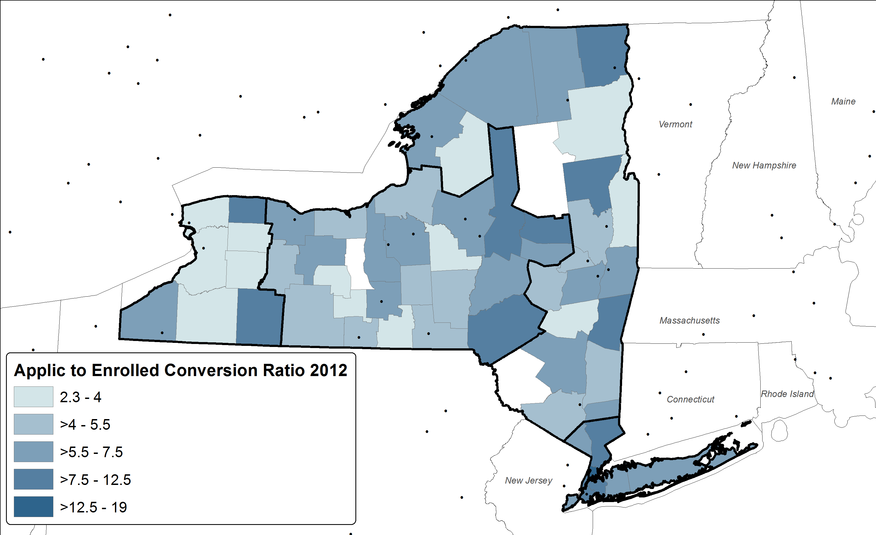
Applicant to Enrolled Conversion Ratio Fall 2012
East
5.5
Rochester
Buffalo
Central
5.5
West
3.5
Albany
New York
Metro
9.0

Slide 42
Summary of findings
Market Segment changes Applications/Accepts/Enrolled 2003 to 2012
 | High School Graduate Projections 2013 to 2020 |  | High School Graduate Projections applying to UB 2013 to 2020 |  | Historical UB Info 2003 to 2012
 |  |  |  |  | Applications |  | Acceptances |  | Enrolled |  | Yields |  | HS Averages |  | SAT Averages |  | Applicant to Enroll
Market Segment | Chg | % Chg | Chg | % Chg | Chg | % Chg | Chg | % Chg | Chg | % Chg | Chg | % Chg | Chg | % Chg | Chg | % Chg | Chg | % Chg
Central | (2,929) | -9.8% | (225) | -8.0% | (232) | -7.2% | (381) | -16.8% | (314) | -36.6% | -0.090 | -23.8% | 0.6 | 0.7% | -19 | -1.7% | 1.734 | 46.3%
East | (2,022) | -7.8% | (79) | -6.7% | 121 | 9.7% | 37 | 4.0% | (7) | -2.7% | -0.018 | -6.5% | 1.3 | 1.5% | -11 | -1.0% | 0.623 | 12.8%
Metro | (1,786) | -1.7% | (184) | -1.8% | 3,057 | 41.9% | 1,151 | 28.8% | 276 | 31.5% | 0.005 | 2.1% | 1.5 | 1.8% | -19 | -1.8% | 0.659 | 7.9%
West | (1,322) | -8.7% | (259) | -7.6% | (498) | -12.1% | (422) | -15.3% | (296) | -22.2% | -0.039 | -8.1% | 1.6 | 1.8% | 10 | 0.9% | 0.399 | 12.9%
All NYS | (8,059) | -4.6% | (747) | -4.2% | 2,448 | 15.4% | 385 | 3.9% | (341) | -10.3% | -0.045 | -13.6% | 1.1 | 1.2% | -13 | -1.2% | 1.366 | 28.6%

Slide 43
Next steps
Refine High School projections for better estimates
Add in Financial dimension (e.g. average gross need, Pell grant, TAP, Other School, Loans)
Add in domestic out of state perspective and international students
Add in retention/graduation perspective
Add in students next career info (go to grad school locations, get a job locations, go on to other school locations)

