Slide 1
“Herding Effective-dated Cats”
Challenges for a Student-term Data Model
in a Decentralized Business Environment
Jonathan Havey
Information Analyst
SUNY Buffalo Office of Institutional Analysis

Slide 2
Successful 2011 Implementation of
PeopleSoft Campus Solutions
“On time and Under Budget”
Campus Community
Admissions
Student Records
Academic Advising
Student Financials
Financial Aid

Slide 3
Reporting was Not Ignored
Blackboard Analytics (iStrategy) was purchased to meet two immediate needs:
“Instant” data warehouse
BI Dashboard
A pre-existing OBIEE instance, utilized for financial and human resources reporting, was leveraged to deliver web-accessible, “canned” reports based on the BbA generated dimensional models
A custom reporting app for State Reporting
was developed in-house

Slide 4
Full Speed Ahead
Data Validation was promising
Counts were within range
Spot-checking revealed no obvious errors
BbA-generated dimensional models revealed no major differences from PeopleSoft source tables. For example, counts of students by Career and Term in the Student Term model mirrored
counts of students by Career and Term
in PS_STDNT_CAR_TERM
OBIEE reports fit the bill

Slide 5
Change Management: The Reporting Community
In anticipation of reactions to the new data warehouse, a group of reporting professionals from our many decanal areas was convened
These “DDAs”, or “Distributed Data Access” professionals were to be trained in the new data models
Our legacy warehouse was popular and easy to use, as any query of the strongly de-normalized views would never find more than one student record per term
PeopleSoft, much richer in its dimensionality, a fact reflected in the BbA-generated models, was not so simple

Slide 6
On the Movement of Cheese
The DDAs, together with the users of the newly minted OBIEE operational reports, found themselves needing to deal with the possibility that a student might have more than one record per term in the new models
These changes were managed through educational efforts
As time went on, however, some legitimate “holes” in the cheese were identified

Slide 7
Associating Effective Dated Rows to Student Terms
PeopleSoft handles enrollment data with a Student-Career-Term concept.
Career/Program/Plan (majors, to the rest of us) data is effective dated. You are not a major as of a certain term; you are a major as of a certain date.
BlackBoard does a good job of associating effective-dated data to terms, but it needs something to work with: A student term record, first of all, and an effective dated row that falls within those term dates.
Our validation was done against converted data. After go-live, ~200 functional users able to edit data started throwing curveballs at BlackBoard. Challenges arose…

Slide 8
Challenge 1: Disappearing Applicants
The University at Buffalo receives approximately 500 Early Decision Applicants every year.
Nightly bulk loads of SUNY and Common Application data are processed, assigned IDs, and imported into PeopleSoft.
Students indicating an interest in Early Decision are automatically added to a Student Group, which is an effective dated action.
Inactivations are also dated.

Slide 9
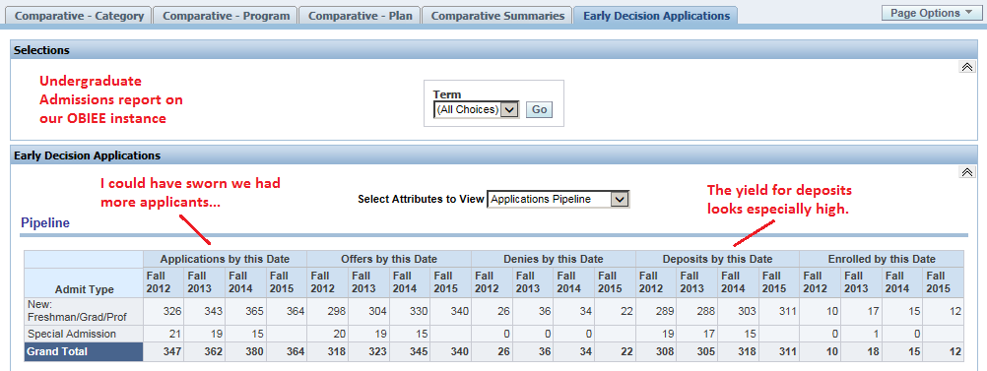
We get a high yield from Early Decision applications, but not as high as the sample OBIEE report below indicates. Between November and April, we “lose” a third of our Early Decision applicants, which makes the yield look higher than it is. Where did they go?

Slide 10
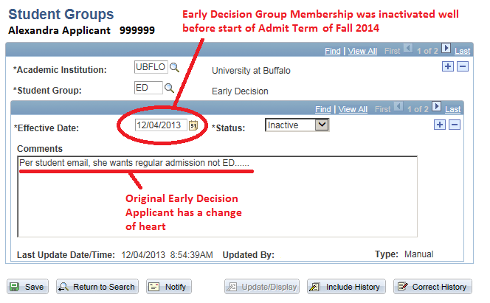
Oftentimes, Early Decision Applicants will change their minds and request to be considered for regular admissions. When they do so, their membership in the Early Decision Student Group is inactivated by adding a new row:

Slide 11
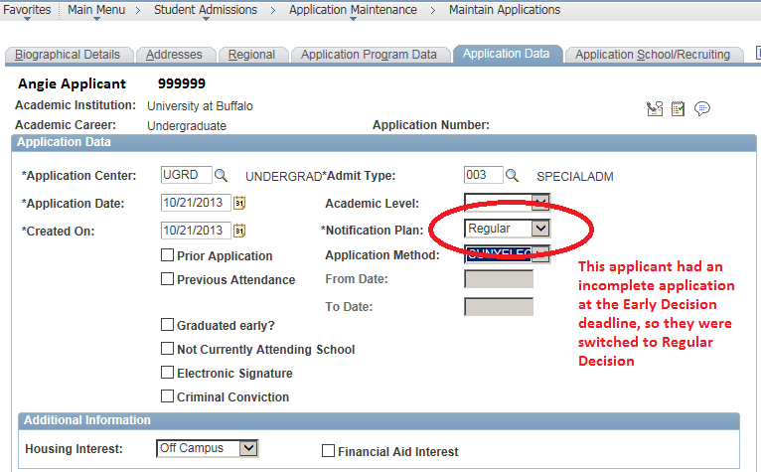
An additional source of inactivations in the Early Decision Student Group is incomplete applications at the time of the Early Decision deadline. These applicants are rolled into the Regular Decision pool.

Slide 12
Data mining revealed that the “gap” between our Early Decision totals captured in the Fall and the numbers we were seeing on our report in the Spring were due to the dating of the Early Decision Student Group inactivations. Possible solutions included:
Changing our effective dating practices (major business process change for admissions office)
Customizing the Student Groups model to capture any Student Group membership falling out of range—many undesirable effects
Pointing the OBIEE report to source data for Student Groups

Slide 13
Challenge 1: Solution
This particular challenge was met by creating a new Historical Student Groups dimension in the OBIEE .rpd. For a given Student Group membership, an Activate and Inactivate Date is calculated. Using these columns in expressions allows a true date-to-date comparison of Early Decision applicant totals, no matter when the inactivation happened. (Each row of dates below belongs to an individual applicant.) Here, we bypassed the logic in the BbA models by using the PeopleSoft source table. Downside: This solves the problem in OBIEE only.

Slide 14
Challenge 2: Applicants that won’t Go Away
The rise in electronic application submissions has created opportunities and challenges for colleges and universities. The University at Buffalo receives tens of thousands of applications every year from the Common Application and from a similar SUNY electronic application form. There is a tendency for applicants to use the strategy “when in doubt, check every box”. In our case, many more students self-identify as EOP (Educational Opportunity Program) than actually qualify. As with Early Decision, we use PeopleSoft Student Group functionality to track this cohort, and inactivate non-qualifying candidates.

Slide 16
Solution to Challenge 2: Business Process Change
The solution to challenge #2 was to alter business process and create a new EOP Student Group that is distinct from the current group, which is populated at admissions. The “student” EOP Group will contain validated members in good standing rather than simply self-identified candidates.
Achieving this solution required bringing two offices together to devise and agree on a solution. These can be difficult situations to negotiate.

Slide 17
Challenge 3: Disappearing Graduates
The University at Buffalo enrolls approximately 30,000 students in Undergraduate, Graduate, Medical, Dental, Pharmacy, and Law Careers. The conferral results here, for June 1, 2014, represent less than 10% of the expected total graduates. Examining the records of the few students who were captured here revealed they were all “early” conferrals.

Slide 18
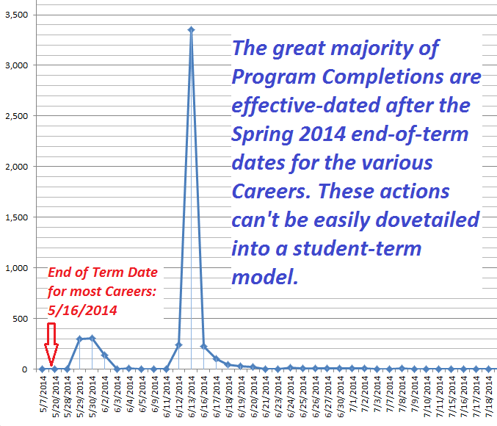

Slide 19
Which Way did they Go?
The effective dating of the Program Completions after the end of the Spring Term might lead you to think that these graduates are being incorrectly associated with the Summer Term immediately following. Once again, however, the totals do not approach the expected results for either term separately or in aggregate:

Slide 20
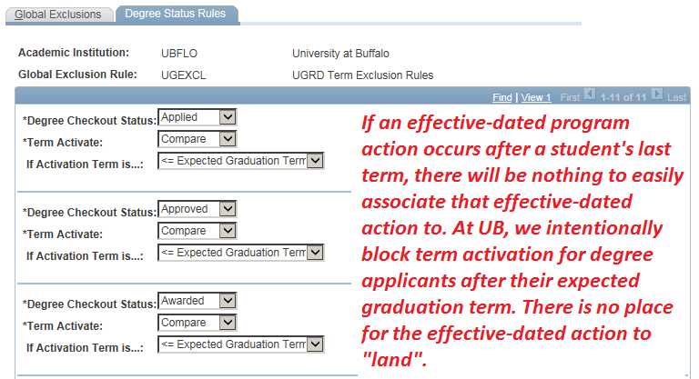
My Kingdom for a Term

Slide 21
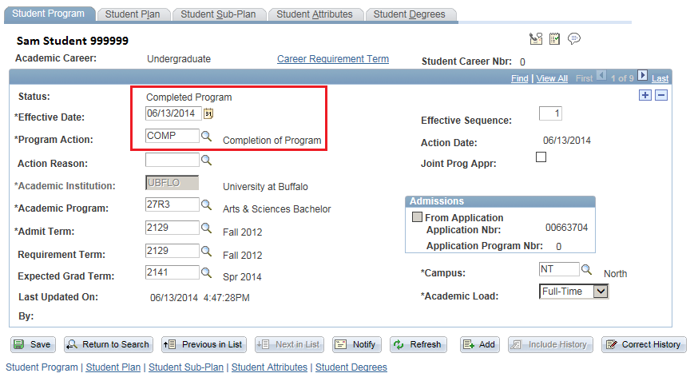
Exhibit A: Sam Student’s Program/Plan “Stack”

Slide 22
Exhibit B: Sam Student’s Term History
The effective-dating practices (historical in origin) are at odds with term activation (which is set-up to help control post-conferral registration). The negative effects are strictly in the reporting arena, however.

Slide 23
Possible Solutions to Challenge 3
Just use Completion Term or Expected Graduation Term
Might work here, but term dimensionality like this is generally unavailable for program actions
Effective date differently
Major training/oversight/coordination challenges
Customization to existing views
Technical resources scarce
Build a new model
Begs the question—why have the view in the first place?

Slide 24
Two Solutions were devised: A Customization and a New View
Customization “Specs”
Find students’ final terms in a Career
Find the end-of-term dates for those Terms/Careers
Look for Program Actions effective dated after those terms’ End-of-Term Dates
Define new fields that display the maximum effective-dated Program Status after a student’s last term

Slide 25
Two Solutions were devised: A Customization and a New View
Customization: 4000 Missing Graduates Found
Of Note: The truncation of individual students’ Program Plan effective-dated history is especially noticeable in the cases where a student who had previously been on leave or discontinued due to a gap in enrollment returned to graduate.

Slide 26
Two Solutions were devised: A Customization and a New View
New View: Fuller Detail for Reporting on Degree Applicants in addition to Awardees
Delivered suite of BbA data models does not include detail on degree applicants—no “pipeline”
Degree Awards models truncates number of awards
Here, we found a custom view was called for

Slide 27
Challenge 4: The Applicant Made out of Rubber
Some savvy functional users pointed out that some of our new students had GPAs—not an expected result except in the case of some non-degree-seeking students with previous work.

Slide 28
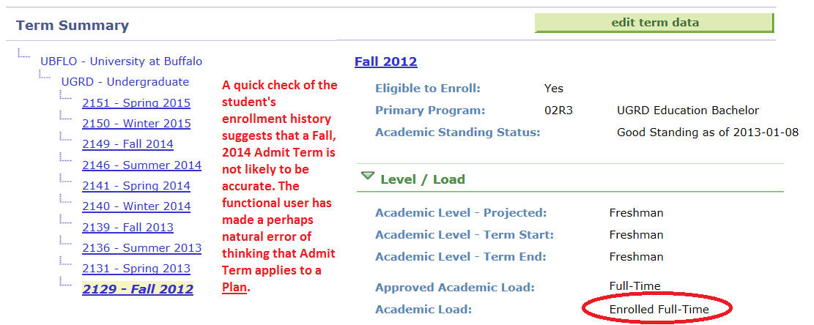
This student’s Admit Term of Fall 2014 together with certain upstream admissions attributes caused them to appear briefly as a New Freshman in Fall 2014, when they had in fact started in Fall 2012.

Slide 29
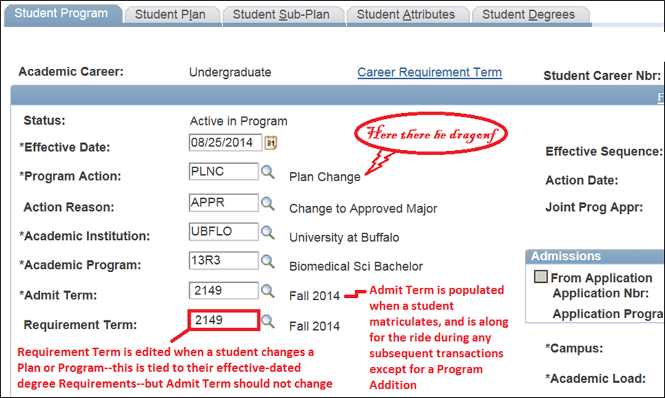

Slide 30
Solution to Challenge 4: Fix the Data
In this case, a customization, .rpd update, or business process change was insufficient. We needed the functional users to stop making these changes.
Edit checks are customizations in PeopleSoft.
We decided to utilize some custom functionality that our technical team had recently provided—a Data Integrity Checker that would utilize built-in queries designed to identify particular errors after they were made.

Slide 31
When report-based solutions, business process redesign, and data model customizations are too expensive, you have to go to the source: The data itself.
Data Integrity Checker

Slide 32
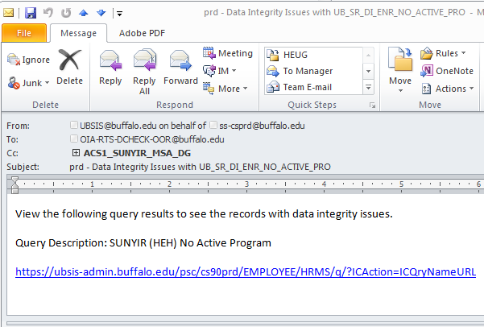
Here, the work is in the query design. It has to be a surgical instrument to ensure the trust of the users that they are part of a successful process.
When the query runs at night, it will—if records are found—email the alias with a link to the query output, every morning until the records are fixed.

Slide 33
Sample output from The Data Integrity Checker. Attempt is made to cue the functional user in to the nature of the problem. Here, the Data Integrity Checker is finding Minors that are coded incorrectly.

Slide 34
Summary
Systems that rely heavily on effective dating can create challenges when attempting to associate that data to a higher level of aggregation such as a term.
Our instant warehouse, a good product, was able to handle most of the effective dated data in our implementation.
The University at Buffalo has nearly two hundred users across campus performing effective dated transactions. Training and oversight is an exercise in herding cats.
After using Business Process Redesign and customizations to dimensional models, we are now focusing on data quality, making sure it is within expected ranges.

