Slide 1
Different Questions, Different Views: A Guide to Selecting a Visualization
Lauren Young and Craig W. Abbey
AIR Forum
June 2nd, 2016

Slide 2
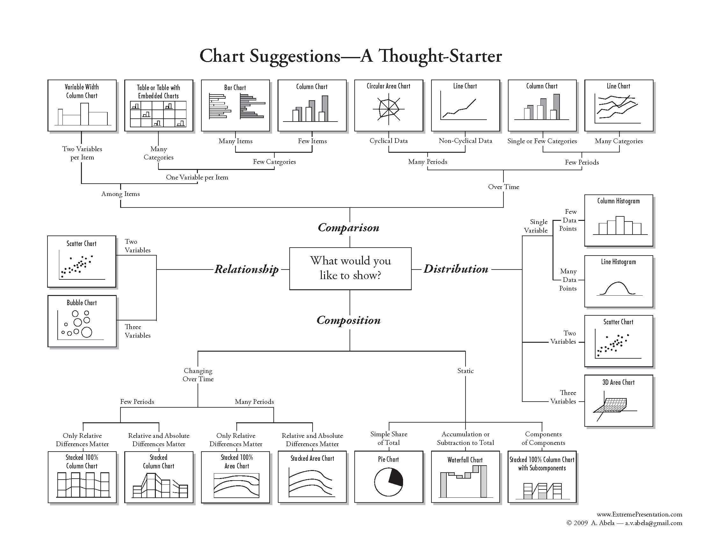
Inspiration

Slide 3
Data, Information and Knowledge
Data are raw. They are symbols or isolated and non-interpreted facts.
Information is data that has been given meaning through interpretation by way of relational connection and pragmatic context.
Knowledge is information, which has been cognitively processed and integrated into an existing human knowledge structure.
Source: S.-O. Tergan and T. Keller (Eds.): Knowledge and Information Visualization, LNCS 3426, 2005. p.3
Notes:
The content of the human mind can be classified into five categories:
Data: symbols
Information: data that are processed to be useful; provides answers to "who", "what", "where", and "when" questions
Knowledge: application of data and information; answers "how" questions
Understanding: appreciation of "why“
Wisdom: evaluated understanding
Ackoff, R. L., "From Data to Wisdom", Journal of Applied Systems Analysis, Volume 16, 1989 p 3-9.
Ackoff indicates that the first four categories relate to the past; they deal with what has been or what is known. Only the fifth category, wisdom, deals with the future because it incorporates vision and design. With wisdom, people can create the future rather than just grasp the present and past. But achieving wisdom isn't easy; people must move successively through the other categories.
A further elaboration of Ackoff's definitions follows:
Data... data is raw. It simply exists and has no significance beyond its existence (in and of itself). It can exist in any form, usable or not. It does not have meaning of itself. In computer parlance, a spreadsheet generally starts out by holding data.
Information... information is data that has been given meaning by way of relational connection. This "meaning" can be useful, but does not have to be. In computer parlance, a relational database makes information from the data stored within it.
Knowledge... knowledge is the appropriate collection of information, such that it's intent is to be useful. Knowledge is a deterministic process. When someone "memorizes" information (as less-aspiring test-bound students often do), then they have amassed knowledge. This knowledge has useful meaning to them, but it does not provide for, in and of itself, an integration such as would infer further knowledge. For example, elementary school children memorize, or amass knowledge of, the "times table". They can tell you that "2 x 2 = 4" because they have amassed that knowledge (it being included in the times table). But when asked what is "1267 x 300", they can not respond correctly because that entry is not in their times table. To correctly answer such a question requires a true cognitive and analytical ability that is only encompassed in the next level... understanding. In computer parlance, most of the applications we use (modeling, simulation, etc.) exercise some type of stored knowledge.
Understanding... understanding is an interpolative and probabilistic process. It is cognitive and analytical. It is the process by which I can take knowledge and synthesize new knowledge from the previously held knowledge. The difference between understanding and knowledge is the difference between "learning" and "memorizing". People who have understanding can undertake useful actions because they can synthesize new knowledge, or in some cases, at least new information, from what is previously known (and understood). That is, understanding can build upon currently held information, knowledge and understanding itself. In computer parlance, AI systems possess understanding in the sense that they are able to synthesize new knowledge from previously stored information and knowledge.
Wisdom... wisdom is an extrapolative and non-deterministic, non-probabilistic process. It calls upon all the previous levels of consciousness, and specifically upon special types of human programming (moral, ethical codes, etc.). It beckons to give us understanding about which there has previously been no understanding, and in doing so, goes far beyond understanding itself. It is the essence of philosophical probing. Unlike the previous four levels, it asks questions to which there is no (easily-achievable) answer, and in some cases, to which there can be no humanly-known answer period. Wisdom is therefore, the process by which we also discern, or judge, between right and wrong, good and bad. I personally believe that computers do not have, and will never have the ability to posses wisdom. Wisdom is a uniquely human state, or as I see it, wisdom requires one to have a soul, for it resides as much in the heart as in the mind. And a soul is something machines will never possess (or perhaps I should reword that to say, a soul is something that, in general, will never possess a machine).
(Source: http://www.systems-thinking.org/dikw/dikw.htm)

Slide 4
Thinking Visually
90% of all information is taken in visually
65% of all people are visual learners
Most people who are auditory learners (30%; learn by listening) or kinesthetic learners (5%; learn by doing) also use visual cues

Slide 5
Good Visualizations Reveal Data
Guide the viewer to think about patterns in data rather than graphic design, technology, etc. (Tufte)
Clarify data patterns rather than distorting
Encourage comparison of various data elements
Have a clear purpose
Help tell a story

Slide 6
Visual Attributes of Data
All the following are perceived to have quantitative values in and of themselves:
Length
Width
2D position
Size
Intensity
Length and 2D position are perceived with greater precision

Slide 7
A Flowchart Approach to Choosing Visualizations
2016 AIR Forum – Lauren Young and Craig W. Abbey

Slide 8
Comparisons

Slide 9
Visualizing Comparisons Between Groups
Key is to be able to quickly distinguish outcomes for each group on a visually salient dimension
Groups to be compared may consist of people, institutions, etc.
Useful approach for data series, as in comparing across a block of survey items
Often use statistics that summarize distribution: count, percentage, average, median

Slide 10
Group Comparison: One Dimension, Few Items
“How did we compare to our peers in terms of expenditures per student FTE, across different IPEDS expenditure categories, last year?”
Visualization: Column Chart

Slide 11
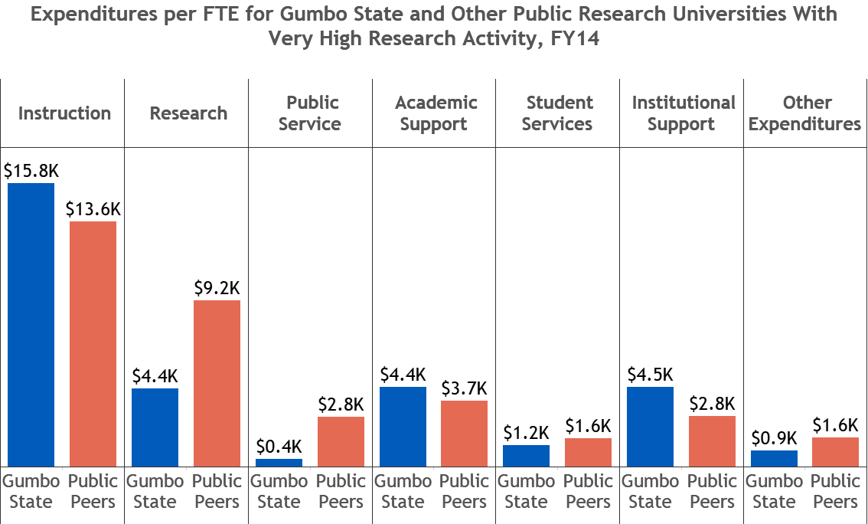
Group Comparison: One Dimension, Few Items

Slide 12
Group Comparison With Distributions
“Where do our retention rates fall among those of other public institutions and private institutions that might also be competitors?
Visualization: Multiple Boxplots

Slide 13
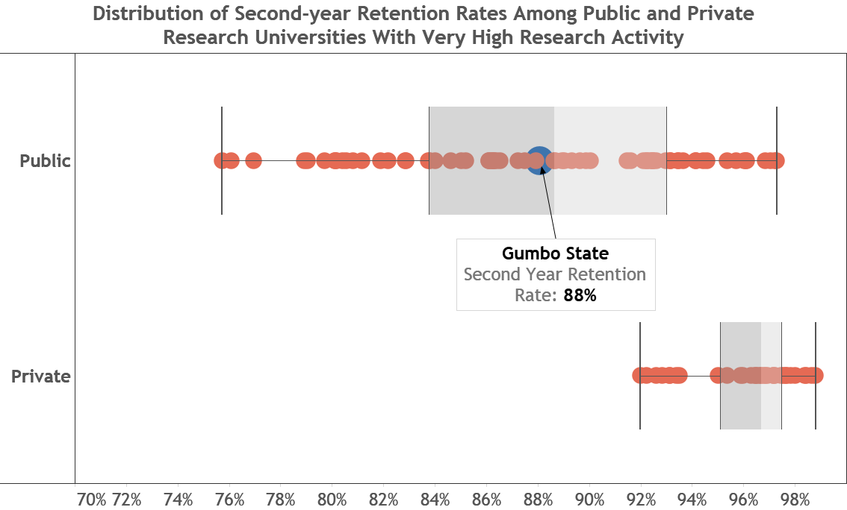
Group Comparison With Distributions

Slide 14
Group Comparison: One Dimension, Many Items
“What were the most important and least important college choice factors that our new students identified in our freshman survey?”
Visualization: Horizontal Bar Chart

Slide 15
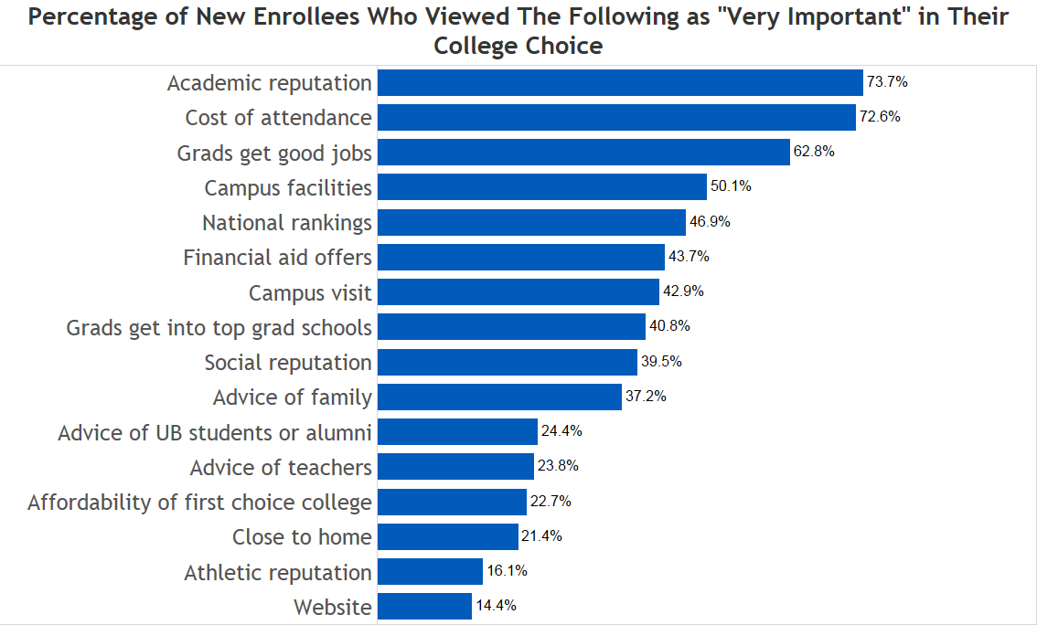
Group Comparison: One Dimension, Many Items

Slide 16
Group Comparison Across Two Dimensions
“What is the average QPA for students in different decanal units enrolling at different credit hour levels?
Visualization: Heat Map

Slide 17
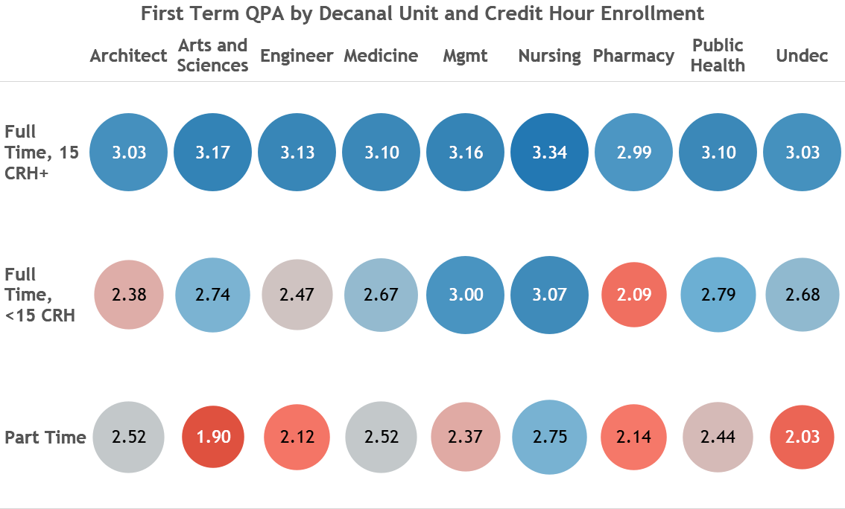
Group Comparison Across Two Dimensions

Slide 18
Visualizing Comparisons Across Time
Key aspects to look for:
Trends
Rates of change
Variability including seasonality and other cycles
Discontinuity
Can combine visualizations of distribution and correlation with a time aspect
Small number of charts in sequence
Animation of changes in distributional/correlational charts

Slide 19
Comparing Over Few Periods, Few Categories
“How much did our research expenditures grow over the course of the last 10 years?”
Visualization: Column Chart

Slide 20
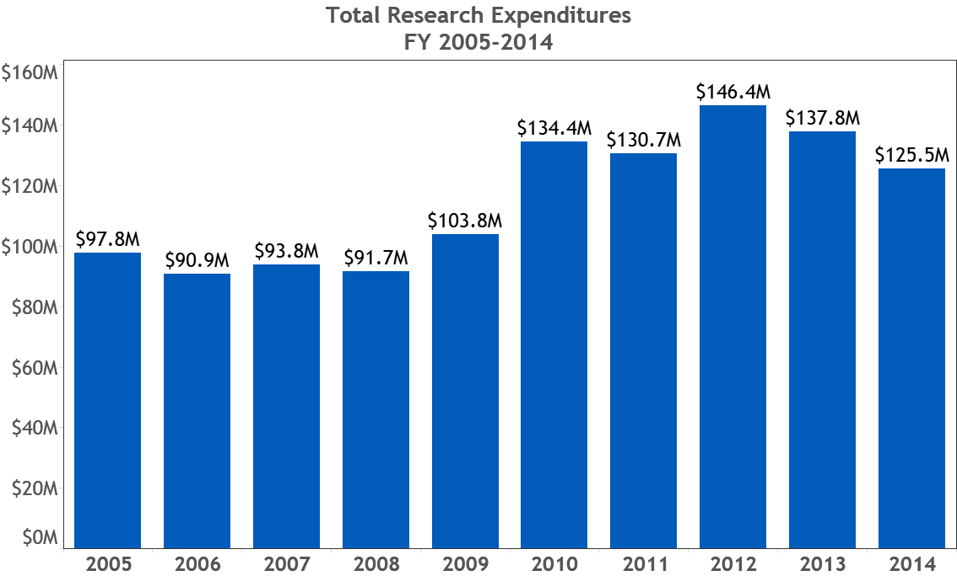
Comparing Over Few Periods, Few Categories

Slide 21
Comparing Over Few Periods, Many Categories
“How much did our instructional expenditures grow over the last 10 years relative to those of our peers?”
Visualization: Line Graph

Slide 22
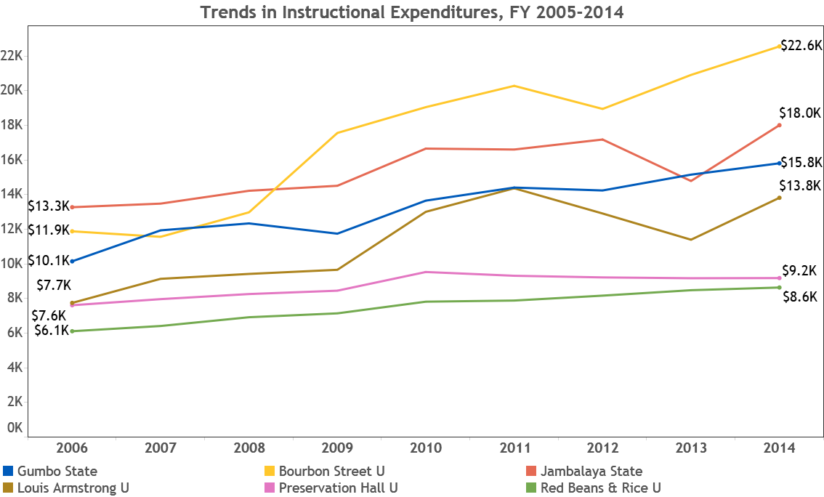
Comparing Over Few Periods, Many Categories

Slide 23
Comparing Over Many Periods
“How does the number of enrolled seats in BIO 200 change over the time period leading up to and into the Fall 2015 semester?”

Slide 24
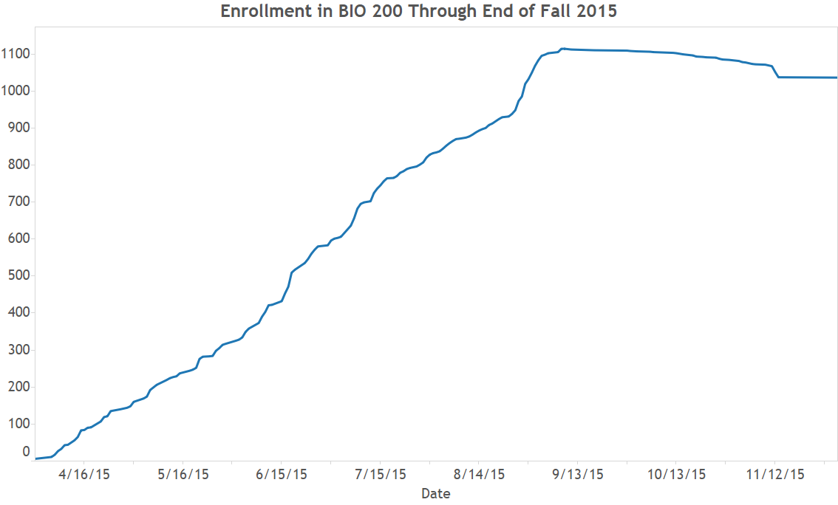
Comparison Over Many Periods

Slide 25
Composition

Slide 26
Visualizing Static Composition
Key is to quickly compare size of components; if this isn’t easy you need a different visualization
Readability depends on:
Number of components
Very small components
Large variation in component sizes

Slide 27
Static Composition With Fewer vs. More Categories
“What do our undergraduates look like in terms of gender and race/ethnicity?”
Visualizations: Pie Chart or Tree Map or Column Chart

Slide 28
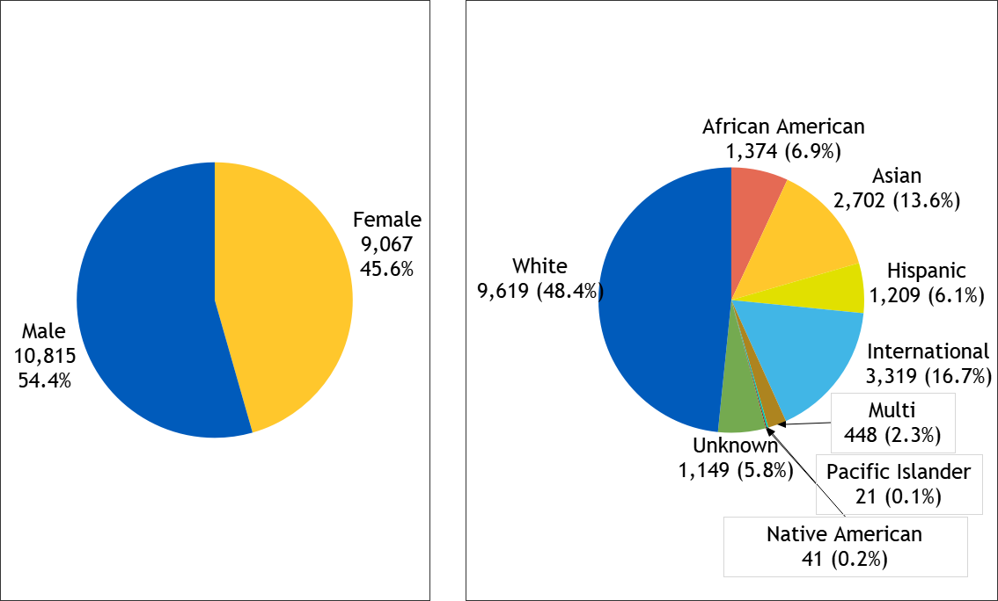
Static Composition With Fewer vs. More Categories

Slide 29
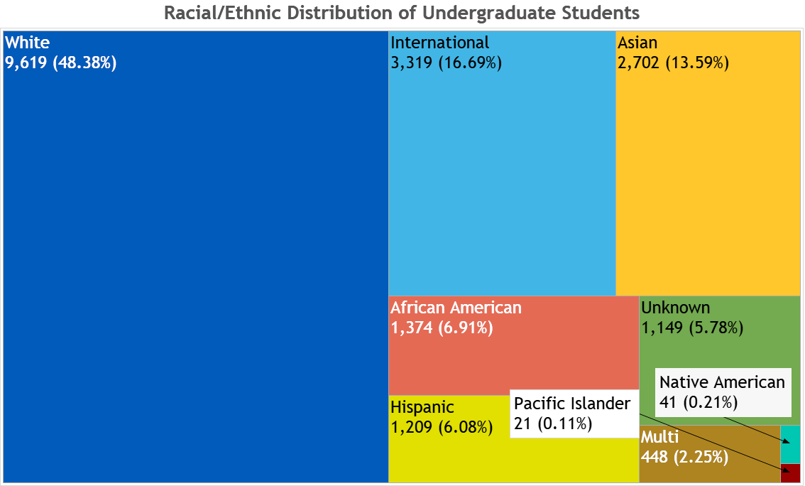
Static Composition With More Categories

Slide 30
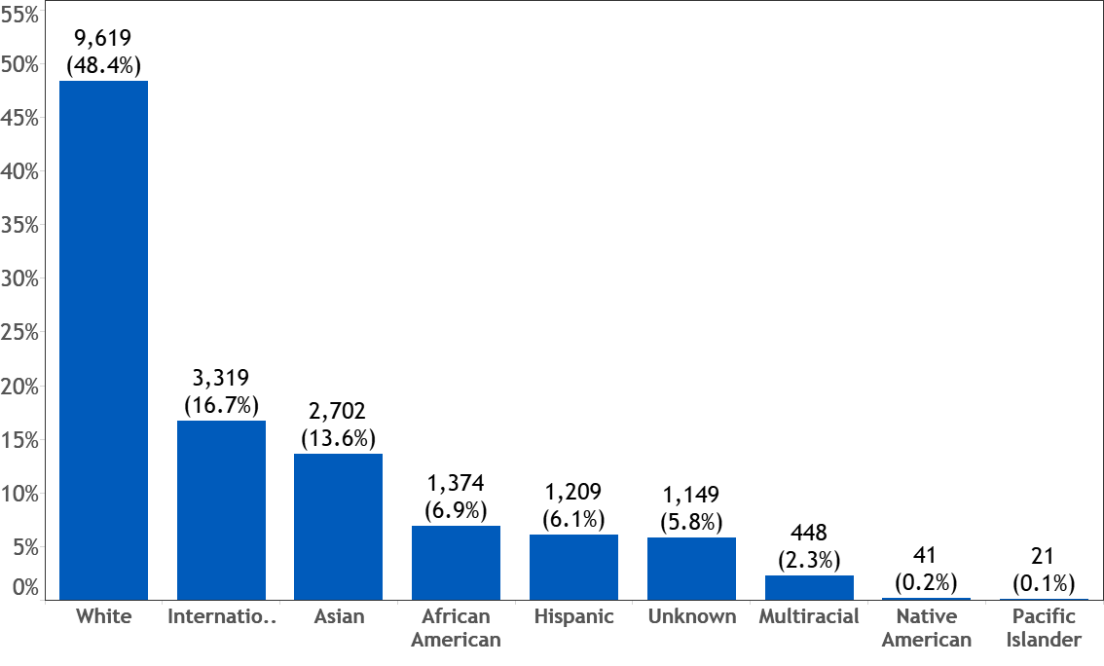
Static Composition With More Categories

Slide 31
Static Composition With Subcategories
“Can you show me the racial and ethnic distribution of our undergraduate population and total up the underrepresented minorities?”
Visualization: Stacked 100% Bar of Bar Chart or Stacked 100% Column of Column Chart

Slide 32
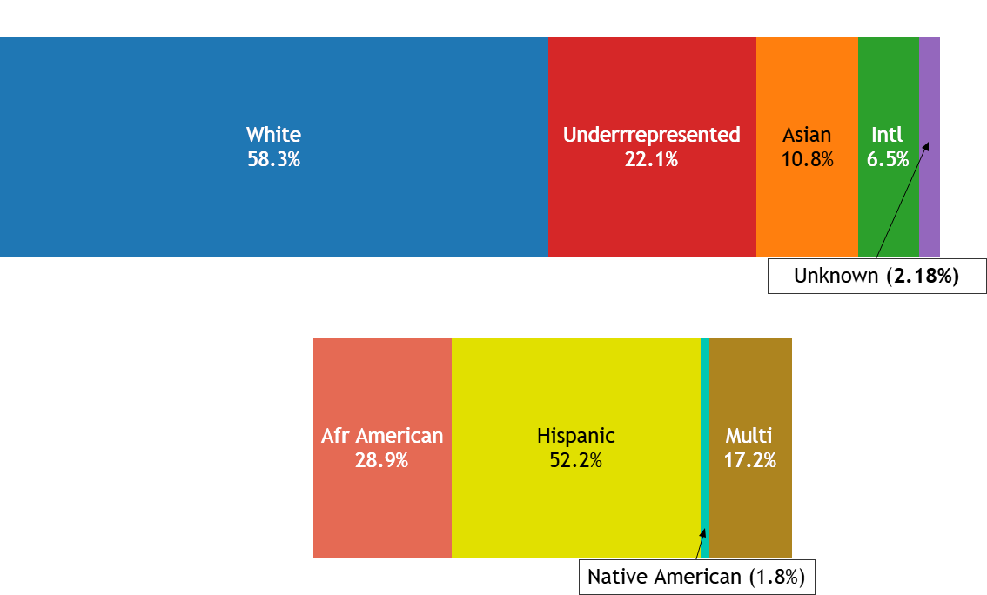
Static Composition With Subcategories

Slide 33
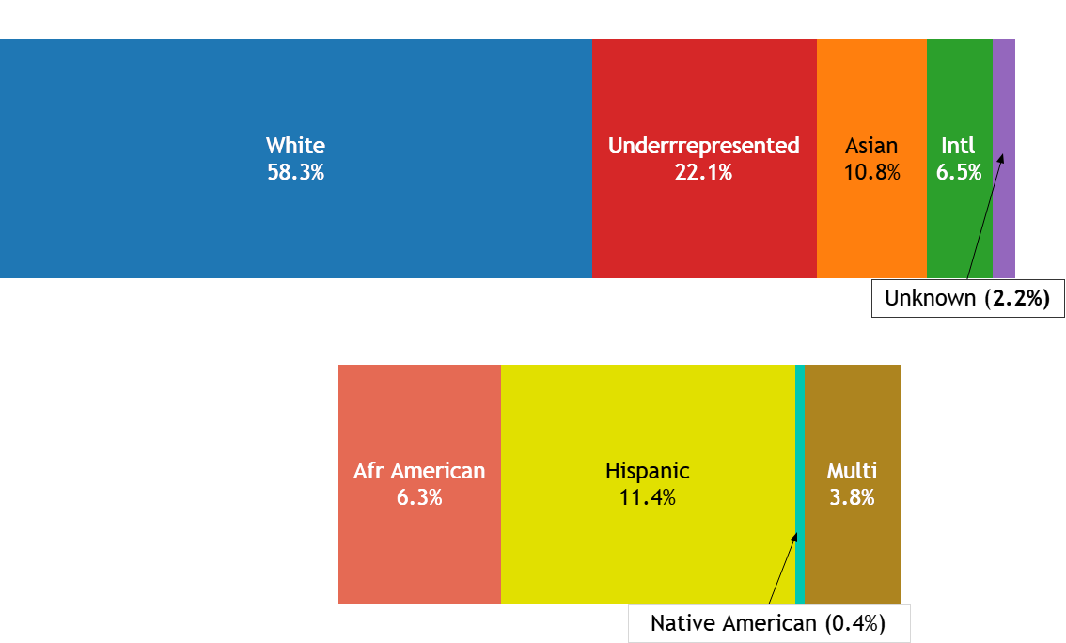
Static Composition With Subcategories

Slide 34
Visualizing Changes in Composition
Stacked bar or area chart is best
Key decision points building your visualization time:
How many time periods to be shown?
Are absolute or relative differences most important?
Relative → need to show percentages that sum to 100% and bars/areas are of equal size
Absolute → counts or sums are primary even if percentages also shown, bars/areas are unequal

Slide 35
Changes in Composition Over Few Periods
“How have the proportions of our institutional revenue that come from various sources changed over the past few years?”
Visualization: Stacked 100% Column Chart

Slide 36
Changes in Composition Over Few Periods

Slide 37
Changes in Composition Over Few Periods

Slide 38
Changes in Composition Over Many Periods
“How have the relative numbers of undergraduate, graduate, and professional applicants changed over this year?”
Visualization: Stacked Area Chart

Slide 39
Changes in Composition Over Many Periods

Slide 40
Changes in Composition Over Many Periods

Slide 41
Distribution

Slide 42
Visualizing Distributions
Broad description of a numeric variable, shows all values from low to high
Key aspects to be captured:
Spread
Central tendency
Shape of distribution

Slide 43
Distribution of One Variable Over Few Data Points
“What’s the grade distribution for CHEM 101 ?”
Visualization: Column Histogram

Slide 44
Distribution of One Variable Over Few Data Points

Slide 45
Distribution of One Variable Over Many Data Points
“What’s the distribution of SAT scores of for College-Bound Seniors?”
Visualization: Line Histogram

Slide 46
Distribution of One Variable Over Many Data Points

Slide 47
Joint Distribution of Two Variables
“What do our first semester GPAs look like across students that take different credit loads?”
Visualization: Scatterplot

Slide 48
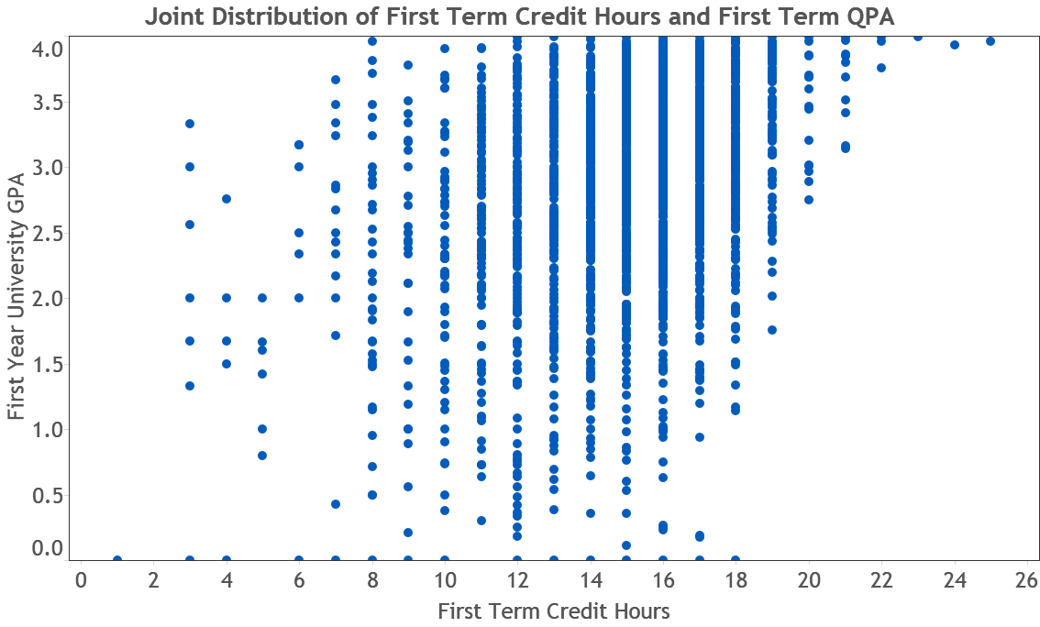
Joint Distribution of Two Variables

Slide 49
Relationships

Slide 50
Visualizing Relationships
Key aspects are:
Direction
Strength of relationship
Shape (linear, curved, other nonlinear)
Should be able to show concentration of values (or ranges) that co-occur (or gaps where they don’t)

Slide 51
Two Variable Relationships
“Are first semester grades related to high school GPA?”
Visualization: Scatterplot with Trend Line

Slide 52
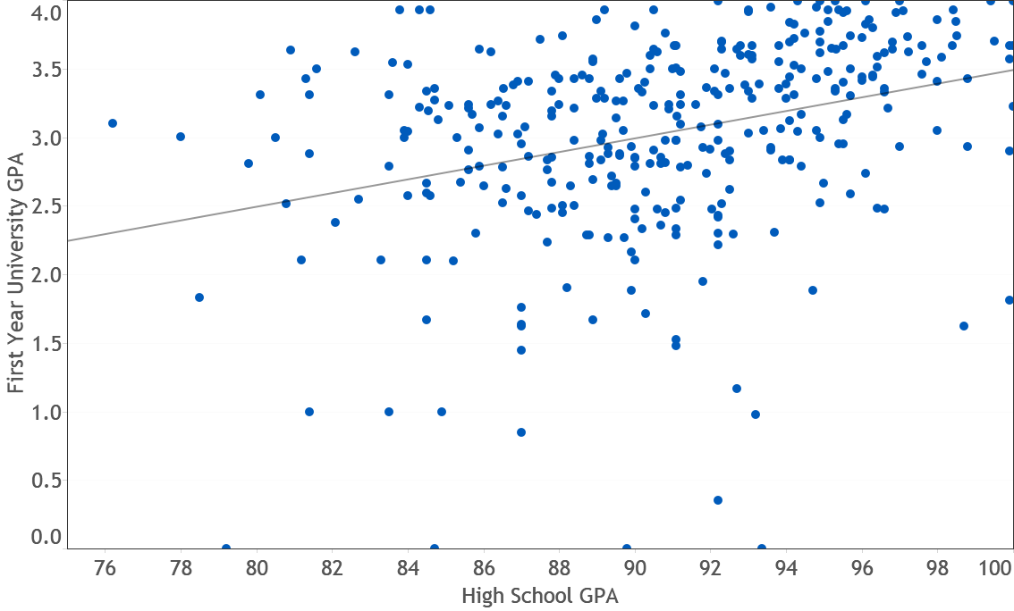
Two Variable Relationships

Slide 53
Three Variable Relationships
“Are first semester grades related to high school GPA and/or SAT composite score?”
Visualization: Bubble Chart or Scatterplot

Slide 54
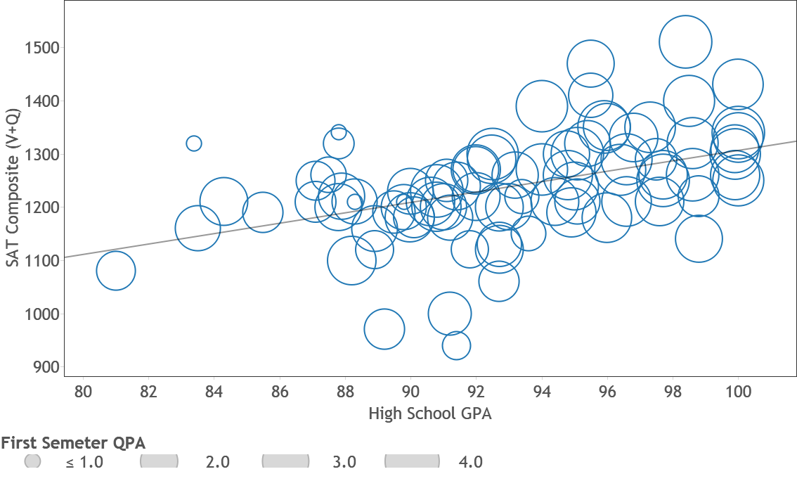
Three Variable Relationships

Slide 55
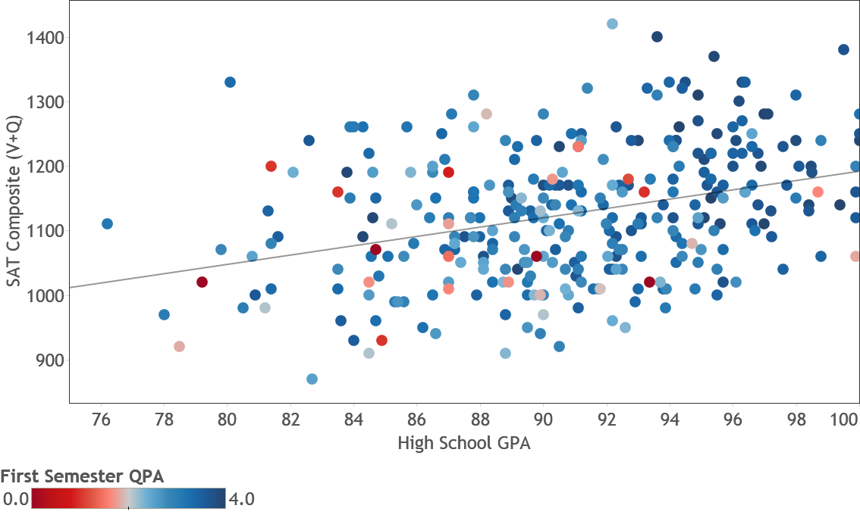
Three Variable Relationships

Slide 56
Conclusions
Visualizations and their formats should be driven by the question at hand
Visualizations should succinctly guide the viewer to the answer
Each visualization can be viewed as part of a larger story in many projects
Questions?

