Slide 1
Who Wants to Finish in 4? A Cluster Analysis of Retention Program Reach
Lauren Young
Office of Institutional Analysis
University at Buffalo

Slide 2
Why Finish in 4? The Institutional View
4-year graduation increasingly held up as an indicator of institutional quality and effectiveness
Longer times to degree require more institutional resources
Longer times to degree increase the likelihood that resource commitments will not result in a degree
Qualified degree holders add prestige to the institution

Slide 3
Why Finish in 4? The Student View
Save money on tuition
Ensure that student will finish; a longer stay decreases the chance of earning a degree and its benefits
Quicker progress to career and personal goals
More earnings if choosing to enter the workforce
More flexibility earlier in a career

Slide 4
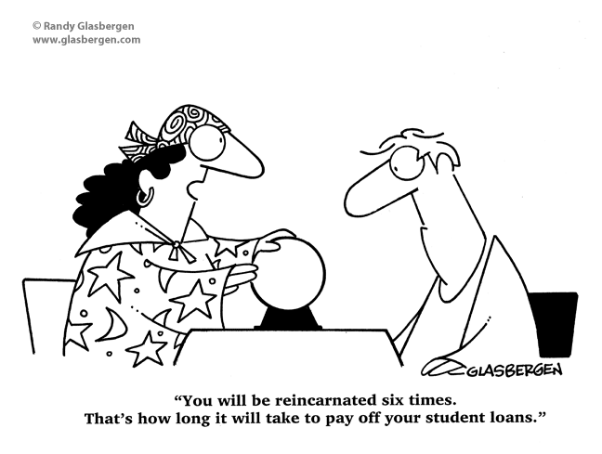
Why Finish in 4? The Student View

Slide 5
National 4-Year Graduation Initiatives
“15 to Finish” initiatives implemented in 15 states
  Increase awareness of benefits of staying on a 4-year plan and taking 15 credits per term
  Promote strategies for on-time graduation, including a pledge to take 15+ credits per semester
Increasing number of institutions implementing 4-year graduation commitments
  Student pledge to graduate in 4 years is matched by an institutional commitment to provide advising and instructional resources
  Centerpiece is typically an assurance that required courses will be made available

Slide 6
What is Finish in 4?
An institutional commitment to provide pledging students with the resources to graduate in 4 years
A roadmap for pledging students’ success
The pledge is available to all full-time freshmen except for those who:
  Are intending or approved for a program that includes both undergraduate and graduate components (e.g., PharmD; DPT)
  Are intending or approved for another dual/combined degree
  Enroll in a Spring term

Slide 7
The Finish in 4 Pledge for Students
Students pledging Finish in 4 agree to:
Successfully complete a freshman seminar by the end of their first year
Participate in mandatory advisement prior to enrollment in each term
Follow a personalized curricular plan
  Register for and complete an appropriate number of planned credit hours
  Maintain good academic standing
  Complete prerequisites and gain acceptance to a major on time
Register in plan courses in the first week of each term
Complete a career assessment by the end of their second year

Slide 8
The Finish in 4 Pledge for Students
Students also agree to adhere to the following guidelines that promote academic success:
Make academics their #1 priority (e.g., limiting work to fewer than 20 hours)
Choose a major by the end of their third term
Consult with an advisor on any planned change of major
Monitor their progress using an online self-service center and get help if they fall into academic difficulty
Check their university e-mail every day
Conduct all university-related tasks on time

Slide 9
The Finish in 4 Pledge for UB
In return for the student pledge to Finish in 4, the institution commits to:
Provide academic advisement each term to help develop a curricular plan tailored to a major
Offer sections and seats as required by curricular plans
Monitor student progress each term
Communicate via e-mail about academic problems or pledge non-compliance
Offer assistance with academics and progress toward a four-year graduation
Provide students who fulfill the pledge but still cannot graduate in four years with the opportunity to complete the courses needed for their degree free of any tuition and comprehensive fee charges.

Slide 10
But Who’s in Finish in 4?
Most analysis centered on effectiveness of initiatives to promote 4-year programs (i.e., are students retained/graduated?)
Virtually no published analysis of who pledges such initiatives, though outcomes likely impacted by inputs
About half of all eligible students entering in Fall 2012 and Fall 2013 pledged Finish in 4
  Why did the others not pledge?
  Can we influence some who would be non-participants to take the pledge?
  What might be the messages used to do so?

Slide 11
Classifying Students With Cluster Analysis
Method for classifying similar subgroups of a population by imposing structures on data
Incorporates diagnostic tests to identify the most informative number(s?) of subgroups
Best handled as both data and theory informed approach
Current analysis included themes/variables possibly related to a Finish in 4 pledge:
  Academic engagement
  Achievement orientation
  Social engagement
  Engagement with the University
  Financial concerns

Slide 12
Variables for Analysis
Finish in 4 pledge
Academic engagement
  High school average and SAT
  Acceptance into Honors program
  Aspiration to earn doctorate
  Importance of academic reputation in choosing UB
Achievement orientation
  Self ratings of drive to achieve and leadership
  Choosing UB because its graduates get better jobs
  Long term interest in being recognized in one’s field, in financial success, and in meeting others’ expectations

Slide 13
Variables for Analysis
Social engagement
  Self-ratings of social confidence and understanding of others
  Expectations of participating in student organizations
  Long term interest in contributing to the community
Engagement with the University
  UB was the first choice institution
  Importance of campus visit in choosing UB
Financial concerns
  Concerns about affordability of a college education
  Importance of financial aid and cost in choosing UB
Other
  Geographic origin in local area (Western New York) or out of state
  Undecided major

Slide 14
Population for Analysis
The institution
  Highly selective public AAU research institution in Western New York State
  Total enrollment of ~29,000 includes ~20,000 undergraduates
  Freshman class of 3,000-3,500 is typical
  Current 4-year graduation rate is 52%
The students (n=867)
  First-time, full-time freshmen in Fall 2012
  Eligible for Finish in 4
  Participated in annual online freshman survey that captures data on background, values, college choice, and future expectations

Slide 15
Clustering Results
Analysis produced 4-cluster and 8-cluster solutions
8-cluster solution ultimately chosen because it provided better detail on students who did not pledge Finish in 4
2 of the 8 clusters included too few students and will not be described further here
Of the remaining 6 clusters:
  2 were associated with high levels of pledging Finish in 4 (shown in blue in graphs of analysis)
  2 were associated with moderate levels of pledging Finish in 4 (shown in green in graphs)
  2 were associated with low levels of pledging Finish in 4 (shown in red)

Slide 16
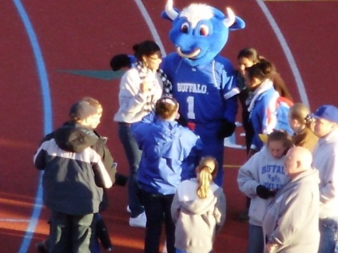


Describing Student Clusters
Cluster 1: Bleeding UB Blue
Cluster 2: Academic Strivers
Cluster 3: Juggling Demands

Slide 17
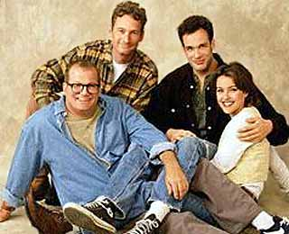
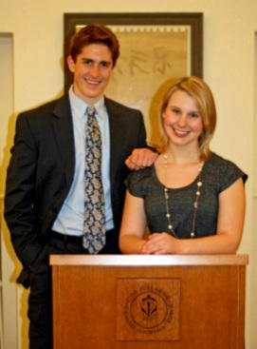

Describing Student Clusters
Cluster 4: Average Joes
Cluster 5: Most Likely to Succeed
Cluster 6: Geek Squad

Slide 18
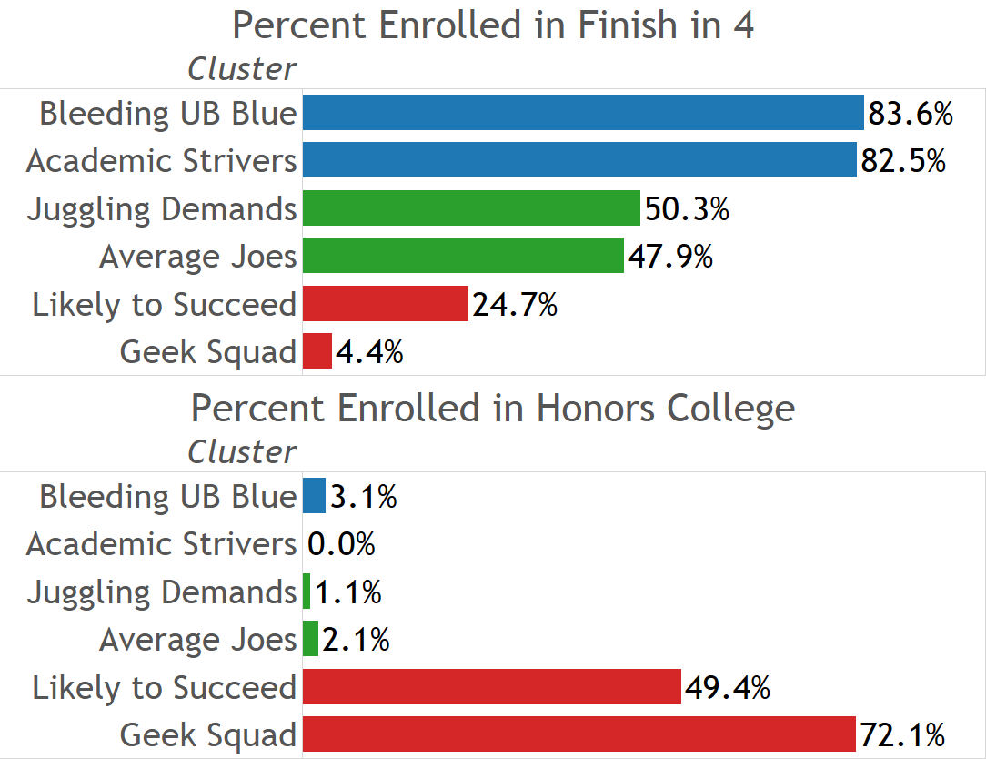
Participation in Finish in 4 vs. Honors

Slide 19
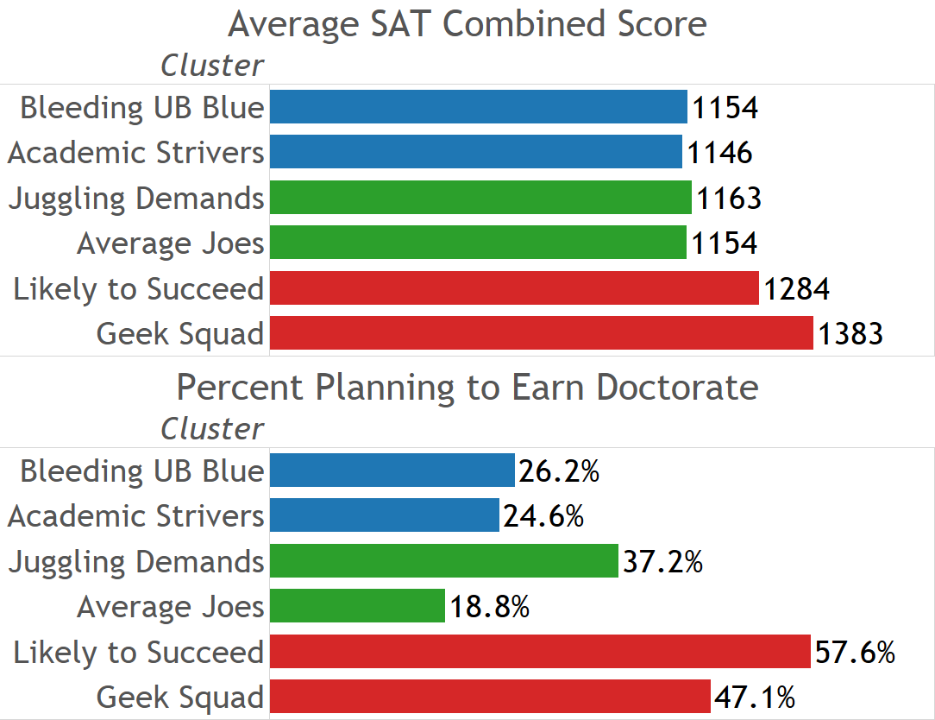
Academic Engagement

Slide 20
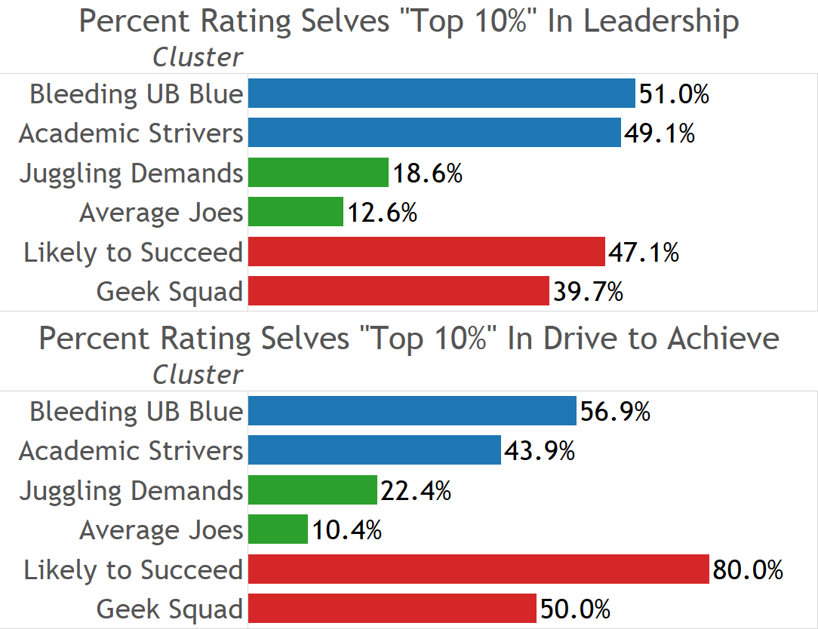
Achievement Orientation

Slide 21
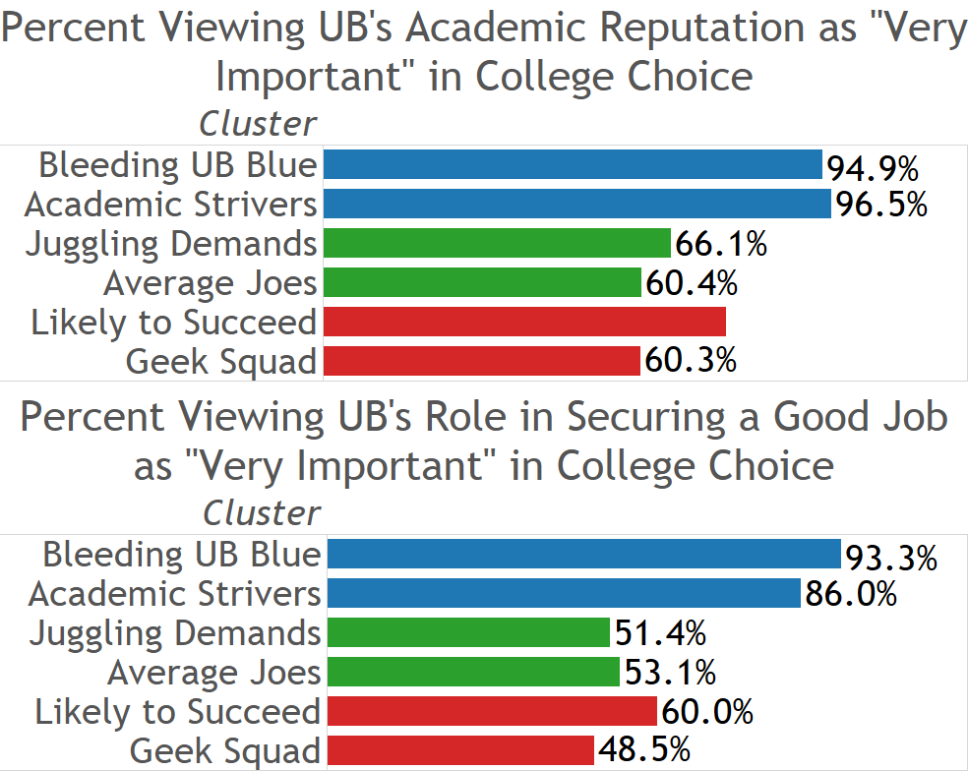
Choosing UB for Reputation

Slide 22
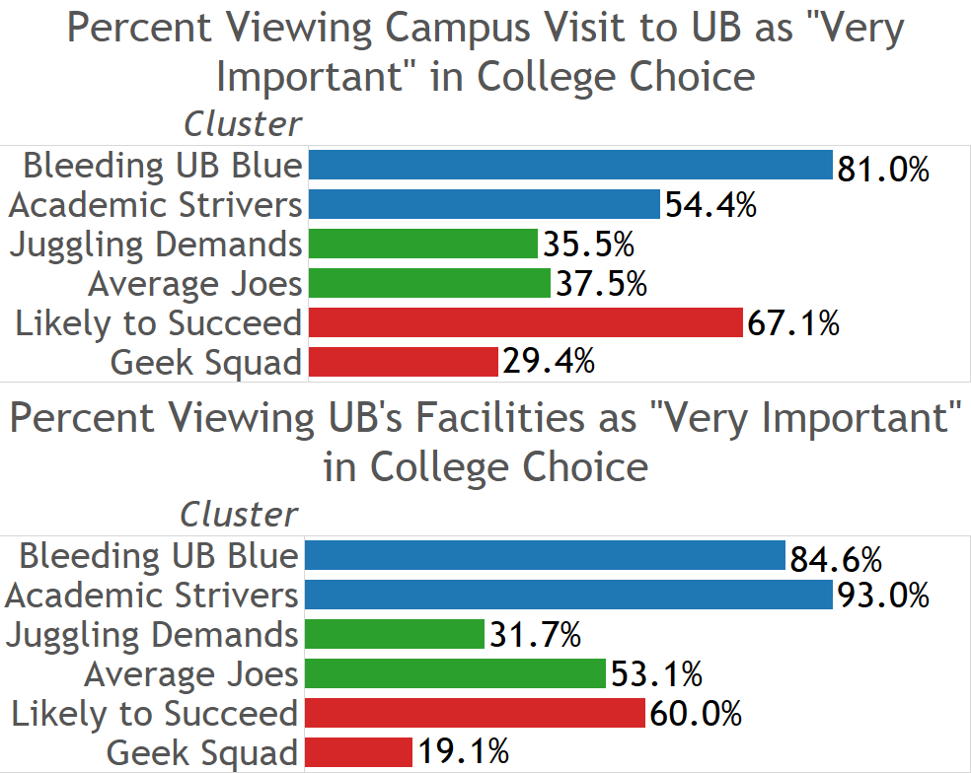
Choosing UB: Familiarity with Campus

Slide 23
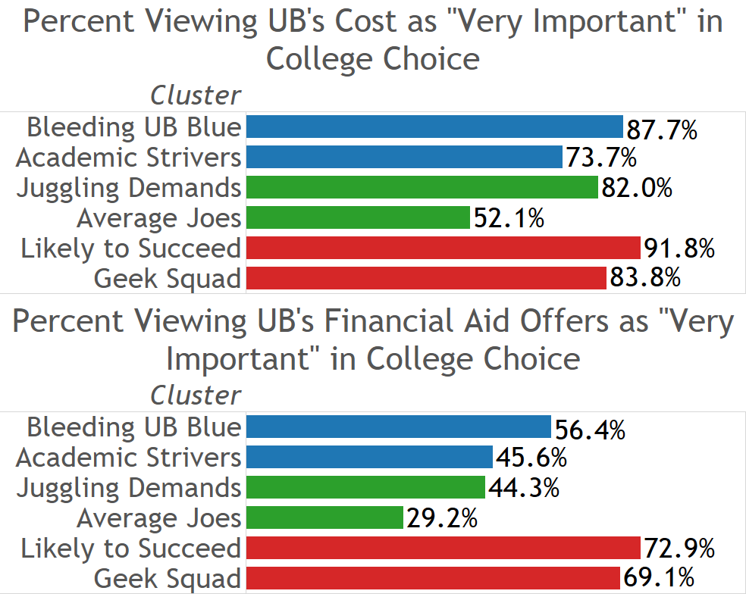
Choosing UB for Value

Slide 24
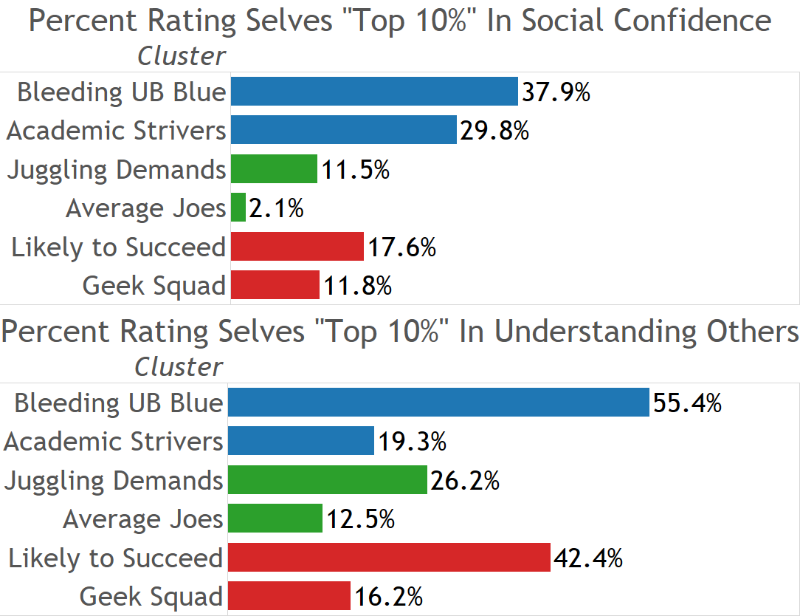
Social Orientation

Slide 25
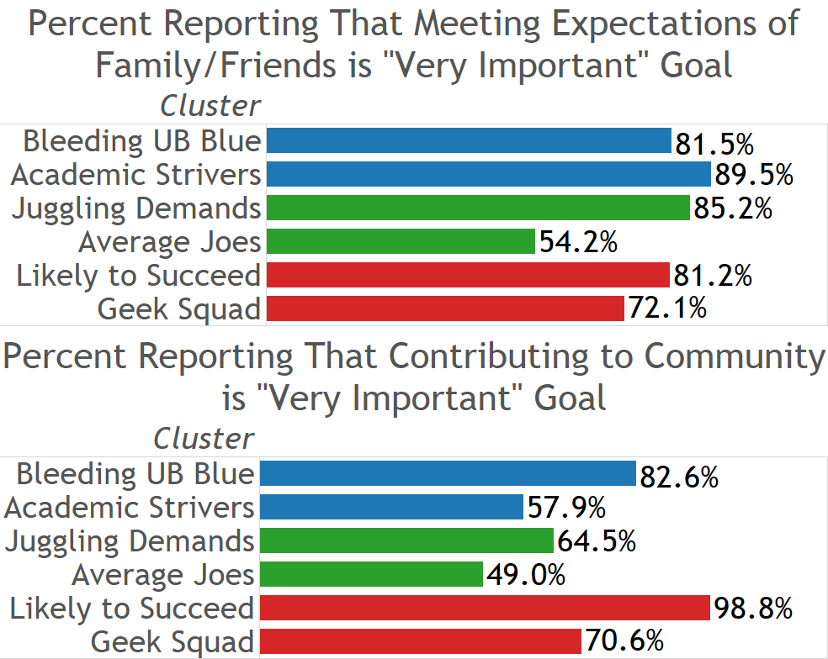
Social Orientation: Long Term Goals

Slide 26
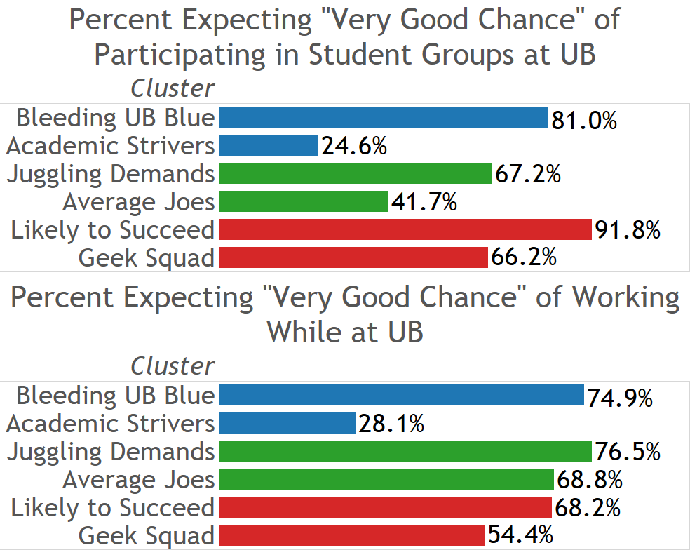
Expected Engagement While at UB

Slide 27
How Do We Reach Them?
Engagement of Jugglers makes this group the best target for the Finish in 4 message if competing demands are addressed
  Message on easier access to the best of UB?
  Message on meeting social expectations?
Average Joes need to receive engagement messages first
Most Likely to Succeed are less interested; achievement oriented messages likely to move just a few
Geek Squadders may be getting support elsewhere and are otherwise a hard sell

Slide 28
How Do We Reach Them?
Tailor Finish in 4 messages based on data and information gained from students during application process?
  Engagement and interest in activities
  Engagement with the University (e.g., making a campus visit during application process; but not necessarily expressed interest in living on campus)
Finish in 4 messages are applicable to all students, regardless of whether they formally pledge Finish in 4 at matriculation

