Slide 1
Identifying Research Strengths through Bibliometric Analysis
Rachel Link, Research Analyst
Craig W. Abbey, Associate Vice Provost and
Director of Institutional Analysis
May 28, 2014
Orlando, FL

Slide 2
What is Bibliometric Analysis?
The use of statistical methods in the analysis of a body of literature to reveal the historical development of subject fields and patterns of authorship, publication, and use.
Most common uses: citation analysis and assessment of academic impact.
Source: ALA Glossary of Library and Information Science

Slide 3
UB’s Use of Bibliometric Analysis
Understanding faculty contributions
Benchmarking against peer institutions
Examining research strengths
Understanding collaborations

Slide 4



Examining Research Strengths:
Software Tools

Slide 5



Examining Research Strengths:
Data Sources

Slide 6
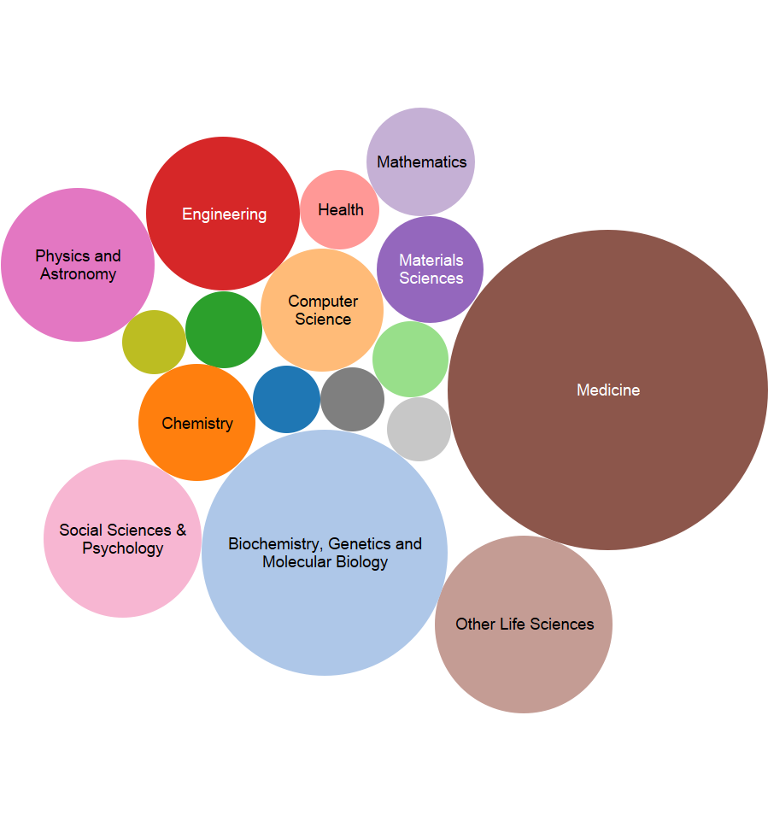
UB Publications Volume by Broad Journal Discipline
Source: Global Research Benchmarking System, 2010

Slide 7
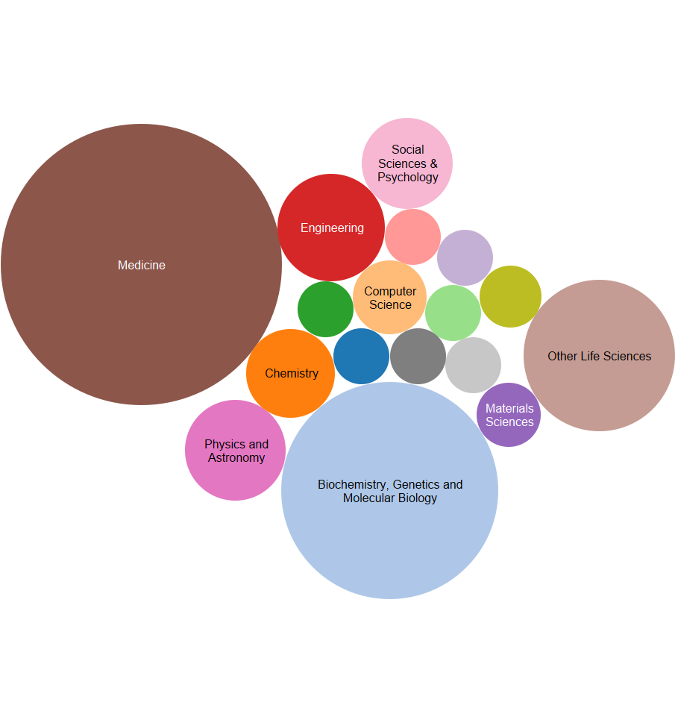
UB Citation Volume by Broad Journal Discipline
Source: Global Research Benchmarking System, 2010

Slide 8
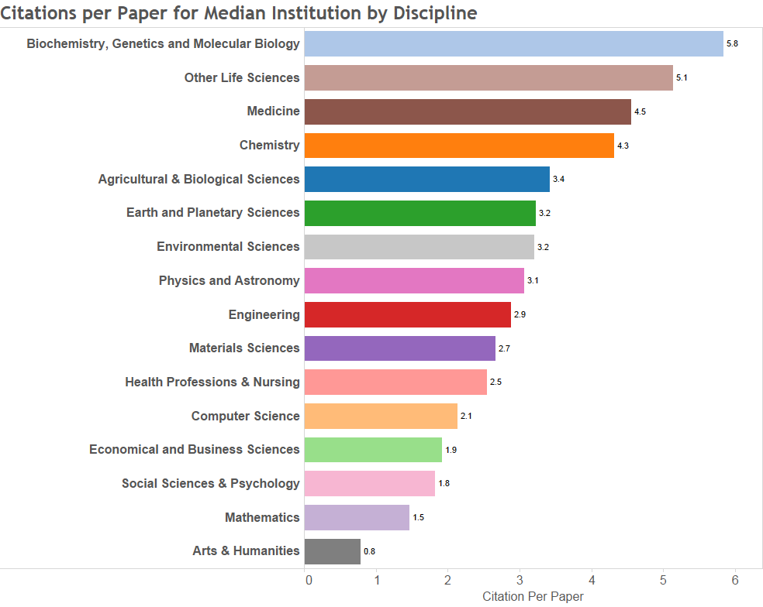
Multidisciplinary Median = 24.1
Source: Global Research Benchmarking System, 2010

Slide 9
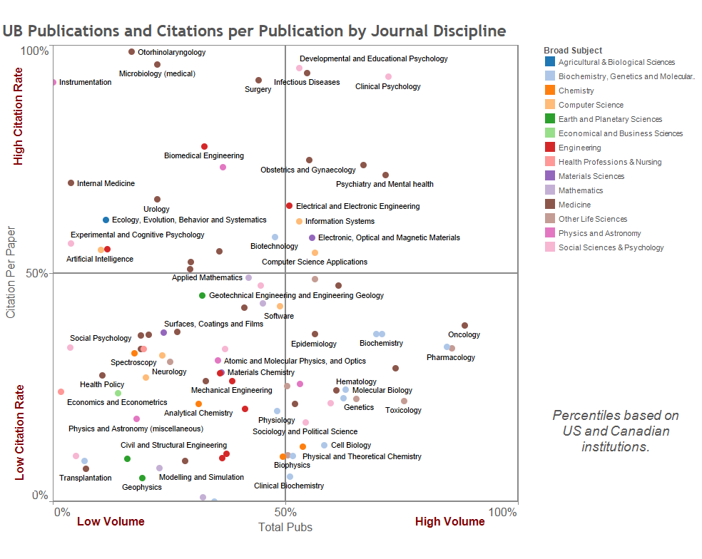
Source: Global Research Benchmarking System, 2010

Slide 10
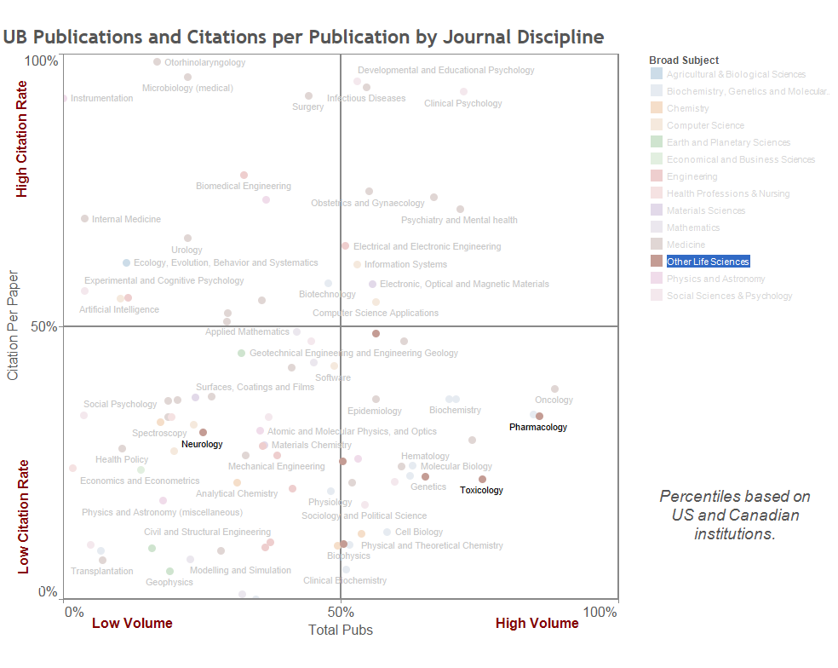
Source: Global Research Benchmarking System, 2010

Slide 11
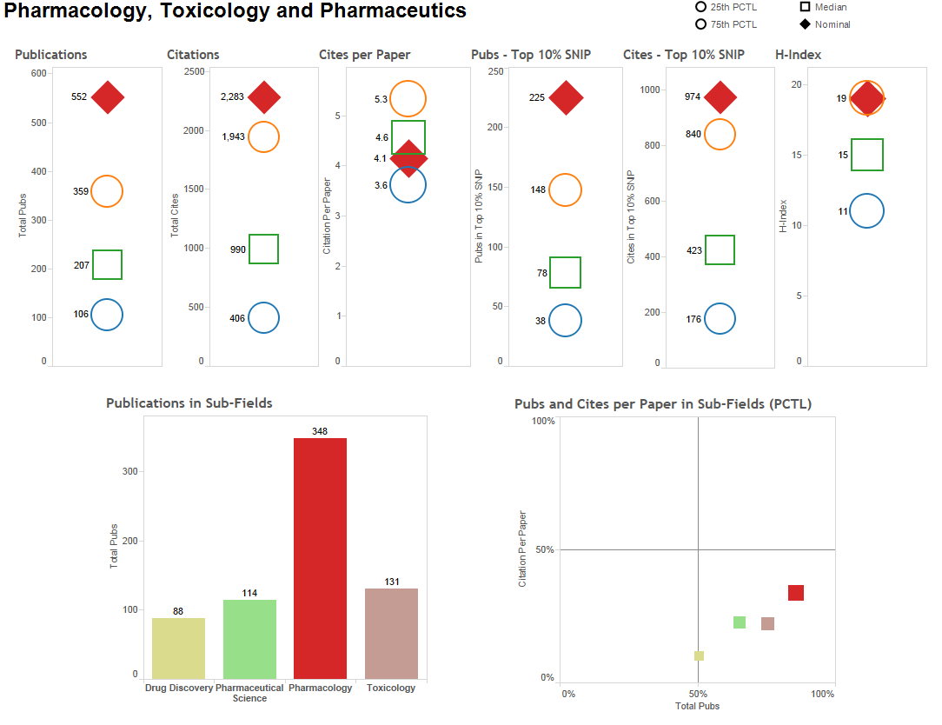
Source: Global Research Benchmarking System, 2010

Slide 12
Understanding Collaborations:
Data Preparation
Scopus article listing for 2008-12
Academic Analytics Details Database
Institutional human resources data

Slide 13
Scopus Data Process
Scopus dataset loaded into Excel
Merging with UB HR data
Faculty view created
Single-article view created
Editing, cleaning, collating, and formatting
Matrices created

Slide 14
Academic Analytics Data Process
ASJC
UB Structure
Co-Authorship Matrix
AA Journals List
AA Faculty Articles

Slide 15

Visualization in a circular format
Makes relationships apparent
Customization options
Free to use
More information: http://www.circos.ca

Slide 16
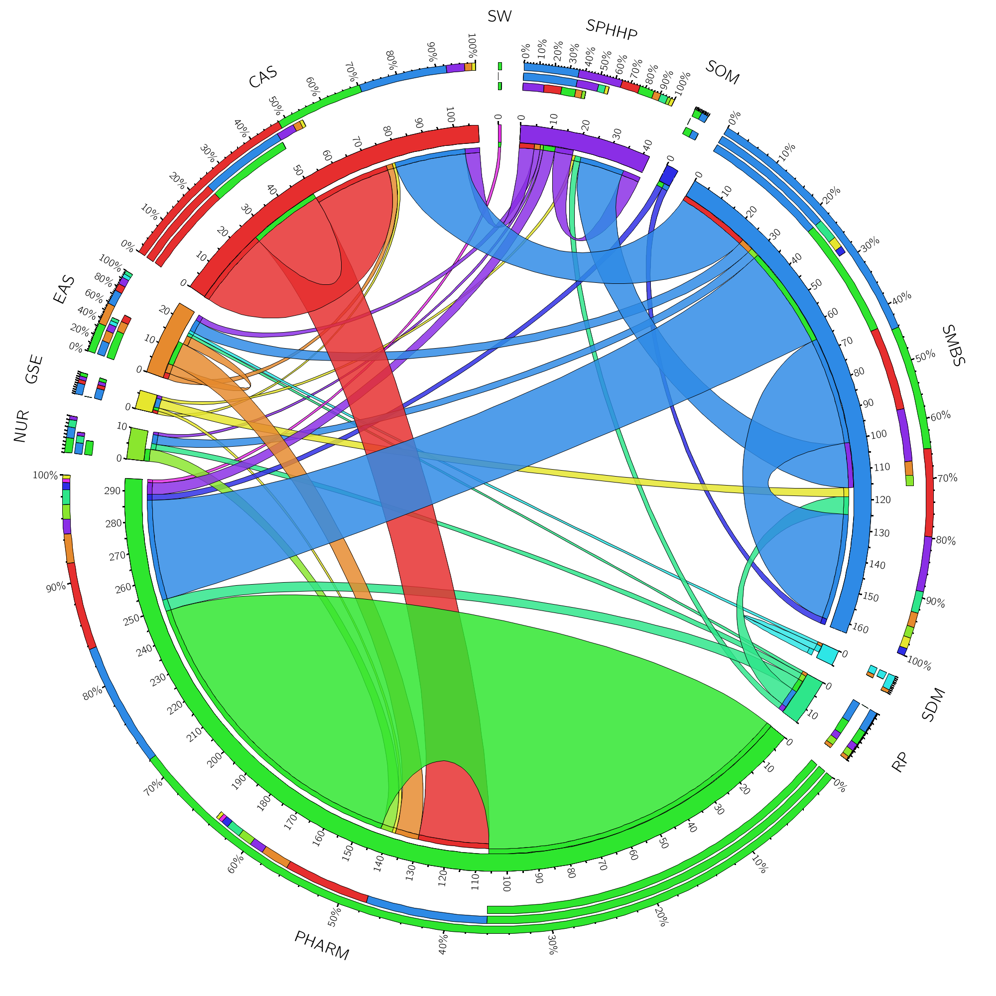
Co-Authorship on Pharmacology, Toxicology and Pharmaceutics Articles
Scopus 2008-12 data

Slide 17
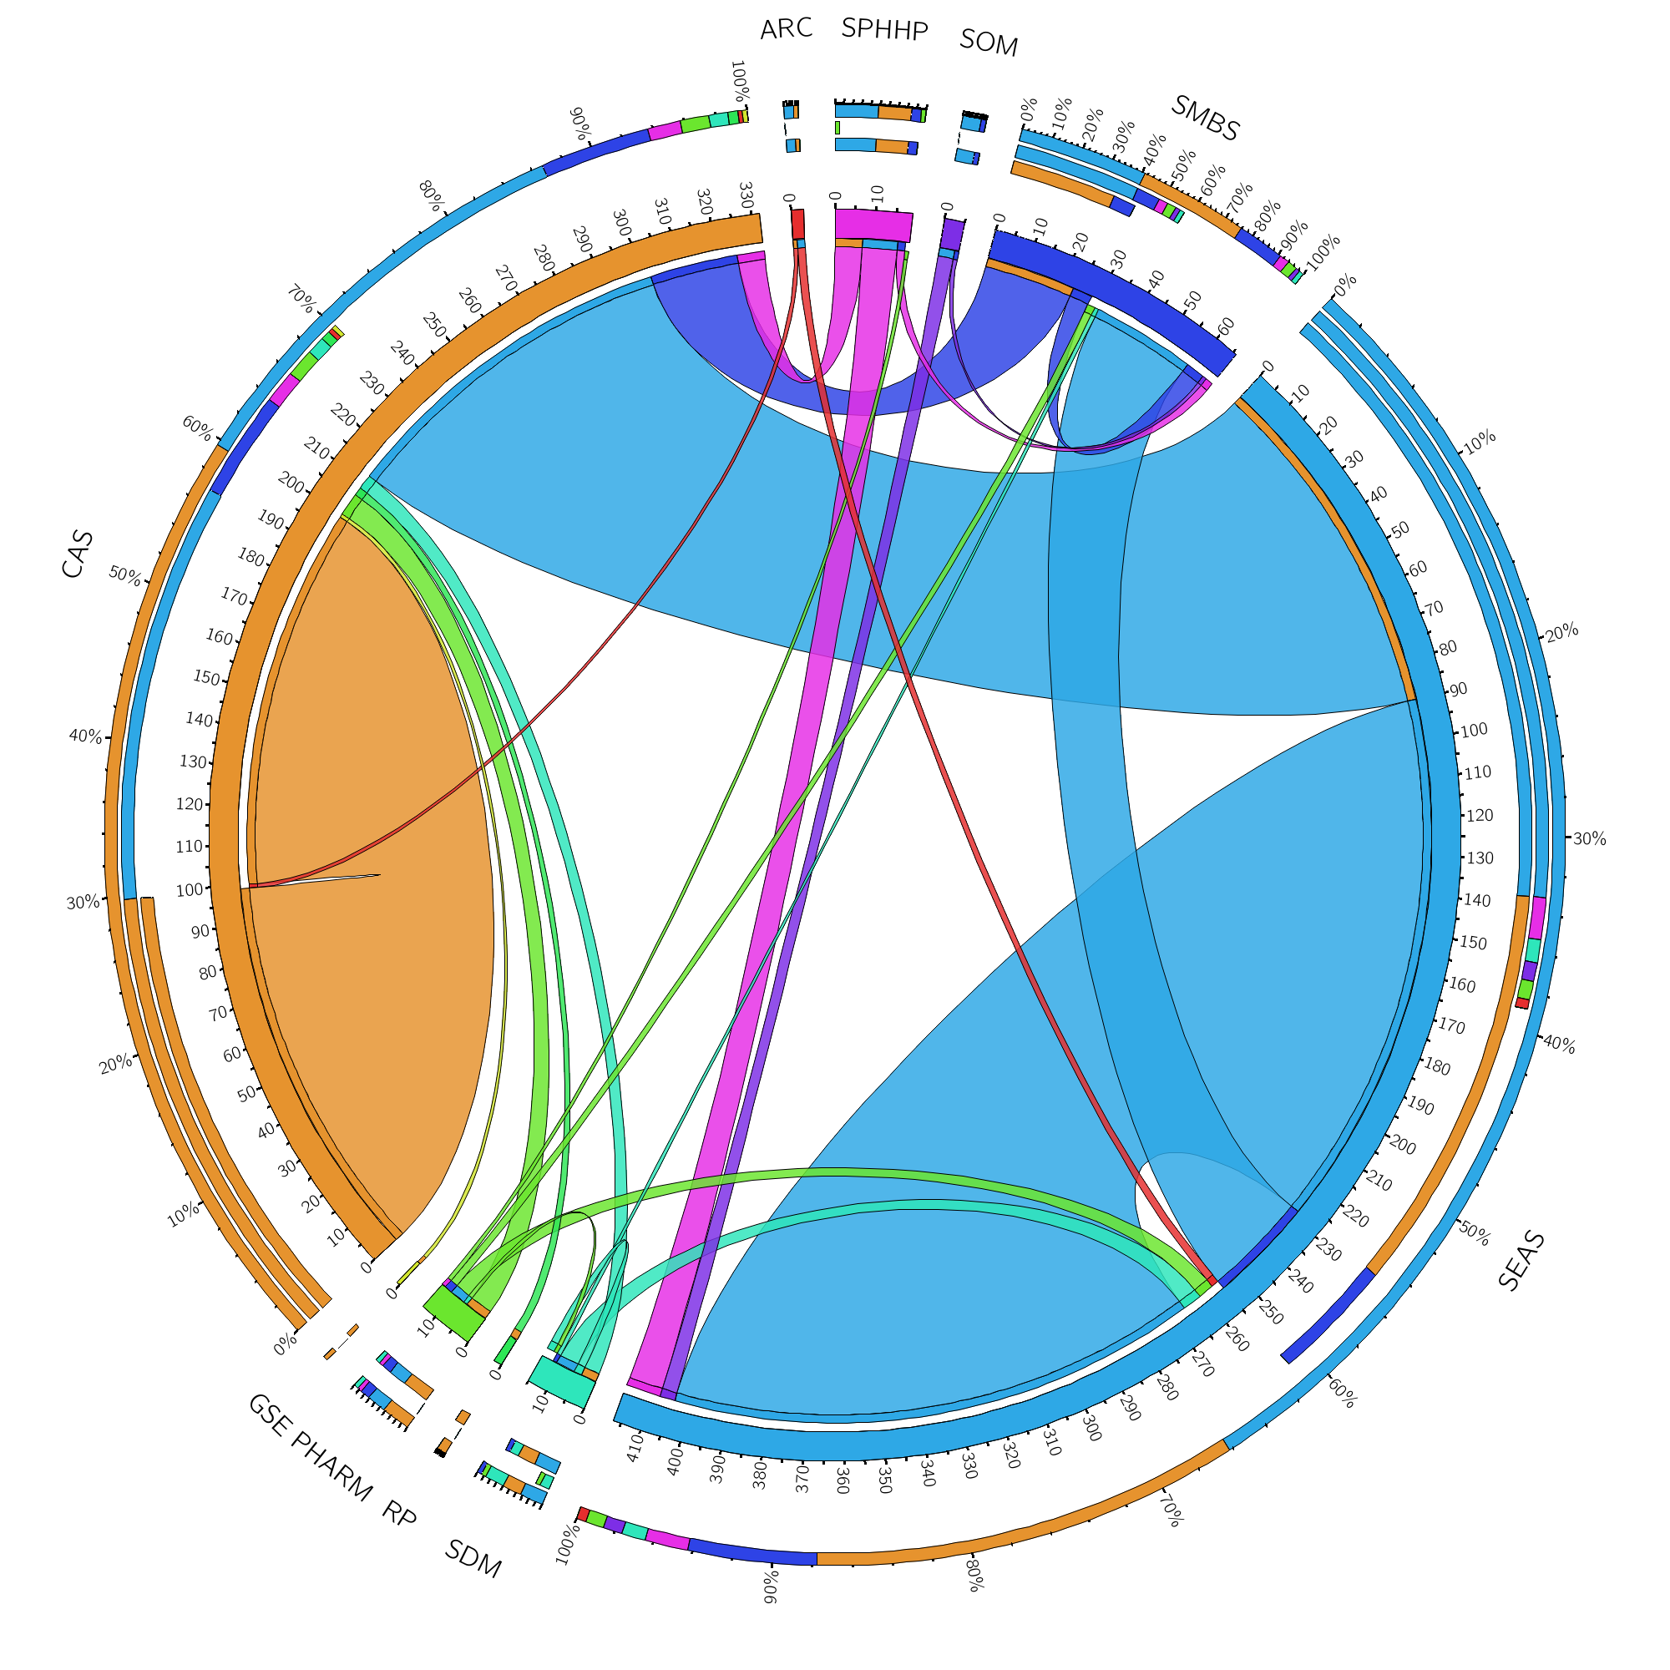
Co-Authorship on Materials Science and Advanced Manufacturing Articles
Source: Scopus 2009-2012

Slide 18
Top Scholars
Name | Unit | Department | Count of Articles | Sum of Citations | Citations per Article
Jones, William A. | PHARM | Pharmaceutical Sciences | 31 | 180 | 5.8
Morrison, David E. | PHARM | Pharmaceutical Sciences | 28 | 150 | 5.4
Smith, Diana K. | PHARM | Pharmaceutical Sciences | 25 | 206 | 8.2
Frank, Adam P. | PHARM | Pharmacy | 23 | 261 | 11.3
Johnson, Mable T. | PHARM | Pharmaceutical Sciences | 15 | 77 | 5.1
Thompson, James A. | PHARM | Pharmacy | 14 | 194 | 13.9
Brown, Frank P. | CAS | Biological Sciences | 13 | 55 | 4.2
Chang, Gao | SMBS | Pharmacology And Toxicology | 12 | 122 | 10.2
Patterson, Margaret R. | PHARM | Pharmacy | 6 | 87 | 14.5
Source: Scopus 2009-2012

Slide 19

Excel template that “plugs in” to Microsoft Excel
Easy to use and customize
Free to download and use
Works well with larger data sets
More information: http://nodexl.codeplex.com

Slide 20
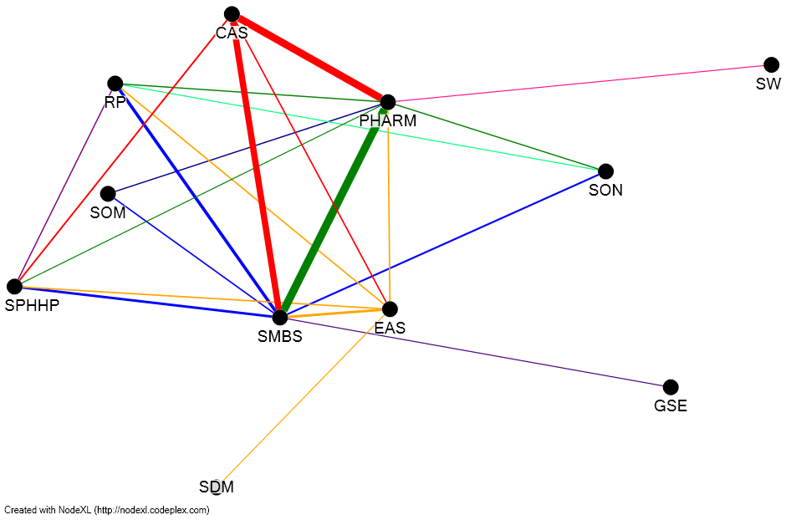
Co-Authorship on Pharmacology, Toxicology and Pharmaceutics Articles
Source: Scopus 2008-12

Slide 21
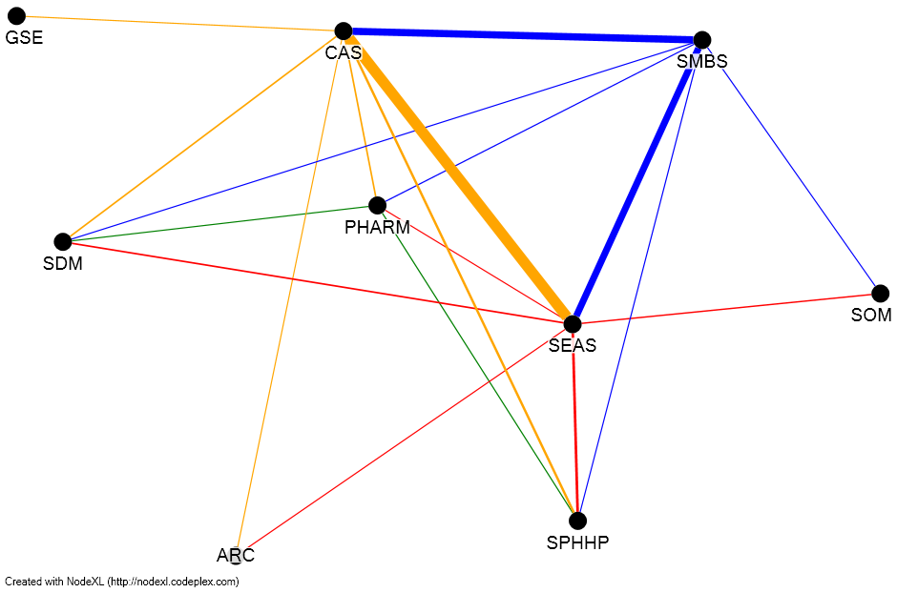
Co-Authorship on Materials Science and Advanced Manufacturing Articles
Scopus 2008-12 data

Slide 22

Text visualization tool
Free to use
Allows removal of common words, or any words of your choosing
Can recognize strings and phrases if data are formatted for that purpose
More information: http://www.wordle.net/

Slide 23
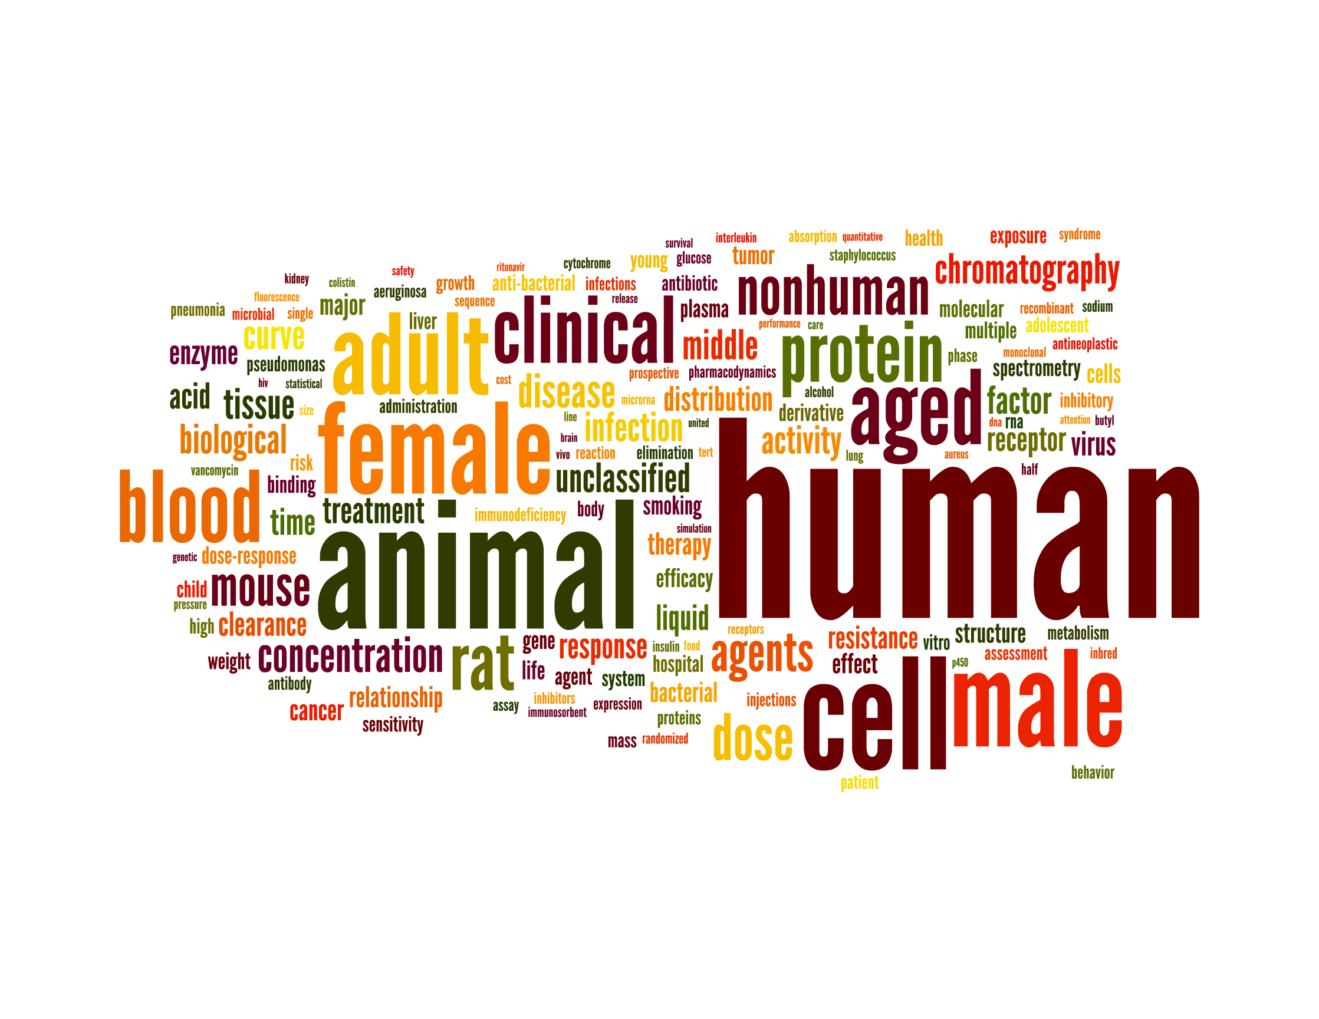
Pharmacology, Toxicology and Pharmaceutics
UB Article Keywords
Scopus 2008-12 data

Slide 24
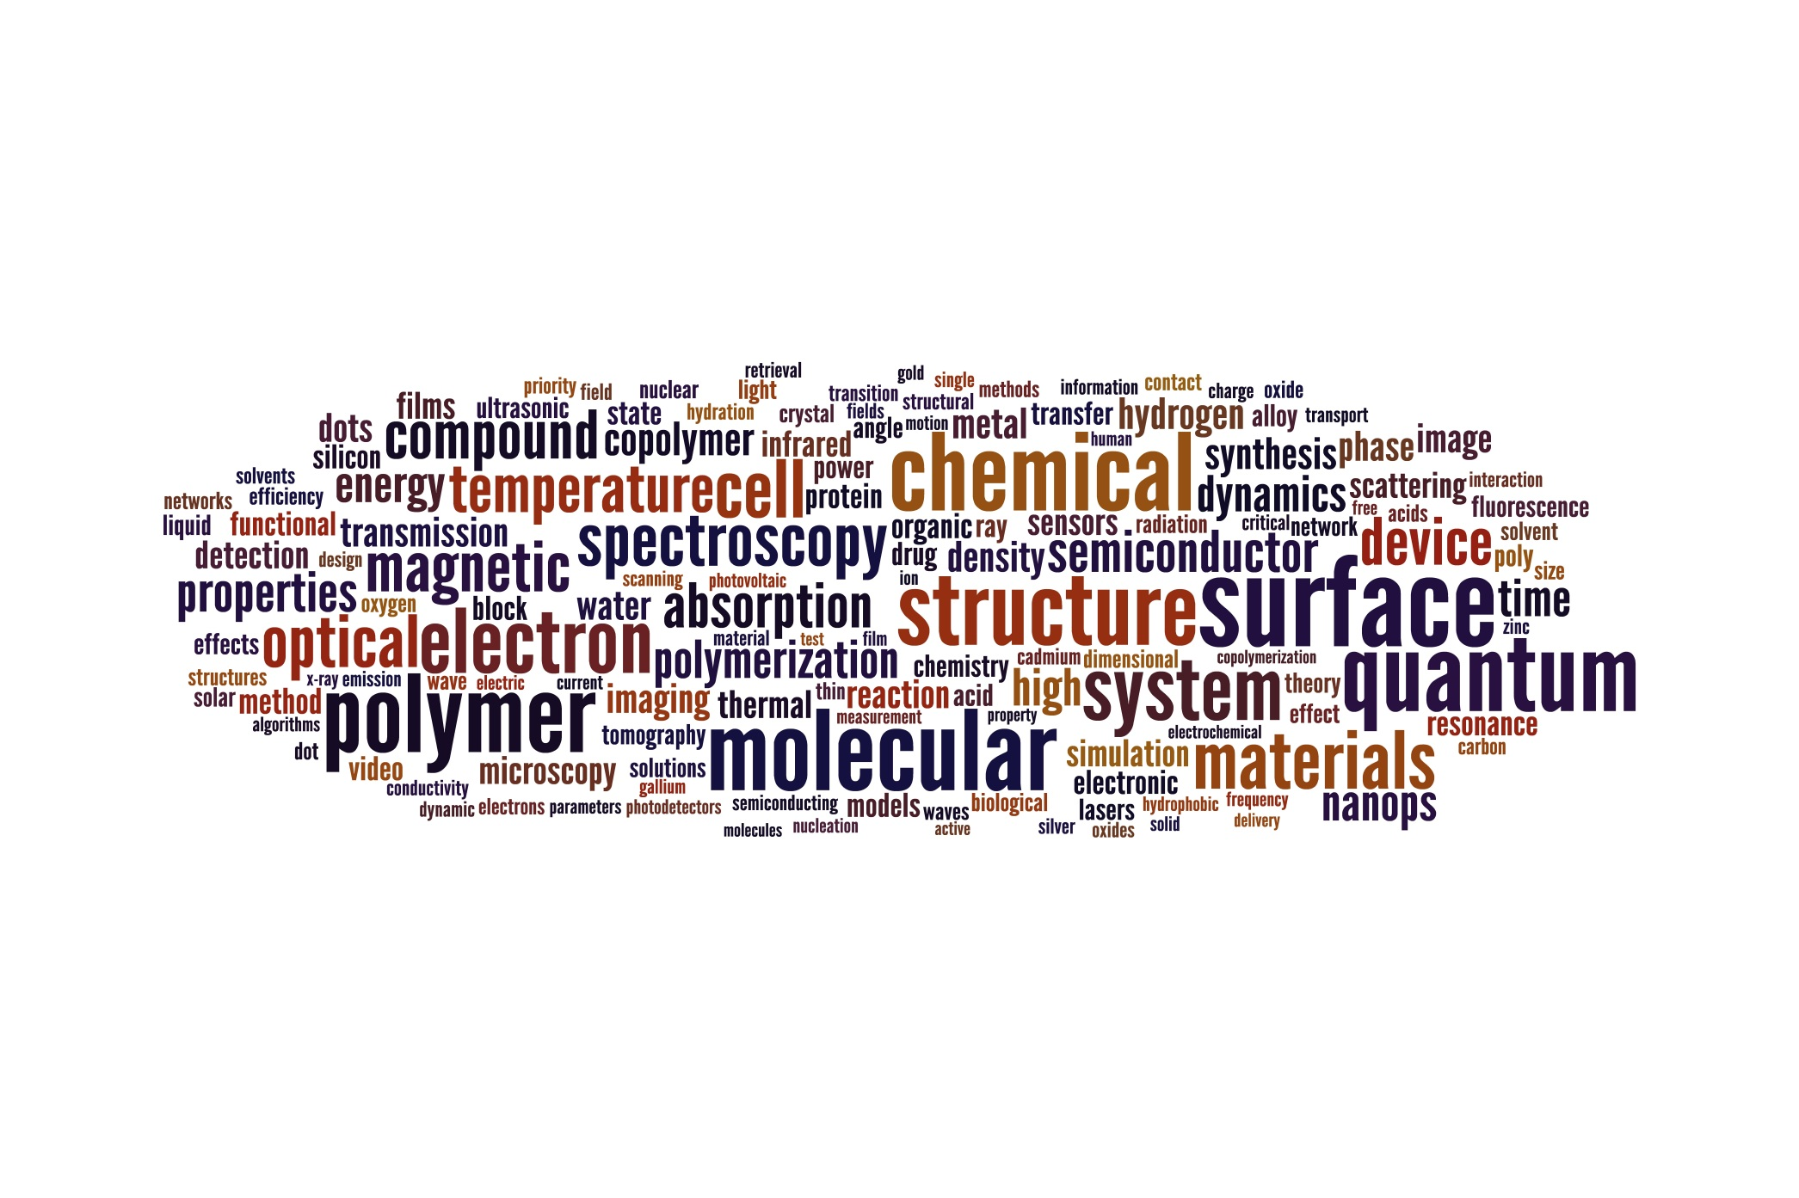
Materials and Advanced Manufacturing
UB Article Keywords
Source: Scopus 2009-2012

Slide 25
UB uses of bibliometric analysis
Analyzing faculty productivity and impact
Resource allocations & investment planning
Unit and departmental collaborations
Inter-university collaborations

Slide 26
Questions?
Craig W. Abbey
cwabbey@buffalo.edu
Rachel Link
rlink2@buffalo.edu

